Slide 1
e200zx Core Training
Notes:
HP presentation template tutorial - Rev. 1

Slide 2
e200 Overview: Core Diagram (e200x)
OnCE / Nexus Control Logic
CPU Control Logic
SIMD & EFP Units
LR, CR, CTR, XER
SPR
GPR
Integer Execution Unit
Memory Management Unit
Instruction Unit
Multiply Unit
Address
32
Instruction Buffer
External SPR Interface
Control
Data
Instruction Bus Interface Unit
Instruction Cache
64
PC Unit
Branch Unit
Data
Control
Load / Store Unit
N
Data Cache
Data Bus Interface Unit
32
64
N
Address
Data
Control
Notes:
HP presentation template tutorial - Rev. 1
SPE provides the e200 to execute a DSP like operations.
Single issue makes a smaller core and lower power consumption than dual issue machines.
ISEL is conditional load of a register.
PowerPC mainly uses only 32-bits but for the special instructions we use all 64-bits.
Load and stores has one clk cycle throughput.
MMU may be used for memory overlays for calibration and provides system protection.
Moccusin has only 16-bit data bus not provided for accesssing external memory but you certainly can.
The bus provided mainly for development purposes.
The core has APUs, which are co processors
The core can fetch 2 instructions per clock, but is single issue

Slide 3
Programming Model: Core Overview (Power Architecture e200zX)
Single and Dual issue architectures
  Multiple execution units:
    Integer Unit: arithmetic, logical, etc. instructions
    Instruction Unit: single cycle execution of successful look-ahead branches
    Load / Store Unit: pipelined for single cycle execution
32 General Purpose Registers (GPRs)
  32 bits wide
  Computations are performed on GPRs (not memory)
Special Purpose Registers (SPRs)
  Used for a dedicated special purpose
  Read and writing SPRs is done throught a GPR
Architectural Extensions via Auxilary Processing Units (APU):
  Signal Processing Engine (SPE): SIMD / DSP instructions
  Single Precision Floating Point: includes int to float, float to int
Cache and MMU
  Unified/Harvard cache; some can be allocated for fast general purpose SRAM
  MMU protects and partitions code and data space
  MMU can be used to assist calibration
Notes:
HP presentation template tutorial - Rev. 1
SPE provides the e200 to execute a DSP like operations.
Single issue (single instruction execution) makes a smaller core and lower power consumption than dual issue machines.
ISEL is conditional load of a register.
PowerPC mainly uses only 32-bits but for the special instructions we use all 64-bits.
Load and stores has one clk cycle throughput.
MMU may be used for memory overlays for calibration and provides system protection.
Moccusin has only 16-bit data bus not provided for accesssing external memory but you certainly can.
The bus provided mainly for development purposes.
The core has APUs, which are co processors
The core can fetch 2 instructions per clock, but is single issue

Slide 4
Programming Model: Core Overview (Device Specific)
Feature | e200z7 | e200z6 | e200z4 (Andorra, Leopard) | e200z3 (Monaco) | e200z1 | e200z0 (Pictus)
Instructions fetched per clock | Two 32-bit or Four 16-bit | Two 32-bit or Four 16-bit | Two 32-bit or Four 16-bit | Two 32-bit or Four 16-bit | One 32-bit or Two 16-bit | One 32-bit or Two 16-bit
Pipeline Size | 10 Stage | 7 Stage | 5 Stage | 4 Stage | 4 Stage | 4 Stage
Bus Architecture | Harvard | Unified | Harvard | Unified Harvard | Unified | Harvard
SPE APU | Yes | Yes | Yes | Yes | - | -
Cache | 16K Instruction 16K Data | 8K / 32K Unified | 4K Instruction | - | - | -
MMU | 64 Entry | 32 Entry | 16 Entry | 16 Entry | 16 Entry | -
Notes:
HP presentation template tutorial - Rev. 1
SPE provides the e200 to execute a DSP like operations.
Single issue (single instruction execution) makes a smaller core and lower power consumption than dual issue machines.
ISEL is conditional load of a register.
PowerPC mainly uses only 32-bits but for the special instructions we use all 64-bits.
Load and stores has one clk cycle throughput.
MMU may be used for memory overlays for calibration and provides system protection.
Moccusin has only 16-bit data bus not provided for accesssing external memory but you certainly can.
The bus provided mainly for development purposes.
The core has APUs, which are co processors
The core can fetch 2 instructions per clock, but is single issue

Slide 5
Programming Model: User Mode Registers 1 of 2
User level registers can be accessed by all software with either User or Supervisor privileges. They include :
GPR0
GPR1
●
GPR31
Thirty-two 32-Bit GPRs*¹ (GPR0–GPR31) serve as data source or destination registers for integer instructions and provide data for generating addresses.
CR
Condition Register consists of eight 4-bit fields, CR0–CR7, that reflect results of certain arithmetic operations and provides a mechanism for testing and branching.
CounT Register holds a loop count that can be decremented during execution of appropriately coded branch instructions. It also provides the branch target address for the Branch Conditional to Count Register (bcctr, bcctrl) instructions.
Link Register provides the branch target address for the Branch Conditional to Link Register (bclr, bclrl) instructions, and is used to hold the address of the instruction that follows a branch and link instruction, typically used for linking to subroutines.
Integer Exception Register indicates overflow and carries for integer operations.
CTR
LR
XER
Notes:
HP presentation template tutorial - Rev. 1

Slide 6
Programming Model: User Mode Registers 2 of 2
Applicable to e200zX
User SPR General register (USPRG0) is accessible in a read-write fashion by user-level software.
PowerPC Book E architecture defines SPR General registers (SPRGx) and a User SPR General register (USPRG0).
  SPRG4 through SPRG7 are read only for user-level software.
USPRG0
Z4 & Z 6 & Z7 | Z 3 & Z1 | Z0
SPRG4(ro)
SPRG5(ro)
SPRG6(ro)
SPRG7(ro)
TBU(ro)
The TB is a 64-bit structure provided for maintaining the time of day and operating interval timers. It is divided into two 32-bit registers.
  Time Base Upper (TBU).
  Time Base Lower (TBL).
  TBU and TBL read only in User mode.
0…..………....31
TBL(ro)
32………….....63
.
SPEFSCR
SPE Status and Control Register (read-write) is used for status and control of both FP or SPE instructions.
L1 Cache Configuration Register (read-only) allows software to query the configuration of the L1 Cache.
L1CFG0(ro)
Notes:
HP presentation template tutorial - Rev. 1

Slide 7
Programming Model: e200z7 Register Overview
Supervisor Mode Base Register Set
User Programmer’s Model
e200zX Book E Registers
Hardware Implementation
Dependent Registers
Cache Flush
& Invalidate
SPR General
Registers
Machine State Register
GPR0
GPR1
GPR31
L1FINV0
SPRG0
SPRG1
●
●
SPRG9
MSR
●
●
●
L1FINV1
Processor Version
HID0
Cache Control
PVR
LR
XER
CR
CTR
HID1
L1CSR0
Processor ID
System Version
L1CSR1
PIR
SPEFSCR
USPRG0
SVR
Cache Config
Interrupt Vector Offset Registers
L1CFG0
Debug Facilities Register Set
Interrupt Register Set
L1CFG1
Debug
Control
Instruction
Addr. Compare
Save & Restore
Registers
Critical S/R
Registers
Interrupt Vector
Offset Registers
IVOR32
●
●
IVOR35
BTB Control
BUSCR
DBCR0-2
IAC1-8
SRR0
SRR1
CSRR0
CSRR1
IVOR1
●
●
IVOR15
MMU Control
and Status
Debug Status
DBSR
Data Exception
Address
MMU Assist
MMUCRS0
Data Address Compare
Machine Check S/R Registers
MAS0
●
●
MAS4
MMU Config
DAC1
DAC2
DEAR
Interrupt
Vector Prefix
MMUCFG
Data Value Compare
MCSRR0
Syndrome
TLBCFG0
TLBCFG1
DVC1
DVC2
MCSRR1
ESR
IVPR
MAS6
e200zX Specific Registers
Storage Control Register Set
Timer Facilities Register Set
Debug Counter
Debug Control
Process Identification Register
Control
& Status
Decrementer
Auto Reload
Time Base
Upper/Lower
DBCNT
DBCR3-6
PID0
Debug Save & Restore
TCR
TSR
DEC
DECAR
TBL
TBU
Debug Save & Restore
DSRR0
DSRR1
Notes:
HP presentation template tutorial - Rev. 1
Process ID Register (PID, also referred to as PID0). This register is provided to
indicate the current process or task identifier. It is used by the MMU as an extension
to the effective address, and by external Nexus 2/3/4 modules for Ownership Trace
Message generation.
The processor ID register (PIR) contains a value that can be used to distinguish the processor from other processors in the system. The PIR value is read into a GPR using mfspr.
The processor version register (PVR) contains a value identifying the version and revision level of the processor. The PVR distinguishes between processors that differ in attributes that may affect software.
On the e200, the PVR is implemented as defined in Book E. The PVR contents are read into a GPR using mfspr. The PVR is read-only.
Process ID Register (PID, also referred to as PID0). This register is provided to
indicate the current process or task identifier. It is used by the MMU as an extension
to the effective address, and by external Nexus 2/3/4 modules for Ownership Trace

Slide 8
Programming Model: e200z6 Register Overview
Supervisor Mode Base Register Set
User Programmer’s Model
e200zX Book E Registers
Hardware Implementation
Dependent Registers
Cache Flush
& Invalidate
SPR General
Registers
Machine State Register
GPR0
GPR1
GPR31
L1FINV0
SPRG0
SPRG1
●
●
SPRG9
MSR
●
●
●
L1FINV1
Processor Version
HID0
Cache Control
PVR
LR
XER
CR
CTR
HID1
L1CSR0
Processor ID
System Version
L1CSR1
PIR
SPEFSCR
USPRG0
SVR
Cache Config
Interrupt Vector Offset Registers
L1CFG0
Debug Facilities Register Set
Interrupt Register Set
L1CFG1
Debug
Control
Instruction
Addr. Compare
Save & Restore
Registers
Critical S/R
Registers
Interrupt Vector
Offset Registers
IVOR32
●
●
IVOR34
BTB Control
BUSCR
DBCR0-2
IAC1-8
SRR0
SRR1
CSRR0
CSRR1
IVOR1
●
●
IVOR15
MMU Control
and Status
Debug Status
DBSR
Data Exception
Address
MMU Assist
MMUCRS0
Data Address Compare
Machine Check S/R Registers
MAS0
●
●
MAS4
MMU Config
DAC1
DAC2
DEAR
Interrupt
Vector Prefix
MMUCFG
MCSRR0
Data Value Compare
Not Available on e200z6
Syndrome
TLBCFG0
TLBCFG1
DVC1
DVC2
MCSRR1
ESR
IVPR
MAS6
e200zX Specific Registers
Storage Control Register Set
Timer Facilities Register Set
Debug Counter
Debug Control
Process Identification Register
Control
& Status
Decrementer
Auto Reload
Time Base
Upper/Lower
DBCNT
DBCR3
PID0
Debug Save & Restore
TCR
TSR
DEC
DECAR
TBL
TBU
Debug Save & Restore
DSRR0
DSRR1
Notes:
HP presentation template tutorial - Rev. 1
Process ID Register (PID, also referred to as PID0). This register is provided to
indicate the current process or task identifier. It is used by the MMU as an extension
to the effective address, and by external Nexus 2/3/4 modules for Ownership Trace
Message generation.
The processor ID register (PIR) contains a value that can be used to distinguish the processor from other processors in the system. The PIR value is read into a GPR using mfspr.
The processor version register (PVR) contains a value identifying the version and revision level of the processor. The PVR distinguishes between processors that differ in attributes that may affect software.
On the e200, the PVR is implemented as defined in Book E. The PVR contents are read into a GPR using mfspr. The PVR is read-only.
Process ID Register (PID, also referred to as PID0). This register is provided to
indicate the current process or task identifier. It is used by the MMU as an extension
to the effective address, and by external Nexus 2/3/4 modules for Ownership Trace

Slide 9
Programming Model: e200z4 Register Overview
Supervisor Mode Base Register Set
User Programmer’s Model
e200zX Book E Registers
Hardware Implementation
Dependent Registers
Cache Flush
& Invalidate
SPR General
Registers
Machine State Register
GPR0
GPR1
GPR31
L1FINV0
SPRG0
SPRG1
●
●
SPRG9
MSR
●
●
●
L1FINV1
Processor Version
HID0
Cache Control
PVR
LR
XER
CR
CTR
HID1
L1CSR0
Processor ID
System Version
L1CSR1
PIR
SPEFSCR
USPRG0
SVR
Cache Config
Interrupt Vector Offset Registers
L1CFG0
Debug Facilities Register Set
Interrupt Register Set
L1CFG1
Debug
Control
Instruction
Addr. Compare
Save & Restore
Registers
Critical S/R
Registers
Interrupt Vector
Offset Registers
IVOR32
●
●
IVOR35
BTB Control
BUSCR
DBCR0-2
IAC1-8
SRR0
SRR1
CSRR0
CSRR1
IVOR1
●
●
IVOR15
MMU Control
and Status
Debug Status
DBSR
Data Exception
Address
MMU Assist
MMUCRS0
Data Address Compare
Machine Check S/R Registers
MAS0
●
●
MAS4
MMU Config
DAC1
DAC2
DEAR
Interrupt
Vector Prefix
MMUCFG
Data Value Compare
MCSRR0
Syndrome
TLBCFG0
TLBCFG1
DVC1
DVC2
MCSRR1
ESR
IVPR
MAS6
e200zX Specific Registers
Storage Control Register Set
Timer Facilities Register Set
Debug Counter
Debug Control
Process Identification Register
Control
& Status
Decrementer
Auto Reload
Time Base
Upper/Lower
DBCNT
DBCR3-6
PID0
Debug Save & Restore
TCR
TSR
DEC
DECAR
TBL
TBU
Debug Save & Restore
DSRR0
DSRR1
Notes:
HP presentation template tutorial - Rev. 1
Process ID Register (PID, also referred to as PID0). This register is provided to
indicate the current process or task identifier. It is used by the MMU as an extension
to the effective address, and by external Nexus 2/3/4 modules for Ownership Trace
Message generation.
The processor ID register (PIR) contains a value that can be used to distinguish the processor from other processors in the system. The PIR value is read into a GPR using mfspr.
The processor version register (PVR) contains a value identifying the version and revision level of the processor. The PVR distinguishes between processors that differ in attributes that may affect software.
On the e200, the PVR is implemented as defined in Book E. The PVR contents are read into a GPR using mfspr. The PVR is read-only.
Process ID Register (PID, also referred to as PID0). This register is provided to
indicate the current process or task identifier. It is used by the MMU as an extension
to the effective address, and by external Nexus 2/3/4 modules for Ownership Trace

Slide 10
Programming Model: e200z3 Register Overview
Supervisor Mode Base Register Set
User Programmer’s Model
e200zX Book E Registers
Hardware Implementation
Dependent Registers
Cache Flush
& Invalidate
SPR General
Registers
Machine State Register
GPR0
GPR1
GPR31
L1FINV0
SPRG0
SPRG1
●
●
SPRG9
MSR
●
●
●
Processor Version
HID0
Cache Control
PVR
HID1
Read Only on e200z3
LR
XER
CR
CTR
L1CSR0
Processor ID
System Version
PIR
SPEFSCR
USPRG0
SVR
Cache Config
Interrupt Vector Offset Registers
L1CFG0
Debug Facilities Register Set
Interrupt Register Set
Debug
Control
Instruction
Addr. Compare
Save & Restore
Registers
Critical S/R
Registers
Interrupt Vector
Offset Registers
IVOR32
●
●
IVOR34
BTB Control
BUSCR
DBCR0-2
IAC1-8
SRR0
SRR1
CSRR0
CSRR1
IVOR1
●
●
IVOR15
MMU Control
and Status
Debug Status
DBSR
Data Exception
Address
MMU Assist
MMUCRS0
Data Address Compare
Machine Check S/R Registers
MAS0
●
●
MAS4
MMU Config
DAC1
DAC2
DEAR
Interrupt
Vector Prefix
MMUCFG
MCSRR0
Data Value Compare
Not Available on e200z3
Syndrome
TLBCFG0
TLBCFG1
DVC1
DVC2
MCSRR1
ESR
IVPR
MAS6
e200zX Specific Registers
Storage Control Register Set
Timer Facilities Register Set
Debug Counter
Debug Control
Process Identification Register
Control
& Status
Decrementer
Auto Reload
Time Base
Upper/Lower
DBCNT
DBCR3
PID0
Debug Save & Restore
TCR
TSR
DEC
DECAR
TBL
TBU
Debug Save & Restore
DSRR0
DSRR1
Notes:
HP presentation template tutorial - Rev. 1
Process ID Register (PID, also referred to as PID0). This register is provided to
indicate the current process or task identifier. It is used by the MMU as an extension
to the effective address, and by external Nexus 2/3/4 modules for Ownership Trace
Message generation.
The processor ID register (PIR) contains a value that can be used to distinguish the processor from other processors in the system. The PIR value is read into a GPR using mfspr.
The processor version register (PVR) contains a value identifying the version and revision level of the processor. The PVR distinguishes between processors that differ in attributes that may affect software.
On the e200, the PVR is implemented as defined in Book E. The PVR contents are read into a GPR using mfspr. The PVR is read-only.
Process ID Register (PID, also referred to as PID0). This register is provided to
indicate the current process or task identifier. It is used by the MMU as an extension
to the effective address, and by external Nexus 2/3/4 modules for Ownership Trace

Slide 11
Programming Model: e200z1 Register Overview
Supervisor Mode Base Register Set
User Programmer’s Model
e200zX Book E Registers
Hardware Implementation
Dependent Registers
Cache Flush
& Invalidate
SPR General
Registers
Machine State Register
GPR0
GPR1
GPR31
L1FINV0
SPRG0
SPRG1
●
●
SPRG9
MSR
●
●
●
Processor Version
HID0
Not Available on e200z1
HID1
Cache Control
PVR
LR
XER
CR
CTR
L1CSR0
Processor ID
System Version
PIR
SPEFSCR
USPRG0
SVR
Cache Config
Interrupt Vector Offset Registers
L1CFG0
Debug Facilities Register Set
Interrupt Register Set
Debug
Control
Instruction
Addr. Compare
Save & Restore
Registers
Critical S/R
Registers
Interrupt Vector
Offset Registers
IVOR32
●
●
IVOR34
BTB Control
BUSCR
DBCR0-2
IAC1-8
SRR0
SRR1
CSRR0
CSRR1
IVOR1
●
●
IVOR15
MMU Control
and Status
Debug Status
DBSR
Data Exception
Address
MMU Assist
MMUCRS0
Data Address Compare
Machine Check S/R Registers
MAS0
●
●
MAS4
MMU Config
DAC1
DAC2
DEAR
Interrupt
Vector Prefix
MMUCFG
MCSRR0
Data Value Compare
Not Available on e200z1
Syndrome
TLBCFG0
TLBCFG1
DVC1
DVC2
MCSRR1
ESR
IVPR
MAS6
e200zX Specific Registers
Storage Control Register Set
Timer Facilities Register Set
Debug Counter
Debug Control
Process Identification Register
Control
& Status
Decrementer
Auto Reload
Time Base
Upper/Lower
DBCNT
DBCR3
PID0
Debug Save & Restore
TCR
TSR
DEC
DECAR
TBL
TBU
Debug Save & Restore
DSRR0
DSRR1
Notes:
HP presentation template tutorial - Rev. 1
Process ID Register (PID, also referred to as PID0). This register is provided to
indicate the current process or task identifier. It is used by the MMU as an extension
to the effective address, and by external Nexus 2/3/4 modules for Ownership Trace
Message generation.
The processor ID register (PIR) contains a value that can be used to distinguish the processor from other processors in the system. The PIR value is read into a GPR using mfspr.
The processor version register (PVR) contains a value identifying the version and revision level of the processor. The PVR distinguishes between processors that differ in attributes that may affect software.
On the e200, the PVR is implemented as defined in Book E. The PVR contents are read into a GPR using mfspr. The PVR is read-only.
Process ID Register (PID, also referred to as PID0). This register is provided to
indicate the current process or task identifier. It is used by the MMU as an extension
to the effective address, and by external Nexus 2/3/4 modules for Ownership Trace

Slide 12
Programming Model: e200z0 Register Overview
Supervisor Mode Base Register Set
User Programmer’s Model
e200zX Book E Registers
Hardware Implementation
Dependent Registers
Cache Flush
& Invalidate
SPR General
Registers
Machine State Register
GPR0
GPR1
GPR31
L1FINV0
SPRG0
SPRG1
●
●
SPRG9
MSR
●
●
●
Processor Version
HID0
Cache Control
PVR
LR
XER
CR
CTR
HID1
L1CSR0
Processor ID
System Version
PIR
SPEFSCR
USPRG0
SVR
Cache Config
Interrupt Vector Offset Registers
L1CFG0
Debug Facilities Register Set
Interrupt Register Set
Debug
Control
Instruction
Addr. Compare
Save & Restore
Registers
Critical S/R
Registers
Interrupt Vector
Offset Registers
IVOR32
●
●
IVOR34
BTB Control
Not Available on e200z0
BUSCR
DBCR0-2
IAC1-8
SRR0
SRR1
CSRR0
CSRR1
IVOR1
●
●
IVOR15
MMU Control
and Status
Debug Status
DBSR
Data Exception
Address
MMU Assist
MMUCRS0
Data Address Compare
Machine Check S/R Registers
MAS0
●
●
MAS4
MMU Config
DAC1
DAC2
DEAR
Interrupt
Vector Prefix
MMUCFG
Data Value Compare
MCSRR0
Syndrome
TLBCFG0
TLBCFG1
DVC1
DVC2
MCSRR1
ESR
IVPR
MAS6
e200zX Specific Registers
Storage Control Register Set
Timer Facilities Register Set
Debug Counter
Debug Control
Control
& Status
Not Available on e200z0
Time Base
Upper/Lower
Process Identification Register
Decrementer
Auto Reload
DBCNT
DBCR3
PID0
Debug Save & Restore
TCR
TSR
DEC
DECAR
TBL
TBU
Debug Save & Restore
DSRR0
DSRR1
Notes:
HP presentation template tutorial - Rev. 1
Process ID Register (PID, also referred to as PID0). This register is provided to
indicate the current process or task identifier. It is used by the MMU as an extension
to the effective address, and by external Nexus 2/3/4 modules for Ownership Trace
Message generation.
The processor ID register (PIR) contains a value that can be used to distinguish the processor from other processors in the system. The PIR value is read into a GPR using mfspr.
The processor version register (PVR) contains a value identifying the version and revision level of the processor. The PVR distinguishes between processors that differ in attributes that may affect software.
On the e200, the PVR is implemented as defined in Book E. The PVR contents are read into a GPR using mfspr. The PVR is read-only.
Process ID Register (PID, also referred to as PID0). This register is provided to
indicate the current process or task identifier. It is used by the MMU as an extension
to the effective address, and by external Nexus 2/3/4 modules for Ownership Trace

Slide 13
Programming Model: Machine State Register (MSR)
Applicable to e200zX
MSR Implemented Bit Fields
Bit | Name | Description | Reset
14 | CE | Critical interrupt Enable | 0 (Disabled)
16 | EE | External interrupt Enable | 0 (Disabled)
17 | PR | Problem state 0: Supervisor mode 1: User mode | 0 (Supervisor)
19 | ME | Machine check Enable | 0 (Disabled)
22 | DE | Debug interrupt Enable | 0 (Disabled)
26 | IS | Instruction address Space (not implemented on z0) | 0 (Disabled)
27 | DS | Data address Space (not implemented on z0) | 0 (Disabled)
6 | SPE | Signal Processing Engine Enable | 0 (Disabled)
Z 3 & Z4 & Z6 & Z7 | Z 1 & Z0
Notes:
HP presentation template tutorial - Rev. 1

Slide 14
Programming Model: e200z7 Register Overview
Supervisor Mode Base Register Set
User Programmer’s Model
e200zX Book E Registers
Hardware Implementation
Dependent Registers
Cache Flush
& Invalidate
SPR General
Registers
Machine State Register
GPR0
GPR1
GPR31
L1FINV0
SPRG0
SPRG1
●
●
SPRG9
MSR
●
●
●
L1FINV1
Processor Version
User Mode Registers
HID0
Cache Control
PVR
LR
XER
CR
CTR
HID1
L1CSR0
Processor ID
System Version
L1CSR1
PIR
SPEFSCR
USPRG0
SVR
Cache Config
Interrupt Vector Offset Registers
L1CFG0
Debug Facilities Register Set
Interrupt Register Set
L1CFG1
Debug
Control
Instruction
Addr. Compare
Save & Restore
Registers
Critical S/R
Registers
Interrupt Vector
Offset Registers
IVOR32
●
●
IVOR35
BTB Control
BUSCR
DBCR0-2
IAC1-8
SRR0
SRR1
CSRR0
CSRR1
IVOR1
●
●
IVOR15
MMU Control
and Status
Debug Status
DBSR
Data Exception
Address
MMU Assist
MMUCRS0
Data Address Compare
Machine Check S/R Registers
MAS0
●
●
MAS4
MMU Config
DAC1
DAC2
DEAR
Interrupt
Vector Prefix
MMUCFG
Data Value Compare
MCSRR0
Syndrome
TLBCFG0
TLBCFG1
DVC1
DVC2
Supervisor Mode Registers
MCSRR1
ESR
IVPR
MAS6
e200zX Specific Registers
Storage Control Register Set
Timer Facilities Register Set
Debug Counter
Debug Control
Process Identification Register
Control
& Status
Decrementer
Auto Reload
Time Base
Upper/Lower
DBCNT
DBCR3-6
PID0
Debug Save & Restore
TCR
TSR
DEC
DECAR
TBL
TBU
Debug Save & Restore
DSRR0
DSRR1
Notes:
HP presentation template tutorial - Rev. 1
Process ID Register (PID, also referred to as PID0). This register is provided to
indicate the current process or task identifier. It is used by the MMU as an extension
to the effective address, and by external Nexus 2/3/4 modules for Ownership Trace
Message generation.
The processor ID register (PIR) contains a value that can be used to distinguish the processor from other processors in the system. The PIR value is read into a GPR using mfspr.
The processor version register (PVR) contains a value identifying the version and revision level of the processor. The PVR distinguishes between processors that differ in attributes that may affect software.
On the e200, the PVR is implemented as defined in Book E. The PVR contents are read into a GPR using mfspr. The PVR is read-only.
Process ID Register (PID, also referred to as PID0). This register is provided to
indicate the current process or task identifier. It is used by the MMU as an extension
to the effective address, and by external Nexus 2/3/4 modules for Ownership Trace

Slide 15
Programming Model: Enter/Exit User Mode
Entering and Exiting User Mode
Supervisor Mode User Mode
  Set the Problem State (PR) bit in the Machine State Register (MSR) to 1
User Mode Supervisor Mode
  Trigger Software Interrupt (in INTC) or System Call Interrupt (use “se_sc” instruction)
  When Interrupt is taken, MSR is changed automatically to supervisor mode.
  In ISR, mask PR bit in SRR1 and set to 0 (Supervisor Mode)
  When Interrupt completes (via “rfi” instruction) the core will be restored to supervisor mode
Notes:
HP presentation template tutorial - Rev. 1

Slide 16
Programming Model: ABI Register Use 1 of 2
The Application Binary Interface (ABI) for the e200 is the e500 ABI, which is based on the Embedded Application Interface (EABI).
This ABI defines certain registers to have dedicated uses:
  Stack pointer is r1
  Small data area pointers r2 and r13
If registers need to be saved across a function call:
  Nonvolatile registers must be saved by called function
  Volatile registers must be saved by calling function
Notes:
HP presentation template tutorial - Rev. 1

Slide 17
Programming Model Reference: ABI Register Use 2 of 2
r0 | function linkage | volatile | acc* | SPE accumulator |  | volatile
r1 | stack frame pointer | dedicated | cr0-cr1 | condition reg. fields |  | volatile
r2 | small data area 2 pointer | dedicated | cr2-cr4 | condition reg. fields |  | non-volatile
r3-r4 | parameters/return values | volatile | cr5-cr7 | condition reg. fields |  | volatile
r5-r10 | parameters | volatile | lr | link register |  | volatile
r11-r12 | function linkage | volatile | ctr | count register |  | volatile
r13 | small data area pointer | dedicated | xer | integer exception reg. |  | volatile
r14-r30 | local variables | non-volatile | spefscr** | SPE float status/control |  | limited-access*
r31 | local variables / env pointer | non-volatile
*Bits may be changed only by a called function which has the documented effect of changing them (per PIM document)
** Not implemented on e200z0, e200z1 cores
Notes:
HP presentation template tutorial - Rev. 1

Slide 18
Programming Model: ABI Stack Frames
Stack grows from high to low addresses
  Only created when necessary
  Size varies as needed
  16-byte alignment required
High Addresses
•••
last parameter save area
last LR save area
last back chain
32-bit GPR save area
CR save area (+ pad)
local variable space (+ pad)
parameter save area
LR save area
r1
back chain
Low Addresses
Notes:
HP presentation template tutorial - Rev. 1

Slide 19

Assembly Basics
e200z7 ☑ e200z6 ☑
e200z4 ☑ e200z3 ☑
e200z1 ☑ e200z0 (VLE Only – Principles Apply)

Slide 20
Core: Assembly Basics
Agenda
  Data Organization in Memory
  General Instruction Syntax
  Instructions
    Load and Store
    Add Immediate/ Add Immediate Shifted
    Loading 32 bits into a register
    Reading and Writing to Memory
    Reading and Writing to Special Purpose Registers (spr’s)
    Branch
Notes:
HP presentation template tutorial - Rev. 1

Slide 21
Assembly Basics: Data Organization in Memory
0x6
 | Big Endian - Most Significant Byte |  |  |  |  | Big Endian – Least Significant Byte
 | 0 |  |  | 31 | 32 |  |  | 63
0x0 | A | B | C | D | E | F | G | H
0x8
0x10
MSb 0 |  | LSb 31
GPR
All BookE instructions are 32 bits wide.
Power architecture is naturally Big Endian, but has switch for Little Endian
Examples:
Load word from address 0x0 loads the word “ABCD”
Load half word from address 0x6 loads the half word “GH”

Slide 22
Assembly Basics: General Instruction Syntax
General syntax:
instruction_mnemonic destination, source A, source B
Examples:
add r1, r2, r3 ; r1 = r2 + r3
and r4, r5, r6 ; r4 = r5 anded with r6
Store instructions are exception to syntax:
store_mnemonic source register, destination memory address
Examples:
stbx r3, r8, r9 ; store byte of r3 where (r8+r9) point
stw r5, 0x10 (r1); store word of r5 where (0x10+r1) point
Notes:
HP presentation template tutorial - Rev. 1

Slide 23
Assembly Basics: Load and Store Instructions
Memory is accessed using load and store instructions
Memory addressing modes:
  Effective Address = rA + rB
    Called “register indirect with index”
  Effective Address = rA + 16 bit signed index
    Called “register indirect with immediate index”
where rA, rB = r0 thru r31
Special case for load and store instructions:
If rA = r0, then a literal zero is used
Notes:
HP presentation template tutorial - Rev. 1

Slide 24
Assembly Basics: Load and Store Instruction Examples
Effective Address = rA + rB (use “x” at end of mnemonic)
lbzx r5, r7, r8 ; load byte into r5 from memory
; with effective address of (r8 + r7)
; and zero out the other 3 bytes in r5
Effective Address = rA + 16 bit signed index
lha r5, 0x10 (r7) ; load half word into r5 from memory
; with effective address of (0x10 + r7)
; and sign extend into r5
Source operand “rA” in both examples is r7
Special case: if r0 is used for rA operand, then a literal zero is used
  Rule applies to load and store instructions
  Simplifies addressing when only one source operand is needed
Notes:
HP presentation template tutorial - Rev. 1

Slide 25
Assembly Basics: Load and Store with “Update” Option
Update option updates source operand “rA” with the effective address
Option is implemented by adding “u” to end of mnemonic
Example: Create a stack frame of 80 bytes
stwu r1, -80 (r1) ; Store r1 into memory with
; effective address of (r1-80)
; then update r1 with the address (r1-80)
Note: updating r0 is illegal in PowerPC architecture.
ADDR DATA
0x4000EFB0 0x0
General Purpose Register
GPR1 = 0x4000F000
0x4000EFB0 0x4000F000
GPR1 = 0x4000EFB0

Slide 26
Assembly Basics: Add Immediate/Shifted with rA = r0
Special case: if r0 is used for rA operand in addi & addis, then a literal zero is used
  Rule applies to addi and addis instructions
  Rule does NOT apply to other arithmetic instructions (like add)
  Equivalent to “load immediate” and “load immediate shifted” instructions (simplified forms)
Instruction: Simplified Form: | addi r3, r0, 5 li r3, 5 | addis r3, r0, 5 lis r3, 5
r0 | 0x00001000 | 0x00001000
imm. data /shifted | 0x00000005 | 0x00050000
result in r3 | 0x00000005 | 0x00050000
Notes:
HP presentation template tutorial - Rev. 1

Slide 27
Assembly Basics: Loading 32 bits into a GPR
Use lis and ori instructions to load a 32 bit value to a 32 bit register.
Example: Load 0xdeadbeef into r30
 |  | r30
lis | r30, 0xdead | 0xdead0000
ori | r30, r30, 0xbeef | 0xdeadbeef
Same instructions using assembler directives for “equate”, “at high”, “at low”:
symbol_name .equ 0xdeadbeef
lis r30, symbol_name@h
ori r30, r30, symbol_name@l
Notes:
HP presentation template tutorial - Rev. 1

Slide 28
Assembly Basics: Reading / Writing to Memory
Using two instructions to read or write memory:
Example: Read word into r5 from address 0x12345678
lis r3, 0x1234 ; Load r3 with upper half of address (0x12340000)
lwz r5, 0x5678 (r3) ; Load r5 from effective address (r3 + 0x5678)
REMEMBER! The “lwz” instruction uses signed index.
If the lower half word is negative, then the upper half word needs adjustment.
  The “at high adjust” assembler directive adjusts the upper half word if the lower half word is negative.
  Example: Read word into r5 from register INTC_IACKR (address 0xFFF4 8010)
INTC_IACKR .equ 0xFFF48010 |  | code generated | r3
lis | r3, INTC_IACKR@ha | lis r3, -0xB | 0xFFF50000
lwz | r5, INTC_IACKR@l (r3) | lwz r5, -0x7FF0(r3) | 0xFFF50000
Effective Address = r3 + sign extended 0x8010
= 0xFFF5 0000 + 0xFFFF 8010 = 0xFFF4 8010
Notes:
HP presentation template tutorial - Rev. 1

Slide 29
Assembly Basics: Reading / Writing to SPR’s
Syntax: mtspr spr_dest, gpr_source
mfspr gpr_dest, spr_source
Examples:
General Form | Alternative Form | Simplified Form | Description
mtspr 9, r4 | mtspr CTR, r4 | mtctr r4 | Copy contents of gpr4 to spr9 (CTR)
mtspr 22, r0 | mtspr DEC, r0 | mtdec r0 | Copy contents of gpr0 to spr22 (DEC)
mfspr r11, 1 | mfspr r11, XER | mfxer r11 | Copy contents of spr1 (XER) to gpr 11
mfspr r0, 26 | mfspr r0, SRR0 | mfsrr0 r0 | Copy contents of spr26 (SRR0) to gpr 0
Notes:
HP presentation template tutorial - Rev. 1
lis r3, 0x1234
ori r3, r3, 0x5678
mtdec r3

Slide 30
Assembly Basics: Branch Addressing Modes & Instructions
Four branch addressing modes:
  Branch Relative Addressing: Displacement in opcode is sign- extende to 32 bits and added to program counter
  Branch Absolute Addressing: Address in opcode is sign- extended to form 32 bit address
  Branch to Count Register Branch to 32-bit address in CTR
  Branch to Link Register Branch to 32-bit address in LR
Branch Instruction | Mnemonic | Range
Branch Always | b (relative addressing) ba (absolute addressing) | 64 MB
Branch Conditional | bc (relative addressing) bca (absolute addressing) | 32 KB
Branch Conditional to CTR | bcctr | 4 GB
Branch Conditional to LR | bclr | 4 GB
Notes:
HP presentation template tutorial - Rev. 1

Slide 31
Assembly Basics: Branch Conditions - 1
CONDITION REGISTER (CR)
COUNT REGISTER (CTR)
CRO
CR1
CR2
CR3
CR4
CR5
CR6
CR7
CTR
0 31
0 31
Branch conditions are derived from testing of 2 registers: CR and CTR
All conditional branches are some combination of 1 (a or b) and 2 (a or b) as described below:
  Test the condition of 1 of 32 flags in CR
  A) branch if flag is FALSE
  B) branch if flag is TRUE
  Decrement the CTR and test it
  A) branch if the decremented CTR is not equal to 0
  B) branch if the decremented CTR is equal to 0
Notes:
HP presentation template tutorial - Rev. 1

Slide 32
Assembly Basics: Branch Conditions - 2
Condition Register (CR) has 8 identical 4-bit comparison result fields
CRO
CR1
CR2
CR3
CR4
CR5
CR6
CR7
0 3 4 7 8 11 12 15 16 19 20 23 24 27 28 31
lt
gt
eq
so
CRx =
0 1 2 3
Common examples using simplified forms:
bdnz LOOP1 ; Branch relative if decremented CTR != 0
bne cr0, ERROR6 ; Branch relative if cr0 bit field’s “eq” (equal) bit = 0
blt cr1, ERROR5 ; Branch relative if cr1 bit field’s “lt” (less than) bit = 1
bltctr cr1 ; Branch to address in CTR if cr1 bit field’s “lt” bit = 1
bgtlr cr3 ; Branch to address in LR if cr3 bit field’s “gt” bit = 1
b __start ; Unconditional branch to __start
Notes:
HP presentation template tutorial - Rev. 1

Slide 33
Assembly Basics: Saving Branch Return Address
“L” option saves return address in the Link Register (LR)
All branch instructions have “L” option
Syntax: add “l” to end of branch mnemonic
Example:
  …
  add r1, r2, r3
  bl SUB1 ; store next instruction's addr. in LR
  add r4, r5, r6
  …
  SUB1: div r18, r3, r22
  …
  blr ; return to prior routine
Notes:
HP presentation template tutorial - Rev. 1

Slide 34
Variable Length Encoding (VLE)
e200z7 ☑ e200z6 ☑
e200z4 ☑ e200z3 ☑
e200z1 ☑ e200z0 ☑
Notes:
HP presentation template tutorial - Rev. 1

Slide 35
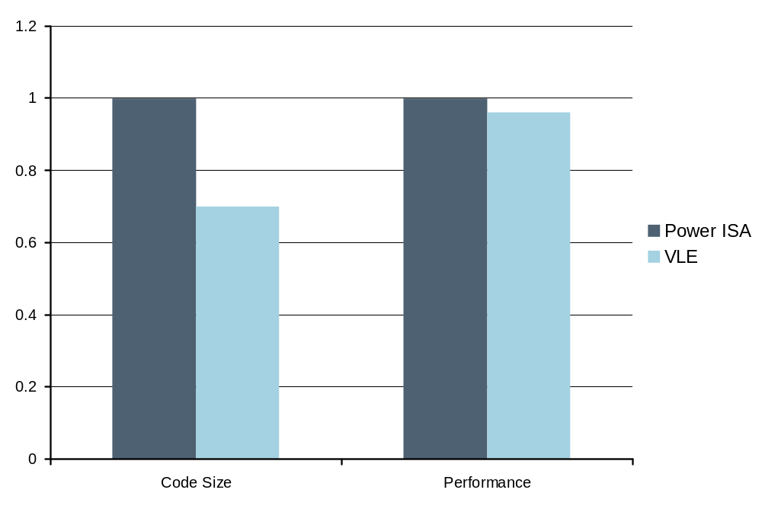
VLE: Variable Length Encoding (VLE) Introduction
VLE is an extension to the existing 32bit Power™ Book E instruction set.
VLE instruction set includes
16-bit and 32-bit VLE instructions
VLE and Power™ code
can be mixed in the application by using separate MMU pages
The e200z0 core only uses VLE instructions
Notes:
HP presentation template tutorial - Rev. 1

Slide 36
VLE: VLE Encoding Mnemonics
VLE Instructions have exact or similar semantics to BookE instructions
Some 32-bit BookE instructions do not need full 32-bit instruction size
16-bit Power™ VLE instructions encoded with “se_” prefix
32-bit Power™ VLE instructions encoded with “e_” prefix
    stw // BookE 32-bit instruction (not used on e200z0)
    e_stw // 32-bit Power™ VLE instruction
    se_stw // 16-bit Power™ VLE instruction
Notes:
HP presentation template tutorial - Rev. 1
- Branch instructions – 16-bit instructions good for code which doesn’t branch much

Slide 37
VLE: VLE 32-Bit Instructions
Equivalents for (nearly) all 32-bit BookE instructions
  Typical VLE 32-bit instruction is 3 operand
  Access to all 32 GPR’s
  Larger literal sizes compared to 16-bit instructions
32-bit VLE instruction
  e_add16i (32-bit add immediate) instruction
    e_add16i rT, rA, SI
      RT - Destination Register
      RA - Source Register
      SI – 16-bit Integer
OPCODE
RT
RA
SI
0
6
11
16
31

Slide 38
VLE: VLE 16-Bit Instructions
‘se_li’ instruction
‘se_sub’ instruction
7-bit integer limit
4-bit range on GPRs
4-bit range on GPRs
OPCODE
0b0000111
r4
OPCODE
RY
RX
0
5
12
15
0
5
7
12
15
~70 16 bit instructions
VLE 16-bit encodings have same constraints as other 16-bit ISAs.
  Typical VLE 16 bit instruction is 2-operand, not 3 operand
  Many zero-operand instructions encoded in 16 bits
    Breakpoint, rfi, return (branch thru link register),switch (branch thu counter register)
  Access to just 16 of the 32 GPR’s (4-bit range)
  Limited literal sizes
Notes:
HP presentation template tutorial - Rev. 1
su_sub - The sum of the contents of GPR(RX), the one’s complement of contents of GPR(RY), and 1 is placed into GPR(RX).
rfi – return from interrupt
Bit Set/Clear operations – sets or clears one bit of a register

Slide 39
VLE: VLE Example – Branching
‘Branch’ VLE Encoding Example
  Require an instruction which will jump (branch) to an instruction with an offset of 0x8 from the current instruction
  e_b 0x8 - PowerPC VLE 32-Bit Encoding
  se_b 0x8 - PowerPC VLE 16-bit Encoding
24-bit offset
OPCODE
0b000000000000000000001000
0
5
6
7
30
31
8-bit Offset
OPCODE
0b00001000
0
5
6
7
8
15
Notes:
HP presentation template tutorial - Rev. 1
Example of branch instruction in VLE. Shows 32-bit and how wasteful this can be. Equivalent 16-bit instruction illustrates how the 32-bit instruction is optimised.
Branch length is limited from 24-bits (~16M instructions) to 8-bits (~256 instructions)

Slide 40
VLE: VLE Encoding Example – OR
‘OR’ VLE Encoding Example
  or r4,r5,r6 - OR contents of r4 with r6 - Store in r5
  or r4,r5,r6 - PowerPC BookE 32-Bit Encoding
  se_or r4,r5 - PowerPC VLE 16-bit Encoding
Destination, Source A, Source B Register
OPCODE
r4
r5
r6
OPCODE
0
6
11
16
21
30
31
Source A, Source B (destination) Register
OPCODE
r4
r5
0
5
7
12
15
Notes:
HP presentation template tutorial - Rev. 1
Example of a Book E instruction that cannot be implemented in a 16-bit VLE instruction. 2-operand 16-bit VLE instruction equivalent below. se_or is preferred form of no-operation

Slide 41
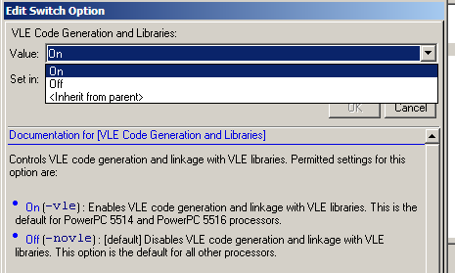
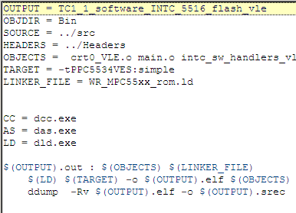
VLE: Enabling VLE
“What is required to enable VLE?”
For existing “C” functions – switch in the compiler call is required
-tPPC5534VES:simple
GHS – Build Options Windriver – Makefile
MMU needs to have VLE bit enabled for the memory space with VLE code
Notes:
HP presentation template tutorial - Rev. 1
- Branch instructions – 16-bit instructions good for code which doesn’t branch much

Slide 42
SPE (Signal Processing Engine)
e200z7 ☑ e200z6 ☑
e200z4 ☑ e200z3 ☑
e200z1 ☒ e200z0 ☒

Slide 43
SPE: Overview
SPE is an Auxiliary Processing Unit (APU) designed to accelerate signal processing applications normally suited to DSP operation
Accomplished using short (two-element) vectors within 64-bit GPRs and using Single Instruction Multiple Data (SIMD) operations to perform the requisite computations.
  2 x 32-bit operation simultaneously
  2 x 16-bit operation simultaneously
SPE also architects an accumulator register to allow for back-to-back operations without loop unrolling.
SPE uses a unique instruction set for performing the DSP operations
Provides Single Precision Floating Point Operation
Notes:
HP presentation template tutorial - Rev. 1

Slide 44
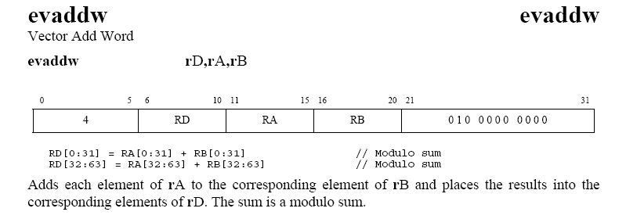
SPE: Parallel Add Instruction
0
31
32
63
RA
RB
+
+
RD
Notes:
HP presentation template tutorial - Rev. 1

Slide 45
SPE: Instruction Decoder
SPE Instructions can look complex, however it is simple to break down into easy to understand segments
evmheumiaaw
Intsruction Type
ev = Vector Operation
evfs = Vector Floating Point Operation
efs = Non-Vector Floating Point Operation
Data Operation
m = multiply
Add, Subtract, Convert, Divide, Compare, Merge, etc…
Source Data Size
h = half word (16-bit)
w = word (32-bit)
d = double word (64-bit)
Data Location
e = EVEN Side of Vector
o = ODD Side of Vector
Notes:
HP presentation template tutorial - Rev. 1

Slide 46
SPE: Instruction Decoder
SPE Instructions can look complex, however it is simple to break down into easy to understand segments
evmheumiaaw
Data Sign
u = unsigned
s = signed
Rollover
m = modulo
s = saturate
Data Type
i = integer
f = fixed point
For Floating Point use “evf” for instruction type.
Accumulator Options
a = move result to accumulator
aaw = add accumulator to intermediate product, move result of this to ACC and Destination register
anw = subtract accumulator from intermediate product, move result of this to ACC and Destination register
Notes:
HP presentation template tutorial - Rev. 1

Slide 47
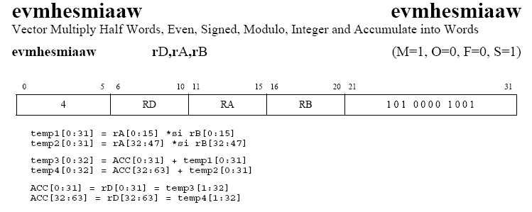
SPE: Multiply and Accumulate
0
15
16
31
32
47
16-bits
48
63
Does Data contain negative numbers or is it all positive?
EVEN side of 32-bit element used for operation
RA
Does data rollover or saturate if max 32-bit value is exceeded?
RB
×
×
RD
ACC
+
+
ACC
Notes:
HP presentation template tutorial - Rev. 1

Slide 48
SPE: Instruction Overview
Loads and stores
  load and store full 64 bit vectors
  load and store 32 bit values
  load and store 16 bit values
  16 bit values can be in upper or lower half of 32 bit word
  Sign extension or not
  Sometimes want to replicate a 16 or 32 bit value throughout the 64 bits
  Effective addresses must be naturally aligned for the length of the values loaded or stored
Operations
  Arithmetic, logical, comparison, selection, movement, floating point
  Vector and scalar
Multiply and Multiply-Accumulate
  16 x 16 -> 16, with or without accumulation
  16 x 16 -> 32, with or without accumulation
  16 x 16 or 32 x 32 -> 64, with accumulation
  When accumulating, result is also written to destination register
Control
  Rounding, IEEE compliance etc
Notes:
HP presentation template tutorial - Rev. 1

Slide 49
SPE: Embedded Floating Point APU
Provides single precision floating point capabilities
  May be configured to be fully IEEE compliant, in which case awkward corner cases (NaN’s, Infinities, denormalized values) will be handled by software through the raising of exceptions
  May be configured to be not fully IEEE compliant, in which case arithmetic will saturate or round to zero and no value-dependent exceptions will be raised
  Is a proper subset of the Signal Processing Engine APU
Uses IEEE Single Precision Data Format
SPE provides both vector and scalar versions
Notes:
HP presentation template tutorial - Rev. 1

Slide 50
SPE: Supporting Tools for Developing SPE
DSP Library Functions
    Libraries of pre-built SPE DSP functions
    Similar to eTPU function set
SPE Intrinsics
    A “C” interface for using SPE assembly instructions
    Compiler friendly
Notes:
HP presentation template tutorial - Rev. 1
Data produced by an analog-to-digital converter is moved to a coprocessors memory where this data can be processed. The processed data is then moved back to system RAM. The component parts of the system (eQADC, eDMA, eTPU, and eMIOS) as they pertain to the decimation system are described.

Slide 51
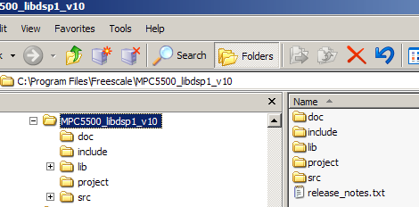
SPE: DSP Library Development
Installation package C-API for calling functions
Example C-Coded function usage
  Greenhills
  Metrowerks
  Windriver
Full documentation including cycle count information.
  highly optimised functions written directly in assembly.
Phase 1 complete.
Phase 2 complete.
Available at www.st.com
Notes:
HP presentation template tutorial - Rev. 1

Slide 52
SPE: DSP Library – Phase 1
conv_enc_mux rate 1/2 constraint length 9 convolutional encoder
corr_mn cross-correlation
crc_calc 16-bit cyclic redundancy code
Dct 2-D 8x8 DCT
Fft256 256-point complex FFT, single precision floating point
Fir20 real 20TAP FIR filter
Fir22sym real 22TAP FIR filter with symmetrical impulse response
Fir32sym real 32TAP FIR filter with symmetrical impulse response
Fir64sym real 64TAP FIR filter with symmetrical impulse response
iir_2nd_o direct form 2nd order IIR filter•lu_decomp - LU decomposition
Notes:
HP presentation template tutorial - Rev. 1

Slide 53
SPE: DSP Library – Phase 2
FFT
  bitrev_table - Bit Reversal Permutation for 16-bit data (frac16)
  fft_radix4 - N-point radix-4 complex to complex float/ frac16/frac32 in-place FFT, N is even power of two
  fft_quad - N-point quad radix-2 complex to complex float/ frac16/frac32 in-place FFT, N is even power of two
  fft_radix2_last_stage - calculates the last stage of N-point radix-2 complex to complex float/ frac32 in-place FFT, together with fft_quad function is used to calculate N-point complex to complex float/frac32 in-place FFT where N is odd power of two
  fft_real_split - split function for N-point real to complex float/ frac32 FFT
  window_apply_complex - complex float/ frac16 windowing function
  window_apply_real - real float/ frac16 windowing function
Pressure Sensing
  mfb50_pmh - calculates mass fraction burned (MFB), MFB50 value and PMH index
  mfb50_index - calculates MFB50 position index
Image
  conv3x3 - 2-D convolution with 3x3 kernel
  sobel3x3 - sobel filter
Filter
  corr_frac16 - frac16 correlation function
  fir_float - float FIR filter
  fir_frac16 - frac16 FIR filter
  iir_float_1st - float first-order IIR filter
  iir_float_2nd - float second-order IIR filter
  iir_float_casc - cascade of float second-order IIR filters
  iir_frac16_1st - frac16 first-order IIR filter
  iir_frac16_2nd - frac16 second-order IIR filter
  iir_frac16_casc - cascade of frac16 second-order IIR filters
  iir_frac16_2nd_hc - frac16 second-order IIR filter with half coefficients
Notes:
HP presentation template tutorial - Rev. 1

Slide 54
SPE: SPE Intrinsics
Provide high-level language access to SPE functionality through intrinsic functions
  Each function typically maps to single instruction
  Avoids difficulties and limitations of autovectorizing compilers
Alleviate issues with writing assembly
  Handling ABI calling and stack conventions
  Handle register allocation
  Handle code scheduling
  Allows compiler to perform other optimizations
Let Compiler handle these tasks
  But the “physics” of SPE is still exposed - some complexity is unavoidable
Documentation available at www.st.com
  Programming Interface Manual (PIM)
Notes:
HP presentation template tutorial - Rev. 1

Slide 55
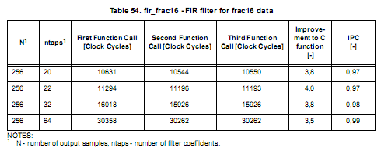
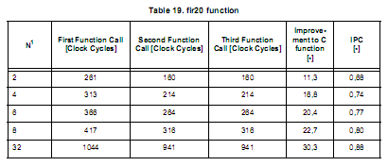
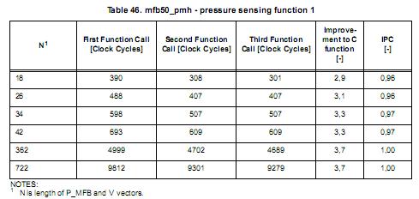
SPE: Performance Improvement
Comparisons of performance between SPE and equivelant C function
73% faster than original “C” code
Notes:
HP presentation template tutorial - Rev. 1

Slide 56
SPE2
e200z7 ☑ e200z6 ☒
e200z4 ☒ e200z3 ☒
e200z1 ☒ e200z0 ☒

Slide 57
SPE2: SPE2 Features
Provides additional instructions to allow more complex SPE operations
  More Vector Operations per Instruction
  Byte Operations
  Matrix Operations
Notes:
HP presentation template tutorial - Rev. 1

Slide 58
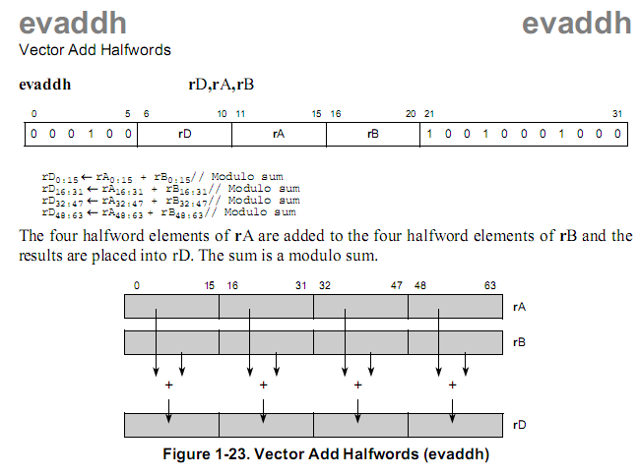
SPE2: More Vector Operations per Instruction
Notes:
HP presentation template tutorial - Rev. 1
SPE provides the e200 to execute a DSP like operations.
Single issue (single instruction execution) makes a smaller core and lower power consumption than dual issue machines.
ISEL is conditional load of a register.
PowerPC mainly uses only 32-bits but for the special instructions we use all 64-bits.
Load and stores has one clk cycle throughput.
MMU may be used for memory overlays for calibration and provides system protection.
Moccusin has only 16-bit data bus not provided for accesssing external memory but you certainly can.
The bus provided mainly for development purposes.
The core has APUs, which are co processors
The core can fetch 2 instructions per clock, but is single issue

Slide 59
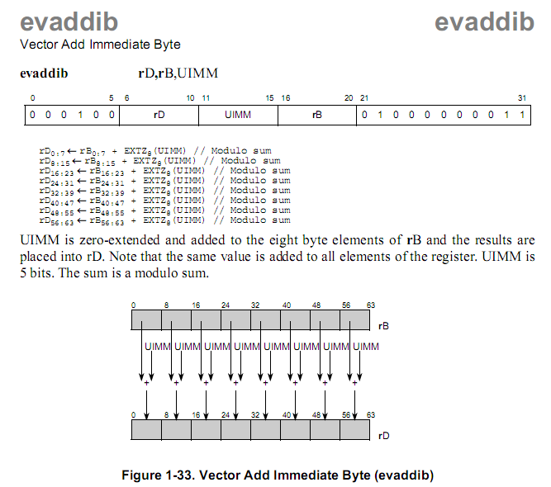
SPE2: Byte Operations
Notes:
HP presentation template tutorial - Rev. 1
SPE provides the e200 to execute a DSP like operations.
Single issue (single instruction execution) makes a smaller core and lower power consumption than dual issue machines.
ISEL is conditional load of a register.
PowerPC mainly uses only 32-bits but for the special instructions we use all 64-bits.
Load and stores has one clk cycle throughput.
MMU may be used for memory overlays for calibration and provides system protection.
Moccusin has only 16-bit data bus not provided for accesssing external memory but you certainly can.
The bus provided mainly for development purposes.
The core has APUs, which are co processors
The core can fetch 2 instructions per clock, but is single issue

Slide 60
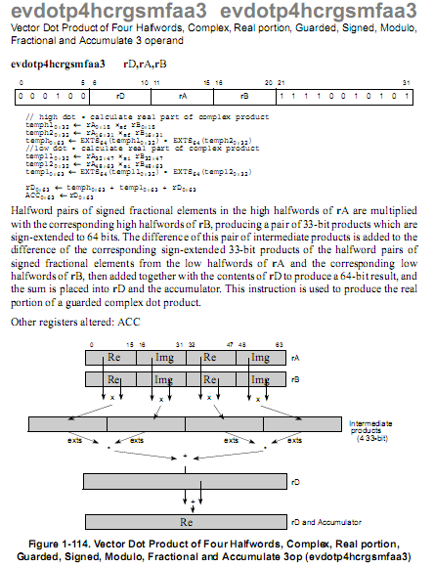
SPE2: Matrix Operations
Notes:
HP presentation template tutorial - Rev. 1
SPE provides the e200 to execute a DSP like operations.
Single issue (single instruction execution) makes a smaller core and lower power consumption than dual issue machines.
ISEL is conditional load of a register.
PowerPC mainly uses only 32-bits but for the special instructions we use all 64-bits.
Load and stores has one clk cycle throughput.
MMU may be used for memory overlays for calibration and provides system protection.
Moccusin has only 16-bit data bus not provided for accesssing external memory but you certainly can.
The bus provided mainly for development purposes.
The core has APUs, which are co processors
The core can fetch 2 instructions per clock, but is single issue

Slide 61
Instruction Timing
e200z7 ☑ e200z6 ☑
e200z4 ☑ e200z3 ☑
e200z1 ☑ e200z0 ☑

Slide 62
Instruction Timing: Instruction Execution
Simplified Flow of Instruction Execution
Instruction unit in core attempts to issue a single instruction each cycle to one of the cores execution units.
Execution units perform instruction specific task
  E.g. Add / Multiply / OR / etc…
When the execution units have finished with an instruction they write the results into the proper bus and into the destination registers.
Writeback logic retires an instruction when it has finished execution.

Slide 63
Instruction Timing: Instruction Pipeline Stages
Pipelines for e200zX cores:
Core | Pipeline Stages | Architecture
e200z7 | 10 stage | Dual Issue
e200z6 | 7 stage | Single Issue
e200z4 | 5 stage | Dual Issue
e200z3 | 4 stage | Single Issue
e200z1 | 4 stage | Single Issue
e200z0 | 4 stage | Single Issue

Slide 64
Instruction Timing - Single Issue
e200z7 ☒ e200z6 ☑
e200z4 ☒ e200z3 ☑
e200z1 ☑ e200z0 ☑

Slide 65
Instruction Timing: Instruction Pipeline Stages
e200z3/1/0 implement a 4 stage single issue pipeline
Pipeline stages are:
STAGE | Description
IFETCH | Instruction Fetch from Memory
DECODE / EA | Instruction Decode / EA Calculation
EXECUTE / MEM | Instruction Execution / Memory Access
WB | Write Back to Register
Instructions proceed through pipeline stages in linear manner
  Cannot “bypass” pipeline stage
  Only one instruction can be used by a pipeline stage at a time

Slide 66
Instruction Timing: Simple vs Load / Store Instruction
DECODE / EA stage & EXECUTE / MEM stage of pipeline are treated differently depending on instruction used
DECODE / EA – used for calculating effective address for load / store instruction
EXECUTE / MEM – used for accessing memory to load or store data when processing a load / store instruction.

Slide 67
Instruction Timing: Single Cycle Pipeline Operation
Time Slot (Cycles)
e_and
IF | DEC | EXE | WB
e_or2i
IF | DEC | EXE | WB
e_xor
IF | DEC | EXE | WB
e_add2i
IF | DEC | EXE | WB
Instruction Complete & Retired
Throughput of 1 cycle per instruction

Slide 68
Instruction Timing: Basic Load and Store Pipeline Operation
Take example of load instruction followed by add
  “add” instruction is dependent on data from the load instruction
Time Slot (Cycles)
e_lwz
IF | DEC/EA | MEM | WB
Feedforward
e_add2i
IF | DEC | EXE | WB
Throughput of 1 cycle per instruction

Slide 69
Instruction Timing: Dependent Load/Store Pipeline Operation
If a load or store instruction depends on the previous instruction for the destination address calculation (i.e. EA) then the latency of the instruction is affected.
Example,
  e_lwz r3, 0x0(r4) ; Load 32-bits into r3 from r4 + 0
  e_stw r7, 0x0(r3) ; Store 32-bits from r7 into r3 + 0
Time Slot (Cycles)
e_lwz
IF | DEC/EA | MEM/ EXE | WB
Feedforward
IF | DEC | DEC/ EA Calc | MEM | WB
e_stw
Stall in pipeline – has to wait for result from previous instruction

Slide 70
Instruction Timing: Dependent Load/Store Pipeline Operation – Wait State
If a load or store instruction depends on the previous instruction for the destination address calculation (i.e. EA) then the latency of the instruction is affected – Stall can also be introduced with memory access wait state.
Example,
  e_lwz r3, 0x0(r4) ; Load 32-bits into r3 from r4 + 0
  e_stw r7, 0x0(r3) ; Store 32-bits from r7 into r3 + 0
Time Slot (Cycles)
e_lwz
IF | DEC/EA | EXE - 0 | EXE - 1 | WB
Feedforward
IF | DEC | DEC | EA Calc | MEM | WB
e_stw
2 stalls in pipeline – extra stall introduced by memory wait state

Slide 71
Instruction Timing: Multiply & Divide Pipeline Operation
Multiply and Divide Instruction are susceptible to introducing larger stalls to pipeline
Require longer time in execute stage
Example, multiply instruction followed by a store of the result of the multiply
Time Slot (Cycles)
e_and
IF | DEC | EXE | WB
e_mulli
IF | DEC | EXE - 0 | EXE - 1 | EXE - 2 | EXE – 3 | WB
Feedforward
e_stw
IF | DEC/EA | Stall | Stall | Stall | MEM | WB
Latency of 4 cycles

Slide 72
Instruction Timing: Effects of Operand Placement
The placement of operands in memory affect the relative performance memory accesses, and in some cases, affects it significantly
Operand |  | Performance
Size | Byte Aligned
4 Byte | 4 < 4 | Optimal Good
2 Byte | 2 < 2 | Optimal Good
1 Byte | 1 | Optimal
lmw, stmw | 4 < 4 | Good Poor
Optimal – One effective address (EA) calculation occurs
Good – Multiple EA calculations occur which may cause addition bus activity with multiple transfers
Poor – Alignment Interrupt Occurs

Slide 73
Instruction Timing: Specific Instruction Timings
Majority of instructions allow single cycle execution
All integer instructions (except multiply & divide) have throughput and latency of 1 cycle
Majority of load and store instruction have throughput and latency of 1 cycle
Branch instructions have throughput and latency of 2 cycles
  This can be reduced to 1 cycle by using branch prediction
Specific instruction timings can be found in e200zx Reference Manual

Slide 74
Instruction Timing - Dual Issue
e200z7 ☑ e200z6 ☒
e200z4 ☑ e200z3 ☒
e200z1 ☒ e200z0 ☒

Slide 75
Instruction Timing: Instruction Pipeline Stages
e200z7 implements a 10 stage pipeline
Pipeline stages are:
STAGE | Description
IFETCH0 | Instruction Fetch from Memory, stage 0
IFETCH1 | Instruction Fetch from Memory, stage 1
IFETCH2 | Instruction Fetch from Memory, stage 2
DECOD0 | Instruction Decode, stage 0
DECODE1 / EA | Instruction Decode, stage 1 / EA Calculation
EXECUTE0 / MEM0 | Instruction Execution / Memory Access, stage 0
EXECUTE1 / MEM1 | Instruction Execution / Memory Access, stage 1
EXECUTE2 / MEM2 | Instruction Execution / Memory Access, stage 2
EXECUTE3 | Instruction Execution / Memory Access, stage 3
WB | Write Back to Register

Slide 76
Instruction Timing: Instruction Pipeline Stages
e200z4 implements a 5 stage pipeline
Pipeline stages are:
STAGE | Description
IFETCH | Instruction Fetch from Memory
DECODE / EA | Instruction Decode / EA Calculation
EXECUTE0 / MEM0 | Instruction Execution / Memory Access, stage 0
EXECUTE1 / MEM1 | Instruction Execution / Memory Access, stage 1
WB | Write Back to Register

Slide 77
Instruction Timing: 2 Instructions per Clock Pipeline Operation
Time Slot (Cycles)
e_and
IF | DEC | EXE0 | EXE1 | WB
e_or2i
IF | DEC | EXE0 | EXE1 | WB
e_xor
IF | DEC | EXE0 | EXE1 | WB
e_add2i
IF | DEC | EXE0 | EXE1 | WB
e_or2i
IF | DEC | EXE0 | EXE1 | WB
e_sub
IF | DEC | EXE0 | EXE1 | WB
2 Instruction Complete & Retired
For simple instructions throughput of 0.5 cycles per instruction

Slide 78
Instruction Timing: Load Pipeline Operation
Take example of 2 simple instructions followed by a load instruction
Time Slot (Cycles)
e_and
IF | DEC | EXE0 | EXE1 | WB
e_or2i
IF | DEC | EXE0 | EXE1 | WB
e_lis
IF | EA | MEM0 | MEM1 | WB
e_lwz
IF | EA | STALL | MEM0 | MEM1 | WB
Can only perform 1 memory access per clock.
Second load instruction is stalled.

Slide 79
Branch Target Buffer
e200z7 ☑ e200z6 ☑
e200z4 ☑ e200z3 ☑
e200z1 ☑ e200z0 ☑

Slide 80
Instruction Timing: Instruction Buffers
e200zX Core has instruction buffers that supply instructions into the Instruction Register (IR) for decoding
In normal operation, instructions are loaded into the IR from SLOT 0
  When a slot is empty then bus prefetch is performed to earliest empty slots starting a slot 0
  When no full slots, instruction fetched directly from bus into IR (e.g. branch)
Figure below is instruction buffers for e200z0
SLOT 3
SLOT 2
SLOT 1
SLOT 0
MUX
IR
DECODE
DATA 0:31

Slide 81
Instruction Timing: Branch Target Buffer 1 of 2
“n” Entry Branch Target Buffer (BTB) “Predicts” Address that branch instruction will jump to
BTB Enabled in Branch Unit Control and Status Register (BUCSR)
When branch is taken a 2-bit counter is altered in the BTB depending on the result of the branch, and target address stored in BTB
  If branch is taken the counter is incremented (counter saturates if 0b11)
  If branch is not taken then counter is decremented (counter saturates if 0b00)
Counter is represented by 4 states
Strongly Taken
Weakly Taken
Weakly Not Taken
Strongly Not Taken

Slide 82
Instruction Timing: Branch Target Buffer 2 of 2
When next branch instruction is executed (and BTB enabled) then address in BTB will be fed into slot 0 if state of counter is Strongly / Weakly Taken
If state is Weakly / Strongly Not Taken then address in BTB will not be fed into IR. Next sequential instruction from Slot 0 will be used instead.
Branch Prediction can reduce latency of branch instructions to single cycle.
BTB STATE
Weakly / Strong Not Taken
SLOT 3
SLOT 2
SLOT 1
SLOT 0
MUX
IR
DECODE
DATA 0:31
BTB STATE
Weakly / Strong Taken
BTBn

Slide 83
Instruction Timing: Branch (Change of Flow) Pipeline Operation
Branch instructions take either 1 or 2 cycles to execute.
Simple change of flow requires 2 cycles
Time Slot (Cycles)
e_lwz
IF | DEC/EA | MEM | WB
ADDR :
e_b 0x10
IF | DEC | EXE
ADDR + 0x10 :
e_and
IF | DEC | EXE | WB

Slide 84
Instruction Timing: Branch (Speculative) Pipeline Operation
If branch target buffer is enabled then speculative branches can be made
Address of Target instruction is taken from BTB if a “hit” is recorded (i.e. strongly / weakly taken state) and instruction pre-loaded into slot0
Single Cycle Throughput and Latency Possible
Time Slot (Cycles)
e_lwz
IF | DEC/EA | MEM | WB
ADDR :
e_bgt 0x10
IF | DEC | EXE
ADDR + 0x10 :
e_and
BTB hit | TFetch | DEC | EXE | WB

Slide 85
Instruction Timing: e200zX Branch Target Buffer
“n” Entry Branch Target Buffer (BTB)
Tag |  | Data
Branch Address |  | Target Address | Counter | Entry0
Branch Address |  | Target Address | Counter | Entry1
… |  | … | … | …
Branch Address |  | Target Address | Counter | Entry n
Core | BTB Entries
e200z7 | 32
e200z6 | 8
e200z4 | 8
e200z3 | 4
e200z1 | 4
e200z0 | 1

Slide 86
Performance Monitor
e200z7 ☑ e200z6 ☒
e200z4 ☒ e200z3 ☒
e200z1 ☒ e200z0 ☒

Slide 87
e200z7 Performance Monitor
Allows user to measure time between internal events in the e200z7 core
158 Events to select from
  General Events
  Instruction Types Completed
  Branch Prediction and Execution Events
  Pipeline Stalls
  Load/Store, Data Cache and Data Line Fill Events
  BIU Interface Usage
  Snoop, Chaining Events
  Interrupt Events
  Debug/Nexus Events
  Watchpoint Events
  Threshold Events
See z760n3 spec (Table 8-10) for list of events
Notes:
HP presentation template tutorial - Rev. 1
SPE provides the e200 to execute a DSP like operations.
Single issue (single instruction execution) makes a smaller core and lower power consumption than dual issue machines.
ISEL is conditional load of a register.
PowerPC mainly uses only 32-bits but for the special instructions we use all 64-bits.
Load and stores has one clk cycle throughput.
MMU may be used for memory overlays for calibration and provides system protection.
Moccusin has only 16-bit data bus not provided for accesssing external memory but you certainly can.
The bus provided mainly for development purposes.
The core has APUs, which are co processors
The core can fetch 2 instructions per clock, but is single issue

Slide 88
Memory Management Unit (MMU)
e200z7 ☑ e200z6 ☑
e200z4 ☑ e200z3 ☑
e200z1 ☑ e200z0 ☒

Slide 89
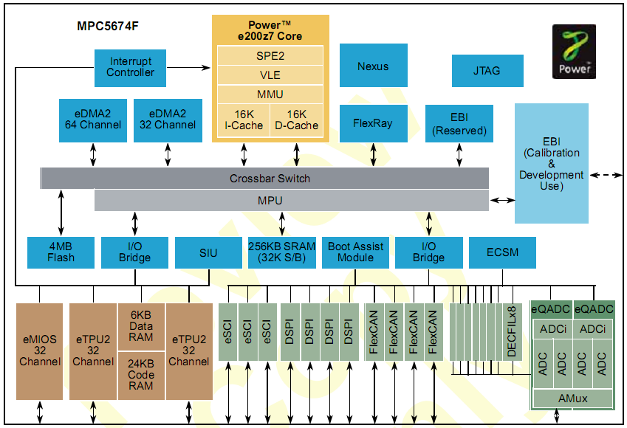
MMU: Introduction
All e200zX core accesses go through the MMU.
Memory must be defined in the MMU to be visible to the core
  Otherwise an exception occurs
MMU does not control memory accesses from:
  External bus
  eDMA
  Nexus
  Flexray
  Ethernet
Accesses for these master are based on physical memory addresses
  0x0000_0000 (Int Flash)
  0x4000_0000 (Int RAM)
  etc...
Nexus tools can read MMU settings when the processor stops.
Notes:
HP presentation template tutorial - Rev. 1
This presentation will explain these features and how to use them.
The MMU does address translation but you can map logical addresses to physical addresses.
Address translation may be used for the purpose of calibration.
Assembly software must be used to execute the TBL instructions to initialize the MMU. Compiler can not generate the TLB initialization code.
Also MMU provides for memory access timing to allow for external memory emulation during development.

Slide 90
MMU: Page Overview
MMU
Physical
Memory
e200zX TLB
TLB Entry 0
TLB Entry 1
TLB Entry 2
TLB Entry 3
…
TLB Entry n
Real Address
(32-bits)
Effective Address
(32-bits)
…
Page
Core
Page
(from instruction fetch, branch and load/store units)
…
Memory space is divided into n pages, each having:
  SIZE (4K, 16K, 64K, 256K, 1M, 4M, 16M, 64M, 256M)
  Effective Page Number (EPN) = Address that code thinks memory is located, which is translated to the Real Page Number (RPN) = physical address of memory
  Permission control
  Memory attributes
  Each page is created by an entry in the Translation Lookaside Buffer (TLB)
Page
…
Page
Notes:
HP presentation template tutorial - Rev. 1
Each entry specifies a page size.
We can have a memory system in a particular implementation scattered all over the 4MB space, the MMU can be used to coniguously re-map the memory.
For 48K flash block, we may use 3 TLB entries of 16K size each but with possibly different attributes.
A miss may be generated due to a bad address and you must recover which would probably be a Reset.

Slide 91
MMU: e200zX Page Entries
An MMU Entry defines a new memory page (or area)
The following is a list of MMU entries available for each e200zX core
Core | MMU Page Entries
e200z7 | 64
e200z6 | 32
e200z4 | 16
e200z3 | 16
e200z1 | 8
e200z0 | n/a
Leopard
Notes:
HP presentation template tutorial - Rev. 1
MAS is used to access TLBs which require assembly language because compiler can not generate TLB initialization.

Slide 92
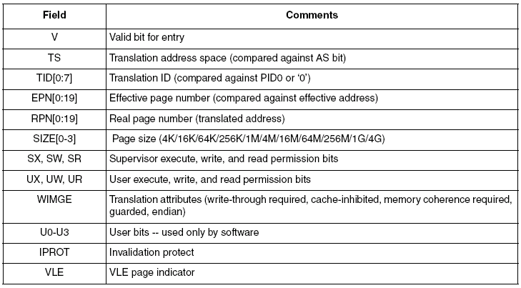
MMU: TLB Entry Bit Definitions
W – Write Through
(Determines if cache writes are written through main memory or not)
I – Cache Inhibit Mode
(Whether page is cacheable or not)
M – Memory Coherence (Not supported)
G – Guarded Access (Not supported)
E – Little or Bit Endian mode
0 = Big Endian (Default)
1 = Little Endian
Translation Space
(Compared with AS)
BookE defines 2 effective address spaces for instruction accesses and 2 effective address spaces for data accesses.
Current effective address space is defined by MSR[IS] or MSR[DS] which is latched to AS field and becomes an extension to the effective address
Translation ID
(Compared with Process ID)
Each effective address (instruction or data) has an 8-bit long Process ID associated with it.
As with TS, this is included as part of the virtual address.
User Bits
No effect on translation, can be used by software
Notes:
HP presentation template tutorial - Rev. 1
Process ID – Can be defined by user by writing to PID register (SPR 48). PID is ASSOCIATED with current instruction, not defined by it so if you write PID register that value is then set into PID and remains until user clears it.
=> Write to PID to define process ID’s of tasks and use MMU / MPU to allow block these based on process ID.
asm void setPID0_AB()
{
lis r3, 0x0
ori r3,r3,0x00AB
mtspr 48,r3
}

Slide 93
MMU: Page Identification in TLB
MSR[DS] for data access
MSR[IS] for instructions
Core Software
A page is identified in the TLB by comparing all TLB entries marked valid (v) to the “virtual address” which includes:
  32-bit Effective Address
    Effective Page Address
    is compared to EPN
    in TLB entries
  Process ID (PID): 8-bit field from SPR PID0
    Compared to TID, Translation ID,
    in TLB entries
    Enables restricting a page to specific software tasks
    PID = 0 matches all TID’s
  Address Space (AS) bit
    Compared to TS,
    Translation Space, in TLB entries
    Allows separate space for application [DS, IS = 1] and OS [DS, IS =0 (reset values)]
32-bit Effective Address
PID0[0:7]
AS
PID
Effective Page Address
Offset
0
n-1
n
31
TLB
(8 entries)
RPN of matching entry
Compare
Real Page Number
Offset
0
n-1
n
31
32-bit Real Address
Memory Mapped Hardware
Failure to locate a matching TLB entry results in a data or instruction TLB error exception.
Notes:
HP presentation template tutorial - Rev. 1
Optional MMU with privilege features
PID is an extension of the Address. There is an option not use the PID field by writing the PID0 with 0.
AS is a an address qualifier to extend the system address space.
If we have two TLB entries match, we have no way to check it nor does the system recognize a double hit as an error.

Slide 94
MMU: Page Permissions
After a matching TLB entry has been identified, access is permitted based on privilege level (user/supervisor), read, write and execute access.
TLB match
MSR[PR]
Instruction fetch
TLB entry [UX]
(User Exectue Permission)
TLB entry [SX]
Data read access
TLB entry [UR]
TLB entry [SR]
Data write access
TLB entry [UW]
TLB entry [SW]
PR = User or supervisor mode
access granted
E.G Permitted instruction fetch in user mode
OR
Permitted instruction fetch in supervisor mode
Failure to allow access to the matching TLB entry results in an data or instruction storage interrupt.
- SRR0 used for inst. address
- DEAR used for data address
Notes:
HP presentation template tutorial - Rev. 1

Slide 95
MMU: TLB Access
The TLB is accessed indirectly through several MMU Assist (MAS) registers.
Software can write and read the MAS registers with mtspr (move to SPR) and mfspr (move from SPR) instructions.
A TLB write entry (tlbwe) instruction writes the MAS register values to a TLB entry..
  The entry written is specified by the TLBSEL, and ESELCAM fields of the MAS0 register
    TLBSEL = ‘01’ for e200zX
    ESELCAM = desired TLB entry (0..n)
At reset all but TLB entry 0 are invalidated
  TLB entry 0 is loaded with the default values
    4K page, Supervisor/User mode, Cache inhibited
  BAM code then initializes TLBs
Notes:
HP presentation template tutorial - Rev. 1
MAS is used to access TLBs which require assembly language because compiler can not generate TLB initialization.

Slide 96
MMU: TLB Access Diagram
gpr
gpr
mtspr
mfspr
spr’s MAS1:3
spr’s MAS1:3
tlbwe*
*Entry # in MAS0
tlbre*
TLB
Entry 0 | V | TS | TID | EPN | RPN | SIZE | Perm | Mem* | User | IPROT | VLE
Entry 1 | V | TS | TID | EPN | RPN | SIZE | Perm | Mem* | User | IPROT | VLE
Entry 2 | V | TS | TID | EPN | RPN | SIZE | Perm | Mem* | User | IPROT | VLE
. | . | . | . | . | . | . | . | . | . | .
. | . | . | . | . | . | . | . | . | . | .
. | . | . | . | . | . | . | . | . | . | .
Entry n | V | TS | TID | EPN | RPN | SIZE | Perm | Mem* | User | IPROT | VLE
Notes:
HP presentation template tutorial - Rev. 1
Once setup, the MMU
To modify the the TLB to point to other memory area for the purpose of CALIBRATION, then we change the REAL PAGE NUMBER. The <EA> should not be changed in case of calibration. This equivalent to the OAK family dual mapping.
Mem = Memory Attributes = WMAGE = Write-through/copy back, Cache inhibited, Guarded/not Guarded, Endianness (see page 132 for more definition of these fields)
Iprot = if set to ‘1’, this entry is protected.
Perm = Read/Write, User/Supervisor, Execute/no Execute.

Slide 97
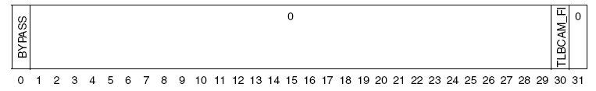
MMU Registers: MMUCSR0
Control and Status Register 0. SPR 1012
Bypass – Bypass Translation
  0 – TLB translates effective to real addresses normally
  1 – TLB bypasses the effective address directly to the real address
  (Note – the maximum system clock speed is only supported in MMU Bypass mode)
TLBCAM_FI – TLBCAM Flash Invalidate
  0 – No Flash Invalidate
  1 – TLBCAM Invalidation Operation.
    When written to “1”, TLBCAM invalidation is initiated by hardware and takes 3 cycles to complete.
    Once complete, this bit is set back to “0”.

Slide 98
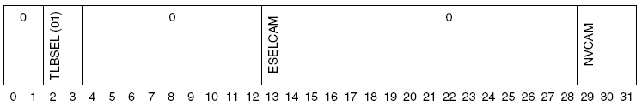
MMU Registers: MAS0
MMU Assist Register 0. SPR 624
TLBSEL selects TLB for access.
  01 = TLBCAM (write to 01 for future compatibility)
ESELCAM Entry select for TLBCAM.
  Defines TLB entry (0..n)
  Receives contents of NVCAM on a TLB error.
NVCAM Next replacement victim for TLBCAM (software managed)
  Software updates this field; it is copied to the ESELCAM field on a TLB Error

Slide 99

MMU Registers: MAS1
MMU Assist Register 1. SPR 625
VALID TLB Entry Valid.
  0 - This TLB entry is invalid
  1 - This TLB entry is valid
IPROT Invalidation Protect
  0 - Entry is not protected from invalidation
  1 - Entry is protected from invalidation
TID Translation ID Bits
  TID is compared with the current process IDs of the effective address to be translated.
  A TID value of 0 defines an entry as global and matches with all process IDs.
TS Translation address space
  This bit is compared with the IS or DS fields of the MSR (depending on the type of access) to determine if this TLB entry may be used for translation.
TSIZE Entry’s page size
  Supported page sizes are 4KB (0b0001) to 256MB (0b1001) in 4x increments.

Slide 100
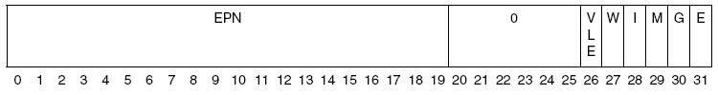
MMU Registers: MAS2
MMU Assist Register 2. SPR 626
EPN Effective Page Number
  Effective address for page
VLE Power Architecture VLE
  0 – Standard BookE
  1 – VLE
W Write Through Required (Set to 1 for 5510 to disable write through)
I Cache Inhibited (Set to 1 for 5510 to inhibit cache)
M Memory Coherence Required (This bit is ignored for 5510)
G Guarded (Ignored for 5510)
E Endianness
  0 – Big Endian byte order
  1 – Little Endian byte order

Slide 101

MMU Registers: MAS3
MMU Assist Register 3. SPR 627
RPN Real Page Number
  Actual (Physical) address for page
U0-U3 User bits [0-3]
PERMIS Permission bits (UX, SX, UW, SW, UR, SR)

Slide 102
MMU Reference: MMU Assist Registers 4 & 6
MAS4
0 1 2 3 4 5 6 7 8 9 10 11 12 13 14 15 16 17 18 19 20 21 22 23 24 25 26 27 28 29 30 31
SPR - 628
R/W
TLBSELD
(01)
0 0
0 0 0 0 0 0 0 0 0 0
TIDSELD
0 0 0 0
TSIZED
0 0 0
WD
ID
MD
GD
ED
TLBSELD
(01)
TIDSELD
WD
ID
MD
GD
ED
TSIZED
TLBSELD_{(2:3)} Default TLB selected:
  01=TLBCAM (ignored by e200z)
  should be written to 01 for future compatibility)
On a TLB miss, the “defaults” in MAS4 (along with AS and EPN of the offending address) get loaded to MAS0:2.
TIDSELD_{(14:15)} Default PID# from which to load TID.
  00 - PID0
  01 - Reserved, do not use
  10 - Reserved, do not use
  11=TIDZ (8’h00) (Use all zeros, the globally shared value)
TSIZED_{(20:23)} Default TSIZE value.
DWIMGE_{(27:31)} Default WIMGE values.
0 1 2 3 4 5 6 7 8 9 10 11 12 13 14 15 16 17 18 19 20 21 22 23 24 25 26 27 28 29 30 31
SPR - 630
R/W
0 0 0 0 0 0 0 0 0
SPID
0 0 0 0 0 0 0 0 0 0 0 0 0 0 0
SAS
MAS6
SPID
SAS
The “tlbsx” instruction uses its EA plus MAS6 fields for TLB entry searches.
SPID_{(8:15)} PID value for searches.
SAS₍₃₁₎ AS value for searches.
Notes:
HP presentation template tutorial - Rev. 1
In the event we get a TLB miss, the MAS4 will be used to update the entry to automatically configure that entry.

Slide 103

MMU Registers: MMUCFG
MMU Configuration Register. SPR 1015 (Read Only)
NPIDS – No of PID Registers
  0001 – This version of the e200 MMU implements one PID (PID0)
PIDSIZE – PID register Size
  00111 – 01000 - PID registers contain 8 bits
NTLBS – Number of TLB’s
  01 – This version two TLB structures (A null TLB0 and a TLBCAM for TLB1)
MAVE - MMU Architecture Version Number
  00 – This version implements 1.0 of the EIS MMU Architecture

Slide 104

MMU Registers: TLB1CFG
TLB1 Configuration Register. SPR 689 (Read Only)
ASSOC – Associativity
  0x8 - Indicates that TLB1 Associativity is 8.
MINSIZE - Minimum Page Size
  0b0001 = Smallest page size is 4
MAXSIZE - Maximum Page Size
  0xB = Largest page size is 4 GB
IPROT - Invalidate Protect Capability
  1 - Invalidate Protect Capability is supported in the TLBCAM
AVAIL - Page Size Availability
  1 - All page sizes between MINSIZE and MAXSIZE are supported
NENTRY - Number of Entries
  0x8 – TLB1 contains 8 entries

Slide 105
MMU Registers: DEAR
Data Exception Address Register. SPR 61
Loaded with effective address of data access resulting in an alignment, Data TLB Miss or DSI exception
  Written to and read (like all MMU registers) via mtspr and mfspr

Slide 106
Cache
e200z7 ☑ e200z6 ☑
e200z4 ☑ e200z3 ☒
e200z1 ☒ e200z0 ☒

Slide 107
Cache : Block Diagram
Cache enables faster memory access
Cache is only accessible to the core.
Cache is not accessible to other masters such as:
  External bus
  eDMA
  Nexus
  FlexRay
  Fast Ethernet Controller
However Nexus tools can read cache when the processor stops.
Leopard device includes only Instruction Cache
Notes:
HP presentation template tutorial - Rev. 1

Slide 108
Cache: Overview
Cache is implemented on the following cores:
Core | Unified L1 Cache (Instr. & Data) | L1 Instruction Cache | L1 Data Cache
e200z7 | n/a | 16K – 4 way | 16K – 4 way
e200z6 | 32K – 8 way 32K – 4 way 8K – 2 way | n/a | n/a
e200z4 | n/a | 4K – 2 or 4 way | n/a
e200z3 | n/a | n/a | n/a
e200z1 | n/a | n/a | n/a
e200z0 | n/a | n/a | n/a
All Cache is implemented with a 32-byte (8 x 32-bit instructions) line size
Notes:
HP presentation template tutorial - Rev. 1

Slide 109
Cache: Typical Sequence
System
Memory
Cache
…
Physical
(Real)
Address
…
A cache line fill occurs on an instruction or data fetch miss
  The instruction or data address must be marked cacheable
A burst fill for the line is then performed, critical double word first.
The critical double word is forwarded directly to the Instruction unit (instructions) or load/store unit (data)
  This minimizes stalls due to fill delays.
Read accesses may hit in the cache line buffer and supply data to the CPU.
  Updates to the cache array are delayed until the next cache line fill is initiated.
Notes:
HP presentation template tutorial - Rev. 1

Slide 110
Cache: Line Organization of Memory
TAG # A_{0 . . .} A₁₉ | INDEX # A_{20 . . .}A₂₆ | System Memory
. | . | . | 4 GB
. | . | .
2 | 0 | Line (32 bytes)
1 | 127 | Line (32 bytes)
. | . | .
. | . | .
1 | 2 | Line (32 bytes)
1 | 1 | Line (32 bytes)
1 | 0 | Line (32 bytes)
0 | 127 | Line (32 bytes)
. | . | .
. | . | .
0 | 3 | Line (32 bytes) | 0x60
0 | 2 | Line (32 bytes) | 0x40
0 | 1 | Line (32 bytes) | 0x20
0 | 0 | Line (32 bytes) | 0
Cache divides memory into 32 byte “Lines”
Memory Addressing:
A0-A19: TAG #
(0 to 1M in 4GB space)
A20-A26: INDEX #
(0 to 127)
A27-A31: select byte in line
Notes:
HP presentation template tutorial - Rev. 1

Slide 111
Cache: Cache Lookup Flow
Physical Address
0 … 19
Virtual Address
20 … 26 27.. 31
Tag
Index
Way 7
(Miss: Tag updates a cache line)
…
1. Index selects set
Way 2
Way 0
Way 1
Set 127 | Tag | Status | DW0 | DW1 | DW2 | DW3
… | … | … | … | … | … | …
Set 1 | Tag | Status | DW0 | DW1 | DW2 | DW3
Set 0 | Tag | Status | DW0 | DW1 | DW2 | DW3
2. Tag is used as compare reference
…
Data or
Instr.
Way 7
MUX
…
Way 2
Select
Way 1
Hit 7
3. The 8 tags from the selected cache set are compared in parallel to the reference tag.
…
Logical OR
Comparator
Way 0
Hit 2
Hit
Hit 1
Hit 0
4. A[27:28] select DW of selected Way
Notes:
HP presentation template tutorial - Rev. 1

Slide 112
Cache: Line Format
Way 0
Way 1
Way 2 …
Way 7
SET 0
SET 1
SET 126
SET 127
●
●
●
●
●
●
●
●
●
●
●
●
Line
Cache Line Format
TAG
L
D
V
Doubleword 0
Doubleword 1
Doubleword 2
Doubleword 3
TAG: 20 bit address [0:19] plus 2 bits parity
L - Lock bit: 1 = The line has been locked and is not available for replacement.
D - Dirty bit; 1 = The data contained in this entry has been modified and is not consistent with physical memory.
V - Valid bit; 1 = This bit signifies that the cache line is valid.
Notes:
HP presentation template tutorial - Rev. 1
Each line consists of a physical address tag, status bits, and four double words of data (8 instructions).
Address bits A[27:29] select the word within the line.
TAG: 20 bit address [0:19] plus 2 bits parity
L - Lock bit
0 = The line has not been locked.
1 = The line has been locked and is not available for replacement.
D - Dirty bit
0 = The data contained in this entry has not been modified.
1 = The data contained in this entry has been modified and is not consistent with physical memory.
V - Valid bit
0 = This bit signifies that the cache line is invalid and a tag match should not occur.
1 = This bit signifies that the cache line is valid.

Slide 113
Cache: Cache Modes
2 Write Modes of Operation for Cache
Write-through Mode – Every write to cache is written through to system memory
Copyback Mode – Data only written to system memory when it is no longer required by cache
Copyback Mode
Write-through Mode
System
Memory
Cache
…
…
Core
Notes:
HP presentation template tutorial - Rev. 1

Slide 114
Cache: Copyback Mode
Copyback mode uses fewer system resource. This is recommended to optimise performance.
Considerations with Copyback mode:
  Memory coherency with other master accessing cached memory
  E.g. DMA accessing cached variable in RAM may use “old copy” of data
Mixing Copyback and Write-Through:
  Configure Cache for Copyback Mode
  In MMU, setup specific memory region for coherent data. Set the “W” bit (write-through required) in the TLB for the memory region.
  This ensures specific memory region uses Write-through Mode and have data coherency between masters
Notes:
HP presentation template tutorial - Rev. 1

Slide 115
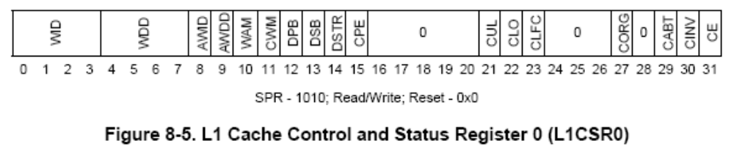
Cache: Configuration
Cache Control and Status Register (L1CSR0) – Unified Cache
  SPR 1010
Cache Write Mode
Cache Invalidate
Cache Enable
Note: Cache registers similar, but different, for Harvard Arch Cache
After Reset,
  The entire cache contents are undefined
  Hardware disables the cache, i.e., L1CSR0[CE] =0
    When the cache is disabled all normal accesses are propagated to the system bus as single-beat (non-burst) transactions.
    The MMU translation logic operates independently of the cache
Notes:
HP presentation template tutorial - Rev. 1

Slide 116
Cache: Configuration Cont.
Steps to configure the cache:
  Software must ensure that any prior invalidation of the cache is completed
    Check L1CSR0[CABT]. If it is set, wait until complete.
  Software must then invalidate the cache by setting L1CSR0[CINV] = 1
    Reset does not invalidate the cache automatically.
  Once set, hardware clears L1CSR0[CINV] after approx. 134 CPU cycles
    During this time, CPU waits for cache invalidation to complete. Code is not executed.
    Software should poll L1CSR0[CINV] bit until it is cleared.
    This works with the cache disabled or enabled
  Software executes msync and isync instructions
  Software then enables cache by setting L1CSR0[CE] = 1
  Software must then set Cache Write Mode,
    Write-through Mode: L1CSR0[CWM] = 0
    Copyback Mode: L1CSR0[CWM] = 1
    (Default CWM is write-through)
  In the MMU, the TLB[I] (Cache inhibited) bit must be cleared for memory areas that are to be cached
  Valid bits and lock bits are cleared during invalidation
  Tag parity is set during invalidation
Notes:
HP presentation template tutorial - Rev. 1

Slide 117
Cache: Cache Way Configuration
The cache can be configured for Applications that are extremely code intensive or data intensive
The 4KB cache “ways” may be allocated for:
  Cache both data and instructions (default)
  Only cache instructions (disable caching data)
  Only cache data (disable caching instructions)
Allocation granularity:
  Ways 0, 1, 2 and 3 may be individually allocated
  Ways 4 through 7 (16KB total) are allocated as a group
Allocation is done using the L1CSR0 register
Notes:
HP presentation template tutorial - Rev. 1

Slide 118
Cache: Parity
Cache parity can be enabled for both Tag and Data arrays.
  Enabled by L1CSR0[CPE]
  Parity is checked on each cache access, whether for lookup or for dirty line replacement
Parity includes:
  Data: byte basis (1 bit per byte)
  Tag: 2 bits
  If a parity error is detected:
    Machine Check exception occurs
    A syndrome bit sets in the Machine Check Syndrome register
Cache Parity Enable
Notes:
HP presentation template tutorial - Rev. 1

Slide 119
Cache: Error Detection & Auto Correction
New feature for e200z7 and e200z4 only
On all e200 cores - Cache Parity flags if an error is present
  It is up to the user to handle this error in SW
e200z4 & e200z7 only - Error Detecting Codes (EDC) Protection
  Single bit errors in “Tag”- HW automatically corrects
  Multi bit errors in “Tag” – HW auto invalidates the cache line and re-fills from memory
  Errors in cache “Data” – HW auto invalidates the cache line and re-fills from memory
Notes:
HP presentation template tutorial - Rev. 1

Slide 120
Cache: Management Instructions
Instruction dcb: data cache block |  | Copies line back if modified | Invali-dates line | Zeros line without fetching | Comments
Store | dcbst rA, rB | Yes |  |  | Line is marked clean. Lock status is unchanged.
Flush | dcbf rA, rB | Yes | Yes
Invalidate | dcbi rA, rB |  | Yes |  | Invalidation can also be done by index + way using spr L1FINV0
Set to zero | dcbz rA, rB |  |  | Yes | Allows allocating space in cache with no corresponding system memory Requires copyback (MMU W=0 & L1CSR0[CWM] is copyback).
The line being managed has the Effective Address of:
rA + rB (when rA is not r0)
0 + rB (when rA is r0)
Notes:
HP presentation template tutorial - Rev. 1

Slide 121
Cache: Touch Instructions
Instruction (dcb: data cache block, icb: instruction cache block) |  | Locks line in cache | Clears line’s lock bit | Comments
Touch and lock set | dcbtls rA, rB | Yes |  | If the line is already locked in cache, then: - no new line is cached - no exception is generated - “Overlocked” bit is set, L1CSR0[CLO]
 | icbtls rA, rB | Yes
Lock clear | dcblc rA, rB |  | Yes
 | icblc rA, rB |  | Yes
The line being managed has the Effective Address of:
rA + rB (when rA is not r0)
0 + rB (when rA is r0)
Notes:
HP presentation template tutorial - Rev. 1

Slide 122
Cache: Instruction Summary
 | Instruction |  | Copies line back if modified | Invali-dates line | Zeros a line without fetching | Locks line in cache | Clears line’s lock bit
 | Store | dcbst | Yes
Management | Flush | dcbf | Yes | Yes
Instructions | Invalidate | dcbi |  | Yes
 | Set to zero | dcbz |  |  | Yes
 | Touch and | dcbtls |  |  |  | Yes
Touch | lock set | icblts |  |  |  | Yes
Instructions | Lock clear | dcblc |  |  |  |  | Yes
 |  | icblc |  |  |  |  | Yes
If cache is not enabled, management instructions are treated as nops.
Notes:
HP presentation template tutorial - Rev. 1

Slide 123
Cache: Using Cache as RAM
Cache can be configured as RAM (local RAM).
  128k to 160k of system RAM, and 32k to 0k of cache.
  Partitioning of local RAM is in increments of 32 bytes.
Benefits
  Software transparent additional data space memory.
  Deterministic memory
  Low latency for interrupt handlers.
Applications Usages
  Lock critical performance routines in cache for faster execution
  Place the stack in cache
Not Valid for Z4
Notes:
HP presentation template tutorial - Rev. 1

Slide 124
Cache: Configuring Cache-as-RAM
Steps to configure the cache as RAM:
  Configure cache in copyback mode
  Configure an MMU region at the end of system RAM for cache-as-RAM
  Setup loop counter for size of RAM that is required in cache
  Point Register to beginning of RAM address (as defined in MMU)
  Use cache lock instructions to lock a line of cache for RAM usage
  Repeat for full size of required RAM in cache
Cache Lock Instructions
Not Valid for Z4
cache_loop:
dcbz r0, r5 # Establish address in cache for 32 bytes and zero
dcbtls 0, r0, r5 # Lock the address into the cache
addi r5, r5, 32 # Increment to start of next cache line (+32 bytes)
bdnz cache_loop # Decrement the counter (CTR), branch if nonzero
dcbz : Set data cache block to zero
dcbtls : Lock line in cache for RAM usage
Notes:
HP presentation template tutorial - Rev. 1

Slide 125
Cache: Stack in RAM
Stack is ideally suited for being stored in cache
  Constantly accessed
  Fast memory would reduce access times
  Avoids crossbar activity
Setting stack in RAM
  Configure size of stack
  Set register to point to the end of the stack (Low Address)
  Lock lines of cache from the end of the stack to the beginning of the stack
  Set the stack pointer to the address of RAM in cache
Not Valid for Z4
Notes:
HP presentation template tutorial - Rev. 1

Slide 126
Cache: Stack in RAM
# Load size of Cache to be used for Stack (4K)
lis r5, __STACK_SIZE@h # Stack size is 4KBytes
ori r5, r5, __STACK_SIZE@l
# Each stack lock instruction covers 32 bytes, so divide the input parameter
srwi r5, r5, 5 # Shift the contents of R5 right by 5 bits (size/32)
mtctr r5 # locations per cache line loaded to the CTR (SPR 9) register
# Point R5 to just past the system RAM. Set in the Linker file.
lis r5, __SP_END@h
ori r5, r5, __SP_END@l
# Run the loop to lock the cache lines for the stack
# The loop count is: 4KB / 32B = 128 = 0x80
_cache_loop:
dcbz r0, r5 # Establish address in cache for 32 bytes and zero
dcbtls 0, r0, r5 # Lock the address into the cache
addi r5, r5, 32 # Increment to start of next cache line (+32 bytes)
bdnz _cache_loop # Decrement the counter (CTR), branch if nonzero
# Set the stack pointer
lis r1, (__SP_INIT-0x10)@h
ori r1, r1, (__SP_INIT-0x10)@l
Configure stack size
Not Valid for Z4
Point to end of the stack (Low Address)
Lock lines in cache from the end of the stack to the beginning of the stack
Set the stack pointer to the address of RAM in cache
Notes:
HP presentation template tutorial - Rev. 1

Slide 127
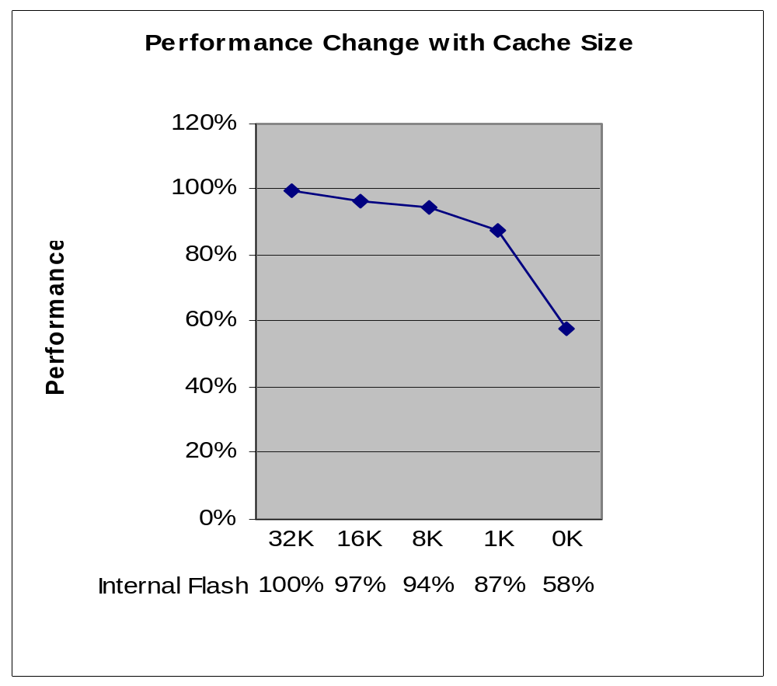
Cache: Cache as RAM Performance Impact
A simulation of code shows
  A small amount of cache has significant performance improvement
  Performance differences if not using 16KB or even 24KB of cache are not large
  Cache memory could be configured for other purposes
Not Valid for Z4
Cache Size
Notes:
HP presentation template tutorial - Rev. 1

Slide 128
e200 Resources
e200z7 ☑ e200z6 ☑
e200z4 ☑ e200z3 ☑
e200z1 ☑ e200z0 ☑

Slide 129
APPENDIX
Documentation:
  EREF: A Programmer’s Reference Manual for Book E Processors
    http://www.st.com
  SPEPEM : SPE Programming Environments Manual
    http://www.st.com
  VLEPEM : VLE Programming Environments Manual
    http://www.st.com
  BookE UM: BookE User Manual
    http://www.st.com
  e200zX Reference Manuals
    Available at: http://www.st.com
Notes:
HP presentation template tutorial - Rev. 1

Slide 130
Thank’s

