Slide 1

THE END (of the code/rapid)

Slide 2
"A rapid response is called on a patient for agitation. They appear intoxicated, perhaps from methamphetamine use. They are tachycardic and mildly hyperthermic, but vitals are otherwise stable. At the last rapid, 2mg of lorezapam, 2.5 mg of haloperidol, and 25 mg of benadryl were used. This was effective, but took 25 minutes before he was safely calmed, and was short-lived. The nurse has been unable to leave the room all morning. What should you do?"
Advocate for moving the patient to the ICU for staffing reasons.
Increase the strength of sedative by switching to phenobarbital
Defer management to the primary team
Place the patient in restraints so that the nurse can go care for their other patients.

Slide 3
"A rapid response is called on a patient for agitation. They appear intoxicated, perhaps from methamphetamine use. They are tachycardic and mildly hyperthermic, but vitals are otherwise stable. At the last rapid, 2mg of lorezapam, 2.5 mg of haloperidol, and 25 mg of benadryl were used. This was effective, but took 25 minutes before he was safely calmed, and was short-lived. The nurse has been unable to leave the room all morning. What should you do?"
Advocate for moving the patient to the ICU for staffing reasons
Increase the strength of sedative by switching to phenobarbital
Defer management to the primary team
Place the patient in restraints so that the nurse can go care for their other patients

Slide 4
Rapid Response: What is the big picture?
Is this (going to be) a code blue?
Do they need to be in an ICU?
(this generally involves eyeballing the patient, asking orientation questions, and 1 set of vitals, and asking what happened leading up to the RRT). 10 minutes tops. Usually, no labs.
NEED FOR TOO MUCH NURSING CARE IS A REASON FOR ICU ADMISSION [Ask]
It is rare to need to do things before moving to ICU
What immediate workup or stabilization do they need if staying put? Hand off to primary team
Keep an eye out for Ethan’s cards
Notes:
With the possible exception of an ABG, do not wait on labs to tell you if a patient needs to go to an ICU
if nursing cares are prohibitively intensive

Slide 5

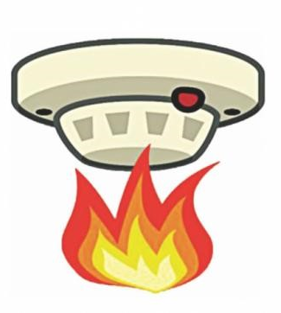
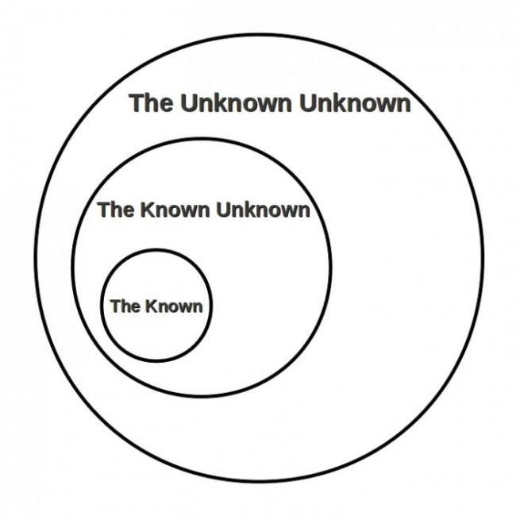
False alarms: Why you shouldn’t (ever!) be dismissive, implicitly or explicitly.
Two rationales:
Signal detection theory: it is ideal to never err. But since we will, we have to balance the harms from false positives (activation that wasn’t needed), and false negatives (no activation, was needed). False negatives are WAY worse, so the optimal balance favors more activations.
More caution is warranted the less you know – and we NEED less experienced caregivers to be monitoring.
Notes:
Terrible politics, but actually an insightful comment.

Slide 6
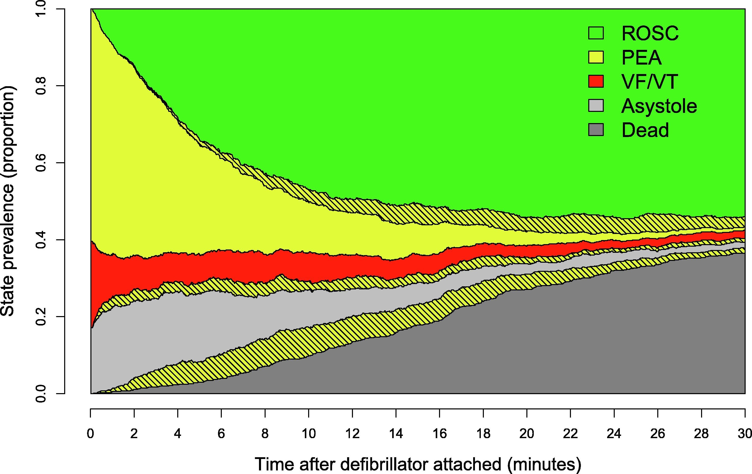
How long do you attempt resuscitation?
Resuscitation 2022 176117-124 DOI: 10.1016/j.resuscitation.2022.04.024
Two things matter:
What was their pre-arrest state?
More ill = shorter
Is the (likely) cause reversible?
Less reversible = shorter
Then, consider rhythm and duration
5-45 min in most
Shockable = Good! Asystole = Bad! PEA = … nuanced.
Notes:
Need to simplify the message here.
https://www.resuscitationjournal.com/article/S0300-9572(22)00142-3/fulltext
PEA: initial rhythm 60% of the time, but precedes ROSC 75% of the time.
Half of patients with VF/VT pass through PEA on the way to ROSC
Transition from Asystole to PEA is a good sign.
If you achieve ROSC once, the likelihood of ROSC is higher

Slide 7

Language to end with:
“Is there anything we haven’t thought of?”
“OK, we’re stopping CPR”
“Thank you everyone for your effort”
“We’ll debrief in 5 minutes at the nursing station”
Notes:
Really sucks, especially in the case where it seemed preventable.
You may take it really hard
The other members of the code team may take it really hard
The primary caregivers / nurse may take it really hard.
Cut this – nurses are required to debrief but it doesn’ thave to involve residents. Usually systems issues that prevent it from happening.

Slide 8
Summary
Consider nursing workload in deciding if ICU admission is needed
As a personal policy, do not snark people for activating an RRT
Consider pre-arrest status, reversibility, and rhythm in deciding how long to attempt resuscitation (5-45 minutes with no ROSC)

