Slide 1
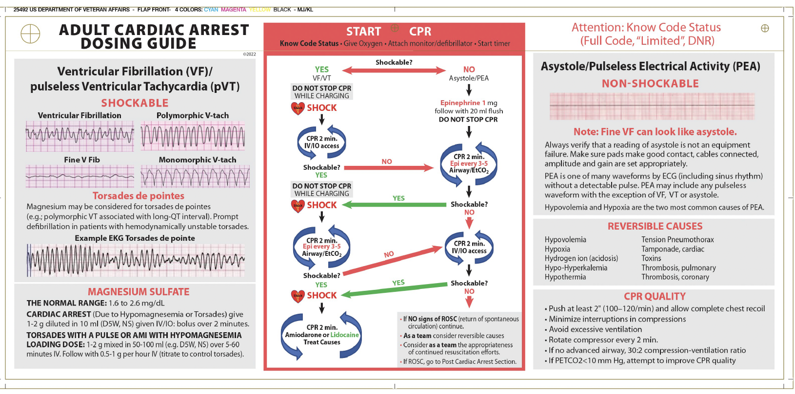
PEA: Don’t Memorize H’s and T’s
Literally every abnormal vital sign or lab value starts with ‘H’
Hypovolemia | Tamponade
Hypoxia | Toxins
Hydrogen Ions (acidosis) | Tension Pneumothorax
Hyperkalemia/ Hypokalemia | Thrombosis (PE)
Hypothermia | Thrombosis (Cardiac)
Just look at the card!

Slide 2
Which of the following is likely to cause a narrow QRS complex pea arrest?
Hyperkalemia
Amitriptyline Overdose
Pulmonary Embolism
Ostial LAD Obstruction

Slide 3
Which of the following is likely to cause a narrow QRS complex pea arrest?
Hyperkalemia
Amitriptyline Overdose
Pulmonary Embolism
Ostial LAD Obstruction

Slide 4
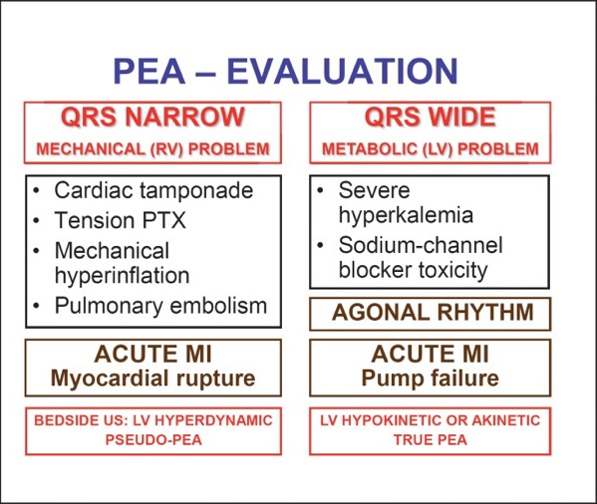
A schema is what is needed:
Littman Approach
doi: 10.1159/000354195
PEA occurs because either:
Heart can’t beat:
nothing in the pump, pump being blocked
Essentially most cases of extreme shock
Heart won’t beat:
signal is there but capture is not
Electromechanical dissociation
Muscle disrupted or out of necessary ingredients
requires a ‘mechanical’ fix
requires a medical fix
Notes:
Meaning: a schema is an approach to think through the problem. You don’t need to memorize (others can do that / help), you need to understand the situation. That way, you can integrate hints about what things are more or less likely to be going on.

Slide 5
Empiric Therapies: Focus on who is coding
Reasonable to give without information:
Glucose
Narcan
Fluids
Give calcium if hyperkalemia plausible
(don’t wait for labs or blood gas)
Bicarb? No one knows, so don’t stress it
unless TCA, Na-channel overdose
Patient | Consider | Do
Post-operative | Opiate resp depression, PE | Narcan
ESRD | Hyperkalemia | Ca, bicarb
Has a chest tube | Tension pneumo | Flush the tube (needle)
Frail, DM | hypoglycemia | glucose
Cirrhotic | Massive hemorrhage | Fluids, blood
Etc.
Notes:
ABGs and VBGs can provide a lot of information. However, is this information useful?
Often already addressing most things you would unveil with a gas.
Depending on timing, gas results can be skewed by ongoing arrest and tissue ischemia.
Bottom Line: Nice to have if you can get it as long as this does not compromise ACLS.
You’re rarely going to get definitive information, so just act.

Slide 6

Verbalize
Verbalize your decision making!
Very helpful to set aside time to summarize the patient and current thought process.
“I think this might be a pulmonary embolism because they are post-op and not receiving anticoagulation”
Ask out loud for input or thoughts.
“Does anyone have ideas we might be missing?”
Lower the power distance
Notes:
-- Verbalizing allows others to correct anything that might be wrong.

Slide 7
Summary Points:
Use resources (cards, med team, code team) > memorizing
Act despite uncertainty, focus on the big picture.
Focus on who is coding;
Most these actions are marginal! The BIG PICTURE is:
Continuous CPR
Shock if shockable
Notes:
Verbalizing allows others to correct anything that might be wrong.
An alternative framing to this might be: you are often not going to get definitive information about the cause. Therefore, the pre-assessment probabilities of various causes rules how likely they are to be present.
Thus, if they have ESRD - move to address hyperkalemia rather than seeking evidence for it.
If they’re post-op
Sometimes questions come up on more intensive therapies.
Thrombolysis for Massive PE
Needle Thoracostomy with Tension Pneumothorax
These diseases are usually not subtle in inpatient codes.
Tension pneumo: known pneumothorax or chest tube in place.
Massive PE: clots usually already found in someone admitted and not already dead.
Tamponade: pre-existing effusion

