Slide 1

Do you have what you need?
Situations you need more people
Is this rapid really a code?
Situations you need less people
Room control
The family?
Providers arriving to code at 2pm…
Notes:
Room management:
Recognize situations where you need more people? Code, shock team
Recognize situations where you need less people (most)
Equipment – move the room around to make space; go drop the bed
Ethan’s Spreadsheet

Slide 2
A cardiac arrest occurring in which of the following patients would warrant calling for additional help beyond those that usually respond at the U of U ?
a code blue in a 30-year-old with myocarditis
a respiratory arrest on the floor that has been paged out as a code blue
a rapid response on a surgical patient.
a rapid response in rehab?

Slide 3
Situations to escalate:
Rapid Responses |  | Code Blues
In 5 minutes, will this be a code? | Brain Attack | STEMI or suspicion | Shock team
Airway In Extremis | Focal Deficit | Cath lab | HF; few comorbidities Shockable rhythms High PE suspicion
RRT → Code early | Call brain attack Transfer after-hours at VA | All sites are capable | Shock team @ U of U TICU* @ IMC

Slide 4
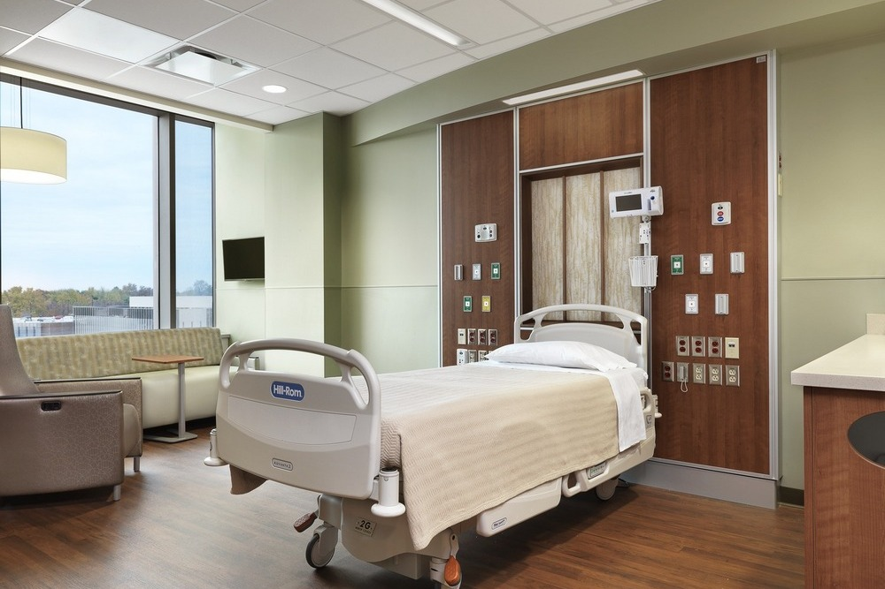
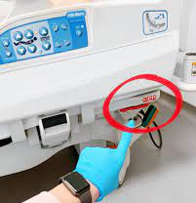
Optimize the room for CPR
Move out from the wall
gives space for airway managers
Rotate if there is insufficient space for compressors to move in and out.
CPR line and next compressor
Direct assignment
Closed loop communication.
“Everyone clear out unless I’ve given you a role”
Notes:
OPA/NPAs/BVMs airway management; oxygen - all (25 mins w portable tank)
Bed issues
Note: the beds at the VA don’t just drop to the floor.

Slide 5
Bringing family in to observe an attempt at resuscitation has been shown to: [select all that apply]
increase ROSC rate
decrease ROSC rate
increase PTSD in the family
decrease PTSD in the family

Slide 6
Bringing family in to observe an attempt at resuscitation has been shown to: [select all that apply]
increase ROSC rate
decrease ROSC rate
increase PTSD in the family
decrease PTSD in the family

Slide 7

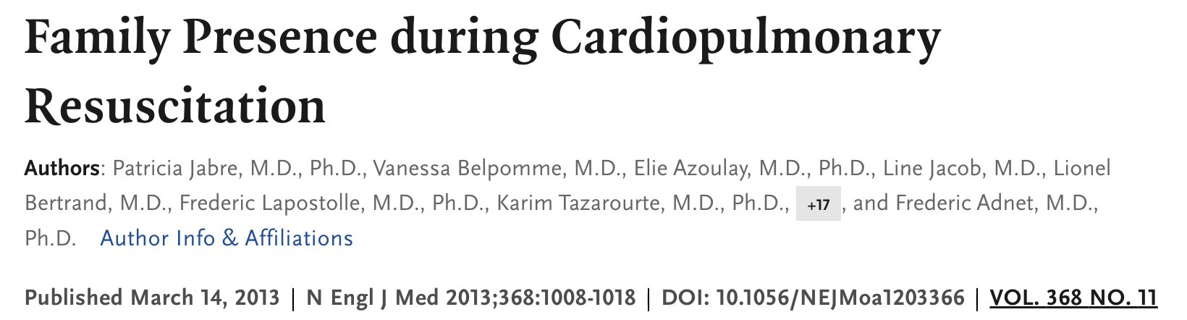
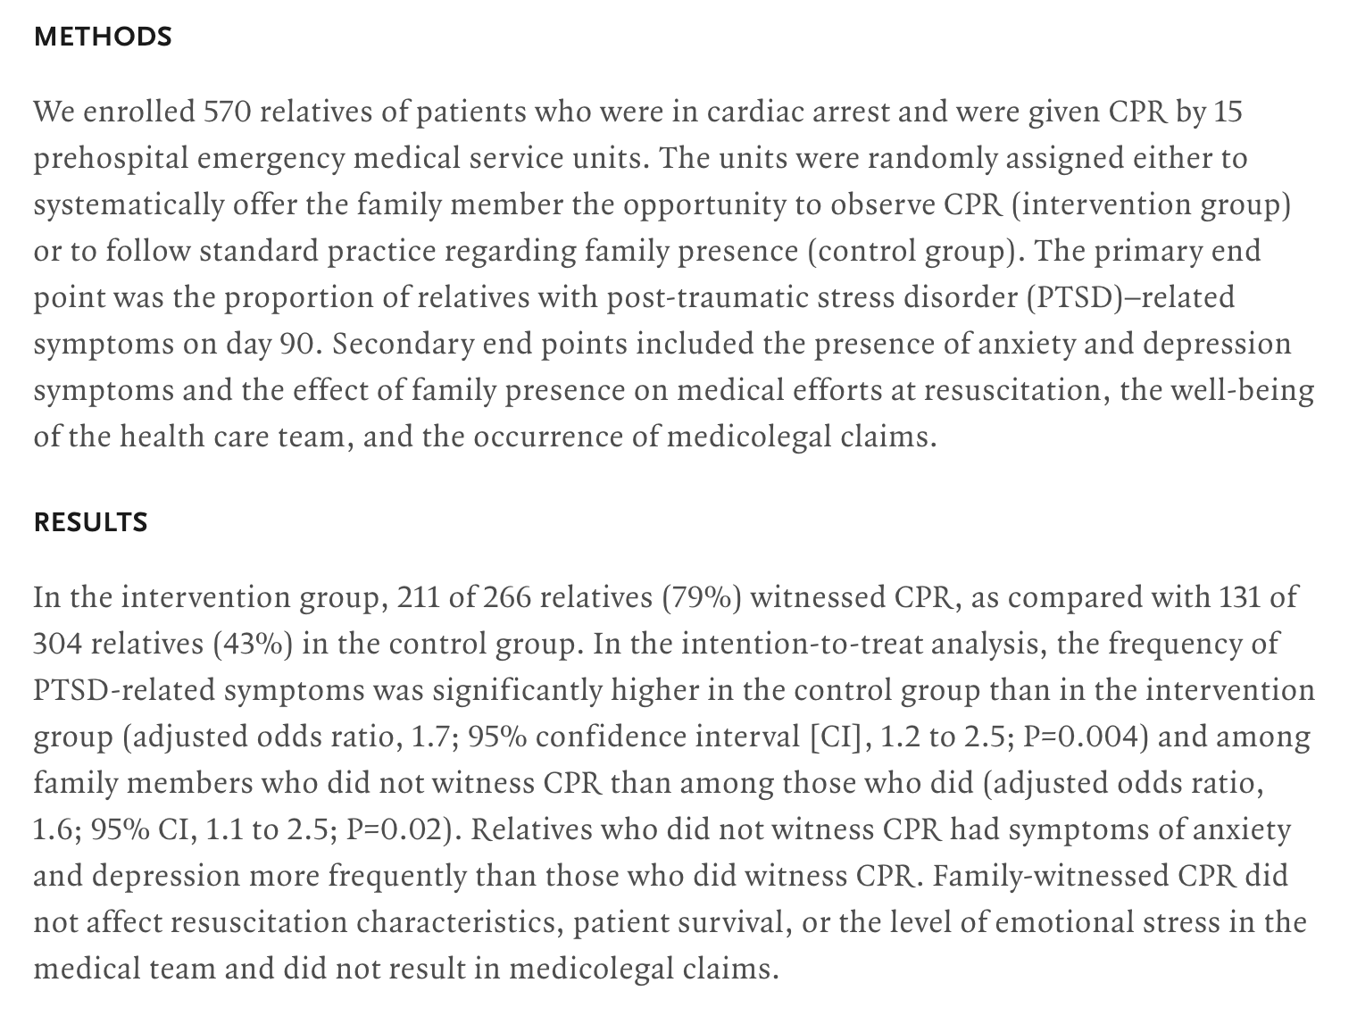
Family involvement:
You can, and should, bring them in
Use your judgement
Delegate attention:
Social work
another resident
Notes:
Social work / delegation.
Other work corroborates this: https://link.springer.com/article/10.1186/s40560-015-0107-2

Slide 8
Review: Do you have what you need?
Situations you need more people: Airway, Cath/Shock Team, Neuro
Is this rapid really a code? Can’t breathe; in extremis
Situations you need less people: Most codes
Room control: move the bed out, lower the bed
The family? Bring them in

