Slide 1

Code Blue Training: Etiology
Moving Beyond the H’s and T’s

Slide 2
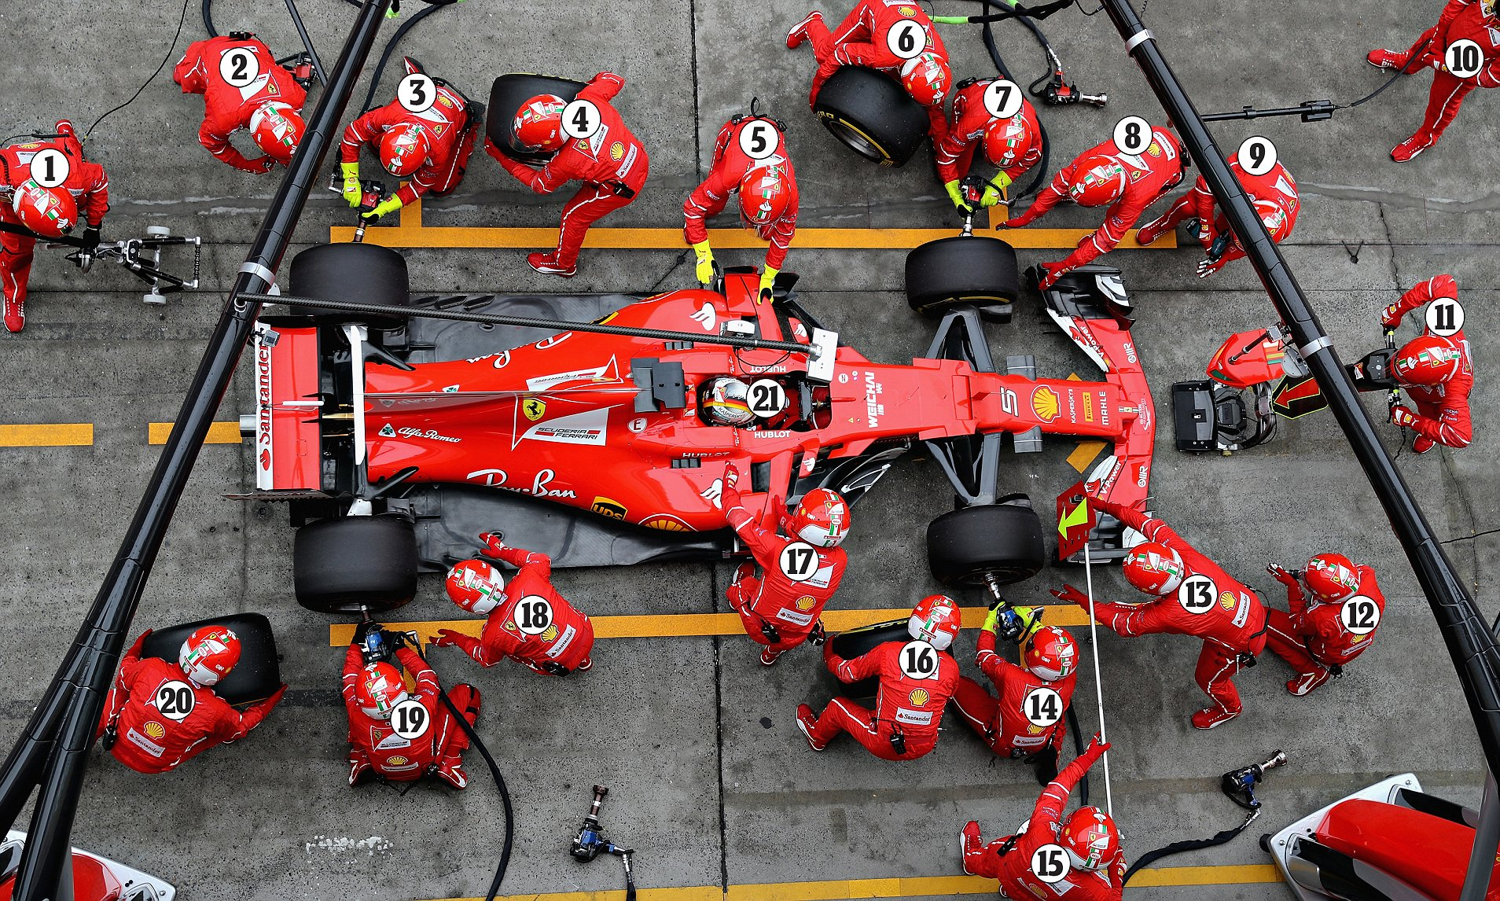
Set up for success: determine roles in advance.
Team/Code Lead: that’s you!
Computer Reviewer
Verify code status.
Look through history, labs, medication list.
History Taker
Talk to family and nursing.
If witnessed code, what happened?
Tele Monitor Review
Important for arrhythmic arrest

Slide 3
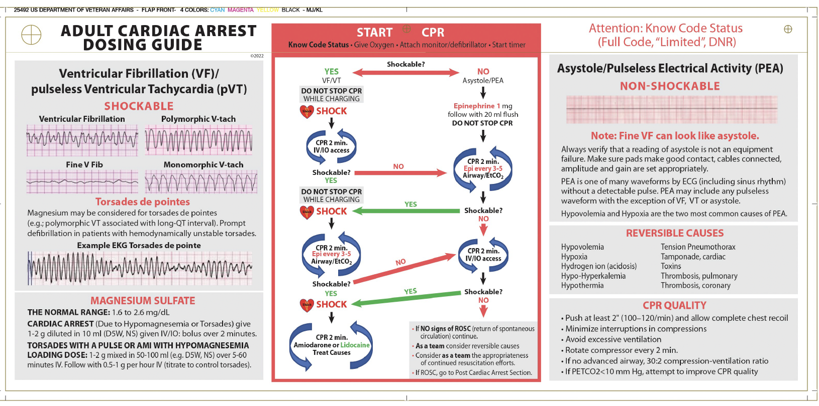
PEA: Don’t Memorize H’s and T’s
Literally every abnormal vital sign or lab value starts with ‘H’
Hypovolemia | Tamponade
Hypoxia | Toxins
Hydrogen Ions (acidosis) | Tension Pneumothorax
Hyperkalemia/ Hypokalemia | Thrombosis (PE)
Hypothermia | Thrombosis (Cardiac)
Just look at the card!

Slide 4
Which of the following is likely to cause a narrow QRS complex pea arrest?
Hyperkalemia
Amitriptyline Overdose
Pulmonary Embolism
Ostial LAD Obstruction

Slide 5
Which of the following is likely to cause a narrow QRS complex pea arrest?
Hyperkalemia
Amitriptyline Overdose
Pulmonary Embolism
Ostial LAD Obstruction

Slide 6
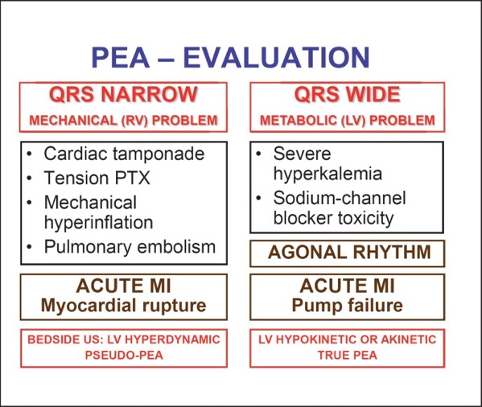
A schema is what is needed:
Littman Approach
doi: 10.1159/000354195
PEA occurs because either:
Heart can’t beat:
nothing in the pump, pump being blocked
Essentially most cases of extreme shock
Heart won’t beat:
signal is there but capture is not
Electromechanical dissociation
Muscle disrupted or out of necessary ingredients
requires a ‘mechanical’ fix
requires a medical fix
Notes:
Meaning: a schema is an approach to think through the problem. You don’t need to memorize (others can do that / help), you need to understand the situation. That way, you can integrate hints about what things are more or less likely to be going on.

Slide 7
Empiric Therapies: Focus on who is coding
Reasonable to give without information:
Glucose
Narcan
Fluids
Give calcium if hyperkalemia plausible
(don’t wait for labs or blood gas)
Bicarb? No one knows, so don’t stress it
unless TCA, Na-channel overdose
Patient | Consider | Do
Post-operative | Opiate resp depression, PE | Narcan
ESRD | Hyperkalemia | Ca, bicarb
Has a chest tube | Tension pneumo | Flush the tube (needle)
Frail, DM | hypoglycemia | glucose
Cirrhotic | Massive hemorrhage | Fluids, blood
Etc.
Notes:
ABGs and VBGs can provide a lot of information. However, is this information useful?
Often already addressing most things you would unveil with a gas.
Depending on timing, gas results can be skewed by ongoing arrest and tissue ischemia.
Bottom Line: Nice to have if you can get it as long as this does not compromise ACLS.
You’re rarely going to get definitive information, so just act.

Slide 8

Verbalize
Verbalize your decision making!
Very helpful to set aside time to summarize the patient and current thought process.
“I think this might be a pulmonary embolism because they are post-op and not receiving anticoagulation”
Ask out loud for input or thoughts.
“Does anyone have ideas we might be missing?”
Lower the power distance
Notes:
-- Verbalizing allows others to correct anything that might be wrong.

Slide 9
Summary Points:
Use resources (cards, med team, code team) > memorizing
Act despite uncertainty, focus on the big picture.
Focus on who is coding;
Most these actions are marginal! The BIG PICTURE is:
Continuous CPR
Shock if shockable
Notes:
Verbalizing allows others to correct anything that might be wrong.
An alternative framing to this might be: you are often not going to get definitive information about the cause. Therefore, the pre-assessment probabilities of various causes rules how likely they are to be present.
Thus, if they have ESRD - move to address hyperkalemia rather than seeking evidence for it.
If they’re post-op
Sometimes questions come up on more intensive therapies.
Thrombolysis for Massive PE
Needle Thoracostomy with Tension Pneumothorax
These diseases are usually not subtle in inpatient codes.
Tension pneumo: known pneumothorax or chest tube in place.
Massive PE: clots usually already found in someone admitted and not already dead.
Tamponade: pre-existing effusion

