Slide 1
The most common way for them to go wrong are problems with social dynamics, not with medical decision making
To avoid the biggest pitfalls:
Establish who is the leader, first by designation then by action
Signal that you want people’s input
Direct the group like a coach, don’t rule like a queen/king
Notes:
[ ] identify your resources
[ ] don’t try to take all the roles on

Slide 2
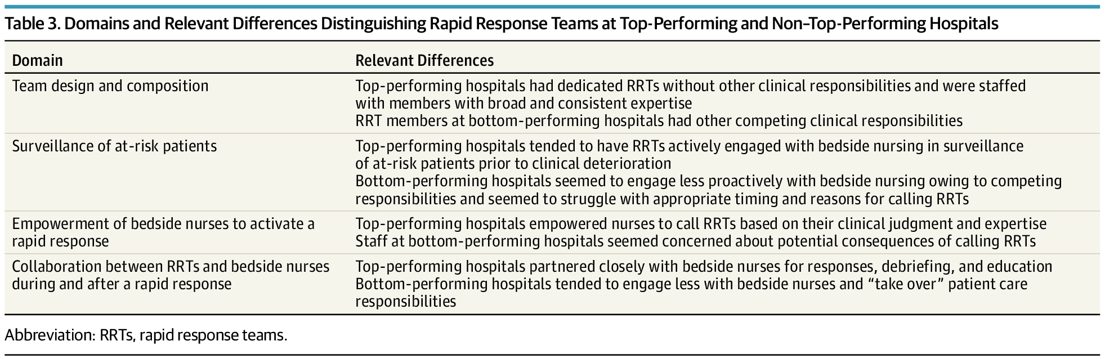
Hello, nice to meet you. Let’s code
(We’ll revisit this)
doi:10.1001/jamainternmed.2019.2420
Many institutions don’t have physicians on the rapid response team at all
(So, consider how you will add value; PMID: 25977203)
Notes:
you're going to go in to a room with ~10+ other people who, in general, you don't know and who don't know you.
They don't know if you're a genius or an idiot (though they do know you're not super experienced).
You have to assemble into a team to adapt to the constraints of the situation
Everyone is stressed, it is an emergency.
No MD or Resident in many places
The code could run without us– our role is to *add value*
This is very different from our simulations

Slide 3
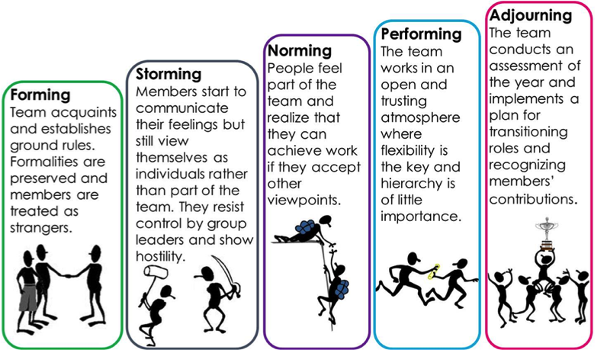
A lot needs to happen at once…
Tuckman’s stages of group development (1965)

Slide 4
First: are you running the code?
Collaboration / Trust
Lower the power distance
Proper tone
Are you the point person
(in practice)?
Are you running the code/rapid (in theory)?
Notes:
You can’t really move up the hierarchy until you hit the lower stages
First impressions matter. It is very hard to re-assert yourself as a code leader if you've been there. Your goal within the first 10 seconds of walking in to that room is to establish the above things
Are you running this code/rapid? (or not)
Signal to everyone that you will be the point person
Signal to everyone that you want their input, and they are valued for what they might notice.
Set the proper tone (calm, collected, and in control)

Slide 5
You are on the code team. You’re paged to a code on a patient on the surgical floor. The attending surgeon is present. You…
defer management to the primary team
ask if anyone is running the code
begin running the code
leave

Slide 6
You are on the code team. You’re paged to a code on a patient on the surgical floor. The attending surgeon is present. You…
defer management to the primary team
ask if anyone is running the code
begin running the code
leave

Slide 7
Step 1: Are you running this code or not?
"I’m ________, the resident on the the Code/RR team. Is anyone running this code?"
“OK, I’m running this code” or “Can I take over?"
What do you do if the primary team comes?
What do you do if the ICU team comes?
Notes:
How do you respond?
If someone IS already running it – that’s OK. They often want to hand over. If they don’t, make yourself useful.
You just need to commit to saying this. Loudly, right when you enter the door.

Slide 8
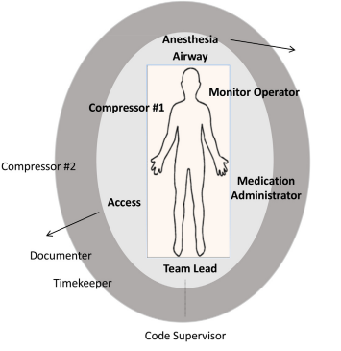
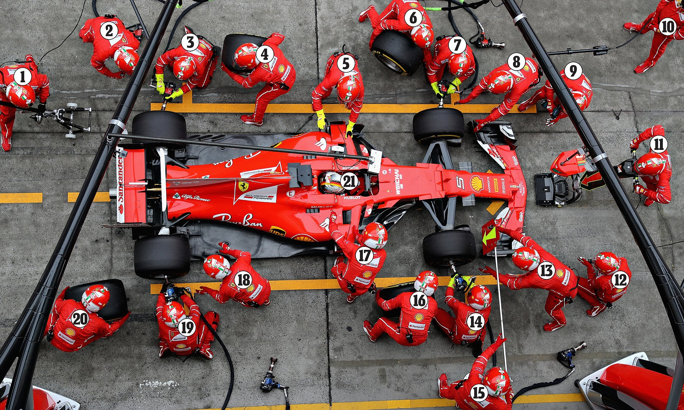
Step 2. Be the point person
https://doi.org/10.1016/j.resuscitation.2020.11.018
NEVER MOVE FROM HERE
DON’T DO IT
Notes:
I recommend foot over groin because it’s too tempting to do things at the groin
Closed Loop communication and delegation
Tell specific people to do specific things
Ask for closed loop communication.
Park yourself at the foot of the bed (do NOT do any tasks unless there are <4 people present)
feet in a power pose – power posing is bullshit and won’t change how you feel, but it will change how other people perceive you.
+/-ACLS card in front of you.
Direct traffic.
If someone asks for a task you agree with, say "Yes, <repeat it>" - all commands are coming from you.

Slide 9


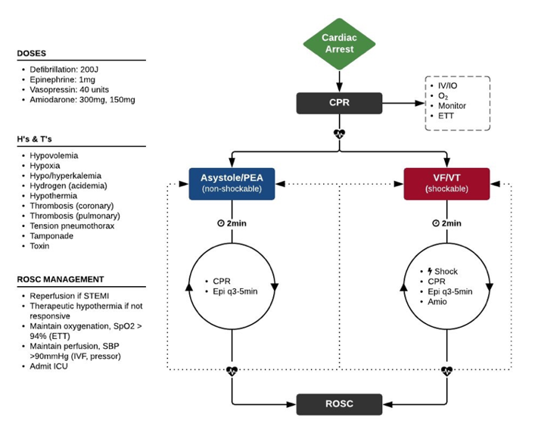
ACLS isn’t hard… with some help
Vs.
Notes:
The card is socially better than looking at your phone.
This is almost always where teams struggle
ACLS algorithms:
not that complex
there are cards in the code carts
there will be ~5+ other people there who know ACLS like the back of their hand*
RRTs can be medical complex, but the key decisions are simple
Sociology lens. Why? The medicine isn't that hard (not that easy, either) - but a lecture isn't the right place to review it. I will end with some medical hints because I can't resist.

Slide 10
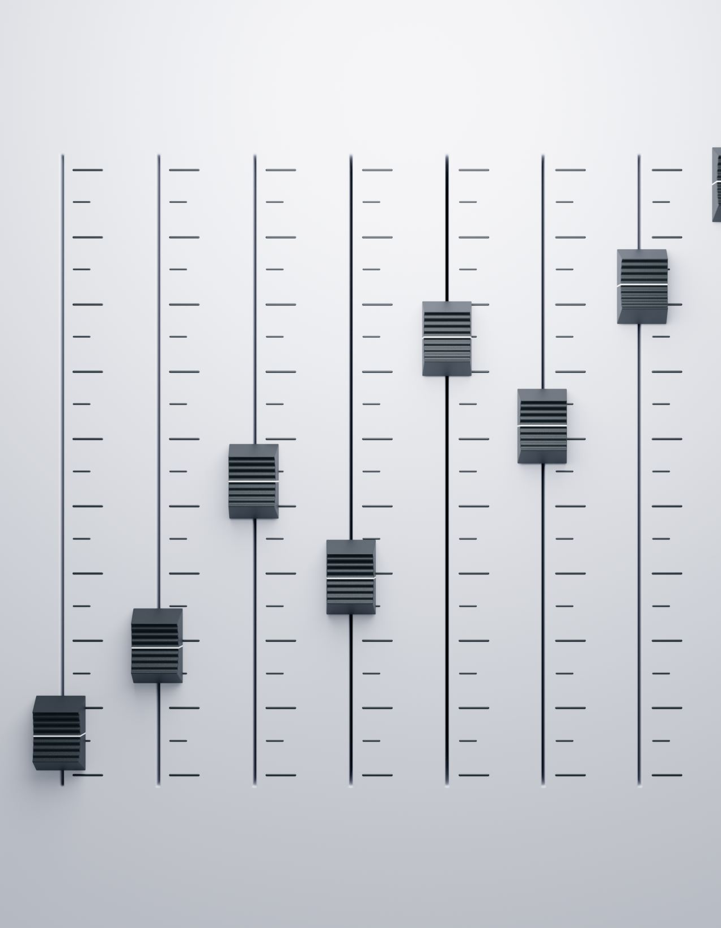
Step 3: Set the tone: constructive
Calm, collected, and in control
Modulate your voice; no yelling
Coach, don’t reprimand.
Give encouragement.
What about suggestions you don’t like?
Use social capital on what’s important…
Notes:
You can call for quiet to lower the noise level. Have folks step out if too crowded – you control the environment.
https://twitter.com/ross_prager/status/1769700101629399542?s=46&t=5eJ6uoTQrbbYTlHIOnRYRg – good thread with more detail and dope pixel art

Slide 11

Step 4: Lower the Power Distance
Coach, not monarch.
The first time anyone makes any suggestion that's not ludicrous address them and say: "great point/idea/catch .."
“Thinking out loud …”
Notes:
What is the point of the bottom two?
Think of motivational interviewing with a patient.. You NEVER want to argue. You want to direct. Do the same thing here. You are directing a competent team of professionals who could do a pretty good job running a code on their own (they do in lots of places). Don’t break the machine – you want to productively guide it.
Fine V-Fib example. RN notices, but not empowered.

Slide 12
In summary:
The most common way for them to go wrong are problems with social dynamics, not with medical decision making
To avoid the biggest pitfalls:
Establish who is the leader, first by designation then by action
Signal that you want people’s input
Direct the group like a coach, don’t rule like a queen/king
Notes:
Last point is a Segway to the next segment.

