Slide 1
Pulse-Check Decisions

Slide 2
The consequences of errors:
Your Decision
 | You defibrillate | You don’t
They have VF or VT* | 👍👍 | 👎👎👎👎👎👎👎👎👎👎👎👎👎👎👎👎
They have PEA/Asystole | 👎 | 👍👍
Reality
(unknown)
Therefore:
You(r team) must identify actionable rhythms correctly
When unsure, make the better error
Notes:
* The same is true for other rhythms e.g. complete heart block or Afib vs NSR, but answers aren’t needed as fast and consequences aren’t severe.

Slide 3
Scenarios
Pulse check
What do you do?

Slide 4
Scenarios
Pulse check
What do you do?
(VF can be easy)
(Or, hard)
Notes:
Do not miss fine V Fib.
This is harder than you think
Have someone bring the tele strip to all RRTs or code that occur when someone is monitored
People who code on monitored units generally don’t go straight to Asystole
Change change size of waveform on machine. Hopefully will have zoll with us on hand to show

Slide 5
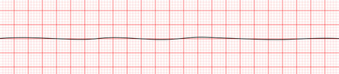
Scenarios
Pulse check
What do you do?

Slide 6
Scenarios
Pulse check
What do you do?
(Are you sure???)

Slide 7
Scenarios
Pulse check
What do you do?
(Are you sure???)
(it’s asystole)
Notes:
The point is – if you got one of those right and one of those wrong, you much prefer the error where you shock asystole… because who cares?

Slide 8
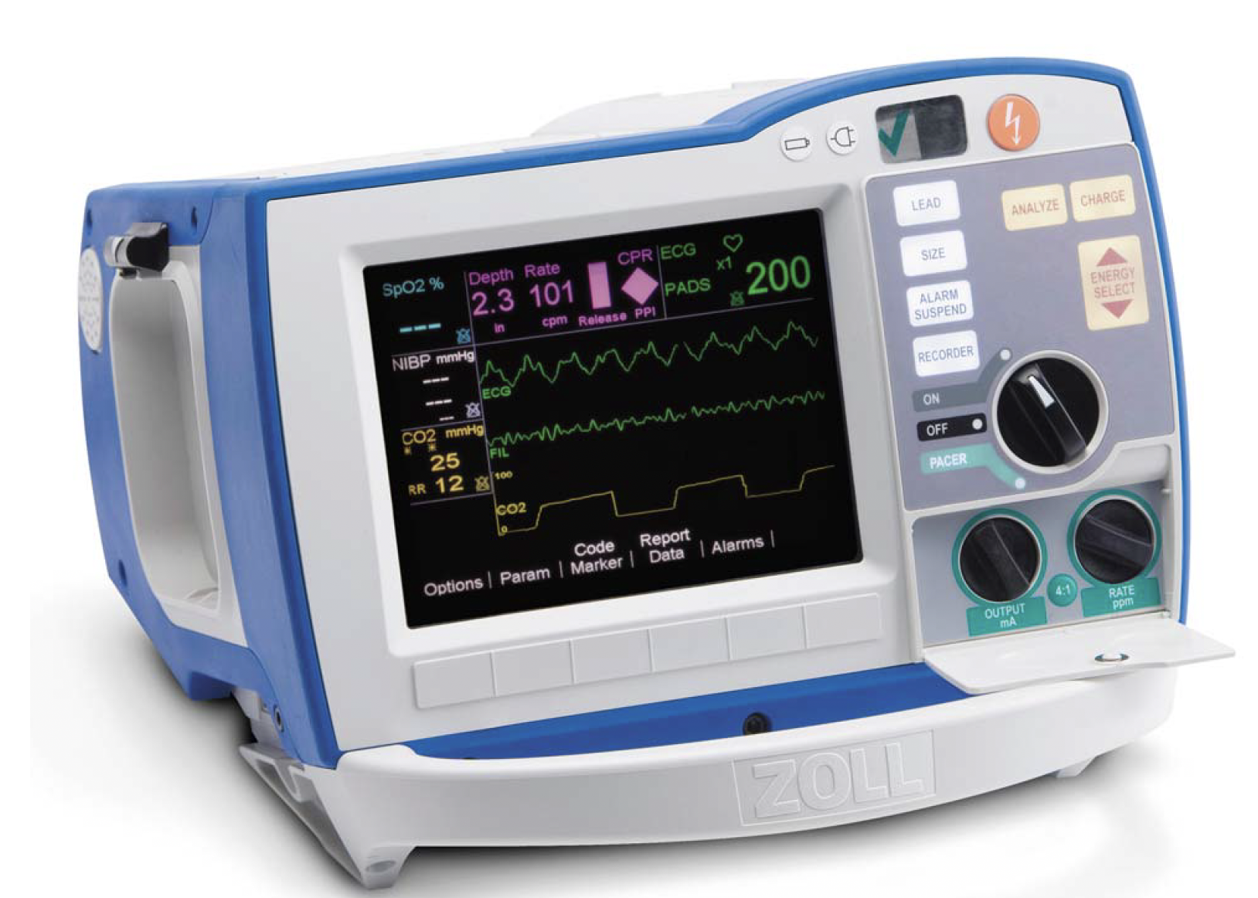
What can you do when you’re unsure?
Make the better error
Enroll help (the nurses are good)
“Are we certain this is asystole?"
Turn up the gain

Slide 9
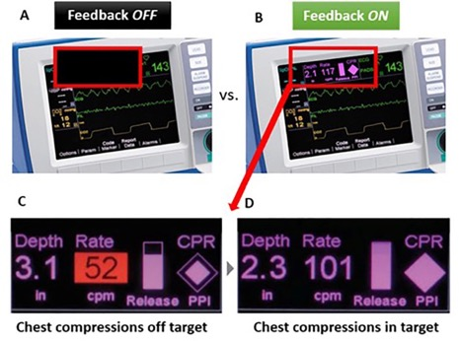
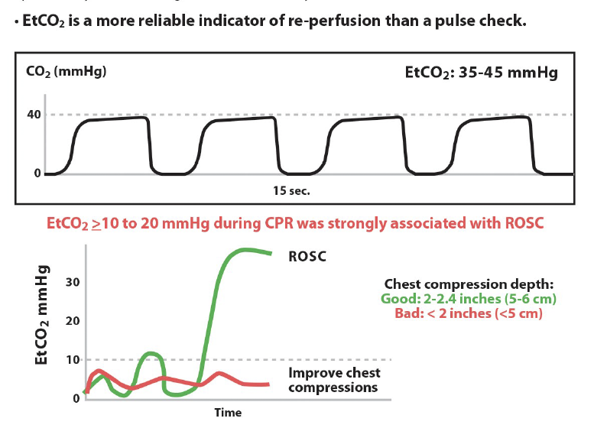
What is the big picture?
If they don’t have a pulse, someone is compressing the chest with high quality CPR. NO significant breaks.
Minimize pauses to necessary position changes, pulse checks, and a little wiggle room to the Lucas or intubation (but only a little)
Shock them if they have a shockable rhythm
The rest (mostly*) not so important
Notes:
Survival from witnessed ventricular fibrillation (VF) decreases by 10–12% for every minute defibrillation is delayed [3, 4], but when CPR is provided the decline in survival is only 3-4% per minute
Utilize code team members – 1 to check pulse and 1 to monitor tele/zoll monitor
Spend only 10 seconds checking for a pulse to minimize interruptions in CPR
You don’t want house md at your code. Don’t try to diagnose lupus in a code.
The rest is whatever (people will be fired up about all sorts of things, but they don't matter). It’s a bonus if you figure out why they coded, but it’s a small, small minority where the etiology is not blindingly obvious but is also easily reversible.
LUCAS: institution policies vary, but
Negative RCT in OHCA - DOI:https://doi.org/10.1016/S0140-6736(14)61886-9
Negative retrospective data in IHCA - https://doi.org/10.1016/j.resuscitation.2024.110142
The only time it may be important is ECMO/long resusc with procedure.
IF pause in compression is more than a few seconds, USE YOUR CRED HERE.

Slide 10
What if the pulse is hard to feel?
10 second pause, total
Use doppler
Use EtCO2 to detect ROSC
When uncertain…
make the better error!
 | You resume compressions | You don’t
They Don’t Have ROSC | 👍👍 | 👎👎👎👎👎👎👎👎👎👎👎👎👎👎👎👎
They Do Have ROSC | 👎 | 👍👍

Slide 11
In cardiac arrest scenarios, what interventions have a known, well established mortality benefit for in hospital cardiac arrest? (Select all that apply)
Minimally interrupted CPR
Sodium bicarb in acidemic patients
LUCAS device compressions for patients undergoing more than 30 minutes of CPR
Defibrillation of Shockable Rhythms
ECMO (E-CPR)

Slide 12
In cardiac arrest scenarios, what interventions have a known, well established mortality benefit for in hospital cardiac arrest? (Select all that apply)
Minimally interrupted CPR
Sodium bicarb in acidemic patients
LUCAS device compressions for patients undergoing more than 30 minutes of CPR
Defibrillation of Shockable Rhythms
ECMO (E-CPR)

Slide 13
Summary: Pulse Check Decisions
Codes are uncertain: if you might make an error, make the better one.
DO NOT MISS FINE V. Fib
Only allow, at most, a few seconds of CPR delay for Lucas / Intubation
This is a decision to spend your “political capital” on

