Slide 1
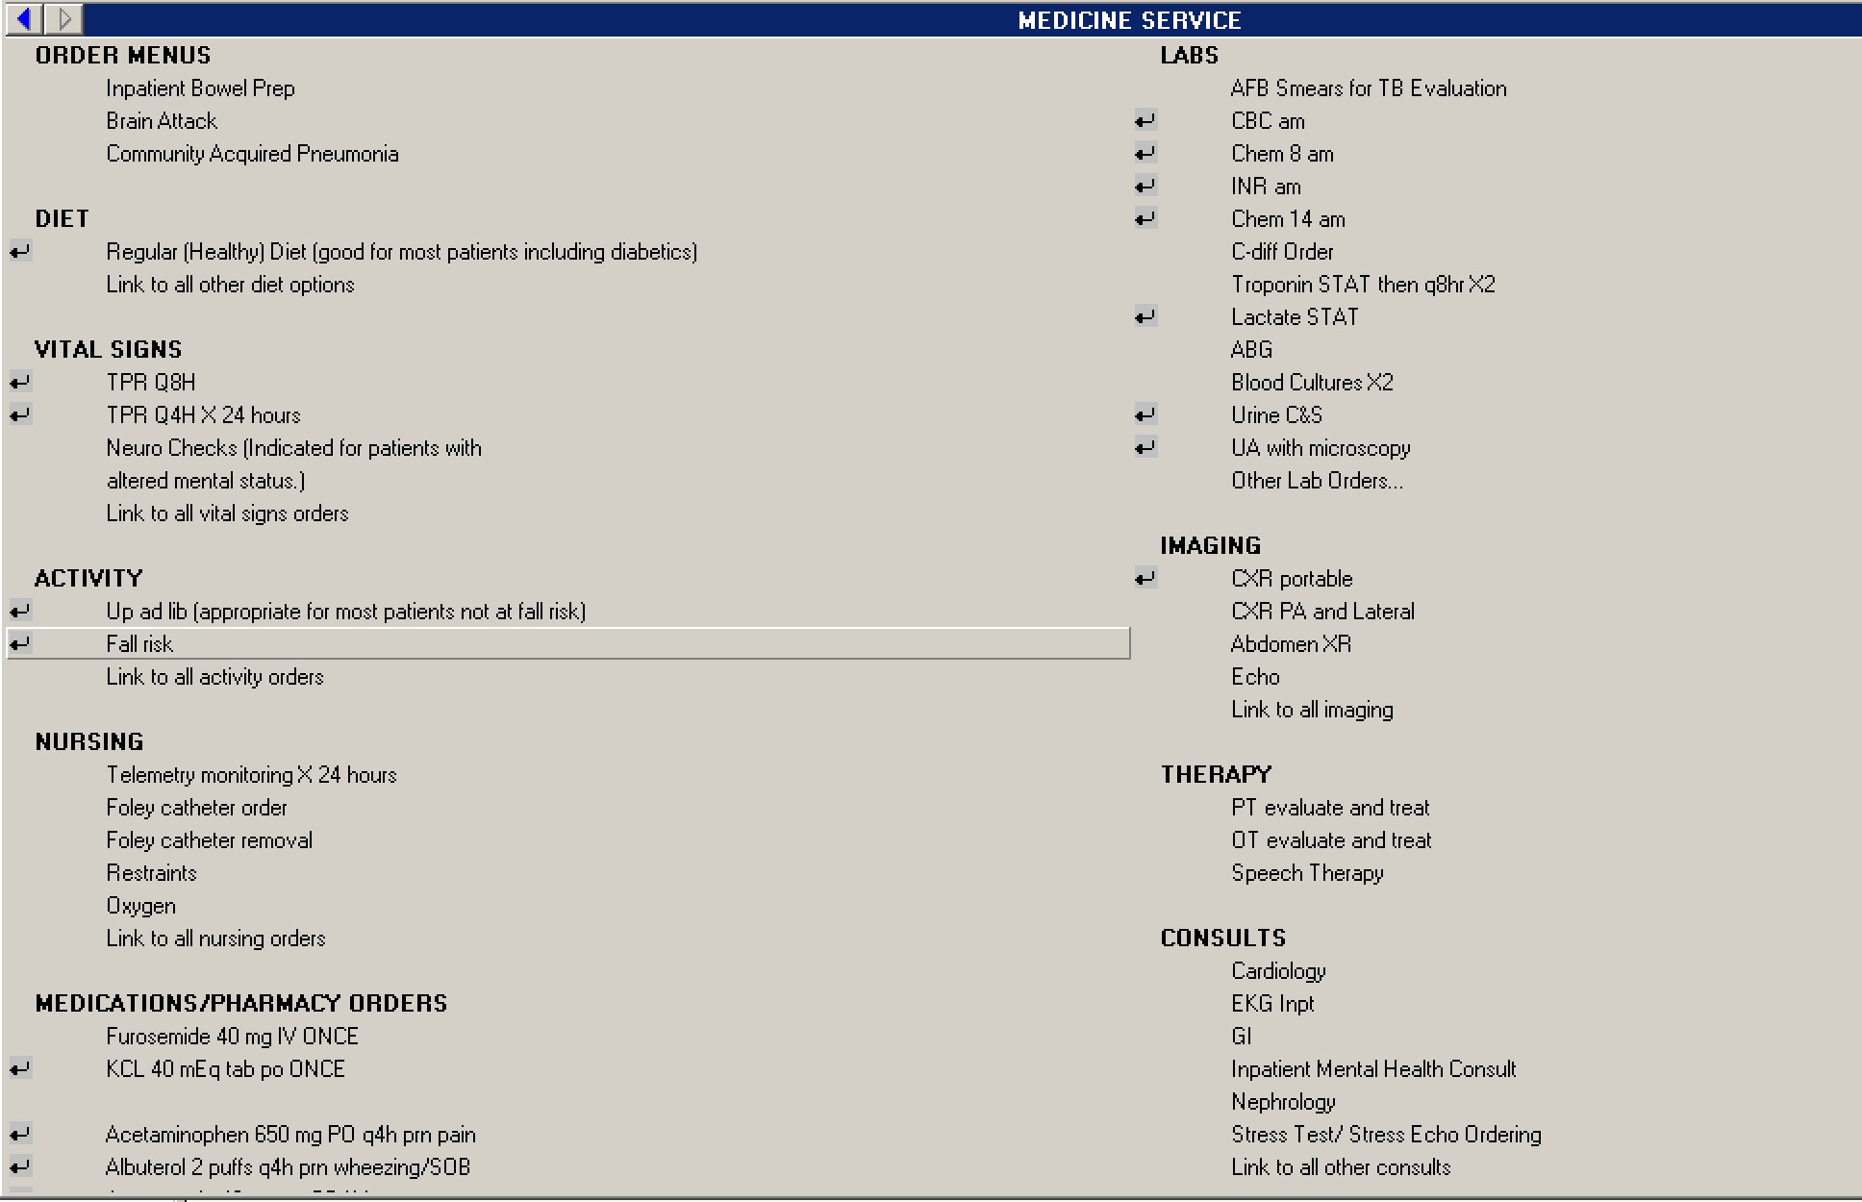
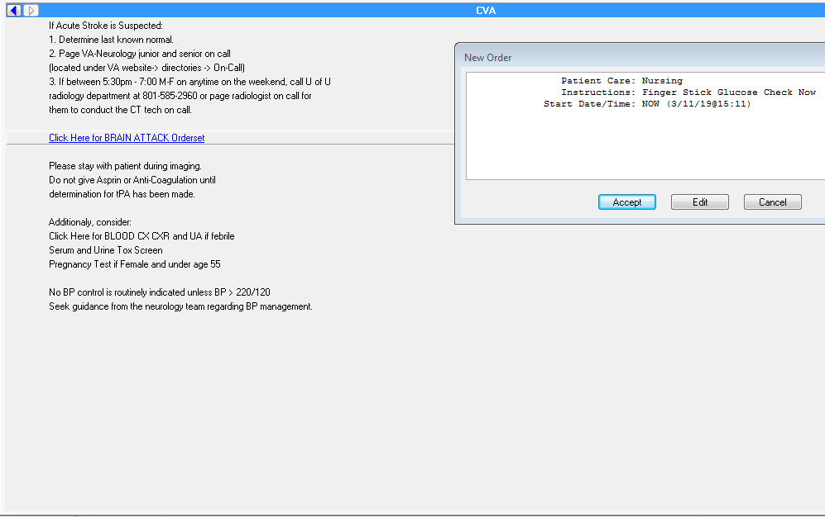

Improving “Brain Attack” Responses at the VA
Brian Locke MD, Wade Brown MD, Jason Carr MD, Chelsea Meyer DO, Jana Wold MD, G Paul Eleazer, MD Departments of Internal Medicine and Neurology, University of Utah and George E Wahlen VA Medical Center, Salt Lake City.
Goal:
Why?
Methods:
Decrease time from recognition of acute neurologic deficit to obtaining all required information and involving necessary teams for potential reperfusion therapies.
University of Utah Radiology Reading Room
On-call neurology team
The George E Wahlen VA is a limited-hours Stroke Center:
-Delays in care (disorganized process, perceived variability in practice patterns, personnel off site after-hours)
-Near misses (uncommon event, limited stroke education)
-Anticipated need for a robust brain attack response with expanding Left Ventricular Assist Device program
Standard Work: increase the reliability of a process by making it easy to follow the best practice
Review of recent cases and assessment of current process
Infrequent occurrences makes PDSA cycles based on quantitative metrics difficult
-
Results
Primary Team | Neurology | Radiology | Radiology Tech
Primary Team | Neurology | Radiology | Radiology Tech
Acute Neurologic Deficit Recognized
Acute Neurologic Deficit Recognized
Brain Attack
Orderset
Find Stroke Protocol at RN station
OR
Printed protocol in team room
OR
Uptodate
Process Map: Before
Brain Attack Orderset in CPRS
Process Map: After
“If acute stroke is suspected:
1. Determine last known normal
2. Page VA-Neurology junior and senior on call (located under VA website -> directories -> On-Call)
3. If between 5:30pm - 7:00am M-F or anytime on the weekend, call U of U radiology department at 801 585 2960 or page the radiologist on call for them to contact the CT tech on call
[ ] Order POC BG
[ ] Order O2 by for goal Sp02 > 90%
[ ] Order mobile telemetry pack
[ ] Order routine EKG (and notify RN to collect)
[ ] Order STAT CBC, PT/PTT, BMP, Troponin
[ ] Order STAT non-contrast CT head
[ ] Order STAT CTA Head and Neck
Please stay with the patient during imaging.
Additionally, consider:
[ ] Blood Cx, UA and CXR if febrile
[ ] Urine Tox Screen
[ ] Urine Pregnancy test if female and under age 55
No BP control is routinely indicated unless BP > 220/120. Seek guidance from the Neurology team regarding BP management
Page Neurology Junior and Senior Residents
Neurology Junior Notified
Neurology Senior Notified
Order tests and imaging
Radiology Techs Notified Directly
Techs come to VA
Page Neurology Junior and Senior Residents
Neurology Junior Notified
Assess Patient, NIHSS stroke scale
Radiology Resident approves contrasted studies
Neurology Senior Notified
Call U. of Utah Radiology Reading Room
Obtain Images
Additional Orders
Interpretation of imaging
Interpretation of imaging
Find radiology by smartweb, page for study approval if after-hours
Radiology Resident approves Studies, calls Techs
Decision for tPA or transfer to U of U
Assess Patient, NIHSS stroke scale
Techs come to VA, obtain images
Interpretation of imaging
Interpretation of imaging
Decision for tPA or transfer to U of U
Challenges
Success: Case Example
Acknowledgments
Guideline Updates
Provider awareness of the order-set
Quantifying changes
A hospitalized patient was found during pre-rounds with acute onset incoherence
Brain attack orderset was activated
Prompt identification of simultaneous NSTEMI and Stroke, received prompt admission to ICU with simultaneous stroke and ACS management.
H Christian Davidson MD, Charles Liu, MD, J Robinson Singleton, MD
Sean J Piad, Nathan Erickson
Danielle Babbel MD, Sean Bradley MD

