Slide 1
SARS-COV-2 TRANSMISSION 101
@UtahIMCMRs
Brian Locke, MD

Slide 2
Viral Characteristics
@UtahIMCMRs

Slide 3
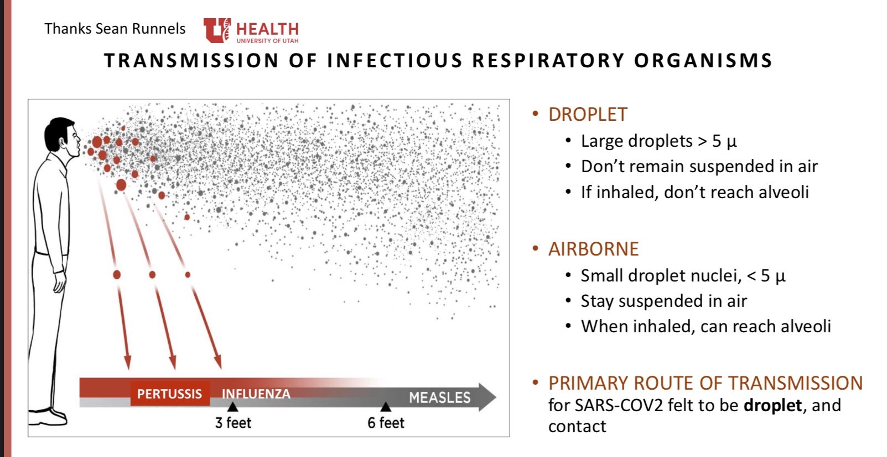
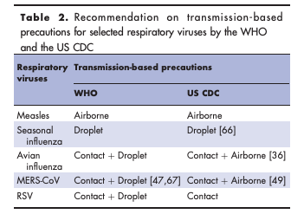
Aerosols Droplet vs airborne
Small Droplet (‘Aerosol’) | <5 microM | Airborne | N95/PAPR
Large Droplet – Ballistic | >5 microM | Droplet | Surgical Mask
Large Droplet – Fomite | >5microM | Contact | Gloves, washing
DOI:10.1097/QCO.0000000000000563
@UtahIMCMRS
Notes:
Aerosolized droplets = occurs when airflow over fluid – little droplets form that contain the viral particle.
Large-droplet (over 5 micron) either 1. ballistic spread (surgical mask) or settle, then on fomite (cleaning, not touching face) - The virus persists on fomites in the environment. Depending on the type of surface, virus may persist for roughly four days (Doremalen et al. 3/17/19).
SARS-COV2 = 5-10 micron (probably)particles when generated by cough, talking, etc. Smaller when generated by CPR / intubation, etc. (note; the NEJM article is using an artificial super-aerosolizer – not reflecting real life – but then seeing what happens). Acutal virus: Exact size of ncov2 is not known, but SARS-CoV was about 1 micron
Small droplet / aerosol = less than 5 micron. => can remain airborn = N95 mask or a powered, air-purifying respiratory (“PAPR”)
JAMA: range, not dichotomous, and cloud dynamics blur the distinction by size. - Video: dear God… https://edhub.ama-assn.org/jn-learning/video-player/18357411
Why is it hard to study? Tough to say how any individual person got infected.
Is HFNC or NIPPV aerosolizing?
HFNC - HFNC supplies gas at a rate of ~40-60 liters/minute, whereas a normal cough achieves flow rates of ~400 liters/minute. Most guidelines say use, but use airborne precautions.
NIPPV – yes, need good mask fit and viral filter.
possibly by the fecal-oral route (and blood) – viral particles are there but unclear if they can then be cultured.
From First10EM summary: In general, aerosols are liquid or solid particles suspended in air. (Tellier 2009; Judson 2019) They can be visible, like fog, but are most often invisible, like dust or pollen.
-----
Both droplets and aerosols can be generated during coughing, sneezing, talking or exhaling, but large droplets settle quickly whereas small aerosols can remain airborne and may transport over longer distances by airflow [11,12].
VERY hard to study: ABT initial rec and space suite Chinese HCW: but recommends both contact and airborne precautions for novel ARIs based on precautionary principle as the modes of transmission for the novel ARIs are unlikely to be known when they are first identified
Annals Letter :https://annals.org/aim/fullarticle/2764367/effectiveness-surgical-cotton-masks-blocking-sars-cov-2-controlled-comparison
We compared disposable surgical masks (180 mm × 90 mm, 3 layers [inner surface mixed with polypropylene and polyethylene, polypropylene filter, and polypropylene outer surface], pleated, bulk packaged in cardboard; KM Dental Mask, KM Healthcare Corp) with reusable 100% cotton masks (160 mm × 135 mm, 2 layers, individually packaged in plastic; Seoulsa).
A petri dish (90 mm × 15 mm) containing 1 mL of viral transport media (sterile phosphate-buffered saline with bovine serum albumin, 0.1%; penicillin, 10 000 U/mL; streptomycin, 10 mg; and amphotericin B, 25 µg) was placed approximately 20 cm from the patients' mouths. Patients were instructed to cough 5 times each onto a petri dish while wearing the following sequence of masks: no mask, surgical mask, cotton mask, and again with no mask.
No difference, but no germs on the inside calls into question the reliability of the study.
However, the size and concentrations of SARS–CoV-2 in aerosols generated during coughing are unknown. Oberg and Brousseau (3) demonstrated that surgical masks did not exhibit adequate filter performance against aerosols measuring 0.9, 2.0, and 3.1 μm in diameter. Lee and colleagues (4) showed that particles 0.04 to 0.2 μm can penetrate surgical masks. The size of the SARS–CoV particle from the 2002–2004 outbreak was estimated as 0.08 to 0.14 μm (5); assuming that SARS-CoV-2 has a similar size, surgical masks are unlikely to effectively filter this virus.
Studies suggesting benefit or cotton and surgical masks done in influenza. Not clear the particle size is the same.

Slide 4
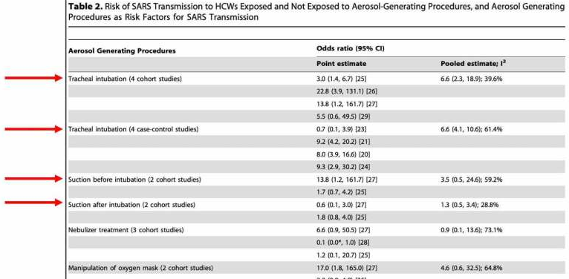
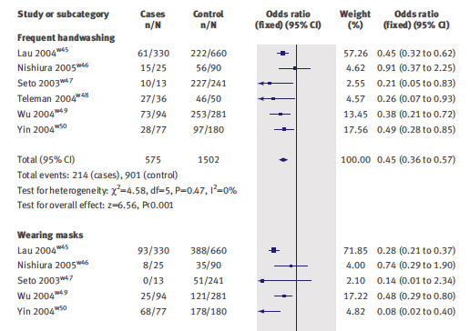
Droplet vs airborne what to do
https://doi.org/10.1136/bmj.39393.510347.BE, DOI: 10.1371/journal.pone.0035797
@UtahIMCMRS
Notes:
`SARS 1 (closest cousin virologically) data from breakout in Toronto = looking at EPIDEMIOLOGIC data of who actually was exposed. Retrospective.
Left picture = stratified by activitity
Right picture = broken down by behaviors that correlated.
“WHO
Respiratory infections can be transmitted through droplets of different sizes: when the droplet particles are
>5-10 μm in diameter they are referred to as respiratory droplets, and when then are <5μm in diameter, they are referred to as droplet
nuclei.1 According to current evidence, COVID-19 virus is primarily transmitted between people through respiratory droplets and
contact routes.2-7 In an analysis of 75,465 COVID-19 cases in China, airborne transmission was not reported.
Airborne transmission is different from droplet transmission as it refers to the presence of microbes within droplet nuclei, which are
generally considered to be particles <5μm in diameter, can remain in the air for long periods of time and be transmitted to others
over distances greater than 1 m.
In this
experimental study, aerosols were generated using a three-jet Collison nebulizer and fed into a Goldberg drum under controlled
laboratory conditions. This is a high-powered machine that does not reflect normal human cough conditions. Further, the finding of
COVID-19 virus in aerosol particles up to 3 hours does not reflect a clinical setting in which aerosol-generating procedures are
performed—that is, this was an experimentally induced aerosol-generating procedure.
“
The United States CDC previously recommended using airborne precautions all the time when managing COVID19 patients. However, the CDC recently updated their position, stating that surgical facemasks are acceptable when N95 masks run out.

Slide 5
Disease Characteristics
@UtahIMCMRs

Slide 6
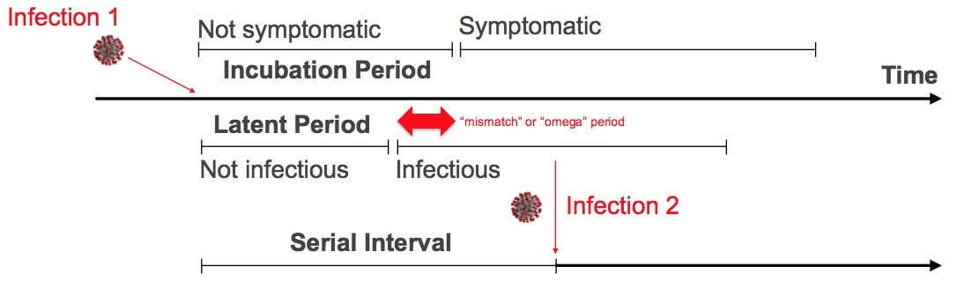
Pre-symptom spread contact tracing
https://twitter.com/NAChristakis/status/1238150077794877440?s=20
@UtahIMCMRS
Notes:
Incubation period = 5.1 days
Mismatch = 2 days (ish) -> this is advantageous for viruses to evolve to have this period.
Latent period = more dependent on virus
Incubation period = more dependent on patient characteristics
Thus mismatch period may be different between populations (SNF residents – where it’s been studied- and HCW as an example)
Serial interval: The serial interval (the time between successive cases in a chain of transmission) has been calculated to be as short as 3.96 days (95% CI 3.53–4.39 days) in one study of 468 confirmed cases reported in mainland China outside of Hubei Province.⁵⁹

Slide 7

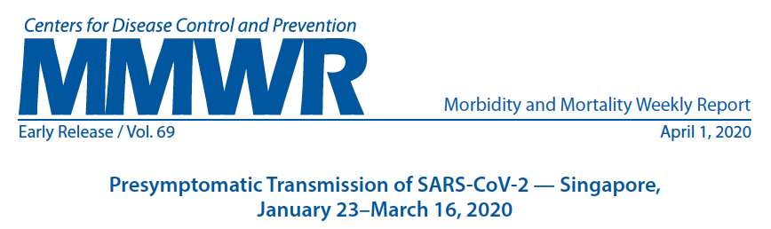
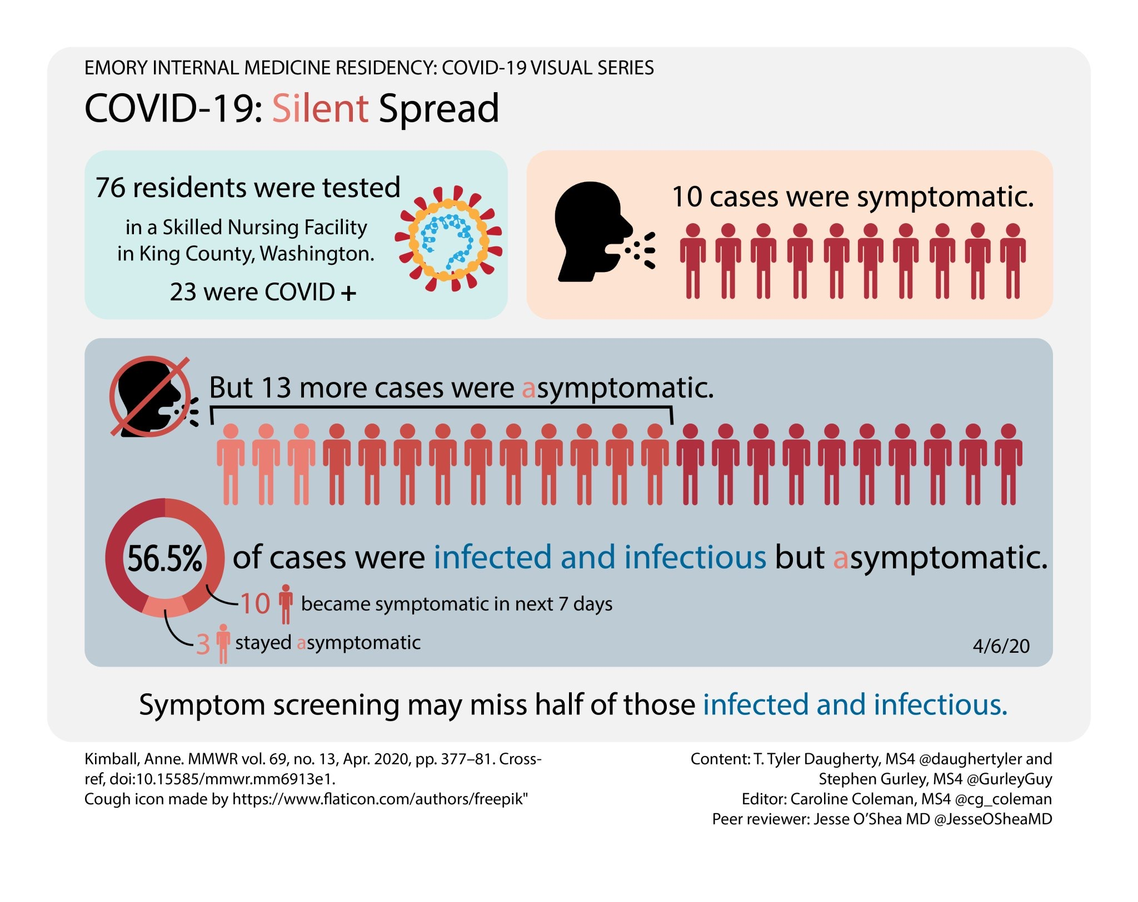

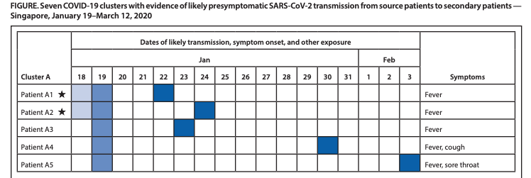
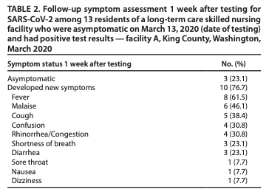
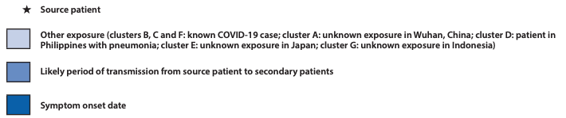
Pre-symptom spread contact tracing
@UtahIMCMRS
Notes:
incubation period range from 1 to 14 days with a median of 5 to 6 days: Split off – difference between infection etc.?
What to do: The following strategies are recommended to slow the rate of SARS-CoV-2 spread:
■ Contact tracing
■ Social /Physical distancing
■ Quarantine of suspected cases and exposed individuals
■ Travel restrictions
Study 1: RN home residents were actively shedding virus before symptoms
Study 2: Infections are documented from these patients. Study of contact tracing in MMWR https://www.cdc.gov/mmwr/volumes/69/wr/mm6914e1. htm?s_cid=mm6914e1_w
“The possibility of presymptomatic transmission of SARS-CoV-2 increases the challenges of COVID-19 containment measures, which are predicated on early detection and isolation of symptomatic persons.” –MMWR Report
Limitation: this spread may be more common in older folks with weaker immune systems (selected in these series) – but does show that it is possible.

Slide 8
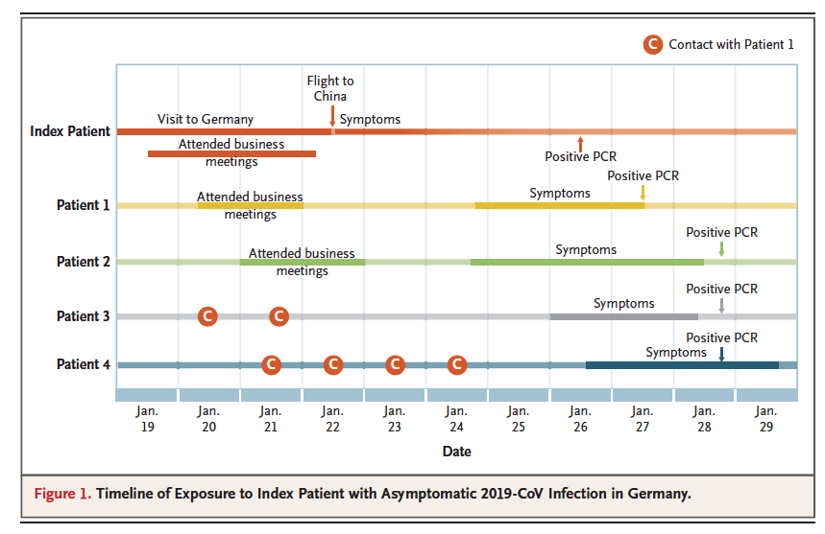
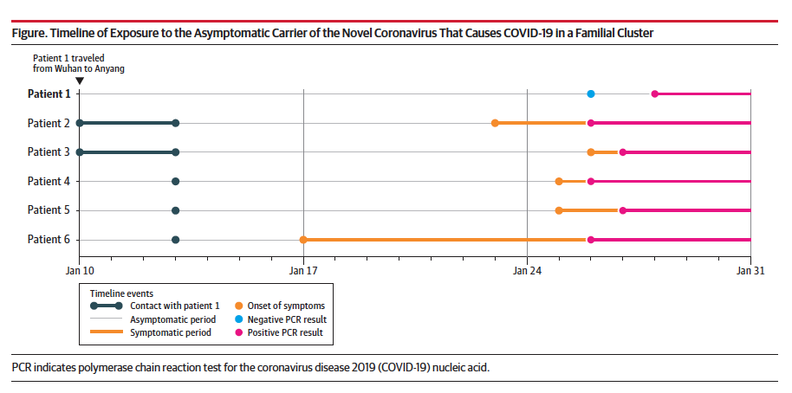
Pre-symptom spread contact tracing
DOI: 10.1056/NEJMc2001468 ,
@UtahIMCMRS
Notes:
2 More cases: NEJM and JAMA – just emphasizes that when rigorous contact tracing occurs, this is seen without question.

Slide 9
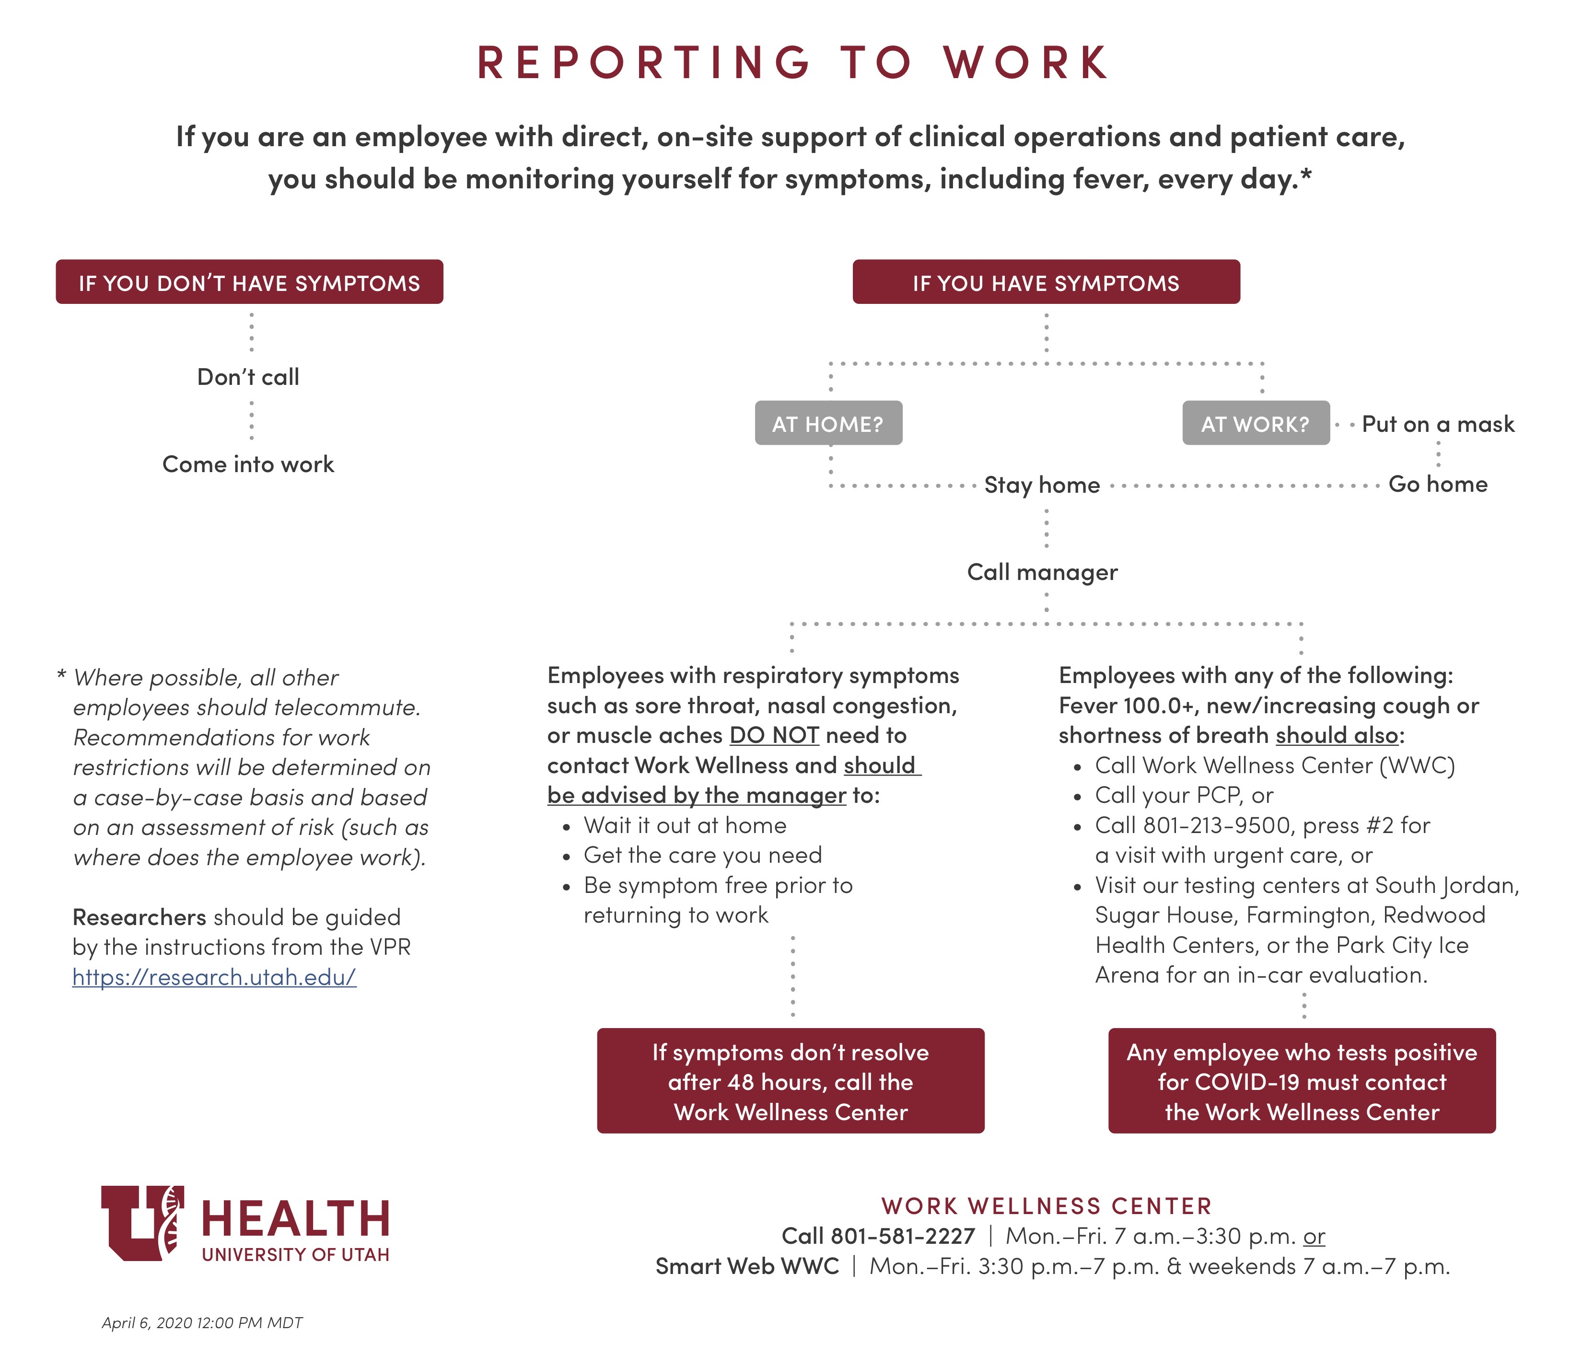
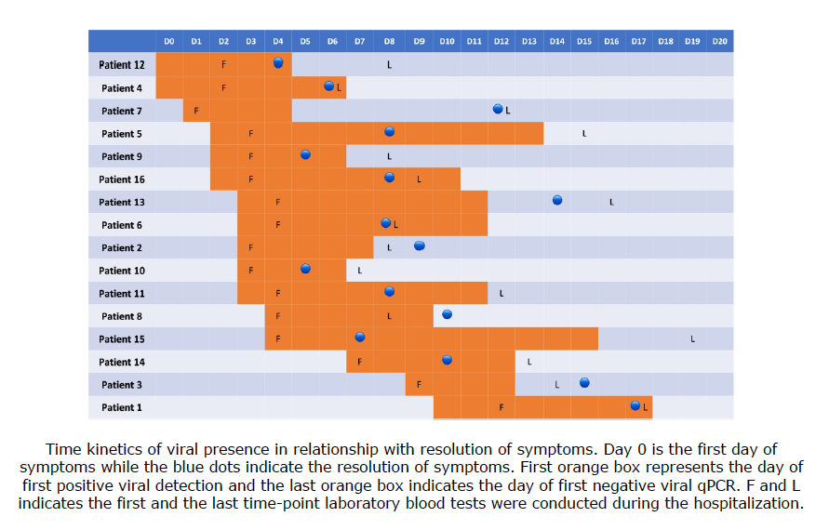
Pre-symptom spread What to do
DOI: 10.1164/rccm.202003-0524LE
@UtahIMCMRS
Notes:
If you don’t have symptoms => obviously we are going to miss the 2 days of pre-symptomatic transmission. Mask policies are to try to combat this, but are not perfect. No other alternatives that I can think of
When can you return to work?
If never positive = we are observing course + tests
If positive (thankfully haven’t happened yet – will probably need tests to confirm clearance.
Orange = PCR + (may not exactly be infectiousness.
Blue dot = resolution of symptoms.
Lancet SARS 1 meta-analysis
. Meta-analysis of six case-control studies suggests that physical measures are highly effective in preventing the spread of SARS: handwashing more than 10 times daily (odds ratio 0.45, 95% confidence interval 0.36 to 0.57; number needed to treat=4, 95% confidence interval 3.65 to 5.52); wearing masks (0.32, 0.25 to 0.40; NNT=6, 4.54 to 8.03); wearing N95 masks (0.09, 0.03 to 0.30; NNT=3, 2.37 to 4.06); wearing gloves (0.43, 0.29 to 0.65; NNT=5, 4.15 to 15.41); wearing gowns (0.23, 0.14 to 0.37; NNT=5, 3.37 to 7.12); and handwashing, masks, gloves, and gowns combined (0.09, 0.02 to 0.35; NNT=3, 2.66 to 4.97)

Slide 10
Epidemiologic Characteristics
@UtahIMCMRs

Slide 11
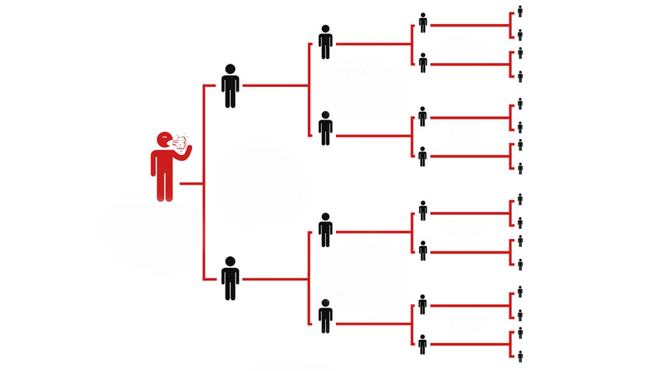
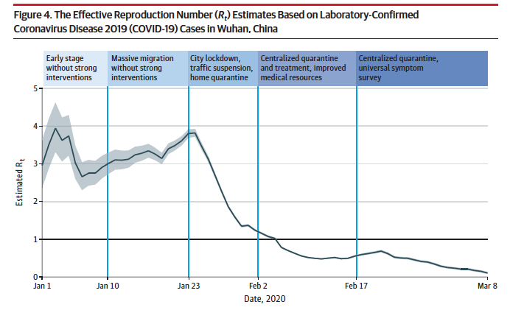
Viral spread: Reproductive Number
R₀ < 1: Epidemic Burns out
R₀ = 1: Continue at same pace
R₀ > 1: Epidemic increases exponentially
R₀ = 2 in example
doi:10.1001/jama.2020.6130
@UtahIMCMRS
Notes:
Characteristics such as the attack rate (% of individuals in an at-risk population who acquire the infection),
R0 (R naught, the expected number of cases directly generated by one case in a population where all individuals are susceptible to infection), factors such as testing rate, population density, and control strategies that vary from location to location. These factors may also change over time. Table 1 summarizes reported epidemiologic characteristics of SARS-CoV-29
The reproductive number (R₀) (the expected number of secondary cases produced by a single infected person in a susceptible population) for SARS-CoV-2, although still preliminary, is estimated between 2 and 3,
The effective reproduction number Rt, defined as the mean number of secondary cases generated by a typical primary case at time t in a population
Modifiable - The R⌀ on board the Diamond Princess cruise ship was 15 – illustrating that cramped quarters with inadequate hygiene will increase R⌀ (Rocklov 2/28).
Containment vs mitigation of spread = containment is only valid if there is not csignficant community spready.
ACP: nitial cases in Wuhan, China, R₀ was estimated to be 2.2 (95% CI, 1.4 to 3.9)³⁶. A more recently estimated R₀ of 1.32 (95% CI 1.16–1.48) was calculated using updated estimates of serial interval and exponential transmission curves⁵⁹. The actual R₀ for SARS-CoV-2 remains to be determined with other estimates generally ranging between 1.5 and 3.5³⁷.

Slide 12
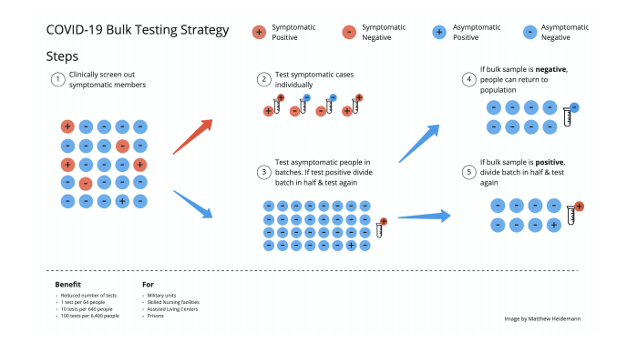
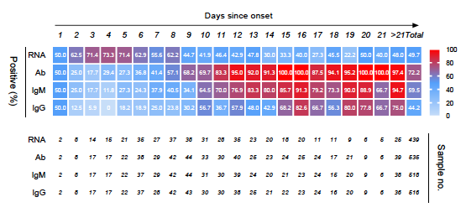
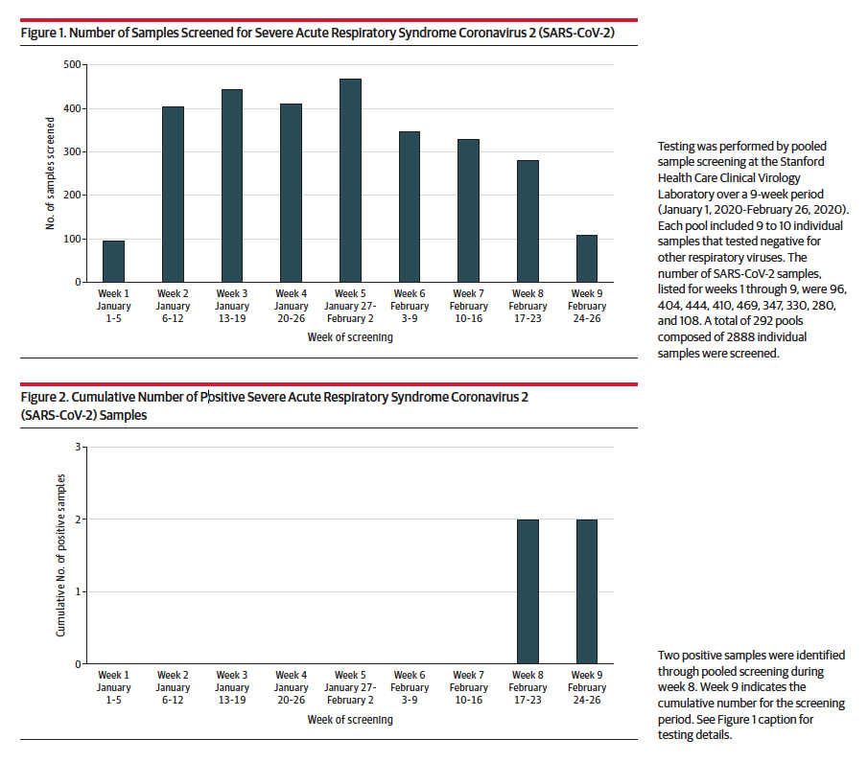
Key unknown: # of mild/Asx cases
https://doi.org/10.1101/2020.04.05.20050245 https://dx.doi.org/10.2139/ssrn.3546052
doi:10.1001/jama.2020.5445
@UtahIMCMRS
Notes:
requires random sampling of population.
2 approaches to help:
Pooled testing
JAMA research letter:
“We performed a retrospective
study that evaluated all nasopharyngeal and bronchoalveolar
lavage samples collectedbetween January 1,2020,
and February 26, 2020, from inpatients and outpatients
who had negative results by routine respiratory virus testing
(respiratory pathogen or respiratory viral panels [GenMark
Diagnostics] or Xpert Xpress Flu/RSV [Cepheid]) and had not
been tested for SARS-CoV-2.
Atotal of 292 poolswere screened, correspondingwith
2740 nasopharyngeal samples and 148 bronchoalveolar lavage
samples (Figure 1).Theconfirmed positivity rate for SARSCoV-
2 was0.07%(2/2888) (Figure 2).
Results from this screening strategy support that
the burden of disease in the San Francisco Bay Area early in
the pandemic was low
Serologies: who has been exposed.
This figure is from the lancet => shows that even among people suspected to have disease, PCR is not perfectly sensitive.
FDA approves first test: Not good enough, https://twitter.com/zbinney_NFLinj/status/1245789672833417217?s=20

Slide 13


