Slide 1
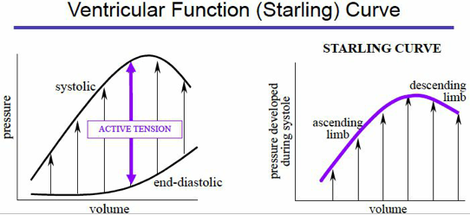
Congestive heart Failure
Brian Locke, MD
PGY2 Internal Medicine
University of Utah
Updated Apr 18 2018
Notes:
TODO:
[ ] add more diagrams, particular re: cardiac output, understanding low perfusion

Slide 2
Objectives
Be able to:
1. Be able to give a concise assessment of cause and status of any heart failure in 1 phrase
2. Identify treatment objectives for acute vs chronic heart failure
3. In acute heart failure, classify a patient’s congestion and perfusion
4. Know basic strategies for diuresis of a congested patient
5. Identify the classes of medication that improve mortality in chronic heart failure

Slide 3
Definitions
Congestive Heart Failure is a syndrome
Most common cause is cardiomyopathy (disease of the heart muscle)
Non-cardiomyopathy causes: valve disorder, constrictive pericarditis, severe anemia, electrolyte imbalance, etc.
Notes:
Syndrome = a collection of signs and symptoms

Slide 4
Types of CHF
Right Heart Failure:
Left Heart Failure:

Slide 5
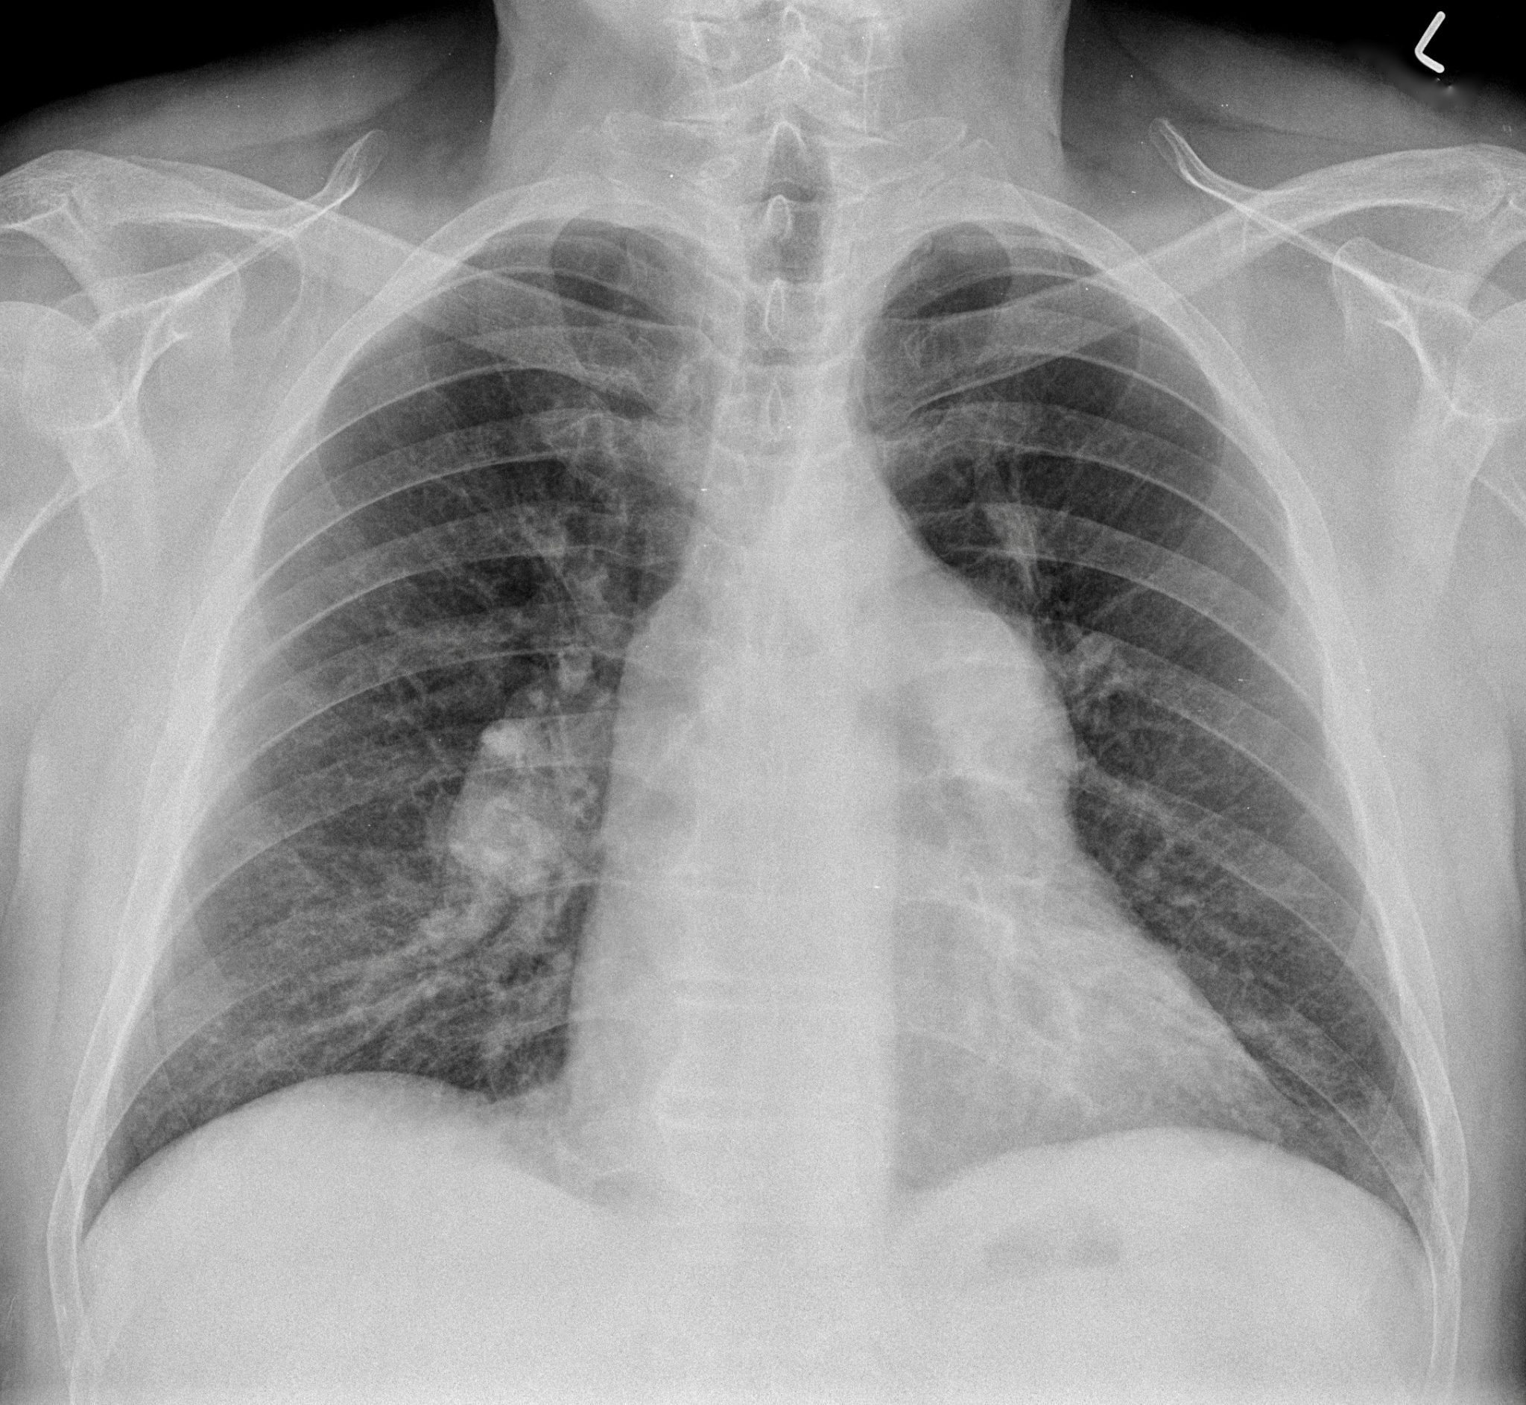
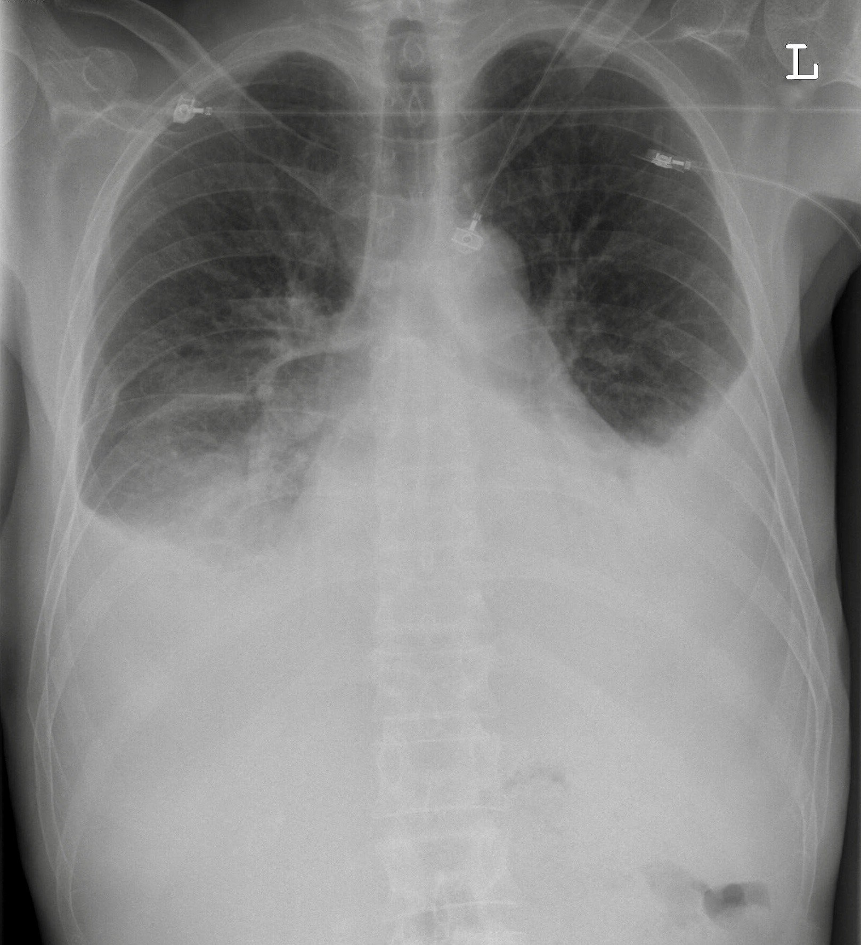
Types of CHF
Right Heart Failure:
Clear Lungs, JVD, peripheral edema, Pulsatile Liver/increased LFTs
Dyspnea on Exertion, Bloating, Abdominal Pain
Left Heart Failure:
Crackles, signs of right heart falure
Dyspnea on Exertion, Orthopnea, PND
Notes:
Upper – clear lung fields, prominent peri-hilar markings
Lower – b/l pleural effusions – horizontal opacities in mid fields = fluid in the fissures

Slide 6
Types of CHF
Heart Failure with Reduced Ejection Fraction (HFrEF)
AKA systolic heart failure
LV EF < ~50%
Heart Failure with Preserved Ejection Fraction (HFpEF)
aka diastolic heart failure
LV EF > 50
Note: exact cutoff varies by source 40-50%

Slide 7
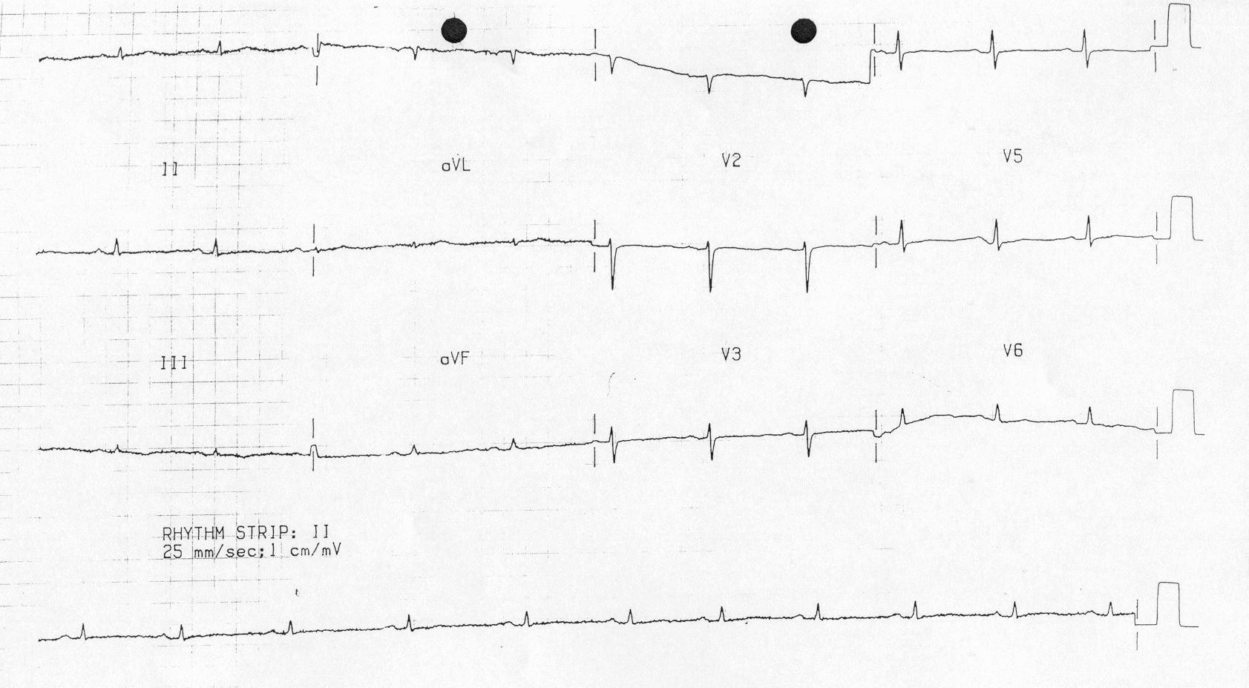
Types of Cardiomyopathy
Classify by etiology:
Ischemic -> Treat CAD
Non-ischemic = everything else
Classify by structure (Echo findings):
Dilated
Hypertrophic
Restrictive
Notes:
Restrictive cardiomyopathy, low voltage

Slide 8
Classification
Classification template:
[Type of Heart Failure] [Cause]
e.g. (Left) Heart Failure with Reduced Ejection Fraction of 25% due to ischemic cardiomyopathy

Slide 9
Time course
Chronic (at recent baseline functional status)
Acute (new)
Acute on Chronic (had heart failure, but now its worse)
Drop in cardiac output is causing problems (dysfunction of other organs = ‘decompensation’

Slide 10
Classification
Classification template:
[Chronicity] [Type of Heart Failure] [Cause]
e.g. Acute on Chronic (Left) Heart Failure with Reduced Ejection Fraction of 25% due to ischemic cardiomyopathy

Slide 11
Time course
Acute (or Acute on Chronic)
Therapy is to decrease congestion and/or increase perfusion!
Chronic
Therapy is to slow the rate of heart function decline

Slide 12
Acute CHF
Starling Curve
Preload: venous return
Afterload: blood pressure
Contractility: systolic function (e.g. inotropes)

Slide 13
Acute chf
Congestion: hypervolemia
Edema, Crackles, JVP
Weight trend, BNP
Perfusion: decrease in cardiac output
Decreased urine output, abdominal pain, narrow pulse pressure
SHOCK: decreased mental status, unstable VS

Slide 14
Acute CHF
 | Congested | Euvolemic
Adequate Perfusion | Warm, Wet | Warm, Dry
Decreased Perfusion | Cold, Wet | Cold, Dry

Slide 15
Acute CHF
 | Congested | Euvolemic
Adequate Perfusion | Warm, Wet | Warm, Dry
Decreased Perfusion | Cold, Wet | Cold, Dry
Warm, Dry: yay! => Chronic Heart Failure management
Warm, Wet: ?

Slide 16
Acute CHF
 | Congested | Euvolemic
Adequate Perfusion | Warm, Wet | Warm, Dry
Decreased Perfusion | Cold, Wet | Cold, Dry
Warm, Dry: yay! => Chronic Heart Failure management
Warm, Wet: (most common, assess for pulm Ed -> LMNOP)
Diurese!
Cold, Dry: ?

Slide 17
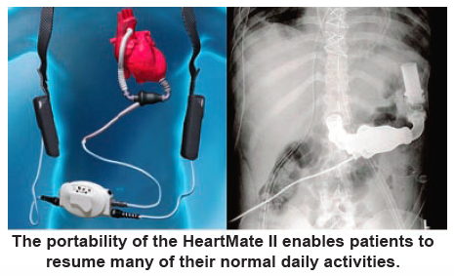
Acute CHF
 | Congested | Euvolemic
Adequate Perfusion | Warm, Wet | Warm, Dry
Decreased Perfusion | Cold, Wet | Cold, Dry
Warm, Dry: yay! => Chronic Heart Failure management
Warm, Wet: (most common, assess for pulm Ed -> LMNOP)
Diurese
Cold, Dry: (assess for shock)
Inotropes (milrinone, dobutamine) and Advanced Therapies (LVAD, Transplant)
Cold, Wet: ?
Notes:
Note: if considering inotropes, hold beta-blocker

Slide 18
Acute CHF
 | Congested | Euvolemic
Adequate Perfusion | Warm, Wet | Warm, Dry
Decreased Perfusion | Cold, Wet | Cold, Dry
Warm, Dry: yay! => Chronic Heart Failure management
Warm, Wet: (most common, assess for pulm Ed -> LMNOP)
Diurese
Cold, Dry: (assess for shock)
Inotropes (milrinone, dobutamine), Advanced Therapies (LVAD, Transplant)
Cold, Wet: (assess for shock, assess for pulm Ed -> LMNOP)
Inotropes and diuretics
Shock: ?
Notes:
If you’re using inotropes, you should hold BB (negative inotrope)

Slide 19
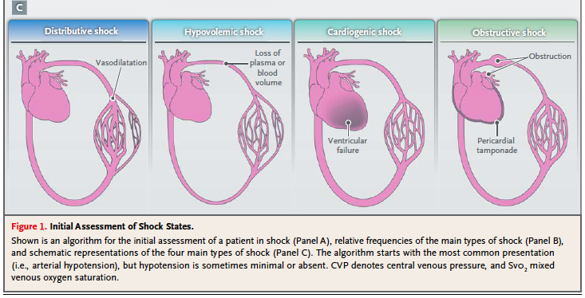
Acute CHF
 | Congested | Euvolemic
Adequate Perfusion | Warm, Wet | Warm, Dry
Decreased Perfusion | Cold, Wet | Cold, Dry
Warm, Dry: yay! => Chronic Heart Failure management
Warm, Wet: (most common, assess for pulm Ed -> LMNOP)
Diurese
Cold, Dry: (assess for shock)
Inotropes (milrinone, dobutamine), Advanced Therapies (LVAD, Transplant)
Cold, Wet: (assess for shock, assess for pulm Ed -> LMNOP)
Inotropes and diuretics
Shock: Vasopressors (epinephrine, NE)
Notes:
If you’re using inotropes, you should hold BB (negative inotrope)

Slide 20
Classification
Classification template:
[Chronicity] [Type of Heart Failure] [Cause]. [Current state]
e.g. Acute on Chronic (Left) Heart Failure with Reduced Ejection Fraction of 25% due to ischemic cardiomyopathy. Currently warm and wet.

Slide 21
Acute CHF, Warm and Wet
Why?
Dietary indiscretions (2g+ Na) (~40%)
Inadequate home medication regimen (e.g. HTN)
Medication non-adherence (diuretics, BB…)
Decreased pump function (MI in 10-15%, arrhythmia)
Vicious cycle:
PO furosemide is poorly absorbed w/ bowel edema!
Notes:
Not sure why fluid restrictions are recommended.
Note: furosemide has absorption limited kinetics in PO – edema delays absorption, thus lowering the peak ceiling and contributing to diuretic resistance.

Slide 22
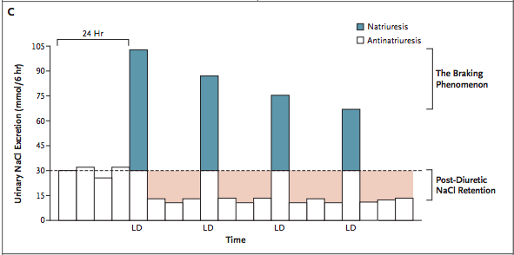
Acute CHF, Warm and Wet
Diuretics: Loop diuretic +/- thiazide
DOSE trial (Crit Care 2014) bolus dosing = gtt dosing
Beware: post-diuretic Na retention
Loop Diuretic | PO Lasix | IV Lasix | IV, PO Torsemide | IV, PO Bumetanide
Equivalent Dose (Duration) | 40mg (6h) | 20mg (6h) | 20mg (12h) | 1mg (4-6 h)
Rec dosing | 6am, Noon | 6am, Noon | 6am daily | BID, gtt
Notes:
Not sure why fluid restrictions are recommended.
When foley is in place, often will dose q6h lasix

Slide 23
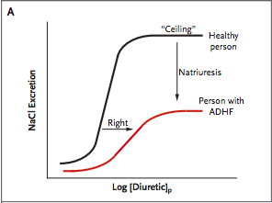
Acute CHF, Warm and Wet
How much to give?
Threshold effect: no diuresis until threshold is met, minimal increase in diuresis increasing past threshold
Higher threshold with lower GFR
DOSE trial: IV dose @ 2.5x outpatient dose
House of God: Age+BUN = Lasix dose
Set goal amount of diuresis (e.g. net 1.5L in 24h), redose or increase dose if not meeting I/O goal at noon
Daily weights in patients who accurate I/O is difficult
Notes:
NEJM

Slide 24
Acute CHF, Warm and Wet
How long to diurese?
Near previously known ‘dry weight’
Ideally Right Heart Catheterization (measure PCWP)
AKI (BUN is more sensitive)
If Urine Output drops before goal is met, consider:
Increasing dose
Adding adjunct (thiazide)
Is perfusion low? Consider inotropes
Notes:
NEJM

Slide 25
Acute CHF, Warm and Wet
A note on Kidneys:
AKI usually pre-renal (U_Na < 20)
However, can be hypervolemic/congestive (improves w/ diuresis, termed cardio-renal) or hypovolemic (will worsen with diuretic)
Loop diuretics (especially if thiazide is added) cause K+ and Mg+ wasting
Daily BMP, empirically replete Mg w/ K.
Aggressive diuresis will cause contraction alkalosis
Notes:
NEJM

Slide 26
Time course
Acute (or Acute on Chronic)
Therapy is to decrease congestion and/or increase perfusion!
Chronic
Therapy is to slow the rate of heart function decline

Slide 27
Chronic chf
Severity Assessment: NYHA Heart Failure Classification Scale
NYHA Class | Definition
I | Asymptomatic
II | Symptoms with vigorous exertion
III | Symptoms with minimal exertion
IV | Symptoms at rest
ACC/AHA Stage | Definition
A | Risk factors, No structural dz
B | +Structural Dz; no sx
C | +Structural dz; current/prior sx
D | End stage HF; sx at rest

Slide 28
Classification
Classification template:
[Chronicity] [Type of Heart Failure] [Cause]. [Severity].[Current state]
e.g. Acute on Chronic (Left) Heart Failure with Reduced Ejection Fraction of 25% due to ischemic cardiomyopathy. NYHA III/C. Currently warm and wet.

Slide 29
Chronic CHF
Goal: reduce decline in functioning over years
Unlike CAD/ACS, start low and double doses every 2 weeks
E.g. lisinopril 2.5, 5, 10, 20, 40 as BP tolerates
Doses of BB, ACEi should be as high as can be tolerated
“has BP [or HR] room”
OK to hold in acute exacerbations!

Slide 30
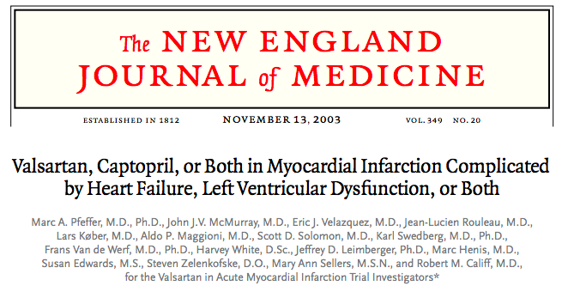
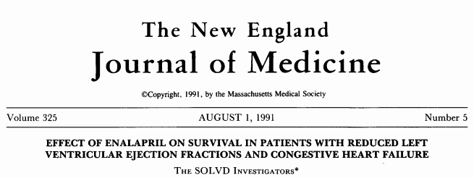
Chronic CHF
ACE Inhibitor and ARB
Indication: HFrEF NYHA II, III, IV (or hx MI)
Contra: SBP < 90. Caution if
sCr < 2, hyper K

Slide 31
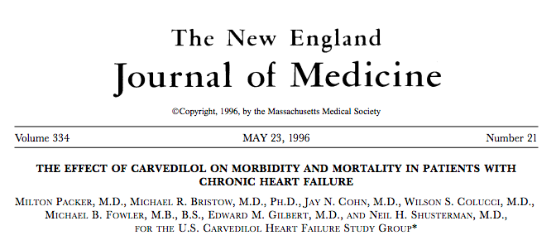
Chronic CHF
BB: Carvedilol (US Carvedilol), Metoprolol (Merit HF), Bisoprolol
Indication: HFrEF <40%, NYHA II-IV (or Hx MI)
Contra: Decompensated Acute HF. SBP < 85, HR < 60. Metoprolol safe in Asthma/COPD ^{(Ann Intern Med 2002; 137:715)}

Slide 32
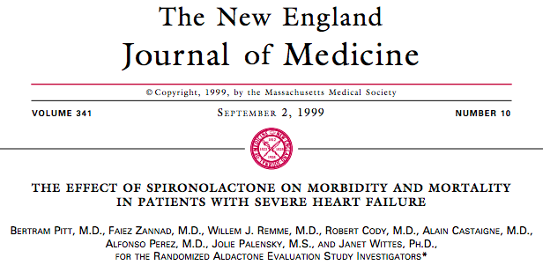
Chronic CHF
Aldosterone Antagonist: Spironolactone, Epleronone
Indication: NYHA II-IV and EF < 35% (40% if recent MI)
Contra: sCr > 2.5 (male) and 2.0 (female), GFR <30 or K 5.0+

Slide 33
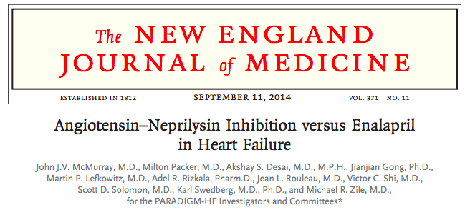
Chronic CHF
ARB – ARNI: Sucubitril-valsartan
Indic: HFrEF – EF < 35%, NYHA II-IV
Contras: eGFR < 30, K 5.2+, intol of ACEi / ARB

Slide 34
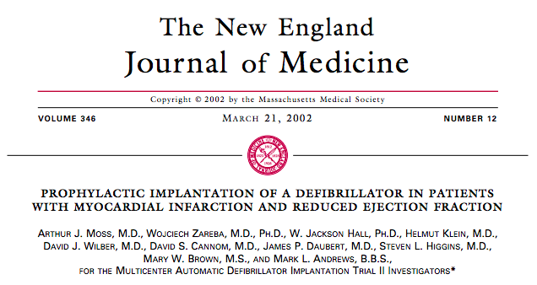
Chronic CHF
(A)ICD: Automatic Implantable Cardioverter Defibrillator
Indication: Primary prevention- EF < 35 after optimized meds, Secondary Prevention- all
Contra: <1y life expectancy, poor functional status

Slide 35
Chronic CHF
Avoid:
-CCB (negative inotrope)
-NSAID (fluid retention – OR 1.19 for use preceding exac. ^{BMJ 2016;354:i4857} , increase risk of MI)
-TZDs (e.g. pioglitazone)
Notes:
Current use of any NSAID (use in preceding 14 days) was found to be associated with a 19% increase of risk of hospital admission for heart failure (adjusted odds ratio 1.19; 95% confidence interval 1.17 to 1.22),

Slide 36
Objectives
Be able to:
1. Be able to give a concise assessment of cause and status of any heart failure in 1 phrase
2. Identify treatment objectives for acute vs chronic heart failure
3. In acute heart failure, classify a patient’s congestion and perfusion
4. Know basic strategies for diuresis of a congested patient
5. Identify the classes of medication that improve mortality in chronic heart failure

Slide 37
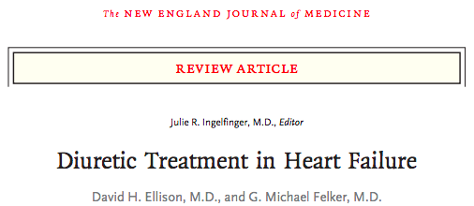
Questions?
Brian.locke@hsc.utah.edu
NEJM 377;20 Nov 2017

