Slide 1
Course Project in CS5351 Software Engineering
Dr W.K. Chan
Department of Computer Science
Email: wkchan@cityu.edu.hk
Website: http://www.cs.cityu.edu.hk/~wkchan

Slide 2
Goal
This is a code project
This is a team-based project
Develop a software engineering tool, in which you realize your original new idea
A software engineering tool is a tool for developers to assist them to carry out their daily technical tasks.
Note that it is not developing a software application or App for ordinary people.

Slide 3
Software Engineering Tool
E.g., a scrum tool, project management tool, a code review assistance, a testing tool, a debugging tool, a code smell tool, a technical debt tool, a design framework, a requirement tracking tool, a tool to identify critical issue in app review pool, …
It can be developed using whatever languages you like.
It can be developed as a standalone tool, a web service, an app, a browser extension, ….

Slide 4
Recommendation
Warning 1: A full-feature tool is too large for a student team to target it within the project timeline.
Don’t do it!
Recommendation: Start with an operable open-source project (e.g., a project with its source code you can get from Github).
The best kind is a tool related to a research paper so that you can read the paper about the key technique implemented in the tool.
Implement your original/improved algorithms to solve a specific software development problem.

Slide 5
Some Areas You May Consider (1)
Improvement on existing tasks: The main focus of a SE tool is to implement a SE technique, which consists of a sequence of tasks. Some tasks may not be good enough (not accurate, far too slow, ineffective, not scalable enough etc). If this is the case, you may develop an alternate approach to solving the same (or larger) problem of that task (i.e., replacing the existing module by your module for that task)
Lower the acceptance boundary of an existing tool: The input/output of a tool may depend on too many setups or assumptions to prevent them to be used practically. Your project may develop a module to solve that problems

Slide 6
Some Areas You May Consider (2)
Extension on top of existing tool: The tool provides an API and solves a particular problem. Your project may modify or enhance the tool to solve a related problem.
E.g., in your ML course, you may use Pytorch to write code for training deep learning models. Can you develop a drag-and-drop GUI so that developers can write code like playing Lego?
Changing the applicability of an existing tool: A tool may statically check the source code and then generate an outputs. Or, a tool may dynamically analyse the execution logs to generate outputs to spot errors in the program executions. You may change the static analysis component to a dynamic analysis component, and vice versa.
Your Own Idea: Highly preferable. Do not bound by what have been described above or presented in lecture notes.

Slide 7
Some Areas You May Consider (3)
Your Own Idea: Highly preferable. Do not bound by what have been described in the previous slides or presented in lecture notes.

Slide 8
Project Team
A project team consists of 6-7 students.
Warning 2: Don’t change teams!
Warning 3: As your project contains research elements, and a team probably only has around 2 months to develop it, a small team will create a risk that the team fails to deliver the tool.
Warning 4: Different team members have different levels of commitment and their available timeslots may not be synchronized.
Try asynchronous project management
If a team targets to deliver the tool in 10 weeks, and attempts to use two weeks for a sprint (in the Scrum sense), your project will have 5 sprints. Use each sprint carefully.

Slide 9
Project Size
The project together with the presentation accounts for 30% of the coursework component.
A few percent is in the quiz
CityU CS weights a FYP as three courses with coursework components.
For a team of 6-7 students, the project size is similar to a single-person FYP in your undergraduate study.

Slide 10
Contributions of Team Members
Use contributed efforts (e.g., hours) instead of number of feature points in determining the relative contributions of team members.
Marks will be pro-rated accordingly. [bounded if extreme, e.g., the presence of a freerunner]
Present the contributions in the final report
Respect your teammates as not every one wants A+.
MyTool | Actual productive hours spent on the project (hrs)
 | Sprint 1 | Sprint 2 | Sprint 3 | Sprint 4 | Sprint 5 | Total
Wei, Zhengyuan | 12 | 12 | 12 | 12 | 12 | 60
CHAN, W.K. | 12 | 10 | 5 | 20 | 8 | 55
Mean contribution = ( 60+55 ) / 2 = 57.5 Wei: 60 / Mean contribution = 60 / 57.5 = 1.04 Chan: 55 / Mean contribution = 55 / 57.5 = 0.96 If the project gets 69 (in the range of B+ [66.5, 69.5), then Zhang gets 72 (A-) and Chan gets 66 (B+)

Slide 11
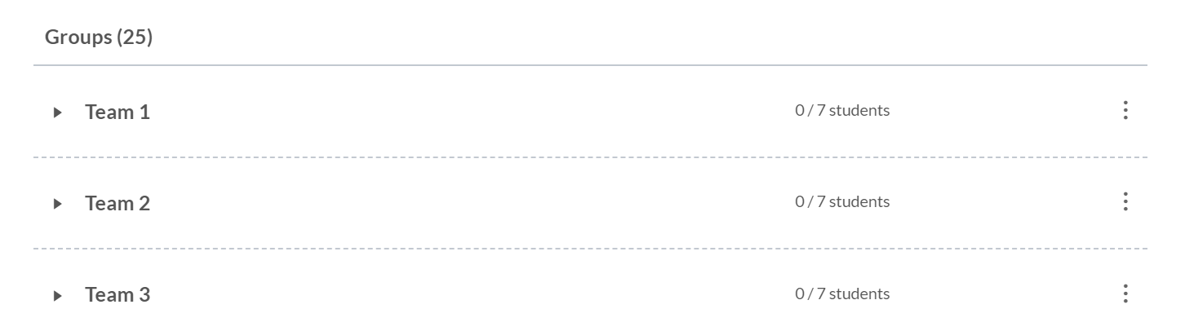
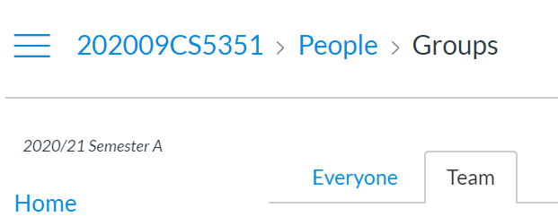
Milestone 0
Form team in Week 1
Nominate a team leader
Team leader chooses and joins an empty project group.
the first one to join an empty group is the team leader.
Other team members join that group
Email to TA about your team list and project number in Week 2
Canvas

Slide 12
Milestone 1: Week 7
The Workshop in Week 7 is a checkpoint.
Some software engineering task requirements will be presented in the lecture time, your team should collaboratively solve them
submit a solution to Canvas (as an assignment) before 10pm in that evening.
The tasks will be specified around the process, testing and debugging activities of your code project.
Note: the workshop also contains other non-project assessment.

Slide 13
Milestone 2: Final Deliverable
a 15-minute Video to present your project
Submit by 30 November Monday 11:59pm.
an Oral (Live) Presentation in Week 13
15 minutes for presentation
5 minutes Q&A
Timeslot selection will be available in Week 11
a Final Report and the source code
Submit in Week 13 on 30 November
Place your project code in a github project. Later, we will provide you an GitHub account for the course assessment. We will fork a branch of your project to serve as the submission.

Slide 14
Content of Final Report (1/4)
Around 10000 words, where each figure/table counts as 250 words.
All contents, including project title, student name, abstract, introduction, related work, preliminaries, all figures/tables, technical contents, evaluation, except the reference list and the bio of each student, should be presented within 10-page in the IEEE Transactions format.
http://ieeeauthorcenter.ieee.org/wp-content/uploads/Computer_Society_Word_template.zip

Slide 15
Content of Final Report (2/4)
A final report is pretty like a paper listed in the reference and resource section of each set of slides presented in the lectures
Project Title: A short title is better than a long title.
Present your team name before listing out each student with their student ID (not EID!)
Abstract: (150 words) Summarize the main problem solved, how your project solves it and its evaluation results.
Introduction (1-1.5 pages): Summarize the background, the problem you solve, the solutions taken by existing approaches/tools, the reason on why existing tools/approaches are still inadequate to solve the problem, your idea, your solution, evaluation.

Slide 16
Content of Final Report (3/4)
Related Work (0.5-1 page): Present your fact finding done about existing solutions toward solving the problem stated in the section on Introduction.
Preliminaries (0-2 page): Summary the technical background information necessary to follow your idea and solution.
Solution (3-4 pages): Present your solution, probably with algorithm, figures, code listing, example walkthrough to assist you to present your solution.
Evaluation (2-4 pages): Summarize what you have verified your solution to have solved the problem stated in the report, compare to the results of existing tools

Slide 17
Content of Final Report (4/4)
Follow the template provided in Week 1
Abstract (200-300 words): Summarize the whole report and include the future work.
Main Content: Introduction, Problem, Solution, Evaluation, Software Engineering Techniques applied, Discussion
Student Bio: Present a bio of each student. Who you are, your background, your technical ideas and current interests, etc. Give a self-reflection on the work done by you.
Relative Contribution: Present the relative contribution as illustrated on Slide 8 (e.g., Chan contributes 40 hours, May contributes 39 hours). If the information is missing, equal contributions among all team members will be assumed.

Slide 18
Enjoy Your Project

