Slide 1

SELF HELP GROUP MANAGEMENT SYSTEM
A Project
Submitted in partial fulfillment of the requirements
For the award of the Degree of
BACHELOR OF COMPUTER APPLICATION
By
AMAN VERMA
ROLL NO: 2120640080004
SRI GADADHAR ACHARYA JANTA COLLEGE
RAMBAGH, BIHTA

Slide 2
Self Help Management System
(Savings & Loans)
Groups & Roles
AMAN VERMA
(2120640080004)

Slide 3
Ideology & concept
In My Village There is Community Which names Samarth Seva Samiti that manage the Money Savings, giving facility of deposit and withdrawal and Providing Loans at very low interest. In this community, all Works are paperless so, there are less chances of mistakes, but it slightly takes much time in calculation, etc.
Basically it is made for small areas where, less availability of all these types of facilities.

Slide 4
Software & database
Java IDE – Eclipse
Database - MySQL

Slide 5
DFD
Login
Member details
New Member
Member deactivate
Transaction
Statement
Taking Loan
Loan detail
Loan payment
Loan payment statement
Manage user
Main Page
Update member
Add User
User Information
Delete User

Slide 6
Database
Database
login
member
loan
transaction
loan transaction

Slide 7
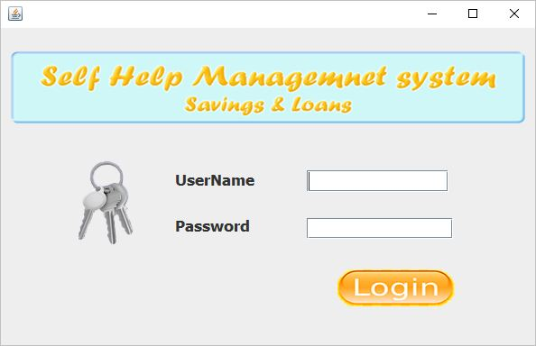
LOGIN Page

Slide 8
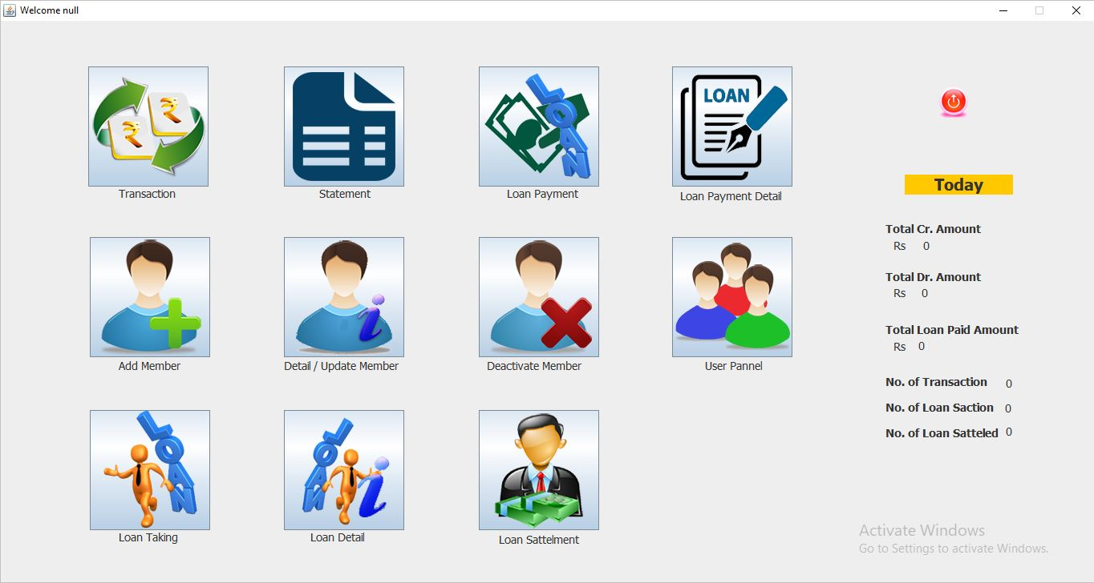
Main page

Slide 9
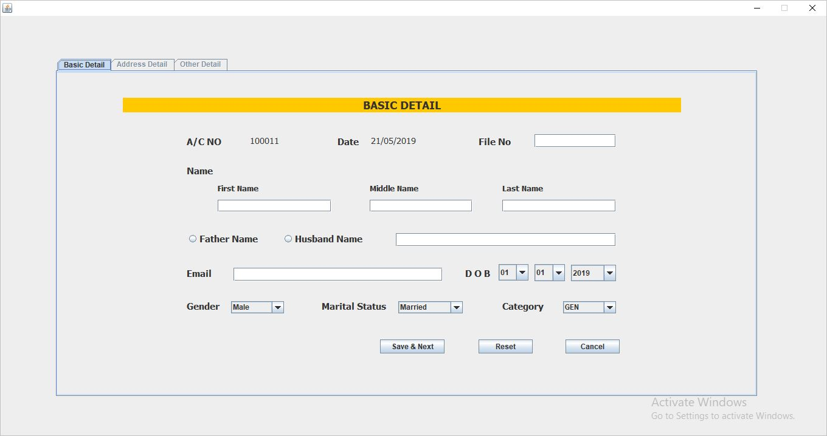
new member page 1

Slide 10
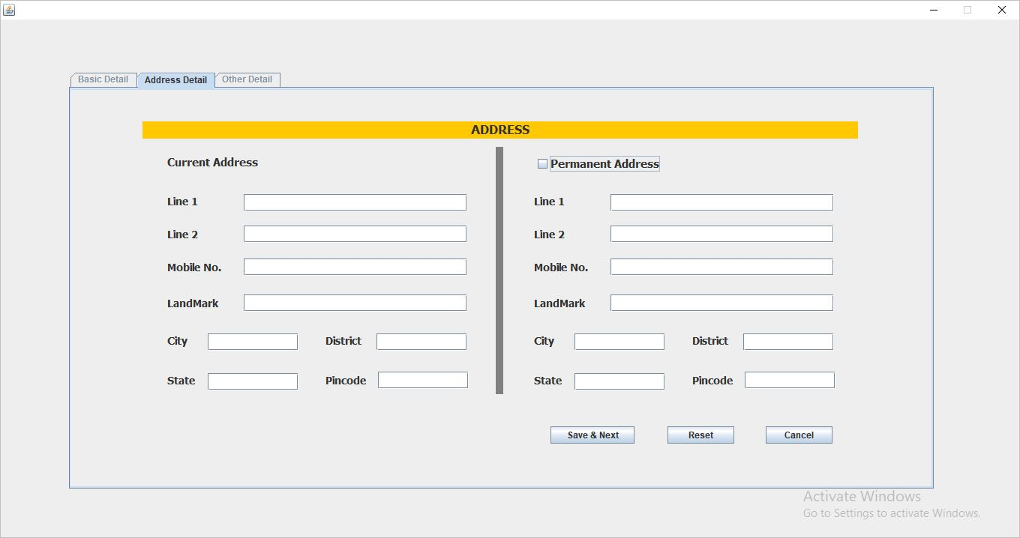
new member page 2

Slide 11
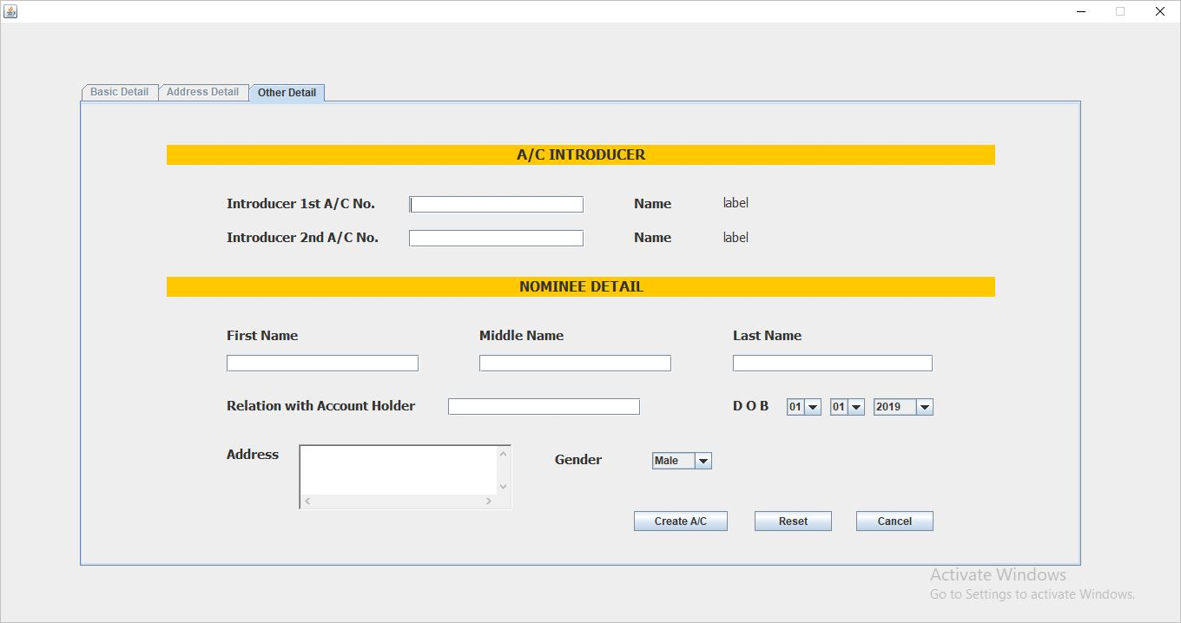
new member page 3

Slide 12
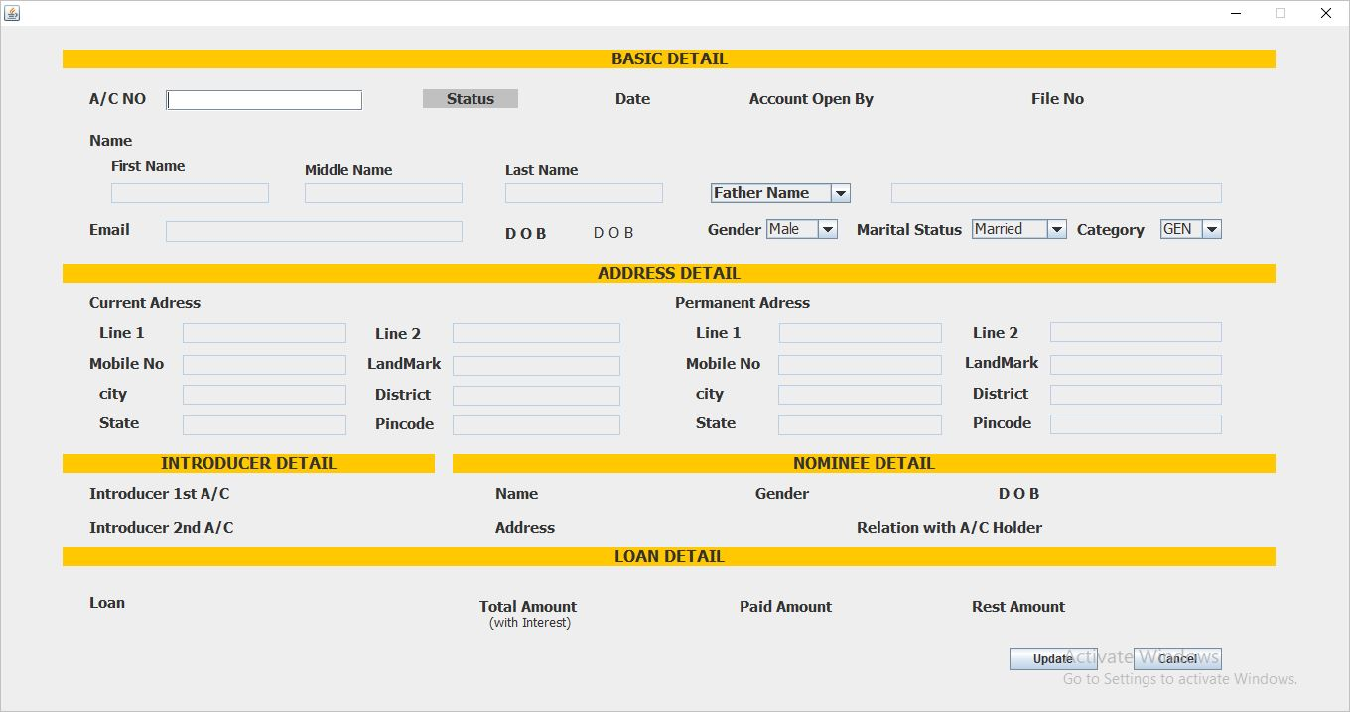
Member detail

Slide 13
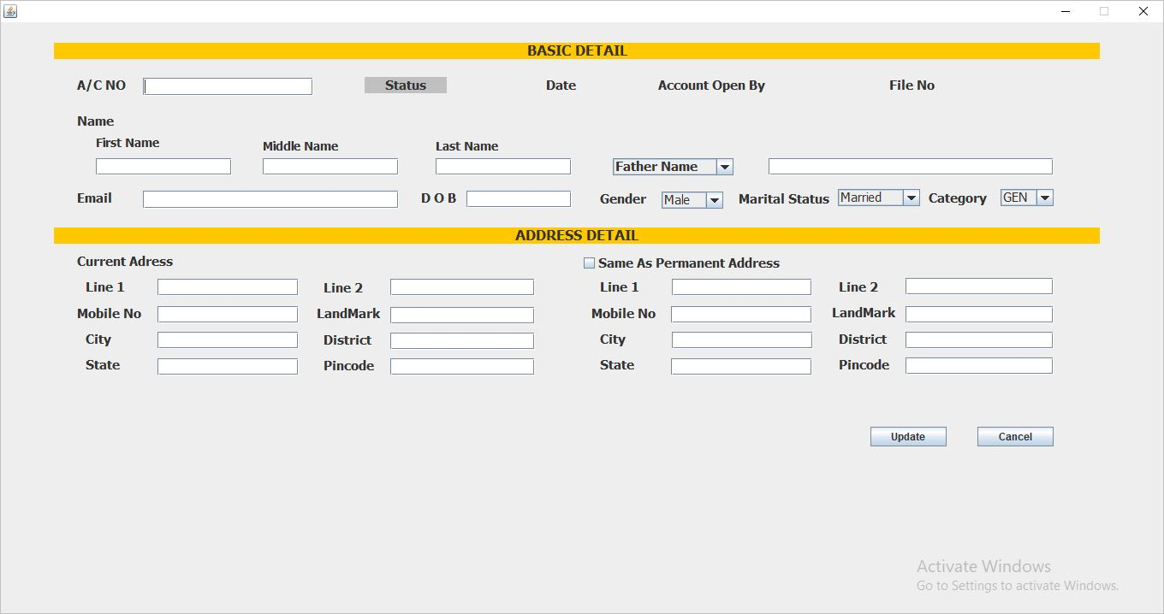
Update member

Slide 14
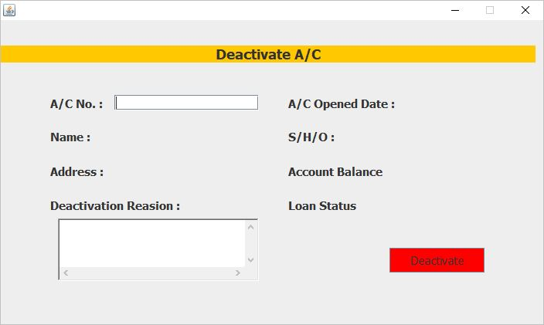
deactivate member

Slide 15
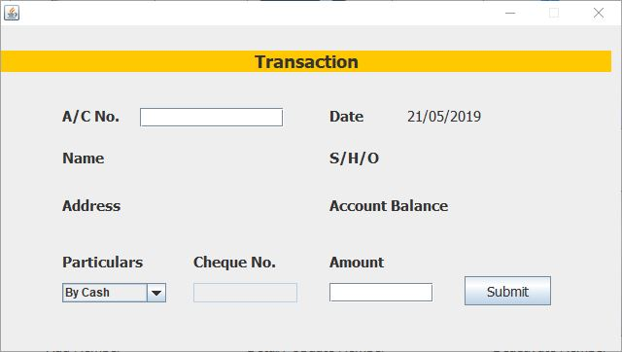
transaction page

Slide 16
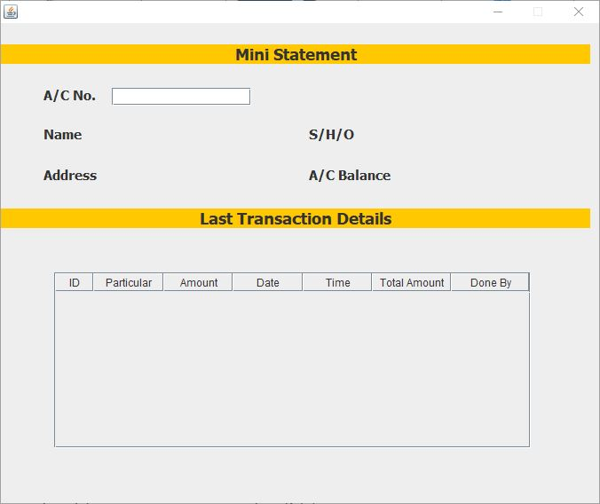
Transaction statement page

Slide 17
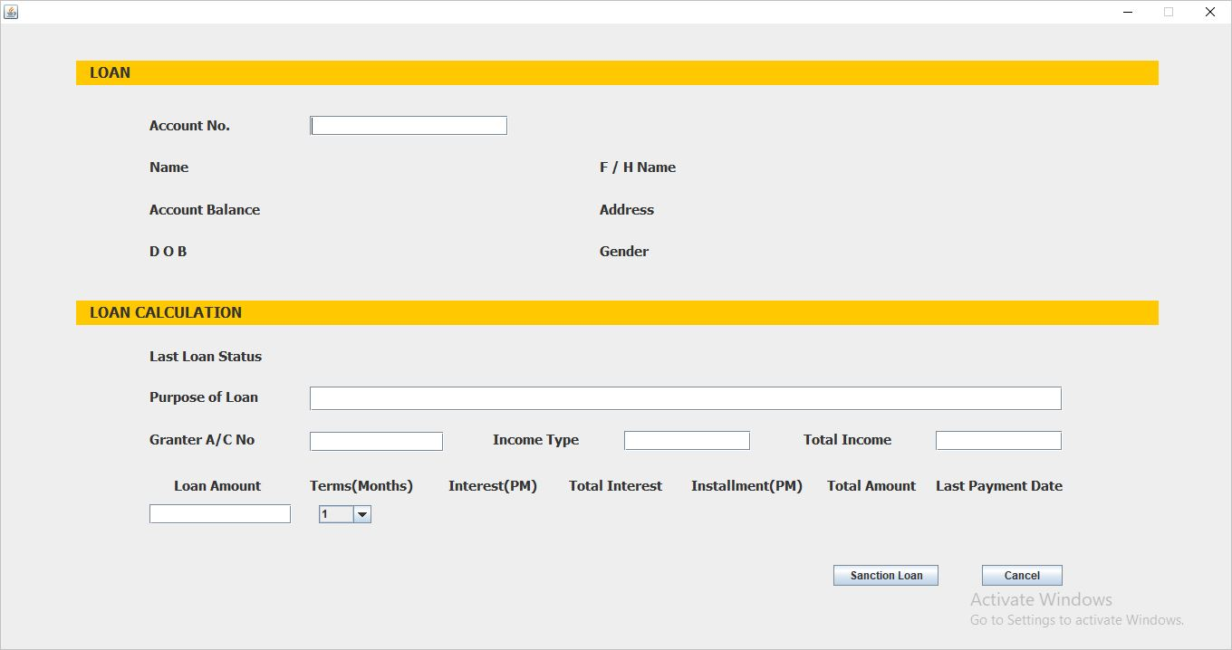
Loan taking page

Slide 18
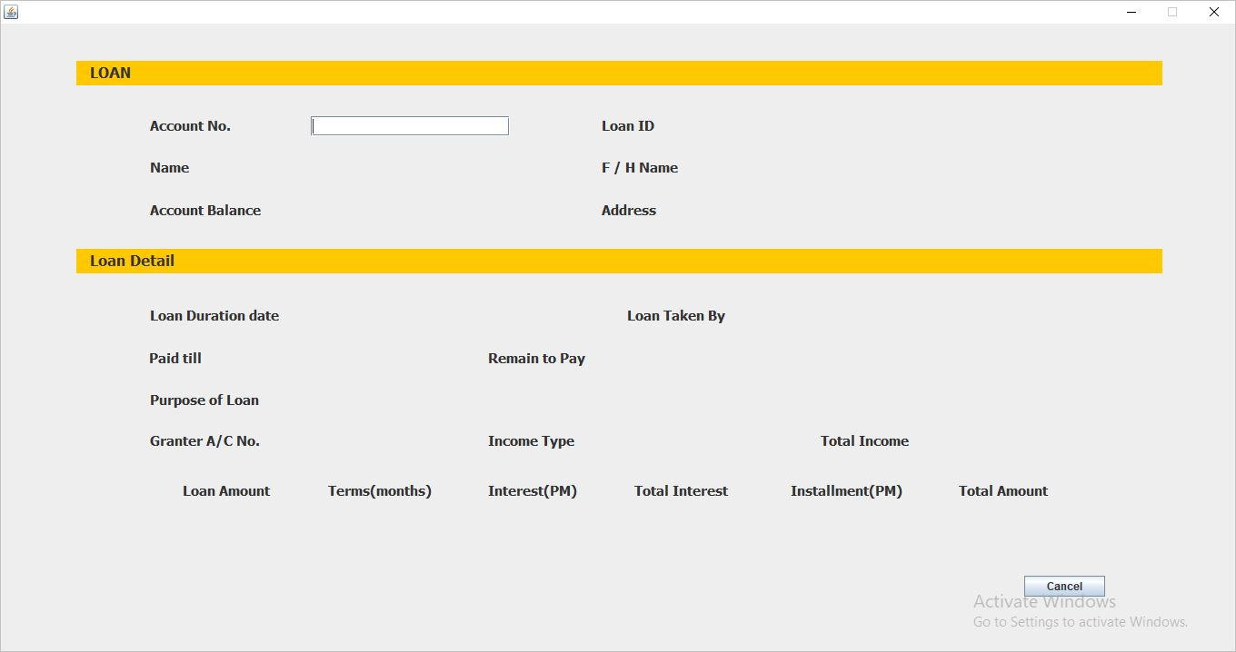
Loan detail

Slide 19
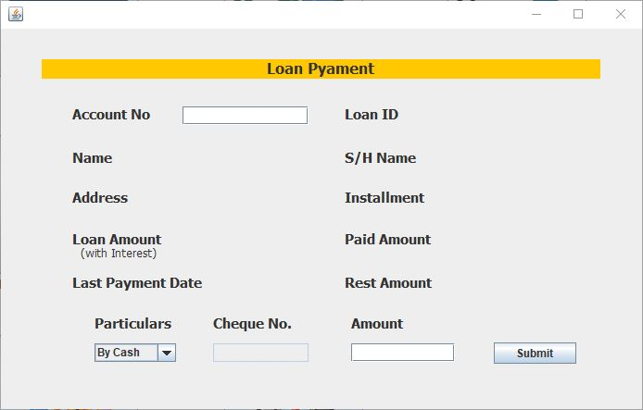
Loan payment page

Slide 20
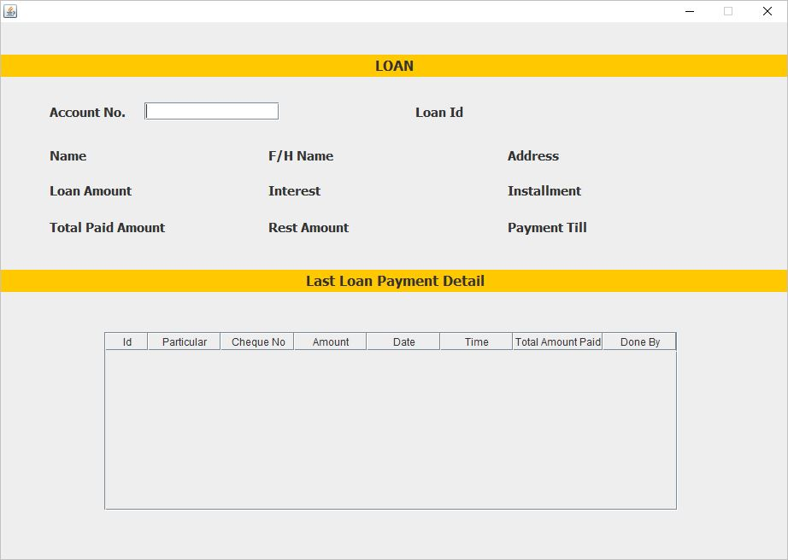
Loan payment detail page

Slide 21
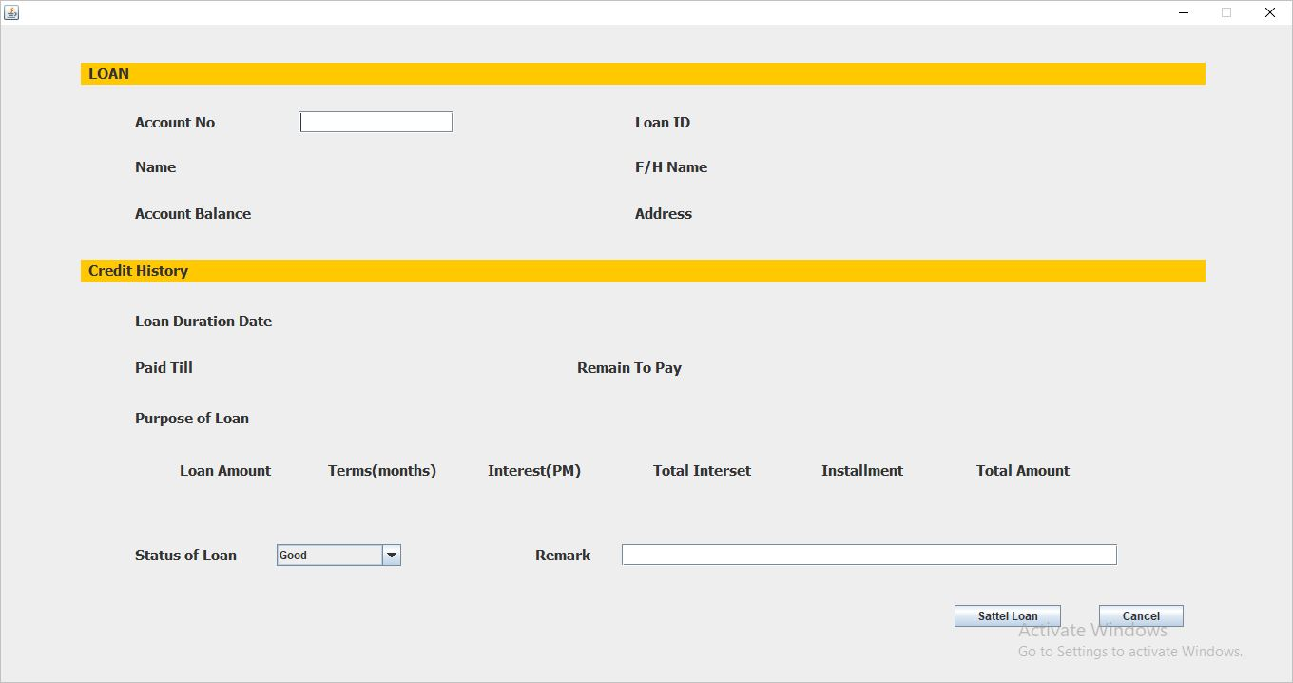
Loan sEttlement page

Slide 22
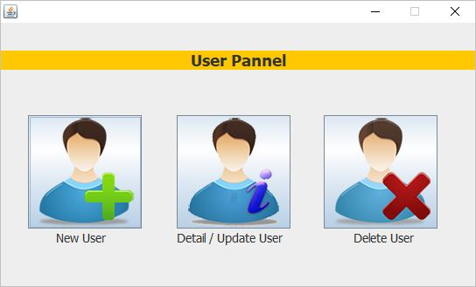
User manage page

Slide 23
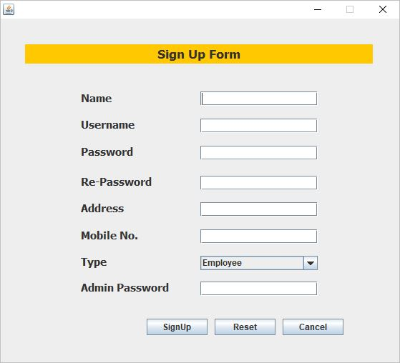
New user page

Slide 24
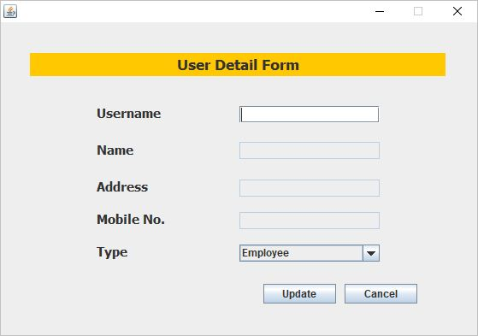
user detail page

Slide 25
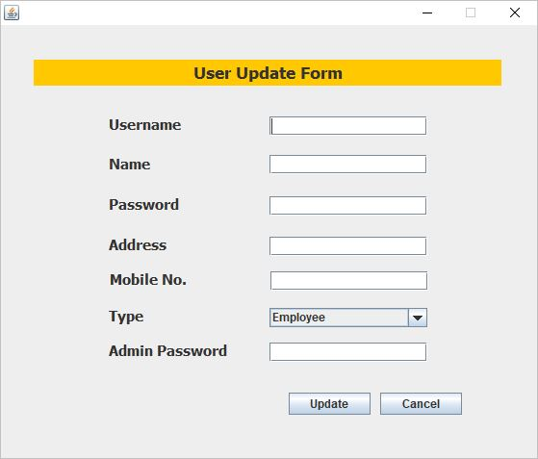
user update page

Slide 26
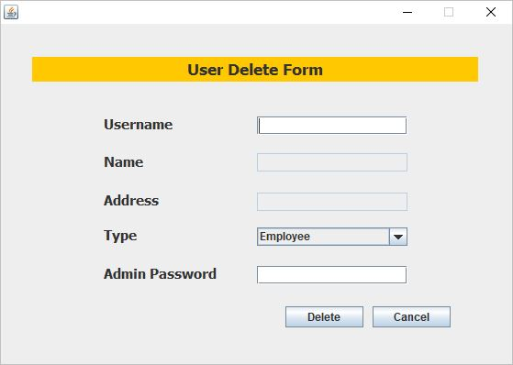
User delete page

Slide 27
Thank You

