Slide 1
Computer Architecture
Performance

Slide 2
Performance
Response time (latency)
  How long it takes to do a task
Throughput
  Total work done per unit time
    e.g., tasks/transactions/… per hour
Notes:
Morgan Kaufmann Publishers
Chapter 1 — Computer Abstractions and Technology

Slide 3

Relative Performance
Define Performance = 1/Execution Time
“X is n time faster than Y”
Example: time taken to run a program
  10s on A, 15s on B
  Execution Time_{B} / Execution Time_{A}
  = 15s / 10s = 1.5
  So A is 1.5 times faster than B
Notes:
Morgan Kaufmann Publishers
Chapter 1 — Computer Abstractions and Technology

Slide 4
Measuring Execution Time
Elapsed time
  Counts everything (disk and memory accesses, I/O, operating system overhead etc.)
  A useful number, but often not good for comparison purposes
    Time sharing among multiple programs
CPU time
  Doesn’t count I/O or time spent in running other programs
  Can be broken into system CPU time and user CPU time
Our focus: user CPU time
  CPU time spent in executing the lines of code that are “in” our program
Notes:
Morgan Kaufmann Publishers
Chapter 1 — Computer Abstractions and Technology

Slide 5
Clock Cycles
Instead of reporting execution time in seconds, we often use cycles
seconds = cycles * seconds / cycle
Clock “ticks” indicate when to start activities (one abstraction):
cycle time = time between ticks = seconds per cycle
clock rate (frequency) = cycles per second (1 Hz. = 1 cycle/sec)
A 2 Ghz. clock has a 1 / 2×10⁹ = 0.5 nano-second (ns) cycle time
time
Notes:
Morgan Kaufmann Publishers
Chapter 1 — Computer Abstractions and Technology

Slide 6

CPU Time
Performance improved by
  Reducing number of clock cycles
  Increasing clock rate
  Hardware designer must often trade off clock rate against cycle count
Notes:
Morgan Kaufmann Publishers
Chapter 1 — Computer Abstractions and Technology

Slide 7
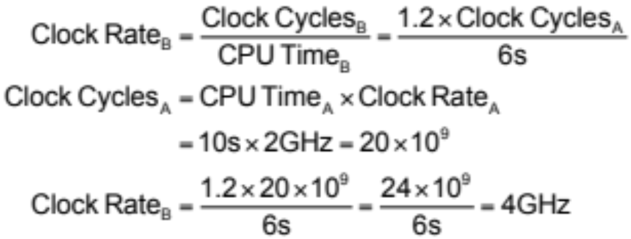
CPU Time Example
Computer A: 2GHz clock, 10s CPU time
Designing Computer B
  Aim for 6s CPU time
  Can do faster clock, but causes 1.2 × clock cycles
How fast must Computer B clock be?
Notes:
Morgan Kaufmann Publishers
Chapter 1 — Computer Abstractions and Technology

Slide 8
Instruction = cycle?
Is the number of cycles identical with the number of instructions?
No!
1st instruction
2nd instruction
3rd instruction
4th
5th
6th
...

Slide 9
Why?
Operations take different time
  Multiplication takes longer than addition
  Floating point operations take longer than integer operations
  The access time to a register is much shorter than to memory location

Slide 10
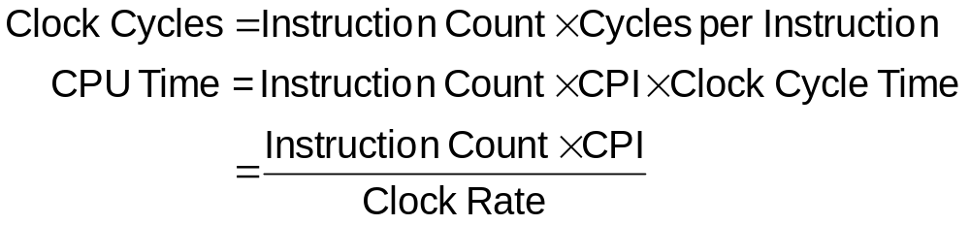
Instruction Count and CPI
Notes:
Morgan Kaufmann Publishers
Chapter 1 — Computer Abstractions and Technology

Slide 11
Instruction Count and CPI
Instruction Count for a program
  Determined by program, ISA and compiler
CPI is an average since the number of cycles per instruction varies from instruction to instruction
CPI varies by application, as well as among implementation with the same instruction set
  Number of cycles for each instruction
  Frequency of instructions (instruction mix)
  Memory access time
Notes:
Morgan Kaufmann Publishers
Chapter 1 — Computer Abstractions and Technology

Slide 12
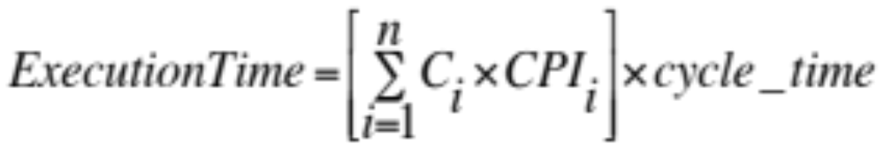
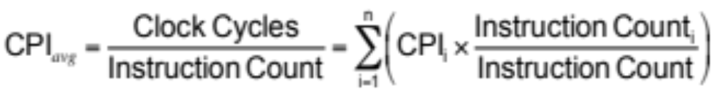
Program Execution time
Number of instruction classes
Relative frequency

Slide 13
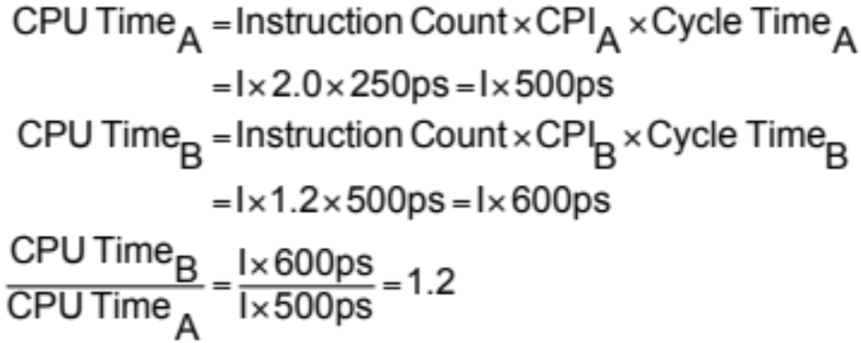
CPI Example
Computer A: Cycle Time = 250ps, CPI = 2.0
Computer B: Cycle Time = 500ps, CPI = 1.2
Same ISA
Which is faster, and by how much?
A is faster…
…by this much
Notes:
Morgan Kaufmann Publishers
Chapter 1 — Computer Abstractions and Technology

Slide 14
CPI Example
Alternative compiled code sequences using instructions in classes A, B, C
Class | A | B | C
CPI for class | 1 | 2 | 3
IC in sequence 1 | 2 | 1 | 2
IC in sequence 2 | 4 | 1 | 1
Sequence 1: IC = 5
  Clock Cycles
  = 2×1 + 1×2 + 2×3
  = 10
  Avg. CPI = 10/5 = 2.0
Sequence 2: IC = 6
  Clock Cycles
  = 4×1 + 1×2 + 1×3
  = 9
  Avg. CPI = 9/6 = 1.5
Notes:
Morgan Kaufmann Publishers
Chapter 1 — Computer Abstractions and Technology

Slide 15

Performance Summary
Performance depends on
  Algorithm
  Programming language
  Compiler
  Instruction set architecture
The BIG Picture
Notes:
Morgan Kaufmann Publishers
Chapter 1 — Computer Abstractions and Technology

Slide 16
Tradeoffs
Instruction count, CPI, and clock cycle present tradeoffs
  RISC – reduced instruction set computer (MIPS)
    Simple instructions
    Higher instruction counts for an application
    Lower CPI
  CISC – complex instruction set computer (IA-32)
    More complex instructions
    Lower instruction counts for an application
    Higher CPI
Notes:
Morgan Kaufmann Publishers
Chapter 1 — Computer Abstractions and Technology

Slide 17
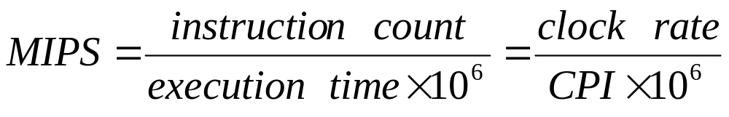
MIPS
MIPS (millions instructions per second)
Is it a good measure for performance?
Notes:
CS252 S05

Slide 18
Problems of MIPS
MIPS does not take into account the instruction set
MIPS are not constant, even on a single machine
MIPS can vary independently from performance

Slide 19
Example
Two compilers, machine instructions
  Class A: 1 cycle
  Class B: 2 cycles
  Class C: 3 cycles
  Compiler 1: 5 million A, 1 million B, 1 million C
  Compiler 2: 10 million A, 1 million B, 1 million C
Cycles
  Clock rate 4 GHz
  Compiler 1: 10 million cycles, 7 million instructions
  Compiler 2: 15 million cycles, 12 million instructions

Slide 20
Example
Execution time₁= 10x10⁹ / 4x10⁹ = 2.5 seconds
Execution time₂= 15x10⁹ / 4x10⁹ = 3.75 seconds
MIPS₁ = 7x10⁹ / 2.5x10⁶ = 2800
MIPS₂ = 12x10⁹ / 3.75x10⁶ = 3200

Slide 21

SPEC CPU Benchmark
Programs used to measure performance
  Supposedly typical of actual workload
Standard Performance Evaluation Corp (SPEC)
  Develops benchmarks for CPU, I/O, Web, …
SPEC CPU2006
  Elapsed time to execute a selection of programs
    Negligible I/O, so focuses on CPU performance
  Normalize relative to reference machine
  Summarize as geometric mean of performance ratios
    CINT2006 (integer) and CFP2006 (floating-point)
Notes:
Morgan Kaufmann Publishers
Chapter 1 — Computer Abstractions and Technology

Slide 22
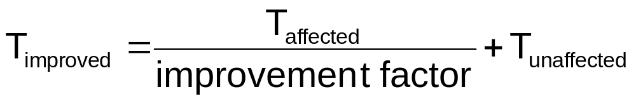
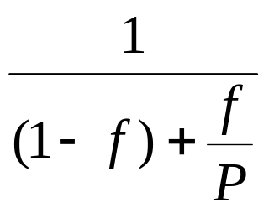
Amdahl’s Law
Speed-up = Perf_{new} / Perf_{old} =Exec_time_{old} / Exec_time_{new} =
Performance improvement from using faster mode is limited by the fraction the faster mode can be applied.
affected
T_{old}
(1 - f)
f
T_{new}
(1 - f)
f / P

Slide 23
Example
Suppose a program runs in 10 seconds.
Given is a benchmark program that spends 50% of it's time executing floating point instructions.
We improve the floating point unit by a factor of five.
How big is the speedup?
Time after = 5 s / 5 + 5 s = 6 s
Speed-up = Exec_time_{old} / Exec_time_{new} = 10/6

Slide 24

Amdahl’s Law
Improving an aspect of a computer and expecting a proportional improvement in overall performance
Example: multiply accounts for 80s/100s
  How much improvement in multiply performance to get 5× overall?
  Can’t be done!
Notes:
Morgan Kaufmann Publishers
Chapter 1 — Computer Abstractions and Technology

Slide 25
Amdahl’s Law
Corollary: make the common case fast
Examples:
  All instructions requires an instruction fetch, only a fraction require a data fetch/store => optimize instruction access over data access
  Programs spend a lot of time accessing memory and exhibit spatial and temporal locality =>design a storage hierarchy such that the most frequent access are to the smallest (fastest) memories

Slide 26
Acknowledgements
These slides contain material developed and copyright by:
  Krste Asanovic (UCB) (Course# 152, Spring 2012)
  James Hoe (CMU) (Course# 18-447, Spring 2011)
  Li-Shiuan Peh (MIT) (Course# 6.823, Fall 2012)
  Sudhakar Yalamanchili (GATECH) (Course# ECE3056, Fall 2012)
  Amirali Baniasadi (UVIC) (Course# CENG450, Summer 2012)
  Xiaoyu Zhang (CSUSM) (Course# CS331, Spring 2008)
Notes:
CS252 S05

Slide 27
The End

