Slide 1
We start at 12pm!
0. Intro
Notes:
5 min - Opening vid
15 min: Intro & context
40 min: Scratch
30 min: Python
5 min: Code & Algorithms
15 min: Use Cases x2
5 min: Wrap up

Slide 2

Everyone should learn code
0. Intro
Notes:
Coding is intimidating, and today you have taken the first step to learn more about it.

Slide 3


About Me
0. Intro
National Infocomm Competition
First language

Slide 4
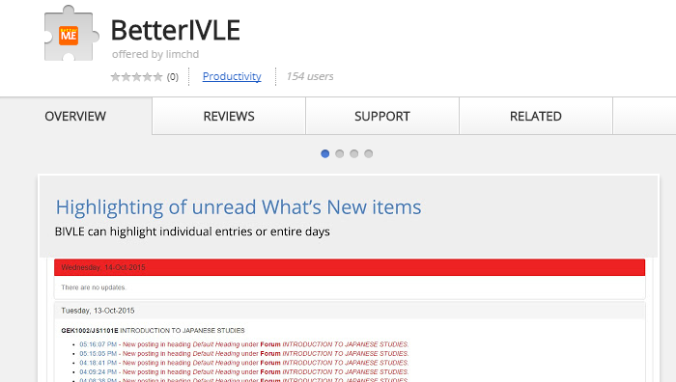


About Me
0. Intro
Wrote a few programs
TD Tech Infra

Slide 5

Notes:
RPA, automation, data
Not to turn everyone into programmers – basic understanding, possibilities
GIC use cases at the end

Slide 6

Notes:
Owner’s Mentality. Agile’s Project Owners
If someone wants to do renovation on your house, would you want to leave it with the person for 6 months? Or would you want to know exactly what the builder is going to change?

Slide 7
What is programming?
0. Intro
Telling the computer to do things
The computer is a fast worker but very stupid
“Make me a sandwich”
How about this?
Take a slice of bread, put it on the board
Apply a 1mm layer of butter on the bread
Take a slice of ham, put it on the bread
What actually happens
Move arm to coordinates (49, 50, 0) with power 1W
Move arm down to (49, 50, -40) with power 1W
Tighten fingers with power 2W
Automation is difficult!
Notes:
Process of breaking down problems

Slide 8
What you will learn today
0. Intro
Scratch
Python

Slide 9
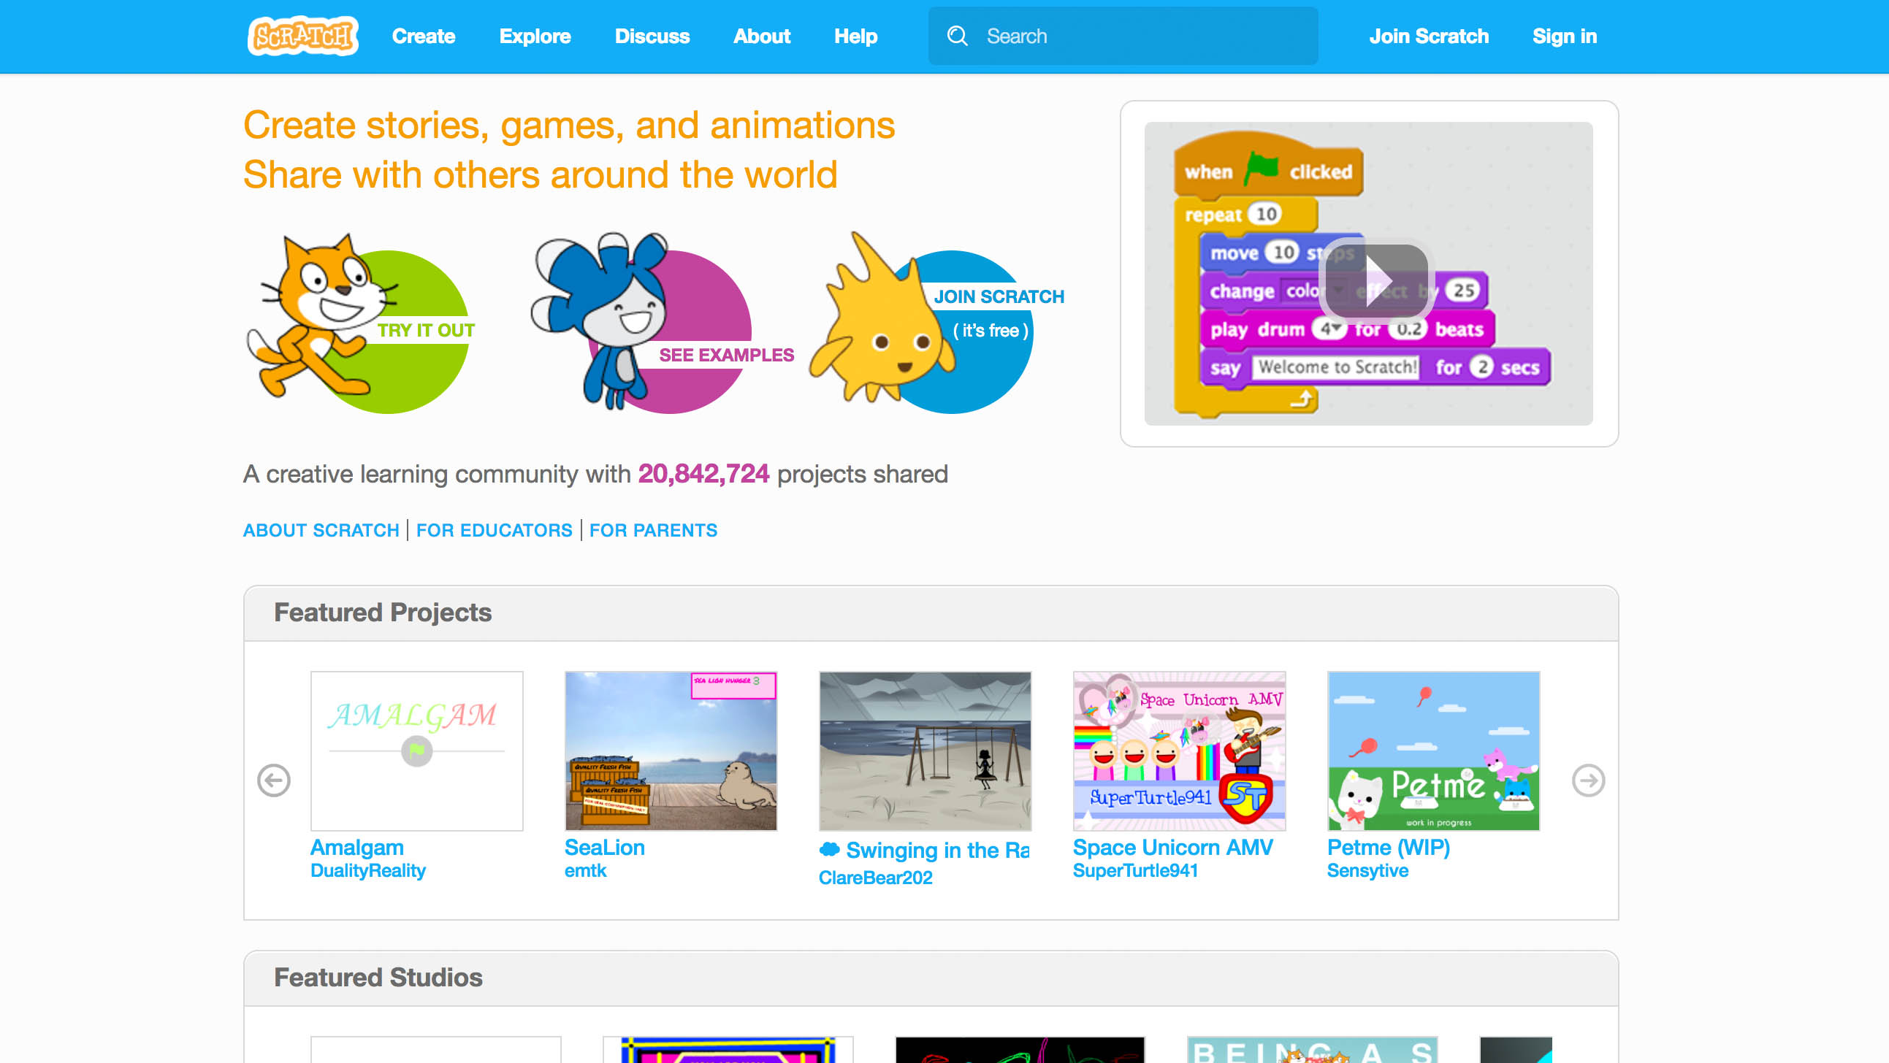
Intro to Scratch
1. Scratch
https://scratch.mit.edu/
Notes:
Interface
Sprites, stage
Commands

Slide 10
Program 1: Make the cat meow
1. Scratch

Slide 11
Program 2: Make the cat move
1. Scratch
Notes:
After this: some free play time

Slide 12
Program 3: Pair up!
1. Scratch
Take turns playing the role of a user and a developer.
User: set requirements by telling the developer what you want the cat to do
“I want the cat to move left and right”
Developer: fulfill requirements and clarify if necessary
“How many steps left/right? How fast?”
Notes:
Users, raise your hand

Slide 13
Using multiple objects
1. Scratch
Stage – white background
Orange cat with code earlier
Time to make the stage and cat interact!
Program 4: Cat avoids the wall

Slide 14
Program 5: Basic Pong
1. Scratch
Someone else has created a game called “Basic Pong”
Search for it, play with it and modify it!

Slide 15
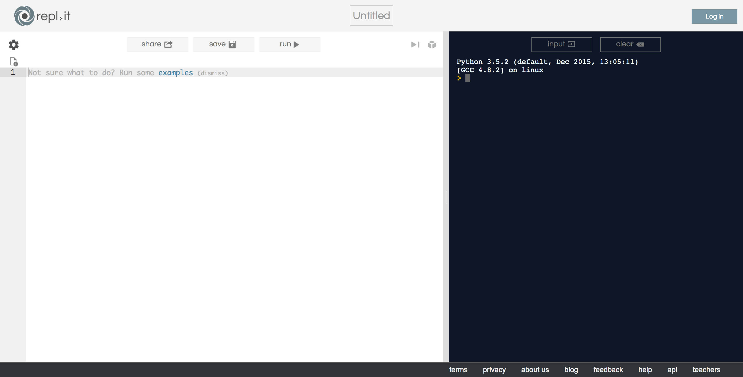
Now for some real code!
3. Python
https://repl.it/languages/python3
Notes:
print(1+2)
a=1
b=2
print(a+b)

Slide 16
Think you have what it takes?
3. Python
Do the first assignment of this intro course
https://repl.it/community/classrooms/17929
Finish it all and you’re ready for the next step!

Slide 17

Python on your Cloud PC
3. Python
Download and install Anaconda
Scrape web pages
Work with Excel
Work with EDMS
Can’t do all these on repl.it!
Notes:
You can’t start with the advanced stuff without knowing the basics
How to write a recipe without knowing the alphabet? Vocabulary?

Slide 18
Code and Algorithms
4. Conclusion
Programming languages are easy to learn
Writing recipes: easy. Making the recipe: hard
Don’t translate your work procedure to code
5, 9, 10, 4, 11, 3, 6
Highest and lowest number?
What’s the recipe?

Slide 19
Programming paradigms
4. Conclusion
Imperative / Procedural
One recipe (Cat)
Object-Oriented
Multiple people with their own recipes (Paddle, ball)
Interact with each other
Declarative / Functional
Excel
Describe outcome with expressions
Cell = IF(SUM(A:A) > 1, SUM(A:A), “No”)

Slide 20
You can start now
4. Conclusion
Coding has improved processes in GIC:
Nathaniel (ISPM)
Sherene (EQ)
LEVA

Slide 21
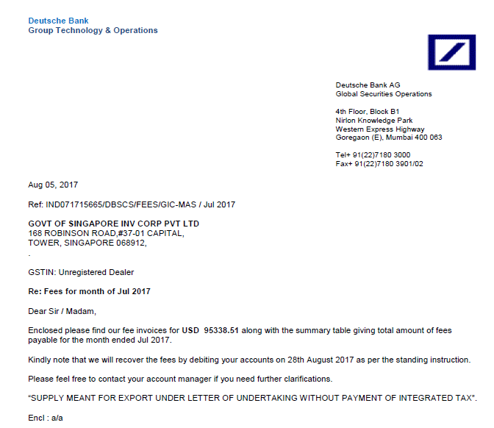
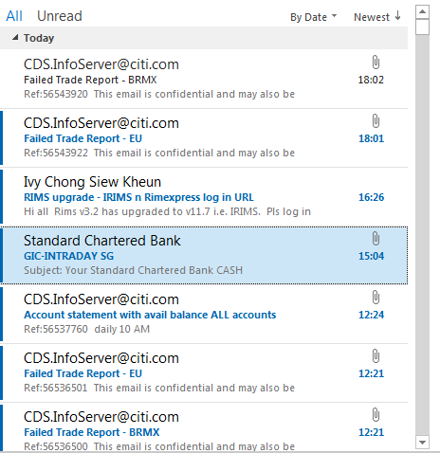





DIGITIZATION IN ISPM
A Day in the Life of Custody & Control
Custody & Control Team
What Do We Do?
We reconcile between Internal Accounts v External Accounts.
Some Common Headaches
1
Validating Monthly Invoices
2
Dealing w/ tons of FYA Emails
3
Handling Queries from Others
2,000+ emails monthly
Calculating against internal records, etc.
“Hi, can I confirm with you the following? Please help to pull this up, thanks!”

Slide 22
DIGITIZATION IN ISPM
A Day in the Life of Custody & Control
Custody & Control Team
What Do We Do?
We reconcile between Internal Accounts v External Accounts.
Some Common Headaches
1
Validating Monthly Invoices
2
Dealing w/ tons of FYA Emails
3
Handling Queries from Others
We want Monthly Invoice Validation to be completed in < 1 hour if w/o errors.
We want all our actionable emails to be pre-sorted and flagged out for us.
As far as possible, we want people to self-help instead of asking us.
2,000+ emails monthly
Calculating against internal records, etc.
“Hi, can I confirm with you the following? Please help to pull this up, thanks!”

Slide 23

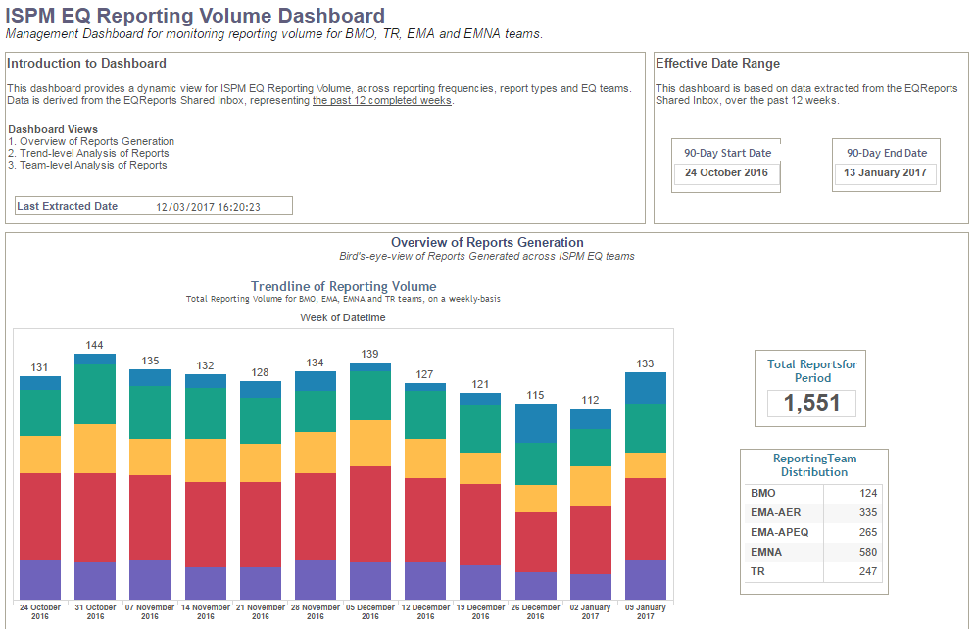
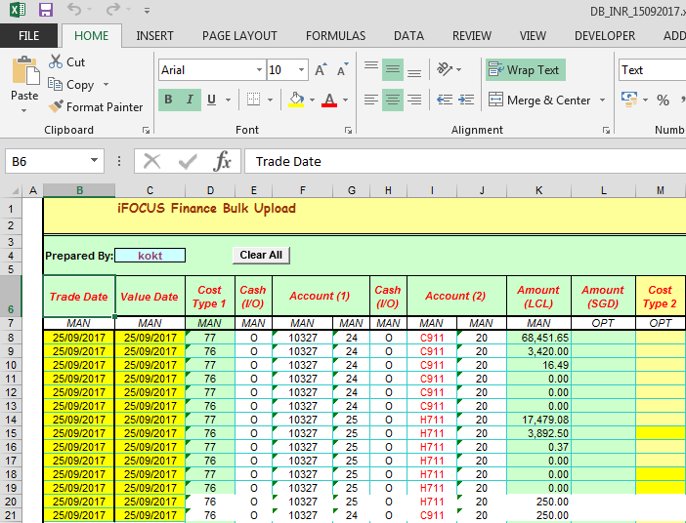




DIGITIZATION IN ISPM
A Day in the Life of Custody & Control
How Did We Tackle Them?
1
Validating Monthly Invoices
2
Dealing w/ tons of FYA Emails
3
Handling Queries from Others
>> Bank Invoice Templates
>> Outlook Attachment Extractor
>> Self-Help Dashboards
Invoice Templates that enable
Pulling from ODBC
Auto-calculation for verification
Generation of iFOCUS Posting
Outlook Macro that extracts FYA attachments, renames, and files them in EDMS
Bank Invoices
Sec Lending Income
Interest Statements
4 Sets of Self-Help Tableau Dashboards
Cash Receipts
Finance Postings
Cash Ageing
Sec Lending Income
Coding Level: Basic
Coding Level: Medium
Coding Level: Basic
Embedded SQL queries for ETHSYS, GEMS databases
Simple macros to populate sheets required
Outlook Macro that auto extracts attachments, then renames and files them according to parameters
SQL Query for ETHSYS, GEMS, EVE databases
Simple calculated fields in Tableau Desktop

Slide 24
DIGITIZATION IN ISPM
A Day in the Life of Custody & Control
Team Effort for Blue Skies
1
Validating Monthly Invoices
2
Dealing w/ tons of FYA Emails
3
Handling Queries from Others
>> Bank Invoice Templates
>> Outlook Attachment Extractor
>> Self-Help Dashboards
Invoice Templates that enable
Pulling from ODBC
Auto-calculation for verification
Generation of iFOCUS Posting
Outlook Macro that extracts FYA attachments, renames, and files them in EDMS
Bank Invoices
Sec Lending Income
Interest Statements
4 Sets of Self-Help Tableau Dashboards
Cash Receipts
Finance Postings
Cash Ageing
Sec Lending Income
Impact
Less time spent wrangling data from several sources to validate invoices
Impact
Reduced frustration and fear in missing out emails that need to be acted on
Impact
Huge reduction in queries that the team has to handle daily from other teams

Slide 25


Speeding Up Report Generation
with Python & SQL
- An EQ Case
Sherene
Investment Services Analyst
Notes:
Facilitator Guide
In this example from EQ, we heard from Shereen (not her real name though – she’s shy so asked to mask her identity), an investment services analyst on how she managed to learn coding to speed up one of the routine tasks in her portfolio.
This task has to do with report generation which is probably a very common activity that many of us need to do, so hope you find some inspiration from her example.

Slide 26
The Slow Process
Sherene’s task: Run exposure & performance reports for PMs
The Pain:
Long time taken (up to 1 hour each time) to download a lot of data; multiple times per month
Reports can only be run 1 at a time; can’t do other work when reports are run
Notes:
Facilitator Guide
As part of her role supporting the Portfolio Managers in her department, Shereen regularly runs exposure (holdings) & performance reports for them.
This involves downloading large amounts of data from the corporate database every month which takes her 30 minutes to 1 hour to do each time, depending on the number of reports required.
As the reports can only be run one at a time, Sherene increasingly feels frustrated about the slow process and by the fact that she is unable to carry out any other work when the reports are being run.

Slide 27

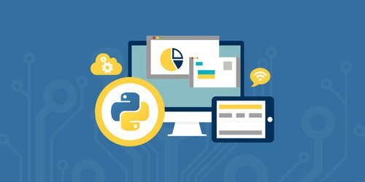

Finding a Solution
“I need to find a solution!”
Research!
Ask around!
Learning Python & SQL via online courses on Coursera
Peer learning and getting tips from others who know coding
Notes:
Facilitator Guide
Motivated to find a solution for this, Sherene did her own research and also reached out to colleagues in the department to see if she can get any suggestions.
She realised that the process can be made more efficient by writing scripts to execute the task, and thus decided to learn python and SQL to do so. With a quick search on Google, Sherene found several online courses teaching these and after reading reviews by past students, she selected one offered by University of Michigan and which is accessible from Coursera, one of the largest online course providers in the market.
The course offers many hands-on exercises along the way which helped Sherene practise what she learnt. Through this self-paced learning process and also getting tips from a PM who is well-versed in python, Sherene eventually managed to write the scripts to run the reports more efficiently.

Slide 28




The Result
Reduced effort by 50%
Time Savings: From 7 hours per month to 30 minutes
Satisfied!!
Can multi-task -> Higher productivity
Reusable scripts by colleagues for similar tasks.
Estimated savings for dept: 30 hours/month!
Notes:
Facilitator Guide
Sherene managed to reduce the effort required to do this task by 50% and what used to take her about 7 hours to complete in a month was now reduced to just 30 minutes.
Besides the time savings from automating the process, she was also able to multi-task and carry out other parts of her work, increasing her productivity level.
The scripts she wrote were also reusable by other colleagues for similar tasks, which really scaled up the benefits that was otherwise derived from automating just one aspect. As a result of this, the whole business group was able to save around 30 hours per month from this.

Slide 29
Sherene’s Takeaways
On coding skills:
Improve work processes, automate routines in personal life
May not always need to code from scratch – tap on existing codes/libraries
On learning and keeping pace:
New perspectives on how to learn new skills these days
Easy access to flexible web-based learning: anytime, anywhere
“I found the whole experience of learning coding very empowering as it opened up many possibilities for me to do my work more smartly and easily.
Without learning coding, I may always have to rely on others and would not be able to make improvements to my work processes as quickly and as timely as I would like.”
Notes:
Facilitator Guide
As Sherene shared her example with us, we also asked her on how she felt about the whole experience and what else she learnt besides the actual coding skills.
Her thoughts on coding were these:
Firstly there is so much that can be done with the ability to code – from improving work processes to even automating simple routines in personal life.
She also learned that besides writing scripts herself, there were also many libraries of existing codes out there that others had come up with and shared, so one can quite simply leverage on these with some basic familiarity with coding concepts.
The whole experience has also changed her view of how learning can be done. With many web-based learning courses easily available these days, anyone can learn at their own pace, anywhere anytime. She can also easily replay the online learning videos if she needs to revisit or refresh any of the concepts learnt.
This has convinced her to embrace web-based learning as a way to keep learning new skills and knowledge. She feels the only way ahead is to make the best use of such resources to keep abreast with latest developments.
Finally, here’s her quote summarising her experience:
“I found the whole experience of learning coding very empowering as it opened up many possibilities for me to do my work more smartly and easily.
Without learning coding, I may always have to rely on others and would not be able to make improvements to my work processes as quickly and as timely as I would like.”

Slide 30
LEVA
4. Conclusion
Others in GIC are doing the same!
Existing libraries and scripts to leverage on
Submit yours to multiply its benefits

Slide 31
You can start now
4. Conclusion
You can program
You just don’t know it yet
See the possibilities
What can you do with it?
Have an Owner’s Mindset.
Have a basic understanding to tell a developer what you want!

Slide 32
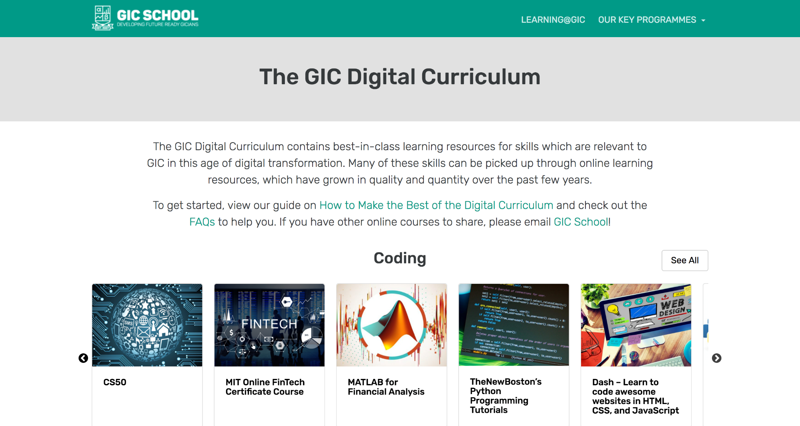
Where to from here
4. Conclusion
Notes:
Facilitator Guide
If you are keen to learn more, check out the GIC Digital Curriculum on the GIC School Microsite. There are curated offerings on 4 different tracks – coding, data, communications design, design thinking.
Many of these are online courses offered free by providers like Coursera, Udemy, and so on.

