Slide 1
HTML 101

Slide 2
HTML - Code Visualization
RAW CODE
CODE BLOCKS
ABSTRACT VISUALIZATION
<HTML>
<HEAD>Awesome Title!<HEAD>
<BODY>
<DIV>
<SPAN>
Hello World!
</SPAN>
</BODY>
</HTML>
<HTML>
</HTML>
Container (HTML)
<HEAD>
Awesome Title!
</HEAD>
Container (HEAD)
<BODY>
</BODY>
Container (BODY)
<DIV>
</DIV>
Container (DIV)
<SPAN>
Hello World!
</SPAN>
Container (SPAN)
These codes are encased in tags.
They are the main components used to build basic websites.
Notes:
We are just going to learn some basic tags
<span>

Slide 3
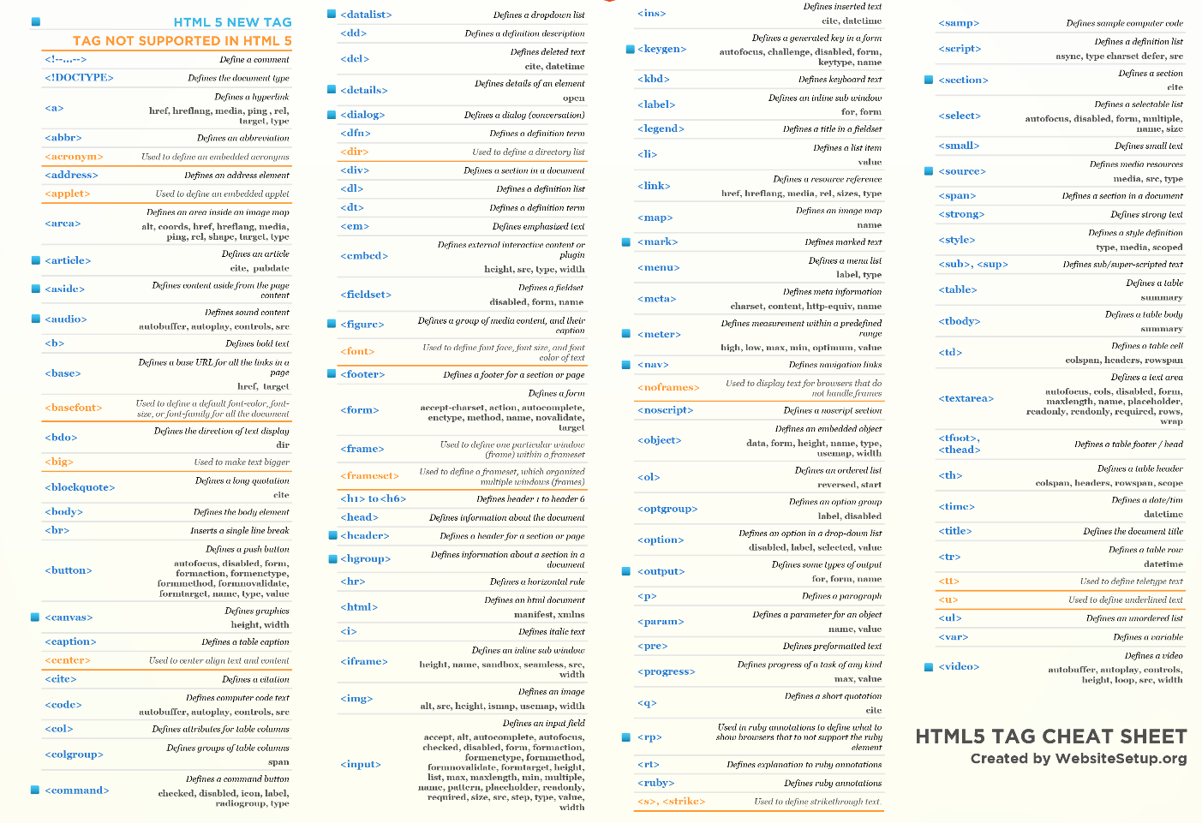
HTML - Building Blocks of Internet Websites
For
Illustration Purposes Only
Notes:
There are a multitude of different such tags.

Slide 4
End

Slide 5
It Begins
End

Slide 6
