Slide 1
Code?
What is Code?
Notes:
5 min - Opening vid
15 min: Intro & context
40 min: Scratch
30 min: Python
5 min: Code & Algorithms
15 min: Use Cases x2
5 min: Wrap up

Slide 2




Notes:
RPA, automation, data
Not to turn everyone into programmers – basic understanding, possibilities
GIC use cases at the end

Slide 3
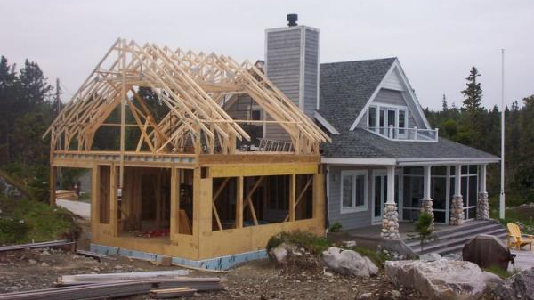
Notes:
Owner’s Mentality. Agile’s Project Owners
If someone wants to do renovation on your house, would you want to leave it with the person for 6 months? Or would you want to know exactly what the builder is going to change?

Slide 4
What is programming?
1. Code?
Telling the computer to do things
The computer is a fast worker but very stupid
“Make me a sandwich”
How about this?
Take a slice of bread, put it on the board
Apply a 1mm layer of butter on the bread
Take a slice of ham, put it on the bread
What actually happens
Move arm to coordinates (49, 50, 0) with power 1W
Move arm down to (49, 50, -40) with power 1W
Tighten fingers with power 2W
Automation is difficult!
Notes:
Process of breaking down problems

Slide 5
Python?
Uh.. Eating a snake?
Notes:
5 min - Opening vid
15 min: Intro & context
40 min: Scratch
30 min: Python
5 min: Code & Algorithms
15 min: Use Cases x2
5 min: Wrap up

Slide 6
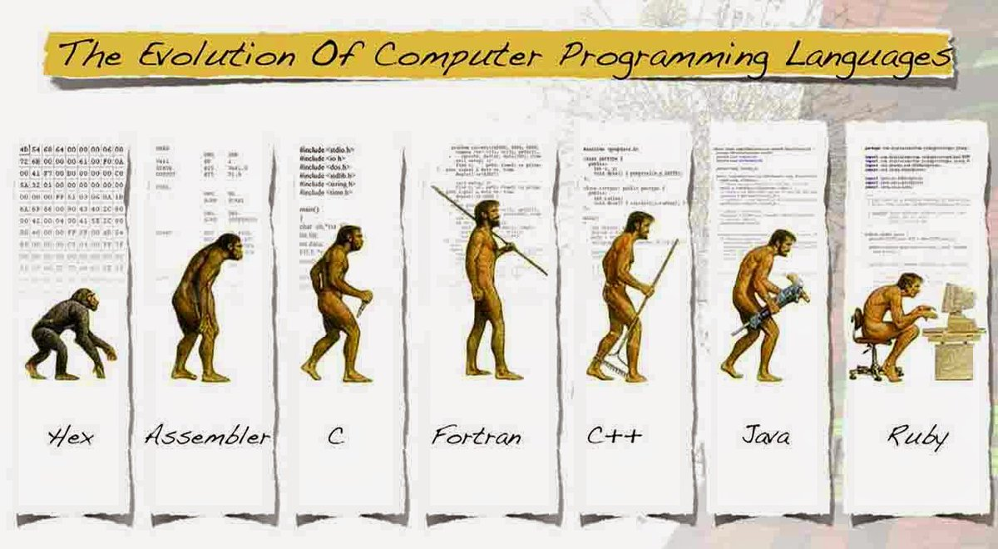
What is Python?
2. Python
Considered a Fourth Generation Language
Simple & mighty for mathematical libraries
Relatively natural to read
Python!

Slide 7
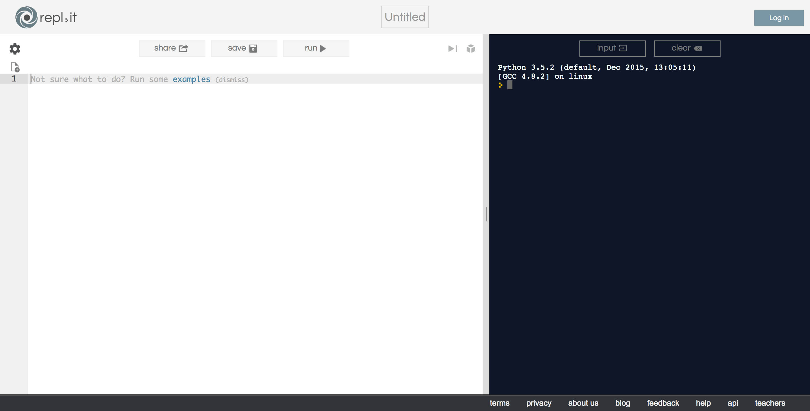
Now for some real code!
2. Python
http://rebot.chat/python.html
Notes:
print(1+2)
a=1
b=2
print(a+b)

Slide 8
Playground: Repl.it
2. Python
Print “Hello World”
Explain concept of variables (containers)
Create a string variable “name”
Print “Hello, my name is …”
Try addition, multiplication, division, subtraction
QN: what is 1 + 1?
Concept of variable types. Int, string etc.
Concept of ( if… else)

Slide 9
Code and Algorithms
3. Python
Programming languages are easy to learn
Writing recipes: easy. Making the recipe: hard
Don’t translate your work procedure to code
5, 9, 10, 4, 11, 3, 6
Highest and lowest number?
What’s the recipe?

Slide 10
Familiar?
3. Python
Excel
Describe outcome with expressions
Cell = IF(SUM(A:A) > 1, SUM(A:A), “No”)

Slide 11
You can start now
3. Python
You can program
You just don’t know it yet
See the possibilities
What can you do with it?
Have an Owner’s Mindset.
Have a basic understanding to tell a developer what you want!

Slide 12
Chatbot?
Putting it Together
Notes:
5 min - Opening vid
15 min: Intro & context
40 min: Scratch
30 min: Python
5 min: Code & Algorithms
15 min: Use Cases x2
5 min: Wrap up

Slide 13
Install Telegram / Visit Website
4. Chatbot
Download the “Telegram” app on iTunes or Google Playstore
Add bot @R_E_Gbot
Say “Hi” to the chatbot
Play around

Slide 14
Jupyter
4. Chatbot
Lets create make your chat bot smarter.
Return “Hello world”
What is the day today?
What is your name?
I am bored?
Return random results.
Notes:
Give roles – product owner, tester, developer

Slide 15
Challenge
Scrapping Real Data from Websites
Notes:
5 min - Opening vid
15 min: Intro & context
40 min: Scratch
30 min: Python
5 min: Code & Algorithms
15 min: Use Cases x2
5 min: Wrap up

Slide 16
What is HTML?
5. HTML
Building block that brings the Internet to Life

Slide 17
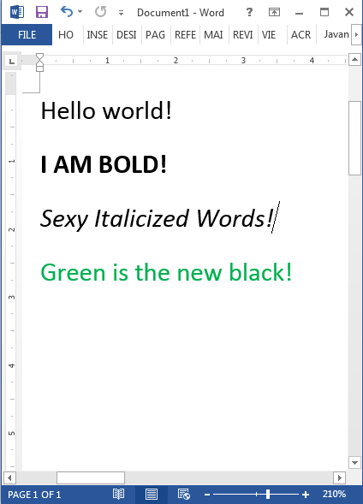
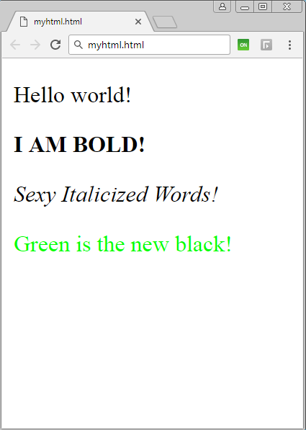
5. HTML
Word Document
HTML Document

Slide 18
5. HTML
Word Document
HTML Document

Slide 19
5. HTML
<!DOCTYPE html>
<html>
<body>
<p>Hello world!</p>
<p><strong>I AM BOLD!</strong></p>
<p><i>Sexy Italicized Words!</i></p>
<p><font color='#00FF00'>Green is the new black!</color></p>
</body>
</html>

Slide 20
HTML - Code Visualization
ABSTRACT VISUALIZATION
CODE BLOCKS
RAW CODE
Container (HTML)
<HTML>
</HTML>
<HTML>
<BODY>
<P>Hello World!</P>
</BODY>
</HTML>
Container (BODY)
<BODY>
</BODY>
Container (P)
<P>
Hello World!
</P>
These codes are encased in tags.
They are the main components used to build basic websites.
Notes:
We are just going to learn some basic tags
<span>

Slide 21
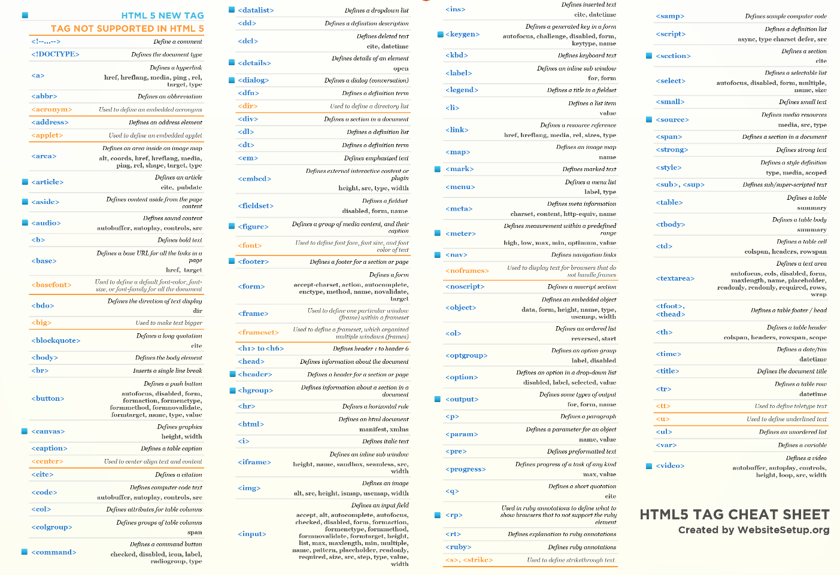
For
Illustration Purposes Only

Slide 22
Step 1: Import libraries
Coders in the community can create libraries of commonly used features. These templates are pre-defined and can help us simplify and reuse code.
Step 2: What is the document filename? Eg. “Quarterly reporting.doc”, “Mydocument.html”, “http://rebot.chat/index.html”
Step 3: Get the raw content within the document
Step 4: Format the content into a readable format
Step 5: Find the data-point we need
Notes:
Now you have a lot of containers. How do you find the container that contains the data point that you want.
For this exercise, we will be using a class as attribute identifier
Library – there are a lot of ppl developers out there that have created reusable libraries that simply things we commonly do.
Template that we can reuse for our coding. That have been predefined. For this programming, are importing two libraries.

Slide 23

How to find a container?
Notes:
Now you have a lot of containers. How do you find the container that contains the data point that you want.
For this exercise, we will be using a class as attribute identifier
Library – there are a lot of ppl developers out there that have created reusable libraries that simply things we commonly do.
Template that we can reuse for our coding. That have been predefined. For this programming, are importing two libraries.

Slide 24
End
Notes:
5 min - Opening vid
15 min: Intro & context
40 min: Scratch
30 min: Python
5 min: Code & Algorithms
15 min: Use Cases x2
5 min: Wrap up

Slide 25
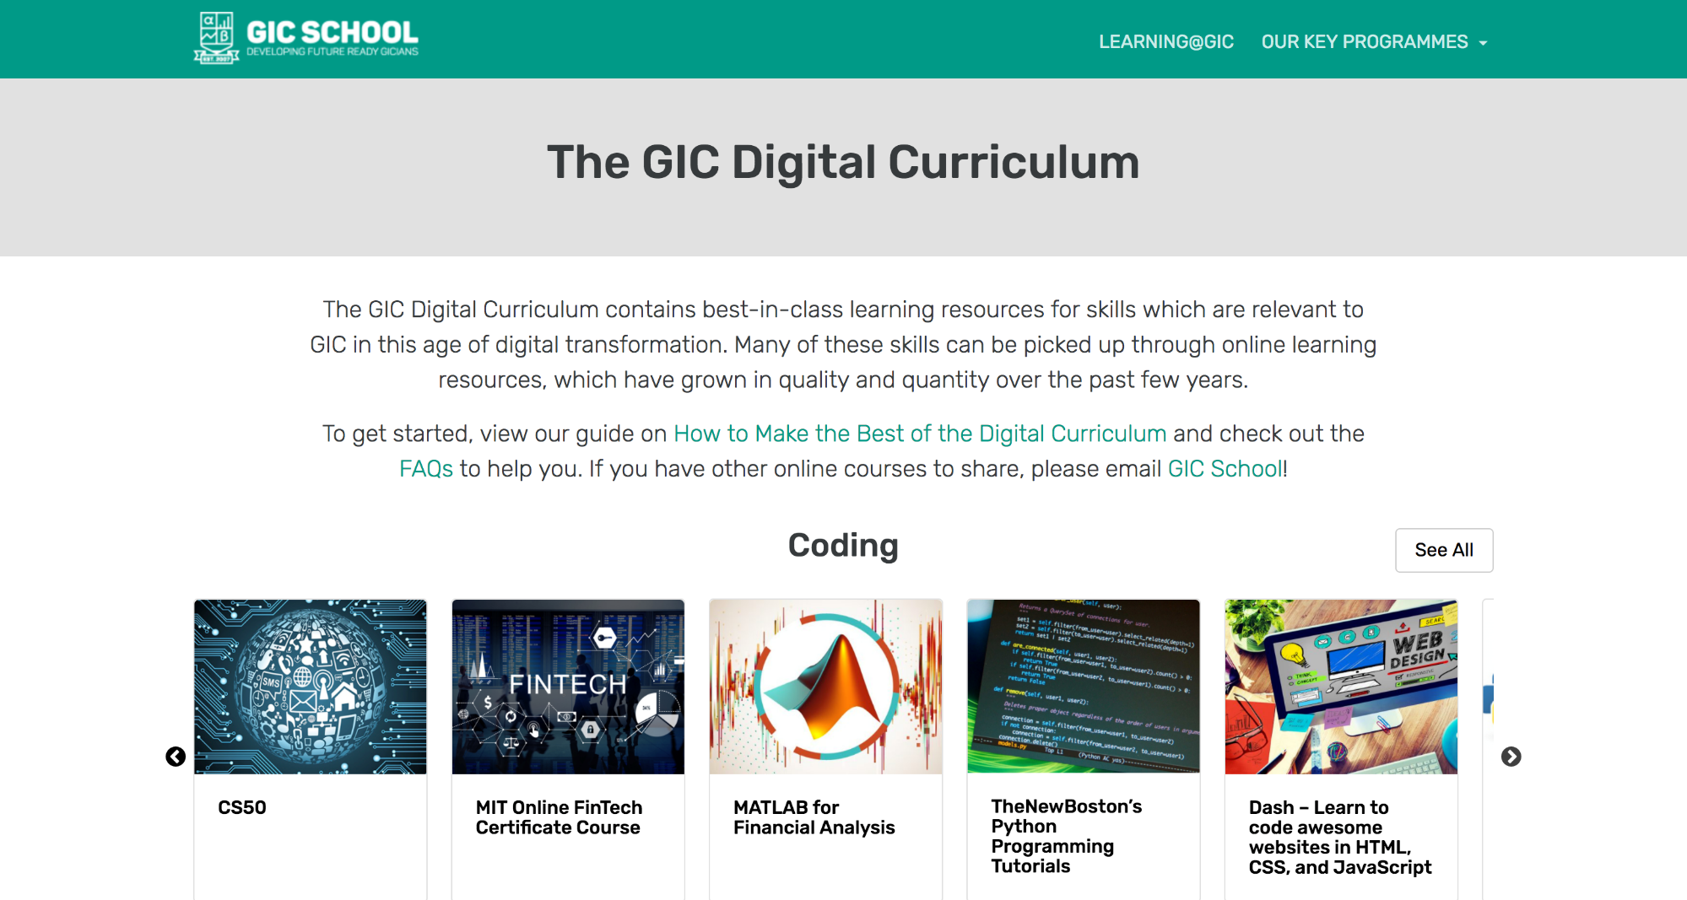
Where to from here
4. Conclusion
Notes:
Facilitator Guide
If you are keen to learn more, check out the GIC Digital Curriculum on the GIC School Microsite. There are curated offerings on 4 different tracks – coding, data, communications design, design thinking.
Many of these are online courses offered free by providers like Coursera, Udemy, and so on.

Slide 26
Think you have what it takes?
3. Python
Do the first assignment of this intro course
https://repl.it/community/classrooms/17929
Finish it all and you’re ready for the next step!

Slide 27

Python on your Cloud PC
3. Python
Download and install Anaconda
Scrape web pages
Work with Excel
Work with EDMS
Can’t do all these on repl.it!
Notes:
You can’t start with the advanced stuff without knowing the basics
How to write a recipe without knowing the alphabet? Vocabulary?

