Slide 1
tracks overview
feb 2024
Renato poli (rep2656)

Slide 2
Research tracks
TRACK #1 – Flow in fractured media
TRACK #2 – Fracture propagation
TRACK #3 – Salt rock mechanics
TRACK #4 – Homogenization of mechanical parameters
TRACK #5 – Computational performance
TRACK #6 – Multiscale data assimilation

Slide 3
TRACKS
TRACK #1 – Flow in fractured media
EDFM/CEDFM/PEDFM
Comparison of the techniques.
Seems a good starting point for learning the code, getting something published, and moving forward.
TRACK #2 – Fracture propagation
Long-term thermo-hydraulic fracture propagation without predefined fracture track
Can EDFM be extended to fracture propagation?
Check SBFEM
TRACK #3 – Salt rock mechanics
THM modeling of salt geomechanics (elasticity, plasticity, creep)
Apply to fracture containment, caverns, drilling, well abandonment, etc
TRACK #4 – Homogenization of mechanical parameters
Wrap up of the results and publish
Need some thorough validation, comparison analytical results and to expand to other parameters.
Writing paper with Prof Espinoza
TRACK #5 – Computational performance
Computational and mathematics improvement for overall simulation performance.
Codesign and building applications for specific architectures are something
I've been willing to work on for a long time.
TRACK #6 – Multiscale data assimilation
Lab-to-field scale modeling, digital rocks, relative permeability, fingering etc
Translating capillary pressure to relative permeability
Interface between models in different scales

Slide 4
PROBLEM STATEMENT
feb 2024
IDEAS
Renato poli (rep2656)

Slide 5
PROBLEM #1 - NON-PLANAR FRACTURE PROPAGATION
Object of study
Conventional reservoirs, deep fields, high temperature
Sandstone or carbonates (naturally fracture)
Shale or salt caprock
Salt caverns
The problem
Multiphysics fracture nucleation and tracking are difficult to model as it happens in multiple scales (space and time)
Long term cold fluid injection thermally stresses the rock, hydraulic fractures are likely to occur
Salt caverns designs for cyclic storage and abandonment
Many physical processes concur with similar characteristic time and length (elasticity, plasticity, pressure and heat dissipation, creep etc)
Objective
Understand the mechanics of long term effects of cold water and gas injection for EOR and storage
Operate with highest possible injection rates (safety!)
Enable long term fluid injection above the fracturing pressure (produced water)
Promote safety and fluid containment. Support regulations
Possible to apply to salt caverns
Methodology
Multiscale simulations around the injection wells
Fracture propagation is driven by small scale phenomena
Propose a set of parameters to embed small-scale findings to field scale simulations
Create a large database with the small scale simulations => AI to feed field scale fracture models

Slide 6
PROBLEM #1 - NON-PLANAR FRACTURE PROPAGATION
Geomechanics
Single-phase-flow
Multiscale
Identify the most important phenomena
Mixed-FEM
Discretization
Remeshing
Molecular
Phase field
Peridynamics
Cohesive
Solvers
Physics
Math
Lab
Computers
Best use of resources
Parallelism
HPC
Existing libraries
Existing code
GPU
Literature review
History match

Slide 7
Seminars
Kazemy
Microcracks play importante role HF
Firoozabadi
Surface energy
Fracture branching
molecular simulation
The difficulty in going 3D
Mary Wheeler
IPACS
Need for better remeshing
Phase-field has

Slide 8
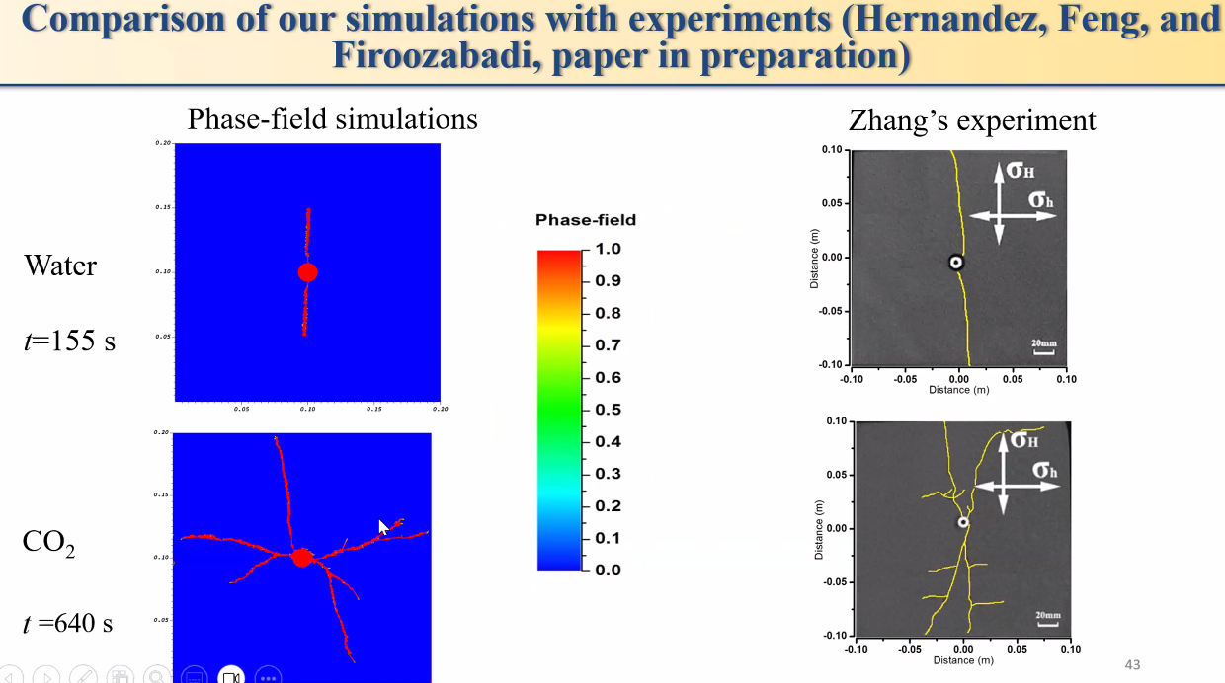

Slide 9
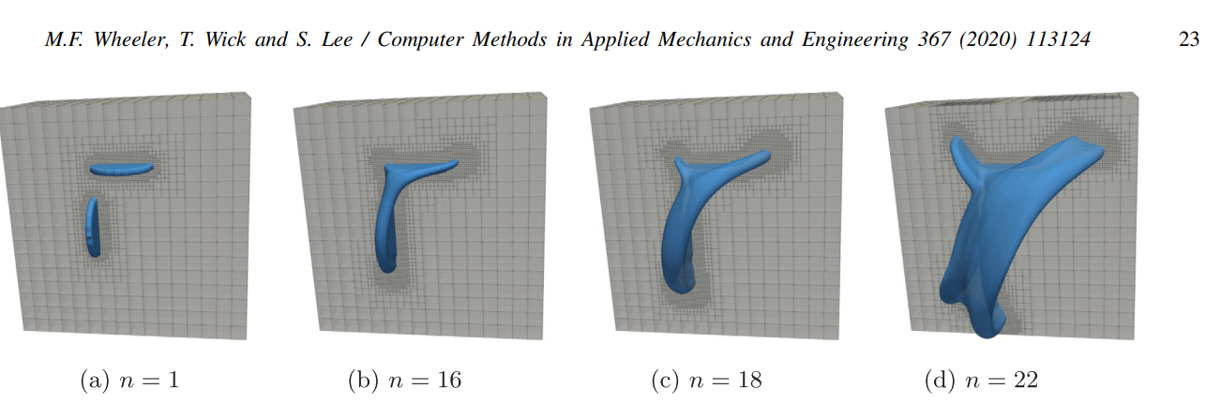
IPACS

Slide 10
PROBLEM #2 - FLOW IN FRACTURES
Object of study
Conventional carbonate field, naturally fractured, mixed wet
Large models, field scale
Permeable matrix
Wells are acidized (not fractured)
Fractures provide additional permeability
The problem
Description of the natural fracture network ignores important physics
Mass transference parameters are mostly based on history matching
Multiphase flow is not adequately treated in the interface fracture-matrix
Models with detailed fractures are numerical impractical
Objective
Enhance the understanding of the field based on numerical simulation
Promote better communication between geoscientists and numerical simulation
Enable the description of a fracture network based on high level parameters (wettability, fracture network density, fracture genesis etc)
Assimilation of geological understanding to the numerical models
Methodology
Understand geological geometries and hydraulic characteristics of natural fractures
Understand the limitations of current models, especially multiphase and closed fractures
Implement a preprocessor to embed fractures optimally, keeping the model numerically reasonable

Slide 11
Dec 2023
RESEARCH PLAN AND BRAINSTORMING
notes and remarks
Renato poli (rep2656)

Slide 12
MACRO TOPICS
Fractures
Salt geomechanics
Numerics and speedup
Multiphase flow and multiscale data assimilation

Slide 13
FRACTURES
Flow/heat
EDFM
CEDFM – Conforming discrete fracture model
pEDFM – projection based embedded discrete fracture model
Mechanics
Elastic
Homogeneization – mech model for fractured media
Upscaling of biot, skempton, shear modulus etc
Plasticity
Thermal fracture nucleation near wellbore

Slide 14
SALT MECHANICS
Physiscs: creep, fracture, stress relaxation, long term conformation (geologic time)
Large strains model
Risk assessment
Analyze worst case scenarios, use of safety coefficients
Mechanic dynamic of salt targetting process optimization
Uncertainty analysis to support design decisions
Fractures, deviatoric strain relaxation
Specific applications – case study
Salt caverns
Salt as a caprock

Slide 15
Multiphase flow and multiscale data assimilation
Multiphase pore scale simulation
Numerical simulation of intermediate scales
Models and parameters tying the different scales
Assimilation of laboratory data
Guidance of the laboratory practice

Slide 16
Citations
A indústria tende à simplicidade ingênua, a academia para a complexidade exagerada. O desafio é se encontrarem no meio termo.

