Slide 1
tracks overview
feb 2024
Renato poli (rep2656)

Slide 2
TRACKS
TRACK #1 – Flow in fractured media
EDFM/CEDFM/PEDFM
Multiphase improvement in EDFM
Comparison of the techniques.
It seems to be a good starting point for learning the code, getting something published, and moving forward.
TRACK #2 – Fracture propagation
Long-term thermo-hydraulic fracture propagation without predefined fracture track
Can EDFM be extended to fracture propagation?
Check SBFEM
TRACK #3 – Salt rock mechanics
THM modeling of salt geomechanics (elasticity, plasticity, creep)
Apply to fracture containment, caverns, drilling, well abandonment, etc
TRACK #4 – Homogenization of mechanical parameters (Prof. Espinoza)
Wrap up the results and publish
Need thorough validation, comparison to analytical solutions, and expansion
TRACK #5 – Computational performance
Computational and mathematics improvement for overall simulation performance.
Codesign and building applications for specific architectures are something
TRACK #6 – Multiscale data assimilation
Lab-to-field scale modeling, digital rocks, relative permeability, fingering, etc
Translating capillary pressure to relative permeability
Interface between models in different scales

Slide 3
PROBLEM STATEMENT
feb 2024
IDEAS
Renato poli (rep2656)

Slide 4
RESEARCH PROBLEM STATEMENT
Research question
What is the relevance of facture dynamics in reservoir drainage?
We want to build a computationally effective model for the dynamic behavior of large sets of fractures coupled with field-scale compositional simulation.
Scientific gap:
Research papers and commercial codes on fracturing rarely deal with low-efficiency fluids and complex geometries.
Most papers are only able to map single fracture and planar geometries.
Vision
We want to design technologies that are commercially usable.
We want the technology to empower (not replace!) existing software.

Slide 5
DYNAMIC EMBEDDED FRACTURE MODEL
Object of study
Conventional reservoirs, deep fields, high-temperature contrast with the injected fluids
Naturally fractured sandstone or carbonates
Salt as a caprock and salt caverns
Problems
Multiphysics fracture nucleation and tracking are difficult to model as they happen in multiple scales (space and time)
Long-term cold fluid injection thermally stresses the rock, and hydraulic fractures are likely to occur
Many physical processes concur with similar characteristic time and length (elasticity, plasticity, pressure, and heat dissipation, creep etc.)
Salt cavern designs for cyclic storage and abandonment need plasticity and creep
The value of the outcomes
Operate with the highest possible injection rates (safety!)
Enable long-term fluid injection above the fracturing pressure (produced water)
Estimate maximum storage considering mechanical aspects
Promote safety and fluid containment and support regulations
Methodology
Hybrid simulations (multiple meshes and technologies) to accurately map the propagation and incorporate the outcomes into large-scale flow models
Propose a set of parameters to embed small-scale findings to field scale simulations
Build a consistent database with the small-scale simulations. Does it make sense to use AI to feed field scale models?

Slide 6
DYNAMIC EMBEDDED FRACTURE MODEL
CLAIM | BELIEVE/EVIDENCE/DON'T KNOW
PHYSICS
Multiphase flow does not impact fracture propagation as long as we have a good estimate of the global temperature and pressure fields. | Believe
The fracture dynamics in which we are interested (NF distributed along the reservoir, temperature driven) are not planar. Branching and fracture swarms are a fact. | Evidence
LEFM is insufficient for fracture propagation in conventional reservoirs, and plasticity plays a role. | Don't know. Need to investigate
Creep is important to model fracture propagation in a salt layer, as it acts within minutes-to-hours. | Believe
Reactive transport does not play a role in propagation but may fill the fracture and reduce permeability. | Believe
Fracture propagation characteristic time concur with pressure diffusion in early times or with high-efficiency fluids (fully coupling may apply). Higher times are expected otherwise (weak coupling is enough) | Believe

Slide 7
DYNAMIC EMBEDDED FRACTURE MODEL
CLAIM | BELIEVE/EVIDENCE/DON'T KNOW
NUMERICS
Only small-scale meshes can deal with the complex physics of fracture propagation. | Believe
EDFM works in coarse meshes and has no resolution to model physics behind fracture propagation driven by low-efficiency fluids. In fine meshes, we know better technology. | Believe. Do we have enough evidence from Lily's work?
Phase field models are expensive for 3D models because they require high resolution to map a 2D mesh in volumes. We do not know any technology to overcome that. | Believe
FEM provide more mathematical flexibility than FVM and FDM to work with fracture mechanics. | Believe
We can numerically estimate the velocity vector at the tip of an existing fracture, which can be mapped to a point (2D domain) or a line (3D domain). | Don't know. Need to investigate.
We can numerically estimate a nucleation vector in any point P of the continua. | Don't know. Need to investigate.
CONFORMING VS NON-CONFORMING MESHES
Conforming meshes require remeshing, but are still less expensive because they explicitly represent the fracture domain | Believe
Non-conforming meshes are less expensive because they do not require remeshing. The technologies are ILSA, XFEM, Phase-field, SBFEM | Evidence
Non-conforming meshes have a hard time dealing with fracture interaction because they need to embed complex scenarios into the equations. (no explicit fracture representation) | Evidence

Slide 8
DYNAMIC EMBEDDED FRACTURE MODEL
CLAIM | BELIEVE/EVIDENCE/DON'T KNOW
APPLICATIONS
NF opening or new fractures propagating as a strain release mechanism due to low-temperature fluid injection. | Believe
Natural fractures closure due to reservoir depletion. | Evidence. Simple tables in flow simulators can handle effectively.
Cold drilling fluids are enough to fracture the rock even in original pressure. | Believe
Salt cavern fracture analysis for safety needs hundreds to thousands of years. | Evidence. Does any simulator can handle this?
Secondary fractures in geothermal systems due to the pressure gradient. | Evidence
Increase in HF effective stress due to depletion, causing proppant crushing | Evidence. Existing simulators can handle effectively.

Slide 9
DYNAMIC EDFM - WORK-SPLIT
Geomechanics (HTM)
Single-phase-flow
Multiscale
Identify the most important phenomena
Build set of PDEs we want to solve
Discretization
Remeshing
Molecular
XFEM
EDFM
Phase field
Peridynamics
Cohesive
Mixed-FEM
Solvers
Physics
Numerics
Lab
Computers
Best use of resources
Parallelism
HPC
Existing libraries
Existing code
GPU
Literature review
Find most important frac propagation results
History match

Slide 10
DYNAMIC EDFM - TIMELINE
Year/semester | PLAN
2024/1 | Paper: EDFM Review Define research scope. Literature review on fracture physics. Simulate homogenization of Biot parameters in fractured rocks. Use the current FEM code to stress the fracture numerics.
2024/2 | Paper: Homogenization of Biot parameters Write and defend the proposal. Implement and validate fracture dynamics in an elastic environment (THM). Implement fracture branching.
2025/1 | Back-integrate with EDFM. Paper: validation of the simulator. Application: multiple simultaneous fracture propagation.
2025/2 | Paper: Application: Fracture branching in heterogeneous media Implement fracture dynamics in a plastic environment. Implement fracture dynamics with creep.
2026/1 | Paper: Application: fracture propagation in salt rock (caprock and caverns) Improve implementation and try to overcome limitations.
2026/2 | Wrap up results. Write dissertation.
2027/1 | Wrap up dissertation.

Slide 11
DYNAMIC EDFM - DISSERTATION
INTRODUCTION, MOTIVATION, OBJECTIVES
LITERATURE REVIEW
Fractures as physical entities in nature
Numerical features to represent fractures
Motivate our technical choices
EDFM
FEM
Hybrid coupling
SIMULATOR
Mathematics - THM
Discuss characteristic times of the phenomena to motivate the coupling
Validation
APPLICATION #1
Multiple fractures propagating
APPLICATION #2
Fracture branching in heterogeneous media
APPLICATION #3
Fracture propagation in presence of plasticity and creep
CONCLUSION

Slide 12
ADDITIONAL SLIDES
APR 2024
IDEAS
Renato poli (rep2656)

Slide 13
Seminars
Kazemy
Microcracks play importante role HF
Firoozabadi
Surface energy
Fracture branching
molecular simulation
The difficulty in going 3D
Mary Wheeler
IPACS
Need for better remeshing
Phase-field has

Slide 14
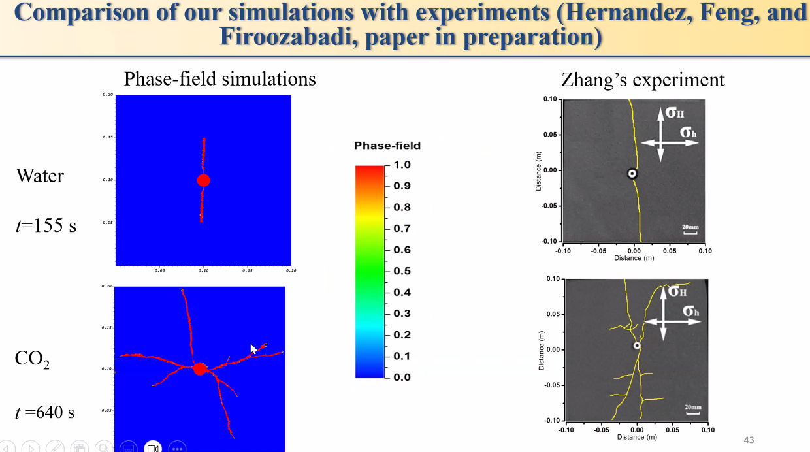

Slide 15
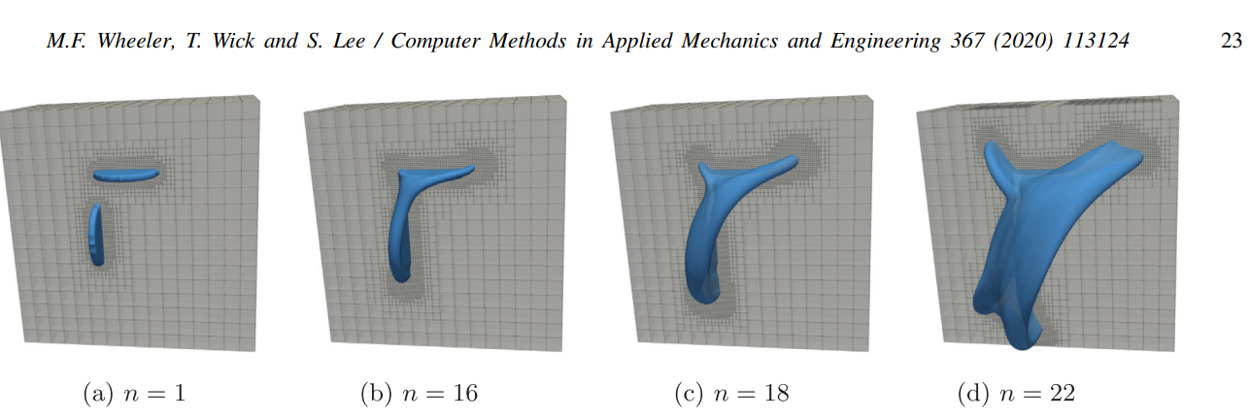
IPACS

Slide 16
SECOND PROBLEM STATEMENT
APR 2024
IDEAS
Renato poli (rep2656)

Slide 17
PROBLEM #2 - FLOW IN FRACTURES
Object of study
Conventional carbonate field, naturally fractured, mixed wet
Large models, field scale
Permeable matrix
Wells are acidized (not fractured)
Fractures provide additional permeability
The problem
Description of the natural fracture network ignores important physics
Mass transference parameters are mostly based on history matching
Multiphase flow is not adequately treated in the interface fracture-matrix
Models with detailed fractures are numerical impractical
Objective
Enhance the understanding of the field based on numerical simulation
Promote better communication between geoscientists and numerical simulation
Enable the description of a fracture network based on high level parameters (wettability, fracture network density, fracture genesis etc)
Assimilation of geological understanding to the numerical models
Methodology
Understand geological geometries and hydraulic characteristics of natural fractures
Understand the limitations of current models, especially multiphase and closed fractures
Implement a preprocessor to embed fractures optimally, keeping the model numerically reasonable

Slide 18
Research tracks
TRACK #1 – Flow in fractured media
TRACK #2 – Fracture propagation
TRACK #3 – Salt rock mechanics
TRACK #4 – Homogenization of mechanical parameters
TRACK #5 – Computational performance
TRACK #6 – Multiscale data assimilation

