Slide 1
Dec 2023
RESEARCH PLAN AND BRAINSTORMING
notes and remarks
Renato poli (rep2656)

Slide 2
MACRO TOPICS
Fractures
Salt geomechanics
Numerics and speedup
Multiphase flow and multiscale data assimilation

Slide 3
FRACTURES
Flow/heat
EDFM
CDFM – Conforming discrete fracture model
pEDFM – projection based embedded discrete fracture model
Mechanics
Elastic
Homogeneization – mech model for fractured media
Upscaling of biot, skempton, shear modulus etc
Plasticity
Thermal fracture nucleation near wellbore

Slide 4
SALT MECHANICS
Physiscs: creep, fracture, stress relaxation, long term conformation (geologic time)
Large strains model
Risk assessment
Analyze worst case scenarios, use of safety coefficients
Mechanic dynamic of salt targetting process optimization
Uncertainty analysis to support design decisions
Fractures, deviatoric strain relaxation
Specific applications – case study
Salt caverns
Salt as a caprock

Slide 5
NUMERICS AND SPEEDUP
GPU
Explicit formulation
SBFEM (Scaled Boundary)
Novel math formulation for solvers and assemblage

Slide 6
Multiphase flow and multiscale data assimilation
Multiphase pore scale simulation
Numerical simulation of intermediate scales
Models and parameters tying the different scales
Assimilation of laboratory data
Guidance of the laboratory practice

Slide 7
Dec 2023
PAPER REVIEW
notes and remarks
Renato poli (rep2656)

Slide 8
(Yanli Pei, 2022) Coupled Geomechanics and Multiphase Flow Modeling in Naturally and Hydraulically Fractured Reservoirs
Recent (2022)
Verbose notation
Comprehensive literature review: XFEM, EDFM, Discrete fractures, …
Do not address Biot coefficient in the large scale (??)
Stress reorientation in a depletion scenario.
  I think it is more interesting in a low temperature/high pressure
Mainly 2D?
No propagation of the fractures. Models flow when fractures are mapped a priori.

Slide 9
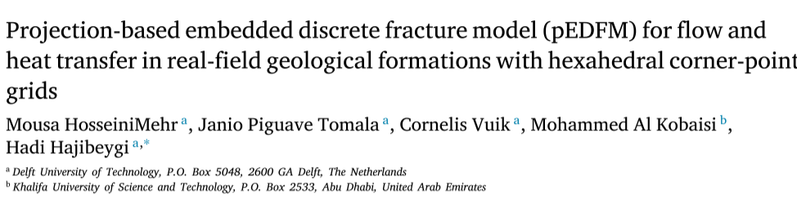

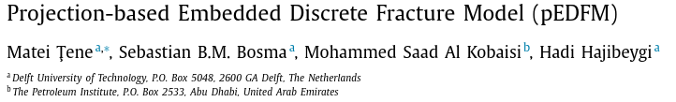
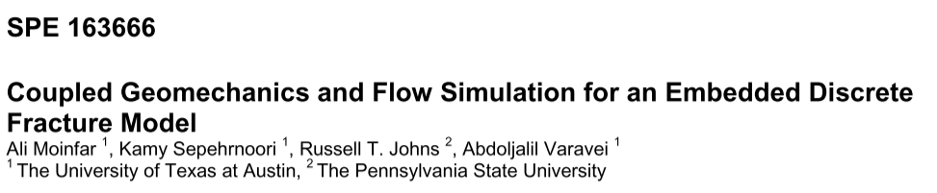
EDFM, CDFM, pEDFM ...
2022
2018
2017
2013

Slide 10

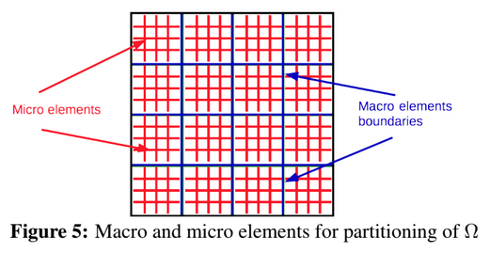
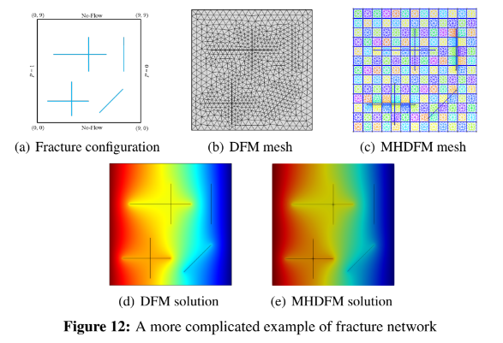
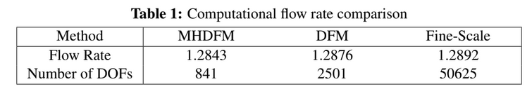
Multiscale FEM (MHM, hybrid mixed)
Embeds fractures “numerically”.
Reduces dramatically the dofs in the global matrix
Micro elements are processed in parallel
Very simple fracture configuration, 2D
2019

Slide 11
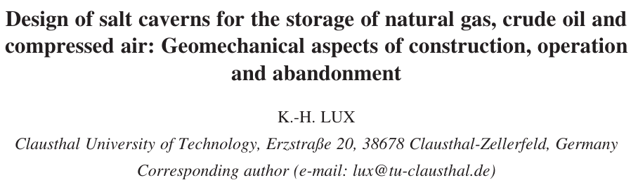
( Lux, 2009 )
PAPER REVIEW
Lux, K. H. (2009). Design of salt caverns for the storage of natural gas, crude oil and compressed air: Geomechanical aspects of construction, operation and abandonment. Geological Society, London, Special Publications, 313(1), 93-128.

Slide 12
Salt caverns (Lux, 2009) – Review Paper
Objectives of the modeling:
  Safety assessment (construction, operation, abandonment)
  Cavern design technical and economic aspects
Caverns
  Excavation ; operation ; abandonment; maintenance-free long-term
Safety
  Mechanical stability
  Subsidence
  Tightness (fluid containment, impermeability maintenance)
  Long term abandonment – maintenance free
  Fault reactivation

Slide 13
Salt caverns (Lux, 2009) – Review Paper
Monitoring
  Construction: material balance, geometry inspection (sonar)
  peration: Well head pressure, periodic geometry inspection (sonar), subsidence
Abandonment
  Leave the site in a safe, maintenance-free, longterm condition
  Leave it with brine, sand, cement the hole (or not necessary?)
  Consider public acceptance and economicity of the techniques used
  Long term infiltration: pressure buildup due to mechanical creep (HM coupled process), microfractures and creation of secondary permo-porosity (infiltration zone), seepage, stationary seepage
Design considerations
  Proof of safety (describe the load bearing behavior), proof of tightness (long term), economicity, nearby fault reactivation, admissible subsidence and maximum local strain
  Provide directions for lab experiments. Validate and calibrate models with the lab.
  Admissible range of injection rate, withdrawal rate, pressure, temperature
  Estimate how long the cavern will last: convergence
  Consider extreme disaster cases

Slide 14
Salt caverns (Lux, 2009) – Review Paper
Physical behavior of the salt
  Cavern convergence
  Creep
    Transient, Stationary and tertiary (accelerated)
    Tertiary: creep failure
    Temperature is an important parameter
  Healing
  Thermo-mechanics
  Infiltration
    Fractures close to the wall generate secondary permeability and porosity
    Long term response (centuries)
  Convergence
  Progressve micro to macro fractures
    Microfractures cause dilation and permeability (infiltration)
  Bedded salt: different constitutive laws for each bed (brittle or ductile)
  Upscaling: joint systems and their mechanical impacts on the continua
Modelling
  Brittle rock: no creep! Mohr coulomb, elasto-plastic models, Continuum Model (CM). Must consider joints on mechanical properties.
  Salt: Visco-plastic, Continuum Damage Model (CDM)
    Damage mechanics, laboratory testing
  Loads in a cavern: primary rock mass, internal pressure and temperature
  Analyze stress distribuition and evolution on the cavern wall responding to pressure, temperature, creep and fractures

Slide 15
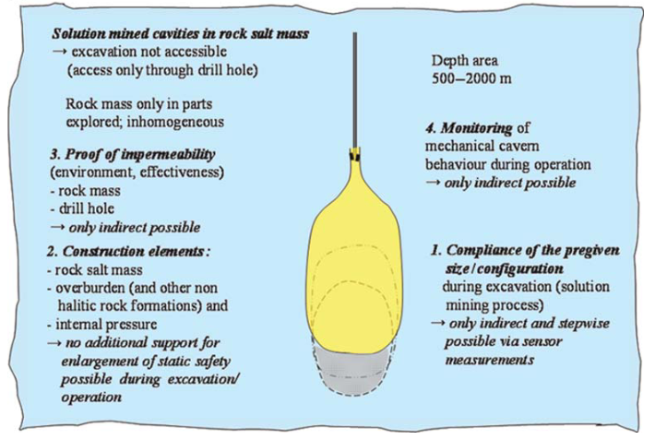
Salt caverns (Lux, 2009) – Review Paper

Slide 16
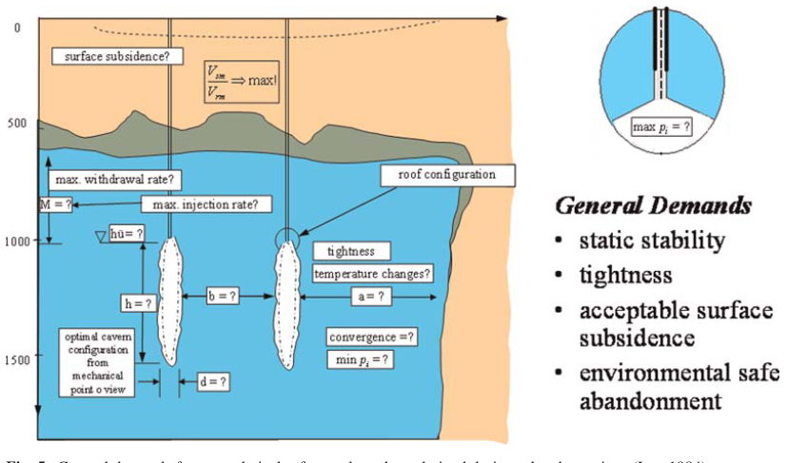
Salt caverns (Lux, 2009) – Review Paper

Slide 17
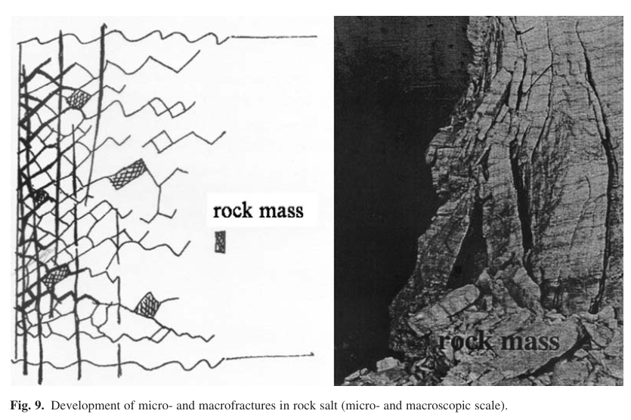
Salt caverns (Lux, 2009) – Review Paper

Slide 18
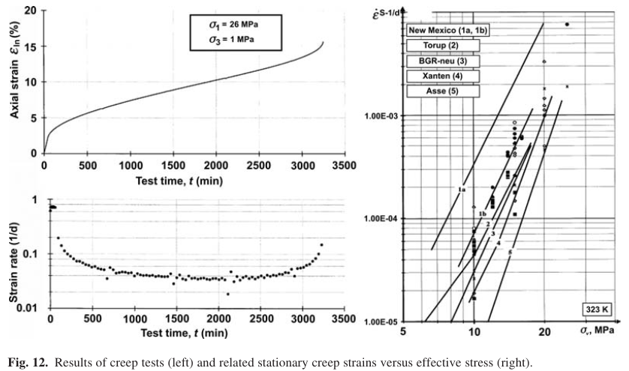
Salt caverns (Lux, 2009) – Review Paper

Slide 19
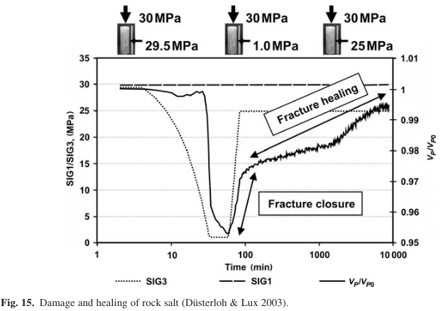
Salt caverns (Lux, 2009) – Review Paper

Slide 20
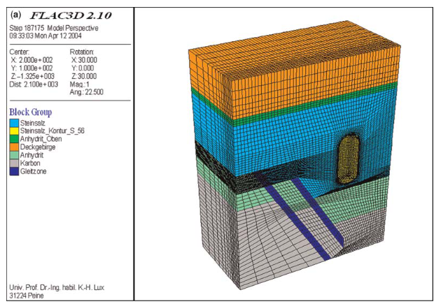
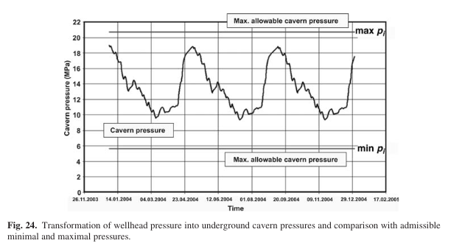
Salt caverns (Lux, 2009) – Review Paper

Slide 21
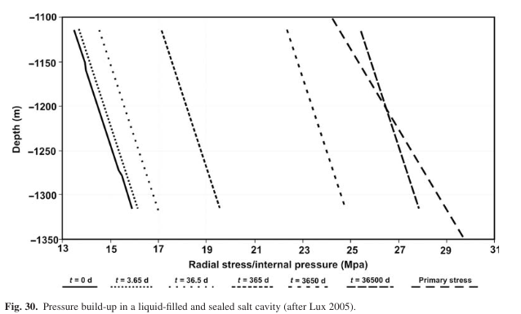
Salt caverns (Lux, 2009) – Review Paper
Pressure buildup due to creep

Slide 22
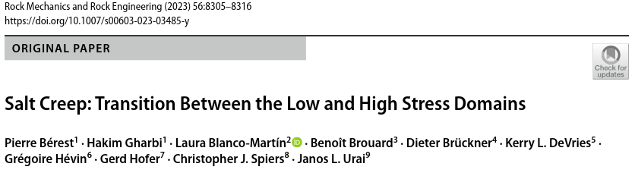
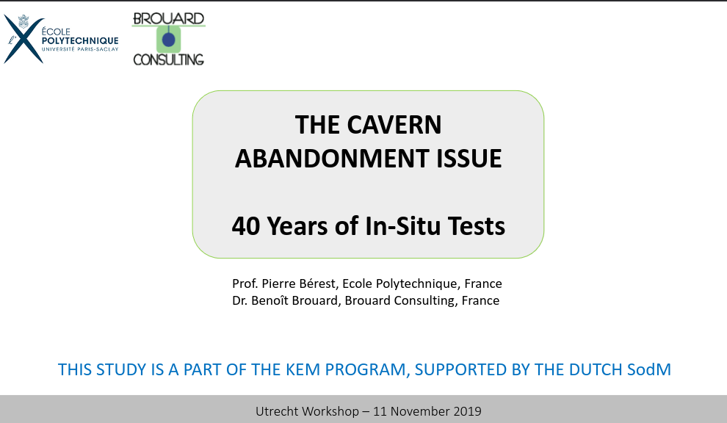
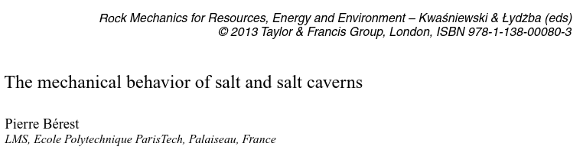
Pierre berest
RESEARCH REVIEW

Slide 23
BEREST, 2019
SALT IS VISCOPLASTIC RATHER THAN ELASTIC; WHEN CAVERN PRESSURE INCREASES SLOWLY, SLOW STRESS REDISTRIBUTION TAKES PLACE, AND PRESSURE CAN INCREASE TO A VALUE LARGER THAN GEOSTATIC BEFORE FRACKING. (WALLNER, 1986)
SALT FORMATION IS MICRO-PERMEABLE (6 x 10⁻²⁰m² ≈ 60 nd)
PRESSURE EVOLUTION IN AN SHUT-IN CAVERN RESULTS FROM:
  BRINE WARMING
  CAVERN CREEP CLOSURE
  BRINE MICRO-PERMEATION THROUGH THE CAVERN WALLS
CREEP CLOSURE RATE IS A DECREASING FUNCTION OF CAVERN PRESSURE
MICRO-PERMEATION RATE IS AN INCREASING FUNCTION OF CAVERN PRESSURE
AFTER BRINE WARMING HAS VANISHED (OFTEN A LONG PROCESS) AN EQUILIBRIUM PRESSURE IS REACHED SUCH THAT CREEP CLOSURE RATE EQUALS MICROPERMEATION RATE
IN SHALLOW CAVERNS (<1000 m): THIS EQUILIBRIUM PRESSURE IS SIGNIFICANTLY SMALLER THAN GEOSTATIC; A SAFE ABANDONMENT CAN BE CONSIDERED.
IN DEEP CAVERNS (>1000 m), THE EQUILIBRIUM PRESSURE IS CLOSER TO GEOSTATIC, RAISING A MORE DIFFICULT PROBLEM

Slide 24
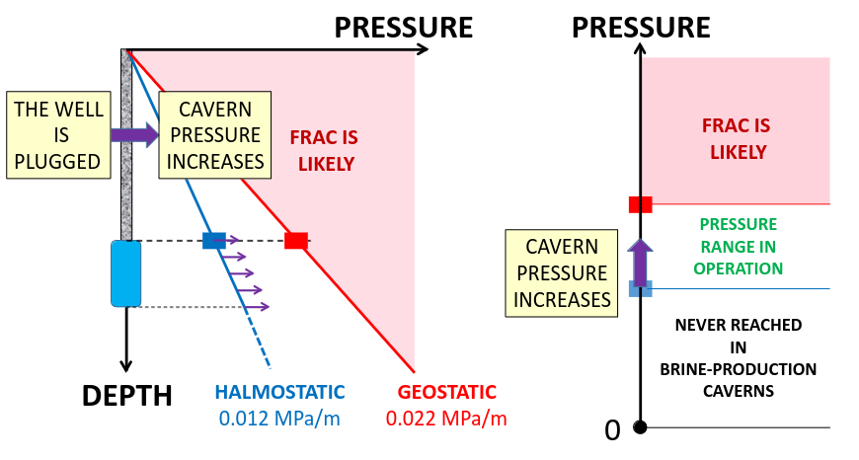
BEREST, 2019

Slide 25
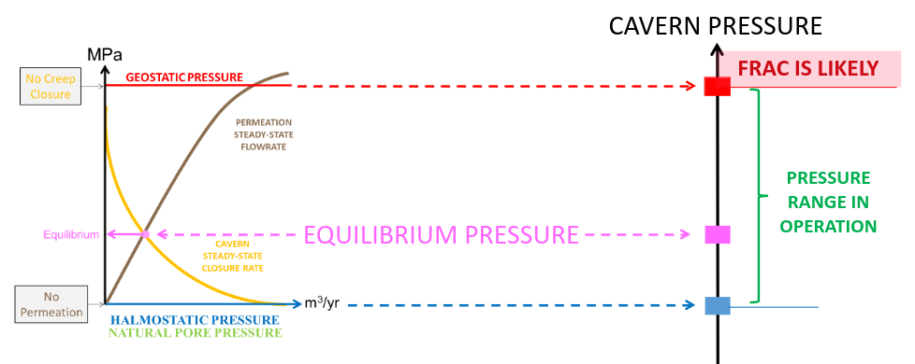
BEREST, 2019

Slide 26
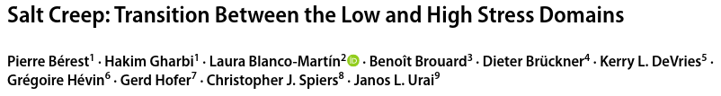
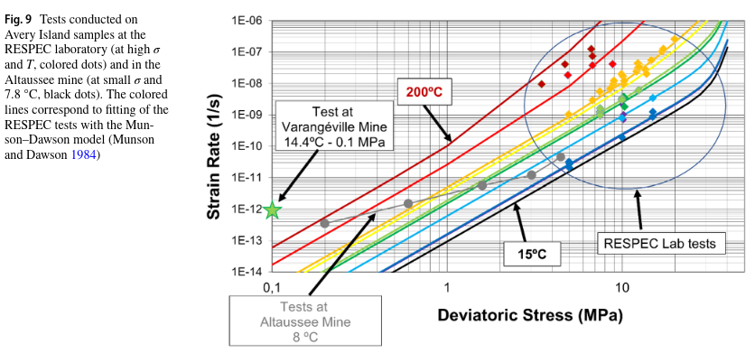
BEREST, 2023

Slide 27
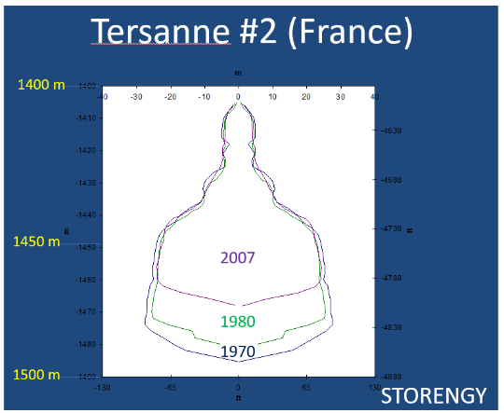
BEREST, 2013
Cavern looses volume along the years
The bottom rises:
  Failure of the overhanging banks?
  Breakouts?
  Blocks fall?
  Salt creep?

Slide 28

conference
The mechanical behavior of salt
PROGRAM:
https://www.saltmech.com/program-smx/#!/program

Slide 29

CONFERENCE – SALTMECH X (every 4 years)
Papers:
https://www.taylorfrancis.com/books/oa-edit/10.1201/9781003295808/mechanical-behavior-salt-hangx-niemeijer-de-bresser-spiers-drury-gazzani-fokker

Slide 30
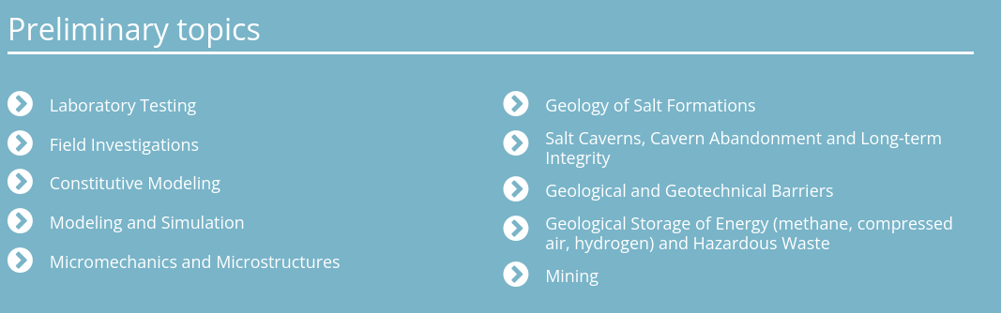
CONFERENCE – SALTMECH X (every 4 years)

Slide 31
Dec 2023
RESEARCH LINEUP
Renato poli (rep2656)

Slide 32
Research guidelines
Research on Salt Geomechanics.
Physical phenomena
Numerical methods
Uncertainty analysis
Applications:
  Salt caverns for storage
  Geohazards
  Caprock of presalt fields
  Abandonment of presalt wells
Tasks:
1 – Temperature
2 – Brittle rock models
3 – Plasticity
4 – Creep and healing
5 – Infiltration (propagation)
6 – Fundamental Applications
7 – Uncertainty analysis
For each of them
  Design
  validate analytically
  calibrate with lab
  uncertainty assessment

Slide 33
Dec 2023
FURTHER CONSIDERATIONS
Renato poli (rep2656)

Slide 34
My considerations ….
Fracture examples are rather simple in most papers. Usually 2D. Mostly SINGLE fracture. What about distributed? Like warren and root assumptions.
It is a scale issue: no mesh can conform to fractures and continua in the field scale,with realistic fractures.
  Fractures are 1e-3 in width vs. fieldscale cells are 1e2 /// 5 order of magnitude ////
  Fractures are 1e0 in length vs 1e2 fieldscale /// still 2 orders of magnitude
  Fracture tip phenomena are in 1e-1 scale. Scaled boundaries may be useful here.
Width dimension must be analytically reduced in all cases. Mechanically, it is a boundary condition for the continua or a stiffness relief
What about the length? We cannot cope with 100x more discretization; conforming mesh will work for large faults. We can embed… analytically? Numerically?
Can we tweak the FEM shape functions? If we can deform the eta-xi space, we can represent fractures with higher order shape functions (??) Apply the theory of non lnear fem to deform the pressure mesh configuration. This way we can “approximate” hydraulically edges of a mesh. This would require a preprocessing step, numerical (?).

Slide 35
My considerations ….
What about storage of the fracture and continua? I see papers dealing with permeability. How does EDFM manages storage?
I can see that there is a transition from fracture storage to matrix storage, as a response to pressure gradient transitions. Convolution may apply here, as long as we can determine effective porosity transfer function φij ^{u} as the step function response for each cell.
Such response can be derived from the cell fracture configuration.
Note that this will drive us into a effective saturation understanding – ex:
Saturation is normally solved explicetly (IMPES), hence some processes may be highly parallelizable and wont impact solver time… maybe this is too similar to the 2phi2k approach … simply reinventing the wheeeeel
I believe this kind of approach is known as shape or transfer functions in the literature (need to review...)

Slide 36
My considerations ….
If working with fractures, we need to overcome restrictions in most of papers
1) Need to deal with real fracture distribuition (lots and lots of fractures)
2) Need to deal with path tracking of multiple tips (if dealing with mechanics of the propagation)
3) Discrete fracture models wont handle. Likely need to get transfer functions from numerical experiments………… as analytical or geometrical approaches won’t be able to handle complex geometries. (any paper does that?)

