Slide 1
HPC for reservoir simulation
Renato Poli
Oct 1st, 2023

Slide 2
Preliminary information

Slide 3
Nelson Inoue Sept 2023
People from PUC-RIO:
Prof. Sérgio Fontoura
Dr. Nelson Inoue
C++ or Fortran?
C++ is more supported.
But need to rewrite a lot from scratch
Not big deal to program CUDA
Old software have trouble to migrate to GPU (ex: Abaqus)

Slide 4
Nelson Inoue Sept 2023
Successful software in GPUs are written from scratch
Bottleneck: memory management
Axes of study:
FEM/FD
CUDA
Programming

Slide 5
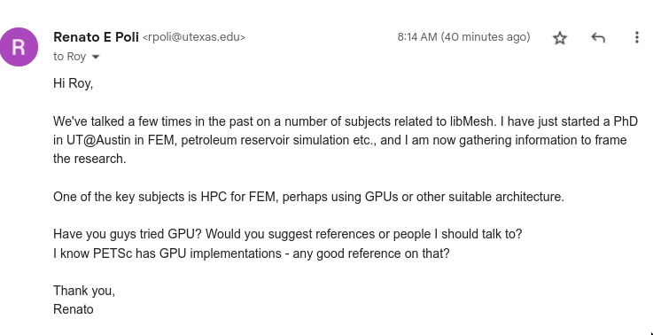
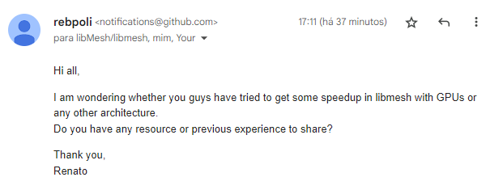
libmesh

Slide 6
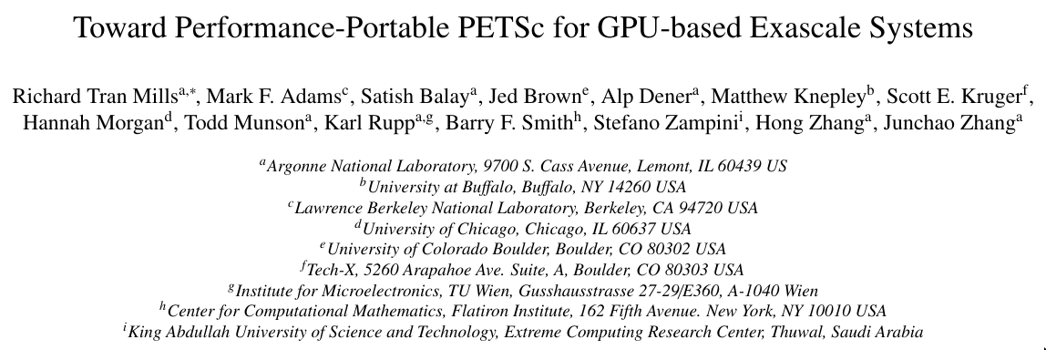
Petsc with GPU? Peper from 2021
Shall we talk to these guys?
https://escholarship.org/content/qt9wg9p5kj/qt9wg9p5kj_noSplash_fd4961edbceb753ac93f63e148bce988.pdf

Slide 7
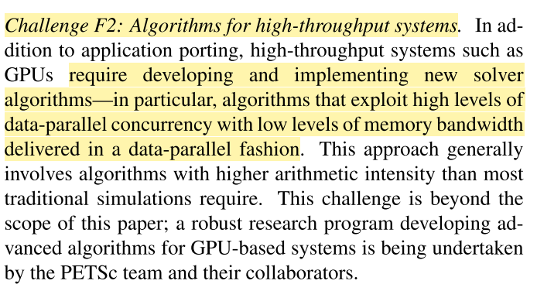
Petsc with GPU? Peper from 2021
Rethink outer-level algorithms
Increase arithmetic intensity
Quasi-newton methods
Sequence of matrix-vector products
Architecture-aware algorithms

Slide 8

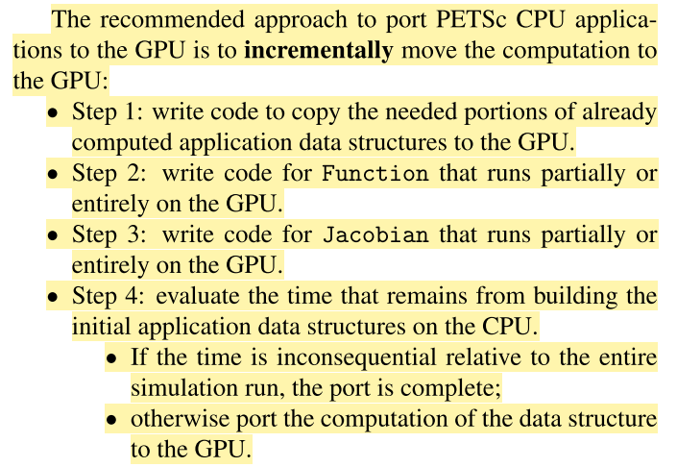
Petsc with GPU? Peper from 2021
Recommended approach

Slide 9
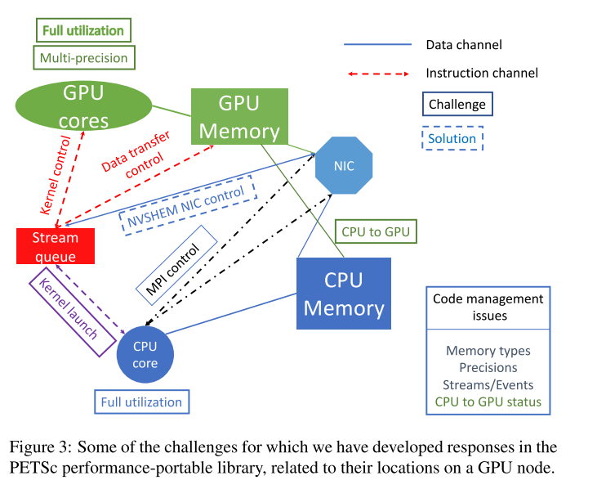
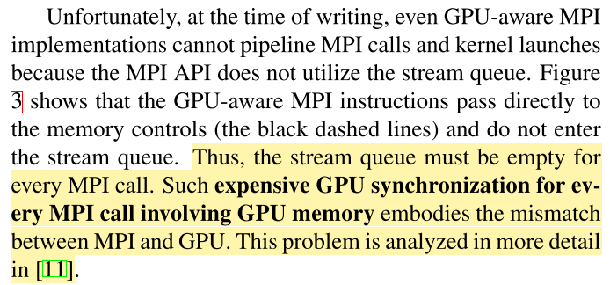
Petsc with GPU? Peper from 2021
MPI + GPU
GPU aware MPI
Combination of CPU and GPU computations
Complex control flows and data flows

Slide 10
Petsc with GPU? Peper from 2021
Kokkos
OpenCL
Uneven implementation quality
Performance has not met the standard needed for many application codes (Pennycook, 2013)
OpenMP
imposes difficulties for libraries

Slide 11
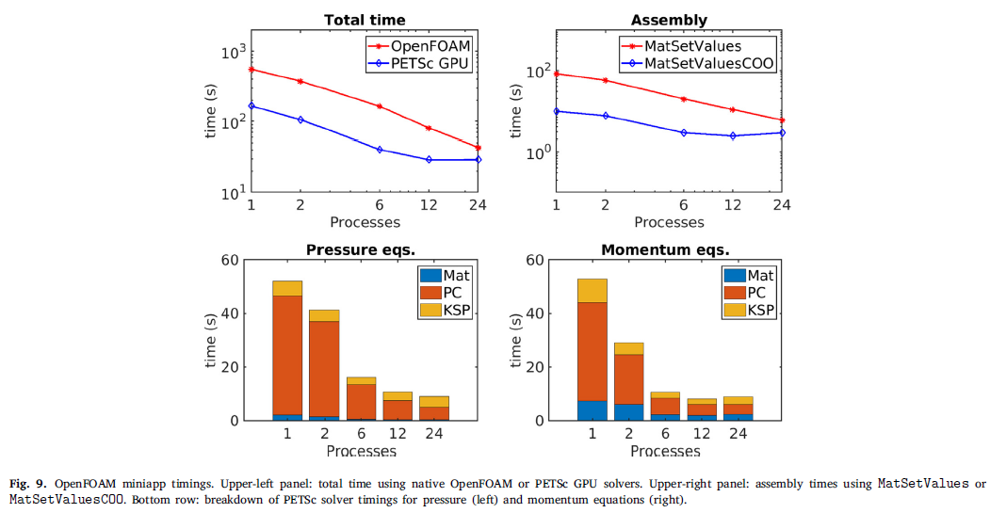
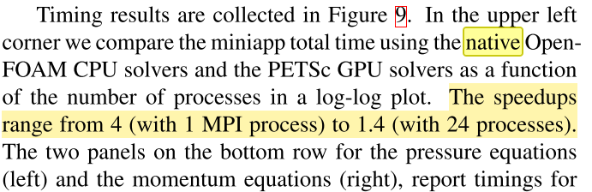
Petsc with GPU? Peper from 2021
8 million cell problem, 24 timesteps, computational intensive
?
Preconditioners scale well in CPU with number of processes

Slide 12

Petsc with GPU? Peper from 2021
Shall we talk to these guys?
Flexibility, works in any GPUs
Backend in CUDA, Kokkos, HIP
What are the strategies behind Echelon and tNavigator?

Slide 13
Work from the group in HPC

Slide 14
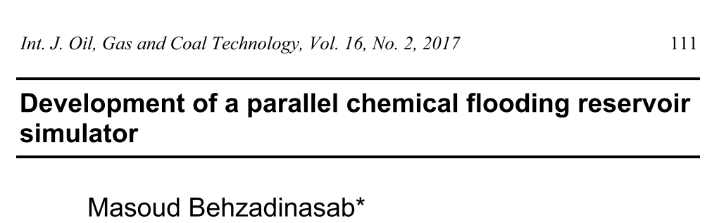
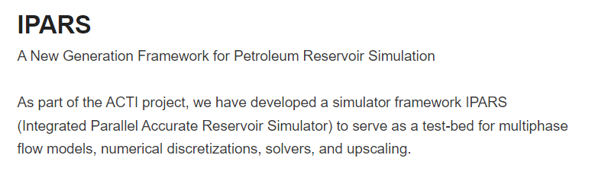
MPI
Domain decomposition methodology
IPARS

Slide 15
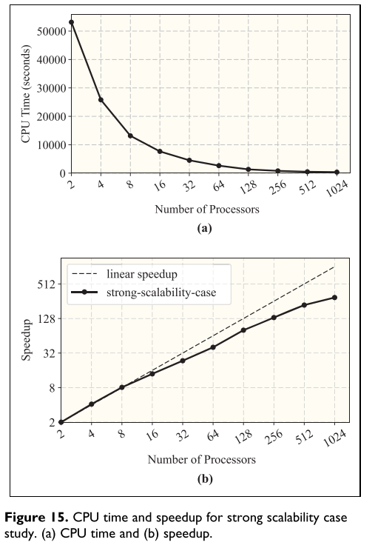
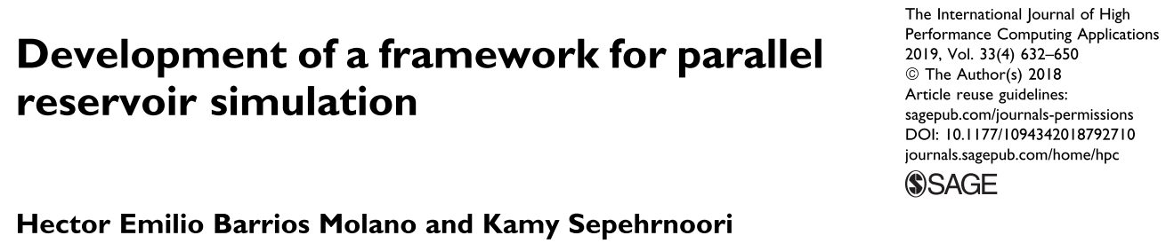
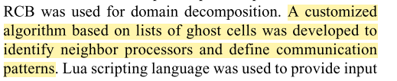

Slide 16
OPM flow
Equinor
Black oil
Open source
https://opm-project.org/wp-content/uploads/2023/06/OPM_Flow_Reference_Manual_2023-04_Rev-0_Reduced.pdf

Slide 17
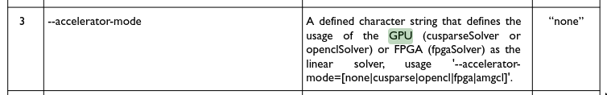
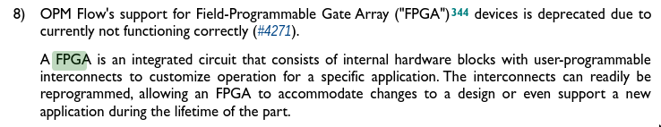
OPM GPU? FPGA?

Slide 18
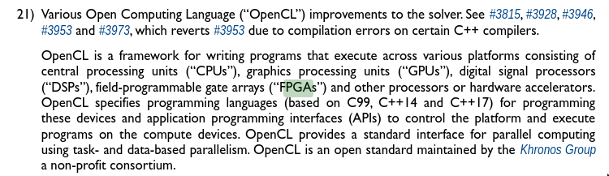
OPM GPU? FPGA?

Slide 19
Let's learn some keywords ...

Slide 20
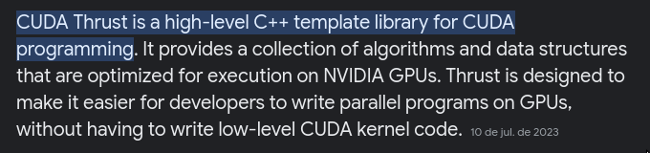

Some keywords to look at
CUDA Thrust
https://github.com/NVIDIA/thrust
OpenCL
Kokkos
Application specific architecture
FPGA?
Quantum computing?

Slide 21
Some keywords to look at
Exascale computing is a type of ultra-powerful supercomputing, with systems performing billions of computations per second utilizing an infrastructure of CPUs and GPUs to process and analyze data.

Slide 22
OpenCL https://www.run.ai/guides/nvidia-cuda-basics-and-best-practices/cuda-vs-opencl
OpenCL programs are designed to be compiled at run time, so applications that use OpenCL can be ported between different host devices.
OpenCL is not just for GPUs (like CUDA) but also for CPUs, FPGAs… In addition, OpenCL was developed by multiple companies, as opposed to NVIDIA’s CUDA.

Slide 23
Next steps -- draft

Slide 24
How to make things practical
Setup benchmarks and key testcases
Detach a module of a large (but not so large) size
Rewrite the module from scratch
Use as a testbench for the HPC technologies

Slide 25
What would be a reasonable timeline?
Infrastructure setup
HW specific numerics
2023
2024/1
2024/2
2025/1
2025/2
Benchmarks
Module #1
Profile performance and latencies
Choose target problem
Design testbenches and golden results
IT
Coding
Mathwork

