Slide 1
Dec 2023
COMPUTATIONAL PERFORMANCE
TRACK #5
Renato poli (rep2656)

Slide 2
TRACK #5 – COMPUTATIONAL PERFORMANCE
Challenges
The available computational power is not used in full
Simulators are designed for general purpose CPU
Designing and redesigning simulators is impractical: need a solution to be more portable, taking advantage of new architectures
The main challenge is compiling the simulator to take advantage of the target architecture potential
Approach #1
Design a simple black oil simulator in CPU
Map the code to GPU
Design a single code that can be compiled in both with no performance loss.
Approach #2
The ability to parallelize higher resolution scales is tempting
If the time scales are significantly different, it makes sense to use one scale as BC of the next
Approach #3
Create building blocks for simulators, independent of architecture
Implement the building blocks in different architectures
The user can write his simulator using the building blocks
Automated test structure enables benchmarking, reliability and accuracy of every implementation

Slide 3
LITERATURE
Implementing a Hardware Agnostic Commercial Black-Oil Reservoir Simulator.
SLB and TOTAL ENERGIES
Szyndel, Matthew, Lemon, Christopher, de Brito Dias, Daniel, Dodds, Eamon, Khramchenkov, Eduard, Rinco, Simone, Sheth, Soham, Tene, Matei, Han, Choongyong, Shi, Xundan, Wolfsteiner, Christian, Cao, Hui, Liao, Terrence, Sekachev, Michael, and Rustem Zaydullin.
Paper presented at the SPE Reservoir Simulation Conference, Galveston, Texas, USA, March 2023.
doi: https://doi.org/10.2118/212205-MS

Slide 5

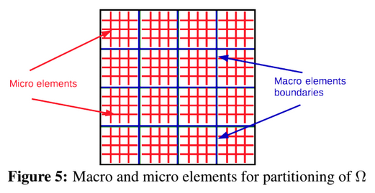
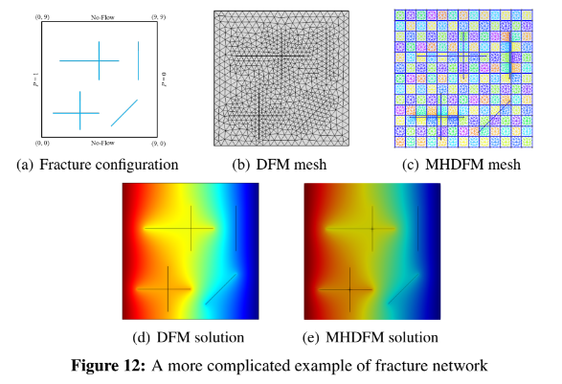
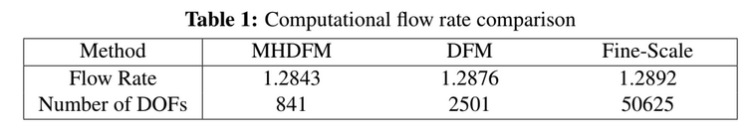
Multiscale FEM (MHM, hybrid mixed)
Embeds fractures “numerically”.
Reduces dramatically the dofs in the global matrix
Micro elements are processed in parallel
Very simple fracture configuration, 2D
2019

Slide 6
HPC for reservoir simulation
Renato Poli
Oct 1st, 2023

Slide 7
Preliminary information

Slide 8
Nelson Inoue Sept 2023
People from PUC-RIO:
Prof. Sérgio Fontoura
Dr. Nelson Inoue
C++ or Fortran?
C++ is more supported.
But need to rewrite a lot from scratch
Not big deal to program CUDA
Old software have trouble to migrate to GPU (ex: Abaqus)

Slide 9
Nelson Inoue Sept 2023
Successful software in GPUs are written from scratch
Bottleneck: memory management
Axes of study:
FEM/FD
CUDA
Programming

Slide 10
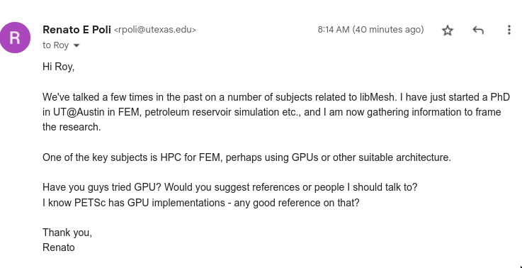
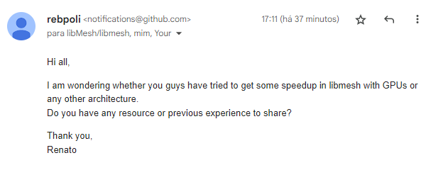
libmesh

Slide 11
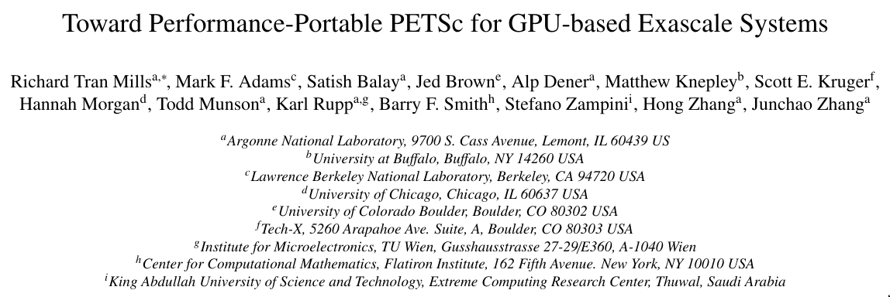
Petsc with GPU? Peper from 2021
Shall we talk to these guys?
https://escholarship.org/content/qt9wg9p5kj/qt9wg9p5kj_noSplash_fd4961edbceb753ac93f63e148bce988.pdf

Slide 12
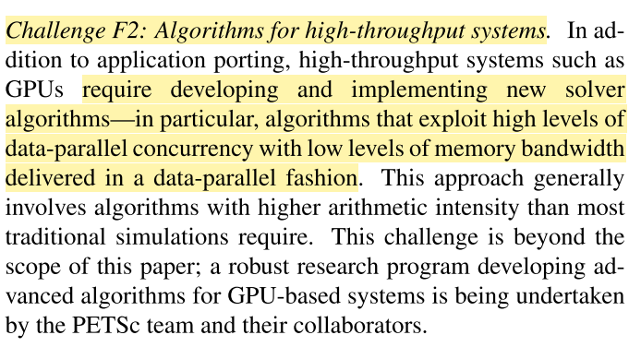
Petsc with GPU? Peper from 2021
Rethink outer-level algorithms
Increase arithmetic intensity
Quasi-newton methods
Sequence of matrix-vector products
Architecture-aware algorithms

Slide 13

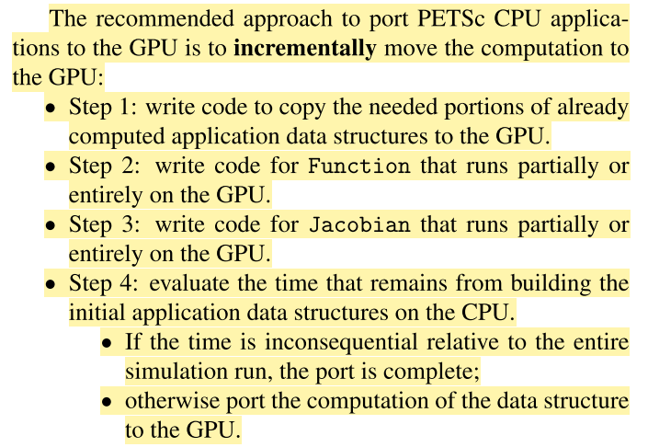
Petsc with GPU? Peper from 2021
Recommended approach

Slide 14
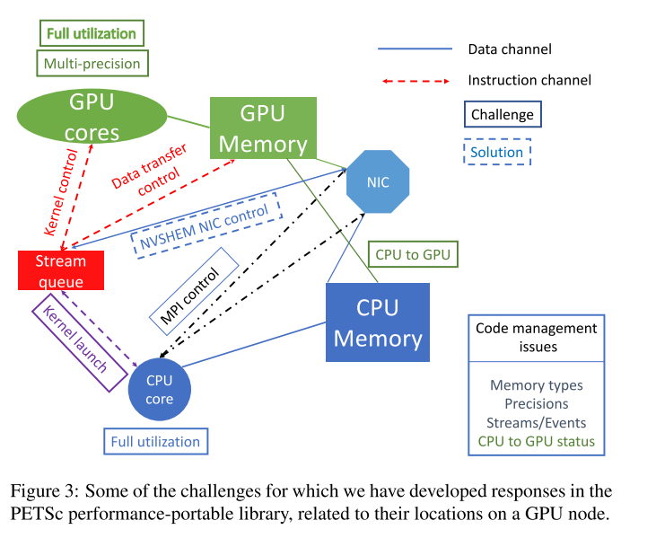
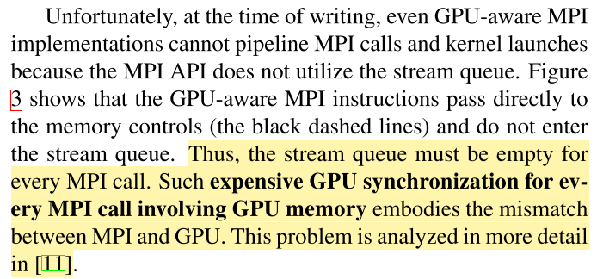
Petsc with GPU? Peper from 2021
MPI + GPU
GPU aware MPI
Combination of CPU and GPU computations
Complex control flows and data flows

Slide 15
Petsc with GPU? Peper from 2021
Kokkos
OpenCL
Uneven implementation quality
Performance has not met the standard needed for many application codes (Pennycook, 2013)
OpenMP
imposes difficulties for libraries

Slide 16
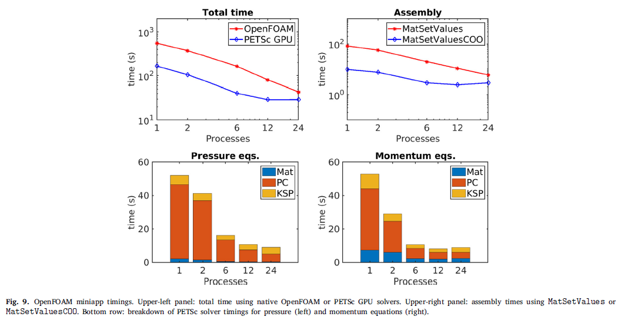
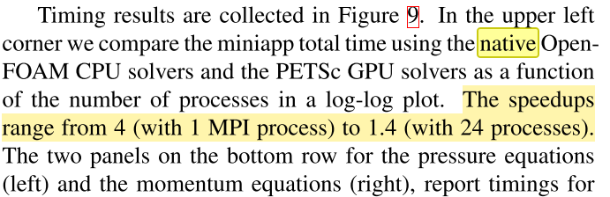
Petsc with GPU? Peper from 2021
8 million cell problem, 24 timesteps, computational intensive
?
Preconditioners scale well in CPU with number of processes

Slide 17

Petsc with GPU? Peper from 2021
Shall we talk to these guys?
Flexibility, works in any GPUs
Backend in CUDA, Kokkos, HIP
What are the strategies behind Echelon and tNavigator?

Slide 18
Work from the group in HPC

Slide 19
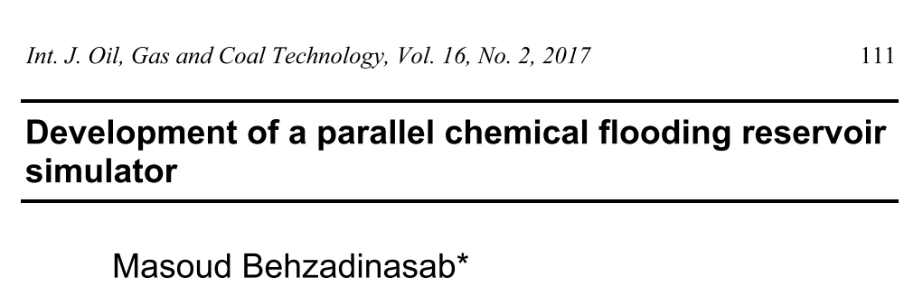
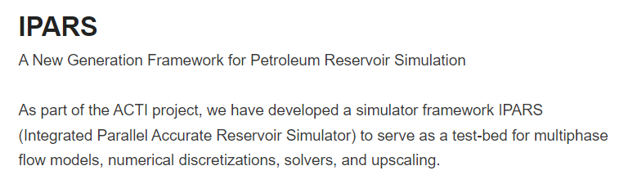
MPI
Domain decomposition methodology
IPARS

Slide 20
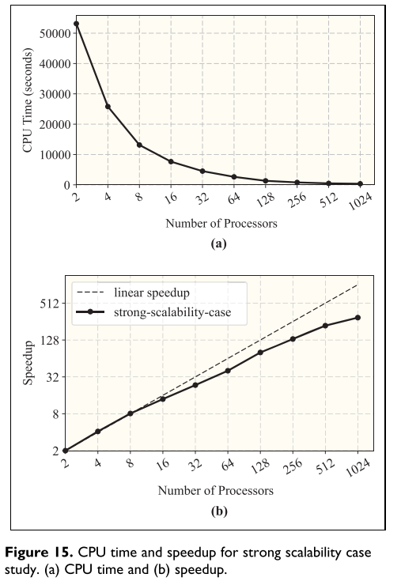
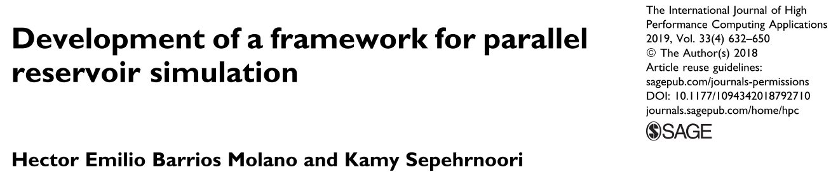
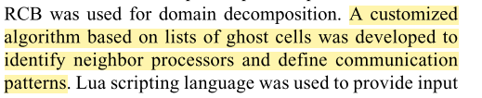

Slide 21
OPM flow
Equinor
Black oil
Open source
https://opm-project.org/wp-content/uploads/2023/06/OPM_Flow_Reference_Manual_2023-04_Rev-0_Reduced.pdf

Slide 22
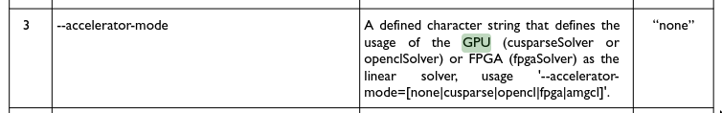
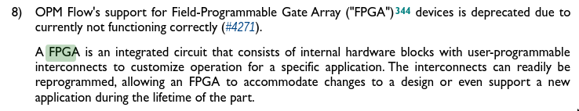
OPM GPU? FPGA?

Slide 23
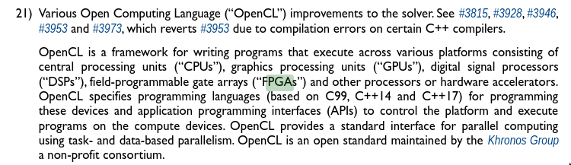
OPM GPU? FPGA?

Slide 24
Let's learn some keywords ...

Slide 25
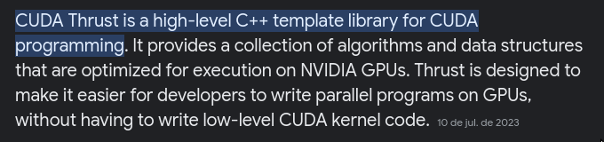

Some keywords to look at
CUDA Thrust
https://github.com/NVIDIA/thrust
OpenCL
Kokkos
Application specific architecture
FPGA?
Quantum computing?

Slide 26
Some keywords to look at
Exascale computing is a type of ultra-powerful supercomputing, with systems performing billions of computations per second utilizing an infrastructure of CPUs and GPUs to process and analyze data.

Slide 27
OpenCL https://www.run.ai/guides/nvidia-cuda-basics-and-best-practices/cuda-vs-opencl
OpenCL programs are designed to be compiled at run time, so applications that use OpenCL can be ported between different host devices.
OpenCL is not just for GPUs (like CUDA) but also for CPUs, FPGAs… In addition, OpenCL was developed by multiple companies, as opposed to NVIDIA’s CUDA.

Slide 28
Next steps -- draft

Slide 29
How to make things practical
Setup benchmarks and key testcases
Detach a module of a large (but not so large) size
Rewrite the module from scratch
Use as a testbench for the HPC technologies

Slide 30
What would be a reasonable timeline?
Infrastructure setup
HW specific numerics
2023
2024/1
2024/2
2025/1
2025/2
Benchmarks
Module #1
Profile performance and latencies
Choose target problem
Design testbenches and golden results
IT
Coding
Mathwork

