Slide 1
Dec 2023
Homogenization of mechanical parameters
TRACK #4
Renato poli (rep2656)

Slide 2
TRACK #4 – HOMOGENIZATION OF MECHANICAL PARAMETERS
Current challenge:
Many mechanical models do not consider fracture mechanics
Propose a paper to offer homogenization guidelines to field-scale geomech models of fractured reservoirs

Slide 3
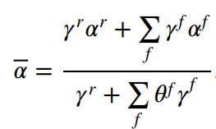
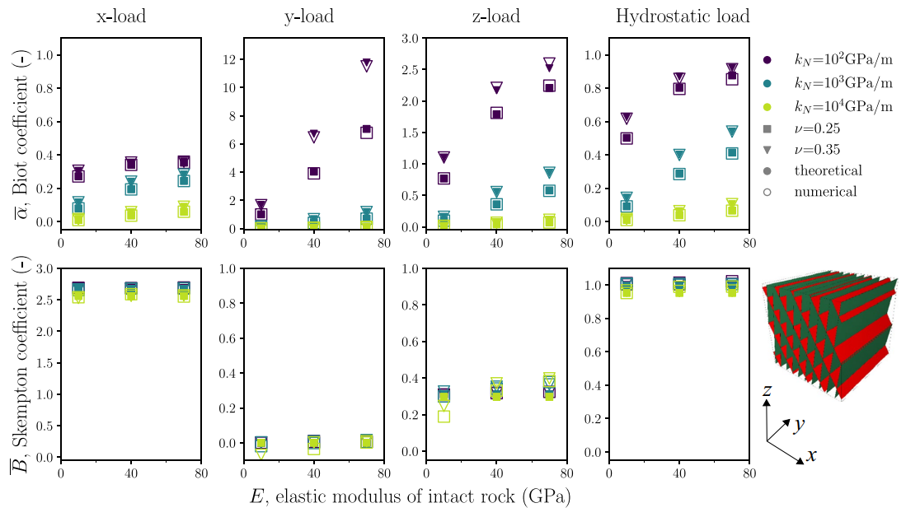
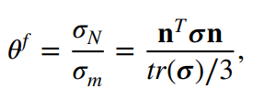

RESULTS - ANALYTICAL FROM SIMONE, 2023

Slide 4
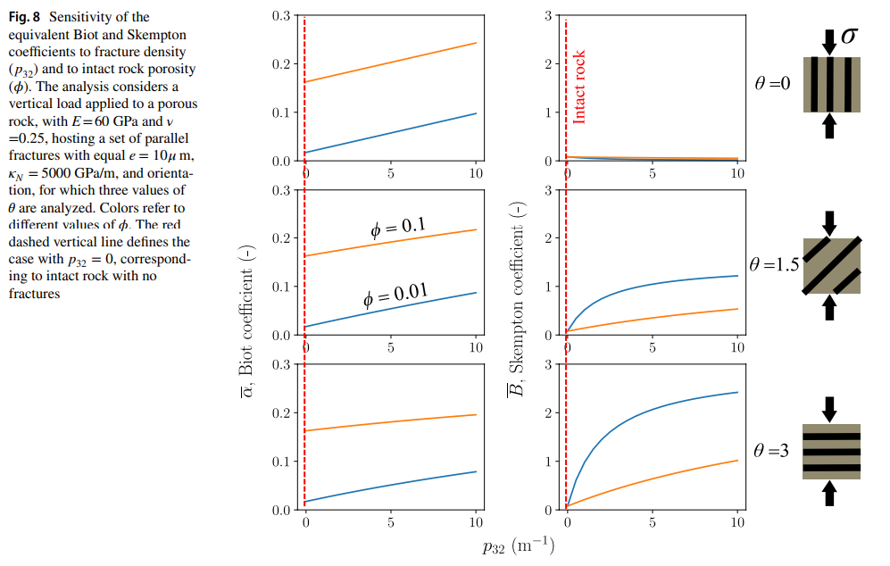
RESULTS - ANALYTICAL FROM SIMONE, 2023

Slide 5
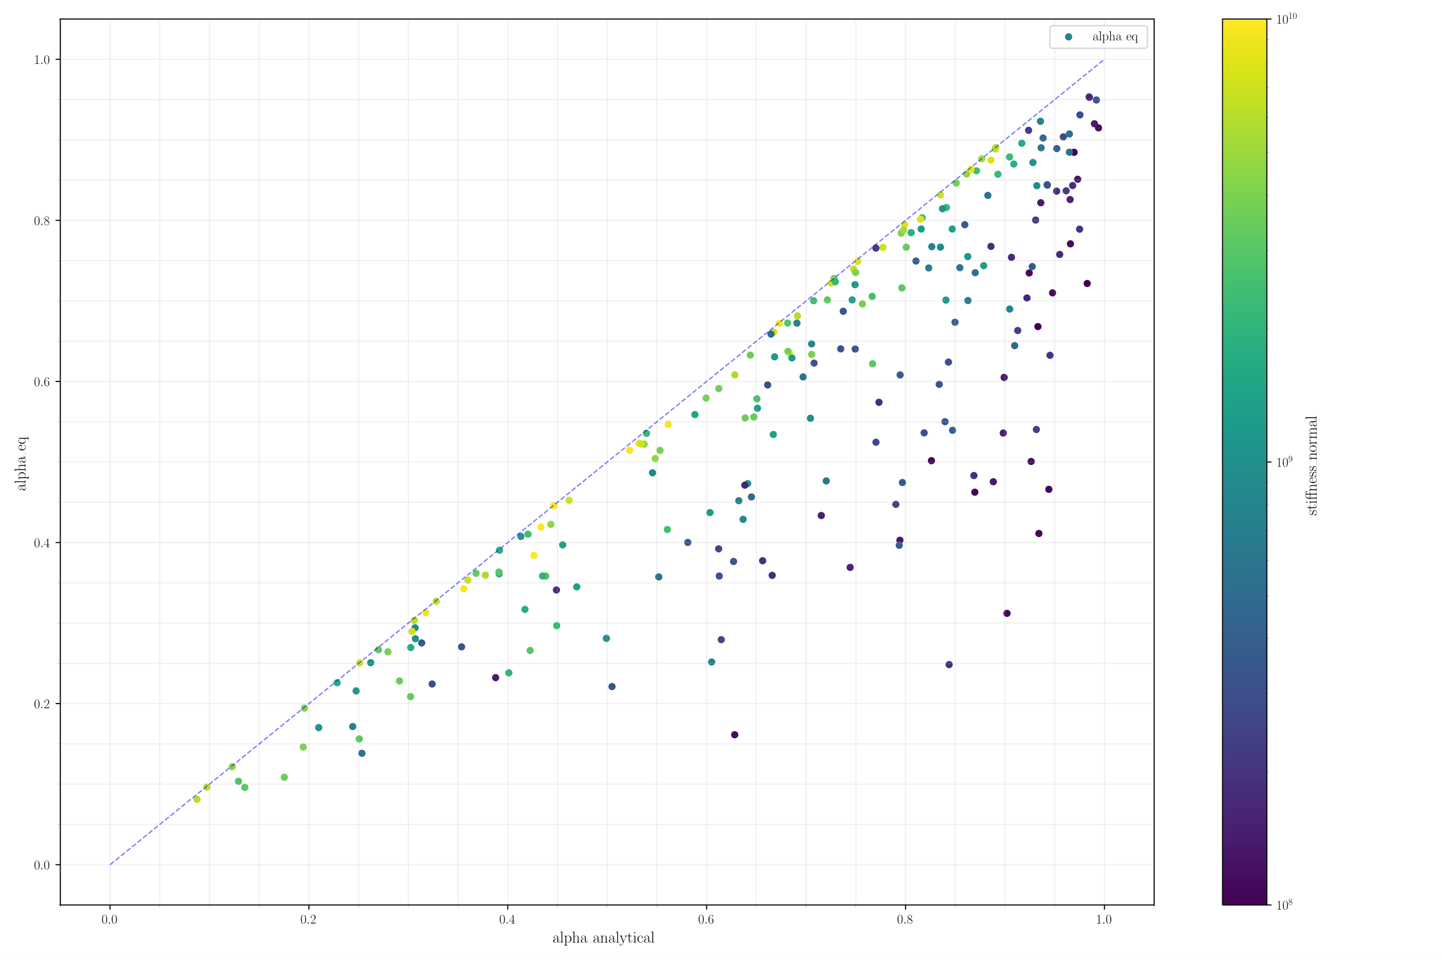
RESULTS - ANALYTICAL FROM SIMONE, 2023

Slide 6
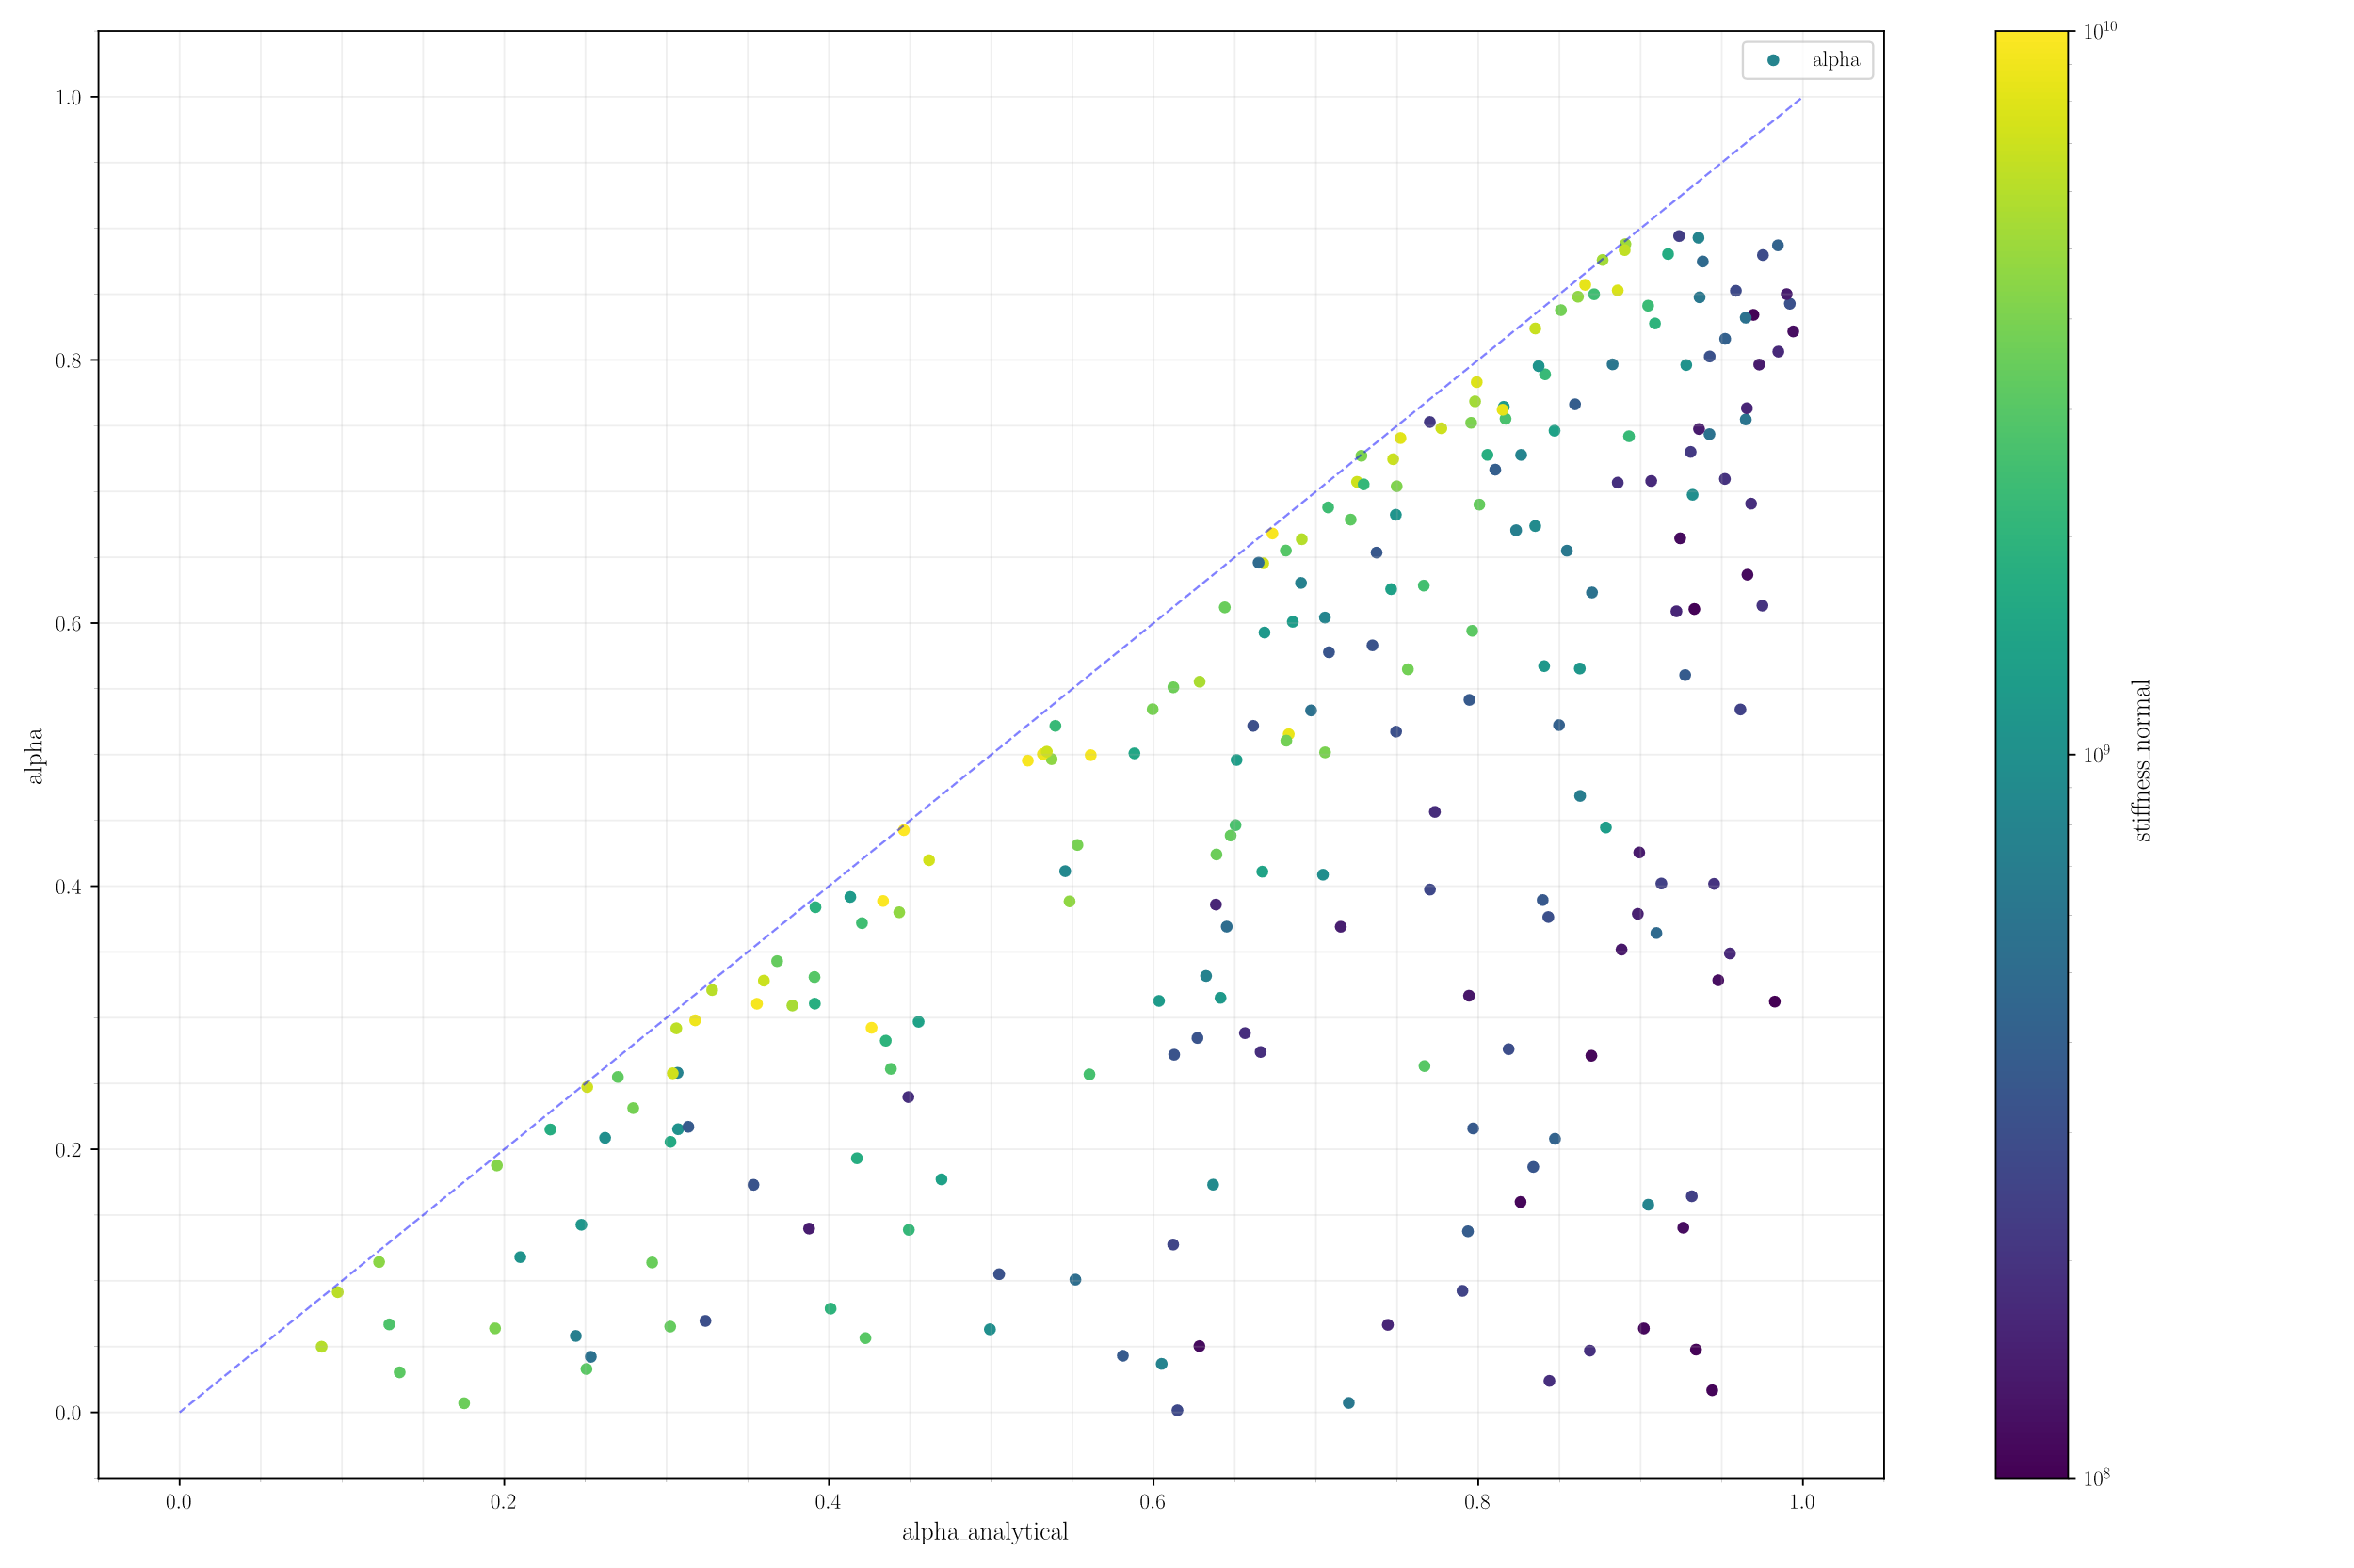
RESULTS - ANALYTICAL FROM SIMONE, 2023

Slide 7
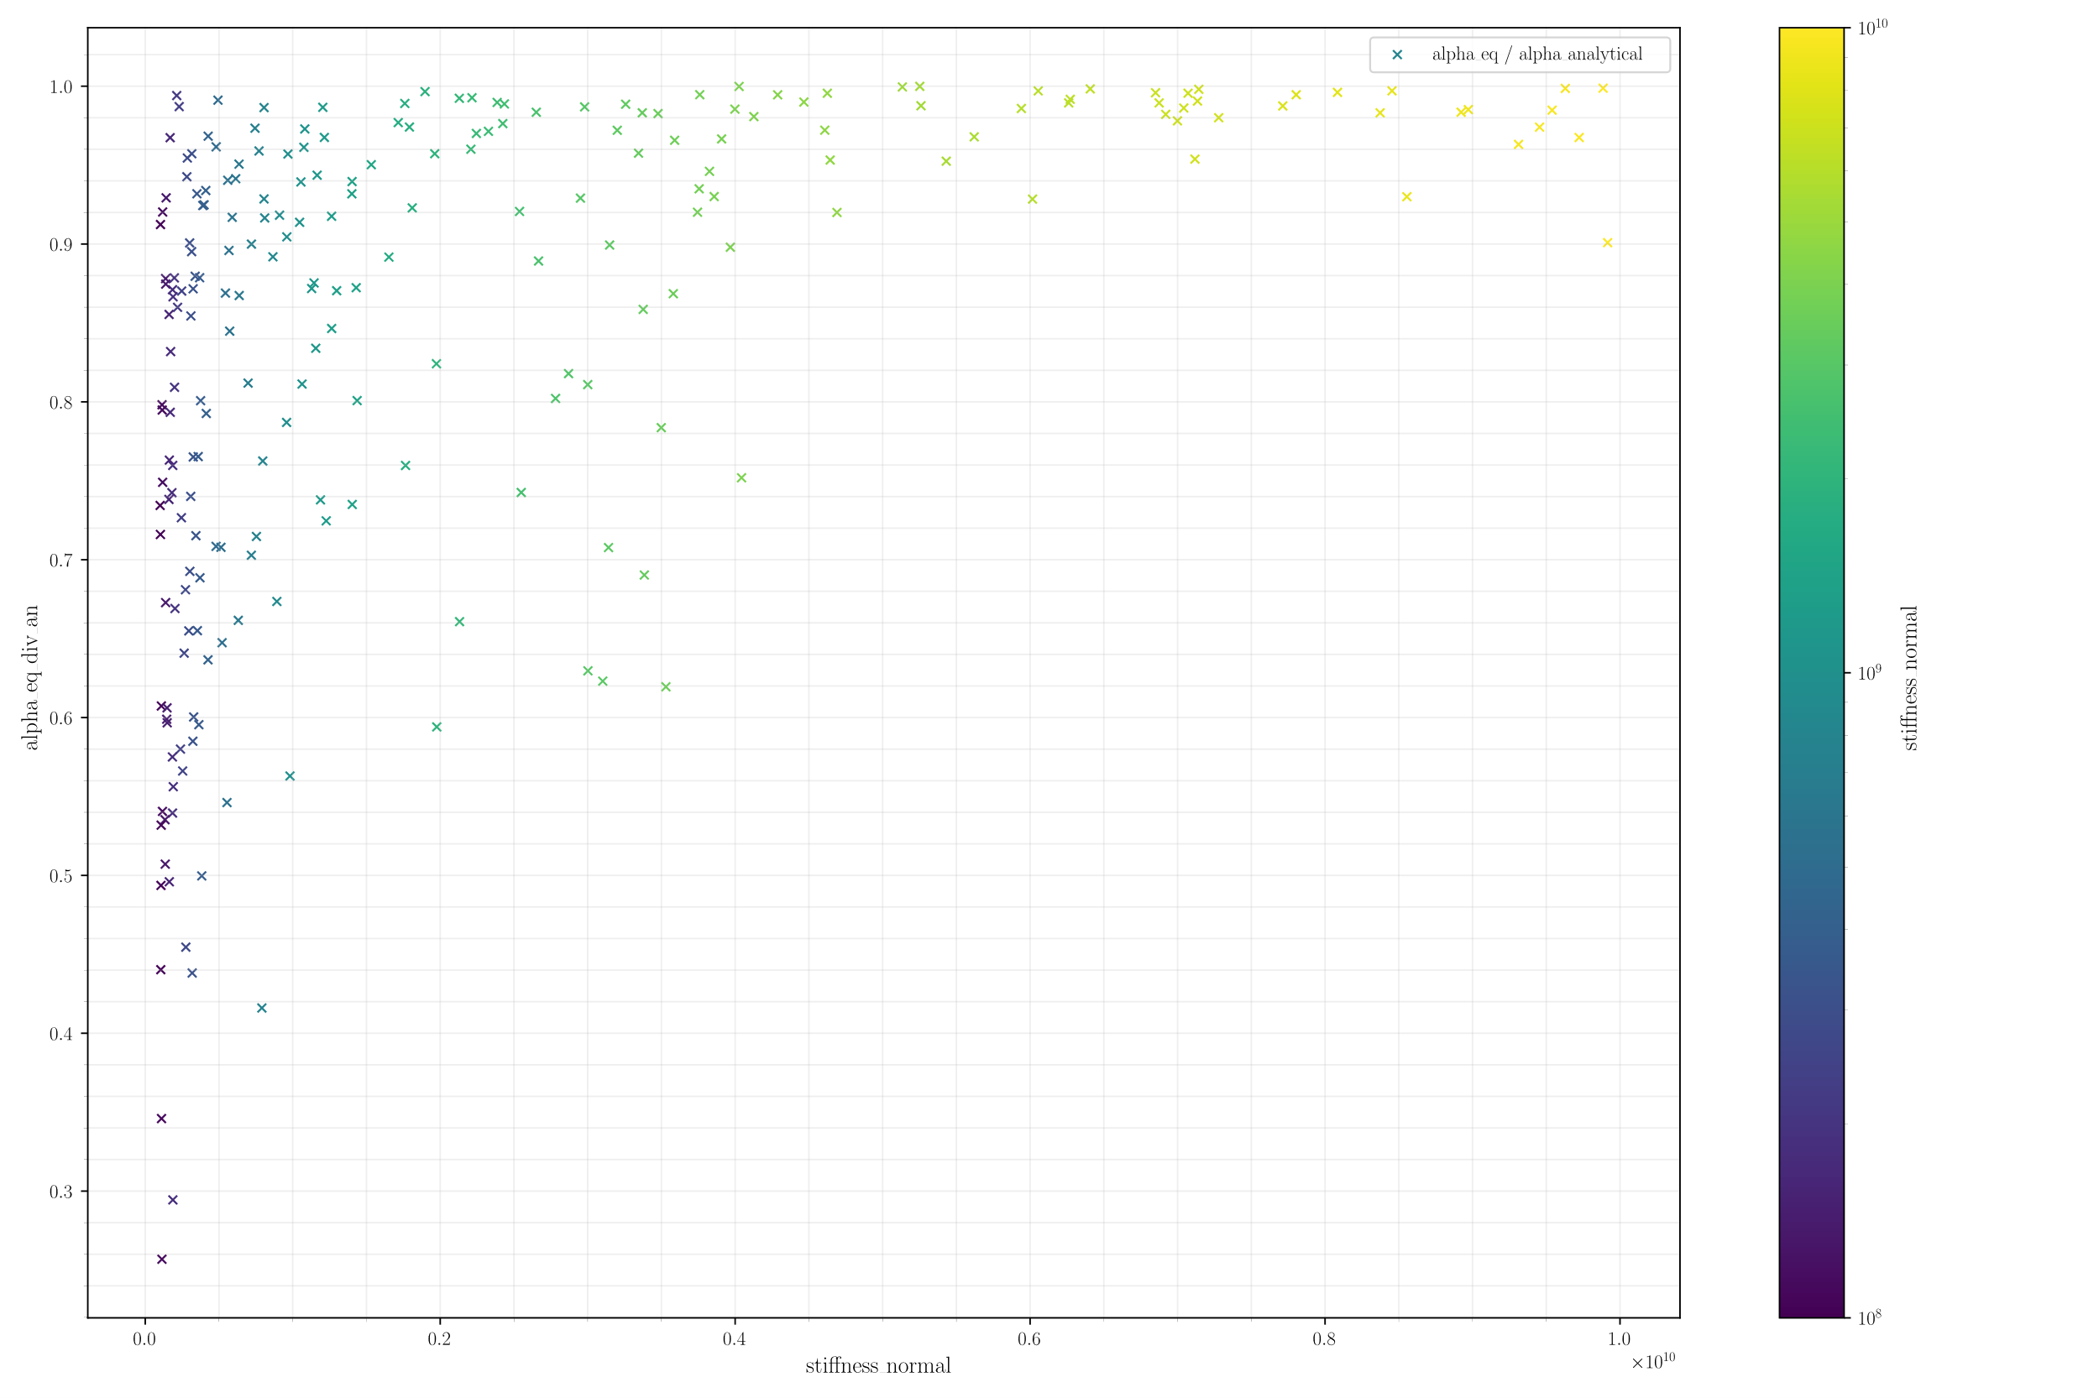
RESULTS - ANALYTICAL FROM SIMONE, 2023

Slide 8
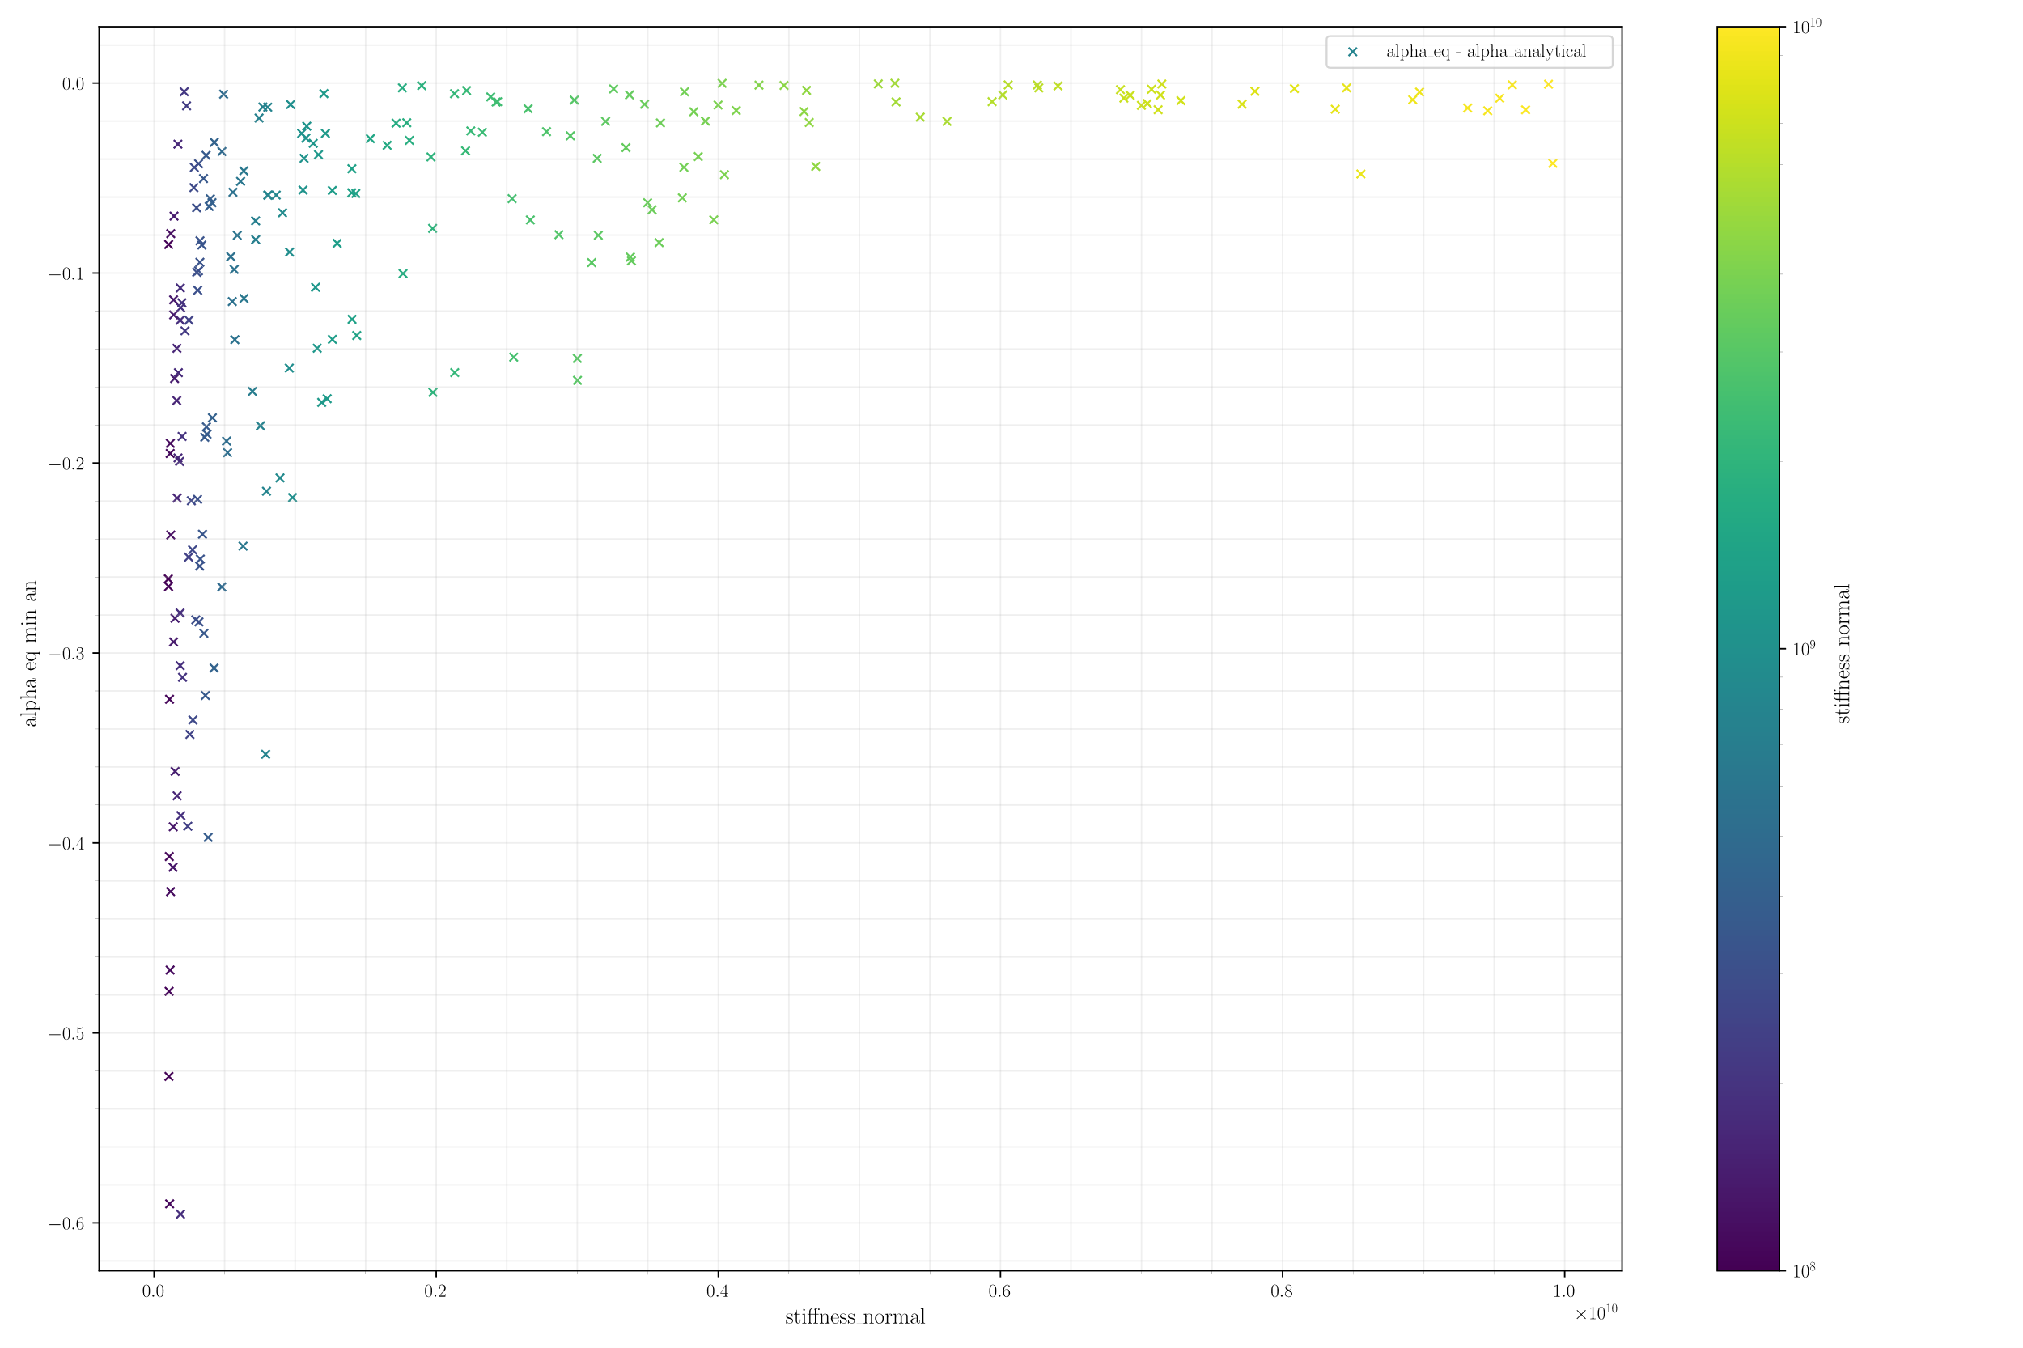
RESULTS - ANALYTICAL FROM SIMONE, 2023

Slide 9
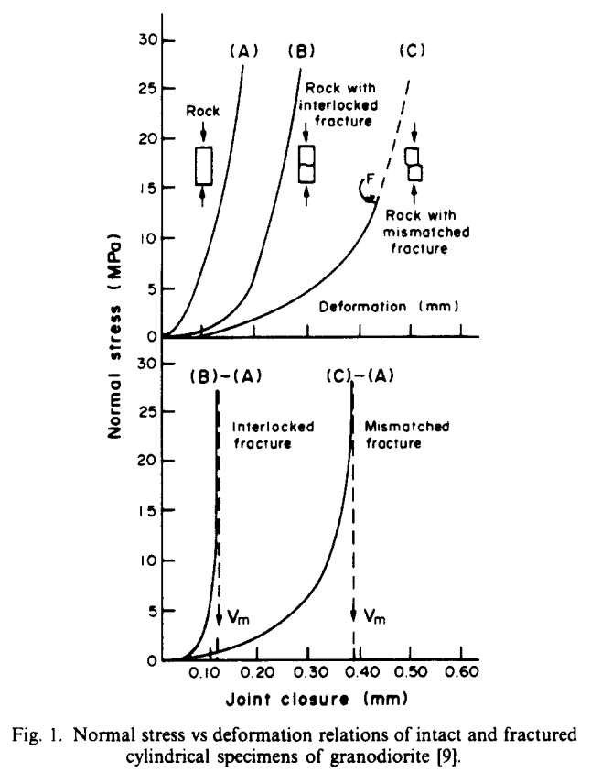
LITERATURE REVIEW
The buildup of the elastic fracture stiffness...
Goodman 1968 - mechanics of joints
Developed the "joint element" (as said by Oda)
Barton&Bandis 1977-1983 - non linear mechanical behavior, loading, unloading, scale effects ...
Aperture: maximum gap across the mated walls
Nonlinear behavior is related to normally compressed joints (Snow, 1972)
Many studies are conduced with artificially generated joints, insufficient!
Under enough compressibility, joints cease to contribute to bulk compressibility
Oda 1986 - the spring model (an equivalent continuum model for ...)
The interaction between the fractures is important
The spring model
Cundall PA (1971) A computer model for simulating progressive large scale movements in blocky rock systems. In: Proceedings of the international symposium on rock fracture, Nancy, October 1971. International Society for Rock Mechanics (ISRM), vol 1, paper no. II–8, pp 129–136
Kachanov, 1993 - Elastic solids with many cracks and related problems
Review of many aspects in cracked solids
Jaeger & Cook (book) 2007 - chap 10.4
Cracks does not have significant porosity, but contributes to mechanical properties
Simone 2023
Analytical solution does not consider interaction
Previous work on analytical solutions: Walsh (1965-1966), Jaeger and Cook (book) etc
It seems that Biot and Skempton are not often analyzed (???)

Slide 10
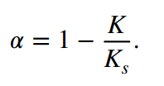
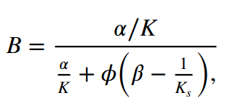

WHAT MATTERS FOR US
Explain that the linear elastic spring approach is enough
Locally linear? Fractures getting tensile?
Biot and Skempton formula depends on $K$
All other variables may be considered constants
Modelling $K$ reduction is enough to get an approximate increase of the Biot modulus?

