Slide 1
HPC for reservoir simulation

Slide 2
Preliminary chats

Slide 3
Nelson
People: Prof. Sérgio Fontoura, Dr. Nelson Inoue (PUC-RIO)
C++ or Fortran? C++ has more support. Need to rewrite from scratch
Not big deal to program CUDA
Old software have trouble to migrate to GPU (ex: Abaqus)
Successful software in GPUs are written from scratch
Bottleneck: memory management
Axes of study: FEM/FD, CUDA, Programming

Slide 4
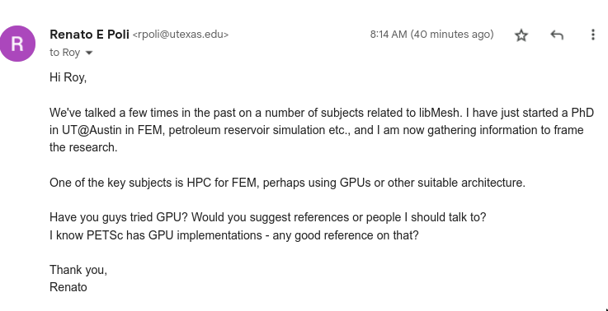
Roy stogner (libmesh)

Slide 5
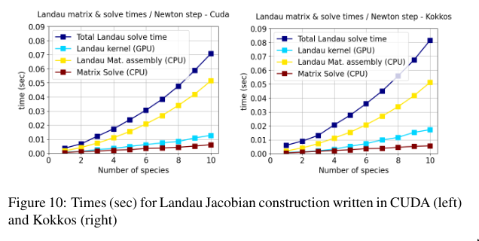
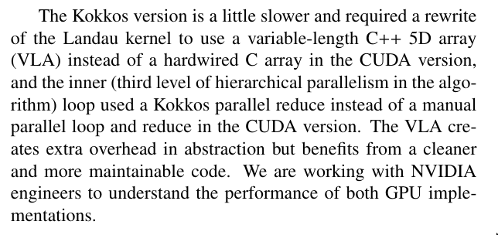
Petsc with GPU? https://escholarship.org/content/qt9wg9p5kj/qt9wg9p5kj_noSplash_fd4961edbceb753ac93f63e148bce988.pdf

Slide 6
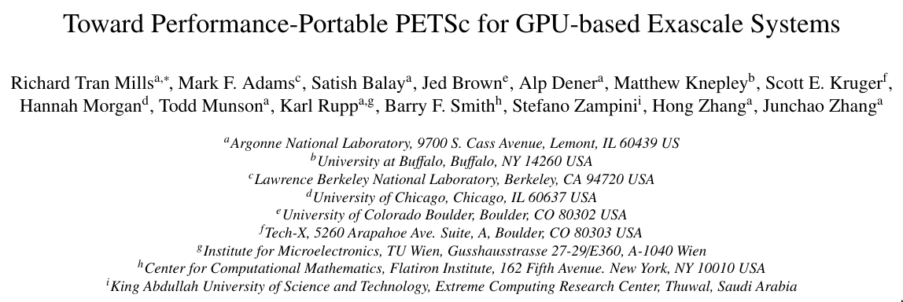
Petsc with GPU? https://escholarship.org/content/qt9wg9p5kj/qt9wg9p5kj_noSplash_fd4961edbceb753ac93f63e148bce988.pdf

Slide 7
OPM flow
https://opm-project.org/wp-content/uploads/2023/06/OPM_Flow_Reference_Manual_2023-04_Rev-0_Reduced.pdf

Slide 8
Highlights
Equinor
Black oil

Slide 9
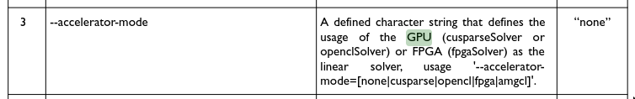
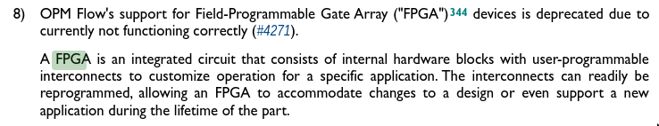

Slide 10
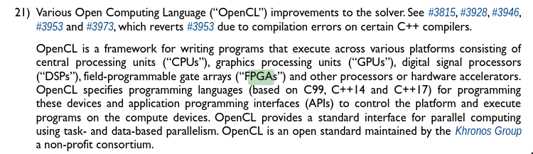

Slide 11
Keywords

Slide 12
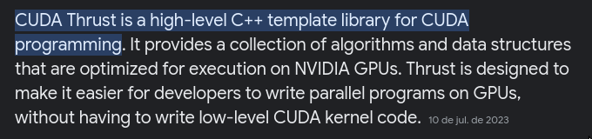

Some keywords to look at
CUDA Thrust
  https://github.com/NVIDIA/thrust
OpenCL
Kokkos
Application specific architecture
  FPGA?
  Quantum computing?

Slide 13
Some keywords to look at
Exascale computing is a type of ultra-powerful supercomputing, with systems performing billions of computations per second utilizing an infrastructure of CPUs and GPUs to process and analyze data.

Slide 14
OpenCL https://www.run.ai/guides/nvidia-cuda-basics-and-best-practices/cuda-vs-opencl
OpenCL programs are designed to be compiled at run time, so applications that use OpenCL can be ported between different host devices.
OpenCL is not just for GPUs (like CUDA) but also for CPUs, FPGAs… In addition, OpenCL was developed by multiple companies, as opposed to NVIDIA’s CUDA.

Slide 15
Research Directions (???)

Slide 16
How to make things practical
Detach a module of a large (but not so large) size and rewrite (?)

