Slide 1
Dec 2023
COMPUTATIONAL PERFORMANCE
TRACK #5
Renato poli (rep2656)

Slide 2
TRACK #5 – COMPUTATIONAL PERFORMANCE
Challenges
The available computational power is not used in full
Simulators are designed for general purpose CPU
Designing and redesigning simulators is impractical: need a solution to be more portable, taking advantage of new architectures
The main challenge is compiling the simulator to take advantage of the target architecture potential
Approach #1
Design a simple black oil simulator in CPU
Map the code to GPU
Design a single code that can be compiled in both with no performance loss.
Approach #2
The ability to parallelize higher resolution scales is tempting
If the time scales are significantly different, it makes sense to use one scale as BC of the next
Approach #3
Create building blocks for simulators, independent of architecture
Implement the building blocks in different architectures
The user can write his simulator using the building blocks
Automated test structure enables benchmarking, reliability and accuracy of every implementation

Slide 3
LITERATURE
Implementing a Hardware Agnostic Commercial Black-Oil Reservoir Simulator.
SLB and TOTAL ENERGIES
Szyndel, Matthew, Lemon, Christopher, de Brito Dias, Daniel, Dodds, Eamon, Khramchenkov, Eduard, Rinco, Simone, Sheth, Soham, Tene, Matei, Han, Choongyong, Shi, Xundan, Wolfsteiner, Christian, Cao, Hui, Liao, Terrence, Sekachev, Michael, and Rustem Zaydullin.
Paper presented at the SPE Reservoir Simulation Conference, Galveston, Texas, USA, March 2023.
doi: https://doi.org/10.2118/212205-MS

Slide 5

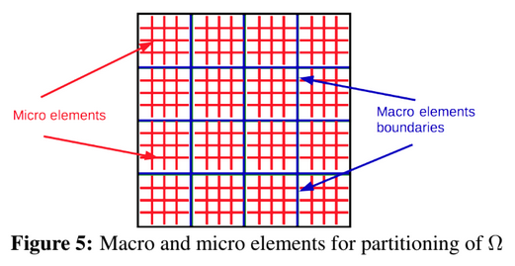
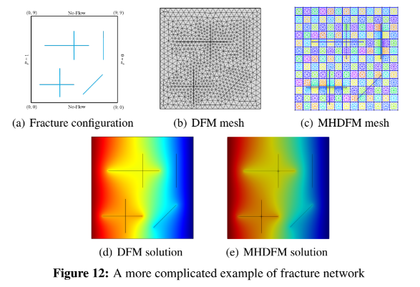
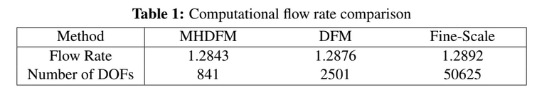
Multiscale FEM (MHM, hybrid mixed)
Embeds fractures “numerically”.
Reduces dramatically the dofs in the global matrix
Micro elements are processed in parallel
Very simple fracture configuration, 2D
2019

