Slide 1
tracks overview
Dec 2023
Renato poli (rep2656)

Slide 2
Research tracks
TRACK #1 – Flow in fractured media
EDFM/CEDFM/PEDFM
Comparison of the techniques.
Seems a good starting point for learning the code, getting something published, and moving forward.
TRACK #2 – Fracture propagation
Long-term thermo-hydraulic fracture propagation without predefined fracture track
Can EDFM be extended to fracture propagation?
Check SBFEM
TRACK #3 – Salt rock mechanics
THM modeling of salt geomechanics (elasticity, plasticity, creep)
Apply to fracture containment, caverns, drilling, well abandonment, etc
TRACK #4 – Homogenization of mechanical parameters
Wrap up of the results and publish
Need some thorough validation, comparison analytical results and to expand to other parameters.
Writing paper with Prof Espinoza
TRACK #5 – Computational performance
Computational and mathematics improvement for overall simulation performance.
Codesign and building applications for specific architectures are something
I've been willing to work on for a long time.
TRACK #6 – Multiscale data assimilation
Lab-to-field scale modeling, digital rocks, relative permeability, fingering etc
Translating capillary pressure to relative permeability
Interface between models in different scales

Slide 3
Research tracks
TRACK #1 – Flow in fractured media
EDFM/CEDFM/PEDFM
Comparison of the techniques.
Seems a good starting point for learning the code, getting something published, and moving forward.
TRACK #2 – Fracture propagation
Long-term thermo-hydraulic fracture propagation without predefined fracture track
Can EDFM be extended to fracture propagation?
Check SBFEM
TRACK #3 – Salt rock mechanics
THM modeling of salt geomechanics (elasticity, plasticity, creep)
Apply to fracture containment, caverns, drilling, well abandonment, etc
TRACK #4 – Homogenization of mechanical parameters
Wrap up of the results and publish
Need some thorough validation, comparison analytical results and to expand to other parameters.
Writing paper with Prof Espinoza
TRACK #5 – Computational performance
Computational and mathematics improvement for overall simulation performance.
Codesign and building applications for specific architectures are something
I've been willing to work on for a long time.
TRACK #6 – Multiscale data assimilation
Lab-to-field scale modeling, digital rocks, relative permeability, fingering etc
Translating capillary pressure to relative permeability
Interface between models in different scales

Slide 4
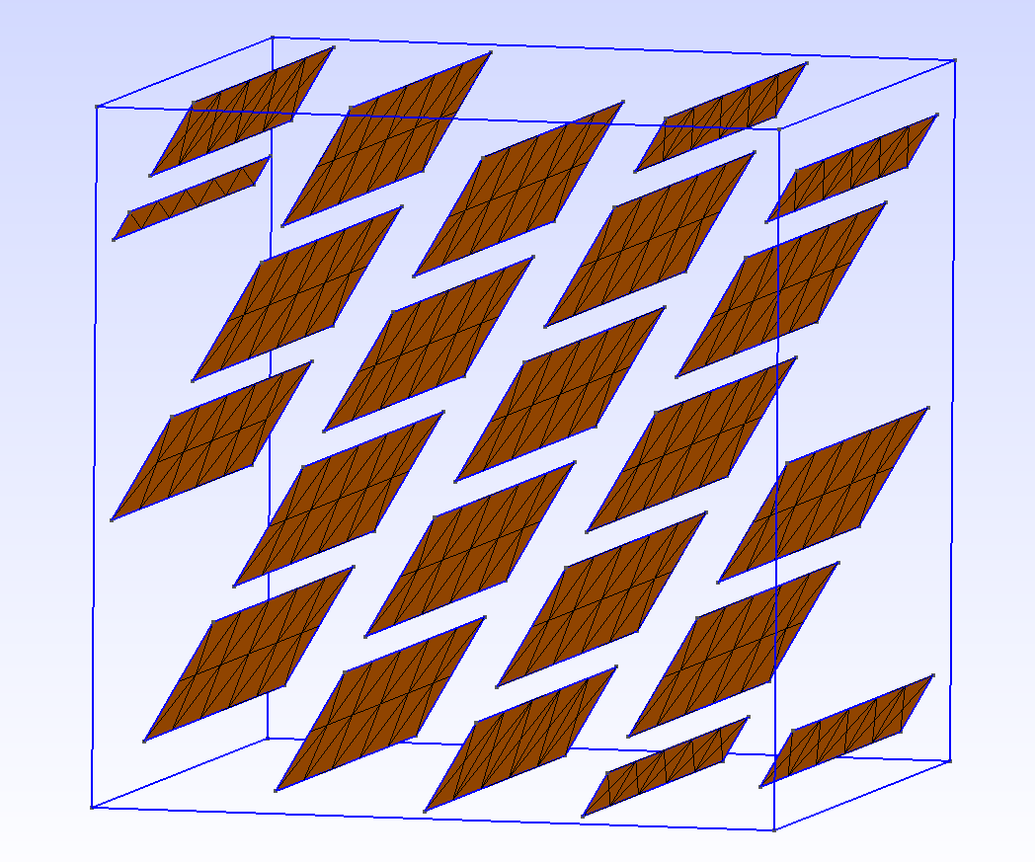
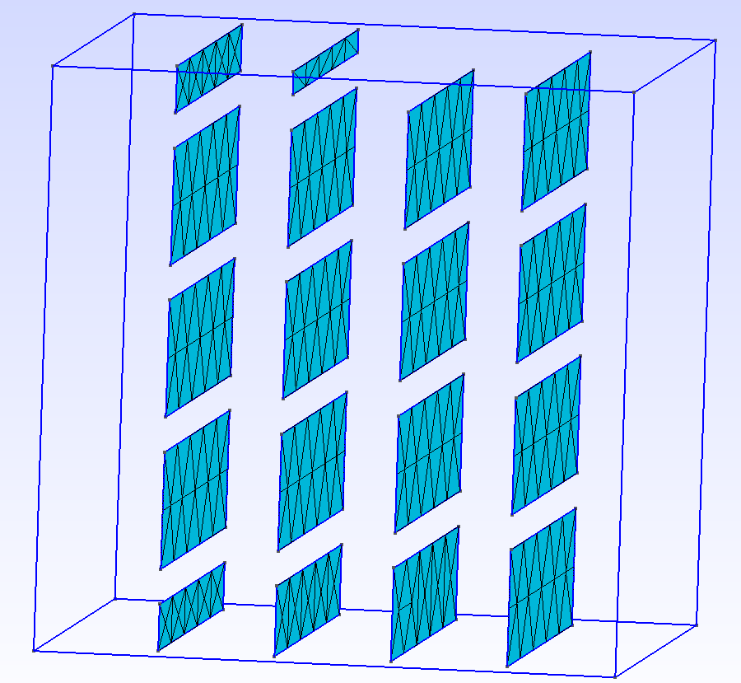
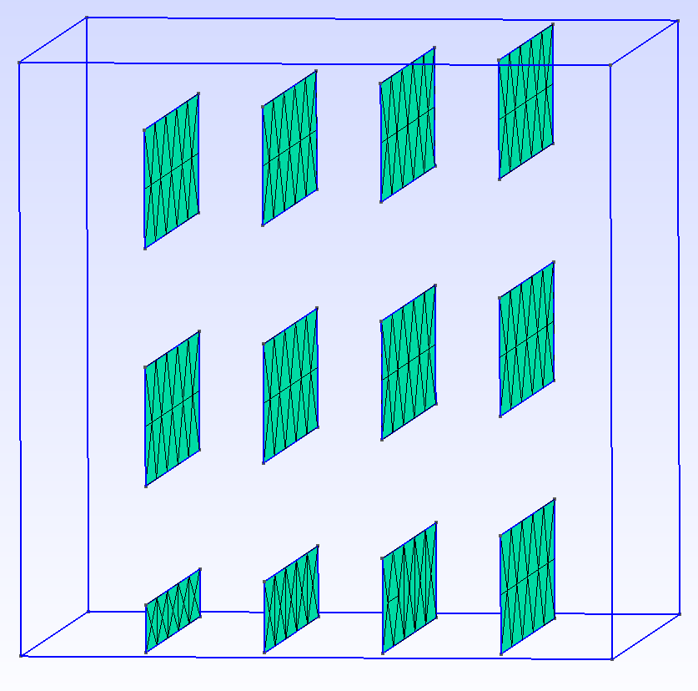

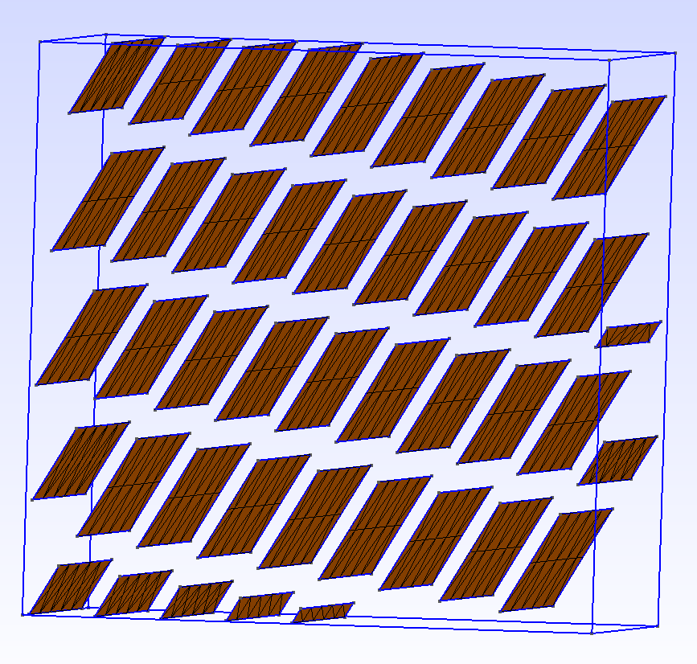
TRACK #4 – Homogenization of mechanical parameters
Literature review and paper outline
Looks like the proposed paper has a good contribution
I still cannot understand the coalescing type curves ...
Is there an analytical solution to explain?
Is there an error in the calculations?
θ

Slide 5
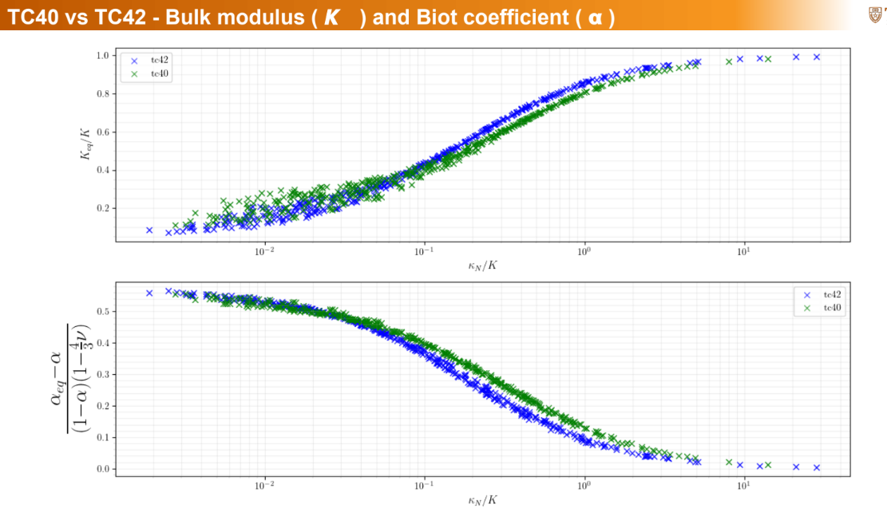
TRACK #4 – Homogenization of mechanical parameters
Literature review and paper outline
Looks like the proposed paper has a good contribution
I still cannot understand the coalescing type curves ...
Is there an analytical solution to explain?
Is there an error in the calculations?

Slide 6
TRACK #3 – Salt rock mechanics
Went through literature review
Main codes are Itasca (in this market for a long time) and simple proprietary/academic
Models normally reduced for 2D
The modelling is well described (geomech especially)
However: the uncertainty in the parameters are high high high!
Creep is too slow and lab characterization is difficult
It depends on water content of the rock, which varies
There are results from real cases, from which parameters can be inferred
However, there are many physics competing. Isolating creep is challenging
Physics around a salt cavern
Fluid thermal response
Rock creep and convergence (transient, steadystate, thermal)
Bedded salt formations (ductile and brittle structures)
Infiltration
Fracture damage and healing (micro and macro fractures)
I could not see how EDFM can be used for salt caverns
Suggestions?

Slide 7
TRACK #1 – Flow in fractured media
Going through literature review
pEDFM has small contribution, I wouldn't invest much energy
cEDFM looks good, and there is room for improvement
Large models are not often addressed in the literature
Bundle of fractures
Upscaling of the infra-cell fractures
Realistic field scale cells (ex: 100x100m)
Fracture physical aperture has no relation to hydraulic aperture
I see this as a common mistake all around.
I prefer to see fractures as virtual, equivalent, entities, as they are physically seen as fractals in any scale
Assuming there are uncertainties and working statistically
Statistically, we can tolerate errors as long as they are lower than the uncertainty levels (which are large!)
That means we should not look for high-high precision results: we can work simplistic and get much more useful results

Slide 8
TRACK #1 – Flow in fractured media
Before talking about numerics, let's talk about fractures...

Slide 9
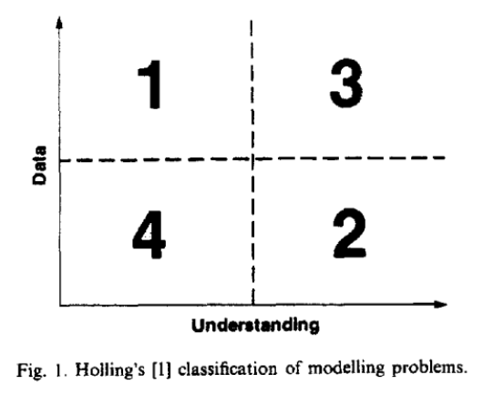
TRACK #1 – Flow in fractured media
Choosing the best model
(1) it is futile ever to expect to have enough
good data to model rock masses accurately ; and (2) as more detail and complexity is added
to the models, we see a decline in intellectual control of the model.
(...) in regions 2 and 4 one is nervous of over-simplifying the problem. As a result, modelers tend to concentrate on detail and build complex, unwieldy models.
(Starfield, 1988)

Slide 10
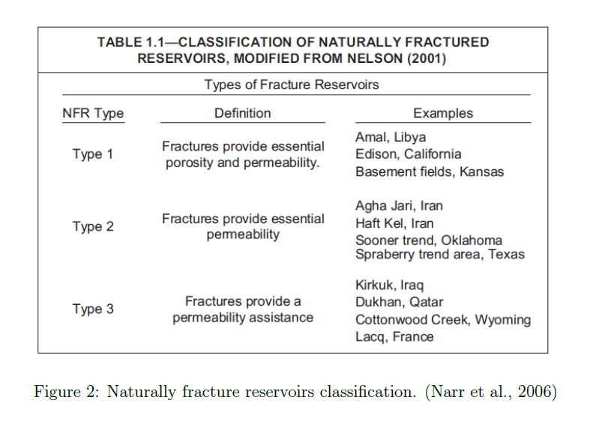
TRACK #1 – Flow in fractured media
Classification of fracture networks

Slide 11
TRACK #1 – Flow in fractured media
Fracture denial (Nelson, 2001)
The reason behind fracture denial would be related to the desire of technical teams reduce reservoir assessment cycle time by avoiding highly uncertain complexity.
To my experience, most fracture-aware workflows in place are normally using classic W&R sugar-box assumptions (Warren and Root, 1963).
Novel approaches must advance from this point, offering improvements in forecast uncertainty, performance or history match cycles.

Slide 12
TRACK #1 – Flow in fractured media
Effective hydraulic networks
Fracture geometry descriptions
roughness
aperture
contact area
fracture network character
non planarity
Assumptions supporting the cubic law are two restrictive for actual field cases, and the resulting fracture transmissibility is significantly higher then what is observed in field conditions
(Frash, 2019) (Pyrak-Nolte, 1987) (Candela, 2012)
A method of predicting subsurface permeability based on knowledge of rock type, fracture type, fracture history and stress condition remains elusive and maybe unachievable due to variability at multiple scales.
Viswanathan et al. (2022)

Slide 13
TRACK #1 – Flow in fractured media
Research goals and ambitions
Seek a solution to a problem
Not the other way around
Set a target user
Users of commercial simulators
Developers of commercial simulators
Set a scope
Field scale problem
Analysis considering fracture network uncertainties
Phenomenological approach
Simulating and matching lab experiments, for example
Viswanathan et al. (2022)

Slide 14
TRACK #1 – Flow in fractured media
Remarks
Whenever the cubic law is used, we may expect resulting permeabilities order of magnitude higher than reality.
Complex models assume we know the fracture permeability, which is terribly false.
Working on hydraulic characterization of individual fractures is counter-productive.
Upscaling to equivalent fracture networks makes more sense to reduce the number of parameter and increase the control of the model
a single fracture will hardly be long enough compared to a typical model element size (50-200m). We need to characterize corridors
Fracture behavior shows only in field scale production data.
working with analog fields is imperative.
Fracture network must be smartly split in parts
Changing the primary porosity and permeability tensor
Adding parallel permoporous systems
The problem turns out to be transmissibility and porosity calculations
Can we train a neural network or machine learning algorithm?
Viswanathan et al. (2022)

Slide 15
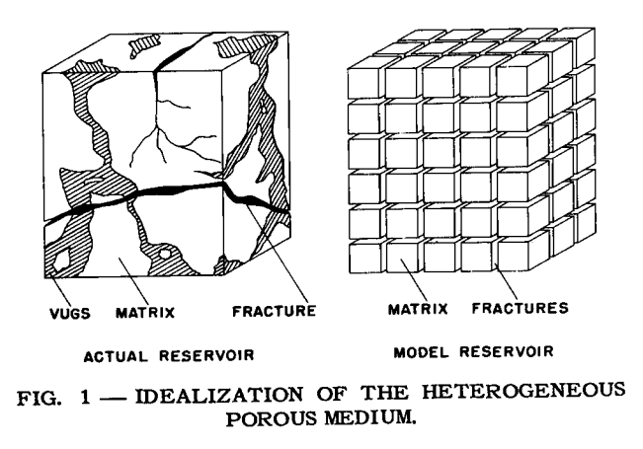
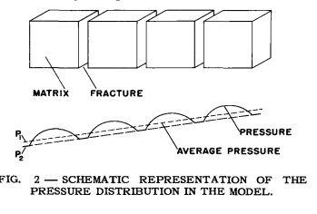
(Warren & Root, 1963) Sugarbox
This is the one to be beaten
in which case this is not valid within the admitted uncertainties?
the resulting PDE is pretty much the same - global transmissibilities vary among the techniques

Slide 16
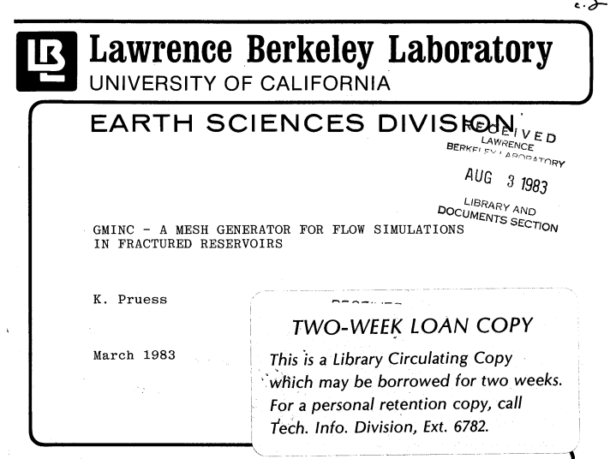
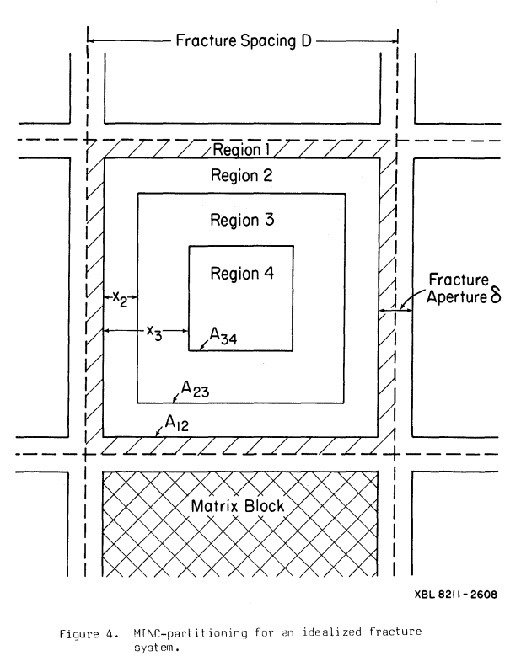
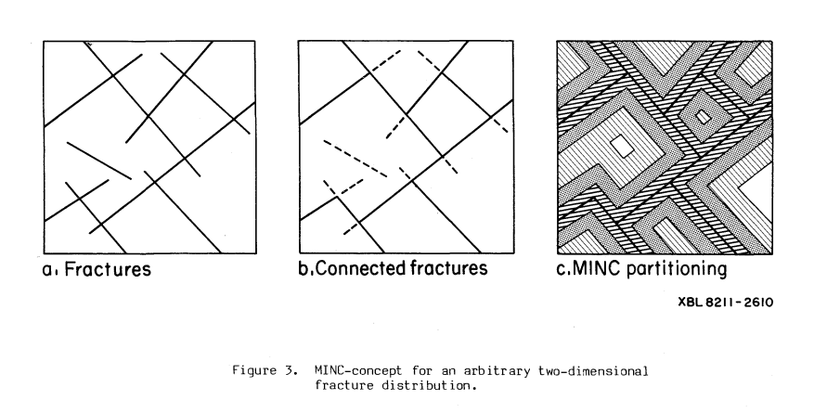
(Pruess, 1983) MINC partitioning
The matrix is partitioned regarding its distance to the fractures
The flow is only through the fractures
Objective: capture the thermodynamics and gradients close to the fracture.
He claims the 2phi2k uses a quasisteady approach, whereas for some phenomena the tranisent is needed.

Slide 17
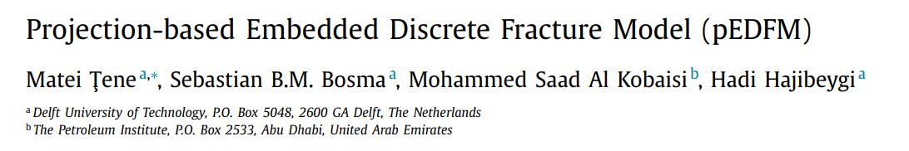
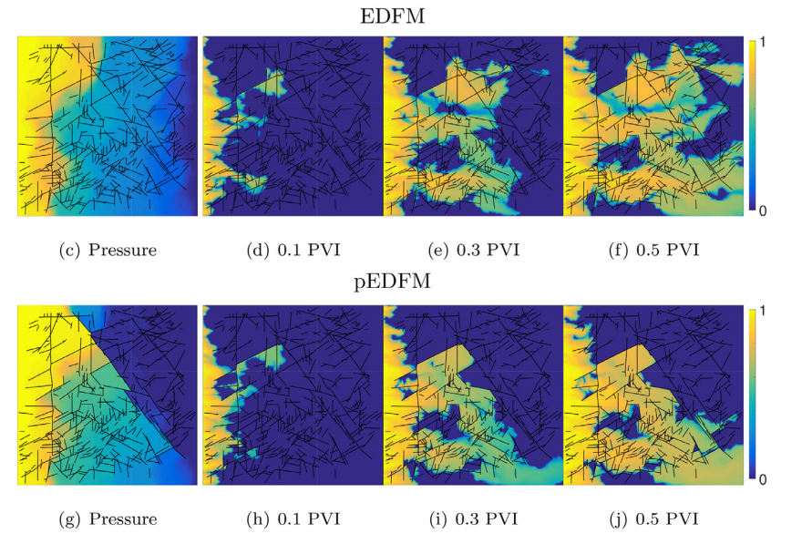
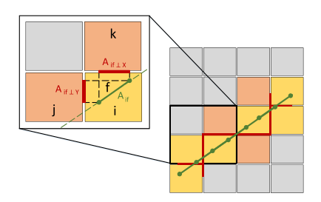

Tene, 2017 - pEDFM
M. Tene worked with pEDFM and algebraic multigrid methods
this paper is widely cited
pEDFM pros:
Deal with 2D permeability barriers inside the cell ($k_{f}<k_{m}$)
The method looks good and straightforward.
The simulations shown use a refined grid, which is against the method interest

Slide 18
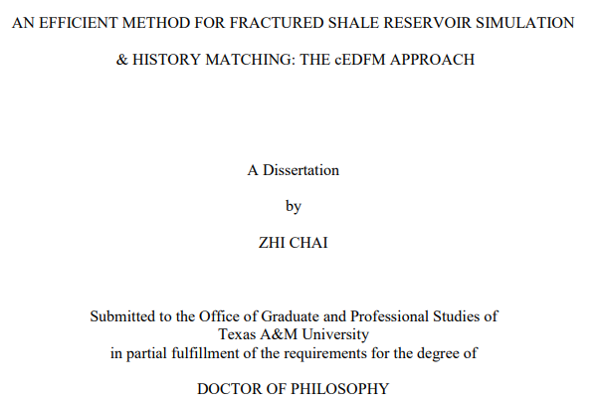
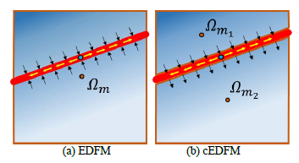
(Chai, 2018) cEDFM - Texas A&M
Very interesting approach, a lot more flexible
cEDFM - compartmental embedded discrete fracture model
preprocesses the mesh, splits the fractured matrix cells
Multiple porosities in a single geometrical position
MINC: Multiple Interacting Continua Method
Create a transmissibility graph among the multiple porosities/matrix splits
Use the graph to create/redefine regular transmissibilities among the cells
Needs a specific simulator, because it adds new dofs (unstructured?)
The inhouse simulator is called GURU
adds infra-grid resolution
The dissertation also deals with history matching and uncertainties.
The notation is quite verbose and confusing. The ideas are really interesting
Doubts
I can see a transmissibility graph - do they consider storage? Is the flow incompressible?

Slide 19
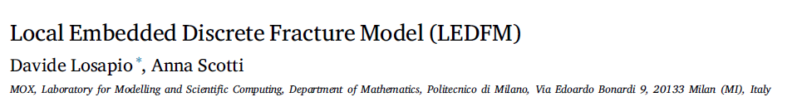
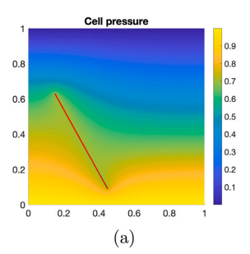
(Losapio, 2023) LEDFM - Local EDFM
The paper is not overall good.
Simplistic analysis, 2D, single frac, ...
Overcomplicated
Some claims are not precise
They look for accuracy. I don't think this is the best objective function
Interesting claims
Small to mid length models => DFM (Discrete fractures)
Large models => CFM (Continuum Fractures)
Local flow based upscaling (Durlofsky, 2005 - Upscaling and gridding of fine ...)
Numerical simulations of the small scale (time consuming!) -- Multiscale Finite Volume (MSFV) -- unstructured?
High discretization
Relief the assumption regarding the pressure gradient around the fractures (EDFM)
Own academic simulator (MATLAB)
Conclusion
LEDFM is an accurate, although expensive, model.
Requires the solution of many local problems.
Neural networks could be used in an offline case and trained to compute transmissibilities for different fractures geometries and permeability contrasts.
This extension will be the subject of a forthcoming paper.

Slide 20
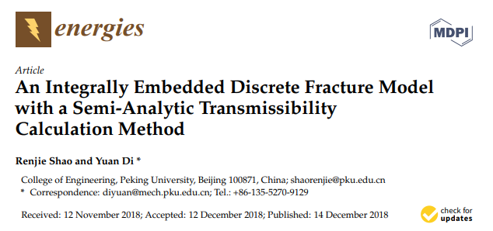
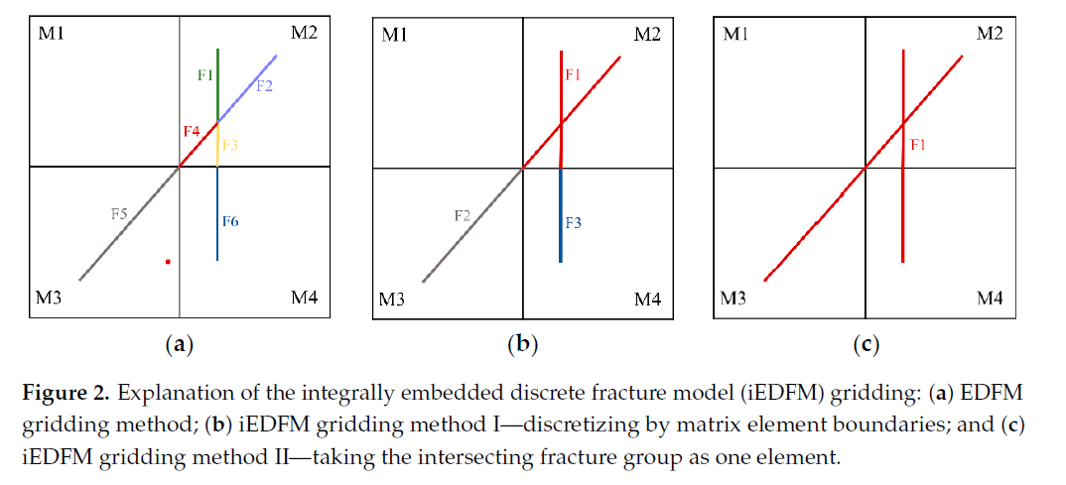
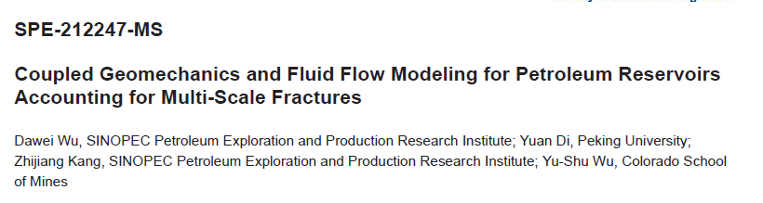
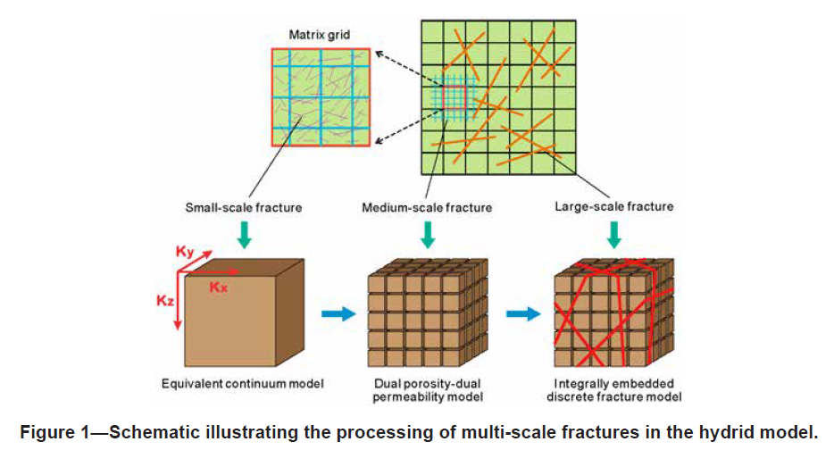
(Shao, 2018) (Wu, 2023) iEDFM - Integrally EDFM
(Shao, 2018) Improved transmissibility calculations considering all fractures at once
Fractures are meshed as a collection of sink points, to calculate the transmissibility
Interesting!
(Wu, 2023) Hybrid model that integrates ECM (equivalent continuum model), DPDK, and an integrally embedded discrete fracture model (IEDFM) to account for multi-scale fractures.

Slide 21
(Nikitin, 2020) mEDFM - Monotone EDFM & (Yanbarisov, 2021) pmEDFM
Finite Volume Approximation
Deals with multipoint permeability, non-orthogonal meshes
Uses the monotone two-point flux approximation [19,20] and the compact multi-point flux approximation satisfying the discrete maximum principle (DMP) [21,22].
[19] K. Lipnikov, D. Svyatskiy, Y. Vassilevski, Interpolation-free monotone finite volume method for diffusion equations on polygonal meshes, J. Comput. Phys. 228 (3) (2009) 703–716.
[20] A.A. Danilov, Y.V. Vassilevski, A monotone nonlinear finite volume method for diffusion equations on conformal polyhedral meshes, Russ. J. Numer. Anal. Math. Model. (2009).
[21] K. Lipnikov, D. Svyatskiy, Y. Vassilevski, Minimal stencil finite volume scheme with the discrete maximum principle, Russ. J. Numer. Anal. Math. Model. 27 (4) (2012) 369–385.
[22] A. Chernyshenko, Y. Vassilevski, A finite volume scheme with the discrete maximum principle for diffusion equations on polyhedral meshes, in: Finite Volumes for Complex Applications VII-Methods and Theoretical Aspects, Springer, 2014, pp. 197–205.
pmEDFM - couples with the pEDFM
To deal with blocking fractures

Slide 22
TRACK #1 – Flow in fractured media
TRACK #1 – Flow in fractured media
TRACK #2 – Fracture propagation
TRACK #3 – Salt rock mechanics
TRACK #4 – Homogenization of mechanical parameters
TRACK #5 – Computational performance
TRACK #6 – Multiscale data assimilation

