Slide 1
ADD SLIDES TO TRACK 4

Slide 2
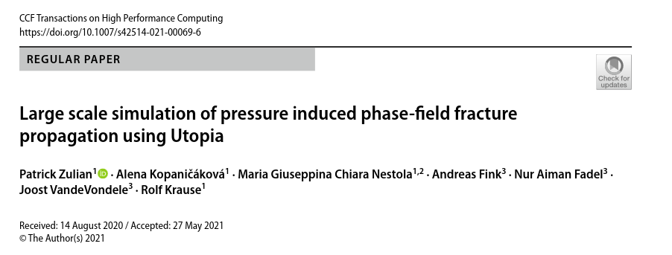

Slide 3
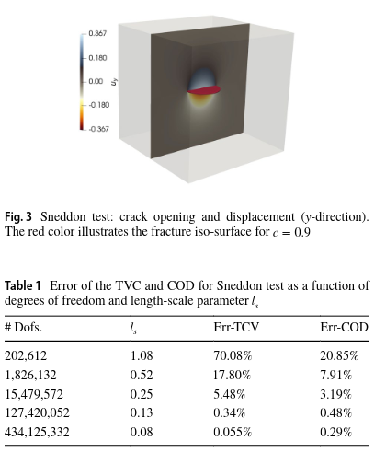
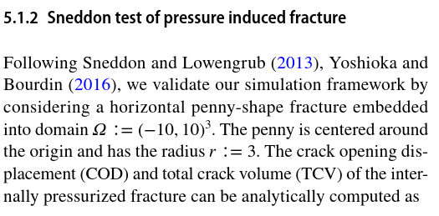
High error in TSV for reasonable numeber of dofs
Error reduces for unfeaseble refinement

Slide 4
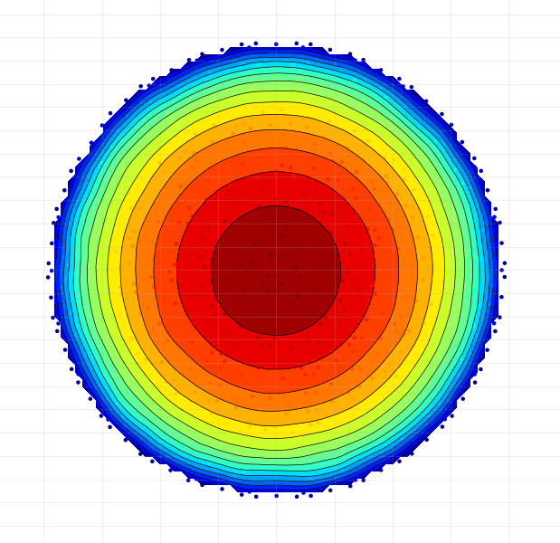
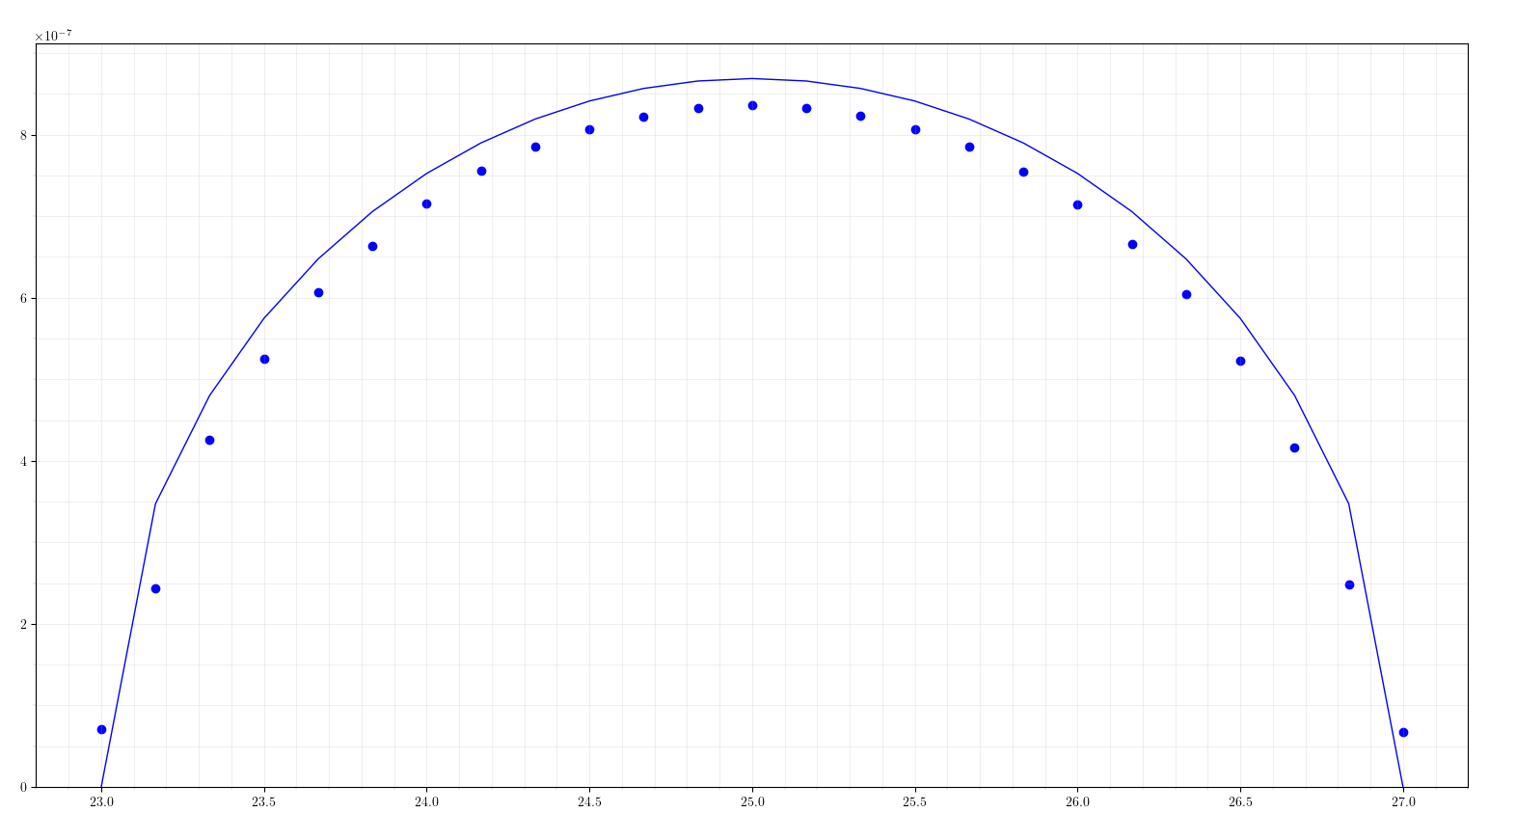
My simulation 1106 nodes / 5273 elements / err_apert=-3.9%

Slide 5
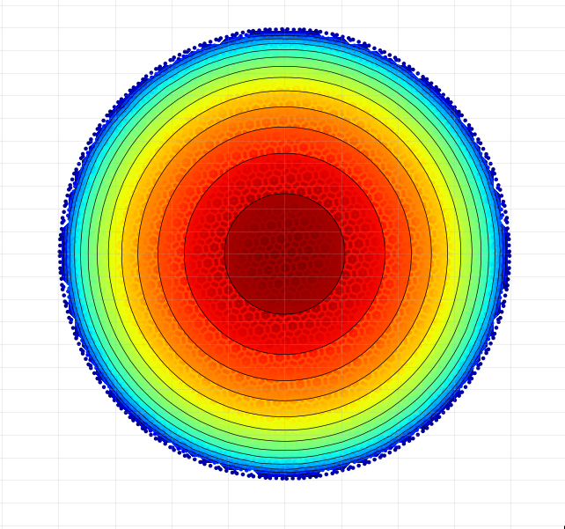
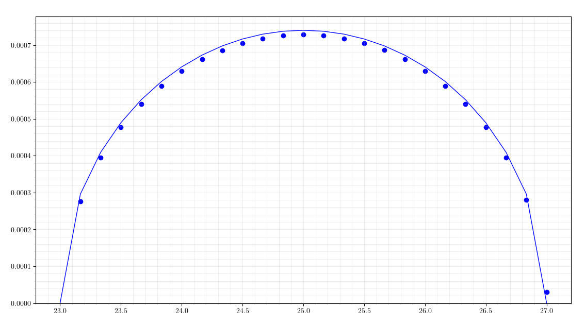
My simulation 12669 nodes / 73429 elements / err_apert=-1.84%

Slide 6
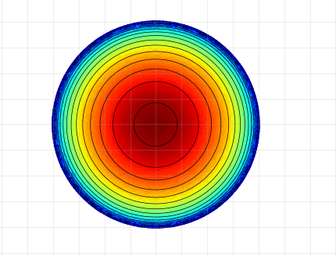
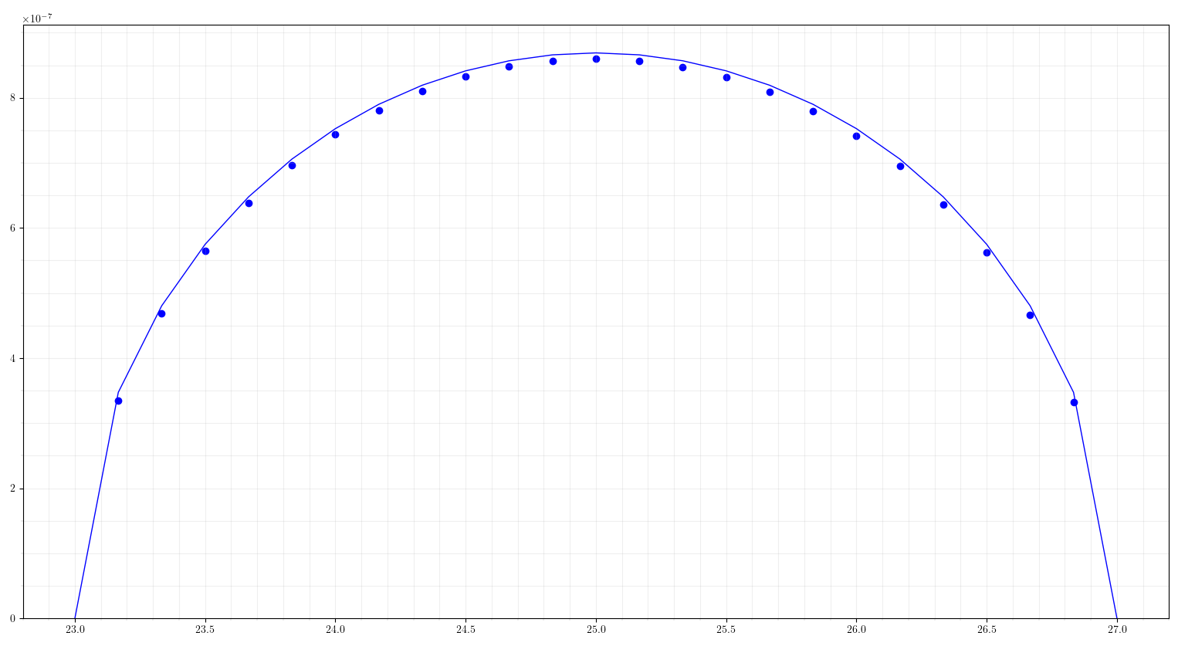
My simulation 13168 nodes / 60916 elements / err_apert=-1.06%
More refinement around the fracture tip.

Slide 7
