Slide 1
Dec 2023
FLOW IN FRACTURED MEDIA
TRACK #1
Renato poli (rep2656)

Slide 2
TRACK #1 – FLOW IN FRACTURED MEDIA
Challenges
3D, cartesian
Large models (>1 milion cells, dx=dy=50-100m dz=5m)
EOR and gás injection through low volume fractures
High fracture density
Objective: high accuracy, high preformance
Choose study case.
Approach #1
Use EDFM. Make necessary improvements.
Reference: standard 2phi2k modelling flow
Approach #2
Homogeneization through 2phi2k
Decide which in cells to use 2phi2k, and in which cells they are not needed
Either due to excessive fractures or to too few fractures
Use machine learning to upspeed
Use EDFM to propose a homogenization
Ideas:
Consider capillary pressure, wettability. Technical upscaling of relative permeability
Fracture density is an issue. How to deal with many fractures individually?
Can we bundle fractures together?
Can we add numerical degrees of freedom for the fractures instead of doing EDFM analytical calculations?
Can we have a fracture grid more refined than the matrix grid?

Slide 3
TRACK #1 – FLOW IN FRACTURED MEDIA
Starting point:
- Compare performance of EDFM, pEDFM and cEDFM in simple models
- Learn and decide how to proceed from there.
Deadline: Spring semester to have the comparison ready

Slide 4
Dec 2023
PAPER REVIEW
notes and remarks
Renato poli (rep2656)

Slide 5
(Yanli Pei, 2022) Coupled Geomechanics and Multiphase Flow Modeling in Naturally and Hydraulically Fractured Reservoirs
Recent (2022)
Verbose notation
Comprehensive literature review: XFEM, EDFM, Discrete fractures, …
Do not address Biot coefficient in the large scale (??)
Stress reorientation in a depletion scenario.
I think it is more interesting in a low temperature/high pressure
Mainly 2D?
No propagation of the fractures. Models flow when fractures are mapped a priori.

Slide 6
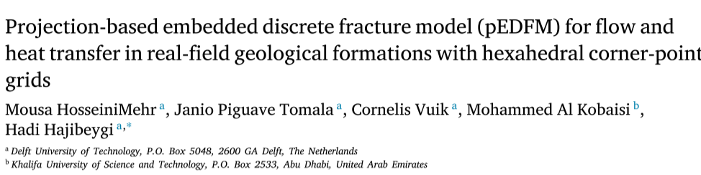
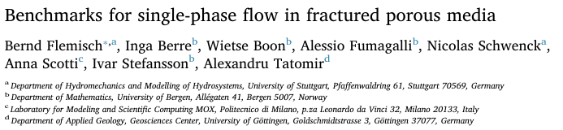
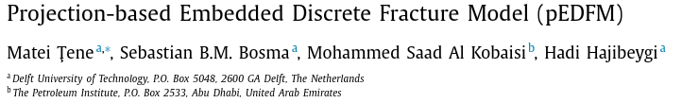
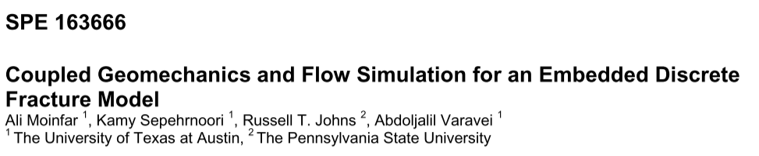
EDFM, CDFM, pEDFM ...
2022
2018
2017
2013

Slide 7

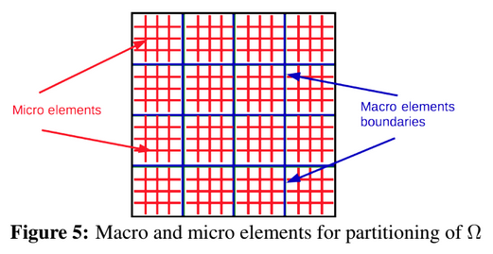
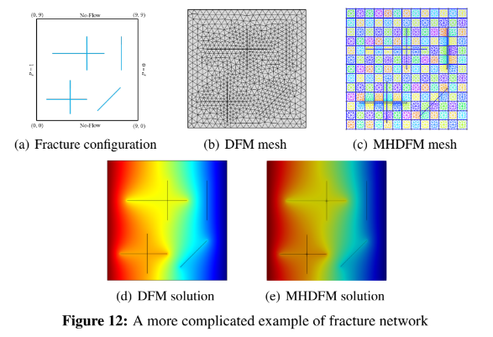
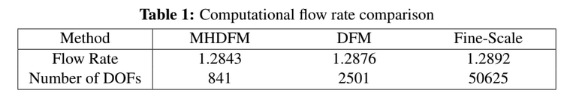
Multiscale FEM (MHM, hybrid mixed)
Embeds fractures “numerically”.
Reduces dramatically the dofs in the global matrix
Micro elements are processed in parallel
Very simple fracture configuration, 2D
2019

Slide 8
Dec 2023
EDFM, pEDFM, CEDFM
Renato poli (rep2656)

Slide 9
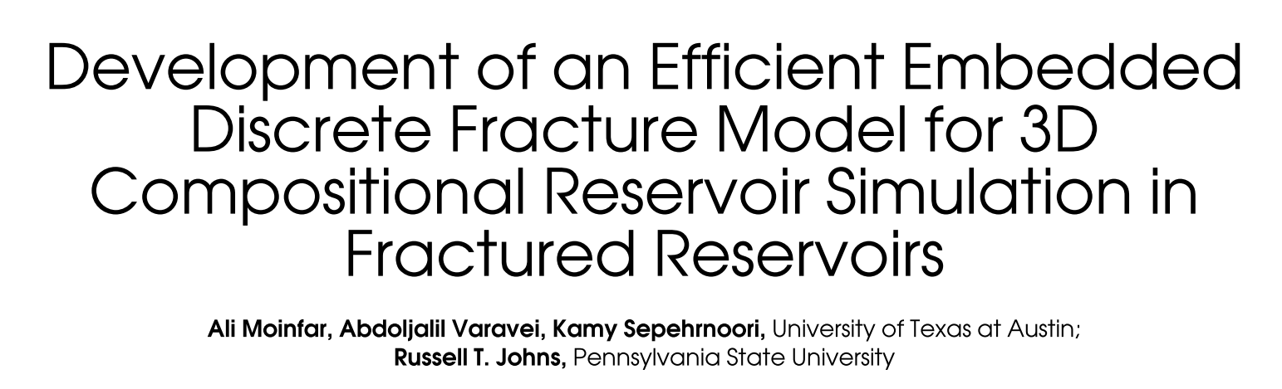
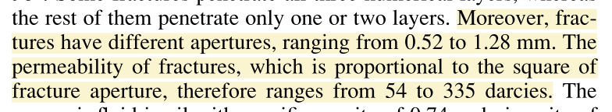
Moinfar, 2014
Where the fracture apertures are used?
I could not translate the fracture apertures to the listed permeabilities.
Must that consider the gridblock size?
Ex: 0.52mm, 1cP
I could not understand how it handles the low porosity and high nonlinearity of the fluid properties inside the fracture. Is this done only in the matrix?
It seems that the aperture and permeabilities used are way too high for the fractures. This model will be more interesting with less permeable fractures (more realistic)
The 2PHI2K model is more interesting as a comparison for performance. Can we use EDFM to derive 2PHI2K parameters?
3D models took more than 3h to run. How to scale EDFM?

Slide 10
Dec 2023
FURTHER CONSIDERATIONS
Renato poli (rep2656)

Slide 11
My considerations ….
Fracture examples are rather simple in most papers. Usually 2D. Mostly SINGLE fracture. What about distributed? Like warren and root assumptions.
It is a scale issue: no mesh can conform to fractures and continua in the field scale,with realistic fractures.
Fractures are 1e-3 in width vs. fieldscale cells are 1e2 /// 5 order of magnitude ////
Fractures are 1e0 in length vs 1e2 fieldscale /// still 2 orders of magnitude
Fracture tip phenomena are in 1e-1 scale. Scaled boundaries may be useful here.
Width dimension must be analytically reduced in all cases. Mechanically, it is a boundary condition for the continua or a stiffness relief
What about the length? We cannot cope with 100x more discretization; conforming mesh will work for large faults. We can embed… analytically? Numerically?
Can we tweak the FEM shape functions? If we can deform the eta-xi space, we can represent fractures with higher order shape functions (??) Apply the theory of non lnear fem to deform the pressure mesh configuration. This way we can “approximate” hydraulically edges of a mesh. This would require a preprocessing step, numerical (?).

Slide 12
My considerations ….
What about storage of the fracture and continua? I see papers dealing with permeability. How does EDFM manages storage?
I can see that there is a transition from fracture storage to matrix storage, as a response to pressure gradient transitions. Convolution may apply here, as long as we can determine effective porosity transfer function φij ^{u} as the step function response for each cell.
Such response can be derived from the cell fracture configuration.
Note that this will drive us into a effective saturation understanding – ex:
Saturation is normally solved explicetly (IMPES), hence some processes may be highly parallelizable and wont impact solver time… maybe this is too similar to the 2phi2k approach … simply reinventing the wheeeeel
I believe this kind of approach is known as shape or transfer functions in the literature (need to review...)

Slide 13
My considerations ….
If working with fractures, we need to overcome restrictions in most of papers
1) Need to deal with real fracture distribuition (lots and lots of fractures)
2) Need to deal with path tracking of multiple tips (if dealing with mechanics of the propagation)
3) Discrete fracture models wont handle. Likely need to get transfer functions from numerical experiments………… as analytical or geometrical approaches won’t be able to handle complex geometries. (any paper does that?)

