Slide 1


CROWD DETECTION USING IMSI AND IEEE 802.11 DATA
2019556025 – Recep Ecem

Slide 2

IMSI (International Mobile Subscriber Identity)

Slide 3
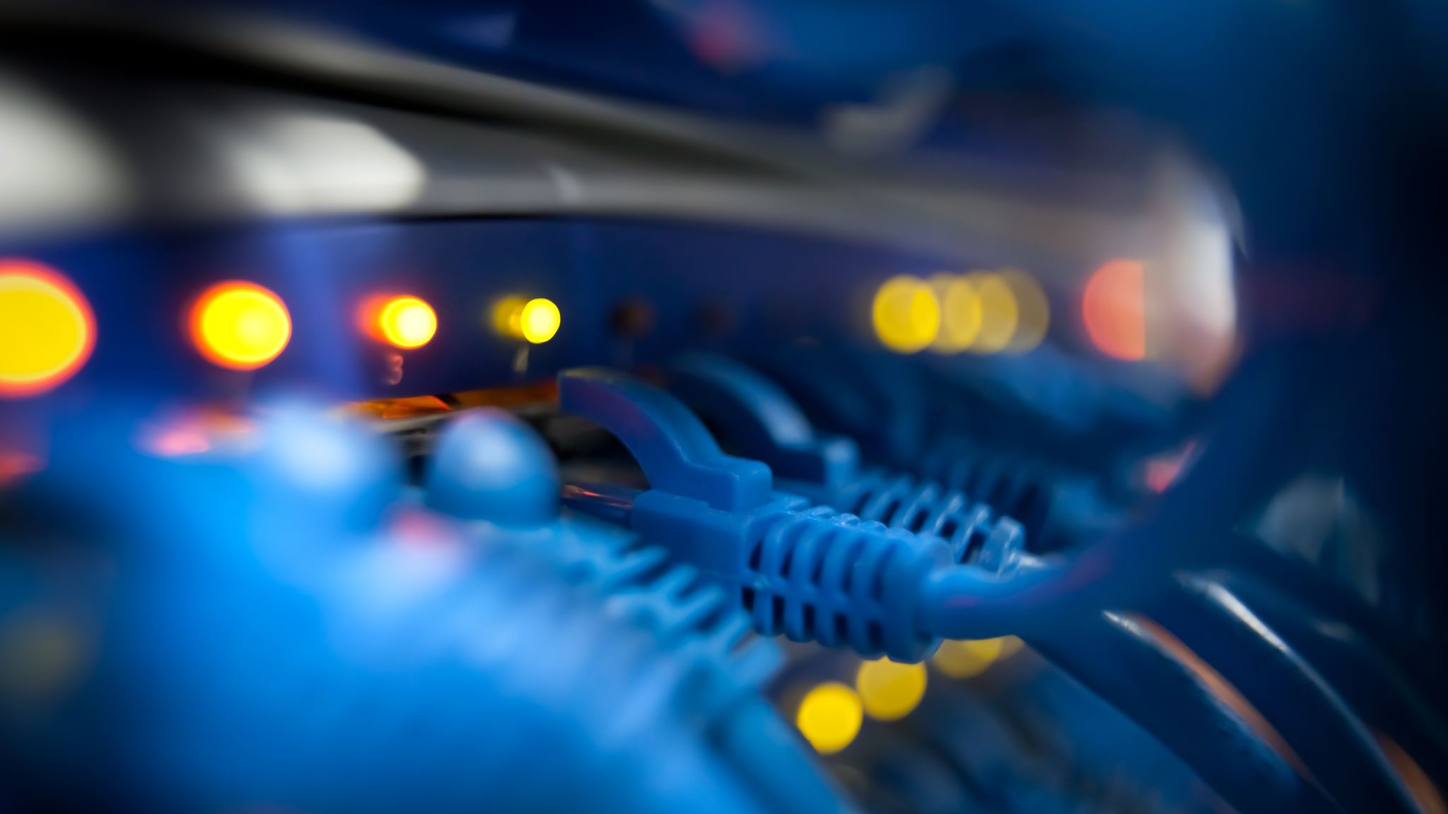
IEEE 802.11

Slide 4
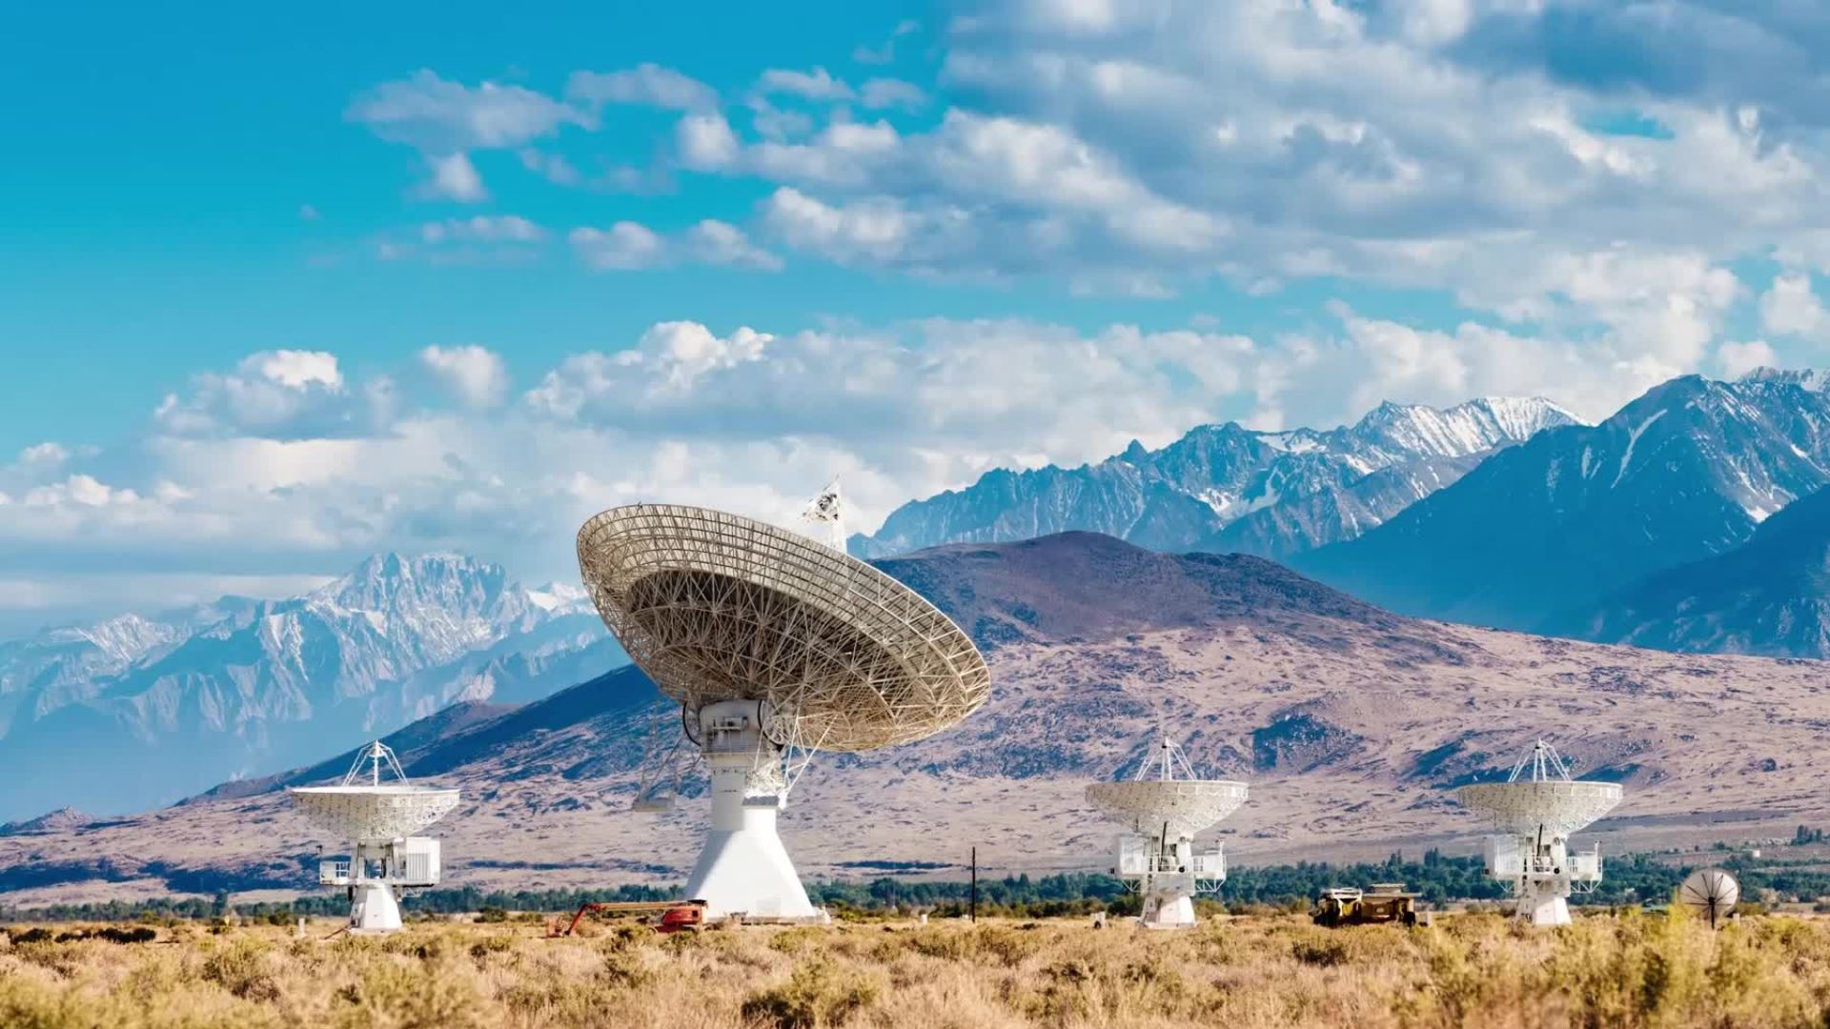
RADIO SIGNALS

Slide 5
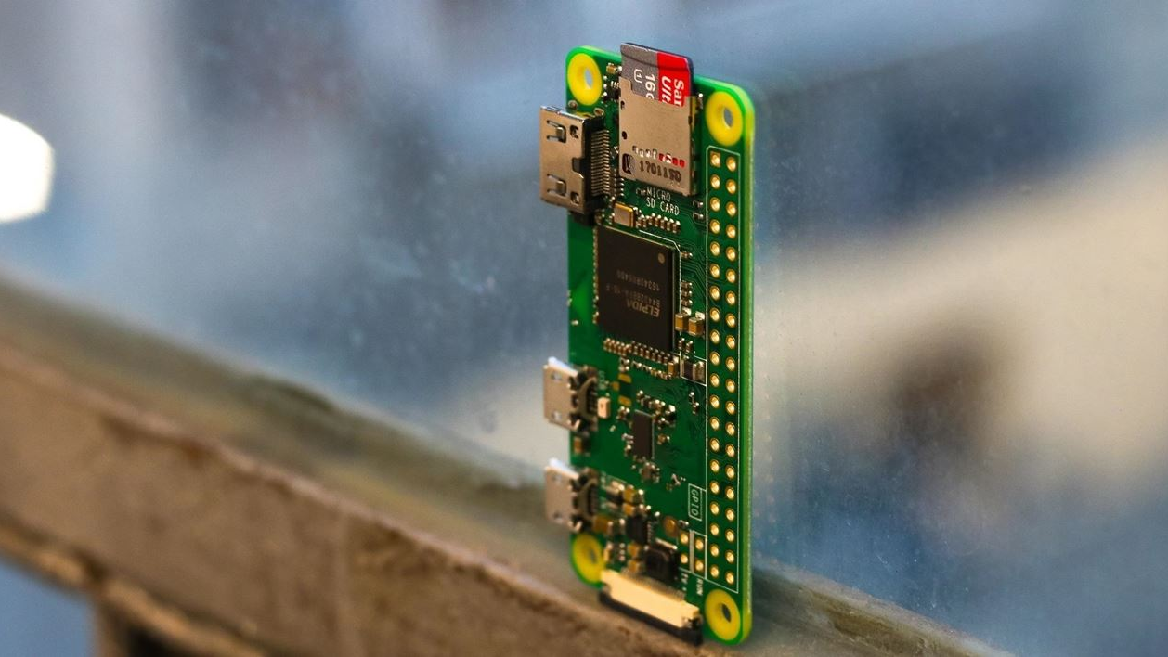
MONITOR MODE

Slide 6
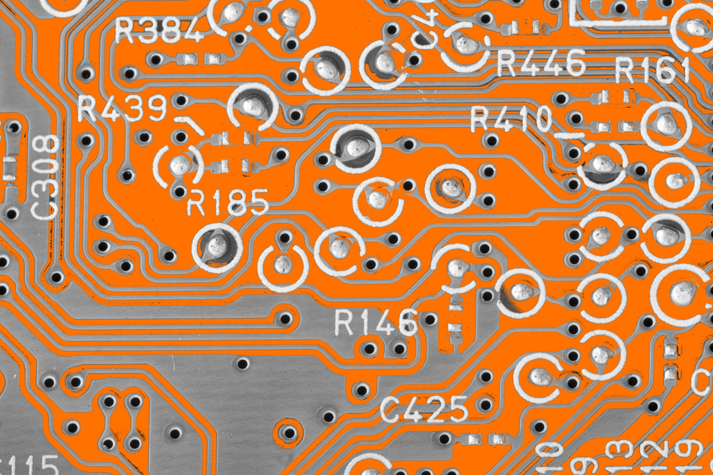
RTL-SDR

Slide 7
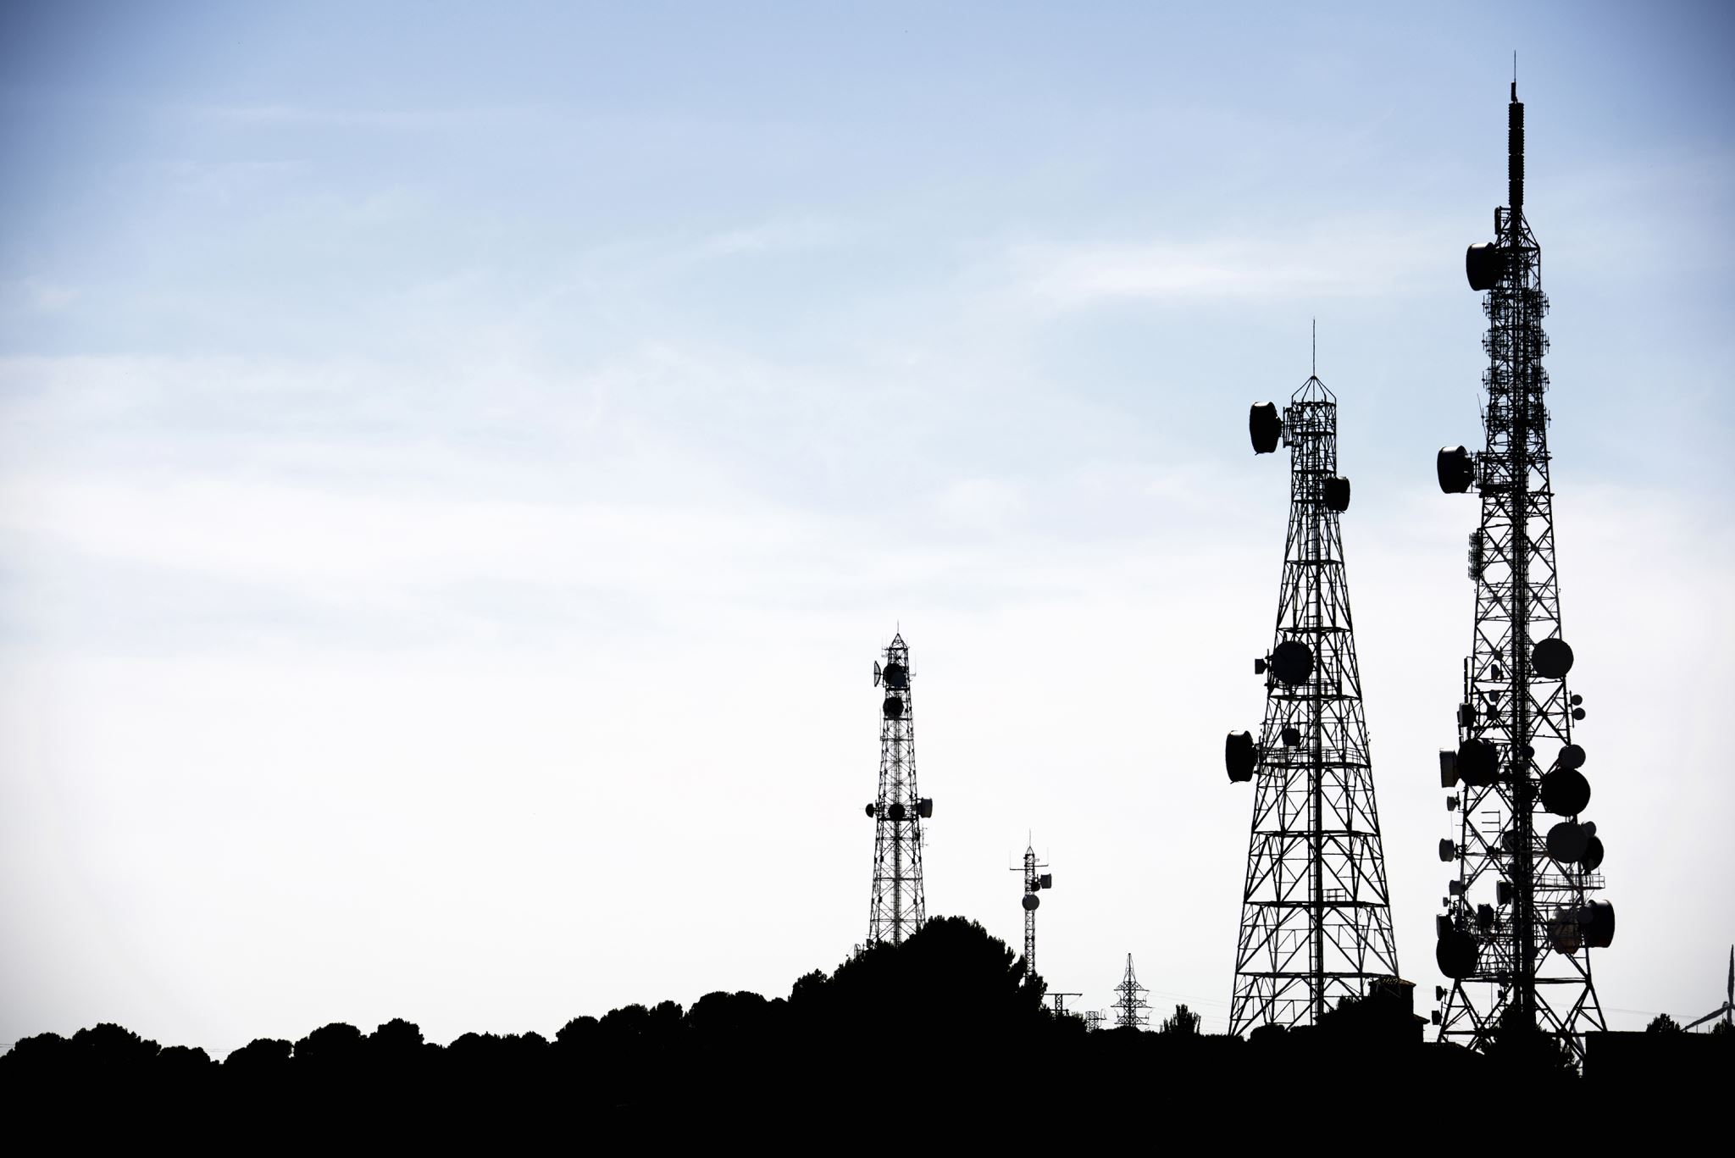
GSM SIGNAL

Slide 8

TÜRK TELEKOM' S HANDICAP

Slide 9
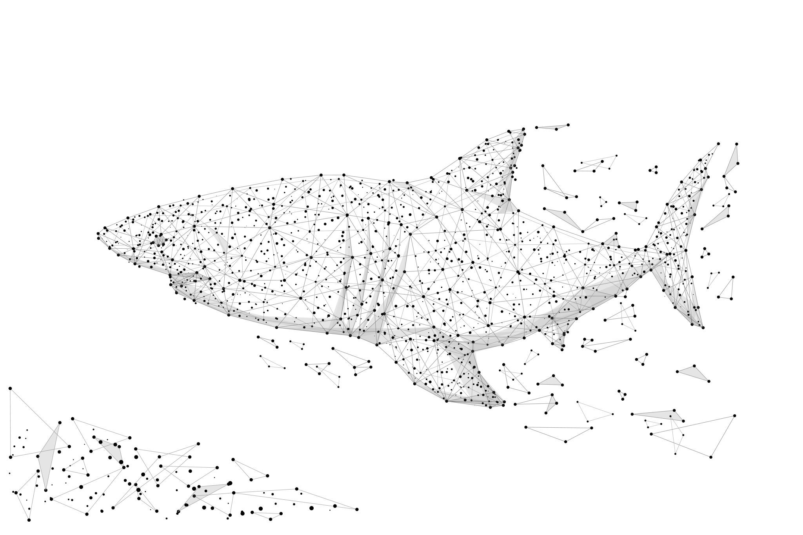
WIRESHARK

Slide 10
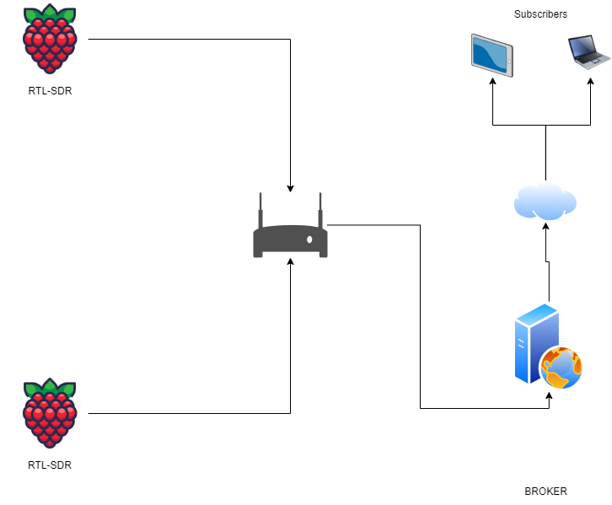

Slide 11
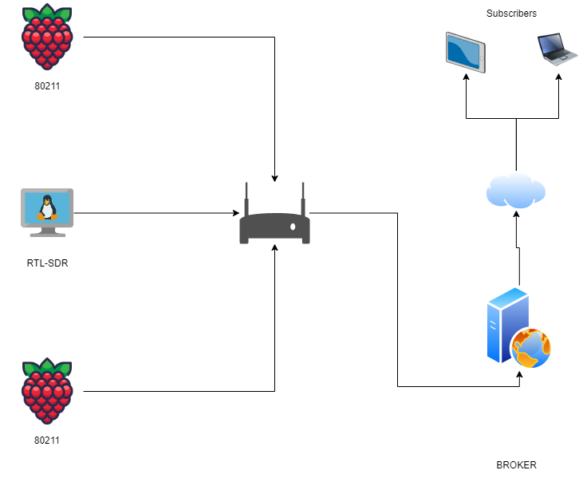

Slide 12


