Slide 1
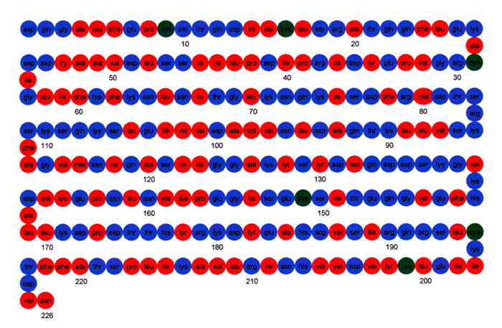
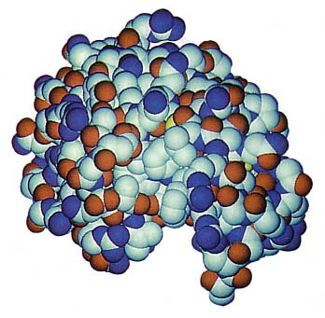
Determine protein structure from amino acid sequence.
Ray Luo
UC Berkeley EECS
?

Slide 2
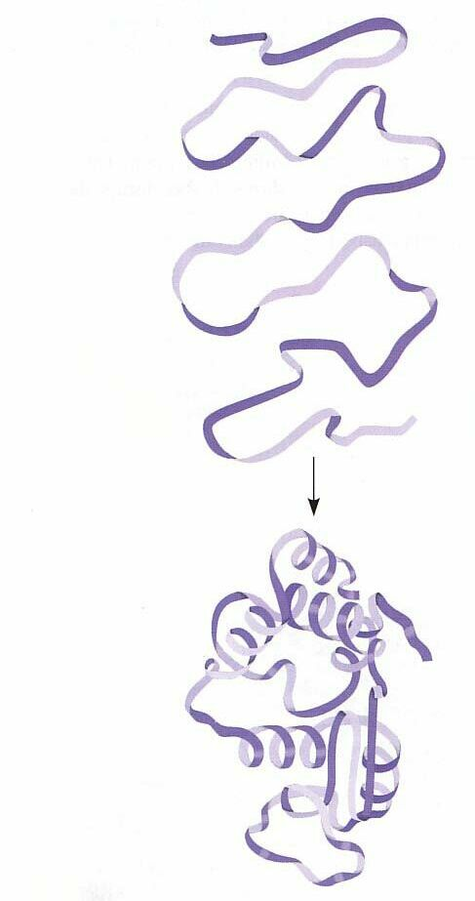
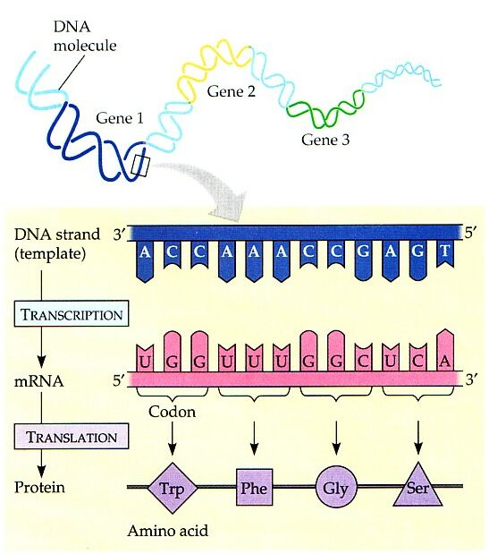
Information flows from DNA to RNA to polypeptide string to folded protein.
Polypeptide:
amino acid
sequence
Folded protein:
3D structure

Slide 3
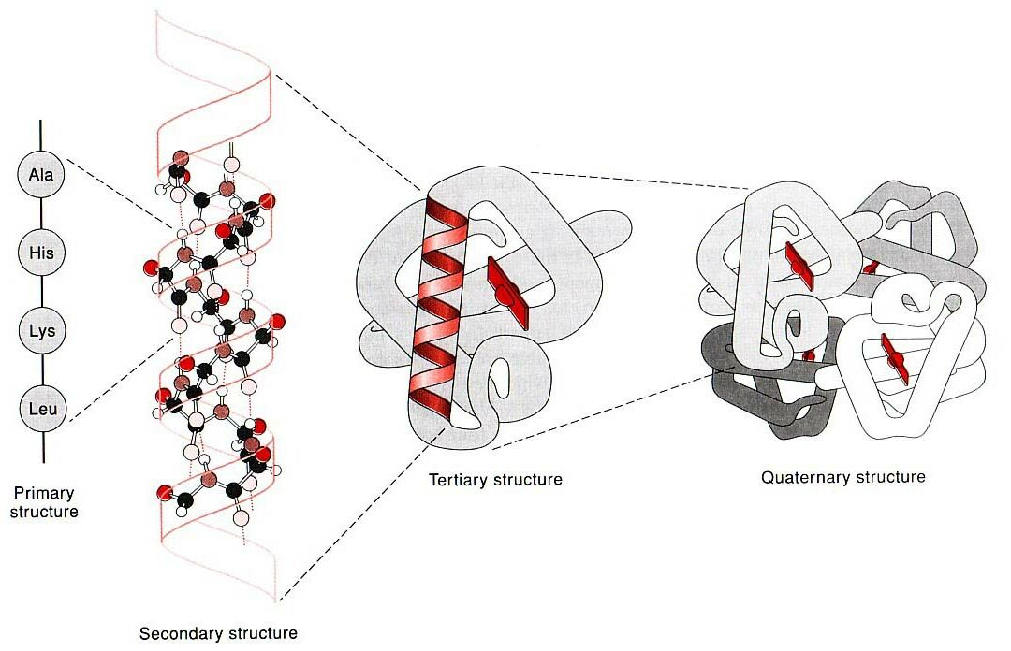
Amino acid sequence encodes the 3D structure and function of a protein.

Slide 4
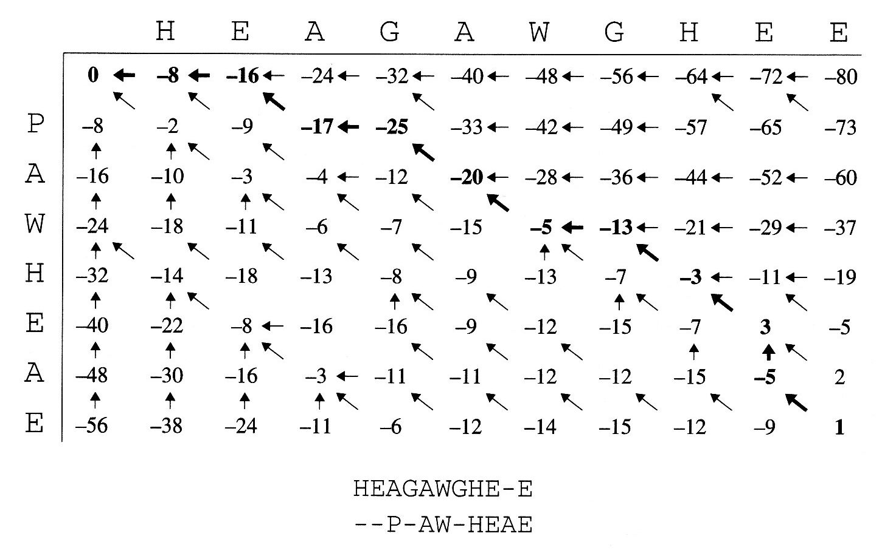
Comparative methods align sequence against known proteins in a database.
Protein in database
New
protein
Alignment {
: Protein in database
: New protein

Slide 5
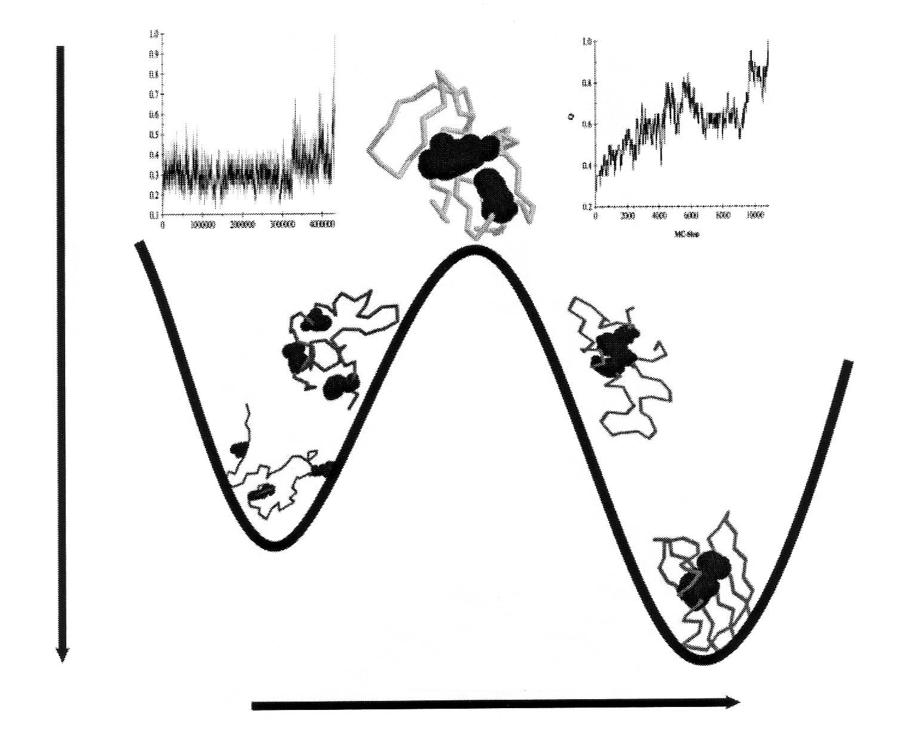
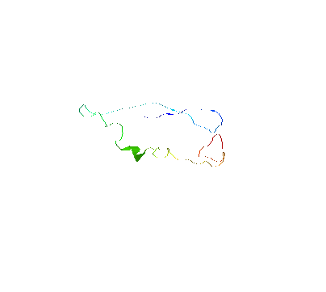
De novo methods search for a stable structure by simulating protein folding.
Transition state
- Free energy
Unfolded protein
Folded protein
Reaction coordinate

Slide 6
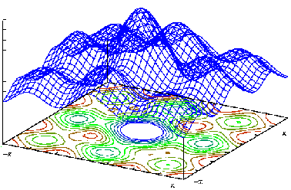
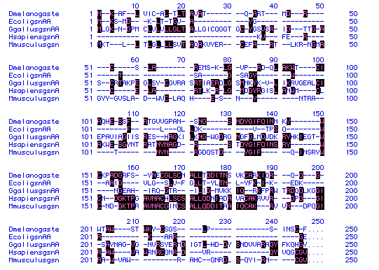
Most proteins have complicated 3D structures requiring efficient algorithms.
De novo
?
Comparative

Slide 7
Utilize de novo simulation to support comparative alignment and vice versa.
Cooperative Approach:
Protein
folding
Clustering
Sampling
Sequence
alignment

Slide 8
Determine protein structure from amino acid sequence using comparative alignment and protein folding simulation.
Protein
folding
Sequence
alignment

