Slide 1

BootCamp Project
TrueCaller

Slide 2
TrueCaller(TC) App A Global Phone Directory
Workflow
User Registers with the App
Uploads Phonebook data to TC servers
TC knows contact name of corresponding numbers.
Each person who register's the app and upload the contact, TC keeps growing

Slide 3
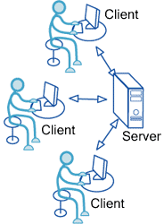

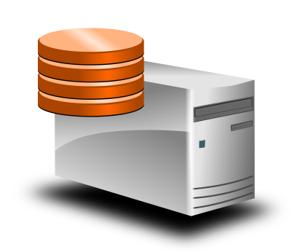
TrueCaller WorkFlow

Slide 4
TrueCaller App Design
Technologies Used
DB (MySQL DB)
Java(Business Logic)
REST API(Maven support for JAX-RS and Jersey)
Postman UI

Slide 5

App Workflow
Client
(POSTMAN Tool)
Signup/Register
REST API URI’s
Client
(POSTMAN Tool)
Upload Contacts
Register User or Login
Client
(POSTMAN Tool)
Search Contacts

Slide 6
Class Design
PhoneBook<Class>
-------------------------
Ph_book_id
Username
Password
Email
-------------------------
Getters
Setters
Contact<Class>
---------------------------
Contact_id
Contact_Name
Description
Location
---------------------------
Getters
Setters
UserService<Class>
--------------------------
PhoneBook obj
ContactService<Class>
-------------------------------
Contact obj
UserResource<Class>
------------------------------
UserService obj
ContactResource<Class>
-------------------------------------
ContactService obj
DatabaseService<Class>
--------------------------------------
UserService obj

