Slide 1


NIKE ANALYSIS Final Project – Financial analytics – Dab-401
Karan Hareshbhai Boghara 0795615
Mahima Gupta 0787630
Sukhjeet Kaur 0774458
Priyal Hetalkumar Patel 0795099
Rechel Thomas Rebello 0787548

Slide 2


INTRODUCTION
Nike was established in 1964 by Bill Bowerman and Phil Knight. It is one of the world's largest and most recognized sports brands, known for its innovative designs and cutting-edge technology in athletic wear.
Nike offers a wide range of athletic footwear, apparel, and accessories for various sports and activities. Their offerings include performance-oriented running shoes, basketball shoes, soccer cleats, workout apparel, sports bras, and lifestyle sneakers.
Here we are taking 2 year of data to analysis which is year 2021-2023

Slide 3
Macroeconomic Environment:
The global economy has been impacted by the COVID-19 pandemic, with widespread lockdowns and disruptions in supply chains leading to economic slowdowns in many regions.
Vaccination efforts and easing of restrictions in many regions have resulted in a rebound of economic activity.
Business Cycle:
Nike Inc. has shown consistent growth over the past decade, driven by its strong brand recognition and innovative product lines.
The pandemic and resulting economic slowdown has impacted Nike's growth.
Current Industry Environment:
- The sports footwear and apparel industry has been impacted by the COVID-19 pandemic, with many physical retail stores closed during the pandemic.- The industry has adapted by increasing e-commerce sales.- There has been an increased focus on sustainability and ethical production practices in the industry.

Slide 4

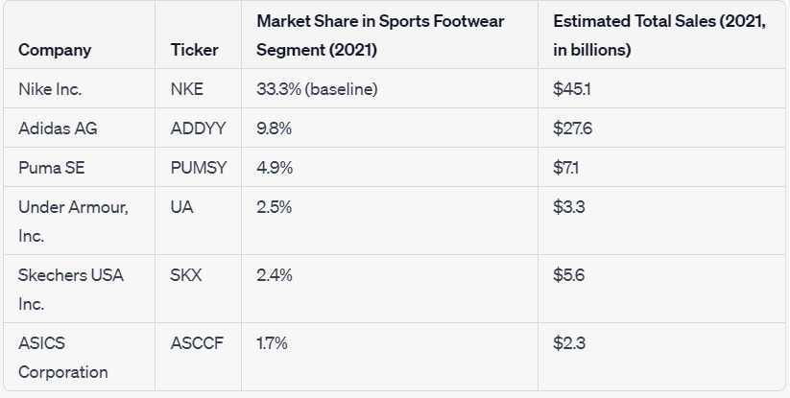
Market Share and Competitors

Slide 5
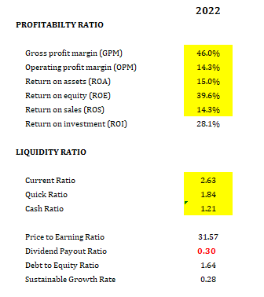
Ratio Analysis

Slide 6
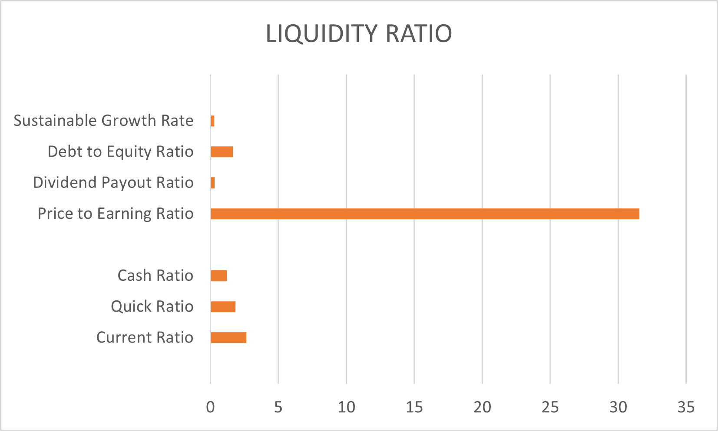
=
These ratios suggest that the company is profitable and efficient in generating profits from its sales revenue, assets, and investments, but may need to manage its debt levels and carefully balance dividend pay-outs with reinvesting in its future growth.

Slide 7

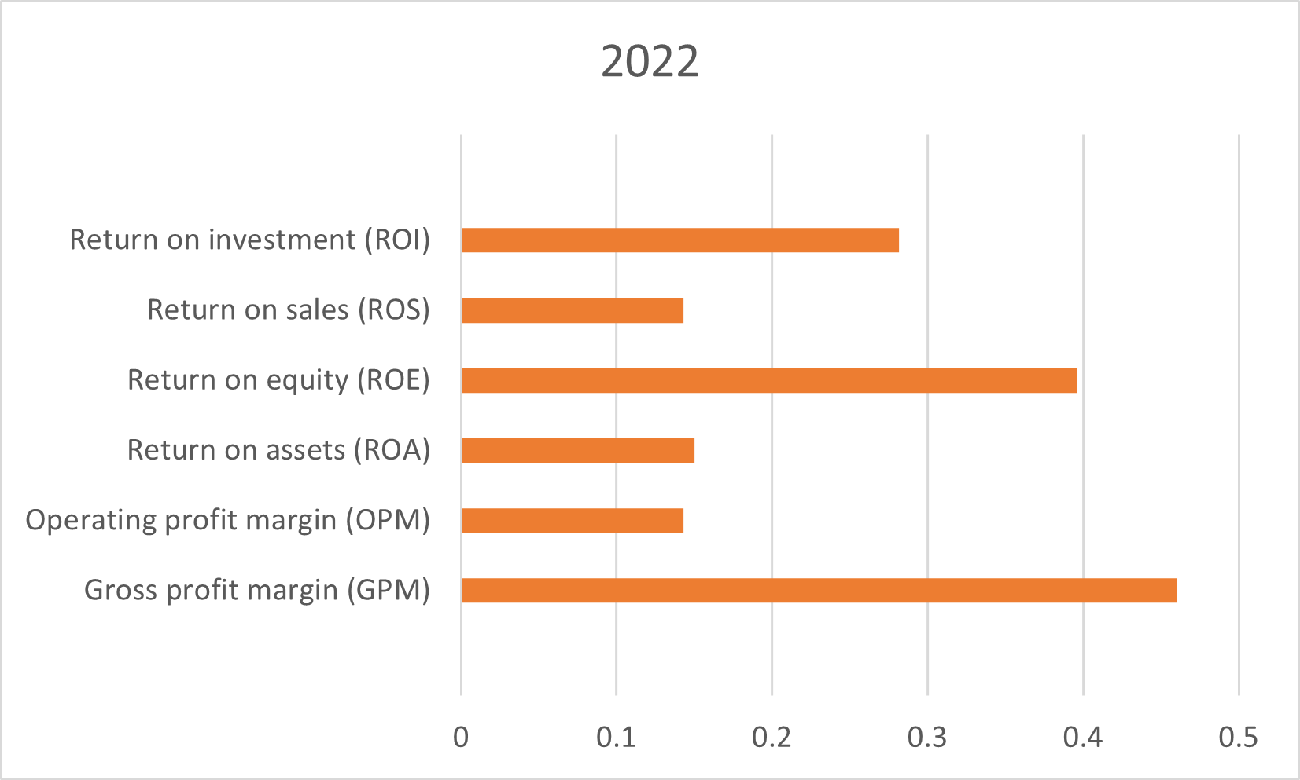
Profitability Ratio The high ROE and ROI ratios indicate that the company is generating substantial profits relative to its equity and investment, while the high GPM and OPM ratios indicate that the company is able to maintain high profit margins even after deducting various expenses.

Slide 8
Particulars | Values
Value OF beta | 1.261
Risk Free rate | 3.41%
Expected Market Return (RM) | 0.0008%
Required Return (RA) | -1%
CAPM
Given that the CAPM's beta calculation is higher than Yahoo Finance's reported beta
It is likely that the stock is more volatile and susceptible to market fluctuations.
Beta, however, should not be the only aspect taken into consideration when analyzing a stock.
The company's financial stability, competitive position, industry trends, management organization, and general market conditions should also be considered.
Based on the analysis of these factors, a potential investor may think about purchasing the stock even if the Beta calculated using CAPM is higher than the Beta reported by Yahoo Finance whether the company has a strong financial position, operates in a growing industry, has a competitive advantage, and has a positive outlook.

Slide 9
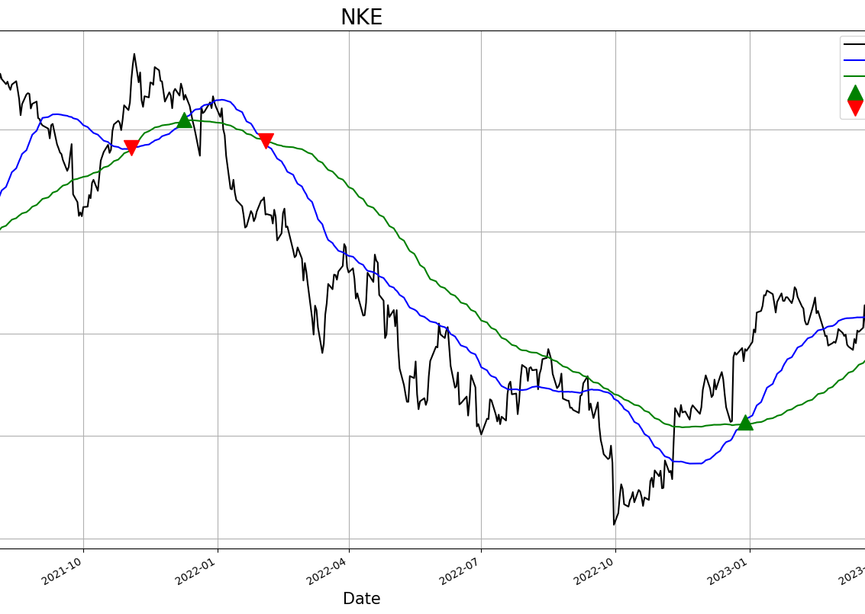
SMA Simple Moving Average
SMA is a statistical computation that is frequently used in data analysis, particularly in time series and financial research.
It entails calculating the average of a group of data points across a predetermined time period or number of points.
SMA uses equal weights for each data point to get the average of the data points inside the window.

Slide 10
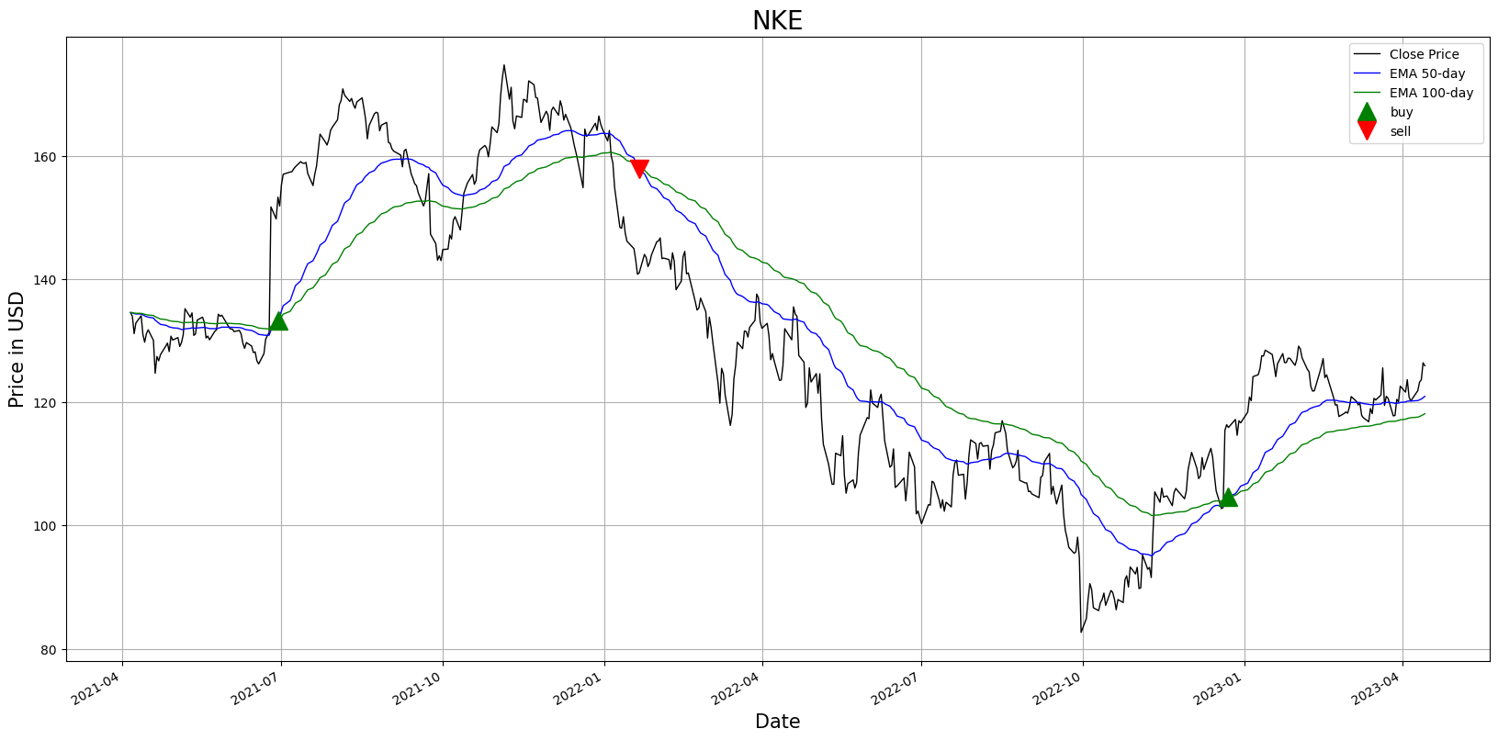
EMA
Exponential Moving Average (EMA) is a commonly used statistical calculation in financial analytics that helps to smooth out price data and identify trends over time.
EMA is used in technical analysis to generate buy or sell signals, identify potential support and resistance levels, and analyze market trends in financial instruments such as stocks, currencies, and commodities.

Slide 11
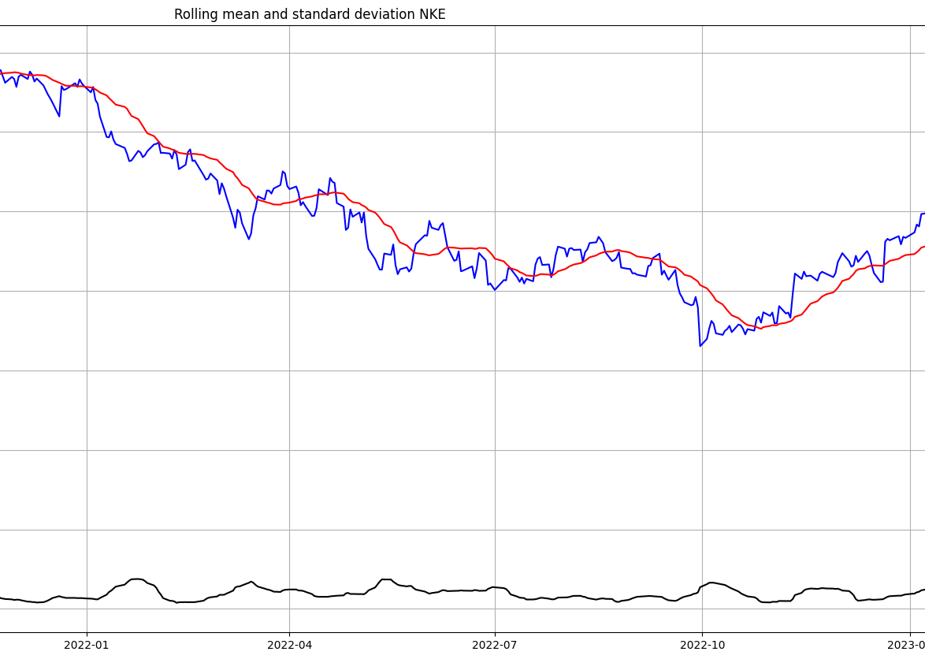
Rolling mean and standard deviation are used to analyze historical data, identify trends, and detect potential changes in the underlying data series over time. They are commonly used in technical analysis, risk management, and investment strategies to make informed decisions and assess the performance and risk of financial assets such as stocks, bonds, and other securities.

Slide 12
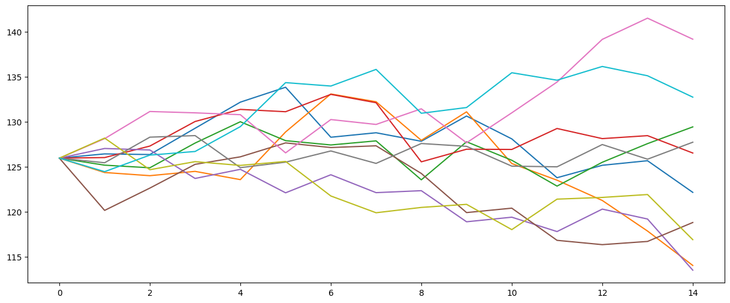
Monte Carlo Simulations
Monte Carlo Stimulation is a mathematical technique that predicts possible outcomes of an uncertain event.
Nike's stock opened at $127 per share and quickly surged to a peak of about $143per share before fluctuating between $143 and $127 per share over the next 15 days.

Slide 13
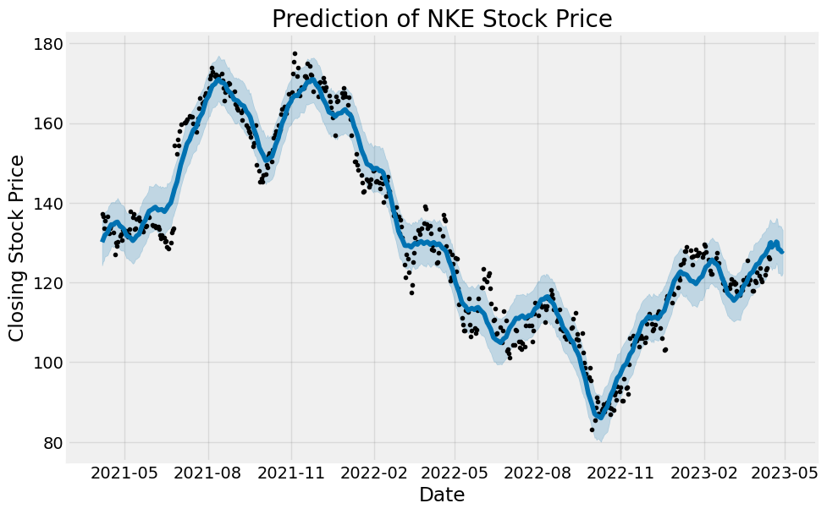
FBPROPHET MODEL
The following graph displays the stock price prediction for Nike.
The price fluctuation range is indicated by the blue shaded area.
The value is represented by black dots.

Slide 14
FBPROPHET MODEL COMPARISON WITH MONTE CARLO SIMULATION FORECASTIONG OF 15 DAYS:
AT Starting from the point where Nike's stock price has been going higher over the past 15 days, if that upward trend continues as the fbprophet model indicates, it may be a sign that the stock price is likely to rise and a good time to buy the shares.
However, if the model indicates a downward trend, it may be a sign that the stock price will likely go down in the future and that it is a good opportunity to sell the stock.

Slide 15
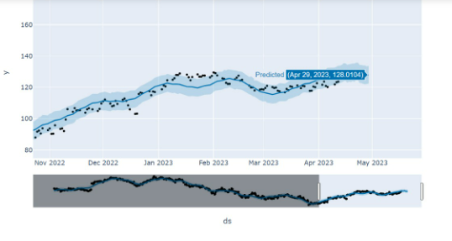
However when making investment decisions, it's important to take other aspects into consideration and not just rely on the model's projections.

Slide 16
Thank You

