Slide 1
Recipy
Robin
Janneke
Raquel

Slide 2
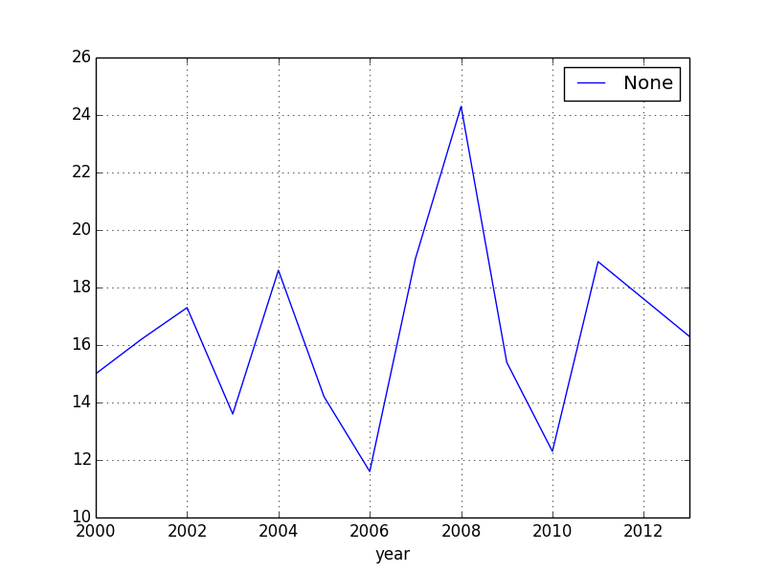
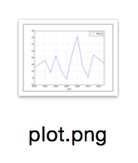
?
Without effort…
Notes:
What’s the problem that is being solved and how are you trying to solve it?
Are you doing something new, better, slick or really useful to yourself or others?
Is the solution purely self-serving, or is it enabling in some other way. Just doing your normal everyday work with a bit of extra help may not get the best marks unless you provide reasons as to how this benefits a wider community of potential users/developers etc.
The advice here is indicative; other justifications in this space are welcome (within the constraints of presenting).

Slide 3
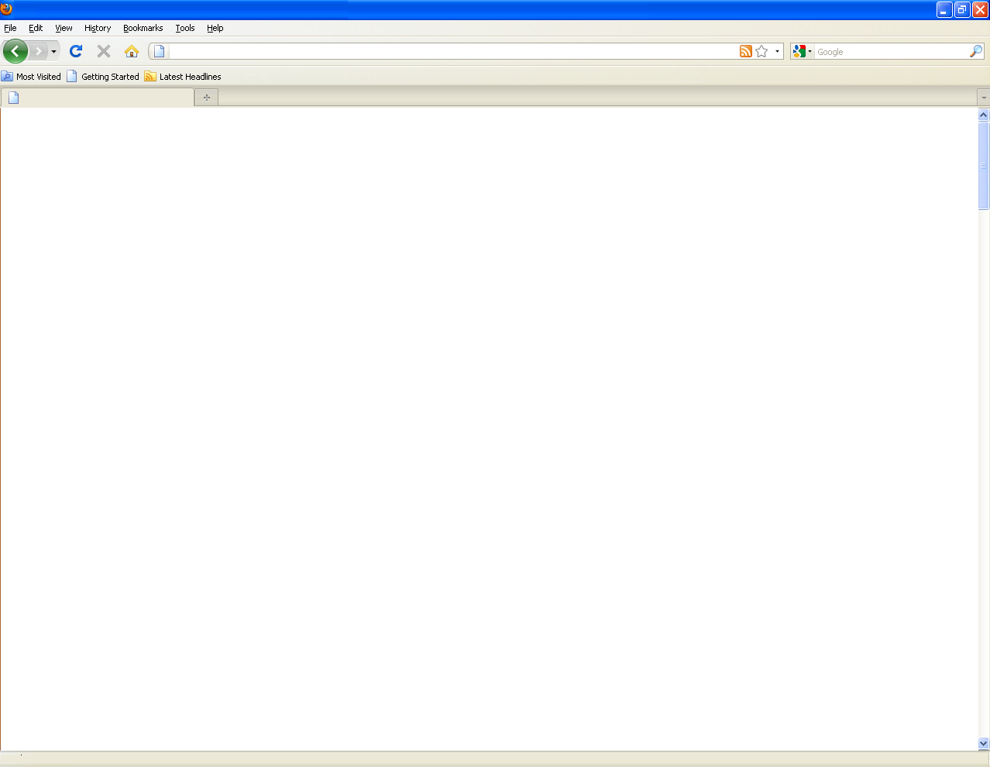
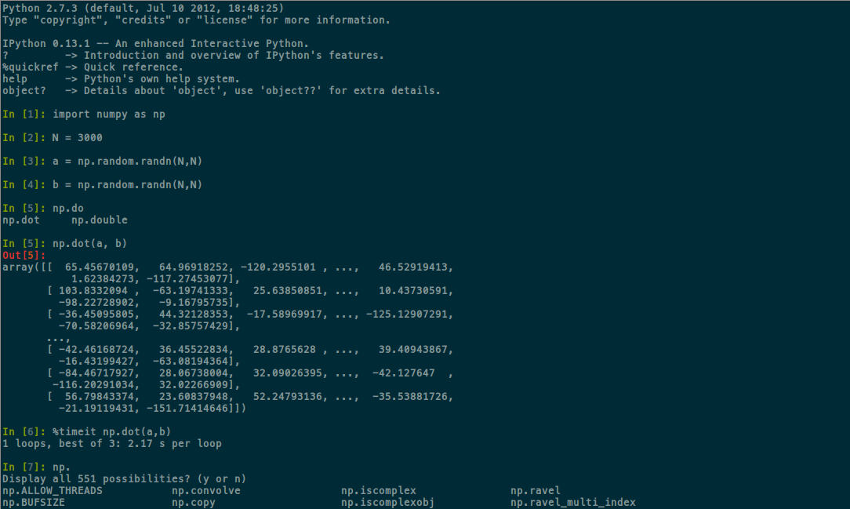








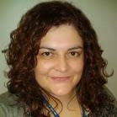

Implementation and infrastructure
Notes:
Is a source code repository being used? Is there documentation? Are appropriate services and infrastructure being used (e.g. cloud computing, databases)?
If you are building on existing work, it’s essential that you are clear about what was done specifically at the HD in terms of adding features and functionality etc. (If this is not clear you will lose marks).
Does the solution work for the stated purpose - can this be shown during the demo?

Slide 4
Demo
Notes:
Was it clear how the work could be taken forward in the future, could it modify existing work or be part of a new paper, initiative or bid?
Were ideas of future steps provided?

Slide 5
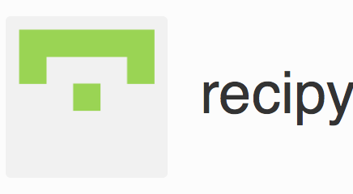
Project reproducibility
All open source (Apache license)
Full README for all repositories
MongoDB code snippets in repo
https://github.com/recipy
Enables reproducibility without effort
Notes:
Was the source code available on an open repository at presentation time? Teams may choose to work open or work closed. However, building and being able to build on each others work during the HD will be viewed favourably.
If you happen to decide that you want a publication from this work then you may choose to be open about your methods but not your data, for example.
Ideally there should be a README covering configuration, make and run instructions included with the code. In addition there should be a brief description of the project and what the software/scripts do along with a license.

Slide 6
Future potential
Designed to be extensible
Language-specific stuff just writes to DB
UIs read from DB
Python hooks are designed to be really simple to implement – data-based
Future Steps
See GitHub issues
DB plugins for other technologies: Matlab, Java, …
Add more Python hooks
Git integration
Notes:
Was it clear how the work could be taken forward in the future, could it modify existing work or be part of a new paper, initiative or bid?
Were ideas of future steps provided?

