Slide 1
HOUSE PRICE PREDICTION
TEAM MEMBER:
Name : BHARKAVI N
Roll No : 231801023

Slide 2

Problem Statement:
Develop a machine learning model to predict house price based on various features such as number of bedrooms, square footage, location and other relevant factors.
OBJECTIVE :
To develop a predictive model that estimates house prices based on a variety of input features, such as location, square footage, number of bedrooms and bathrooms, age of the property, and local economic indicators. The model aims to provide reliable price predictions that can help stakeholders navigate the housing market more effectively.

Slide 3
DATA COLLECTION
1. Historical Housing Data:
Sales prices, property features (size, bedrooms, bathrooms), and transaction dates.
2. Economic Indicators:
4.Market Trends:
5. Additional Factors:
3. Geographic Data:
Median income, employment rates, and economic growth data.
Location attributes such as neighborhood characteristics and proximity to amenities (schools, parks).
Historical trends in property prices, average days on market, and inventory levels.
Property age, condition, and unique features (e.g., pool, garage).

Slide 4
DATA PREPARATION
COLLECT THE DATA
HANDLING NULL VALUES AND MISSING DATA
FIND THE CORRELATION USING HEAT MAP
REGULARISATION
1. Data Cleaning:
4. Data Splitting:
5. Data Validation:
3. Feature Engineering:
Split dataset into training (80%) and testing (20%) sets.
Handle missing values (imputation/removal).
2. Data Transformation:
Create new features (e.g., price per square foot, property age).
Select important features using correlation analysis.
Normalize/standardize numerical features.
Encode categorical variables (one-hot/label encoding
Implement k-fold cross-validation for robustness.
Remove duplicate entries.

Slide 5
WORK FLOW
Gather historical housing data, economic indicators, and geographic information from reliable sources (e.g., real estate databases, government records).
Evaluate both models using appropriate metrics.
Monitor the model’s performance regularly and make adjustments as necessary to adapt to evolving market trends.
Split data into training and test sets.
Preprocess data to handle missing values and encode categorical variables.
Train the final model on the complete training dataset with optimized parameters.
Deploy the model for real-time price predictions, allowing users to input property features.
Continuously update and retrain the model with new data to ensure accuracy over time as market conditions change.

Slide 6
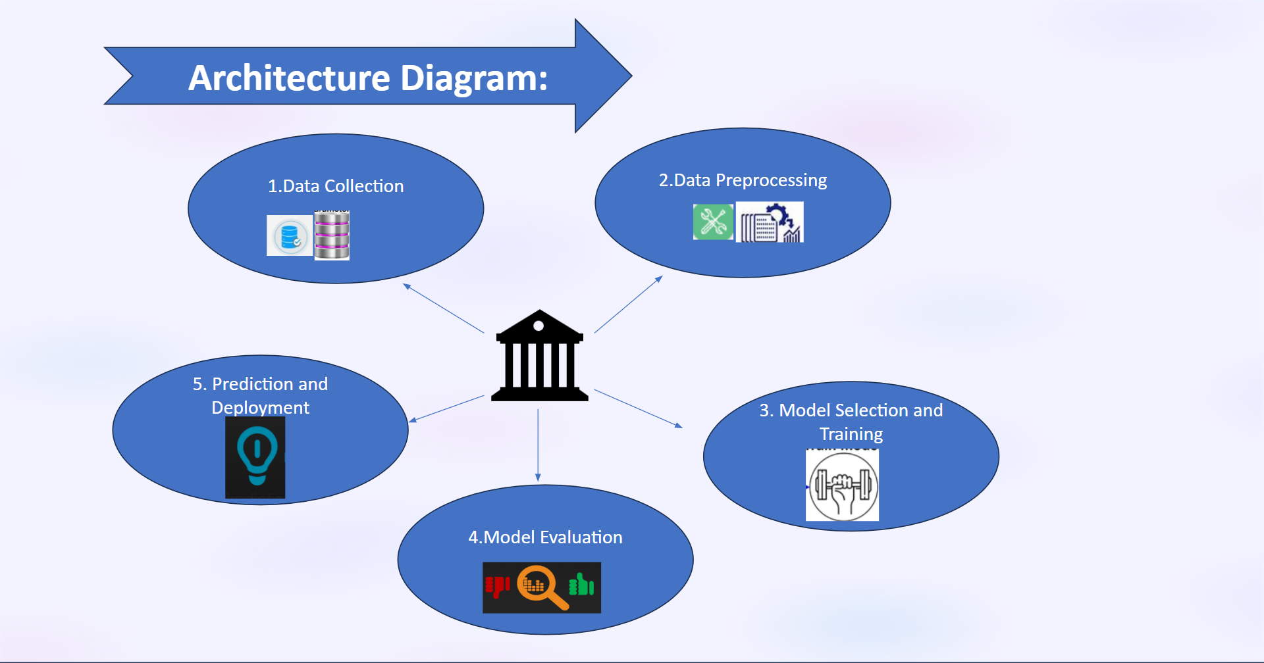

Slide 7
RESULTS
DISCUSSION
Feature Importance:
Identify key features influencing house prices (e.g., location, square footage).
Use visualizations (e.g., bar charts) to illustrate feature significance.
Predictions vs. Actual Prices:
Show a comparison of predicted prices versus actual prices using scatter plots.
Highlight areas of accurate predictions and notable discrepancies.
Model Performance:
Present evaluation metrics (e.g., RMSE, R-squared).
Compare multiple models (e.g., linear regression, decision trees) to highlight the best performer.
Interpretation of Results:
Discuss how the model’s predictions align with real-world pricing trends.
Analyze why certain features had more influence on price predictions.
Limitations:
Acknowledge limitations (e.g., data quality, model assumptions).
Discuss potential biases in the data that may affect predictions.
Implications:
Explore how findings can assist stakeholders (buyers, sellers, agents) in the real estate market.
Suggest how the model can be adapted or improved for specific markets or scenarios.

Slide 8

CONCLUSION
Summary of Findings:
Recap the effectiveness of the predictive model in estimating house prices.
Future Work:
Recommend areas for further research (e.g., incorporating additional data sources, exploring advanced algorithms).
Final Thoughts:
Emphasize the importance of data-driven insights in the real estate market and the potential for improved decision-making.

Slide 9
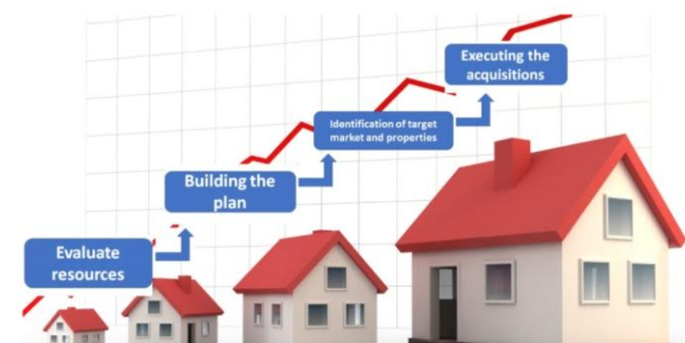
REFERRENCES:
HOUSE PRICE PREDICTION – BY VARUN THYAGI
ML HOUSE PREDICTION MODEL – PYTHON GEEKS
HOUSE PRICE PREDICTION – BY ABISHEK SHARMA

