Slide 1
$fin123
Decision Infrastructure for Investment Research
Data Infrastructure
Execution Infrastructure
Decision Infrastructure
Bloomberg
OMS
$fin123
+
+
FactSet
EMS
Visible Alpha
Risk
Compliance
Investment decisions became production workflows.
$fin123
01

Slide 2
The Industry Built Infrastructure Around Data
Market + Fundamental Data Layer
Bloomberg
FactSet
Visible Alpha
Snowflake
Databases
Centralized. Structured. Queried. Governed.
$fin123
02

Slide 3
The Industry Built Infrastructure Around Execution
Order Lifecycle
OMS
EMS
Risk
Compliance
Routed. Monitored. Controlled. Recorded.
$fin123
03

Slide 4
Research Still Lives In Files
Excel
Word
PDF
Email
Chat
Forecast Changed
Why?
$fin123
04

Slide 5
CORE THESIS
Investment Decisions Are Workflows
Observation
Research
Discussion
Forecast
Decision
Position
Outcome
The decision process is now a production system.
$fin123
05

Slide 6
One Workflow. Five Stakeholders.
Analyst
PM
Decision Model
Head of Research
Trading Desk
Compliance
$fin123
06

Slide 7
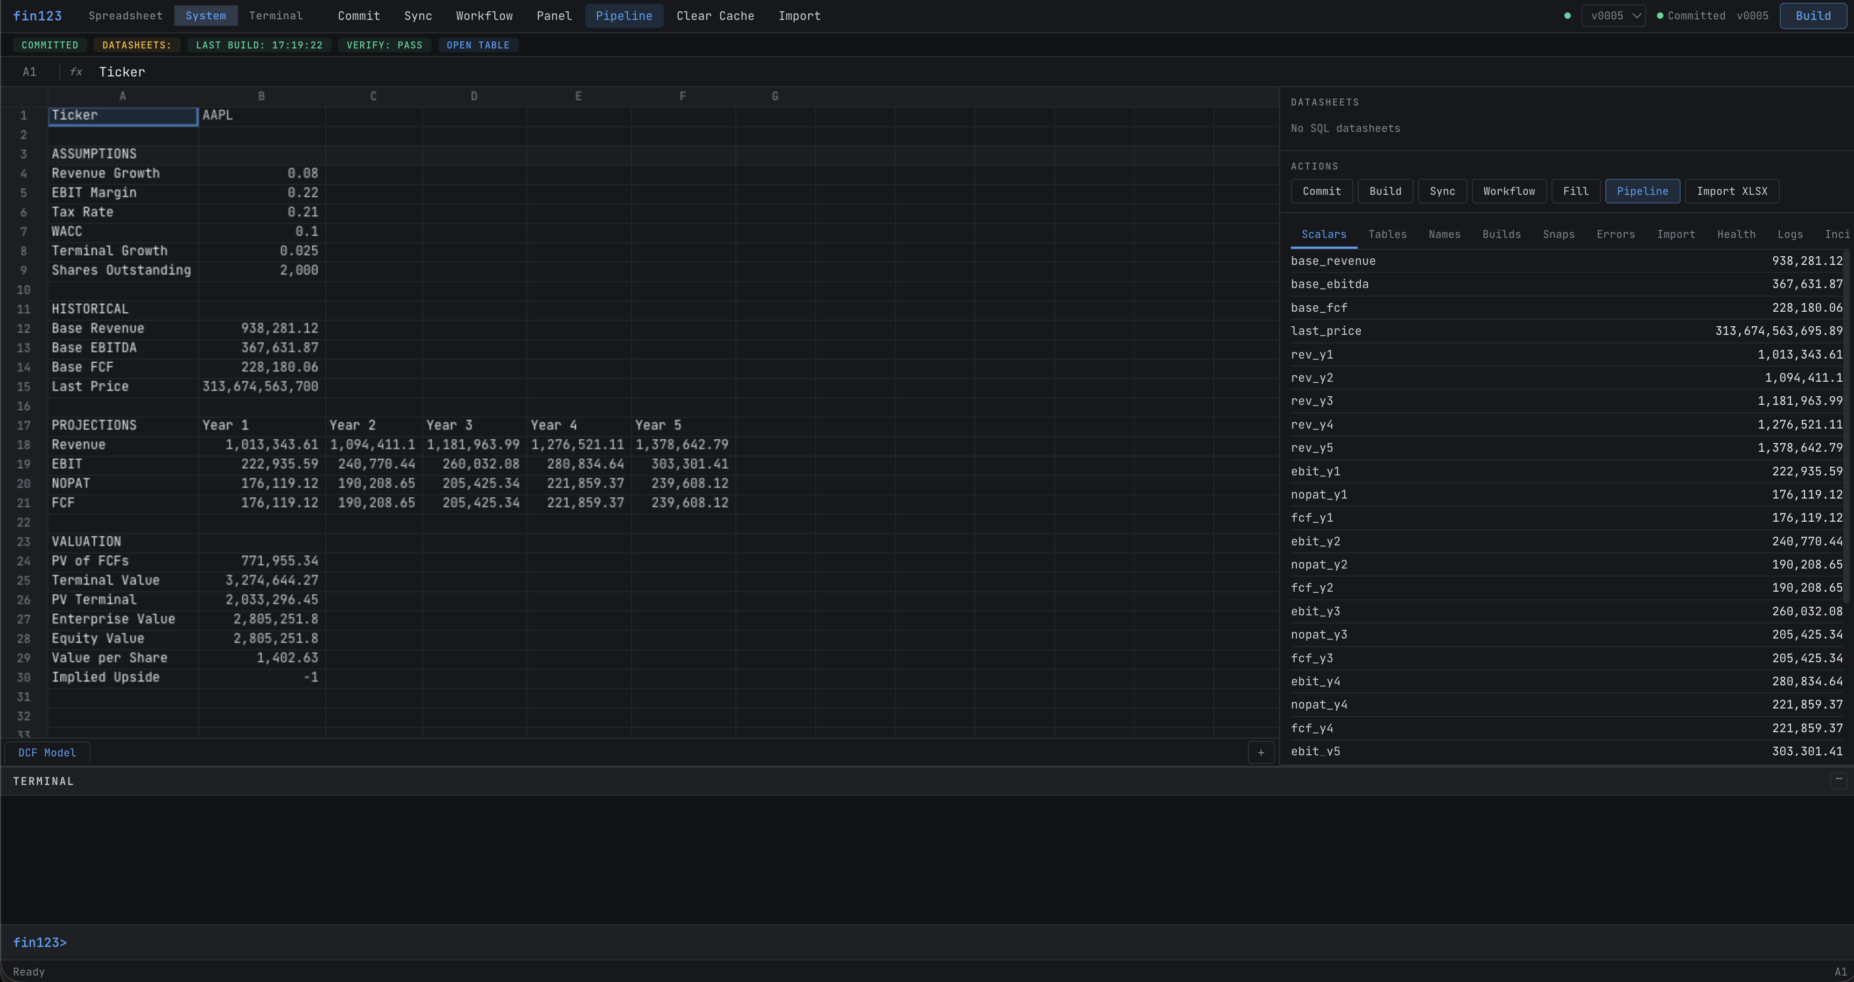
Analyst
How do I build it?
Data
AI
Decision Model
Versions
Scenarios
Runs
$fin123
07

Slide 8
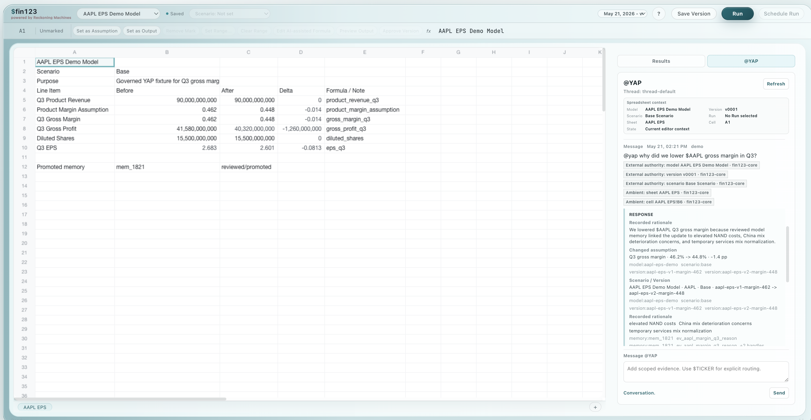
Portfolio Manager
Why did the estimate change?
Memory
Evidence
AI
Data
Methodology
Estimate
$fin123
08

Slide 9
Head of Research
How do I scale methodology?
House View
Coverage Universe
100 Companies
100 Results
Methodology becomes a reusable operating asset.
$fin123
09

Slide 10
Trading Desk
How do I fold real-time knowledge into the decision process?
Current state
Trader
Chat
Phone Call
Lost
Future state
Trader
YAP
Approved Memory
Forecast
Decision
$fin123
10

Slide 11
Market Knowledge Should Compound
Observation
Discussion
Review
Approved Memory
Future Decisions
Research compounds.
Data compounds.
Market knowledge should compound too.
$fin123
11

Slide 12
Compliance
Can I reconstruct the decision?
Data
Evidence
Decision
Replay
Audit
$fin123
12

Slide 13
ONTOLOGY
The Decision Model
Decision Model
Version
Scenario
Run
Result
Replay
Audit
$fin123
13

Slide 14
Workbook
Workbook
Spreadsheet
Document
Different surfaces.
Same governed substrate.
$fin123
14

Slide 15
Why Firms Adopt $fin123
Better Forecasts
Faster Research
Institutional Memory
Replayable Decisions
Governed AI
Decision Infrastructure
The industry built infrastructure around data.
The industry built infrastructure around execution.
$fin123 brings infrastructure to the decision process itself.
$fin123
15

