Slide 1

Contributing to OpenStack 201:
For the Not-so-New Contributor
Andrea Rosa – Scott D'Angelo

Slide 2
About us
Andrea Rosa:
- Software Engineer @ hp
- Midclass OpenStack citizen* since Diablo release
- Twitter: @reclaro
- Email: andrea.rosa@hpe.com
- irc: andrearosa (not a registered nick yet :( )
Scott D'Angelo
- Senior Software Engineer @HP
- HP Public Cloud and Helion since Folsom release
- Email: scott.dangelo@hpe.com
- irc: scottda

Slide 3

Middle class OpenStack citizen

Slide 4




OpenStack contributors
MiddleClass

Slide 5

Share suggestions and tips

Slide 6


We do not want to get...
BANNED
BANNED

Slide 7

Share the pain
I've got a -1 on
my Patch set
Number 45
Because of a
Trailing white
Space

Slide 8

Why we are here

Slide 9


Slide 10

OpenStack community

Slide 11
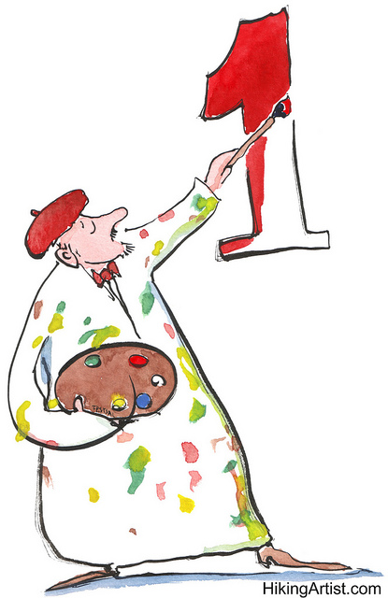
What slows down the process? Bad review
-

Slide 12

What slows down the process? You

Slide 13

What slows down the process? Core reviewers

Slide 14
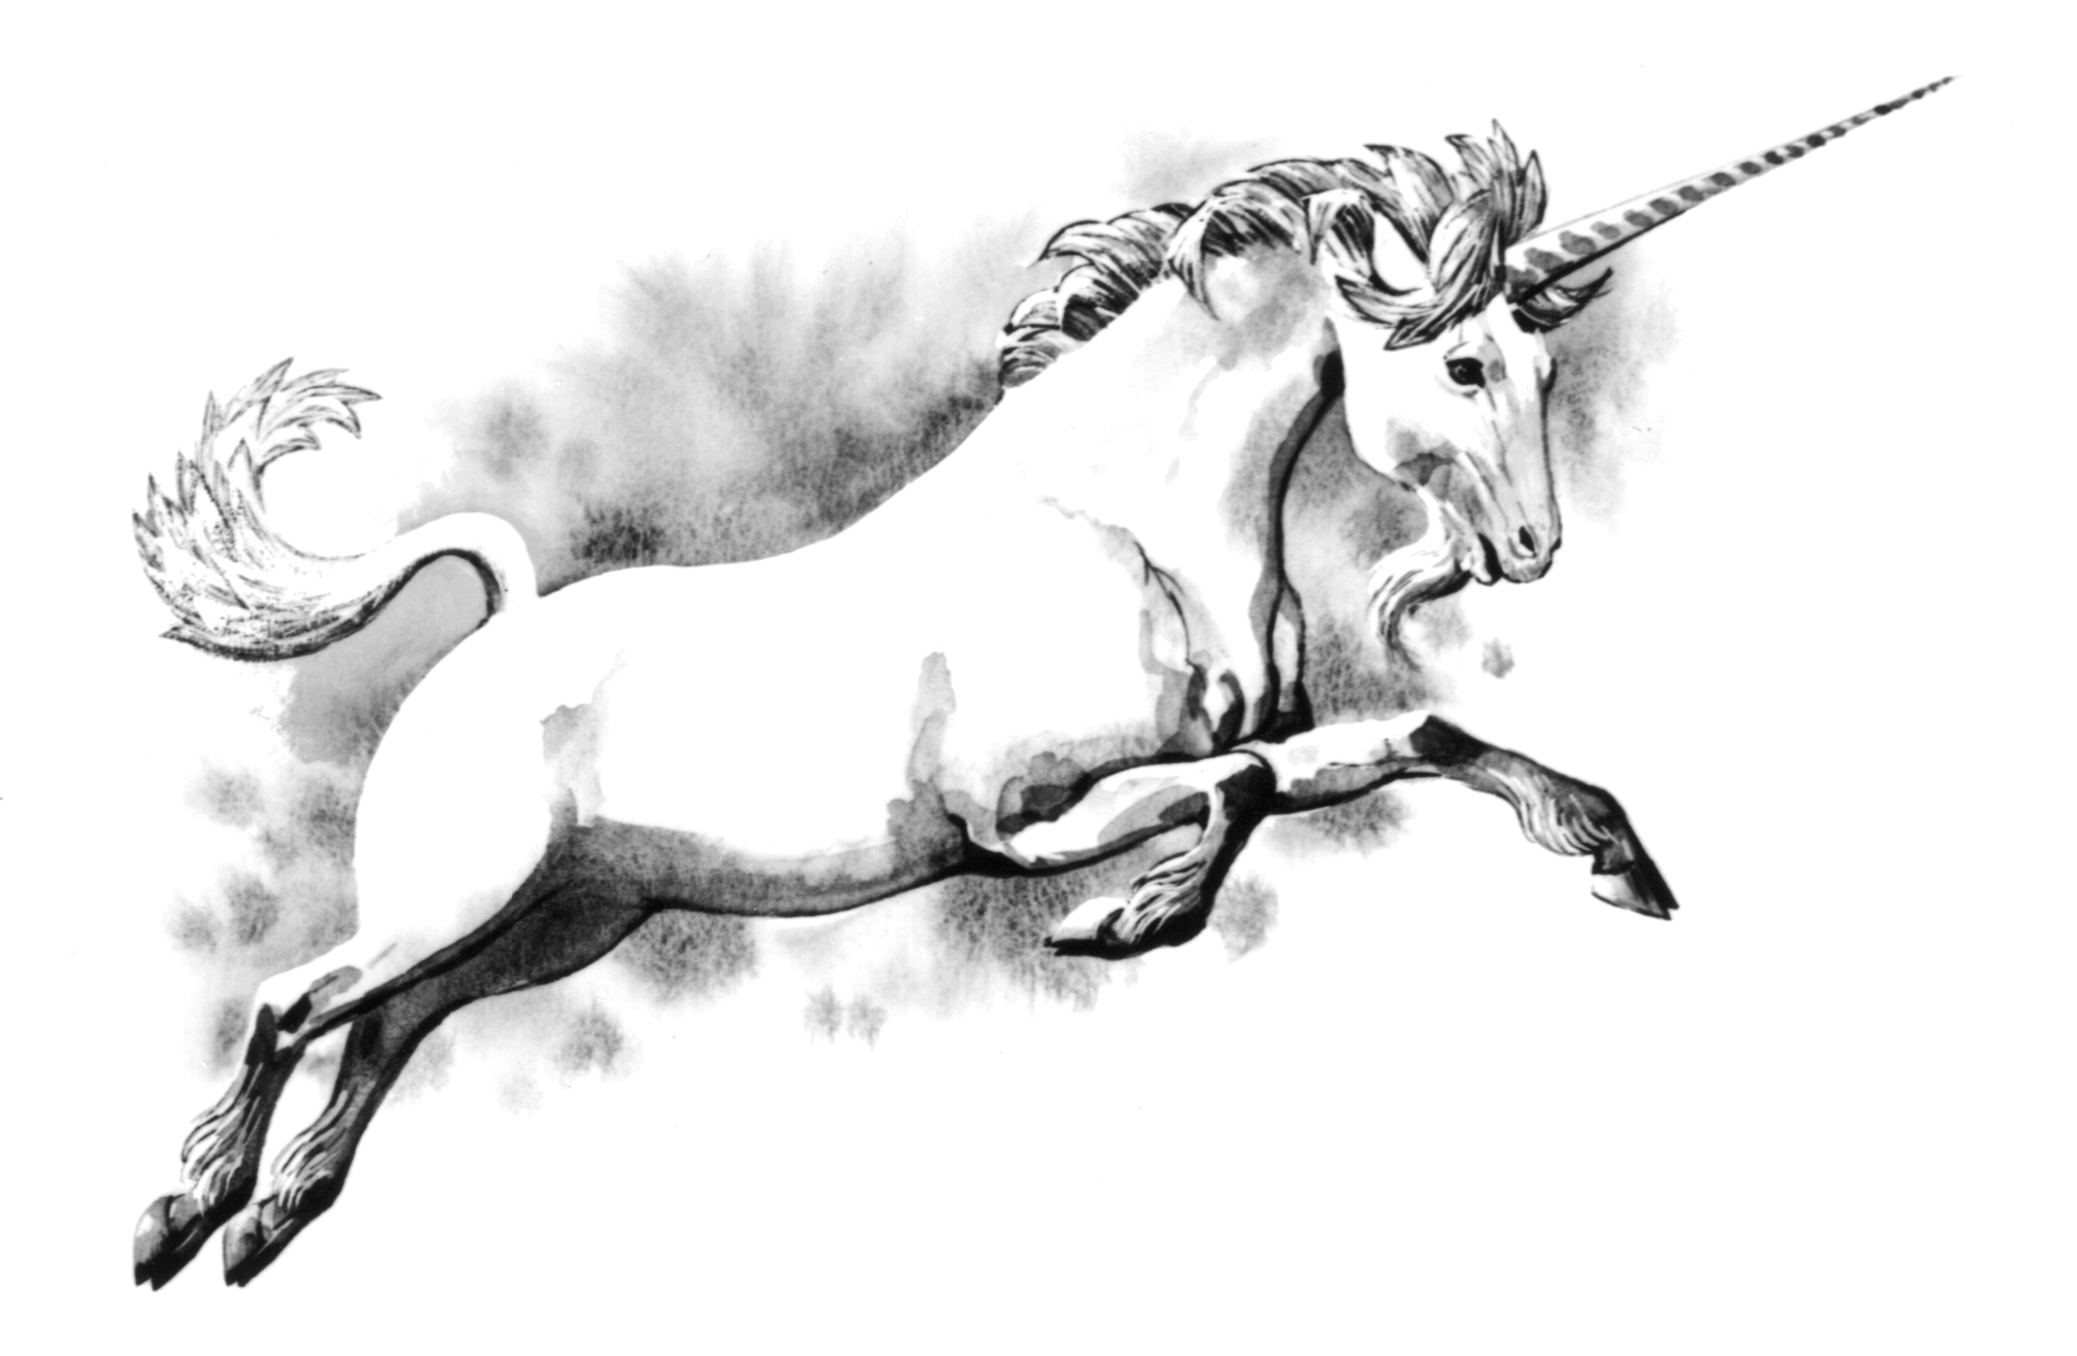
Core reviewers
They are the new Unicorn
They live in a secret land
They are for sure responsible for the dinosaurs extinction

Slide 15
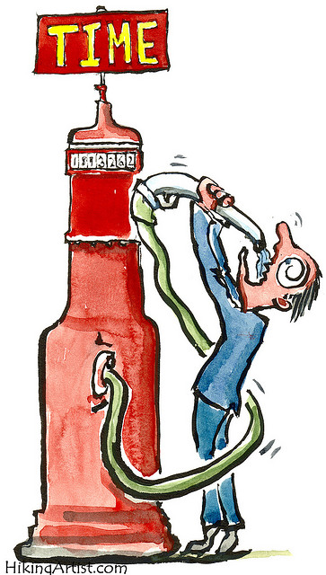
Demyth the myth
Normal people with a single BIG problem

Slide 16
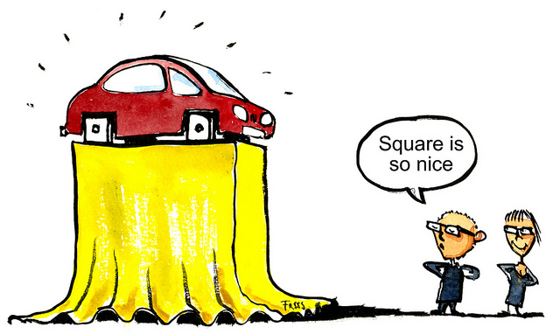
They are not always right
Advice:
“Be prepared to stand up for your design decisions if you think they are right, at least for the first person who disagrees. If you change your code every time somebody makes a suggestion, then you can end up being flipped and flopped between two choices. Wait for consensus, and if one doesn't seem to be emerging, ask a core to get one for you.”

Slide 17
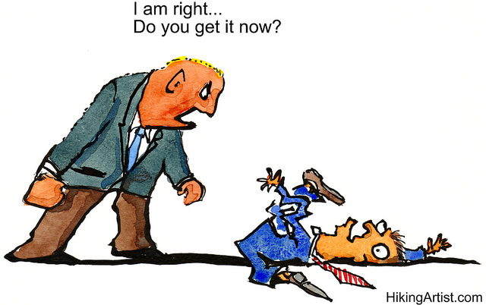
Don't be rude
Annoying:
“People who somehow forget that we are all humans and that we should respect each other and try to encourage each other.”

Slide 18
Annoying:
“Nothing, really. Every annoyance probably refers to a person not knowing the workflow. Therefore, it's just a new opportunity to share, explain and improve. I guess I'm really annoyed by jerks but we don't have those... not many at least ;) “

Slide 19
Annoying:
“Bad Commit Messages”
“Poor explanation of a patch's purpose.”

Slide 20
Commit Message < 72 characters
[openstack-dev] [all] -1 due to line length violation in commit messages Ihar Hrachyshka
[openstack-dev] [all] -1 due to line length violation in commit messages Dmitry Tantsur
[openstack-dev] [all] -1 due to line length violation in commit messages Vikram Choudhary
[openstack-dev] [all] -1 due to line length violation in commit messages Doug Hellmann
[openstack-dev] [all] -1 due to line length violation in commit messages Ivan Kolodyazhny
[openstack-dev] [all] -1 due to line length violation in commit messages Daniel P. Berrange
[openstack-dev] [all] -1 due to line length violation in commit messages Julien Danjou
[openstack-dev] [all] -1 due to line length violation in commit messages Victor Stinner
[openstack-dev] [all] -1 due to line length violation in commit messages Ryan Brown
[openstack-dev] [all] -1 due to line length violation in commit messages Thomas Goirand
[openstack-dev] [all] -1 due to line length violation in commit messages Jeremy Stanley
[openstack-dev] [all] -1 due to line length violation in commit messages Jim Rollenhagen
[openstack-dev] [all] -1 due to line length violation in commit messages Fox, Kevin M
[openstack-dev] [all] -1 due to line length violation in commit messages Russell Bryant
[openstack-dev] [all] -1 due to line length violation in commit messages Jeremy Stanley
[openstack-dev] [all] -1 due to line length violation in commit messages Ian Wells
[openstack-dev] [all] -1 due to line length violation in commit messages Morgan Fainberg
[openstack-dev] [all] -1 due to line length violation in commit messages Gorka Eguileor
[openstack-dev] [all] -1 due to line length violation in commit messages Miguel Angel Ajo
[openstack-dev] [all] -1 due to line length violation in commit messages Andreas Jaeger
[openstack-dev] [all] -1 due to line length violation in commit messages Gorka Eguileor
[openstack-dev] [all] -1 due to line length violation in commit messages Zane Bitter
[openstack-dev] [all] -1 due to line length violation in commit messages Assaf Muller
[openstack-dev] [all] -1 due to line length violation in commit messages Kyle Mestery
[openstack-dev] [all] -1 due to line length violation in commit messages Jeremy Stanley
[openstack-dev] [all] -1 due to line length violation in commit messages Kevin Benton
[openstack-dev] [all] -1 due to line length violation in commit messages Clint Byrum
[openstack-dev] [all] -1 due to line length violation in commit messages Gorka Eguileor
[openstack-dev] [all] -1 due to line length violation in commit messages Mike Spreitzer
[openstack-dev] [all] -1 due to line length violation in commit messages Assaf Muller
[openstack-dev] [all] -1 due to line length violation in commit messages Doug Wiegley
[openstack-dev] [all] -1 due to line length violation in commit messages Clint Byrum
[openstack-dev] [all] -1 due to line length violation in commit messages Fox, Kevin M
[openstack-dev] [all] -1 due to line length violation in commit messages Ihar Hrachyshka
[openstack-dev] [all] -1 due to line length violation in commit messages Zane Bitter

Slide 21

Annoying:
“Poor explanation of a patch's purpose.”

Slide 22

Commit Message:
Should Have Bug or Blueprint Reference for tracking
Should not link to information, should contain the information

Slide 23

Annoying:
no attempt to read the openstack guidelines
http://docs.openstack.org/infra/manual/developers.html

Slide 24
Add atomic conditional updates to objects
To allow atomic state changes across Cinder services we need to
implement a way to easily do compare-and-swap.
This patch adds methods to allow compare-and-swap on DB models and on
Cinder Versioned Objects as well.
Conditions for the compare part of the update can consist of:
- Inclusion: status == 'available'
- Exclusion: status != 'in-use'
- Multi-inclusion: status in ('available', 'error')
- Multi-exclusion: status not in ('attaching', 'in-use')
- Sqlalchemy filters
A complete example of usage would be the compare-and-swap used in volume
delete requests that has to take in consideration not only the status
but the attach and migration status as well as the volume not having
snapshots:

Slide 25
now = timeutils.utcnow()
expected = {'attach_status': db.Not('attached'),
'migration_status': None,
'consistencygroup_id': None}
good_status = ('available', 'error', 'error_restoring',
'error_extending')
if not force:
expected.update(status=good_status)
# Volume cannot have snapshots if we want to delete it
filters = [~sql.exists().where(models.Volume.id ==
models.Snapshot.volume_id)]
updated = vol_obj.conditional_update(
{'status': 'deleting',
'previous_status': vol_obj.model.status,
'terminated_at': now},
expected,
filters)
It can also be specified whether to save already dirtied fields from the
objects or not and by default (if no expected_values argument is
provided) it will make sure that the entry in the DB has the same values
as the objects we are saving.

Slide 26
We can select values based on conditions using Case objects in the
'values' argument. For example:
has_snapshot_filter = sql.exists().where(
models.Snapshot.volume_id == models.Volume.id)
case_values = volume.Case([(has_snapshot_filter, 'has-snapshot')],
else_='no-snapshot')
volume.conditional_update({'status': case_values},
{'status': 'available'}))
Exclusion and multi-exclusion will handle, by default, NULL values like
Python does instead of like SQL does, so NULL values will be considered
different than any non NULL values. That way if we search for something
not equal to 1 we will also get NULL values.
WARNING: SQLAlchemy does not allow selecting order of SET clauses, so
for now we cannot do things like
{'previous_status': model.status, 'status': 'retyping'}
because it will result in both previous_status and status being set to
'retyping'. Issue has been reported [1] and a patch to fix it [2] has
been submitted.
[1]: https://bitbucket.org/zzzeek/sqlalchemy/issues/3541
[2]: https://github.com/zzzeek/sqlalchemy/pull/200

Slide 27
Specs: https://review.openstack.org/232599/
Implements: blueprint cinder-volume-active-active-support
Related-Bug: #1490944
Related-Bug: #1238093
Related-Bug: #1490946
Related-Bug: #1469659
Related-Bug: #1493120
Related-Bug: #1493419
Related-Bug: #1493476
Related-Bug: #1494466

Slide 28

Testing

Slide 29

New feature

Slide 30

No Unit Tests

Slide 31
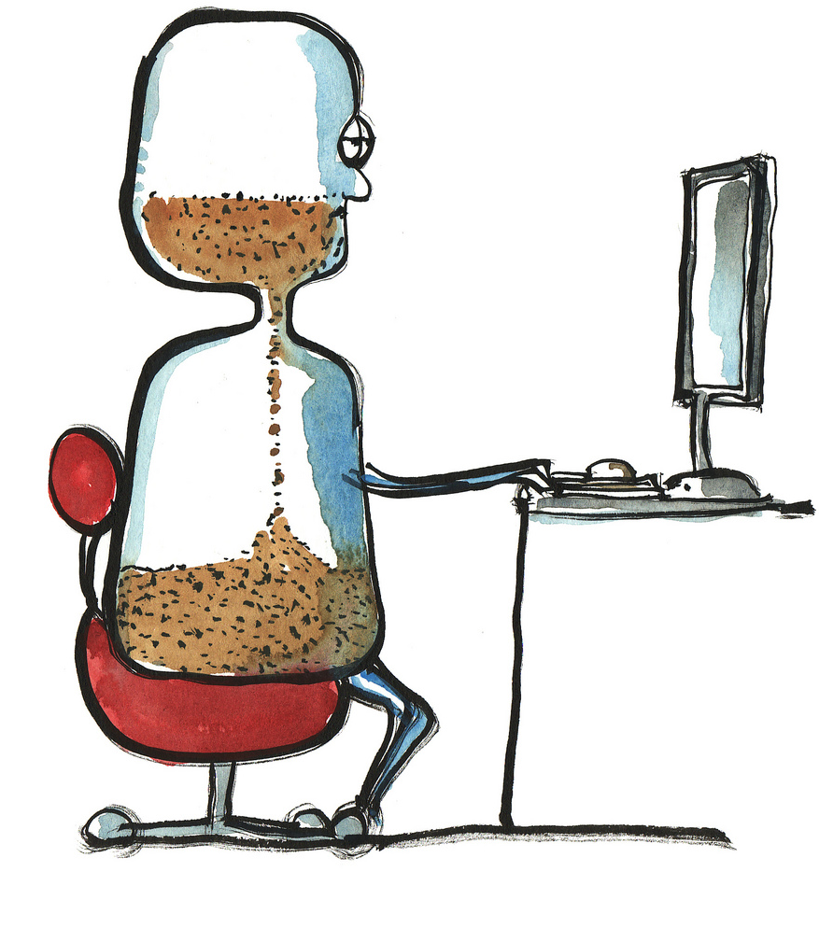
Pep8 and Tox
are your friends

Slide 32

Bug fixing
Write a RED test
Fix the code

Slide 33

There should be a reason to -1
Nitpicking
Opinion over style
Grammar error and Typos
Negative review with no comment
Give a 0

Slide 34


Typos and grammar

Slide 35
Suggestion: use conventional english
Super fish oil
Is not
Superficial

Slide 36

Advice:
“read the history of the patch”

Slide 37

Advice:
“figure out what the project priorities are at this time and ask PTL where you can help.”

Slide 38

Do not play (silly) strategies

Slide 39

Bad practice
Following +1 after a +2
Typo in commit message
Stackalytics
Abusing of -1

Slide 40

Good practice
Advice:
“Read more reviews!!”
“Review as much as possible”

Slide 41

Respond reviews ASAP

Slide 42
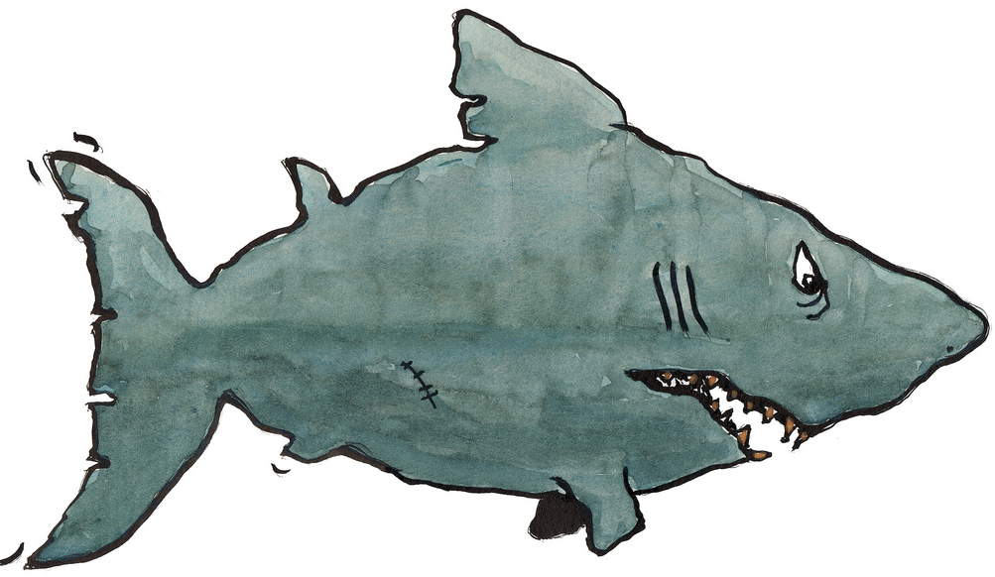
Annoying:
“patch authors that bully, guilt trip, or otherwise coerce people into reviewing their patches”

Slide 43

Co-authoring

Slide 44


Slide 45


Slide 46


Slide 47


Slide 48


Slide 49


Slide 50


Slide 51

Advice:
“Be prepared to be patient, reviews and merging take time. Even quick, simple things can often take a couple of weeks to crank through the system. “

Slide 52

It is never easy

Slide 53


Slide 54


Slide 55
“What could possibly go wrong?”

Slide 56


Slide 57

8 Patches
5 weeks
13 modified files
Not “just a single line change”

Slide 58

It is never easy

Slide 59

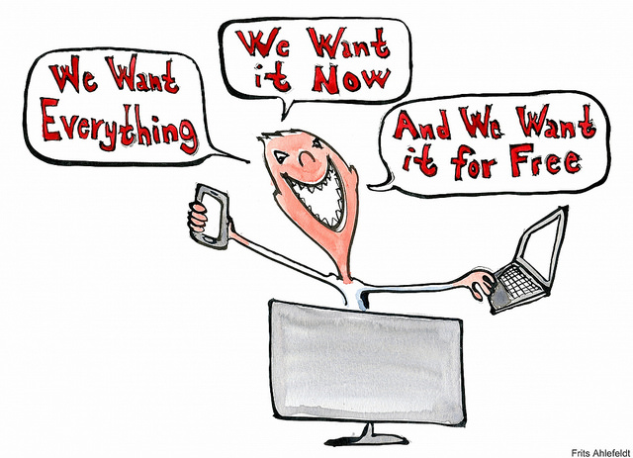
Set your goals in advance

Slide 60

Timing:
“Major Features can take longer than one release. Start early to gather opinions and discuss, write Blueprints and Specs, post POC code...”

Slide 61

How Much are you Influenced by the Author:
“A lot, because if I know the author I'm likely to have an opinion of their competence.“
:

Slide 62

Get Known!
Advice:
“Pay Attention”
“Ask more questions in IRC & ML & IRL“

Slide 63
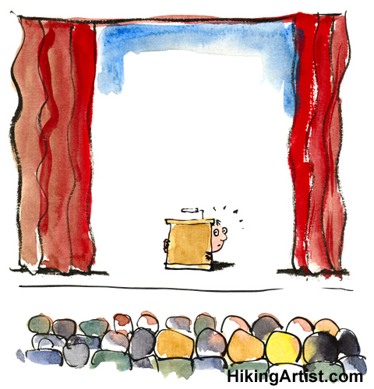
Don't be shy

Slide 64
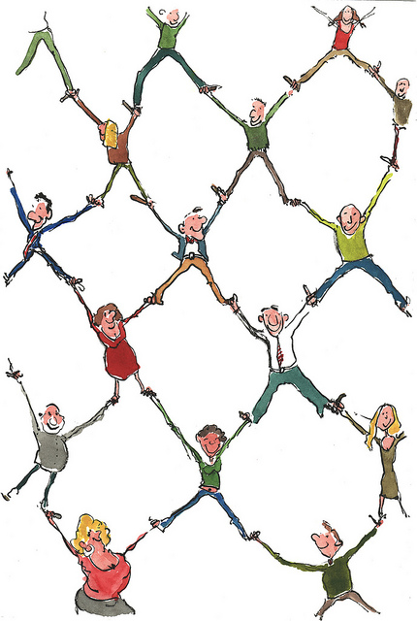
Make connections

Slide 65


Slide 66
HikingArts:
http://hikingartist.com/
NewBie
https://www.flickr.com/photos/ilike/4942572797
RockStar
https://www.flickr.com/photos/quirkybird/5241504561
MiddleClasS:
https://www.flickr.com/photos/meetthemediaguru/4097874133
Semaphore:
https://www.flickr.com/photos/lrosa/539090279
People in circle:
https://www.flickr.com/photos/lwpkommunikacio/16904900381/
Unicorn:
https://commons.wikimedia.org/wiki/File:Unicorn_(PSF).png
The Tower of Babel:
by Pieter Bruegel the Elder (1563) from wikipedia image

Slide 67
Questions?

