Slide 1
Integrated Campaign Registry (ICR)
A FHIR standard for reusable health-campaign data
UNICEF · Ona + Crosscut · worked examples: ESPEN MDA

Slide 2
1 The problem ICR solves
– Campaigns re-collect the same data every round — people, places, eligibility, coverage
– Results end up in one-off spreadsheets; the next round starts from scratch
– ICR: a shared, reusable data model so campaign data compounds
– UNICEF standards framework + open-source reference implementation, on HL7 FHIR R4
ESPEN MDA — An LF MDA re-registers every village and re-estimates every denominator, every round. ICR makes each of those a durable, reusable record.

Slide 3
2 What ICR is
– Core: a FHIR Implementation Guide — profiles, extensions, terminology
– Models what routine health systems don’t: campaigns, populations, geography, delivery, coverage
– Complement to WHO SMART Immunizations (routine-only) — “the campaign SMART-Guidelines IG”
– One typology: Type A fixed post · Type B house-to-house · Type C community-directed
– 17 profiles · 35 extensions · 25 code systems · 6 Measures · 41 worked examples
ESPEN MDA — Community-directed treatment with ivermectin (CDTI) is the canonical Type C model: a CDD treats a whole community against a village register.

Slide 4
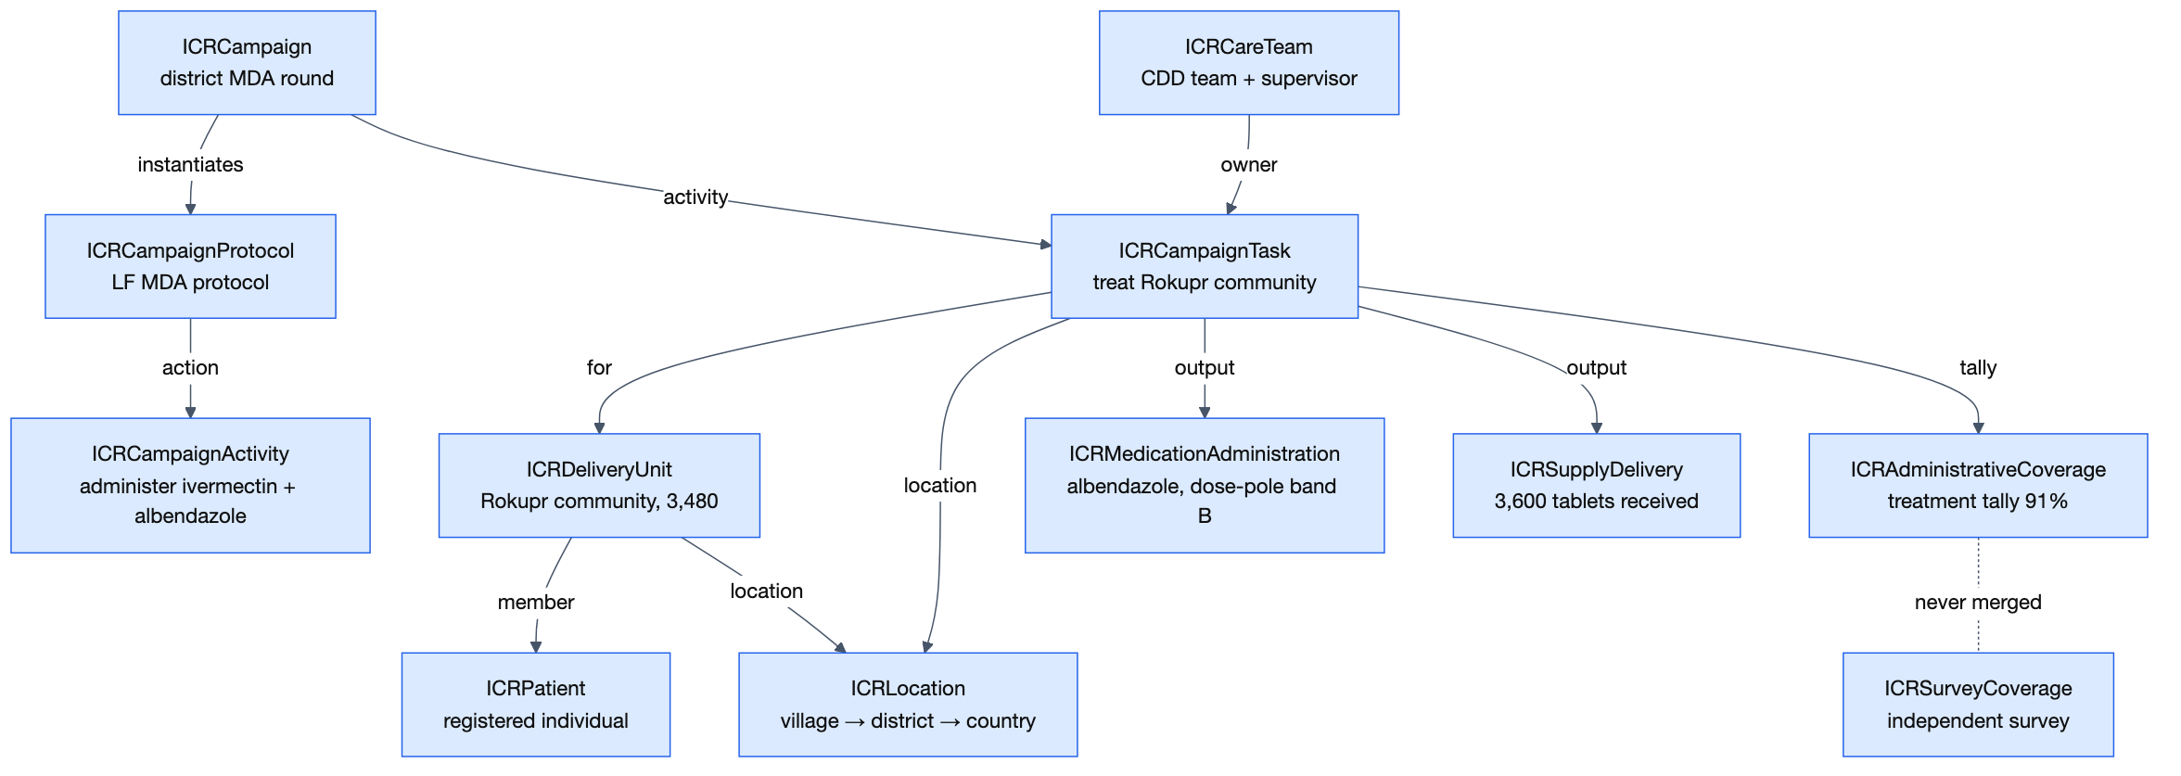
3 The data model at a glance
– Built on CarePlan — FHIR has no native Campaign resource
– Operational layer: protocol → campaign → task → delivery events
– Identity layer: Patient, Group, Location — who kept separate from where
– Analytics layer: Measure + MeasureReport
– Every profile is valid plain FHIR
ESPEN MDA — The diagram traces one MDA thread end to end — LF protocol to the Rokupr treatment tally.

Slide 5
4 Campaign Protocol — the reusable template
– PlanDefinition: the versioned template — define a campaign type once
– Every execution instantiates it → all rounds comparable, one query
– Carries no geography, dates, or denominator — those live on the execution
– Disease-agnostic type; mandatory, repeatable delivery strategies
ESPEN MDA — National LF MDA protocol: type mda, community-directed, ivermectin + albendazole, goal ≥65% epidemiological coverage. Every district round instantiates it.

Slide 6
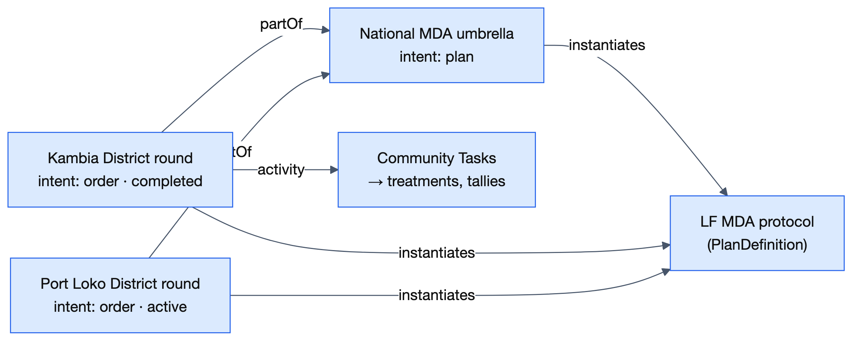
5 Campaign — the execution record
– CarePlan: one execution or round, pointing at exactly one protocol
– Starts as microplan (plan) → becomes the execution record (order) — same resource
– Umbrella and rounds are the same profile, linked by partOf
– One subject (the denominator); target geography separate and plural
ESPEN MDA — The national MDA is the umbrella; the Kambia round runs with its own denominator, dates, and tasks — mobilized via town criers and community leaders.

Slide 7
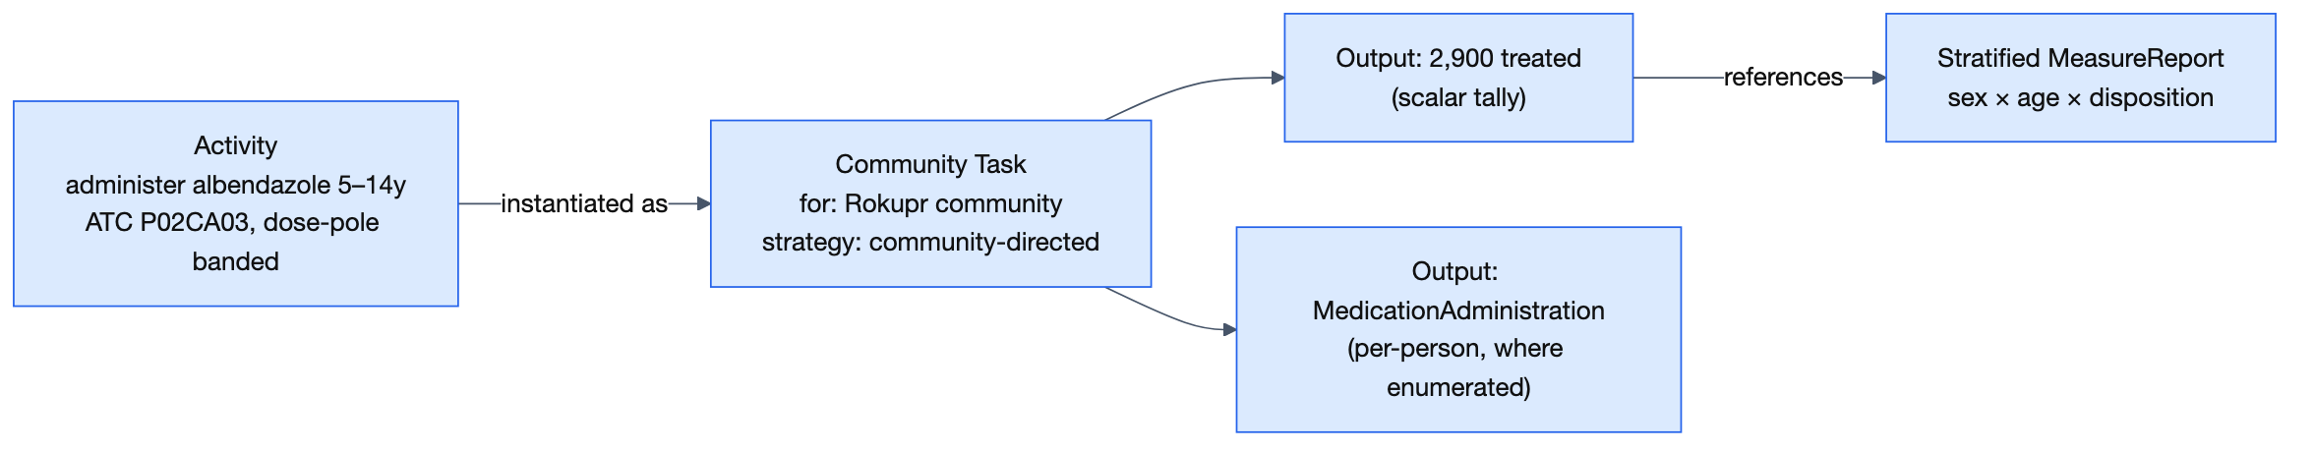
6 Activity & Task — the units of work
– Activity defines the intervention once; thousands of Tasks instantiate it
– One Task per site session or household/community visit — one profile, all models
– Pre-planned or field-registered; field registration measures microplan gaps
– Three reason axes: missed · noncompliance · exclusion
ESPEN MDA — One albendazole activity → one task per village. The Rokupr task: 2,900 treated, plus exclusions, absences, and refusals.

Slide 8
7 Care Team — accountability & supervision
– CDDs / vaccinators + supervisor, coded roles, managing organization
– Task owner is a real reference — “who worked this area” is a query
– Carries the microplan workload: area, population, households, days
– Supervision = coded checklist responses; readiness rolls up to a Measure
ESPEN MDA — CDD team 7, Rokupr — 3,200 people over 5 days. Supervision record: DOC observed ✓, height chart ✓, stock concordant ✗.

Slide 9
8 Patient — the registered individual
– Aligned to WHO IMMZ.Patient — a campaign member is a WHO-conformant subject
– Stable identifier required — national ID preferred
– Gender + birth date mandatory: they drive eligibility and disaggregation
– Rejoins across rounds: person ID, or dwelling + head of household
– Consent profile governs storage and cross-border sharing
ESPEN MDA — The village register becomes persistent Patients — per-person treatment history across rounds, the input TAS-readiness assessments need.

Slide 10
9 Delivery Unit — the group a task acts on
– Group (actual = true): household, community, or school cohort — one profile
– Members are enumerated Patients; a head count is the register-level fallback
– Who separated from where — each keeps a stable identity
– Cross-campaign household join: head of household + dwelling place ID
ESPEN MDA — Rokupr community is one delivery unit: kind community, quantity 3,480, located at the Rokupr settlement.

Slide 11
10 Target Population — the denominator
– Group (actual = false): a count with source + date provenance
– Competing estimates coexist; one is flagged the planning denominator
– Geography-scoped by reference, at any level of the hierarchy
– Total-population vs at-risk: programme vs epidemiological coverage
ESPEN MDA — Form 1 extracts five denominators per village — total, eligible, 1–4, 5–14, 15+ — each carrying its source and date.

Slide 12
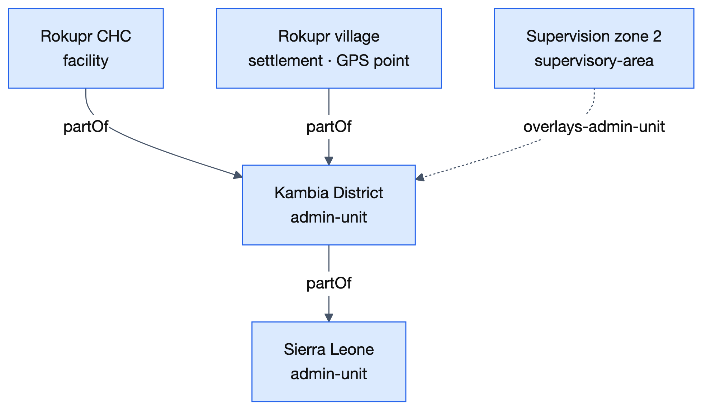
11 Location — the place model
– Admin hierarchy country → dwelling; typed locations; GPS + GeoJSON
– Multi-system identity: GERS preferred; P-codes, national, ISO coequal
– Operational geography overlays the admin tree — it does not sit in it
– Locations created unmatched; GERS IDs back-filled later
ESPEN MDA — Form 1’s cascade — state → district → facility → village + GPS. The supervisor’s zone overlays the district it reports into.

Slide 13
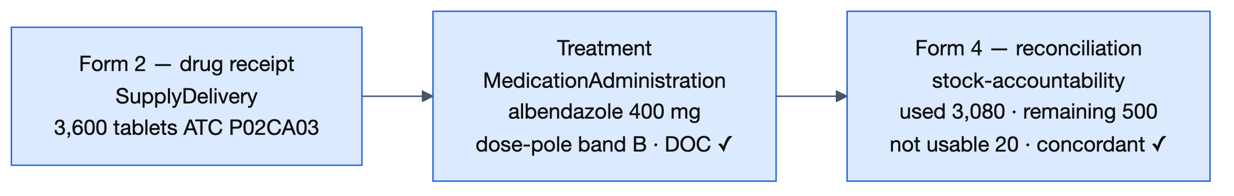
12 Delivery events — what was delivered
– Immunization: dose + lot / manufacturer traceability
– MedicationAdministration: dose-pole band + directly-observed consumption
– SupplyDelivery: commodities + stock accountability
– Individual record with a person; aggregate on Task.output without one
ESPEN MDA — 3,600 tablets received → band-B doses observed swallowed → reconciled: used 3,080, remaining 500 — one ATC code end to end.

Slide 14
13 Adverse events — one safety model
– Intervention-neutral: AEFI and MDA pharmacovigilance in one profile
– Severity, seriousness (WHO/CIOMS criteria), causality A/B/C/D
– Traces to the exact dose, lot, and manufacturer
– Same campaign-vs-routine flag; ConceptMap to WHO artifacts
ESPEN MDA — Abdominal pain after albendazole → references the exact administration; non-serious, causality C (coincidental).

Slide 15
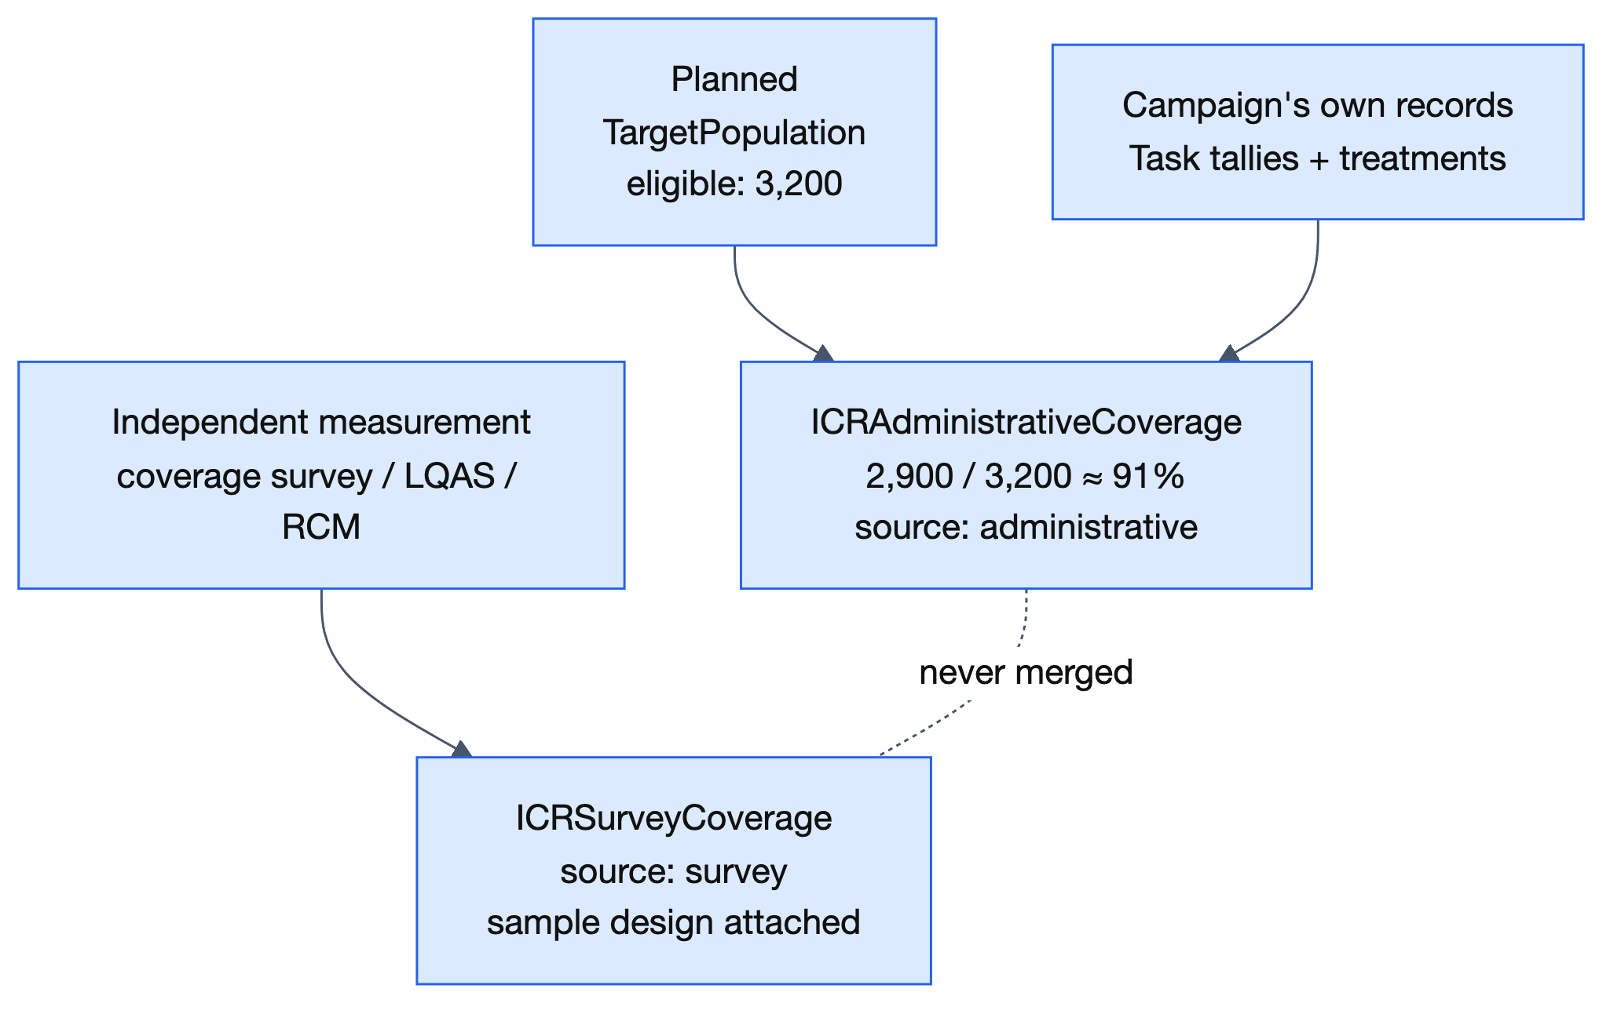
14 Coverage — how MeasureReports work
– MeasureReport: native numerator / denominator, pointing at a canonical Measure
– Administrative (own tallies + denominator provenance) vs survey (independent, sample design)
– Never merged — enforced structurally, not by convention
– Realtime vs reconciled lineage; a reporter is always required
ESPEN MDA — Rokupr: 2,900 / 3,200 ≈ 91% administrative. The independent survey is a separate record that can never be blended with it.

Slide 16
15 Stratification & the Measure library
– Six canonical Measures: admin, survey, MDA treatment, geographic, zero-dose, readiness
– Shared stratifiers: sex, age band, strategy, disposition, geography, dose history
– Coverage units: people or implementation units; denominators: total or at-risk
– Aligned with WHO JAP, ICG M&E, and ESPEN reporting schemas
ESPEN MDA — Form 3 → one stratified report: 91% by sex × age band × disposition. Geographic coverage: 188 / 200 villages ≈ 94%.

Slide 17
16 Terminology — CodeSystems & ValueSets
– Mint only new campaign semantics; reuse CVX, ATC, GS1, ISO
– 25 CodeSystems, each paired with a ValueSet
– Required bindings for structural discriminators; extensible for field vocabularies
– The independent-source ValueSet is what enforces never-merge
ESPEN MDA — ESPEN added the NTD disease axis (lf, oncho, schisto, sth, trachoma) and medicine packages (ivm-alb, pzq, …); drugs stay WHO ATC.

Slide 18
17 Extensions — what FHIR lacks
– 35 extensions in four families:
– Campaign mechanics — strategy, round, geography, planning denominator, lineage
– Task field data — tallies, reasons, finger-marking, revisit outcomes
– Denominator provenance — source, type, date, planning flag
– Delivery & safety — GeoJSON, DOC, dose pole, stock accountability, record origin
ESPEN MDA — One MDA visit uses four of them: dose-pole band, directly-observed consumption, exclusion reason, stock accountability.

Slide 19
18 Design principles
– Campaign vs routine: a mandatory firewall flag on every event
– Three coverage views — planned, administrative, surveyed — never merged
– Delivery strategy is first-class and coded
– Denominator provenance travels with every estimate
– Multi-system geo identity, GERS preferred; accountability queryable
ESPEN MDA — All visible in one round: flagged treatments, 91% vs the survey kept apart, register tallies per strategy, two denominators with sources.

Slide 20
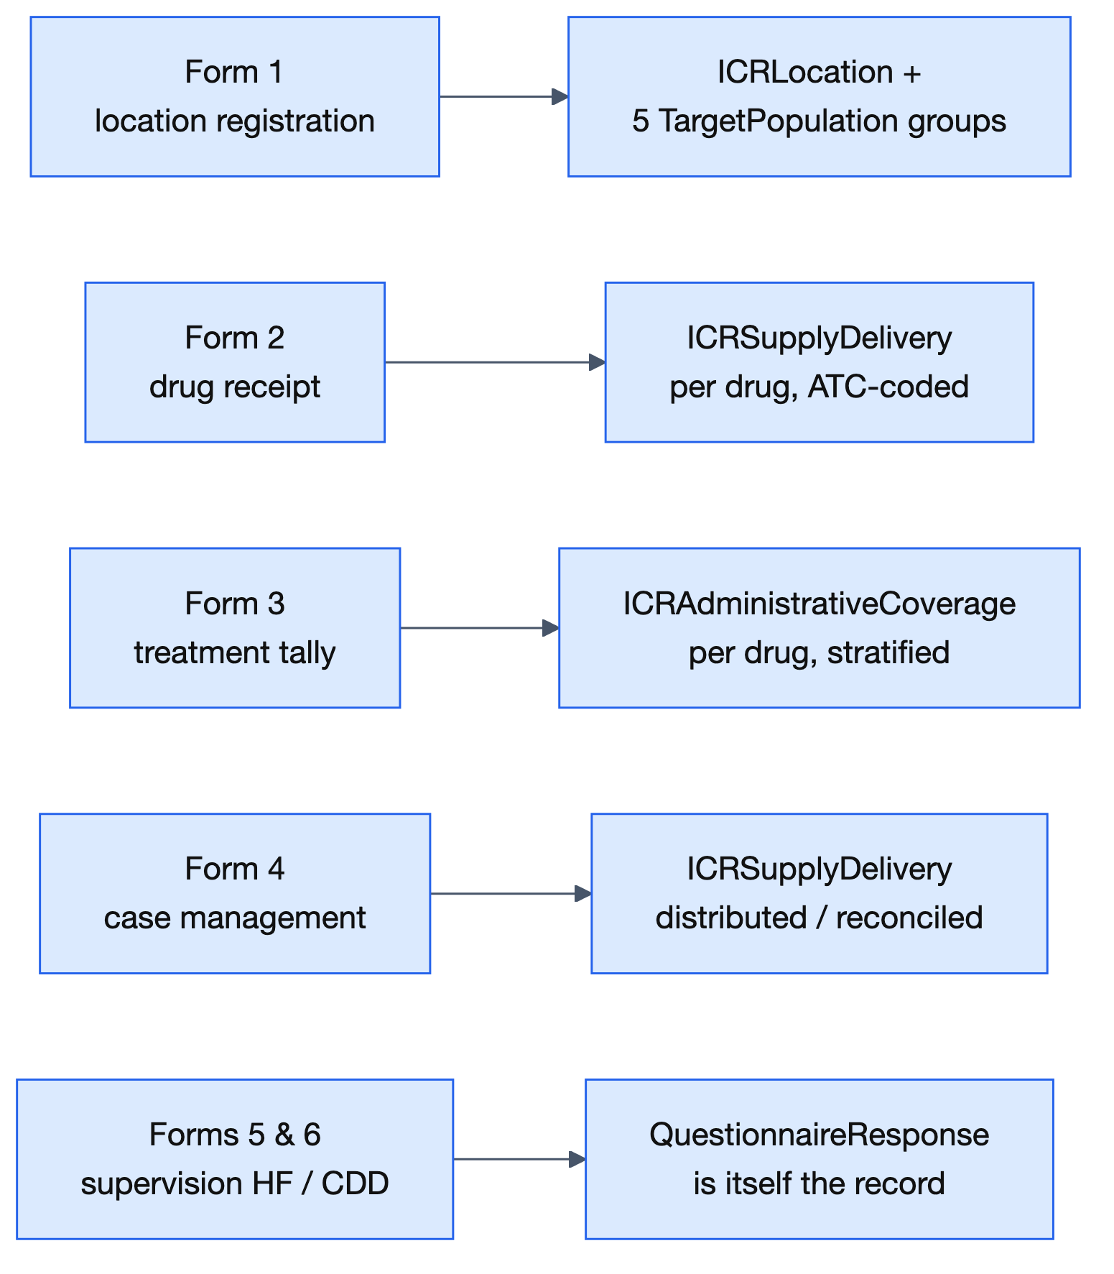
19 Grounded in field evidence
– Complete worked scenario (SIA + MDA), 41 example instances
– Eight global-health source analyses: none contradicts the design
– Hardened on real instruments: 10 polio-SIA forms, 6 ESPEN MDA forms
– Filled ESPEN forms auto-extract to ICR resources (SDC)
ESPEN MDA — The six ESPEN forms in the field become standard registry data — locations, denominators, stock, stratified coverage, supervision records.

Slide 21
20 WHO alignment & roadmap
– The campaign complement to WHO’s routine IG; reuse artifacts at the seams
– Derive Measures from WHO’s 45 indicators; add the campaign-only ones
– Next: executable CQL, SQL-on-FHIR, ConceptMaps, community review, 2-country pilots
– 17 months, 6 phases (May 2026 – Sep 2027) — Ona + Crosscut, for UNICEF
ESPEN MDA — ICR’s MDA treatment-coverage Measure already matches the ESPEN reporting schema — an ICR report is the figure ESPEN expects.

