Slide 1
H&M Fashion Recommendation
Kaggle x H&M Competition
22/2/2022

Slide 2
Goal
https://www.kaggle.com/c/h-and-m-personalized-fashion-recommendations/data
To predict, for each customer, the articles that they will purchase for the next 7-days after training period
Time-series related?

Slide 3
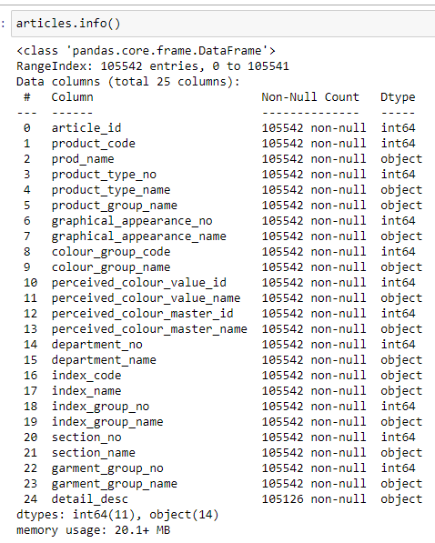
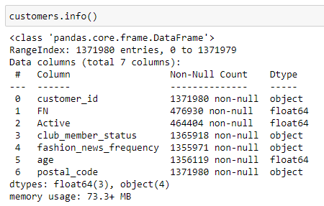
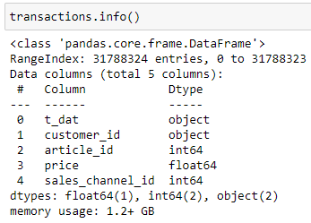
About the data
Articles.csv
25 columns, 105542 rows
Customers.csv
7 columns, 1371980 rows
Transactions_train.csv
5 columns, 31788324 rows
Images.zip
Contains all images of the products for reference

Slide 4
Data exploration
Check for duplicates, typos, NULL values, distributions…

Slide 5
Data cleaning and manipulation
Change data type?
Change all words to lowercase
Fill in NULL
Remove duplicates
Check if the naming have any typo and not picked up from duplicated() method
Same address = same customer?

Slide 6
Feature engineering
Encoding
Selection?

Slide 7
Merging all into one dataframe

Slide 8
Modelling Preparation
Test-train set
Creating x_values for predictions

Slide 9
Baseline model

Slide 10
Model 1

Slide 11
Model 2

Slide 12
Hyperparameter tuning

Slide 13
Evaluation

