Slide 1
H&M Fashion Recommendation
Kaggle x H&M Competition
22/2/2022

Slide 2
Goal
https://www.kaggle.com/c/h-and-m-personalized-fashion-recommendations/data
To predict, for each customer, the articles that they will purchase for the next 7-days after training period
Time-series related?

Slide 3
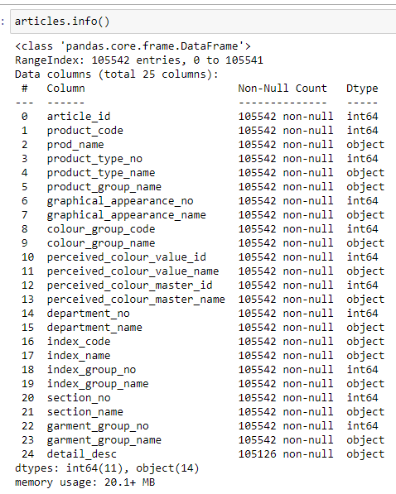
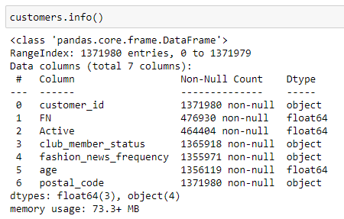
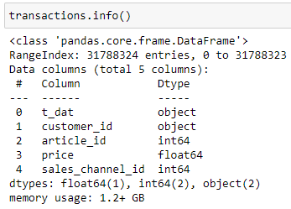
About the data
Articles.csv
25 columns, 105542 rows
Customers.csv
7 columns, 1371980 rows
Transactions_train.csv
5 columns, 31788324 rows
Images.zip
Contains all images of the products for reference

Slide 4
Data exploration
Check for duplicates, typos, NULL values, distributions…

Slide 5
Data cleaning and manipulation
Change data type?
Change all words to lowercase
Fill in NULL?
Remove duplicates (not necessary anymore, checked that each article_id is indeed a different item although described similarly to others)
Check if the naming have any typo and not picked up from duplicated() method
Same product code/product categories but product name is slightly different?
Same address = same customer?
Same product code = same item?

Slide 6
Feature engineering
Encoding
Selection?

Slide 7
Merging all into one dataframe

Slide 8
Modelling Preparation
Test-train set
Creating x_values for predictions

Slide 9
Baseline model

Slide 10
Model 1

Slide 11
Model 2

Slide 12
Hyperparameter tuning

Slide 13
Evaluation

