Slide 1


Development with Windows and Unix
(划划水)作业 | CS1601 | 刘本嵩 | U201614531
Platform API is so important while developing an app. After using Arch Linux for several months, I have really a lot to say.
因为我的windows系统引导刚刚崩溃，Linux系统的多种中文输入法和新安装的多种office都不能快速兼容，为了便利，PPT会使用英文。连这句话都是从其他编辑框拷贝过来的。

Slide 2

Memory management
Simply using a loop with "new" can get all memory free in Arch Linux.
Acquiring too much memory will NOT even throw a exception(std::bad_alloc)!
Windows kernel won't let a process(thread) to acquire ALL resource in the virtual memory pool.(At least, SEH can process a bad_alloc exception)

Slide 3
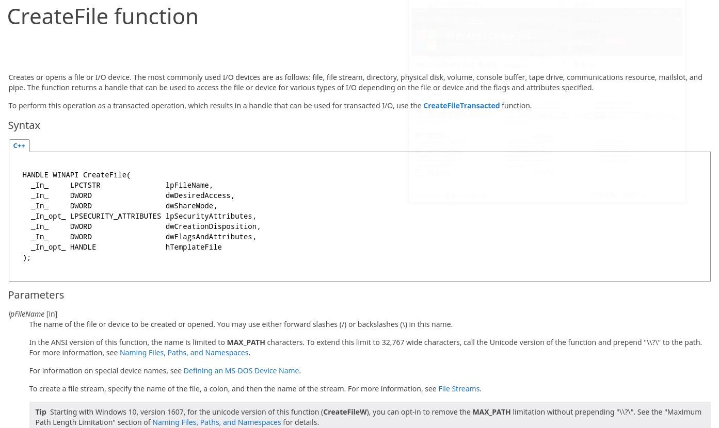

Documents
However, under unix, NO offical developer doc is provided.
Coding with unix api is TOO ...um... uncomfortable.

Slide 4


Kernel
You know... So Linux is widely used on servers.

Slide 5
Source code and security
Obviously, open-source is vitally important for security purposes. Living in others' room is really dangerous, especially for government-users.
With source code provided, we developers can solve (almost) any problems and directly operate on system kernel. Nothing other than src is more useful for learners.

Slide 6
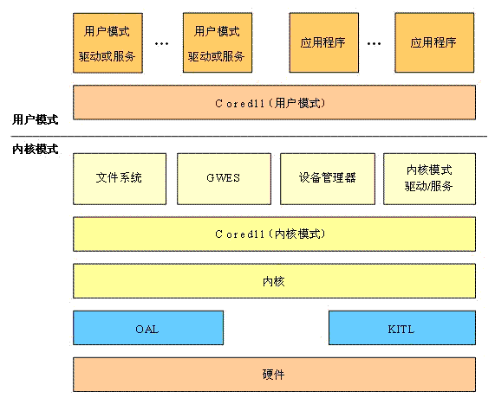

Cross-platform portibility
Needless to say, there's an indestructible wall between Windows and Linux (api). Cross-platform compiling is almost impossible for a large indrustrial project.

Slide 7
Thanks!
Again

