Slide 1
Vision Transformers Need Registers
Reproduction, experiment and deployment of Darcet et al., ICLR 2024
Muhammad Hamza Uzair (30544) · Shaheer Ahmed (31543)
github.com/recommended131225435/vit-registers-reproduction
Notes:
Hello, we are Hamza and Shaheer. We reproduced the ICLR 2024 paper Vision Transformers Need Registers, ran our own experiment on it, and deployed it as a web app. Everything is in our GitHub repository.

Slide 2
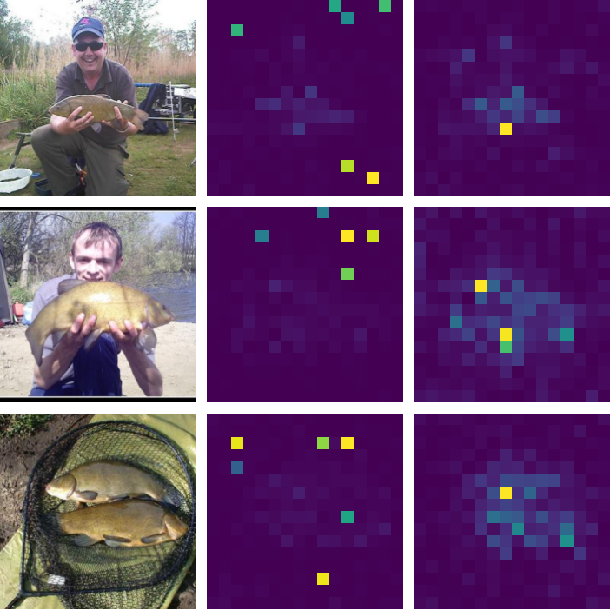
Big ViTs look at empty background
A Vision Transformer cuts an image into patches; [CLS] attention shows where it looks
In large models (DINOv2, CLIP, DeiT-III) this map has bright spots on empty background
These spots make the maps meaningless and hurt tasks that need clean patch features
The paper asks: what are these spots, why do they appear, and how can we remove them?
photo no registers with registers
Notes:
This is our own measurement on Meta's DINOv2 ViT-g. In the middle column, without registers, the attention has random yellow squares in the background, often at the edges. On the right, with registers, the attention sits on the fish and the person. The paper explains these spots and fixes them.

Slide 3
The idea: give the model scratch space
Diagnosis
Explanation
Fix: registers
About 2% of patch tokens become ~10× longer than normal. They sit on boring background and hold global, not local, information.
A large model needs space for global computation, so it takes over patches it considers useless.
Add 4 learnable tokens with no image content and no position. The model uses them instead; they are dropped at the output.
[CLS]
REG
REG
REG
REG
patch
patch
patch
…
patch
Token sequence with registers: [CLS] is used for the prediction, the 4 registers are thrown away, patches describe the image. Cost: < 2% extra compute.
Notes:
The paper has three steps. Diagnosis: the spots are tokens with a very large norm, about 2% of them, on redundant background. Explanation: the model reuses useless patches as scratch space for global information. Fix: add a few extra tokens called registers, which are discarded at the output, so the patches stay clean.

Slide 4
What we built
Part A: the paper's own models
Part B: our own ViT with registers
Meta's released DINOv2 S/B/L/g, each with and without registers. We measure token norms, outliers and attention maps exactly as the paper does.
Written from scratch in PyTorch, trained on Tiny-ImageNet (100k images, 200 classes). 24 forward-pass checks, 15 unit tests, automatic CI.
Experiment: model size
Deployment: FastAPI app
Train ViTs of growing size with 0 and 4 registers and measure whether artifacts appear.
Upload an image: our ViT-Tiny predicts the class, DINOv2 shows its maps without vs with registers.
Notes:
We worked in four parts. Part A uses Meta's released models to check the paper's claims directly. Part B is our own implementation, trained on Tiny-ImageNet because ImageNet is too big for a free GPU. Then our experiment on model size, and finally the deployed app.

Slide 5
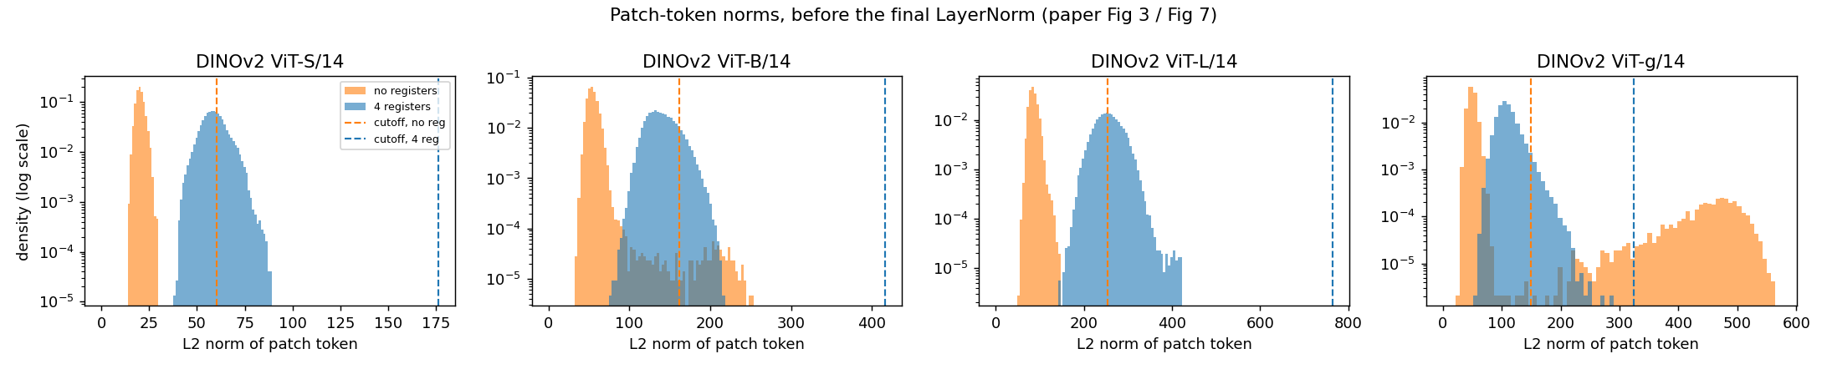
Reproduced: rare, huge tokens that registers remove
2.62%
of ViT-g patch tokens above the paper's cutoff of 150 (paper: 2.37%)
0.00%
outlier tokens in the same model trained with registers
11.3×
largest token norm vs the median (before the final LayerNorm)
Notes:
Our headline number: 2.62% of ViT-g's tokens are above the paper's cutoff, very close to the paper's 2.37%. With registers, zero. The histogram shows the second hump of huge tokens in orange, and it disappears in blue. One detail we found: the norms must be measured before the final LayerNorm, which hides them.

Slide 6
Six claims checked against the paper
Paper claim | Paper | Our evidence | Reproduced?
Rare high-norm tokens exist | Fig 3 | 2.62% vs 2.37% | Yes
They sit on redundant background | Fig 5a | neighbour similarity 0.871 vs 0.662 | Yes
Registers remove them | Fig 7 | 2.62% → 0.00% | Yes
Registers clean the attention maps | Fig 1 | same visual result | Yes
The large values move into registers | Fig 15 | one register at 1390 vs 108 | Yes
Outliers only in large models | Fig 4c | only in ViT-g (released S/B/L are distilled) | Partly
Notes:
Five of the six diagnostic claims reproduce. The size claim is partial: we only see clear outliers in ViT-g, while the paper also sees them in ViT-L. Meta's released smaller models were distilled from ViT-g, unlike the separately trained models in the paper, which likely explains it.

Slide 7
Our ViT-Tiny: registers barely change accuracy
38.99%
without registers (Tiny-ImageNet, 50 epochs)
37.86%
with 4 registers
Gap −1.13 points (lr 1e-3); −0.81 when retrained at lr 2.5e-4. The paper reports −0.1 to +0.5. One seed per setting.
Notes:
We trained our own ViT-Tiny for 50 epochs on Tiny-ImageNet. Both versions learn the same way and end around 38 to 39 percent, about one point apart. The paper reports almost no change. With one run each we cannot tell if one point is real or noise, so we call this partly reproduced. Absolute accuracy is low because the model is tiny and the images are 64 by 64.

Slide 8
Our experiment: do small ViTs get artifacts?
Do high-norm artifacts appear in small ViTs trained from scratch, or only once models are large — and do registers do anything below that size?
Change
Keep fixed
Measure
Model size: ViT-Tiny (5.4M), ViT-Small (21.5M), ViT-Base (85.4M), each with 0 and 4 registers.
Data (Tiny-ImageNet), recipe with lr 2.5e-4 for every size, 50 epochs, seed, patch size. Meta's DINOv2 S/B/L/g give the large end of the axis.
Token norms after every block, % outliers (> 3× median), how much attention the registers get, attention maps, accuracy.
Notes:
The paper says artifacts only appear in large, long-trained models, but it shows this for one training method on huge data. We can only train small models, so we asked: what happens at the small end? We change only model size, keep everything else fixed, and measure the artifacts in our own trained models, next to Meta's large models from Part A. One lesson on the way: with the learning rate of our first runs, 1e-3, the Base models collapsed after the warm-up, so we retrained all six models at 2.5e-4, which is what the DeiT paper's rule gives for our batch size.

Slide 9
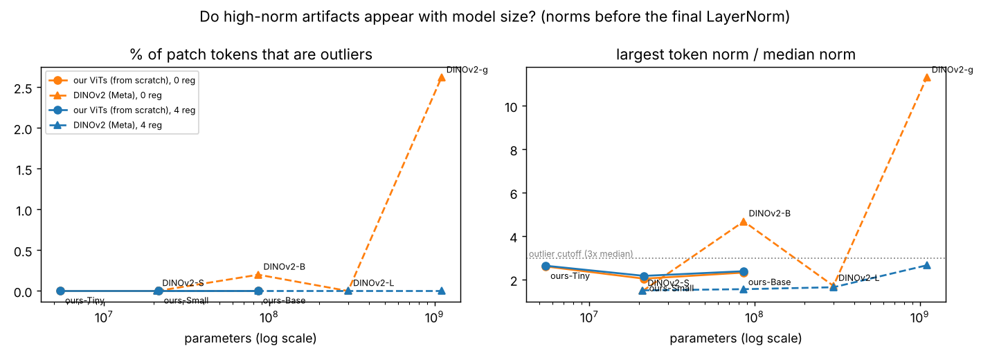
Result: no artifacts below the giant model
0 outlier tokens in all 6 of our models (5M–85M)
Largest token ≤ 2.64× the median (outlier line: 3×)
Clear outliers only in DINOv2 ViT-g (1.1B)
Fits the paper: artifacts need a large model and long training
Notes:
This is the main result of our experiment. On the left, the share of outlier tokens; on the right, the largest token divided by the median. Circles are our own models, triangles are Meta's DINOv2. All six of our models, from 5 to 85 million parameters, stay at zero outliers, and the largest token never reaches the 3x line in the last block. Clear outliers only appear at the top of the axis, in DINOv2 giant. Our Base model has the same size as DINOv2 Base, but it saw 100 thousand small images for 50 epochs instead of 142 million images, and the paper says artifacts need both size and long training. So our answer is: at the sizes we can train, the artifacts do not appear.

Slide 10
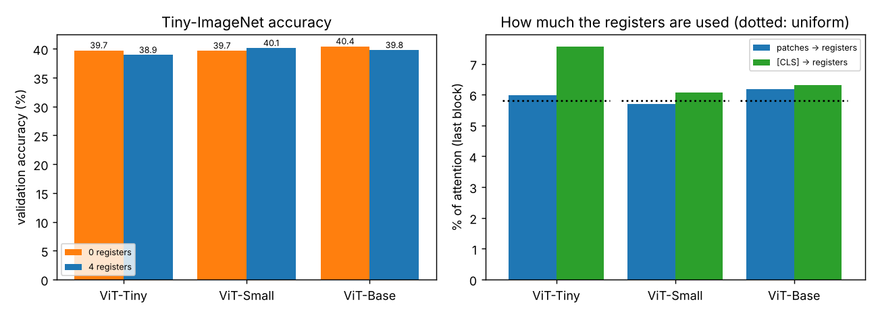
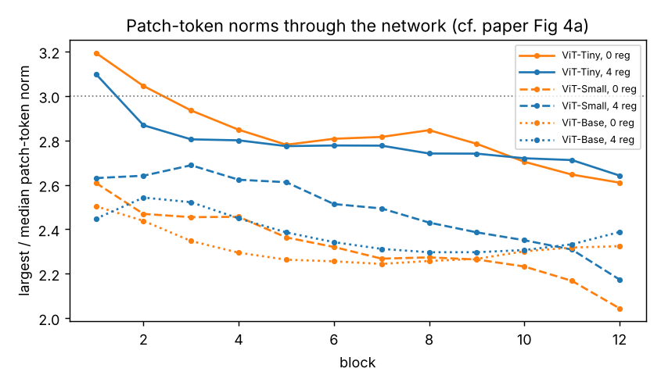
Without artifacts, registers sit idle
ViT-Tiny, 0 reg: 0.00% outliers, peak 3.19×
ViT-Tiny, 4 reg: 0.00% outliers, peak 3.10×, 6.0% attention to registers (uniform 5.8%)
ViT-Small, 0 reg: 0.00% outliers, peak 2.61×
ViT-Small, 4 reg: 0.00% outliers, peak 2.69×, 5.7% attention to registers (uniform 5.8%)
ViT-Base, 0 reg: 0.00% outliers, peak 2.50×
ViT-Base, 4 reg: 0.00% outliers, peak 2.54×, 6.2% attention to registers (uniform 5.8%)
Notes:
Inside our models: on the left, the largest-to-median norm after every block stays below 3 for all models. On the right, accuracy and register use. The registers get about 6 percent of the attention, which is what four tokens out of 69 would get by chance, so the model does not really use them. In DINOv2 giant, one register has a norm 13 times a normal patch. Accuracy changes by less than one point with registers, with no consistent sign. One more lesson: with our first learning rate of 1e-3, ViT-Base collapsed, so we retrained all six models at 2.5e-4 before comparing.

Slide 11
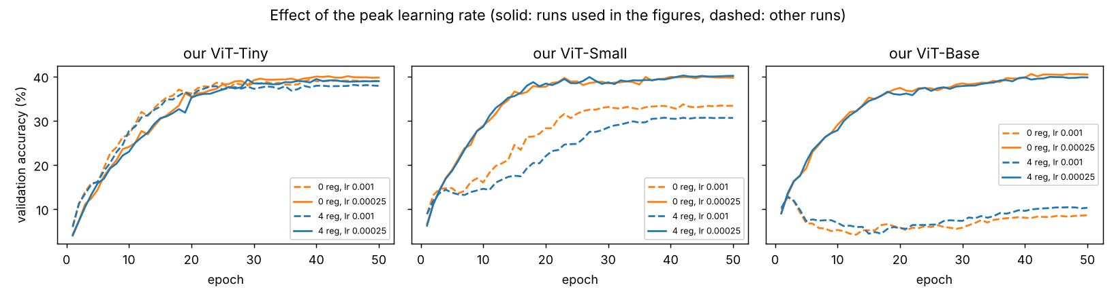
A lesson on the way: the learning rate
At lr 1e-3 (dashed), ViT-Base collapses after the warm-up and ends at 8.6–10.3%; ViT-Small trains worse
At lr 2.5e-4 (solid; DeiT's rule for batch 256), every size trains normally: about 39–40%
We retrained all six models at 2.5e-4 before comparing, and kept the failed runs as a result
Notes:
One thing that went wrong, and what we learned from it. Our first experiment runs used the learning rate of our earlier ViT-Tiny runs, 1e-3. ViT-Tiny was fine, ViT-Small trained worse, and ViT-Base completely collapsed once the learning rate reached its peak: it ended at around 9 to 10 percent accuracy. If we had measured those broken models, the size comparison would have been meaningless. So we retrained all six models at 2.5e-4, the value the DeiT rule gives for our batch size, and every size trained normally. The failed runs are still reported in our results.

Slide 12
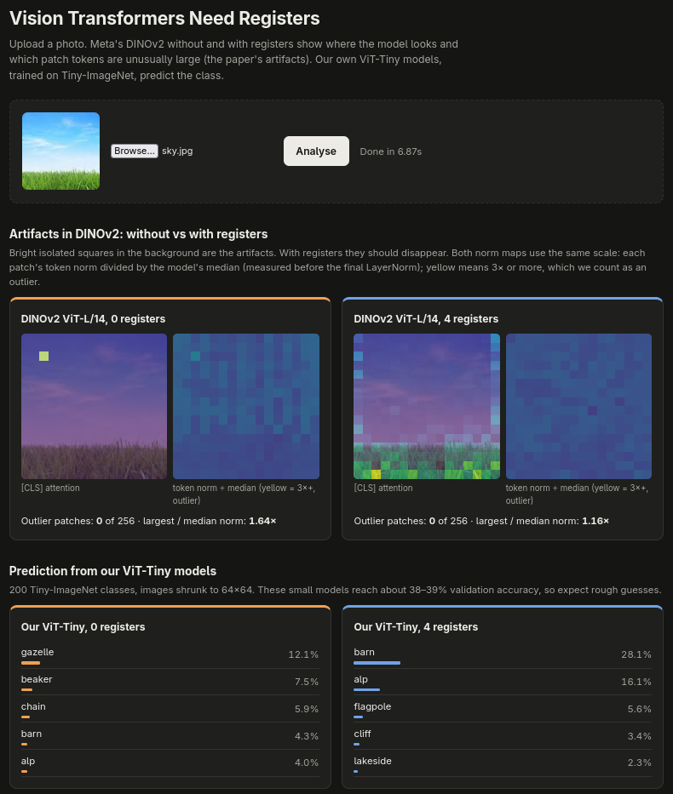
Deployment: try it on any photo
FastAPI app: web page, POST /predict, /health, /docs
Our ViT-Tiny (0 and 4 registers) gives the top-5 classes
DINOv2 without vs with registers: attention map, norm map and outlier count (size S/B/L/G)
Here, DINOv2-L: without registers it stares at one sky patch; with registers it looks at the grass
Bad uploads rejected (400 / 413); 5 automated tests
Notes:
Now the demo. We upload a photo of sky above grass. On the left, DINOv2-Large without registers puts its attention on one random square of empty sky: that is the paper's artifact. On the right, with registers, the attention moves to the grass, the only real content. The norm maps show no outliers at this size, which matches Part A: only the giant model has clear norm outliers. Below, our own ViT-Tiny gives its top-5 classes; sky is not one of its 200 classes, so it guesses scenery like barn and alp. The same thing is available as a JSON API, with documentation at /docs.

Slide 13
What we learned
The paper's diagnosis reproduces: 2.62% outliers in DINOv2 ViT-g (paper 2.37%), 0% with registers
Measure norms before the final LayerNorm, or the artifacts are invisible
Our ViTs (5M–85M, from scratch): no artifacts, registers idle, accuracy within ±1 point
Lesson: fix the training recipe for the largest model before comparing sizes
Limits: Colab GPUs, Tiny-ImageNet, one seed; downstream gains not tested
Notes:
To sum up: the paper's diagnosis holds on its own models, and registers remove the artifacts. We learned that where you measure matters. Our experiment shows when the problem appears. The limits are our compute, the smaller dataset and single seeds. Thank you, we are happy to take questions.

