Slide 1

Anthropology for Epidemiologists:
Qualitative Methods in Public Health Investigations
Lisa Hansen, EPIET Scientific Coordinator
RIVM Twitter:@teachepi

Slide 2



Slide 3

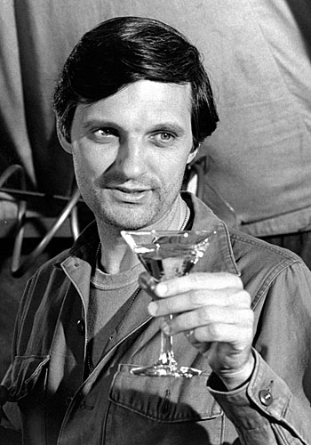
What would Alan Alda do?
Notes:
This actor, from the 70s TV show MASH
Interesting acting career, but it is his second career that is really interesting to me
He has pursued an interest in science communication and established the Alan Alda Center for Communicating Science at Stony Brook University in NY
The goal is training scientists to be better at communicating with people outside their own fields, and Alan Alda uses his background in acting, through improvisation and storytelling techniques to train technical specialists how to get people to care about their work
This emphasis on clear communication is at the heart of qualitative methods in public health: as epidemiologists, we have to talk to people – and when we are undertaking outbreak investigations or other studies, we have to listen to people

Slide 4
Anthropology and Epidemiology: case definitions
What is “anthropology”?
The scientific study of the origin, the behavior, and the physical, social, and cultural development of humans
What is “epidemiology”?
The study of the relationships of the various factors determining the frequency and distribution of diseases in a human community
Notes:
Alan Alda also inspiring because what he’s learned in his first career has informed his second career…
For me, obvious link between anthropology and epidemiology -
The basic question of population health, “Why are some people healthy and others not?”
Asking similar questions about the human condition and why it is the way it is
Anthropology and public health both assume certain value positions about human rights and freedoms, protection from harm
…
EAN 2015 – Anthropology and Ebola
Outbreak module 2015 – anthropology for outbreaks
ECDC summer school 2016 – anthropology for public health
ECDC summer school 2017 – qualitative methods for public health
This workshop was initially conceived of to introduce anthropology and its methods to people working in public health – in response to feedback last year, we shifted the content to focus more on methods, but I think it’s still useful to establish how anthropological approaches can contribute to our public health epidemiology toolbox

Slide 5
When anthropology met epidemiology
Inherently interdisciplinary:
    Academics and applied practitioners work together to develop and use new methodologies
    Discipline-specific perspectives can be synthesized and extended
    Integrated/holistic approaches
    New solutions sought for complex scientific and social issues and “wicked problems”
    One health / all-hazards / health in all policies
Notes:
Epidemiology and anthropology overlap in many ways:
They are both relatively young fields that emerged as human societies were undergoing huge changes in the late 19th and early 20th centuries
They both involve people who work in the ivory towers as well as those who get their hands (or their boots) dirty, and they both borrow freely from many other disciplines
I like this concept of “wicked problems” – as much as we love an elegant solution and finding a clear cause, for most issues that vex us in public health, we can’t point to just one thing
Example of TB: we understand how it’s transmitted, we have tools to characterize the genome to connect cases, but if we want to address root or upstream causes, we have to think about things like why people are not adherent to treatment, and the social and political structures that contribute to poverty, homelessness and marginalization – those are truly wicked problems

Slide 6
Why use qualitative methods?
“Research” = any systematic investigation, designed to develop or contribute to generalizable knowledge
Investigators who use qualitative methods are usually trying to understand rather than predict
  sampling for meaning, not for statistical representativeness
Health and illness happen in a sociocultural context
  qualitative methods allow us to understand why, how and in which circumstances different people take decisions and interpret their own actions relative to their health
Notes:
We have lots of tools as epidemiologists, and that’s part of why we are here today
Why and in what circumstances would we opt to include qualitative methods in our toolbox?
The basic premise of qualitative or anthropological methods is that the investigator wants to allow the subjects to speak for themselves, to describe their own knowledge and understanding, and identify what is important to them in relation to a particular issue
This is part of the reason why qualitative researchers will identify respondents who can provide deep understanding of an issue, rather than sampling a larger number to generate a quantative observation that is generalizable to the larger population

Slide 7
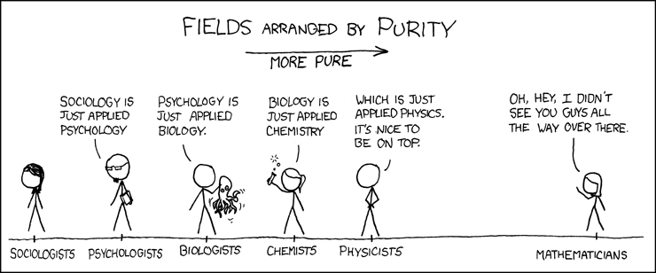
So…what’s the problem?
Notes:
So obviously we have lots to learn from each other – what’s the problem?
Our academic training and the organization of departments and disciplines have created categories that are often silos – and these silos are unfortunately often seen in a hierarchy like this, with your pure quantitative sciences up at the top and your messy squishy social sciences or soft sciences down at the bottom
The product of many generations of scientific culture.
In quantitative fields where modeling and prediction are the most important goals, the most elegant (reductive) solutions are highly prized.
But we know that human behaviour is sometimes hard to quantify and even harder to predict – it’s complicated

Slide 8
“Qualitative researchers don’t count”
…because they are interested in what is, not in how much or how many.
If you do not know what to count, then how can you count how many?
…because they have sampling problems.
Qualitative samples are not usually representative in the dimensions needed to make inferences from the sample to the population
Qualitative samples are representative for meaning, but counting will not necessarily contribute to our understanding
…unless measurement enhances the description, and allows for valid comparison.
Notes:
From Janice Morse, a medical anthropologist who is the editor of the journal Qualitative Health Research, and credited with introducing the term ‘mixed methods’
Part of our challenge in embracing qualitative methods is that they don’t usually give us numbers
There is limited value in quantifying an observation when I don’t know whether it is important
Which is not to say that qualitative researchers NEVER count – but we should do it only when it adds value to our analysis and allows for comparison
If measuring assists the emerging description and understanding, then qualitative researchers have to decide what to compare their results with—if the instrument has been standardized, then their measurements are meaningful in comparison with another group or the general population
And of course in public health we use mixed methods – so qualitative findings may inform what we later choose to quantify

Slide 9
Qualitative data collection in public health
used more often
In-depth interviews
Focus groups
Surveys/questionnaires
Participant observation
Online communities and blogs (‘netnography’)
Oral histories
Photography and video
Diaries, archives and other documentary sources
used less often
Notes:
So what kind of methods are used in qualitative investigations?
We are going to touch on the most common ones
For the most part, qualitative research is about talking to people, but there are other ways of accessing information

Slide 10

Anthropologists (and their methods) in outbreaks
Notes:
Investigators from diverse backgrounds have been doing ‘medical anthropology’ for decades, and contributed to some important understanding of disease transmission dynamics – this is the classic example of kuru, the first known transmissible prion disease identified among the Fore people of PNG
During the Ebola outbreak in West Africa in 2014-2015 was the first time that I saw anthropologists recruited as part of the outbreak response, and academic anthropologists really organized themselves to discuss what they could contribute
The current GOARN RFA for response to the Lassa fever outbreak in Nigeria is a great example: the RFA includes epis to work in surveillance and contact tracing, and anthropologists to work in understanding community and healthcare worker perception and to suggest approaches to risk communication
this is a 2016 study that was done in Sierra Leone – I usually tell fellows to avoid cute titles, but really how could you resist this one

Slide 11
How can qualitative methods contribute to outbreak investigations?
Asking better questions
  Study design is iterative - data collection and research questions are adjusted according to what is learned
Explaining incongruous findings
  Direct observation or trusted informants may contradict ‘desirability bias’
Improving access to some environments
  Building trust and rapport
Notes:
Most of us have had some instruction in questionnaire design; from a teaching perspective it is a topic that it is hard to make exciting –
we tend to assume that writing a questionnaire is not that hard, and yet somehow, we have all seen survey tools that are poorly worded or structured, or just don’t get the responses we are after
Qualitative research is explicitly reflective – this is its hallmark – and qualitative researchers will adjust their questions and the prompts or probes that they use “in real time” , as the study is happenning, which can lead to better and more comprehensive answers and therefore better understanding
In the Lassa fever paper that I showed you on a previous slide, the researchers used several mixed methods: a representative, quantitative survey indicated that more than 2/3 of respondents reported washing their hands after preparing rats for eating, while this behaviour was never seen during direct observations
One of our challenges in public health is that we are part of the establishment and we often work in organizations that have a regulatory or enforcement role: we know that if you are dealing with a population that is engaged in illicit activity, like IDU or CSW, or a group that has seen public health as an adversary, like raw-milk producers and consumers, you have to be really careful about how you do your outreach, especially if you want to get good information about the things people are doing that might put them at risk
Qualitative interviewing is explicitly oriented towards establishing rapport, ensuring understanding, and letting the subject lead the discussion to what he or she thinks is important
…

Slide 12
How can qualitative methods contribute to outbreak investigations?
Connecting policy and practice
  Understanding why evidence-based public health programmes fail
Identifying the negative or unintended consequences of health interventions
  What happens when the response infrastructure is gone?
Characterizing the social context of disease
  Understanding human amplification of infectious diseases requires different analytical tools than those used to understand the dynamics of primary transmission
Notes:
Another example from the Lassa paper was that the qualitative interviewers identified a recurrent theme that community members were reluctant to talk about rat consumption to strangers, because the behaviour of interest (hunting and eating rats) had become stigmatized due to sensitization messages from HCWs and media – people were still doing it, but they didn’t want to admit to it
Respondents thought that if they told researchers about eating rats, they might be prevented from accessing health care or be taken away for testing
So even clear messaging and social mobilization can backfire
One of the main things we teach field epidemiologists to do is to generate clear recommendations for action, based on the evidence, but there are reasons why good recommendations fail:
consider efforts to ban female genital mutilation or implement safe burial practices in West Africa – cultural beliefs, preferences (what tastes good, what is the right thing to do…) , traditions can be a much stronger motivation than the facts
Rift Valley Fever outbreak in Uganda : zoonotic disease, when outbreaks occur, governments usually ban the slaughter of livestock and the consumption of meat and dairy products
For ultra-poor pastoralist communities, the milk, blood and flesh of animals are the crux of both diets and cultures and there really is no alternative offered or put in place
- Producing lasting change
Social determinants of disease is a big tent – all the things people do and eat and think and all the ways that they interact with each other and their environment that all have potential impact on their experience of health and disease

Slide 13
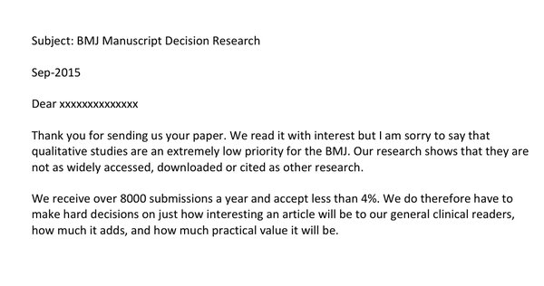
A call to action:
In September 2015, The McGill Qualitative Health Research Group alerted the ‘Twitterverse’ to a manuscript decision letter from BMJ:
Notes:
We know that journal editors make decisions on accepting or rejecting papers for many different reasons, but if leading journals avoid publishing papers in a whole category of research methods, then it becomes a self-fulfilling prophecy that papers using those methods are not widely accessed, downloaded or cited
the methods themselves become marginalized and the journals become arbiters of knowledge and this further contributes to the idea that there is a hierarchy of knowing and some methods are just better than others

Slide 14
What followed was a “Twitterstorm” #BMJnoQual
76 scientists from 11 countries sent an open letter to BMJ in December 2015:
…we argue that The BMJ should develop and publish a formal policy on qualitative and mixed method research and that this should include appropriate and explicit criteria for judging the relevance of submissions. We acknowledge that (as with all methods) some qualitative research is poor quality, badly written, inaccessible, or irrelevant to the journal’s readership.
We also acknowledge that many of The BMJ’s readers (not to mention its reviewers and editors) may not have been formally trained to read, conduct, or evaluate qualitative studies. We see these caveats as opportunities not threats.
Notes:
Many scientific journals have both a tradition and a responsibility for educating their readers about research methods, including those that are new and some that are less familiar for individuals trained in clinical and quantitative sciences
One of the clear points to come out of this issue is that in many disciplines, in the health field, there is little training in the use of qualitative methods and therefore a limited appreciation for what constitutes good qualitative research, or how to use the findings of qualitative research
Different study designs provide complementary perspectives – so that’s what we’re here for: we appreciate that these barriers exist, so let’s take up this opportunity and not feel threatened

Slide 15
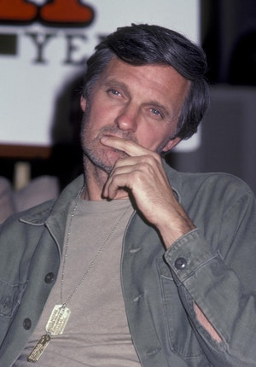
Questions?

Slide 16
Additional material

Slide 17
Comparison of methods
 | Quantitative | Qualitative
General framework | Seek to confirm hypotheses about phenomena Instruments use more rigid style of eliciting and categorizing responses to questions Use highly structured methods such as questionnaires, surveys, and structured observation | Seek to explore phenomena Instruments use more flexible, iterative style of eliciting and categorizing responses to questions Use semi-structured methods such as in-depth interviews, focus groups, and participant observation
Analytical objectives | To quantify variation To predict causal relationships To describe characteristics of a population | To describe variation To describe and explain relationships To describe individual experiences To describe group norms
Notes:
These are generalizations of course
The first point probably makes intuitive sense to you: qualitative methods are more often used to explore what’s going on, while quantitative methods are used to test a specific hypothesis –
many of us would be familiar with the process of generating hypotheses from ‘trawling’- asking lots of open questions to see if a suggestive pattern emerges, and then following that with an analytical design to test the hypothesis, e.g. in a case-control or cohort study

Slide 18
Comparison of methods
 | Quantitative | Qualitative
Question format | Closed-ended | Open-ended
Data format | Numerical (numerical values assigned to responses) | Textual (obtained from audio, video, and field notes)
Flexibility in study design | Study design is stable from beginning to end Participant responses do not influence or determine how and which questions researchers ask next Study design is subject to statistical assumptions and conditions | Some aspects of the study are flexible Participant responses affect how and which questions researchers ask next Study design is iterative, i.e. data collection and research questions are adjusted according to what is learned
Notes:
Qualitative methods are more flexible and iterative – as the researcher gains insight, she may begin to ask respondents some different questions, or identify new topics that had not been considered at the outset
(e.g., the addition, exclusion, or wording of particular interview questions)
This leads to the important question of how do you know when you’re done?
sampling methods in qualitative research

Slide 19
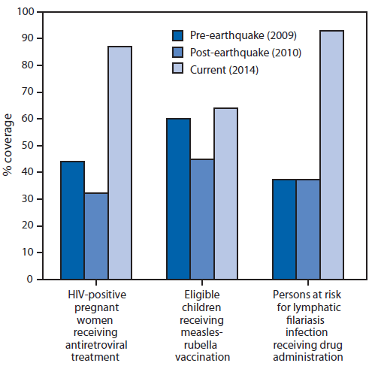
Quantitative vs Qualitative Methods
Update on Progress in Selected Public Health Programs After the 2010 Earthquake and Cholera Epidemic — Haiti, 2014
MMWR February 20, 2015 / 64(06);137-140
Notes:
For illustration, here’s some quantitative information from a recent (2015) publication on the state of recovery in Haiti
3 public health interventions on horizontal axis, quantitative measure of coverage on the vertical axis, and 3 timepoints to illustrate the degree to which the situation in Haiti has been restored to baseline or improved – so we are seeing how Haiti is recovering after a natural disaster and a public health emergency
Note the publication – how many of you are familiar with MMWR?

Slide 20
Quantitative vs Qualitative Methods
In their Own Words: Resilience among Haitian Survivors of the 2010 Earthquake
Social sciences literature highlights the importance of resilience in relation to risk and trauma. The 2010 Haitian earthquake compounded trauma for a nation that has endured slavery/despotic leadership, structural violence and poverty. Since 2010, various sources broadly describe Haitian survivors as resilient. We reviewed definitions of resilience published between 1990 and 2013, comparing them with perspectives of earthquake survivors from economically diverse communities in Haiti who participated in semi-structured interviews (n=38) and in six focus groups (n=63) between 2010–2011. Haitian resilience accords with some definitions from the literature. It also comprises independent, discrete, and isolated contextual resignation and intentional choice to survive and function—when there is no alternative course of action. Understanding Haitian resilience, can inform health/mental health and policy interventions, if these are taken as cultural resources. Intervention efforts should incorporate survivors’ input as key informants on what constitute resilience and reconstruction goals for them.
J Health Care Poor Underserved. 2016;27(2):580-60
Notes:
And for comparison, here is a 2016 publication that is based on some qualitative data on the same population, addressing some aspects of the same issue
What do the survivors think has been important in helping them to recover from the natural disaster? What aspects of recovery do they consider most important?
And how many of you regularly read the Journal of Health Care for the Poor and Underserved?
Considering the two previous slides on Haiti after the 2010 earthquake and cholera epidemic, which one tells the truth? On one side we’ve got lots of numbers and on the other side we’ve got lots of words!!

Slide 21
Qualitative interviewing…
…is qualitatively different from quantitative interviewing
Open-ended questions
Focus on building rapport and trust
Invites respondents to talk about their experience, to get their interpretations and understanding of own reality
Semi-structured interviewing:
  Interviewer(s) use prepared guide that targets critical questions
Notes:
Not so much about pushing respondents to answer YOUR questions
Qualitative interviews rely on a guide to frame questions around specific topics
Semi-structured: must have these questions answered to achieve study goals
but uses prompts, allows for digression….

Slide 22
Open-ended interview questions:
Descriptive questions – to get an idea of how things work
Structural questions – enable interpretation of how things, including knowledge, are organized
Contrast questions – ask the difference between one or more events or objects
Why questions– ask participants to explain the reasons for a situation or an action
Notes:
Different question types can elicit different kinds of information, but most of the time you are not looking for a simple yes/no!
I think of qualitative interview questions like job interview questions – may pose a scenario and ask the respondent how she would react, or ask respondent to talk about a time when she was in a particular situation - except that there isn’t a right answer
e.g.
How often do pregnant women eat meals or snacks?
After a woman has a baby, who influences what she eats?
How does a mother feed a child between 7-24 months when the child is ill? More food? Less food?
Why would a mother in this community choose not to breastfeed?

Slide 23
Probes and prompts
Neutral questions, phrases, sounds, and even gestures interviewers use to encourage participants to elaborate on their answers and explain why or how
Direct probes:
“What do you mean when you say . . .?”
“Why do you think . . .?”
“Can you tell me more?”
“I’m not sure I understand______________. . . .Would you explain that to me?”
“Can you give me an example of ___________________?”
Notes:
It’s a challenge in quantitative data collection, but maybe more so in qualitative when you have multiple researchers
Super important to have a consistent use of probes and prompts – the interviewer should not be inserting herself too much into the responses, but encouraging participants to answer fully

Slide 24
Probes and prompts
Indirect probes:
Neutral verbal expressions such as “uh huh”, “interesting,” “oh” and “I see”
Verbal expressions of empathy, such as, “I can see why you say that was difficult for you.”
Mirroring technique, or repeating what the participant said, such as, “So you were young when you had your first child?”
Culturally appropriate body language or gestures, such as nodding in acknowledgment
Notes:
Indirect probes and prompts seem obvious, but these techniques can be learned and can contribute to building rapport and trust
Culturally appropriate -
Micronesian eyebrow raise example

Slide 25
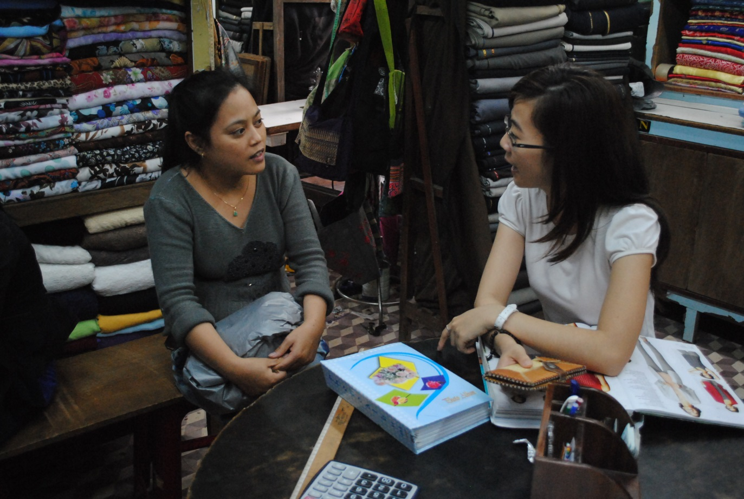
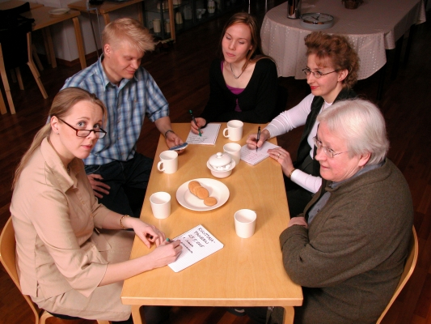
Focus on interview approaches:
One-on-one interviewing
Focus group interviewing
Notes:
Traditional ethnographic methods take time and a great deal of patience… when we are dealing with a disease outbreak, or even a public health programme for which we need to be able to demonstrate impact, we can’t always take that kind of time!
More commonly, we may use different forms of interviewing – researcher and one subject, or researcher and several subjects
Q: who has been part of a focus group? (use in marketing etc)

Slide 26
Data collection:
Interview guide with questions/topics, prompts
2. Documentation of the interview:
Audio (and sometimes video) record
Verbatim text transcript of interview
“Field” notes:
    Observe and document participants’ behaviours and contextual aspects of the interview
    Expand field notes as soon as possible after each interview
Notes:
The data collected in a qualitative study are not just the responses to the questions, but also information about the context
Re: Field Notes
During the interview, you can write your notes on the question guide or in a notebook.
Record all discussions, debates, disagreements, key phrases and terminology in the local language.
Note if the participant seems distracted, becomes emotional over a particular question or topic, or seems reluctant to discuss a subject area.
Also make a note if you suspect the participant is not being truthful and why you think this.

Slide 27
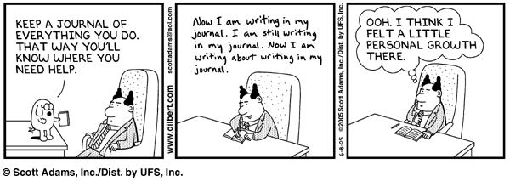
Analysis of qualitative data
Transcription of interviews
Field notes:
  Methodological / practical issues
  Observations, noteworthy occurrences
Notes:
The process of transcribing a recorded interview, and reflecting on your field notes, are the first steps in data analysis
This is why we call qualitative methods iterative – you don’t finish collecting data and THEN start on your analysis
Of course you have to prepare for data collection, but you also need to prepare for analysis
The laborious process of transcribing an interview (from an audio recording to a text document) is the first step in reflecting what you heard from your respondents, what they thought was important
If you are doing participant observation, you may be recording your impressions of what is going on while it is actually happening
That‘s not really possible when you are interviewing someone, so you may want to jot down some notes immediately after the interview
It takes some getting used to, for those of us who are not familiar with keeping a journal of our experiences

Slide 28
Iterative design
Field notes become a source of data:
  “Respondent X got really angry when I asked him what his family members thought about his alcohol consumption, so I did not continue with that question”
  “Respondent Y was late for our interview: she started to cry and said that she was really tired from caring for her new baby”
Field notes may suggest issues to explore, or themes for analysis
Notes:
Field notes become a source of data because this is where the researcher begins to reflect on the content:
This is what we mean by the flexible and iterative nature of qualitative research
I made up some quotes here, but these are scenarios that arose when I was doing a study that was focused on risks for mental health issues in teens – the issues here are both practical (why a specific interview didn’t go as planned) and related to the content of the study
the respondents were family members of the teens, but they told me things about dynamics in the families that I thought were important -
We expanded some of our questions to ask about substance use and emotional and mental health among the adults in the family

Slide 29

Reflexivity in practise
A qualitative researcher must be agnostic:
Question your assumptions
Strive for the “emic” (insider) perspective, rather than imposing the “etic” (outsider) view
“Polynesian gender liminality”
Fa’afafaine in Samoa:
Notes:
We talk a lot about reflexivity in qualitative research – that means questioning your own assumptions and being aware of how you are positioned in relation to your subjects because you can’t really be a completely neutral and impartial observer when you have to interpret what people are telling you
Etic is based on observations and is completely separate from the cultural reasons for the action. The observer makes the conclusions based on the observations (data) and not on the opinions of the people practicing the actions.
The qualitative researcher strives to observe in an "emic" way, meaning that the observer tries to explain behaviours or belief from the viewpoint of someone in the culture being observed
Example : in doing STI and HIV surveillance in the Pacific, and implementing second-generation or risk behaviour surveillance, I learned about the well-known phenomenon of a ‘third gender’ in the Polynesian islands – fakaleiti (Tonga), fa’afafine (Samoa), akavaine (Cooks)….
Social role: these are biologically males who are raised as females and who are essentially considered females by their community. They are accepted by society and they often participate in work that is considered female. They practice domestic chores and are considered by some to be better than males and females due to their unique abilities – like doing chores that females can not due to their superior physical strength and can perform tasks that males are not generally taught.
Sexual role: The Fafafini have sexual relationships with men but because the Fafafini are not considered male these relationships are considered heterosexual –
From an etic perspective we identify 3rd gender as MSM or homosexual - Westerners whose culture includes only two culturally constructed genders, male and female – this really meant that the risk behaviour categories I wanted to impose didn’t translate and didn’t have the same meaning
So I was actually doing quantitive analysis in this situation, but I had to blow up my analytical categories to deal with a 3rd gender and then consider sexual risk behaviours appropriately

Slide 30
Collection – analysis – interpretation continuum
Qualitative data analysis occurs concurrently with data collection
It is an iterative process: the researcher generates an emerging understanding about research questions
Analysis leads to the identification of issues where more data is needed
Analysis informs the sampling process:
      At some point in the data collection/analysis process, no new categories/themes emerge
      This is ‘data saturation’ - data collection is complete
Notes:
In qualitative research, there is not a clear line when you are finished collecting data and then you start analysis
It’s a feedback loop
We’ll walk through the analysis process a bit so you can get a sense of how this might work in practice

Slide 31
Sampling in Qualitative Research
“Go deep”
Aim is to understand the subjective reality of participants
Will NOT be achieved with a superficial understanding of a large representative sample
Range of perspectives to illustrate the variation in the study area
Continue to sample until you no longer get new information or insights into your question:
Saturation is achieved
Notes:
This means that you may enter your study with a ballpark idea of how many interviews you might do (there are rough guidelines) but your study may go longer or all short, depending on how much information you have going in and the composition of your sample
We are not looking for the ‘normative’ view or the view that is held by the majority of respondents (why we don’t count)
We are looking for the ambiguities and the conflicts – the outliers because that’s where we get depth of understanding

Slide 32

Making sense of qualitative data
Close reading of ‘field notes’ and other data
Qualitative analytic coding to identify analytic categories/concepts
  Open or inductive coding
  Focused or deductive coding
Data are analyzed continually throughout the study, from conceptualization through the entire data collection phase, into the interpretation and writing phases
Notes:
When anthropologists are doing this “ culture writing” , how are they making sense of this huge volume of information that they are gathering, by watching and talking to people and participating in daily activities?
Typically, anthropologists collect detailed field notes
Often they will record interviews or events, and then transcribe the text afterward to permit analysis
This can take huge amounts of time: a one-hour conversation could produce pages of text
Observing something complicated like a healing ritual is going to include pictures or video, documenting what people are doing and saying, asking questions about what is going on….
The objective is start with observation, use the observations to generate categories and from there develop an explanatory framework or theory, that is iteratively tested against observations = this is what you might hear referred to as ‘grounded theory”’
There are other approaches to qualitative analysis, but I’m focusing a bit toward grounded theory because it is what I understand best and I think it’s an approach that is more comprehensible for people just getting into qualitative analysis without a lot of theoretical foundation

Slide 33
Coding qualitative data: Grounded Theory
Open coding
  Read (and re-read) carefully
  Identify words and phrases that name issues or ideas
  Generate as many codes as possible
  Don’t use pre-conceived categories
Select themes
  Topics that come up often
  Issues that respondents say are important
  “Transformative insight”
Notes:
The open coding process can also take a long time – consider a researcher who has even 10 or 20 hour-long interviews to analyze
In creating an exercise for another workshop, I used a transcript of a 15 minute interview with Paul Farmer = about 2200 words, or 4 pages of single-spaced text
But there just isn’t a shortcut – qualitative researchers really get immersed in their data and this is how you begin to identify patterns and relationships to explore
Choosing themes can be a process of sorting and grouping, but the researcher is often guided by other criteria and might be led in a direction that she didn’t expect – *codebooks for multiple researchers
You may identify themes based on frequency (not the same as counting) but also based on emphasis
Remember ‘transformative insight’ from Malinowski – this is the point where you might get that flash of inspiration and see a relationship that you could not have anticipated when you went in, or get an understanding of the perspective of your research subject that is a primary goal of anthropological methods

Slide 34
Coding qualitative data
Focused coding
    Further development of analytically interesting themes
    Assessment of data points that could be related under themes
    Identifying examples that are comparable or divergent
    Frequency is only one dimension for analysis
    “While the researcher delights in numerous examples of a theme or topic, the goal in analysis is not representativeness. …When (the researcher) is fortunate enough to find more than one instance, it is important to note how they are the same and how they vary.”
    RM Emerson et.al., Writing Ethnographic Field Notes (1995)
Notes:
Once we have constructed some themes, we can go back to our primary data
Once themes have been identified, you can see how your data fits into themes (and maybe you develop subthemes)
Again paying attention to your outliers – are they real, are they an artefact?
The temptation is to assess how many observations or data points fit into different themes but remember, qualitative researchers don’t (necessarily) count

Slide 35
Basic analytic issues
Defining units for analysis:
For transcribed interview texts, units could be:
Entire transcript
Narratives (stories) embedded in the transcript
Groups of sentences linked thematically
Individual sentences
Lexical entries (words)

Slide 36
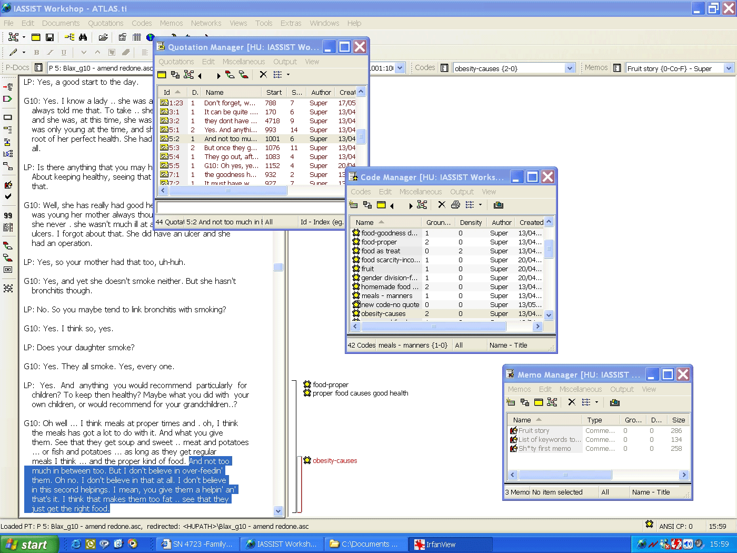
Coding and categorizing qualitative data
Key themes, quotes
Analytical categories
Interview transcript
Memos or links
Notes:
Example of a screenshot of Atlas software - There are a number of qualitative analysis software packages like Atlas, Nvivo and others that permit this kind of coding – but the software doesn’t do the analysis for you, any more than Stata or SPSS will do statistical analysis for you if you just plug in the data
Not to teach you how to use Atlas, but to provide a sense of how a mass of textual data may be analyzed
Text of an interview on the left, and the top window on the right side shows the key themes or topics that emerge, and any really illustrative quotes
Once you’ve gone through reams and reams of interview text, you will have a big long list of themes or codes, and these can be grouped into analytical categories – this is a classificatory system, like constructing a taxonomy
Which themes naturally fall together?
The memos or links functions allows you to connect the data to other sources – photos or video, or field notes
Software can sometimes lead researchers to think that more primary data is better (and manageable) BUT with qualitative data you are not necessarily looking for a representative sample, you are looking for a good understanding

Slide 37
Understanding units of analysis
Personal Meaning (emphasized in Phenomenological approaches to qualitative analysis)
What the experiencing individual intended to mean when she/he provided a linguistic description
Social Significance (emphasized in Grounded theory, Ethnography, Discourse approaches to qualitative analysis)
The social and/or theoretical implications of what was said, (whether or not the respondent intended to express these)
Notes:
We are thinking on two levels when we analyse qualitative data, and this may be informed by the methodological or theoretical framework that informs our approach
I don’t want to get too deep into this, but to make you aware of the language of qualitative research, and the idea that we are interested in what people say in their own words, about their own experiences, but also interested in what that tells us about what’s going on in the population (thinking epidemiologically)

Slide 38
Differentiating Meaning From Significance During Analysis
Text under analysis:
"I hate broccoli and spinach but my dad always tries to make me eat them"
Personal Meaning (paraphrase)
The respondent dislikes some green vegetables and experiences a family member as wanting to make her eat them
Social Significance of the Text Unit (Codes)
[code] Social control over diet
[code] Respondent lives in a family experiencing conflict over diet choices
Notes:
interpretation of personal meaning stays close to the intended meanings expressed and conventional understanding – do I understand what the respondent has said?
Why did I ask that question ? I’m not just interested in whether this kid likes broccoli – I’m not making her dinner
Maybe I am asking this question because I want to get at some larger understanding about how families make healthy food choices, and who is responsible for those choices in a family

Slide 39
How do you know when you’re done…?
Focused coding combined with theoretical sampling – to enhance understanding of how [x] appears in different situations [y]
Synthesis into an explanatory model
Beware the great sins of qualitative analysis:
Excessive analysis, or imposing fancy terminology on a simple phenomenon
Presenting lengthy quotes with no analysis at all
Notes:
When you are doing qualitative analysis, it certainly feels like it can go on forever in an endless loop…but at some point, you have examined all the ways in which the incidents, events and observations relate to each other (x and y)
And you don’t see any new codes coming forth
At this point (one hopes), you’ve actually acquired some understanding of the research issue, and you can explain it
The first sin ( I had this from an undergrad methods textbook…) is something we all do – we want to use jargon-y, sciency writing when we could be using plain English
You may be informed by a theoretical perspective, but don’t be afraid to state a simple observation: “The more generations the people are removed from their ethnic origins, the less anxiety they feel about their ethnic identity”
And of course the other side of this is to just let your data speak for itself – we all know that data doesn’t speak for itself and that your analysis isn’t done until you can interpret what the results mean

Slide 40
The constant validity check
Look for consistency and inconsistency between respondents, and find out why they disagree about important things
Check respondents’ reports against other sources of evidence
Be open to evidence that doesn’t fit:
    Normal human/cultural variation?
    Your lack of knowledge ?
    A truly unusual case?
When you think you understand, seek out alternate explanations from respondents (and colleagues)
Embrace the outliers
Notes:
You’ll have some links for tools to help you assess the quality of qualitative research, but for your own work, a primary step to ensure that you are going in the right direction is, of course, to be analyzing the data at all times
This is what I think is the beauty of qualitative research – this is what we mean when we talk about emerging methods

Slide 41
Qualitative research and quality:
Agar M. Toward a qualitative epidemiology. Qualitative Health Research. 2003; 13 (7)
Critical Appraisal Skills Programme: CASP Qualitative Checklist http://www.casp-uk.net/casp-tools-checklists
Creswell JW, Klassen AC, et.al. Best practices for mixed methods research in the health sciences. August 2011. National Institutes of Health. https://obssr.od.nih.gov/training/mixed-methods-research/
O’Brien B, Harris IB et.al. Standards for Reporting Qualitative Research: A Synthesis of Recommendations. Academic Medicine. 2014; 89 (9)
Tong A, Sainsbury P, Craig J. Consolidated criteria for reporting qualitative research (COREQ): a 32-item checklist for interviews and focus groups. Int J Qual Health Care. 2007; 19(6)
Ulin PR, Robinson ET & Tolley EE. Qualitative methods in public health: a field guide for applied research (2004). San Francisco, CA: Jossey-Bass
Walker D, Myrick F. Grounded Theory: An Exploration of Process and Procedure. Qualitative Health Research. 2006; 16 (4)

Slide 42
Questions?

Slide 43
III: Qualitative Data Collection and Mixed Methods

Slide 44
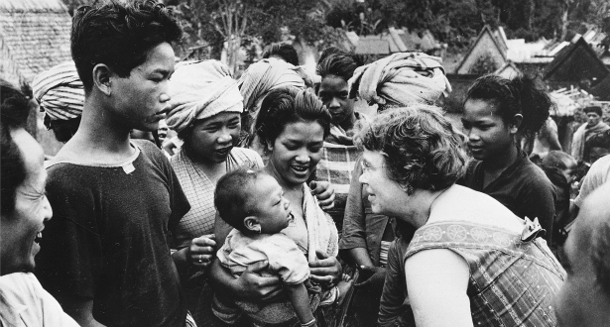
Participant observation: the outsider inside
Ethnography = “culture writing”
Immersion in social setting:
  May include “initiation” or learning a field language
Participation in the daily activities of research informants
Documentation of observed or experienced realities
Notes:
Participant observation is really what is considered “classic” field anthropology – this is what we think of in terms of an anthropologist among her research subjects (like Margaret Mead, here in Samoa)
Methodology codified by 20th century anthropologists like Bronislaw Malinowski – who was forced to stay in his research site in the Trobriand Islands because of WWI
This method is one extreme on the continuum of qualitative methods, but it illustrates the primary objective of qualitative research that Malinowski wrote about
When you access the insider perspective on an issue, you can achieve what Malinowski called “transformative insight”
It sounds like a religious experience but what he was really getting at was the challenge of seeing the world through someone else’s eyes
>>
Ethnography = "analytic descriptions or reconstructions of intact cultural scenes and groups"

Slide 45

REFLEXIVITY
The hallmark of qualitative research is reflexivity
Because qualitative research CAN be very subjective…
Collecting qualitative data means always checking your own interpretation of what you are seeing/hearing
Acknowledging how aspects of our identities (such as race, class, and gender) affect our questioning, analyses, and conclusions
Notes:
Subjective ≠ “poor quality”
How we interpret what we are observing depends on the lenses through which we are looking

Slide 46
Data collection is knowledge creation
Ethnography is both a method and an attitude:
Malinowski: when an anthropologist combines deliberate, systematic data collection with a non-directive openness, a transformative insight into others’ points of view and others’ experience becomes possible
Ethnography produces knowledge (both for the researcher and the research subjects) on the spot, through focused reflection on the everyday, that occurs as a result of everyone’s efforts to make sense of what is going on
Notes:
These concepts of reflexivity and emic perspective are, to me, the absolute foundation of the anthropological approach to qualitative research methods
participant-observation – and by extension, other qualitative methods, - require a kind of mindfulness : seeking what Bronislaw Malinowski called transformative insight
This transformative insight is part of the ongoing process of qualitative data collection and analysis – taking information in, questioning it, trying to make sense of it, holding up to the people around you, checking yourself to make sure that you are not leaping to conclusions because of your own background
- Think about what we do in an enteric outbreak when we use a ‘trawling’ questionnaire to elicit exposure information, when we ask people ‘what do you think made you sick?’ and when we generate a hypothesis and then go back to get more detailed information about specific exposures – you know that being too quick to jump to a conclusion that ‘ it was the undercooked hamburger’ can prevent you from remaining open to other possibilities and actually getting information about the hidden exposure that no one thought to ask about
It is a mindfulness of being-in- place (context); mindfulness of voice and tone (socially differentiated points of view); mindfulness of pattern, contradiction, and complexity (social structure); mindfulness of temporality and unfolding (practice); mindfulness of self and other (accountability and intersubjectivity); and mindfulness of shape and process (theoretical propositions).

Slide 47
IV: Analysing Qualitative Data

Slide 48
Analysis of qualitative data
Rule #1: qualitative data analysis takes TIME
If you record an interview, you will have to watch it at least once to make “field” notes
Then you will need to transcribe the actual interview:
  One hour of recorded interview may take 6-8 hours to transcribe
  You can “outsource” transcription, but
      € / $ / £
      Transcriptionists may impose their own understanding
      Careful transcription is the first step in analysis
Notes:
Judit’s example of transcriptionist who avoided explicit sexual terms from interviews among MSM

Slide 49
Example: Alzheimer family focus group (1)
Lucie: My husband is pretty healthy, but he has some memory loss and I’m, you know, really mostly worried about his driving. He’s still driving but I’ve seen him get kind of confused. I told his doctor more than once but she doesn’t do anything.
Interviewer: What does everyone else think?
George: Oh change doctors! Honestly…
Maria: Yeah, I agree. Second opinion (unintelligible)
Lucie: You know she is a friend of our family and I think that’s part of it. Our son said the same thing to her , you know, he said Dad’s driving is dangerous and who is responsible if we let him keep driving and he gets in an accident or, you know, god forbid he hurts someone.
Pat: You have to take it into your own hands . You can go to the Licensing Bureau .
Lou: I think there is a law that anyone who has, like, a mental deficiency is not supposed to drive.
Lucie: I’m so frustrated. I mean, do I have to talk to a lawyer about this?
George: Isn’t it important for the doctor to tell him not to drive? For health and safety?
Notes:
Study of family caregiving for patients with Alzhemeirs
Data collected in a focus group setting: six participants, plus an interviewer

Slide 50
Alzheimer family focus group (2)
Lucie: Yeah, why won’t she say that? Maybe she’s too close, she’s known us all these years and it would be really uncomfortable .
Lou: What about Nicholson ? [geriatric psychiatrist]
Maria: You just hide the car keys and lie to him! (laughing)
Lucie: I have done that!
George: I bet we all have (others nodding)
Lucie: He can still remember where we keep the extra keys, though. It’s not going to work .
Pat: I talked to my husband about it a while ago and he agreed to stop driving. I honestly thought he would be harder to persuade.
George: You need a doctor to lay it out for him if he won’t listen to you.
Lucie: That’s what I think, too.

Slide 51
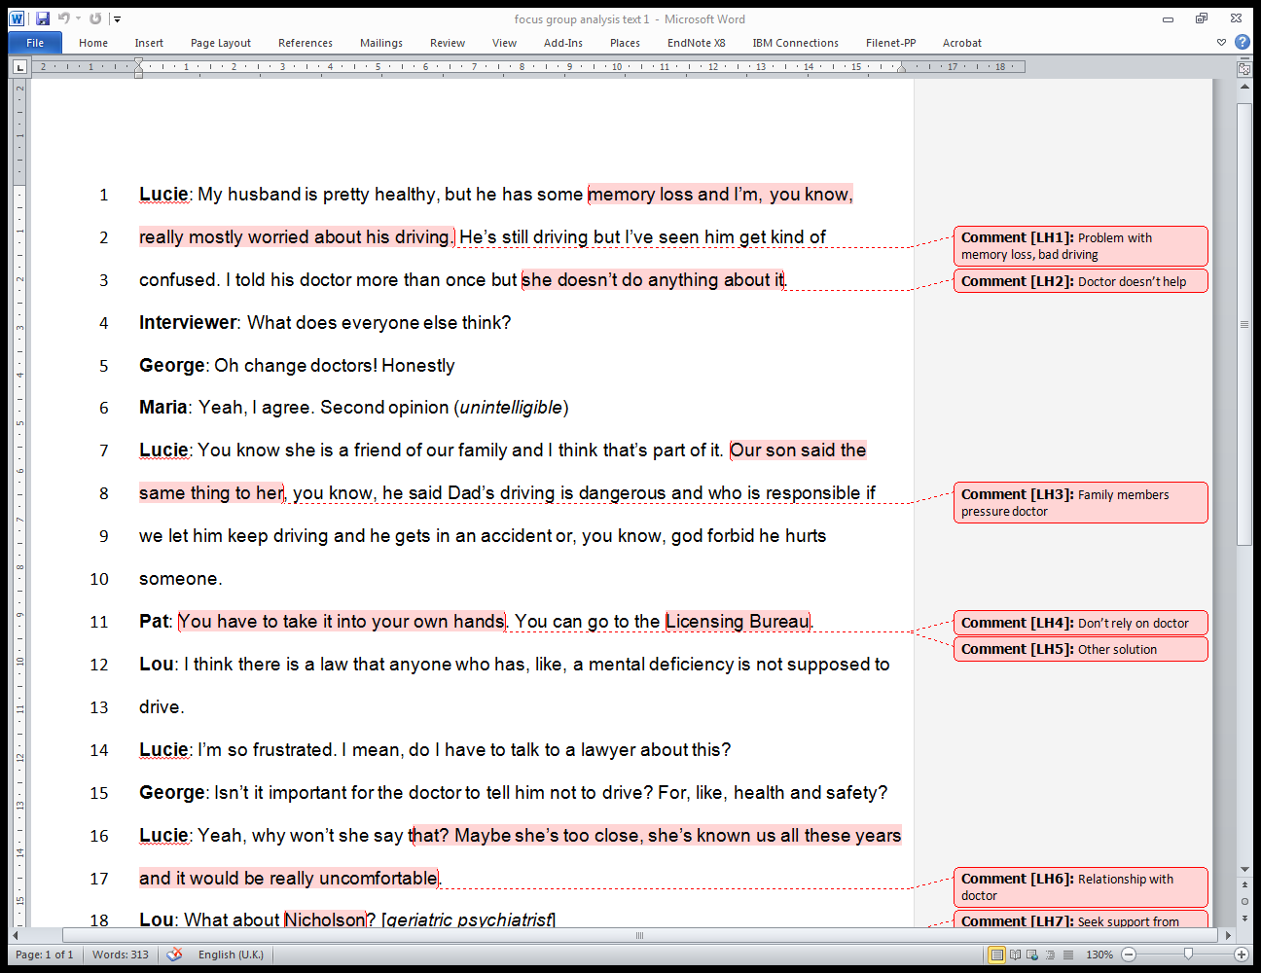

Slide 52
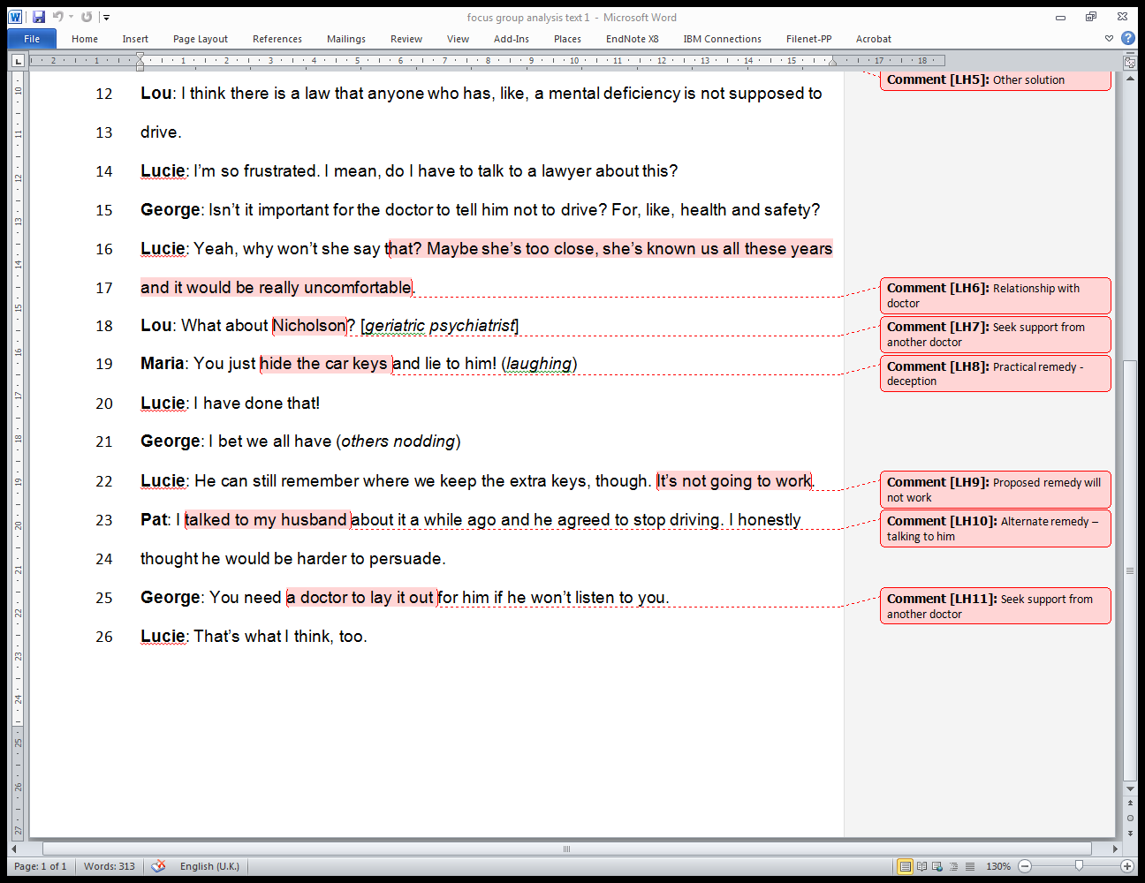

Slide 53
Marginal codes
Driving by someone with Alzheimer’s is dangerous; family caregivers may have to actively manage those who insist on continuing to drive
Healthcare professionals play an important role in caregiver’s efforts to manage patient activities
Caregivers may experience frustration with doctors who do not support family members
Support group members suggest practical solutions to deal with the problem
Notes:
As you saw in the commented text with open coding, there were several different issues that were identified in this single focus group discussion
From the text under analysis, this is one possible interpretation of the social significance of those codes

Slide 54
Selecting themes
After extensive open coding, the researcher has identified an important theme:
“Management practices”
= to include any actions caregivers took to manage and control the patient’s circumstances and behaviour
Focused coding involved returning to data to code instances of
      Monitoring/watching the patient
      Warning the patient
      Deceiving or redirecting the patient
Notes:
Selecting themes is something that would typically happen once you’ve gone through a bit of data – multiple interview or focus group transcripts
Because the focus of this study is family caregiving for patients with Alzheimers, the researcher identified a theme that seemed to be an important issue
Once the theme is identified, the researcher then goes back to all that original data, to identify exchanges where the respondents spoke about actions or thoughts relevant to this theme

Slide 55
Integration and interpretation
Themes may lead to sub-themes…
Theme 1
Subtheme
Code
Code
Code

Slide 56
Integration and interpretation
Qualitative analysis is not just finding out what is in the data
The researcher selects some incidents, events and observations and assesses how they relate to others
Every piece of transcribed text is compared with every other piece of transcribed text, across all participants
Data saturation occurs when no new codes are revealed

Slide 57
In their own words…
Authors present key quotes in Results
Quotes let the reader understand quickly what it took the researcher many hours/days/weeks to figure out
Quotes let the reader “hear” the voice of the subject, in their own words
Authors also presented a clear conclusion:
Although there were many common accounts of barriers and facilitators to immunisation uptake across Traveller communities, historical beliefs held by health professionals regarding these barriers and facilitators may no longer be valid.
Jackson et.al. BMC Public Health 2017
Notes:
We like a good quote in qualitative research – part of the goal is to understand that insider perspective, and you can get that effectively through direct quotes
But like everything, there is an art to using quotes effectively –
And per the previous slide, quotes are results that should support a conclusion, that is based on your rigourous and thorough analysis
The conclusion text cited here is from the paper Needles, Jabs and Jags: in the reference list

Slide 58
V: Choosing the right method
[exercise]

Slide 59
In your small groups:
Choose one of the scenarios distributed:
  Clarify amongst yourselves the study TOPIC and its AIM
  Formulate 2 to 4 specific research questions that capture the objectives of your study
  Describe your overall study design, and its quantitative and qualitative components
  Outline sampling and data collection strategies for the components in your study design. Be specific!
  What challenges regarding sampling, data collection or data analysis do you anticipate?
15 minutes to prepare in your group
20 minutes for plenary presentation/discussion

Slide 60
VI: Debrief - choosing the right method

Slide 61
Evaluation

Slide 62
Learning objectives:
At the end of this session, participants will be able to:
Explain key processes of qualitative and mixed methods research
Distinguish barriers between epidemiologists/microbiologists and their qualitative research colleagues
Describe how structured coding can be used to analyse text data
Articulate challenges and benefits of incorporating qualitative methods in public health investigations
Notes:
A reminder for you about what our learning objectives were for this session:
Do you think we achieved them?

Slide 63
Evaluation
What did you learn today that was new to you?
Can you use this information for your own projects?
What could we do differently next time?

Slide 64
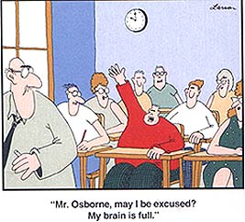
Thank you!

Slide 65
Extra slides
Focused ethnographic studies

Slide 66
Qualitative methods in public health context
Focused ethnographic studies / Rapid ethnographic assessment:
aka “good-enough ethnography“
Methods to gather ethnographic data with triangulation of multiple qualitative (and quantitative) measures
Using an iterative process for data interpretation / analysis
Often involving multiple investigators from different disciplines
It is not possible to understand everything about a society - we do the best we can, with the resources available
Notes:
One of the main barriers to incorporating anthropological approaches in public health is that traditional ethnographic methods take TIME
And often, anthropologists are brought in at the end, when things aren’t going well….
Rapid ethnographic assessment grew from targeted health research design and is now used to assess a variety of situations to gain ethnographic data
Nancy Scheper-Hughes is a medical anthropologist who made this observation about good-enough ethnography and it reminds me of what we say about public health surveillance : when we are designing or evaluating surveillance systems, we have to acknowledge that no system is perfect and our data will always fall short of reality in some way, because we don’t have unlimited resources or time or technical capacity. We do the best we can

Slide 67
Case study:
WHO FES of Acute Respiratory Infection
Public health issue:
ARI is a major killer of young children but prompt and appropriate case management can significantly improve ARI mortality
Challenge:
Parents must distinguish early symptoms of pneumonia from other minor respiratory illnesses, seek appropriate treatment and follow antibiotic recommendations
Qualitative information needed:
Beliefs about ARI causes, treatments in children
Factors that facilitate or constrain care-seeking
Household management of children with ARI
Expectations and cultural factors influencing response to ARI program
Notes:
WHO developed case management guidelines for health workers, with an emphasis on detecting children who may have pneumonia and treating them empirically (without x-ray)
However, health care workers need to be able to guide parents about how to care for children who may have pneumonia and when to seek health care from a professional
A detailed protocol was developed to understand these key household behaviours and facilitate effective communication with families
So it is a focused ethnographic study because it is directed toward getting data on issues relevant to national ARI programs – it is NOT intended to cover all social and cultural aspects of respiratory infections and their management
A unique aspect is that this protocol was developed, applied and refined in 10 different countries and subsequently expanded to more: so the approach was consistent, the methodology was replicable and the findings were used to inform public health action at the local level

Slide 68
The FES Protocol
Community-based research involving:
Open-ended interviews with ‘key informants’
Structured interviews with 25-30 mothers of young children
Interviews with 25-30 mothers who bring children with respiratory symptoms to health facility (+assessment of sick child)
Structured interview with trained health workers and community practitioners, including traditional healers
Presentation of case scenarios to pharmacists and drug sellers
Notes:
What kinds of activities did the Focused Ethnographic Study for ARI involve?
This is a basic outline of the data collection methods – this is where the triangulation comes in: getting information from multiple sources helps to uncover what’s really happening and also to check whether informants with different perspectives offer the same interpretation of what’s happening

Slide 69
The FES Data
Free-listing technique to obtain key local vocabulary and provisional ‘explanatory models’
Narratives from mothers about recent ARI events in their households, and feedback on how they would handle a hypothetical case scenario
Interviews with 25-30 mothers who bring children with respiratory symptoms to health facility (+assessment of sick child)
Structured interview with trained health workers and community practitioners, including traditional healers
Presentation of case scenarios to pharmacists and drug sellers
Notes:
This is what the FES qualitative data look like
Provides terms and categories to talk about ARI illness with community members and starts to identify what people believe about how ARI are caused and should be treated; who are the healthcare providers (including traditional healers) in the community
Provides information about how mothers respond to different signs of illness in their children, and what their perspectives are on seeking care: can include
exercises such as asking mothers to do a sorting exercise where they link signs and symptoms to specific illnesses and indicate which ones are more and less severe
Looking at medications and other remedies kept in the home and asking moms how they are used
Asking moms which type of healthcare provider they would choose for different issues
Showing moms a video of children with signs of pneumonia, other RI, and healthy kids to evaluate their ability to recognize key signs like fast breathing
Information about home care prior to the health facility visit, decisions related to care-seeking, mom’s perception of illness and how these correlate with the child’s current illness
How care providers perceive practices in the community around care at home and from different practitioners, possible barriers
Showing pharmacists and drug sellers the same video that was shown to moms to assess their ability to provide appropriate advise and dispensing

Slide 70
FES Results
Parental beliefs about the causes of illness influence decisions about where and when to seek care
Vocabulary around clinical signs and symptoms need to be tested and refined for local understanding
Mild and severe ARI may be understood as two (or more!) different illnesses;
    there is rarely a direct correlation between biomedical classifications and ‘folk’ illness designations
Respondents may identify structural or social barriers to health care that have not been addressed by public health programs
People may seek advice from a traditional healer about which other practitioner should be consulted
Notes:
These are some of the results from FES in many different settings, that influence how well the program for ARI management is going to work
Example from literature is in Honduras where the literal translation of ‘rapid breathing’ didn’t really convey the same meaning: parents understood another term ‘cansansio’ better although that would translate as tiredness or tired breathing
You can develop a really sound public health program and train people in appropriate case management with all necessary tools at hand, and then find out way down the road that people don’t seek care because the clinic wait times are too long, or that they have past experience with drugs not being available in the pharmacy
Or you might find out that women need to wait for their husband’s to be home to give approval for the child to be taken to the clinic

Slide 71
Using FES for public health action
NOT useful for:
Quantitative assessment of the distribution of behaviours / perceptions
Broad generalization, beyond the community where conducted
IS useful for:
Better vocabulary for other research/practice tools
Identifying key areas for behaviour change and communication
Illuminating issues that are outside the scope of traditional public health interventions/communications
Stimulating advocacy and creative problem-solving
Notes:
A focused ethnographic study is not going to give you a good measure of the prevalence of a certain behaviour or a quantification of how many adults in a community know how dengue transmission is prevented
But it can give you meaningful categories to go forward and ask the right questions for quantitative results – for example, in an outbreak setting where a FES elucidates an unusual food preparation technique that is hypothesized to be associated with a foodborne disease outcome – PH can then go back and ask people specifically about food preparation practices and the consumption of particular products that are unique to a particular community or cultural group
In the ARI example, one local finding (Indonesia) was that moms thought that prescribed antibiotics were ‘too strong’ to give to babies, and should be given to mothers so that infants would receive the medication in a more gentle form through breastmilk – all the right indicators would be there (moms bringing sick babies to health care, getting antibiotics prescribed, reporting that the dosing schedule was adhered to…. ) but still sick babies
Sometimes you get difficult results from qualitative studies that systemic reforms are needed, that there are barriers to public health due to inadequate housing or food insecurity… but we know that most public health issues are not simple fixes
Major focus is to facilitate collaboration among public health scientists so that interventions really reach people

