Slide 1
Nmap

Slide 2
Contents
Introduction
Download and Installation
Target specification
Scan Techniques
Port specification and scan order
Host discovery
OS detection
Firewall spoofing
References

Slide 3
Introduction
Nmap (“Network Mapper”) is a free and open source utility for network exploration and security auditing. Many systems and network administrators also find it useful for tasks such as network inventory, managing service upgrade schedules, and monitoring host or service uptime. Nmap uses raw IP packets in novel ways to determine what hosts are available on the network, what services (application name and version) those hosts are offering, what operating systems (and OS versions) they are running, what type of packet filters/firewalls are in use, and dozens of other characteristics. It was designed to rapidly scan large networks, but works fine against single hosts. Nmap runs on all major computer operating systems, and both console and graphical versions are available.
It is one of the best tools available in market for any type of network reconnaissance.
Nmap was written by Gordon Lyon (also known by his pseudonym Fyodor Vaskovich) on September of 1997.
Although it updated ever since.
The latest version available is nmap 7.70 released on March 21 2018.

Slide 4
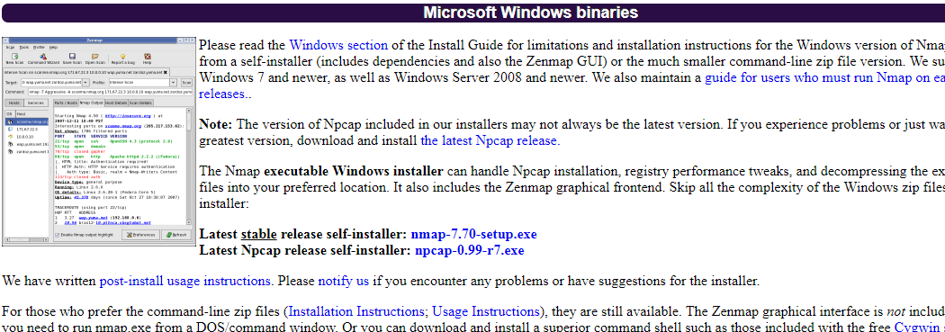
Download and Installation

Slide 5
Target specifications

Slide 6
Everything on the Nmap command-line that isn't an option (or option argument) is treated as a target host specification.
The simplest case is to specify a target IP address or hostname for scanning.
When a hostname is given as a target, it is resolved via the Domain Name System (DNS) to determine the IP address to scan.
If the name resolves to more than one IP address, only the first one will be scanned.
To make Nmap scan all the resolved addresses instead of only the first one, use the ~ --resolve-all ~ option.

Slide 7
Sometimes you wish to scan a whole network of adjacent hosts. For this, Nmap supports CIDR-style addressing.
You can append /<numbits> to an IP address or hostname and Nmap will scan every IP address for which the first <numbits> are the same as for the reference IP or hostname given.
For example, 192.168.10.0/24 would scan the 256 hosts between 192.168.10.0 and 192.168.10.255, inclusive.
Given that the host scanme.nmap.org is at the IP address 64.13.134.52, the specification scanme.nmap.org would scan the 65,536 IP addresses between 64.13.0.0 and 64.13.255.255.
The smallest allowed value is /0 which targets the whole Internet. The largest value for IPv4 is /32 and IPv6 is /128, which scans just the named host or IP address because all address bits are fixed.

Slide 8
CIDR notation is short but not always flexible enough. For example, you might want to scan 192.168.0.0/16 but skip any IPs ending with .0 or .255 because they may be used as subnet network and broadcast addresses.
Nmap supports this through octet range addressing. Rather than specify a normal IP address, you can specify a comma-separated list of numbers or ranges for each octet.
For example, 192.168.0-255.1-254 will skip all addresses in the range that end in .0 or .255, and 192.168.3-5,7.1 will scan the four addresses 192.168.3.1, 192.168.4.1, 192.168.5.1, and 192.168.7.1.
Ranges need not be limited to the final octets: the specifier 0-255.0-255.13.37 will perform an Internet-wide scan for all IP addresses ending in 13.37. This sort of broad sampling can be useful for Internet surveys and research.

Slide 9
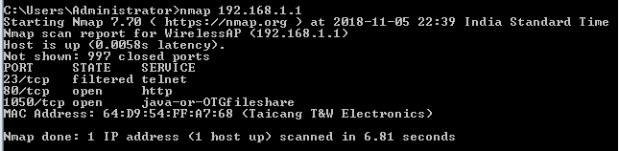
Scanning a single IP
nmap 192.168.1.1

Slide 10
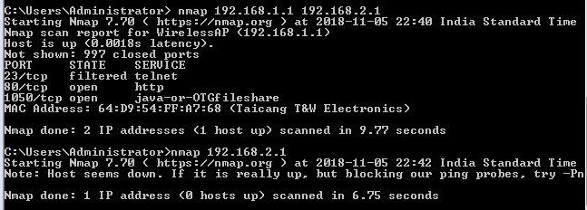
Scanning multiple IPs
nmap 192.168.1.1 192.168.2.1

Slide 11
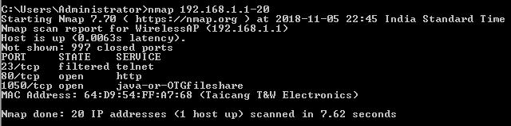
Scanning a range of IPs
nmap 192.168.1-254

Slide 12
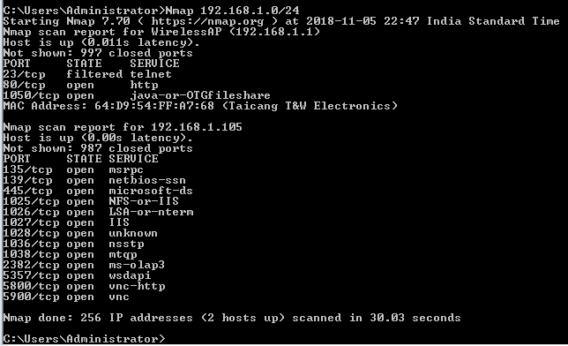
Scan a range of Ips (CIDR notation)
Nmap 192.168.1.0/24

Slide 13
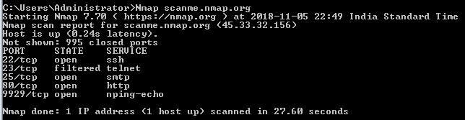
Scanning a domain
Nmap scanme.nmap.org

Slide 14
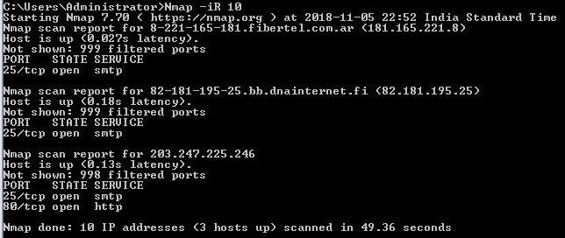
Scanning random hosts
Nmap – iR 100 (scans 100 random hosts)

Slide 15
Scan Techniques

Slide 16
1.TCP SYN port scan (nmap –sS)
SYN scan is the default and most popular scan option for good reasons. It can be performed quickly, scanning thousands of ports per second on a fast network not hampered by restrictive firewalls. It is also relatively unobtrusive and stealthy since it never completes TCP connections.
This technique is often referred to as half-open scanning, because you don't open a full TCP connection.
In this method we send a SYN packet as if we are going to open a real connection and wait for response.
A SYN/ACK packet indicates whether the port is responding ( i.e. active ) or is in RST state ( i.e. indicates a non-listener it sends back RST packets ).
The complete three way handshake doesn’t take place hence it is called half open scanning.
If no response is received after several retransmissions, the port is marked as filtered. The port is also marked filtered if an ICMP unreachable error (type 3, code 0, 1, 2, 3, 9, 10, or 13) is received. The port is also considered open if a SYN packet (without the ACK flag) is received in response. This can be due to an extremely rare TCP feature known as a simultaneous open or split handshake connection.
This scan is mainly used to list all the open ports that use TCP (transmission control protocol)

Slide 17
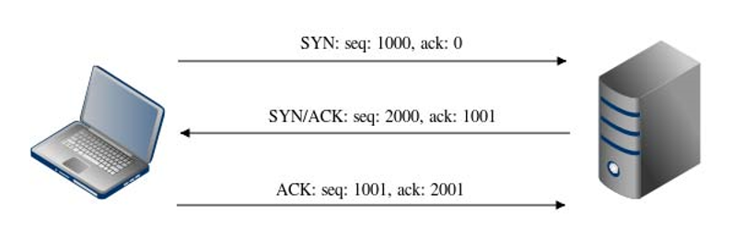
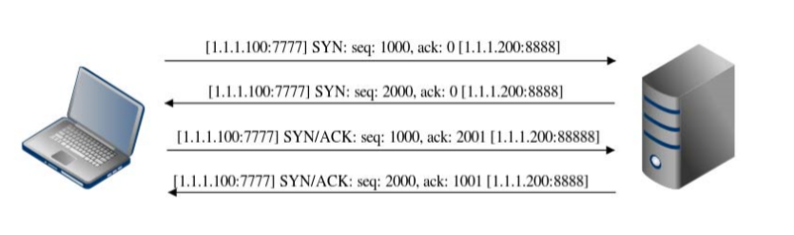
Three way handshake protocol
simultaneous open connection

Slide 18
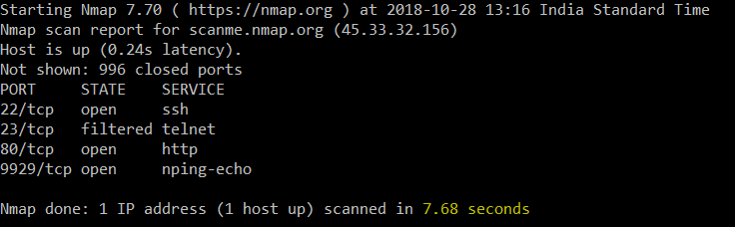
TCP SYN port scan

Slide 19
UDP scan (nmap –sU )
While most popular services on the Internet run over the TCP protocol, UDP services are widely deployed. DNS, SNMP, and DHCP (registered ports 53, 161/162, and 67/68) are three of the most common. Because UDP scanning is generally slower and more difficult than TCP, some security auditors ignore these ports.
UDP scan works by sending a UDP packet to every targeted port. For some common ports such as 53 and 161, a protocol-specific payload is sent to increase response rate, but for most ports the packet is empty unless the --data, --data-string, or --data-length options are specified.
If an ICMP port unreachable error (type 3, code 3) is returned, the port is closed. Other ICMP unreachable errors (type 3, codes 0, 1, 2, 9, 10, or 13) mark the port as filtered.
Occasionally, a service will respond with a UDP packet, proving that it is open. If no response is received after retransmissions, the port is classified as open | filtered. This means that the port could be open, or perhaps packet filters are blocking the communication. Version detection (-sV) can be used to help differentiate the truly open ports from the filtered ones.
A big challenge with UDP scanning is doing it quickly. Open and filtered ports rarely send any response, leaving Nmap to time out and then conduct retransmissions just in case the probe or response were lost. Closed ports are often an even bigger problem. They usually send back an ICMP port unreachable error. But unlike the RST packets sent by closed TCP ports in response to a SYN or connect scan, many hosts rate limit ICMP port unreachable messages by default. Linux and Solaris are particularly strict about this.
Ideas for speeding your UDP scans up include scanning more hosts in parallel, doing a quick scan of just the popular ports first, scanning from behind the firewall, and using --host-timeout to skip slow hosts.

Slide 20
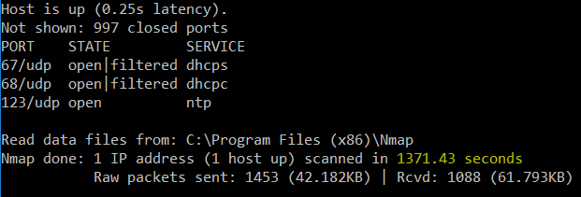
UDP Scan Output

Slide 21
TCP NULL, FIN, and Xmas scans
These three scan types (even more are possible with the --scanflags option ) exploit a subtle loophole in the TCP RFC to differentiate between open and closed ports.
When scanning systems compliant with this RFC text, any packet not containing SYN, RST, or ACK bits will result in a returned RST if the port is closed and no response at all if the port is open.
Null scan (-sN)
Does not set any bits (TCP flag header is 0)
FIN scan (-sF)
Sets just the TCP FIN bit.
Xmas scan (-sX)
Sets the FIN, PSH, and URG flags, lighting the packet up like a Christmas tree.
These three scan types are the same in behavior except for the TCP flags set in probe packets. If an RST packet is received, the port is considered closed, while no response means it is open|filtered. The port is marked filtered if an ICMP unreachable error (type 3, code 0, 1, 2, 3, 9, 10, or 13) is received.

Slide 22
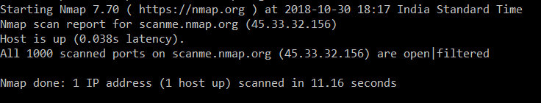
Fin scan output

Slide 23
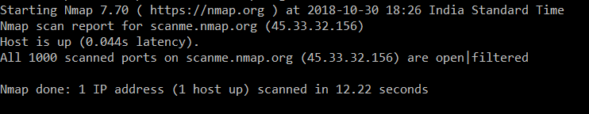
Null scan output

Slide 24
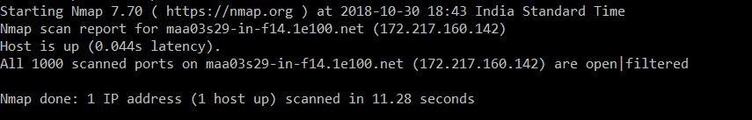
Xmas scan output

Slide 25
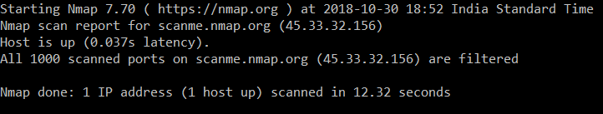
TCP ACK scan ( -sA )
This scan is different than the others discussed so far in that it never determines open (or even open|filtered) ports. It is used to map out firewall rulesets, determining whether they are stateful or not and which ports are filtered.
The ACK scan probe packet has only the ACK flag set (unless you use --scanflags). When scanning unfiltered systems, open and closed ports will both return an RST packet. Nmap then labels them as unfiltered, meaning that they are reachable by the ACK packet, but whether they are open or closed is undetermined. Ports that don't respond or send certain ICMP error messages back (type 3, code 0, 1, 2, 3, 9, 10, or 13), are labeled filtered.
TCP ACK scan output

Slide 26
IP protocol scan (-sO)
IP protocol scan allows you to determine which IP protocols (TCP, ICMP, IGMP, etc.) are supported by target machines. This isn't technically a port scan, since it cycles through IP protocol numbers rather than TCP or UDP port numbers. Yet it still uses the -p option to select scanned protocol numbers, reports its results within the normal port table format, and even uses the same underlying scan engine as the true port scanning methods. So it is close enough to a port scan that it belongs here.
Protocol scan works in a similar fashion to UDP scan. Instead of iterating through the port number field of a UDP packet, it sends IP packet headers and iterates through the eight-bit IP protocol field. The headers are usually empty, containing no data and not even the proper header for the claimed protocol. The exceptions are TCP, UDP, ICMP, SCTP, and IGMP. A proper protocol header for those is included since some systems won't send them otherwise and because Nmap already has functions to create them. Instead of watching for ICMP port unreachable messages, protocol scan is on the lookout for ICMP protocol unreachable messages. If Nmap receives any response in any protocol from the target host, Nmap marks that protocol as open. An ICMP protocol unreachable error (type 3, code 2) causes the protocol to be marked as closed while port unreachable (type 3, code 3) marks the protocol open. Other ICMP unreachable errors (type 3, code 0, 1, 9, 10, or 13) cause the protocol to be marked filtered (though they prove that ICMP is open at the same time). If no response is received after retransmissions, the protocol is marked open|filtered.

Slide 27
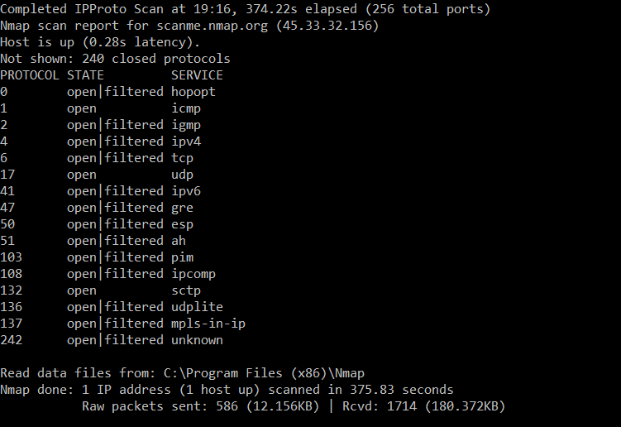
IP protocol scan output

Slide 28
Port Specification and Scan Order
Nmap also provides users with a provision to scan for specific ports

Slide 29
-p <port ranges> (Scan only specified ports) :
This option specifies which ports you want to scan and overrides the default. Individual port numbers are OK, as are ranges separated by a hyphen (e.g. 1-1023). The beginning and/or end values of a range may be omitted, causing Nmap to use 1 and 65535, respectively. So you can specify -p- to scan ports from 1 through 65535. Scanning port zero is allowed if you specify it explicitly. For IP protocol scanning (-sO), this option specifies the protocol numbers you wish to scan for (0–255).
–exclude-ports <port ranges>(excludes specified ports from scan):
This option specifies which ports you do want Nmap to exclude from scanning. The <port ranges> are specified similar to -p. For IP protocol scanning (-sO), this option specifies the protocol numbers you wish to exclude (0–255).
-F (Fast (limited port) scan) :
Specifies that you wish to scan fewer ports than the default. Normally Nmap scans the most common 1,000 ports for each scanned protocol. With -F, this is reduced to 100.

Slide 30
-r (Don't randomize ports)
By default, Nmap randomizes the scanned port order (except that certain commonly accessible ports are moved near the beginning for efficiency reasons). This randomization is normally desirable, but you can specify -r for sequential (sorted from lowest to highest) port scanning instead.

Slide 31
Host Discovery

Slide 32
One of the most important step in any network reconnaissance mission is to reduce a (sometimes huge) set of IP ranges into a list of active or interesting hosts.
It is impossible to scan every port as it is a tedious process. Host discovery is an important step.
An administrator may be comfortable using just an ICMP ping to locate hosts on his internal network, while an external penetration tester may use a diverse set of dozens of probes in an attempt to evade firewall restrictions.
Because host discovery needs are so diverse, Nmap offers a wide variety of options for customizing the techniques used. Host discovery is sometimes called ping scan, but it goes well beyond the simple ICMP echo request packets associated with the ubiquitous ping tool. Users can skip the ping step entirely with a list scan (-sL) or by disabling ping (-Pn), or engage the network with arbitrary combinations of multi-port TCP SYN/ACK, UDP, SCTP INIT and ICMP probes.

Slide 33
- sL (list scan)
The list scan is a degenerate form of host discovery that simply lists each host of the network(s) specified, without sending any packets to the target hosts. By default, Nmap still does reverse-DNS resolution on the hosts to learn their names. It is often surprising how much useful information simple hostnames give out. For example, fw.chi is the name of one company's Chicago firewall. Nmap also reports the total number of IP addresses at the end. The list scan is a good sanity check to ensure that you have proper IP addresses for your targets. If the hosts sport domain names you do not recognize, it is worth investigating further to prevent scanning the wrong company's network.

Slide 34

nmap -sL Output

Slide 35
- sn (no port scan)
This option tells Nmap not to do a port scan after host discovery, and only print out the available hosts that responded to the host discovery probes.
This is often known as a “ping scan”, but you can also request that traceroute and NSE host scripts be run. This is by default one step more intrusive than the list scan, and can often be used for the same purposes.
It allows light reconnaissance of a target network without attracting much attention. Knowing how many hosts are up is more valuable to attackers than the list provided by list scan of every single IP and host name.
The default host discovery done with -sn consists of an ICMP echo request, TCP SYN to port 443, TCP ACK to port 80, and an ICMP timestamp request by default. When executed by an unprivileged user, only SYN packets are sent (using a connect call) to ports 80 and 443 on the target. When a privileged user tries to scan targets on a local ethernet network, ARP requests are used unless --send-ip was specified. The -sn option can be combined with any of the discovery probe types (the -P* options, excluding -Pn) for greater flexibility.

Slide 36

- sn (no port scan) Output

Slide 37
- Pn (no ping)
This option skips the Nmap discovery stage altogether. Normally, Nmap uses this stage to determine active machines for heavier scanning. By default, Nmap only performs heavy probing such as port scans, version detection, or OS detection against hosts that are found to be up. Disabling host discovery with -Pn causes Nmap to attempt the requested scanning functions against every target IP address specified. So if a class B target address space (/16) is specified on the command line, all 65,536 IP addresses are scanned. Proper host discovery is skipped as with the list scan, but instead of stopping and printing the target list, Nmap continues to perform requested functions as if each target IP is active. To skip ping scan and port scan, while still allowing NSE to run, use the two options -Pn -sn together.

Slide 38
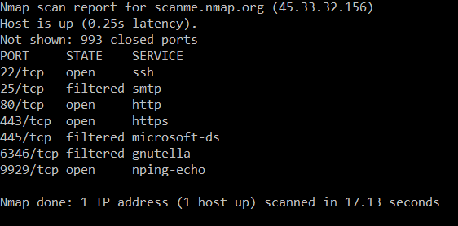
- Pn (no ping) Output

Slide 39
OS detection

Slide 40
One of Nmap's best-known features is remote OS detection using TCP/IP stack fingerprinting.
Nmap sends a series of TCP and UDP packets to the remote host and examines practically every bit in the responses.
After performing dozens of tests such as TCP ISN sampling, TCP options support and ordering, IP ID sampling, and the initial window size check, Nmap compares the results to its ~nmap-os-db~ database of more than 2,600 known OS fingerprints and prints out the OS details if there is a match.
Each fingerprint includes a freeform textual description of the OS, and a classification which provides the vendor name (e.g. Sun), underlying OS (e.g. Solaris), OS generation (e.g. 10), and device type (general purpose, router, switch, game console, etc).

Slide 41
If Nmap is unable to guess the OS of a machine, and conditions are good (e.g. at least one open port and one closed port were found), Nmap will provide a URL you can use to submit the fingerprint if you know (for sure) the OS running on the machine.
OS detection enables some other tests which make use of information that is gathered during the process anyway. One of these is TCP Sequence Predictability Classification.
This measures approximately how hard it is to establish a forged TCP connection against the remote host.
It is useful for exploiting source-IP based trust relationships (rlogin, firewall filters, etc) or for hiding the source of an attack.
This sort of spoofing is rarely performed any more, but many machines are still vulnerable to it.

Slide 42
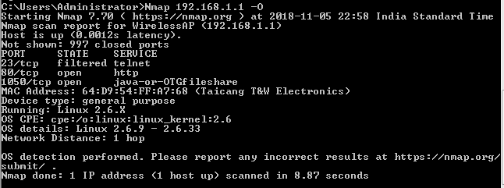
Enabling OS detection ( -o )
Enables OS detection, as discussed above. Alternatively, you can use ~-A~ to enable OS detection along with other things.
Nmap 192.168.1.1 –O

Slide 43
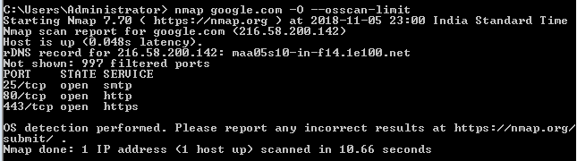
Limit OS detection to promising targets
nmap 192.168.1.1 –O - -osscan-limit

Slide 44
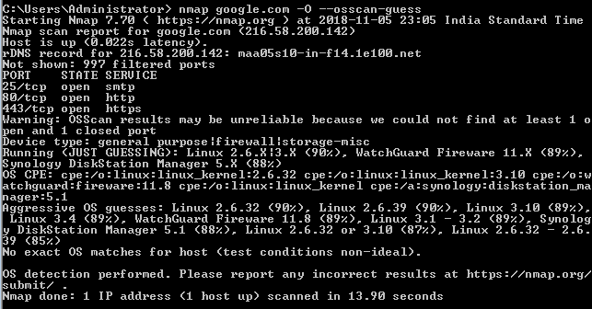
Guess OS detection results (aggressive scanning)
nmap 192.168.1.1 –O - -osscan-guess

Slide 45
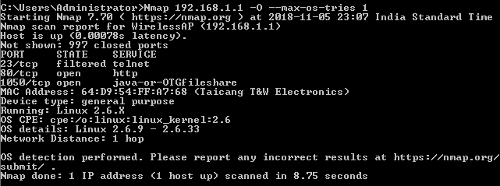
Set the maximum number of OS detection tries against a target
Nmap192.168.1.1 –O - -max-os-tries 1

Slide 46
Firewall spoofing

Slide 47
Many Internet pioneers envisioned a global open network with a universal IP address space allowing virtual connections between any two nodes. This allows hosts to act as true peers, serving and retrieving information from each other.
People could access all of their home systems from work, changing the climate control settings or unlocking the doors for early guests.
This vision of universal connectivity has been stifled by address space shortages and security concerns.
In the early 1990s, organizations began deploying firewalls for the express purpose of reducing connectivity. Huge networks were cordoned off from the unfiltered Internet by application proxies, network address translation, and packet filters
The unrestricted flow of information gave way to tight regulation of approved communication channels and the content that passes over them.

Slide 48
Network obstructions such as firewalls can make mapping a network exceedingly difficult. It will not get any easier, as stifling casual reconnaissance is often a key goal of implementing the devices.
Nmap offers many features to help understand these complex networks, and to verify that filters are working as intended. It even supports mechanisms for bypassing poorly implemented defences.
One of the best methods of understanding your network security posture is to try to defeat it. Place yourself in the mind-set of an attacker, and deploy techniques from this section against your networks.
Launch an FTP bounce scan, idle scan, fragmentation attack, or try to tunnel through one of your own proxies.
There is NO magic bullet (or Nmap option) for detecting and subverting firewalls and IDS systems.

Slide 49
fragment packets ( nmap 192.168.1.1 –f)
The -f option causes the requested scan to use tiny fragmented IP packets.
The idea is to split up the TCP header over several packets to make it harder for packet filters, intrusion detection systems, and other annoyances to detect what you are doing.
A 20-byte TCP header would be split into three packets. Two with eight bytes of the TCP header, and one with the final four.
Specify -f again to use 16 bytes per fragment (reducing the number of fragments).

Slide 50
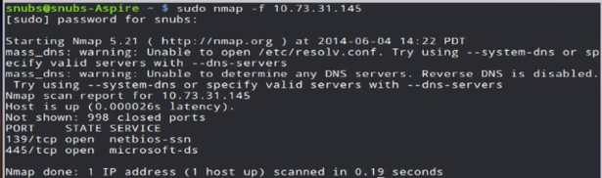

Slide 51
Set own offset size (nmap 192.168.1.1 --mtu 32)
you can specify your own offset size with the --mtu option. Don't also specify -f if you use --mtu.
The offset must be a multiple of eight.
While fragmented packets won't get by packet filters and firewalls that queue all IP fragments, such as the CONFIG_IP_ALWAYS_DEFRAG option in the Linux kernel, some networks can't afford the performance hit this causes and thus leave it disabled.
MTU : Maximum Transmission Unit

Slide 52
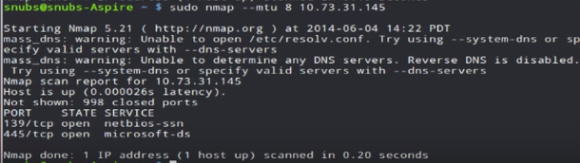

Slide 53
Using given source port number ()
DNS may be broken because the UDP DNS replies from external servers can no longer enter the network when an administrator sets up a new firewall.
Secure solutions to these problems exist, often in the form of application-level proxies or protocol-parsing firewall modules.
Noting that DNS replies come from port 53 and active FTP from port 20, many administrators have fallen into the trap of simply allowing incoming traffic from those ports.
Nmap offers the -g and --source-port options (they are equivalent) to exploit these weaknesses.

Slide 54
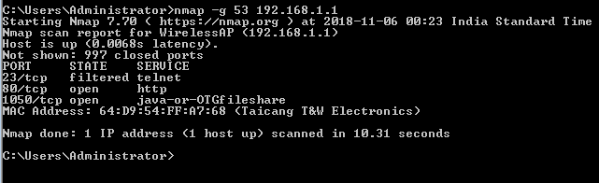

Slide 55
References
Nmap.org
YouTube
Wikipedia

