Slide 2
Data type Declarations
Specify the type of data and the length of the data item in bytes
int, short, long
float, double
boolean
char

Slide 3
The Primitive data type
Declaration Size and Type Number Range
byte b; // 8 bit integer -2⁻⁷ to +2⁺⁷-1
short s; // 16 bit integer -2⁻¹⁵ to +2⁺¹⁵-1
char c; // 16 bit Unicode 0 to +2⁺¹⁶
int i; // 32 bit integer -2⁻³¹ to +2⁺³¹-1
long l; // 64 bit integer -2⁻⁶³ to +2⁺⁶³-1
float f; // 32 bit floating point IEEE754 Standard
double d; // 64 bit floating point IEEE754 Standard

Slide 4
Data formats
The character format—uses an assigned decimal value
The integer format
The floating point format—consists of an exponent part and a mantissa part—for example the 4-byte floating point word might have a 1-byte exponent and a 3-byte mantissa.

Slide 5
The char data type
Holds only a single character
Legal Examples
  char myMiddleInitial = ‘M’;
  char myGradeInChemistry = ‘A’;
  char aStar = ‘*’;
  char aCharValue = ‘9’;
  char aNewLine = ‘\n’;
  char aTabChar = ‘\t’;

Slide 6
Type of variables
 Char
 Int
 Flaot
 Double
 void

Slide 7
Scope of Variable
An objective C program will consist of code divided up into functions, classes ,and code structures
 A typical program will make extensive use of
variable to store and manipulate data
 Once a variable declared it may or may not be
accessible to other section of program code
 This accessibility depends on where and how the variable was declared and where the code is that needed to access .This is known as variable scope.

Slide 8
Types of Variables
Local Variables
Global Variables

Slide 9
Local Variables
Variable that are declared inside a function or
block called local variables
 They can be used only by statements that are
inside that function or block of code
 Local variable not known to functions outside

Slide 10
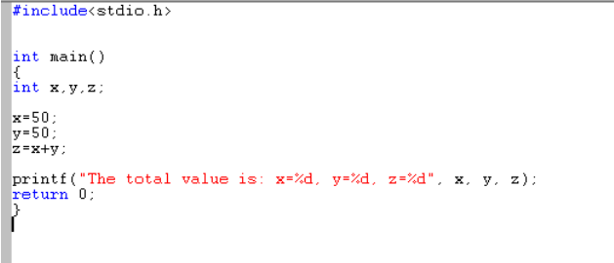
Examples
Here all the variables x , y and z are declared
inside the main , so it is local to main()
Function

Slide 11
Global Variables
 Global variables are defined outside of a
function , usually on top of the program
 The global variables will hold their value
throughout the lifetime of your program and
they can be accessed inside any functions
defined for the program
 A global variable can be accessed by any
function
 Global variable is available for use throughout
your entire program after its declaration

Slide 12
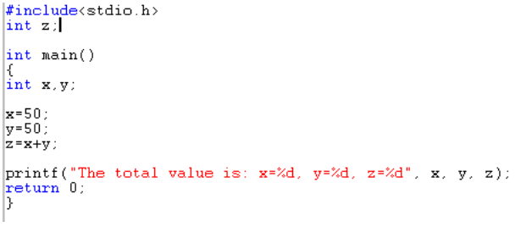
Example

Slide 13
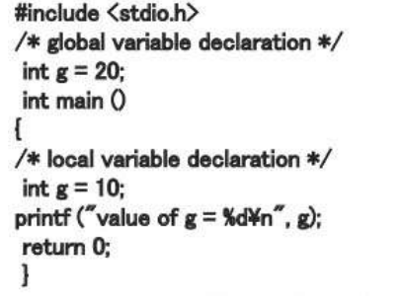
A program can have same name for local and
global variables
But value of local variables inside a function
will take preference

Slide 14
Scope and Lifetime of Variables
Variable Type | Scope | Lifetime
Instance Variables | Throughout the class except in static methods | Untill the object is available in memory
Local Variables | Within the function in which it is declared | Until the control leaves the function in which it is declared
Global Variables | Throught out the class | Untill the end of the program

Slide 15
Operators
JAVA operators can be classified into a number of related categories as below:-
 Arithmetic.
 Relational.
 Logical.
+ - * / %
< <= > >= == !=
&& AND
T && T = T
|| OR
F || F= F
! NOT
T = F
F = T

Slide 16
Simple Arithmetic
public class Example {
public static void main(String[] args) {
int j, k, p, q, r, s, t;
j = 5;
k = 2;
p = j + k;
q = j - k;
r = j * k;
s = j / k;
t = j % k;
System.out.println("p = " + p);
System.out.println("q = " + q);
System.out.println("r = " + r);
System.out.println("s = " + s);
System.out.println("t = " + t);
}
}
> java Example
p = 7
q = 3
r = 10
s = 2
t = 1
>

Slide 17
Shorthand Operators
+=, -=, *=, /=, %=
Common Shorthand
a = a + b; a += b;
a = a - b; a -= b;
a = a * b; a *= b;
a = a / b; a /= b;
a = a % b; a %= b;

Slide 18
Shorthand Operators
public class Example {
public static void main(String[] args) {
int j, p, q, r, s, t;
j = 5;
p = 1; q = 2; r = 3; s = 4; t = 5;
p += j;
q -= j;
r *= j;
s /= j;
t %= j;
System.out.println("p = " + p);
System.out.println("q = " + q);
System.out.println("r = " + r);
System.out.println("s = " + s);
System.out.println("t = " + t);
}
}
> java Example
p = 6
q = -3
r = 15
s = 0
t = 0
>

Slide 19
Shorthand Increment and Decrement ++ and --
Common Shorthand
a = a + 1; a++; or ++a;
a = a - 1; a--; or --a;

Slide 20
Increment and Decrement
public class Example {
public static void main(String[] args) {
int j, p, q, r, s;
j = 5;
p = ++j; // j = j + 1; p = j;
System.out.println("p = " + p);
q = j++; // q = j; j = j + 1;
System.out.println("q = " + q);
System.out.println("j = " + j);
r = --j; // j = j -1; r = j;
System.out.println("r = " + r);
s = j--; // s = j; j = j - 1;
System.out.println("s = " + s);
}
}
> java example
p = 6
q = 6
j = 7
r = 6
s = 6
>

Slide 21
Relational Operators
> < >= <= == !=
Primitives
Greater Than >
Less Than <
Greater Than or Equal >=
Less Than or Equal <=
Primitives or Object References
Equal (Equivalent) ==
Not Equal !=
The Result is Always true or false

Slide 22
Relational Operator Examples
public class Example {
public static void main(String[] args) {
int p =2; int q = 2; int r = 3;
Integer i = new Integer(10);
Integer j = new Integer(10);
System.out.println("p < r " + (p < r));
System.out.println("p > r " + (p > r));
System.out.println("p == q " + (p == q));
System.out.println("p != q " + (p != q));
System.out.println("i == j " + (i == j));
System.out.println("i != j " + (i != j));
}
}
> java Example
p < r true
p > r false
p == q true
p != q false
i == j false
i != j true
>

Slide 23
Logical Operators (boolean)
&& || !
Logical AND &&
Logical OR ||
Logical NOT !

Slide 24
Logical (&&) Operator Examples
public class Example {
public static void main(String[] args) {
boolean t = true;
boolean f = false;
System.out.println("f && f " + (f && f));
System.out.println("f && t " + (f && t));
System.out.println("t && f " + (t && f));
System.out.println("t && t " + (t && t));
}
}
> java Example
f && f false
f && t false
t && f false
t && t true
>

Slide 25
Logical (||) Operator Examples
public class Example {
public static void main(String[] args) {
boolean t = true;
boolean f = false;
System.out.println("f || f " + (f || f));
System.out.println("f || t " + (f || t));
System.out.println("t || f " + (t || f));
System.out.println("t || t " + (t || t));
}
}
> java Example
f || f false
f || t true
t || f true
t || t true
>

Slide 26
Logical (!) Operator Examples
public class Example {
public static void main(String[] args) {
boolean t = true;
boolean f = false;
System.out.println("!f " + !f);
System.out.println("!t " + !t);
}
}
> java Example
!f true
!t false
>

Slide 27
Logical Operator Examples
Short Circuiting with &&
public class Example {
public static void main(String[] args) {
boolean b;
int j, k;
j = 0; k = 0;
b = ( j++ == k ) && ( j == ++k );
System.out.println("b, j, k " + b + ", " + j + ", " + k);
j = 0; k = 0;
b = ( j++ != k ) && ( j == ++k );
System.out.println("b, j, k " + b + ", " + j + ", " + k);
}
}
> java Example
b, j, k true 1, 1
> java Example
b, j, k true 1, 1
b, j, k false 1, 0
>

Slide 28
Logical Operator Examples
Short Circuiting with ||
public class Example {
public static void main(String[] args) {
boolean b;
int j, k;
j = 0; k = 0;
b = ( j++ == k ) || ( j == ++k );
System.out.println("b, j, k " + b + ", " + j + ", " + k);
j = 0; k = 0;
b = ( j++ != k ) || ( j == ++k );
System.out.println("b, j, k " + b + ", " + j + ", " + k);
}
}
> java Example
b, j, k true 1, 0
> java Example
b, j, k true 1, 0
b, j, k true 1, 1
>

Slide 29
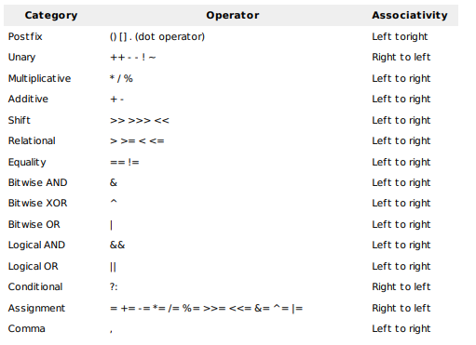
operators with the highest precedence

Slide 30
Expressions
JAVA permits mixing of constants and variables of different
types in an expression, but during evaluation it adheres to
very strict rules of type conversion.
 If operands are of different types, the “lower” type is
automatically converted to “higher” type before the operation
proceeds. The result is of higher type.
 The final result of an expression is converted to the type of
the variable on the left of the assignment before assigning the
value

Slide 31
Use of Casts
EXAMPLES | ACTION
x= (int) 7.5 | 7.5 is converted to integer by truncation
a = (int)21.3/(int)4.5 | Evaluated as 21/4 and the result would be 5
b = (double) sum/n | Division is done in floating point mode
y = (int) (a+b) | The result of a+b is converted to integer
y = (int) a+b | a is converted to integer and then added to b
p = cost ((double)x) | Converts x to double before using it as parameter

Slide 32




Control Statements
Control Statements
Selection
Iteration
Jump

Slide 33







Selection
Selection Statements are also called Decision Making Statements.
Selection
Selection Statements
Switch Statement

Slide 34













If else statements
if Statements
Simple if
if else
if- else- if Ladder Nested if

Slide 35
Simple If Statement
Syntax :
if (condition)
{
statement1;
}
Purpose: The statements will be evaluated if the value of the condition is true.

Slide 36
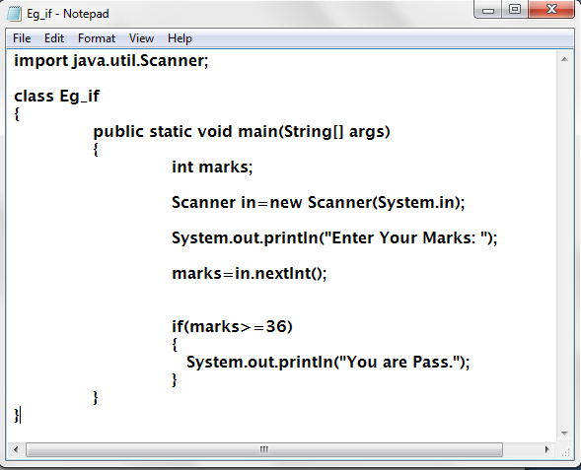
Example

Slide 37
If-Else Condition
Syntax :
if (condition)
{
statement1;
}
else
{
statement2;
}
Purpose: The statement 1 is evaluated if the value of the condition is true otherwise statement 2 is true.

Slide 38
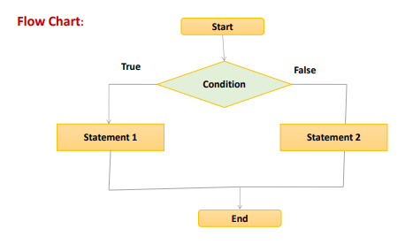

Slide 39
If-else-if statements
Syntax :
if(condition)
statements;
else if(condition)
statements;
else if(condition)
statements;
...
...
else
statements;

Slide 40
Nested if
• A nested if is an if statement that is the target of another if or else.
• Nested ifs are very common in programming.
Syntax :
if(condition)
{
if(condition)
statements....
else
statements....
}
else
{
if(condition)
statements....
else
statements....
}

Slide 41
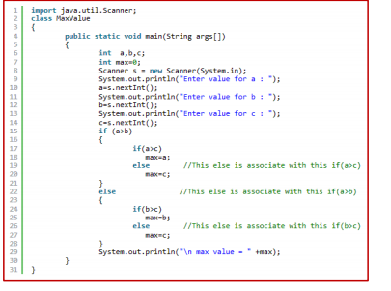
Example

Slide 42
Switch
Syntax :
switch (expression)
{
case value 1 :
statement 1 ; break;
case value 2 :
statement 2 ; break;
...
...
case value N :
statement N ; break;
default :
statements ; break;
}
Purpose: The statements N will be evaluated if the value of the logical expression is true.

Slide 43
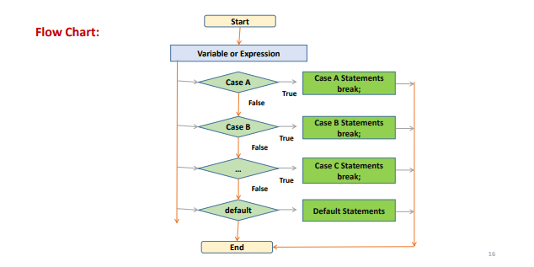
Switch

Slide 44
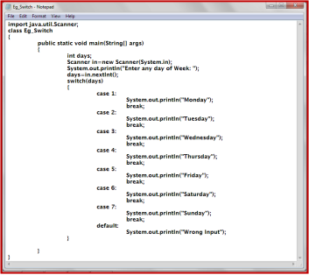
Example

Slide 45




Iteration Statements
Each loop has four
Type of statements :
✓ Initialization
✓ Condition checking
✓ Execution
✓ Increment / Decrement
Iterations/ Loops
 |  | while
 |  | do while
 |  | for

Slide 46
While
Syntax:
initialization
while(final value)
{
statements;
increment/decrement;
}
Purpose: To evaluate the statements from initial value to final value with given
increment/decrement.

Slide 47
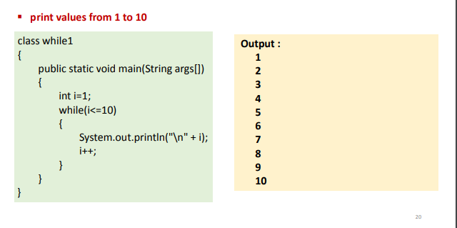
Example

Slide 48
do-while
Syntax:
initialization
do
{
statements;
increment/decrement;
}
while(final value);
Purpose: To evaluate the statements from initial value to final value with given
increment/decrement

Slide 49
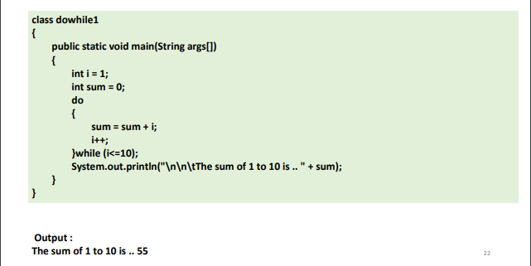

Slide 50
For
Syntax:
for(initialization;final value;increment/decrement)
{
statements;
}
Purpose: To evaluate the statements from initial value to final value with given
increment/decrement.

Slide 51
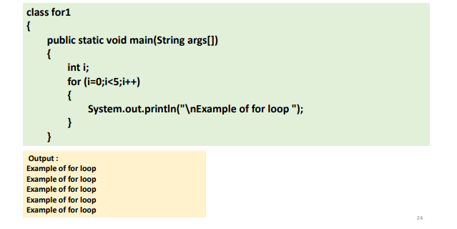
Example

Slide 52
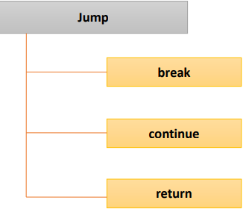
Jump Statements

Slide 53
The Break Statement
This statement is used to jump out of a loop.
✓ Break statement was previously used in switch – case statements.
✓ On encountering a break statement within a loop, the execution continues with the next
statement outside the loop.
✓ The remaining statements which are after the break and within the loop are skipped.
✓ Break statement can also be used with the label of a statement.
✓ A statement can be labeled as follows.
statementName : SomeJavaStatement
✓ When we use break statement along with label as,
break statementName;

Slide 54
Example
class break1 {
public static void main(String args[]) {
Int i = 1;
while (i<=10)
{
System.out.println("\n" +i);
i++;
if (i==5)
{
break;
}
}
}
}
Output:1,2,3,4

Slide 55
Continue
his statement is used only within looping statements.
✓ When the continue statement is encountered, the next iteration starts.
✓ The remaining statements in the loop are skipped. The execution starts from the
top of loop again.

Slide 56
Example
class continue1
{
public static void main(String args[])
{
for (int i=1; i<1=0; i++)
{
if (i%2 == 0)
continue;
System.out.println("\n" + i);
}
}
}
Output: 1,3,5,7,9

Slide 57
The Return Statement
The last control statement is return. The return statement is used to
explicitly return from a method.
✓ That is, it causes program control to transfer back to the caller of the
method.
✓ The return statement immediately terminates the method in which it is
executed.

Slide 58
Example
class Return1
{
public static void main(String args[])
{
boolean t = true;
System.out.println("Before the return.");
if(t)
return; // return to caller
System.out.println("This won't execute.");
}
}
Output:Before the return

Slide 59
Access Modifiers
public – accessible anywhere
private – accessible only within the class in which it is defined
protected – allows members of a derived class to access members of its parent classes
static – does not require instantiation before it can be used and remains in place after use, without being destroyed

