Slide 1
Network Information Services (NIS)
Network File System (NFS)
System Administrator Training session 2018-19
(16MCMT24)

Slide 2
What is NIS?
Problems in running a distributed computing environment :
  Each Workstations has its own copies of common configuration files such as passwd, group, and hosts files
  These files must be consistent and every changes to these common files much be propagated to every hosts on the network

Slide 3

What is NIS?

Slide 4
What is NIS?
The NIS, released by Sun in 1980s, was the first “prime time” administrative database to address these problems.
It was originally called the Sun Yellow Pages, but eventually had to be renamed for legal reasons. Many vendors have licensed Sun’s code, making NIS the most widely-supported network database system

Slide 5
What is NIS?
It is a distributed database system that replaces copies of commonly replicated configuration files with a centralized management facility
Instead of having to manage each host’s files, you maintain one database for each file on one central server

Slide 6
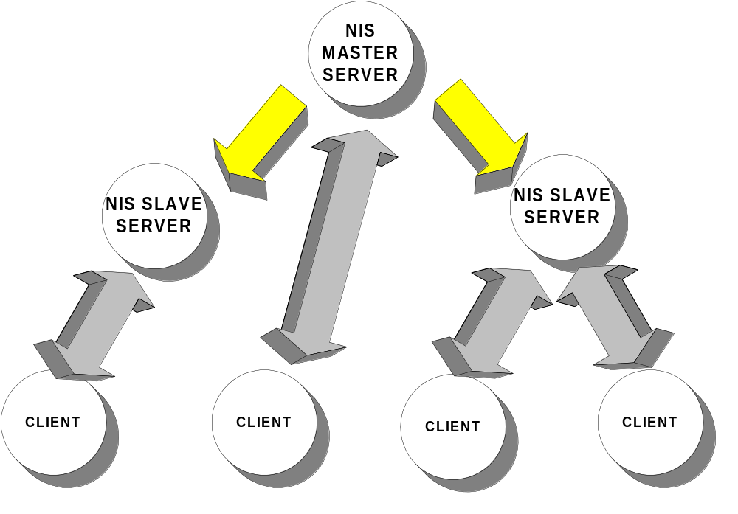
NIS Masters, Slaves, and Clients

Slide 7
NIS Servers
An NIS server is a machine storing a set of maps that are available to network machines and applications.
NIS master server
  contains the set of maps that you, the NIS administrator, create and update as necessary.
  Each NIS domain must have one, and only one, master server.

Slide 8
NIS Servers
NIS Slave server
  A slave server has a complete copy of the master set of NIS maps. Whenever the master server maps are updated, the updates are propagated among the slave servers. The existence of slave servers allows the system administrator to evenly distribute the load resulting from answering NIS requests. It also minimizes the impact of a server becoming unavailable.

Slide 9
NIS Elements
NIS Domains
  An NIS domain is a collection of machines that share a common set of NIS maps. Each domain has a domain name and each machine sharing the common set of maps belongs to that domain.
  Domain names are case-sensitive.

Slide 10
NIS Elements
NIS Maps
  NIS maps are essentially two-column tables. One column is the key and the other column is information value related to the key. NIS finds information for a client by searching through the keys. Some information is stored in several maps because each map uses a different key.

Slide 11
NIS Elements
  Maps for a domain are located in each server's /var/yp/domainname directory.
  For example, the maps that belong to the domain test.com are located in each server's /var/yp/test.com directory.
  An NIS Makefile is stored in the /var/yp directory of machines designated as a NIS server at installation time. Running make in that directory causes makedbm to create or modify the default NIS maps from the input files.

Slide 12
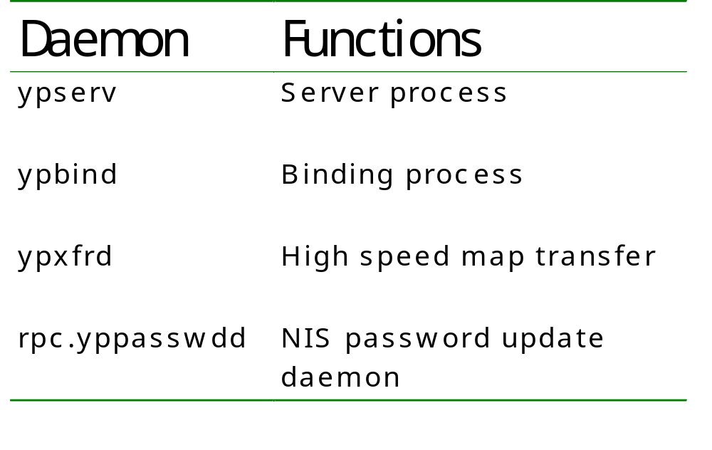
NIS Elements
NIS daemons

Slide 13

NIS Query

Slide 14
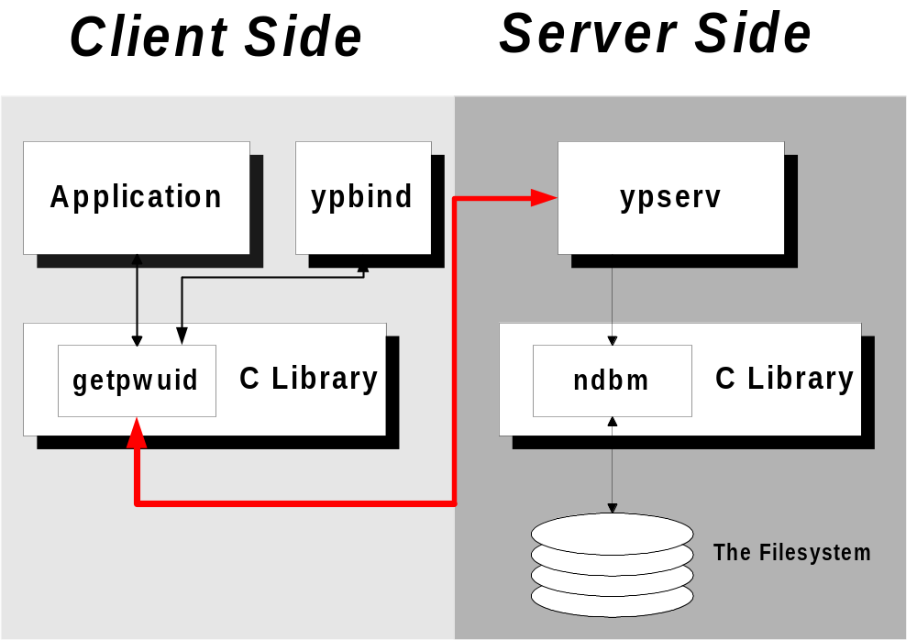
NIS Query

Slide 15
Basic NIS Management
Installing a new NIS Environment, building Master and slave servers
Starting the ypserv daemon, which enables the system to act as NIS Server
Adding new slave servers when growth of your network
Modifying the client’s administrative files
Starting the ypbind daemon, allowing the client to make NIS requests
Ypbind, yppasswdd , ypserv, portmap, ypbind ,ypxfrd NIS server services
Ypbind & portmap are NIS client services

Slide 16
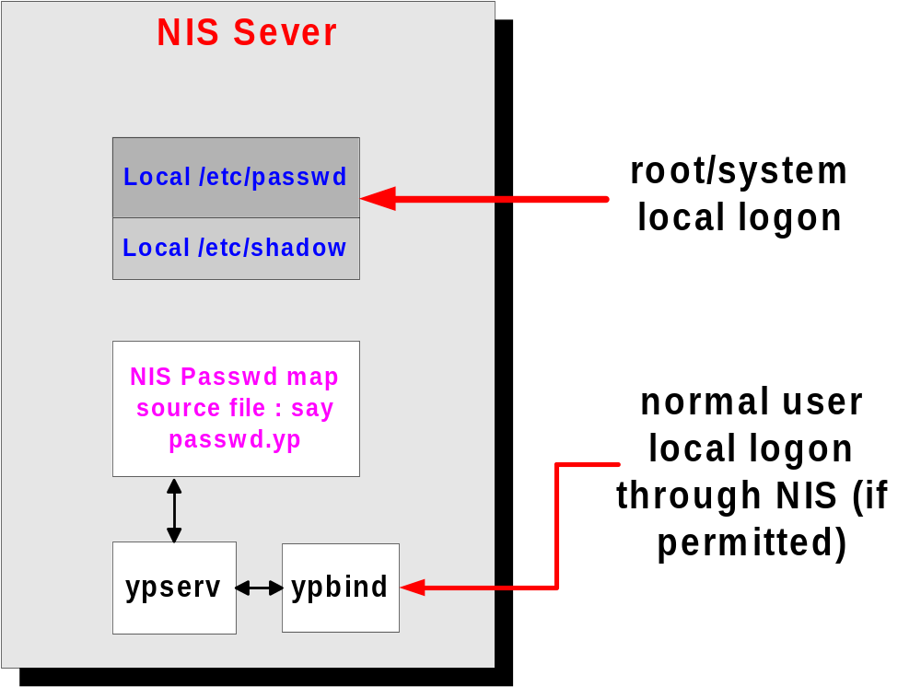
Building NIS Master Server

Slide 17
Enabling NIS on client
Start the ypbind daemon, which is responsible for locating NIS servers and maintaining bindings of domain names to servers

Slide 18
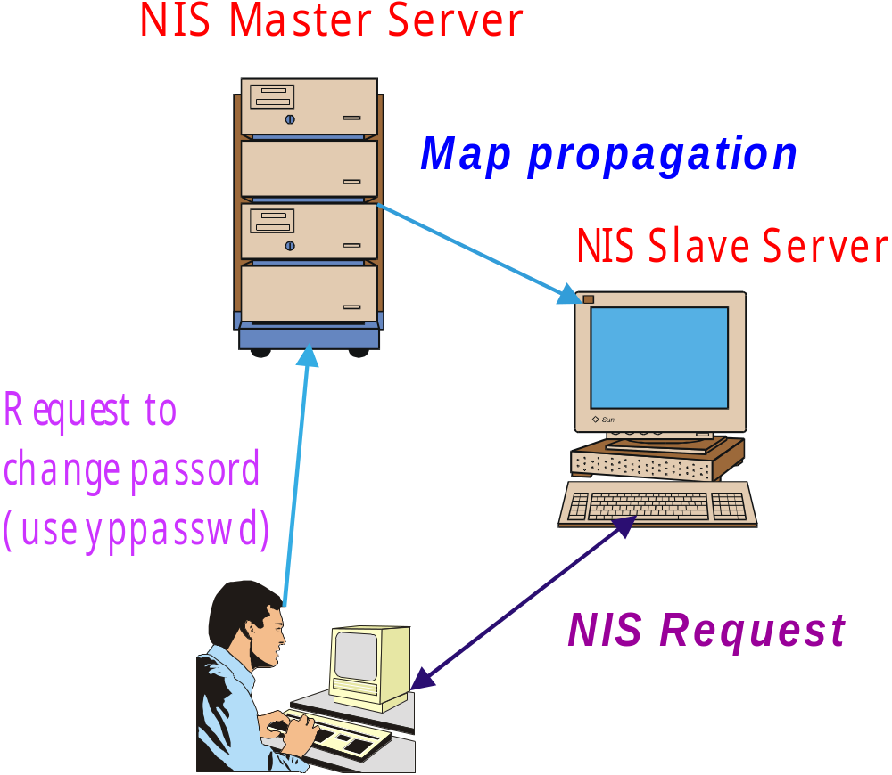
Changing Password in NIS

Slide 19
Merits of NIS
Simple, easy to understand. It’s analogous to copying files around; in most cases, it’s unnecessary for administrators to be aware of NIS’ internal data formats
Widely supported by multiple vendors like DEC, HP, SGI.

Slide 20
Network File System (NFS)

Slide 21
What is NFS?
The Network File System, allows you to share filesystems among computers.
NFS is almost transparent to users.
NFS was introduced by Sun in 1985. It was originally implemented as a surrogate filesystem for diskless clients.

Slide 22
What is NFS?
NFS support has been implemented on many platforms ranging from the MS-DOS to the VMS operating systems. Many use code licensed from Sun.

Slide 23
Benefits of NFS
  Allows multiple computers to use the same files, so everyone on the network can access the same data
  Reduces storage costs by having computers share applications instead of needing local disk space for each user application
  Provides data consistency and reliability because all users can read the same set of files
  Makes mounting of file systems transparent to users

Slide 24
Benefits of NFS
  Makes accessing remote files transparent to users
  Supports heterogeneous environments
  Reduces system administration overhead

Slide 25
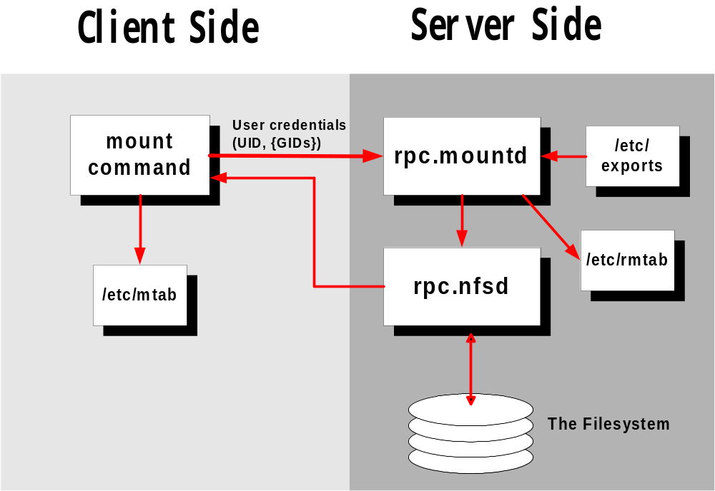
NFS Elements

