Slide 1
SERVICE MANAGEMENT
&
TROUBLESHOOTING

Slide 2
SERVICE MANAGEMENT
Ongoing services offered by a Linux system, such as access to a printer service or login service, are typically implemented by what is referred to as a daemon process.
All this services needs to be managed through a initialization system ( init ).
SysVinit
Upstart
Systemd

Slide 3
init or systemd
The Linux kernel has a process ID (PID) of 0. Thus, the initialization process (init or systemd) daemon has a parent process ID (PPID) of 0, and a PID of 1.
The initialization daemon can be thought of as the “mother of all processes.” This daemon is the first process to be started by the kernel on the Linux server.

Slide 4
Benefits of using INIT
■ Identify runlevels—Put together sets of services in what are referred to as runlevels or targets
■ Establish dependencies—Set service dependencies so, for example, a service that requires network interfaces won’t start until all network startup services have started successfully
■ Set the default runlevel—Select which runlevel or target starts up when the system boots
■ Manage services—Run commands that tell individual services to start, stop, pause,restart, or even reload confi guration files.

Slide 5
TYPES OF INIT SYSTEM
SysVinit— It offers an easy-to-understand method of starting and stopping services based on runlevel.
Upstart—This init system improved handling of dependencies between services and could sub- stantially improve system startup time.
Systemd—It is the most complex of the init systems, but also offers much more flexibility. Systemd not only offers features for starting and working with services, but also lets you manage sockets, devices, mount points, swap areas, and other unit types.

Slide 6
Why Upgrade init
The classic init daemons worked without problems for many years. However, these daemons were created to work within a static environment. As new hardware, such as USBdevices, came along, the classic init daemons had trouble dealing with these and other hot-plug devices.
In addition, as new services came along, the classic init daemons had to deal with starting more and more services.
Thus, the entire system initialization process was less efficient and ultimately slower.
ps -e | head – To know your init flavour.

Slide 7
Classic init daemons
Even though your system has a newer version of init, it is worth understand it
Not only is backward compatibility to the clas-sics often used in the newer init daemons, but many are based upon them.
Understanding the classic init daemons will help you to understand the modern init daemons.
The SysVinit daemon’s configuration information is taken at boot time from the /etc/inittab file.
NOW - It uses /etc/init/rc-sysinit.conf

Slide 8
How does the server know which services to stop and which ones to start when a particular
runlevel is chosen? When a runlevel is chosen, the scripts located in the /etc/rc.d/rc#.d directory (where # is the chosen runlevel) are run.
For example, if runlevel 5 is chosen, then all the scripts in the /etc/rc.d/rc5.d directory are run
To know default runlevel - runlevel

Slide 9
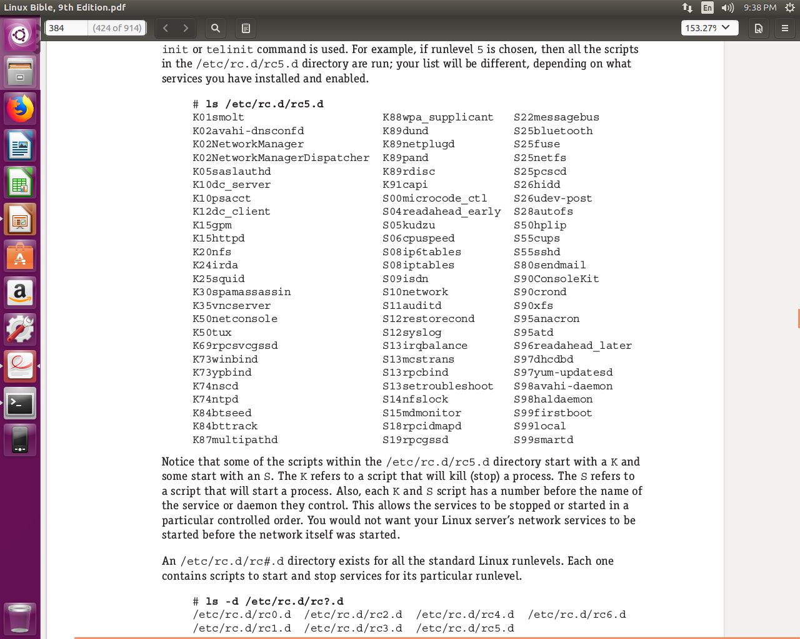

Slide 10
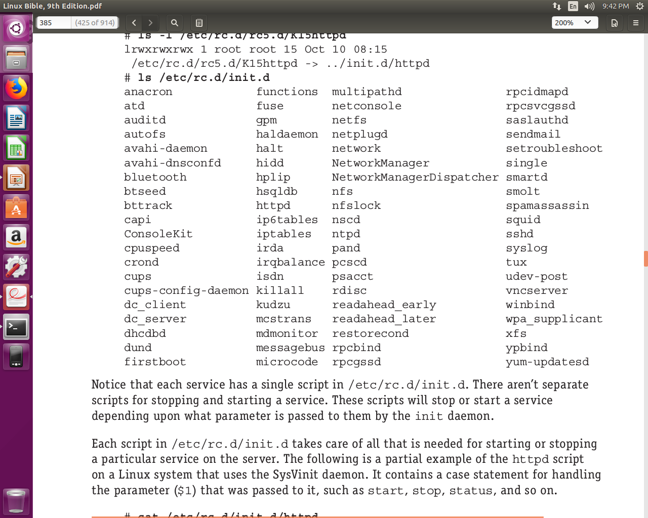
Actually, the files in the /etc/rc.d/rc#.d directories are not scripts, but instead symbolic links to scripts in the /etc/rc.d/init.d directory.

Slide 11
Understanding systemd initialization
The systemd initialization daemon is the newer replacement for the SysVinit and the Upstart init daemons, and is backward compatible
Upstart. System initialization time is reduced by systemd because it can start services in a parallel manner
The systemd is also concerned with runlevels, but they are called target units
A unit is a group consisting of a name, type, and confi guration fi le and is focused on a particular service or action
The two primary systemd units you need to be concerned with for dealing with services are service units and target units.
A service unit is for managing daemons on your Linux server. A target unit is simply a group of other units.

Slide 12
To show the respectives services
# systemctl list-units | grep .service
# systemctl list-units | grep .target
The Linux system unit configuration files
# systemctl list-unit-files –type=service
# systemctl list-unit-files –type=target
Backward compatibility
# ls -l /lib/systemd/system/runlevel*.target

Slide 13
Checking the Status of Services
As a Linux administrator, you need to check the status of the services being offered on your server.
For security reasons, you should disable and remove any unused system services discovered through the process.
Most importantly for troubleshooting purposes, you need to be able to quickly know what should and should not be running on your Linux server.

Slide 14
To see all the services that are being offered by a Linux server using systemd, use the following command:
# systemctl list-unit-files --type=service | grep -v disabled
To see if a particular service is running, use the following command:
# systemctl status cups.service
these information will help to accomplish starting, stopping, and reloading the services on your Linux server.

Slide 15
Stopping and Starting Services
# systemctl status cups.service
# systemctl stop cups.service
# systemctl status cups.service
# systemctl start cups.service
# systemctl status cups.service
Restarting a service means that a service is stopped and then started again. If the service was not currently running, restarting it simply starts the service.
# systemctl restart cups.service
# systemctl status cups.service

Slide 16
You can also perform a conditional restart of a service using systemctl. A conditional restart only restarts a service if it is currently running.
Any service in an inactive state is not started.
# systemctl status cups.service {make sure it is inactive}
# systemctl condrestart cups.service
# systemctl status cups.service
It will still be in inactive mode.

Slide 17
Reloading a service is different from restarting a service. When you reload a service, the service itself is not stopped.
Only the service’s configuration fi les are loaded again.
Doing a reload of a service, instead of a restart, prevents any pending service operations from being aborted.
A reload is a better method for a busy Linux server.
# systemctl reload sshd.service
# systemctl status sshd.service

Slide 18
Enabling Persistent Services
You use stop and start for immediate needs, not for services that need to be persistent.
A persistent service is one that is started at server boot time or at a particular runlevel.
Services that need to be set as persistent are typically new services that the Linux server is offering.

Slide 19
# systemctl status cups.service
# systemctl disable cups.service
You can use the disable option on the systemctl command to keep a service from starting at boot. However, it does not immediately stop the service.
You need to use the stop option discussed in the “Stopping a service with systemd” section.
# systemctl enable cups.service
With systemd, some services cannot be disabled. These services are static services.
# systemctl status dbus.service
# systemctl disable dbus.service
# systemctl status dbus.service

Slide 20
Sometimes, disabling a service is not enough to make sure that it does not run.
Disabling service A would keep the service from starting on its own. However, if some other service listed A as a dependency, that service would try to start service A when it started.
To disable a service in a way that prevents it from ever running on your system, you can use the mask option.
# systemctl mask NetworkManager.service
To be able to use the service again,
# systemctl unmask NetworkManager.service

Slide 21
Troubleshooting
systemd-enabled Linux system starts up systemd daemon as the first one, and to manage it we have systemctl command.
This command will also be used to read logs.

Slide 22
BASICS
To see an overview of your hardware
To disable/enable a device
To change a device setting
To Change boot order

Slide 23
Anything that happens after boot time to present is recorded in a log file. In Linux systems that support systemd, kernel messages are stored in the systemd journal.
# journalctl -k
*put the log info in a file
The messages appear as components are detected, such as your CPU, memory, network cards, hard drives, and so on.
Look for drivers that fail to load or messages that show that certain features of the hardware failed to be enabled.

Slide 24
Troubleshooting systemd init
When the systemd daemon (/usr/lib/systemd/systemd) is started after the kernel starts up, it sets in motion all the other services that are set to start up.
In particular, it keys off the contents of the /etc/systemd/ system/default.target file.
Unlike old init system, here “after” and “wants” is used to decide order of initialization
running the systemctl command lets you see every unit file thatsystemd tried to start up
Incase you find a service which failed to start, we can use
# journalctl -u example.service

Slide 25
Outgoing connections
Check physical connections -
- Make sure cable is connected to your system
- Also make sure the other is also connected
- *If you have multiple NIC, confirm the working one
check that the hardware isn’t disabled.
NIC may have been disabled in the BIOS
View network interfaces
To see the status of your network interfaces,
# ip addr show
It may be possible that ip address is not allotted, this will clear things

Slide 26
Check routes
If your network interface is up, but you still can’t reach the host you want to reach
# route (will show the default gateway)
# ping -c 2 default gateway
if host unreachable, may be router off, or router not connected to switch
if succeded, try to ping outside router

Slide 27
Incoming connections
Checking your own system to see what ports to your server are open to the outside world
use nmap to scan your system to see what is running on common ports
Example - If TCP ports 80 and/or 443 are not shown, it means they are being filtered.
Check whether your firewall is blocking
If blocking then make changes in iptables rules.

Slide 28
Troubleshooting Memory
To find out if the performance problems have occurred because you have run out of memory
# top
Dealing with memory problems
-Kill a process
-Drop page caches
# echo 3 > /proc/sys/vm/drop_caches
-Kill an out-of-memory process.
add kernel.sysrq = 1 to the /etc/sysctl.conf file.

Slide 29
Logs
Linux provides a centralized repository of log files that can be located under the /var/log directory.
The sheer volume of logs can sometimes make it frustrating just to drill down and find the right file that contains the desired information.
To make it a little easier for you, we will introduce you to some of the most critical Linux log files that you must be monitoring.

Slide 30
1 syslog
It is mainly used to store informational and non-critical system messages.
For example, you are facing some issues with the sound card. To check if something went wrong during the system startup process, you can have a look at the messages stored in this log file
2 auth.log
All authentication related events in Debian and Ubuntu server are logged here.
Investigate failed login attempts

Slide 31
3 boot.log
This is the repository of booting related information and messages logged during system startup process.
You should analyze this log file to investigate issues related to improper shutdown, unplanned reboots or booting failures
4 history.log
In directory apt, saves all the package installation and removal information.

Slide 32
5 apport.log
saves information about crashes in your system and reporting them.
6 Xorg.log
include information about the graphics driver, its failures, warnings etc.

Slide 33
THANK YOU

