Slide 1
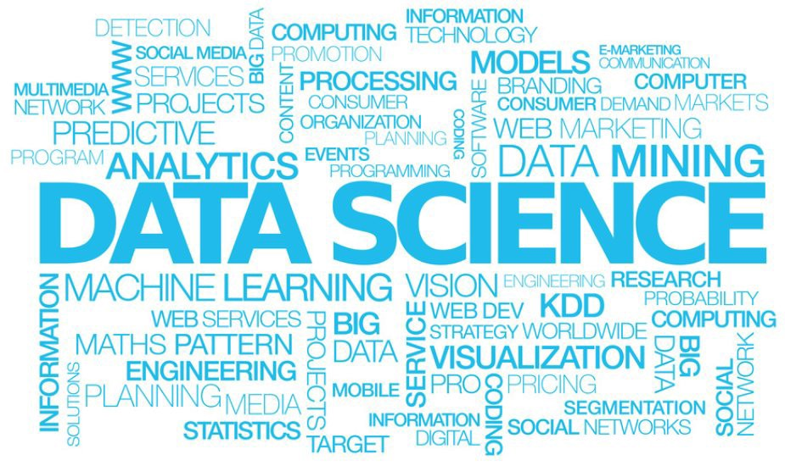
Regression techniques

Slide 2
The World of Analytics
Analytics aimed at enabling governments or enterprises in making quantitative data driven decisions
Descriptive Analytics -- What happened?
Predictive Analytics -- What might happen?
Prescriptive Analytics -- What should we do?
Purpose – Making data talk and work for entities

Slide 3
Evaluation Metrics
Regression----------------?
Classification-------------?
Z-Score?
Hypothesis Tests?

Slide 4

PREDICTIVE MODELLING

Slide 5
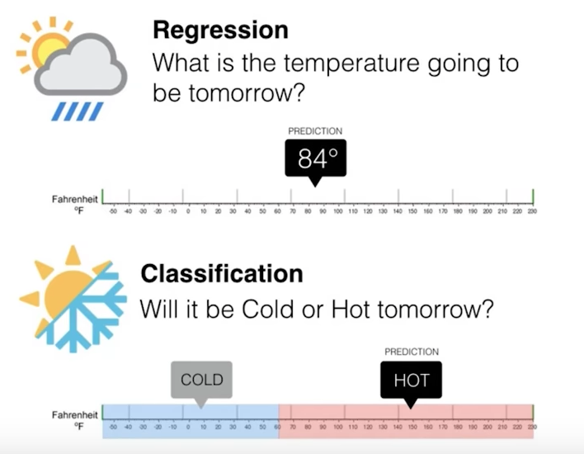
Regression vs Classification

Slide 6
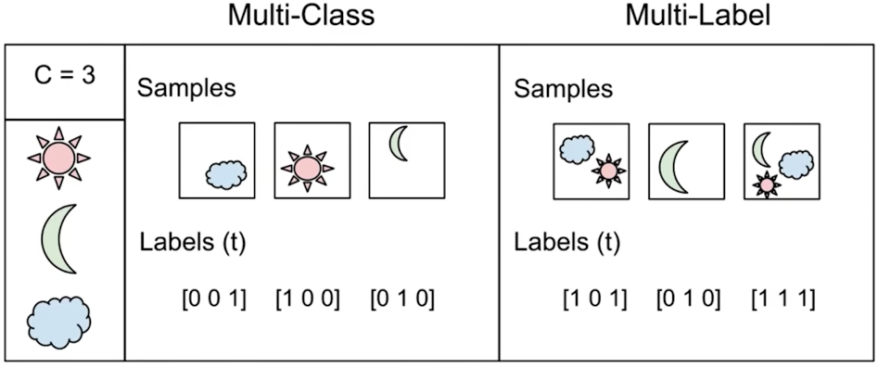
Multi-class vs Multi-Label

Slide 7
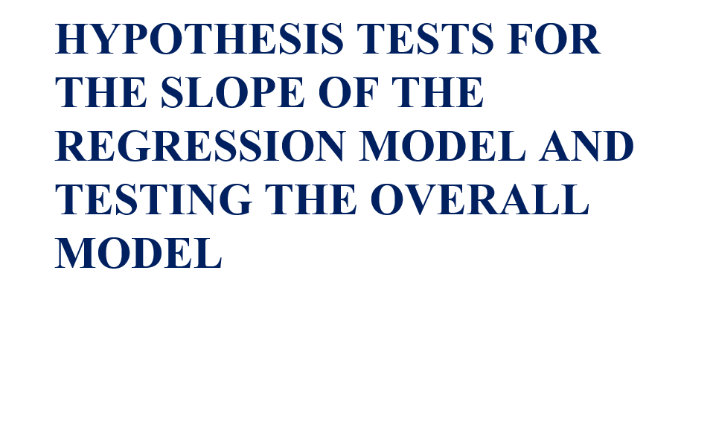

Slide 8
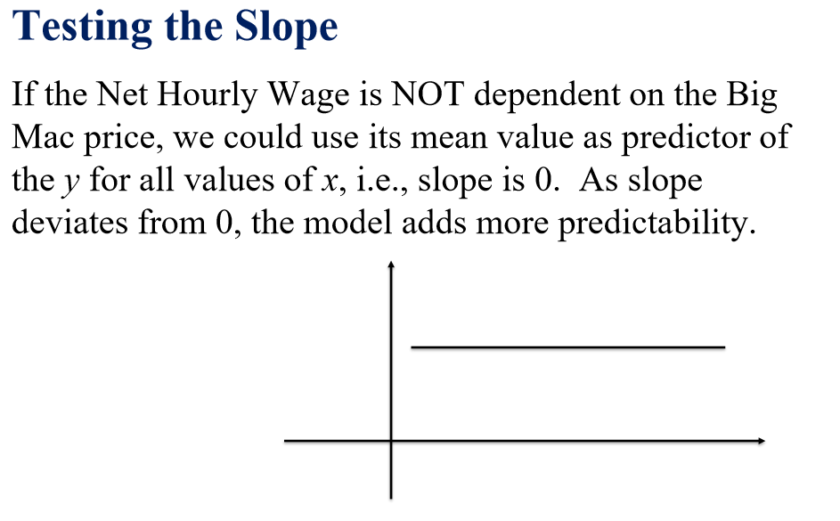

Slide 9
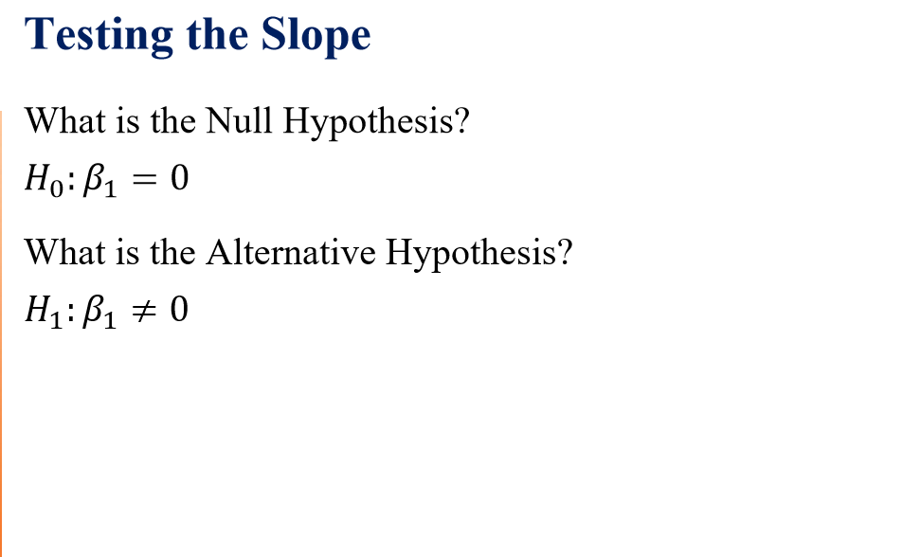

Slide 10
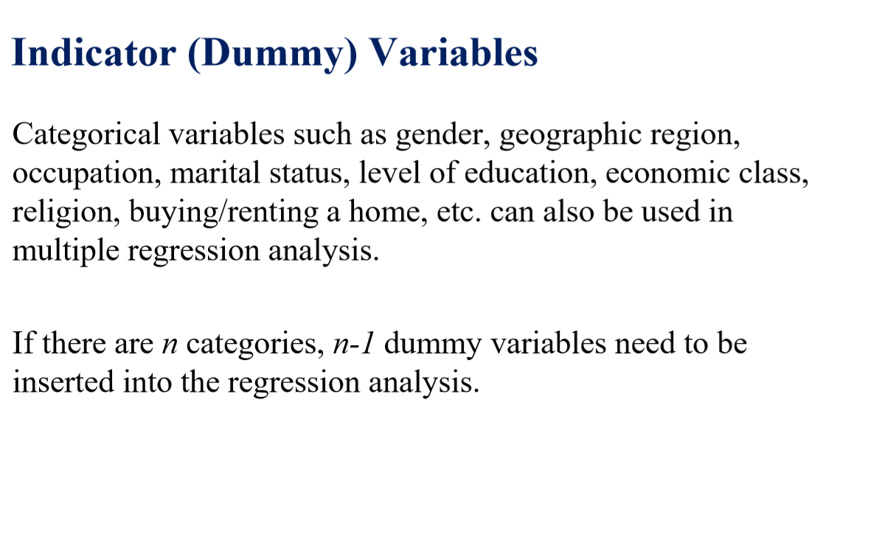
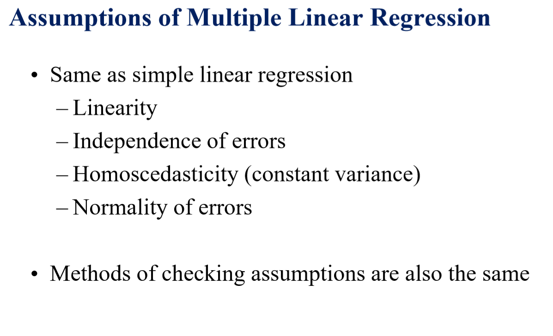

Slide 11
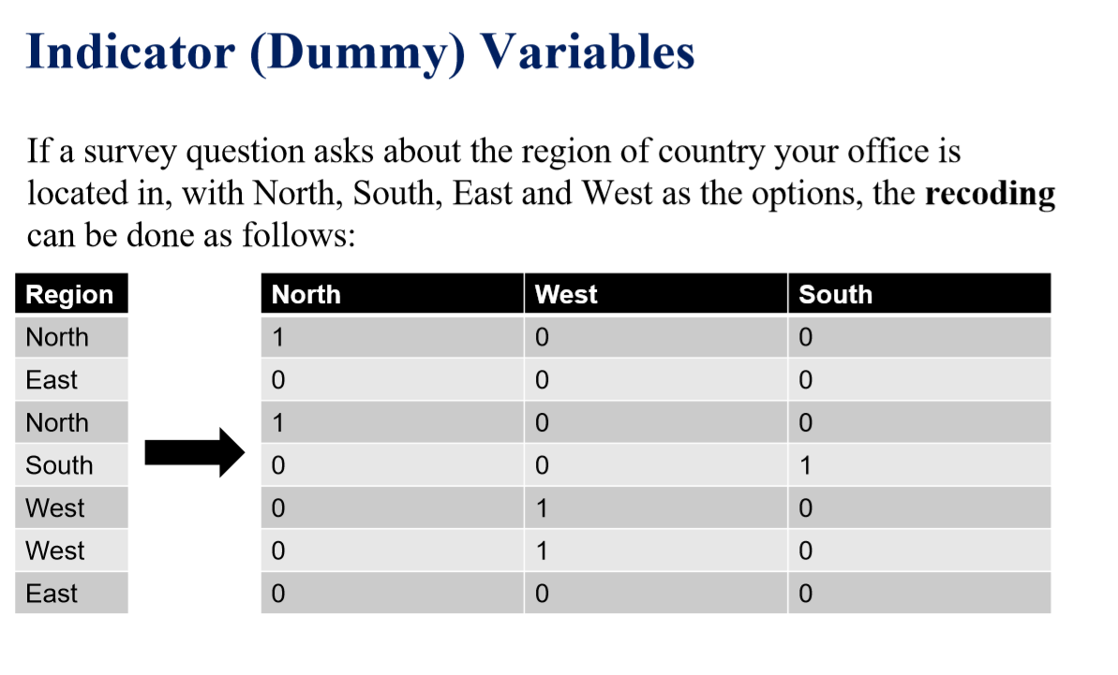

Slide 12
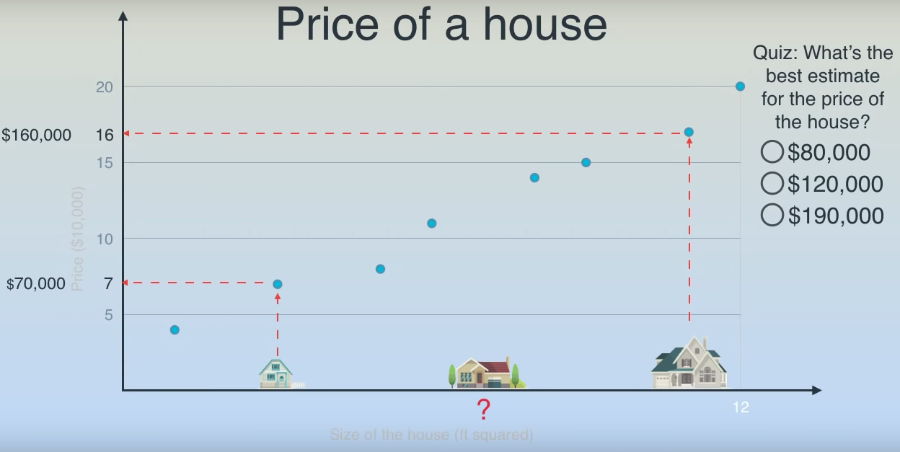
Linear Regression

Slide 13
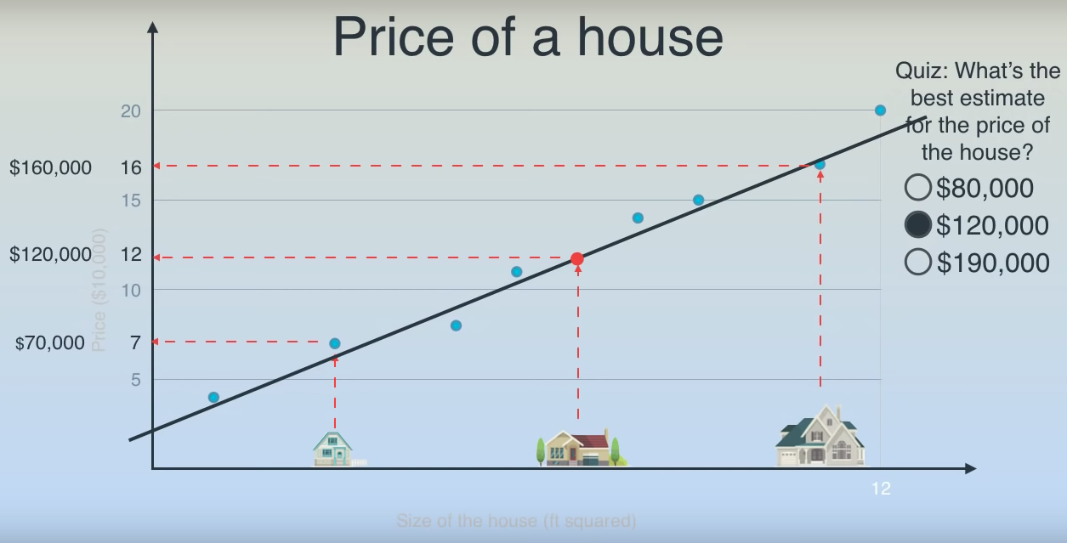
Linear Regression

Slide 14
Linear Regression

Slide 15

Linear Regression

Slide 16
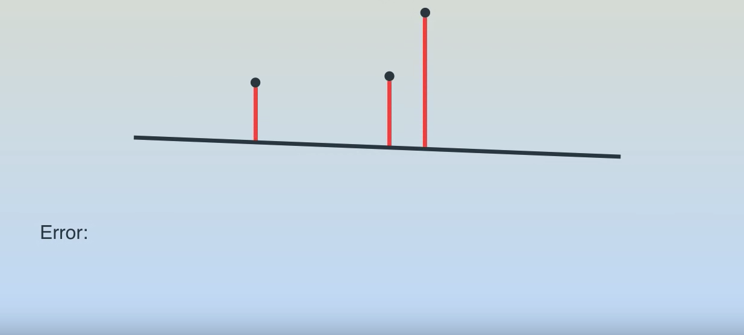
Linear Regression

Slide 17
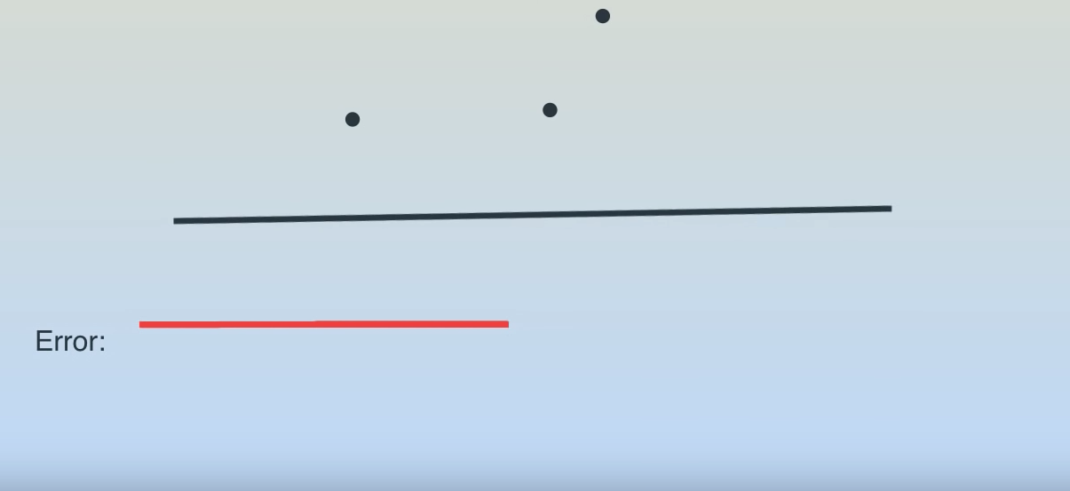
Linear Regression

Slide 18
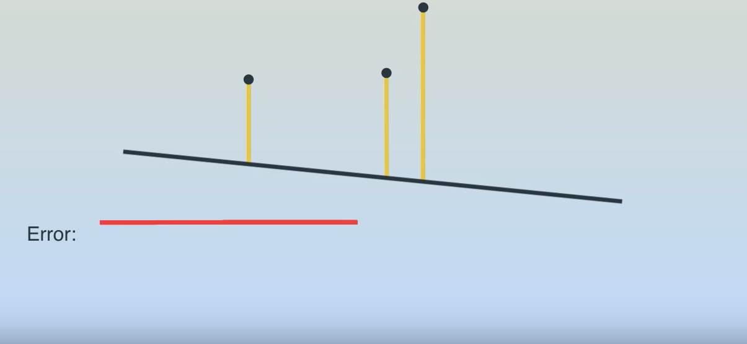
Linear Regression

Slide 19
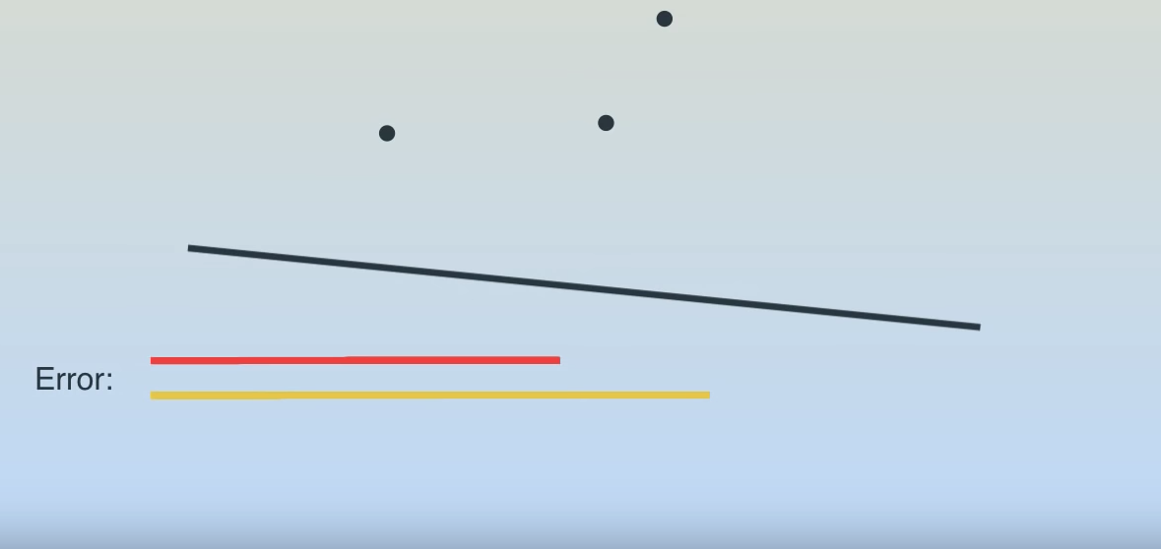
Linear Regression

Slide 20
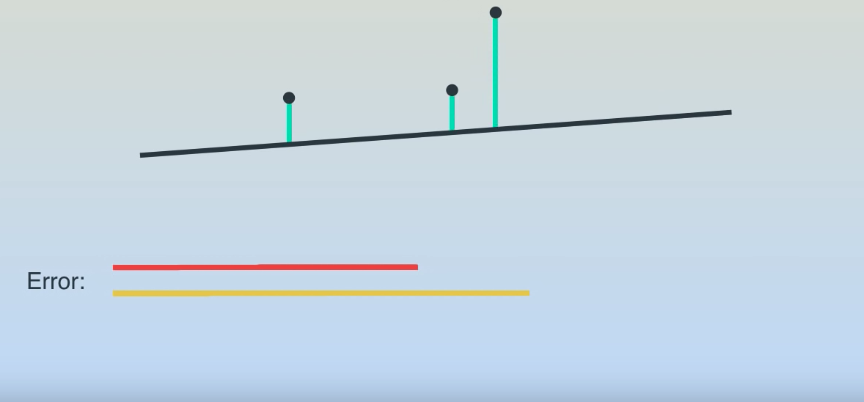
Linear Regression

Slide 21

Linear Regression

Slide 22
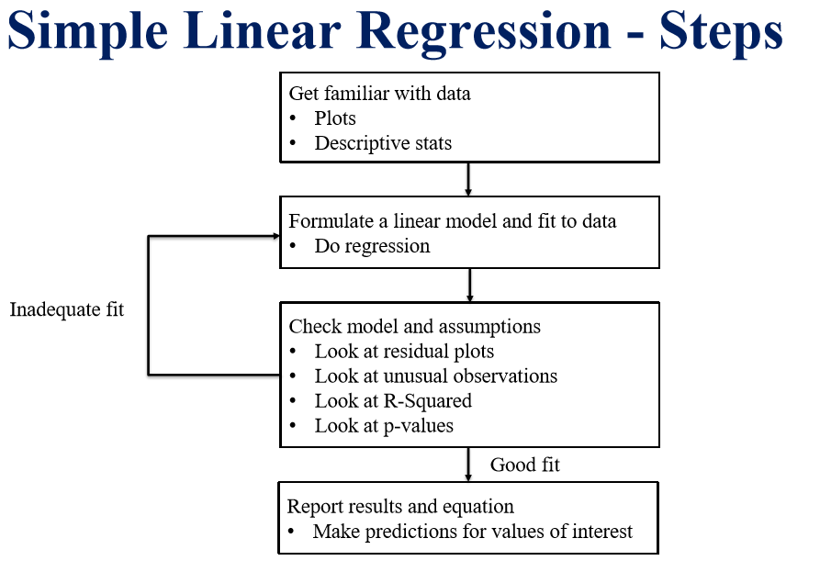

Slide 23
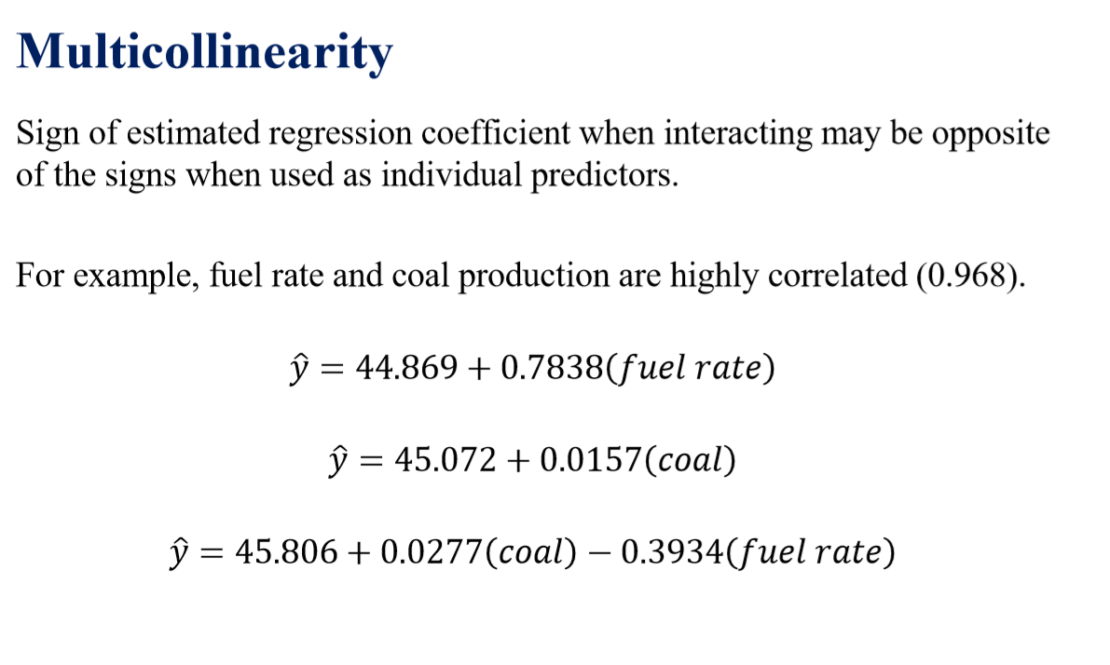

Slide 25
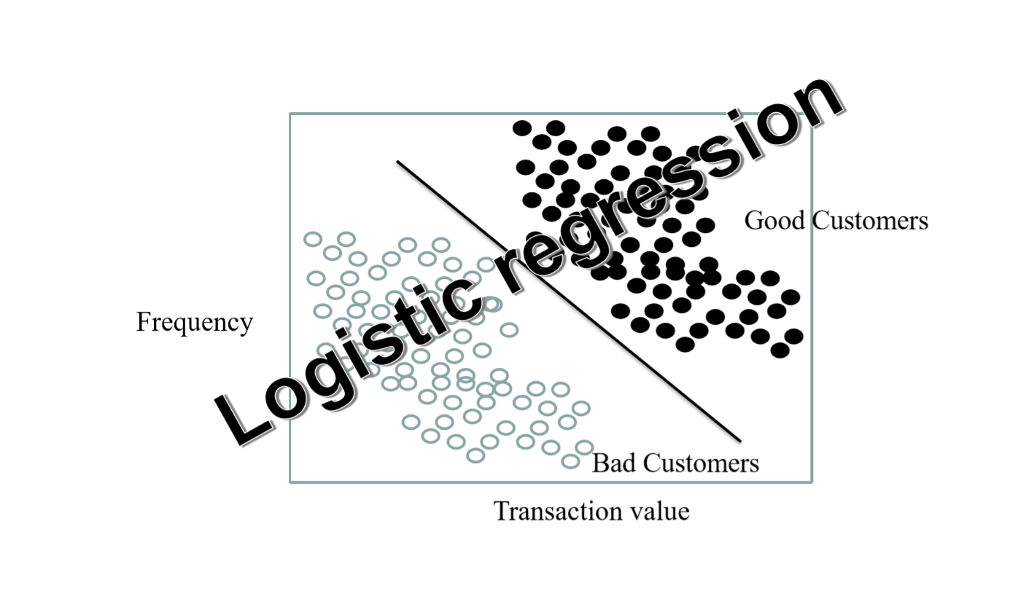

Slide 26
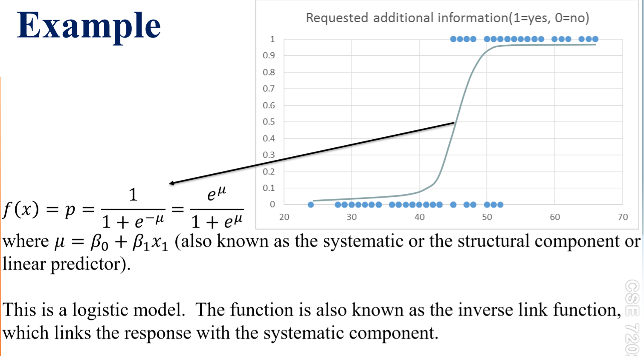

Slide 27
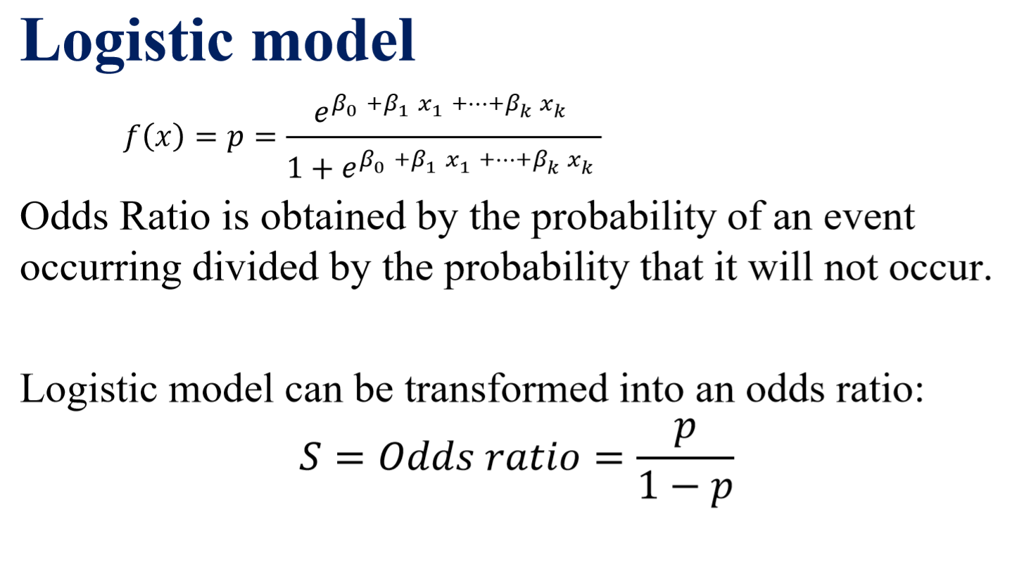

Slide 28
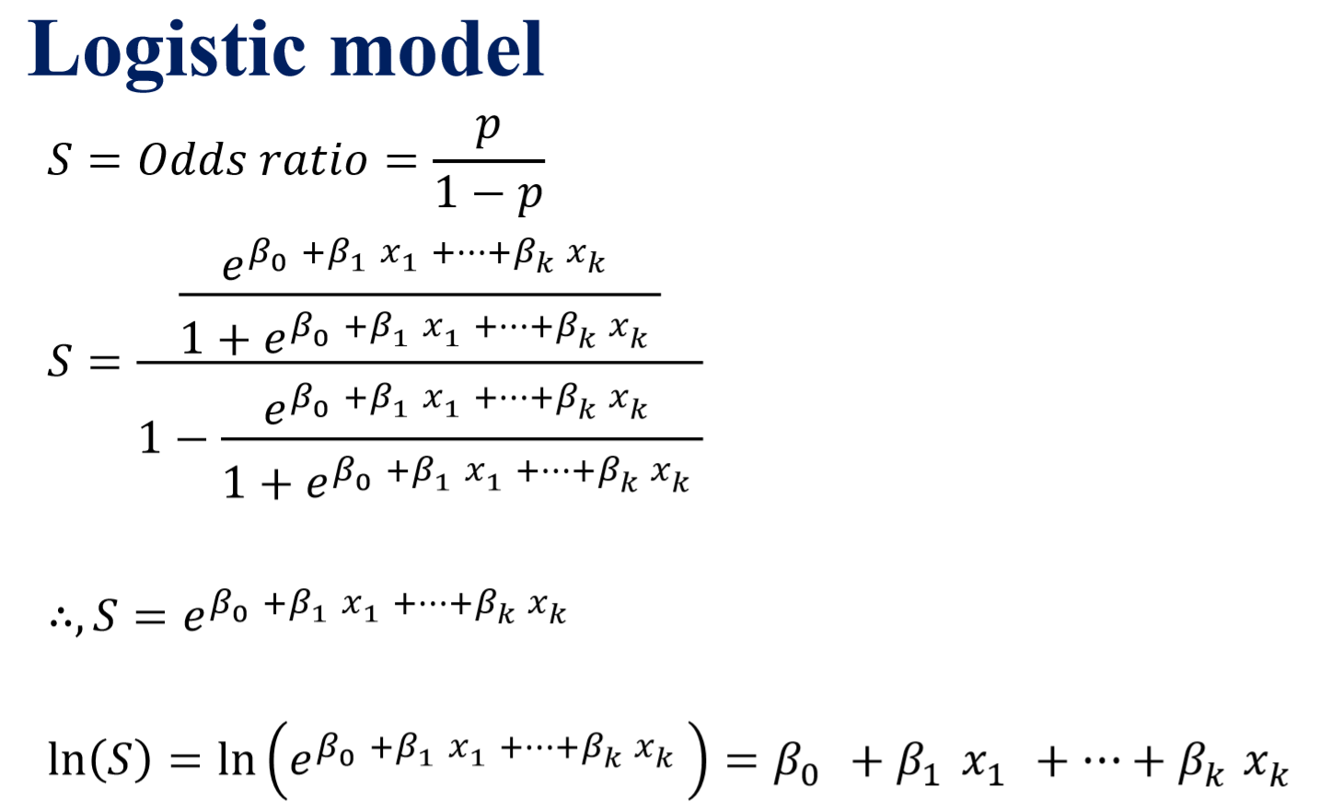

Slide 29
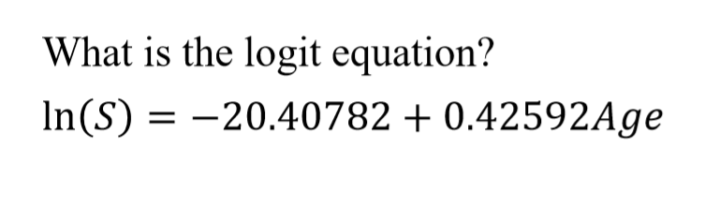
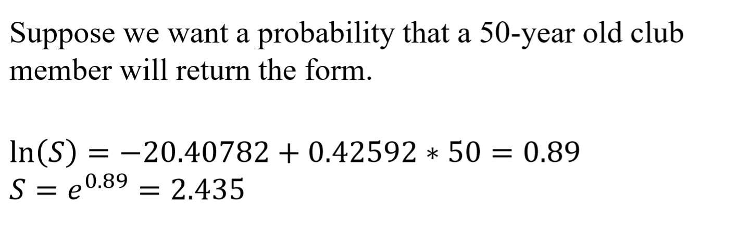
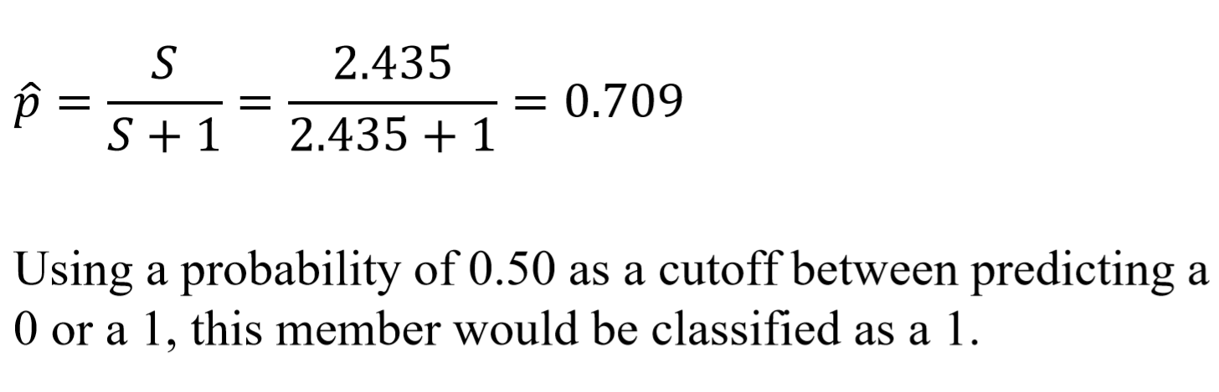

Slide 30
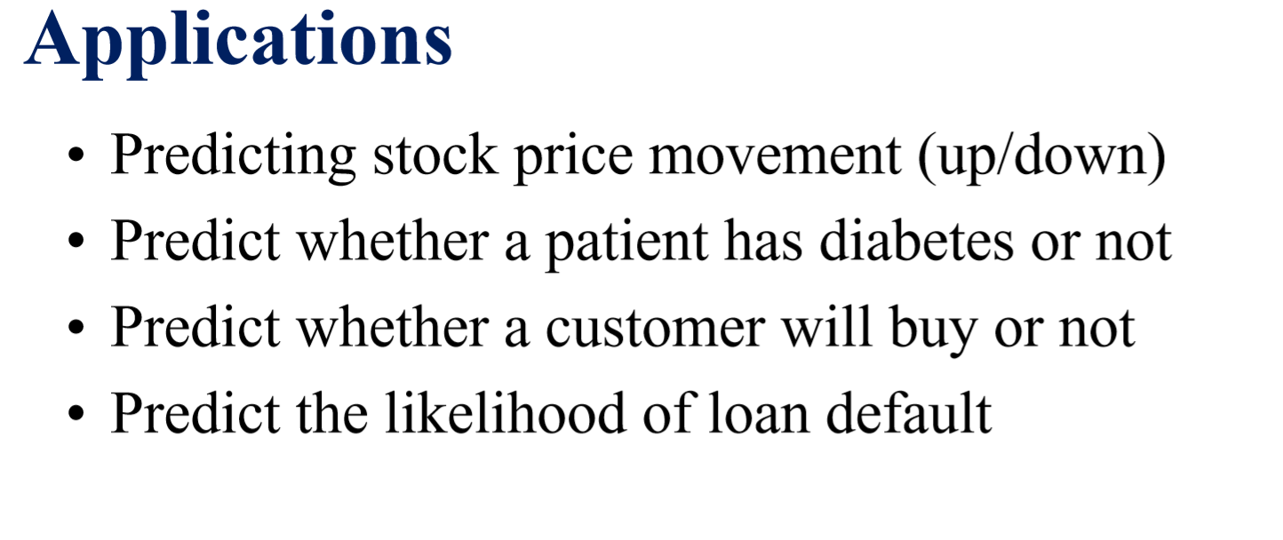

Slide 31
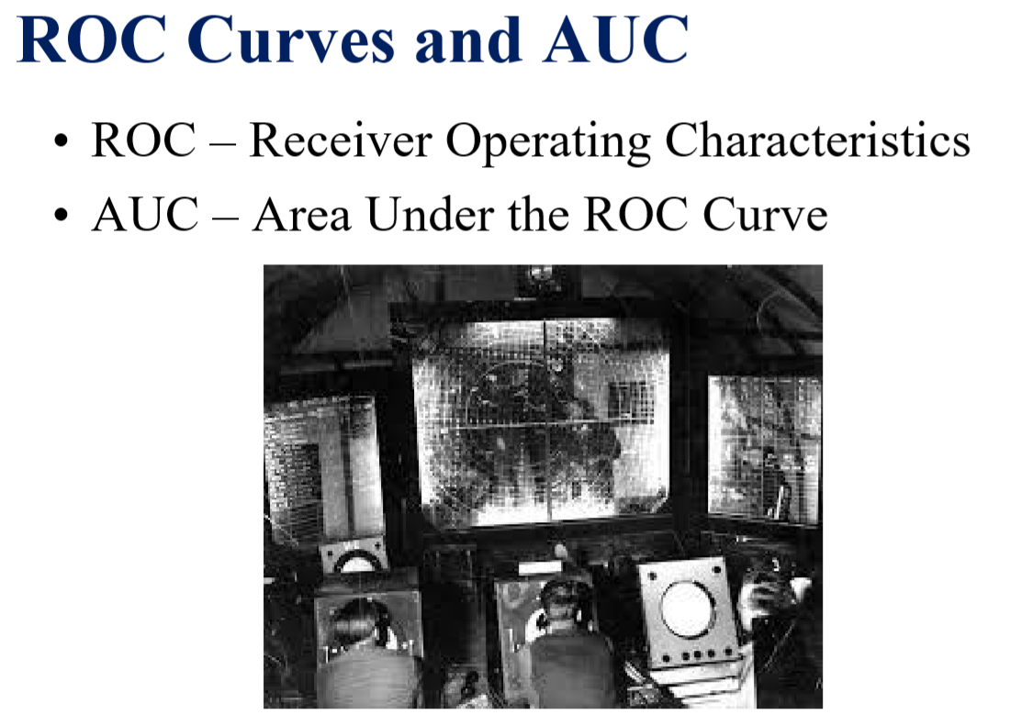

Slide 32
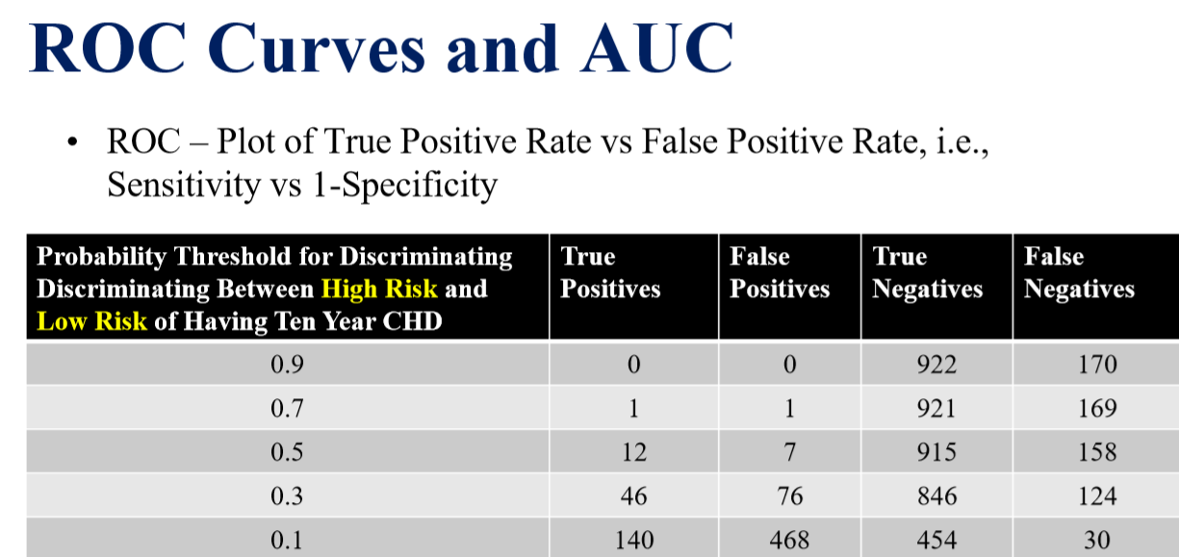

Slide 33
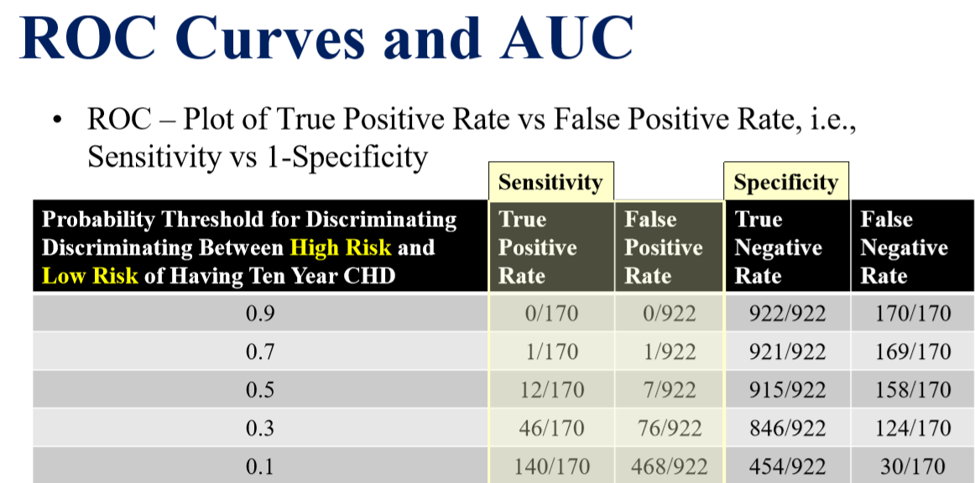

Slide 34
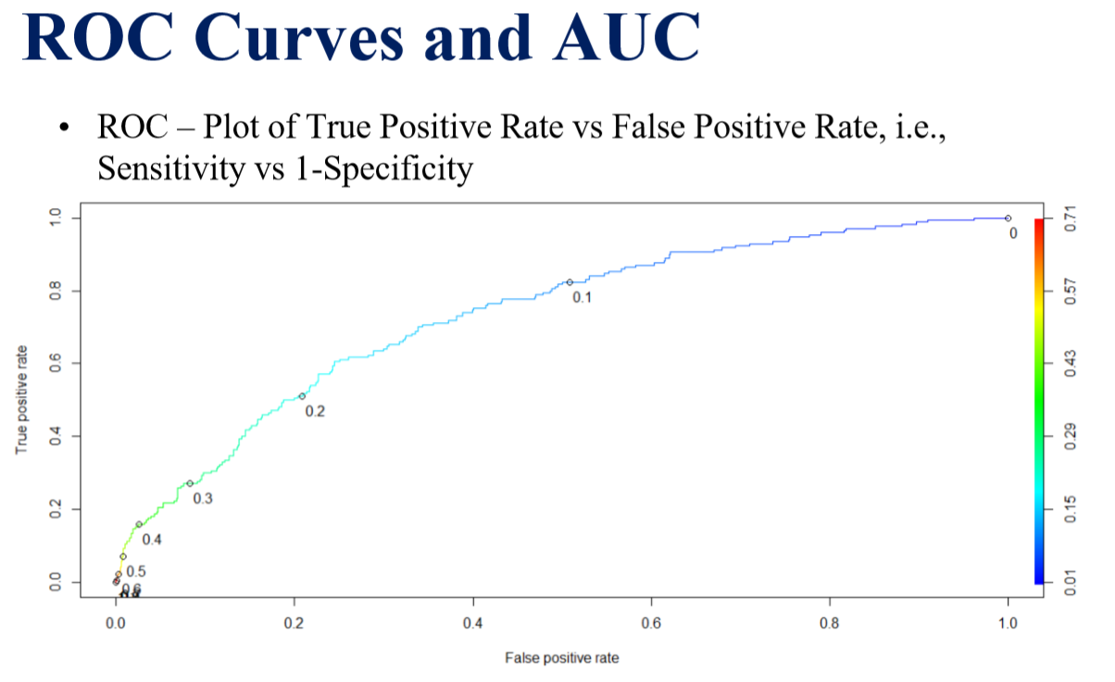

Slide 35
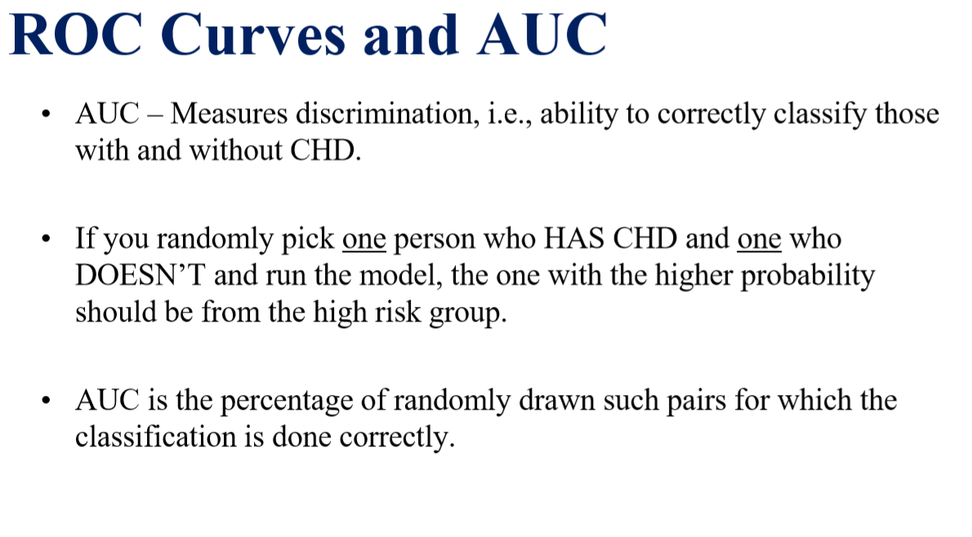

Slide 36

Support Vector Machine

Slide 37
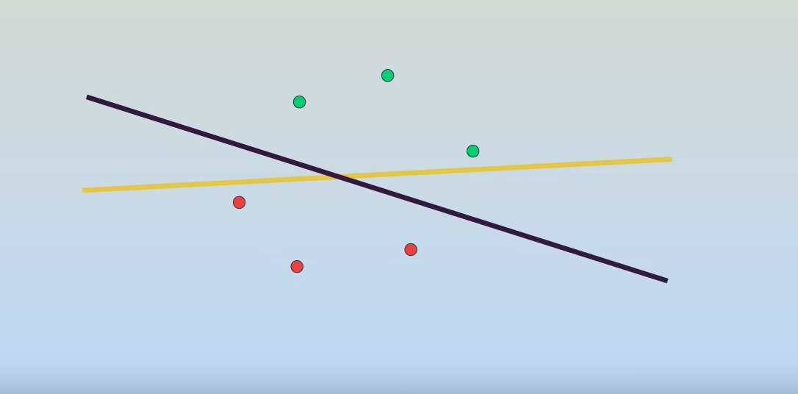
Support Vector Machine

Slide 38
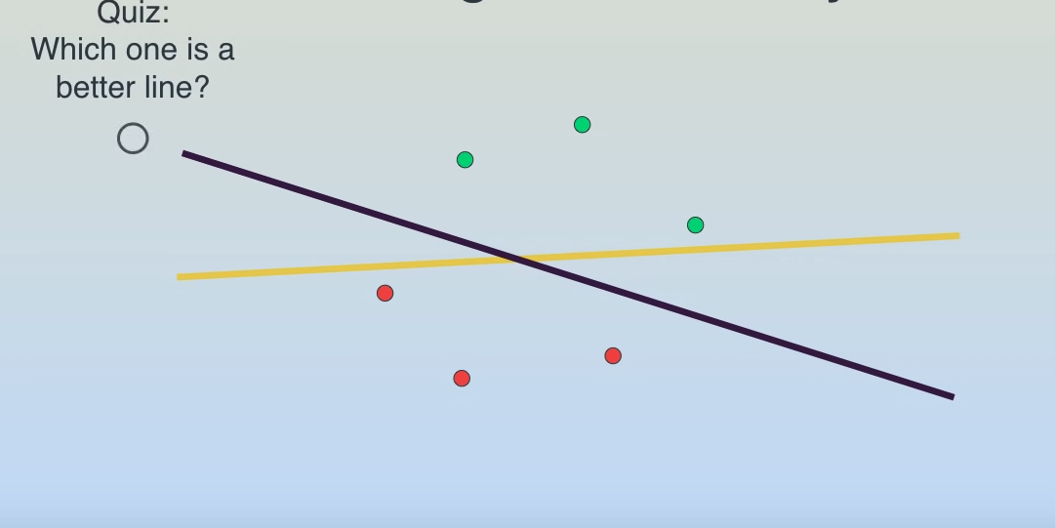
Support Vector Machine

Slide 39
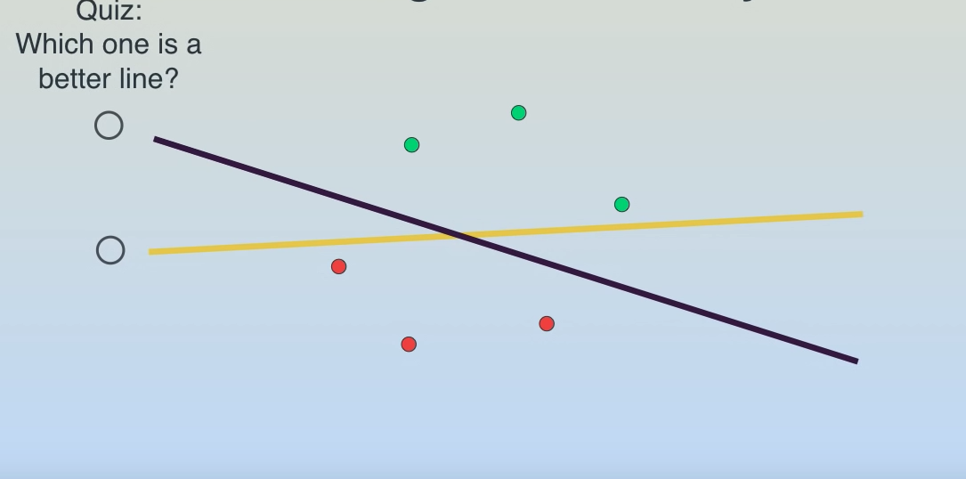
Support Vector Machine

Slide 40
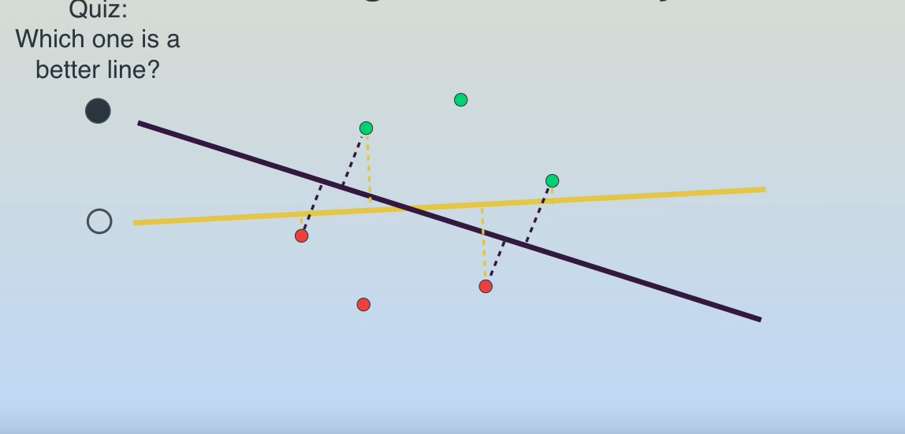
Support Vector Machine

Slide 41
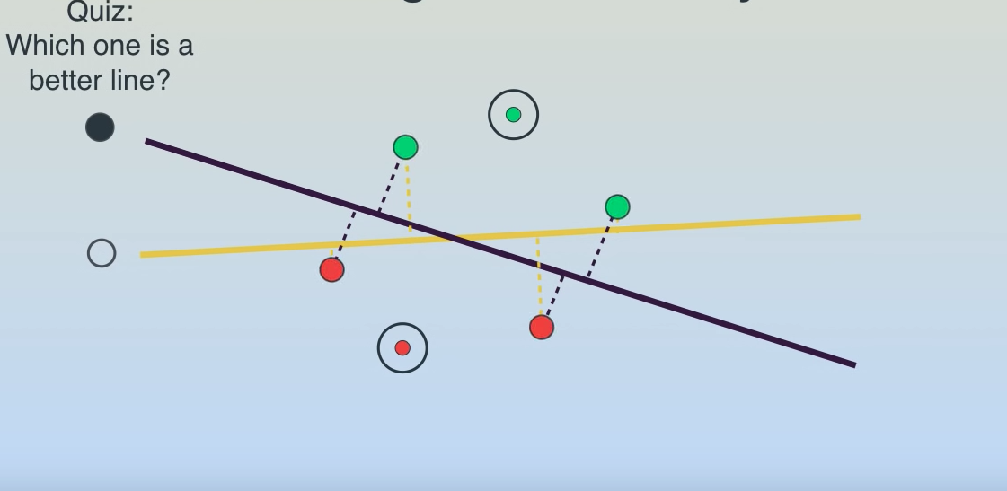
Support Vector Machine

Slide 42
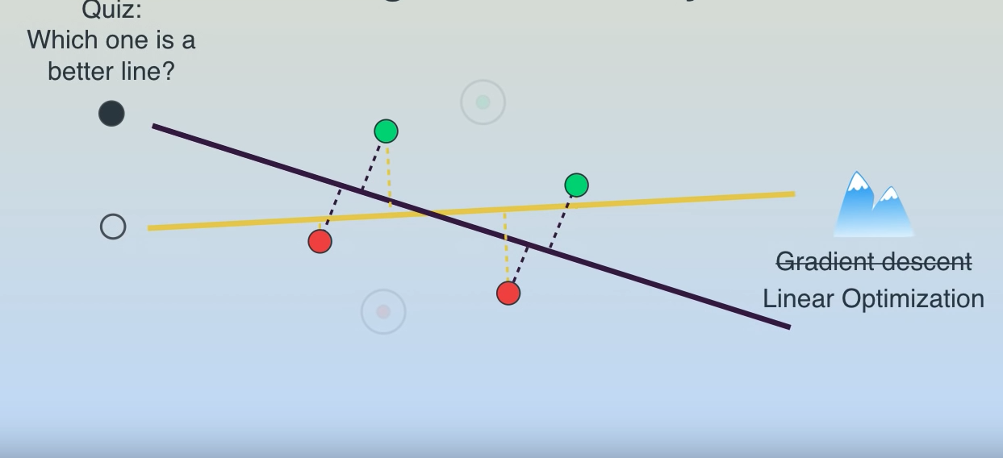
Support Vector Machine

Slide 43

Support Vector Machine

Slide 44
Thank you

