Slide 1

Web service
Allows clients to form a query and get an xml input string

Slide 2
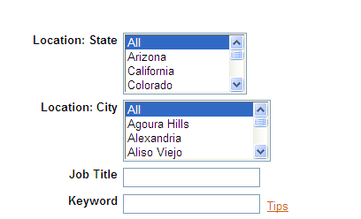
WB Config- Search Screen Fields
The below fields are currently set as search fields for Archstone
Additional fields would need to be mapped to the search page in order to be used in a query

Slide 3
Sample Input XML sent to the webservice
<Envelope version="01.00"> <Sender><Id>12345</Id><Credential>25152</Credential></Sender> <TransactInfo transactId="1" transactType="data"><TransactId>01/27/2010</TransactId> <TimeStamp>12:00:00 AM</TimeStamp></TransactInfo> <Unit UnitProcessor="SearchAPI"> <Packet> <PacketInfo packetType="data"> <packetId>1</packetId></PacketInfo><Payload><InputString> <ClientId>25152</ClientId><SiteId>5244</SiteId> <PageNumber>1</PageNumber><OutputXMLFormat>0</OutputXMLFormat> <AuthenticationToken/><HotJobs/> <ProximitySearch><Distance/> <Measurement/> <Country/><State/> <City/><zipCode/> </ProximitySearch><JobMatchCriteriaText/> <SelectedSearchLocaleId/> <Questions> <Question Sortorder="ASC" Sort="No"> <Id>7982</Id> <Value> <![CDATA[TG_SEARCH_ALL]]></Value></Question> </Questions><Questions><Question Sortorder="ASC" Sort="No"> <Id>15616</Id> <Value> <![CDATA[TG_SEARCH_ALL]]></Value> </Question></Questions></InputString> </Payload> </Packet> </Unit></Envelope>
OutputXML Formats:
0—XML
1—RSS
2—Link
ID’s for search fields:
7982 = Keyword
7996 = Job Title
15615 = Location: City
15616 = Location: State
If you don’t want to search All, you can specify the values to search on.
Ex: use CDATA[Arizona, New Mexico] rather than CDATA [TG_SEARCH_ALL]
Copyright Kenexa®, 2009

Slide 4
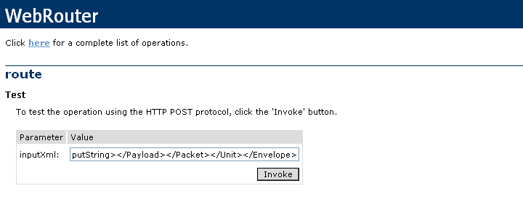
Kenexa’s webservice Router
Build the specific string: as per slide 3
Copy and paste onto Kenexa’s web service Router
Production Environment:
http://Import.brassring.com/WebRouter/WebRouter.asmx
Copyright Kenexa®, 2009

Slide 5
Output XML:
<?xml version="1.0" encoding="utf-8" ?>
<string xmlns="http://integrationuri.org/"><Envelope version="01.00"><Sender><Id>12345</Id><Credential>25152</Credential></Sender><TransactInfo transactType="response" transactId="5839b29d-43ef-4a28-9639-7d1f40b0d1fa"><TransactId>01/27/2010</TransactId><TimeStamp>12:00:00 AM</TimeStamp></TransactInfo><Unit UnitProcessor="SearchAPI"><Packet><PacketInfo packetType="data" encrypted="no"><packetId>1</packetId></PacketInfo><Payload><InputString><ClientId>25152</ClientId><SiteId>5244</SiteId><PageNumber>1</PageNumber><OutputXMLFormat>2</OutputXMLFormat><AuthenticationToken /><HotJobs /><ProximitySearch><Distance /><Measurement /><Country /><State /><City /><zipCode /></ProximitySearch><JobMatchCriteriaText /><SelectedSearchLocaleId /><Questions><Question Sortorder="ASC" Sort="No"><Id>7982</Id><Value>TG_SEARCH_ALL</Value></Question></Questions><Questions><Question Sortorder="ASC" Sort="No"><Id>15616</Id><Value>TG_SEARCH_ALL</Value></Question></Questions></InputString><ResultSet><TBD</Link></ResultSet></Payload><Status><Code>200</Code><ShortDescription>Successful Search API Call</ShortDescription><LongDescription>The Search API call has been successfully completed and returned with results.</LongDescription></Status></Packet><Status><Code>200</Code><ShortDescription>Successful Search API Call</ShortDescription><LongDescription>The Search API call has been successfully completed and returned with results.</LongDescription></Status></Unit><Status><Code>200</Code><ShortDescription>Success</ShortDescription><LongDescription>All units are processed with success codes</LongDescription></Status></Envelope></string>

