Slide 1
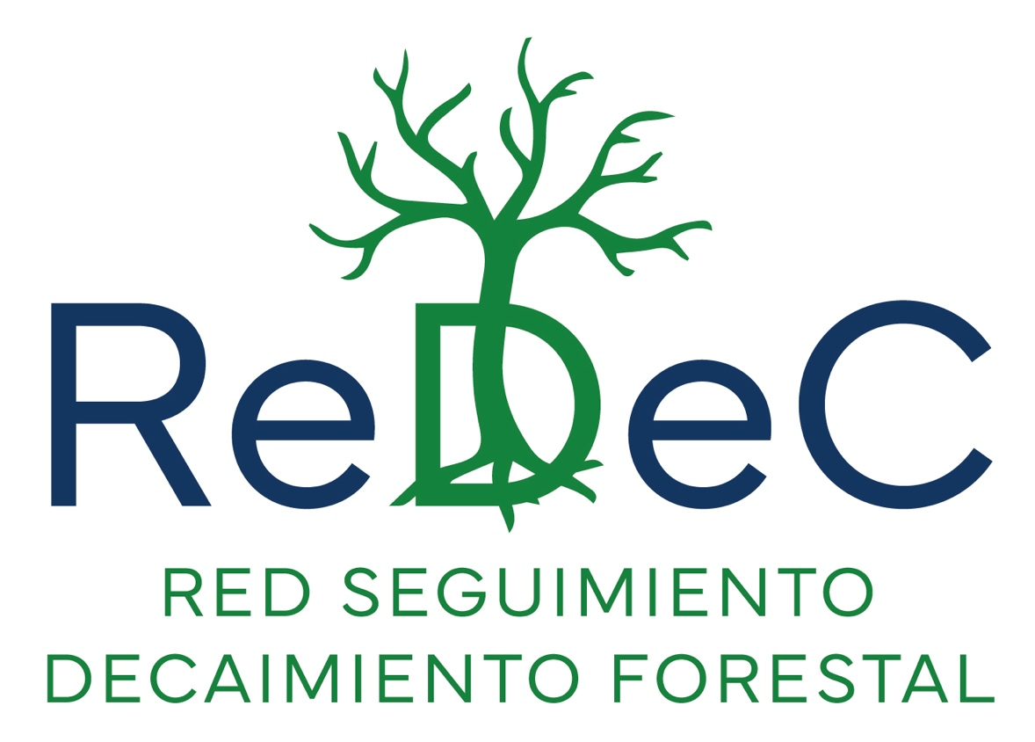
Spanish Network for monitoring climate-induced forest decline
Monitoring and analysis of climate impacts on Spanish forests
https://decaimiento.es/

Slide 2
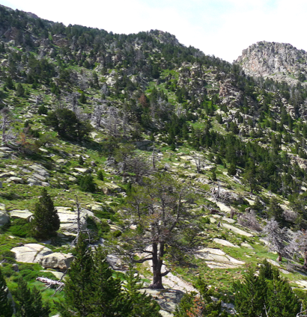
ReDeC in a nutshell
Objective
  ReDeC was constituted in 2023 and brings together more than 130 researchers and practitioners working in Spain to understand and monitor climate-induced forest decline.
  Broad coverage of climate change impacts on forests
  Extreme climatic events (e.g., severe droughts and heatwaves) and their interaction with biotic agents (pests and pathogens) are all expected to increase under climate change and cause rising impacts on forests.
Diversity of approaches
  We integrate people working with forest inventory data, ecophysiology, dendrochronology, remote sensing, modelling and other approaches to identify patterns, assess causality and inform management and policy.
Focus on national and international collaboration
  We are an active working group within the Spanish Association for Terrestrial Ecology (AEET, https://www.aeet.org), funded by the Spanish Government. We aim at promoting international collaborations and positioning Iberian forests as a natural laboratory to address global change impacts on forests.

Slide 3
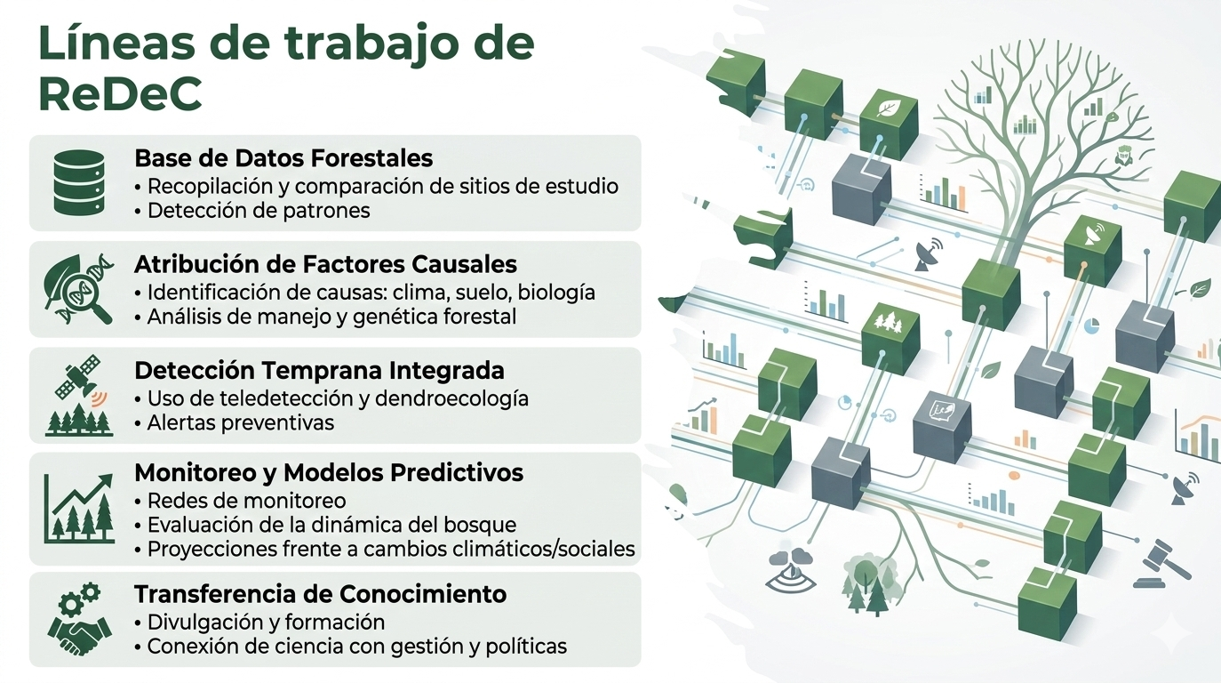
Main working groups within ReDeC
Forest decline databases
Mortality attribution (standards and protocols)
Long-term monitoring and modelling
Remote sensing and early warning signals
Soils and forest decline
Biotic agents
Internationalization
Knowledge transfer, management and decision making

Slide 4
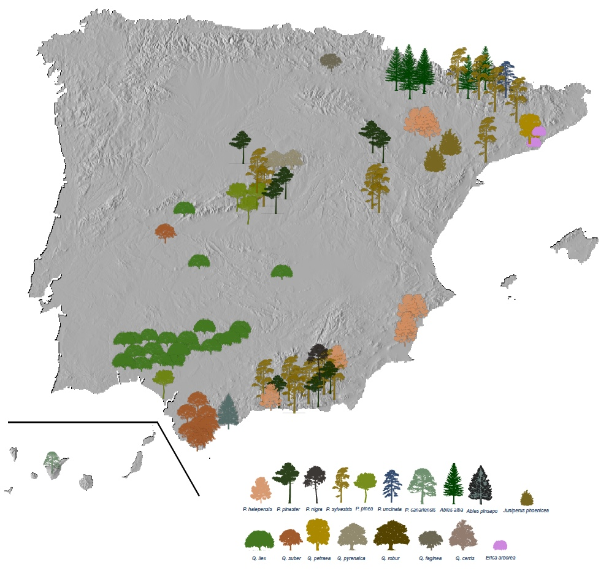
Examples of products
Updated database of the sites where forest decline is being studied in Spain, with metadata.
Decalogue of forest decline (https://decaimiento.es/productos/decalogo/decalogo_decaimiento.html).
Yearly meetings that bring together the ReDec community.
Scientific presentations and papers.
Pérez-Luque et al. (2025)

