Slide 1

Red
Less is more

Slide 2
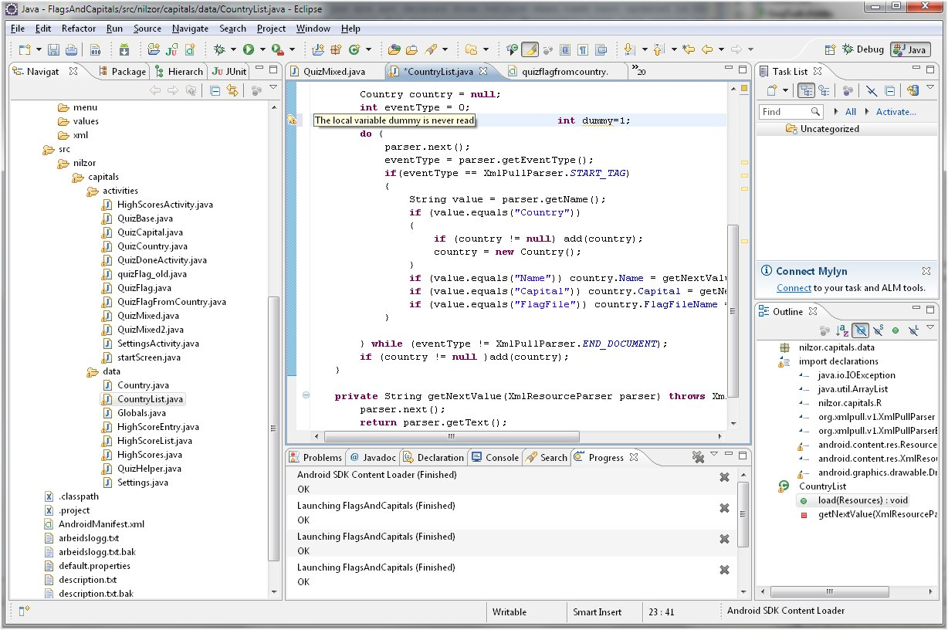
Android app developement in 2014…

Slide 3
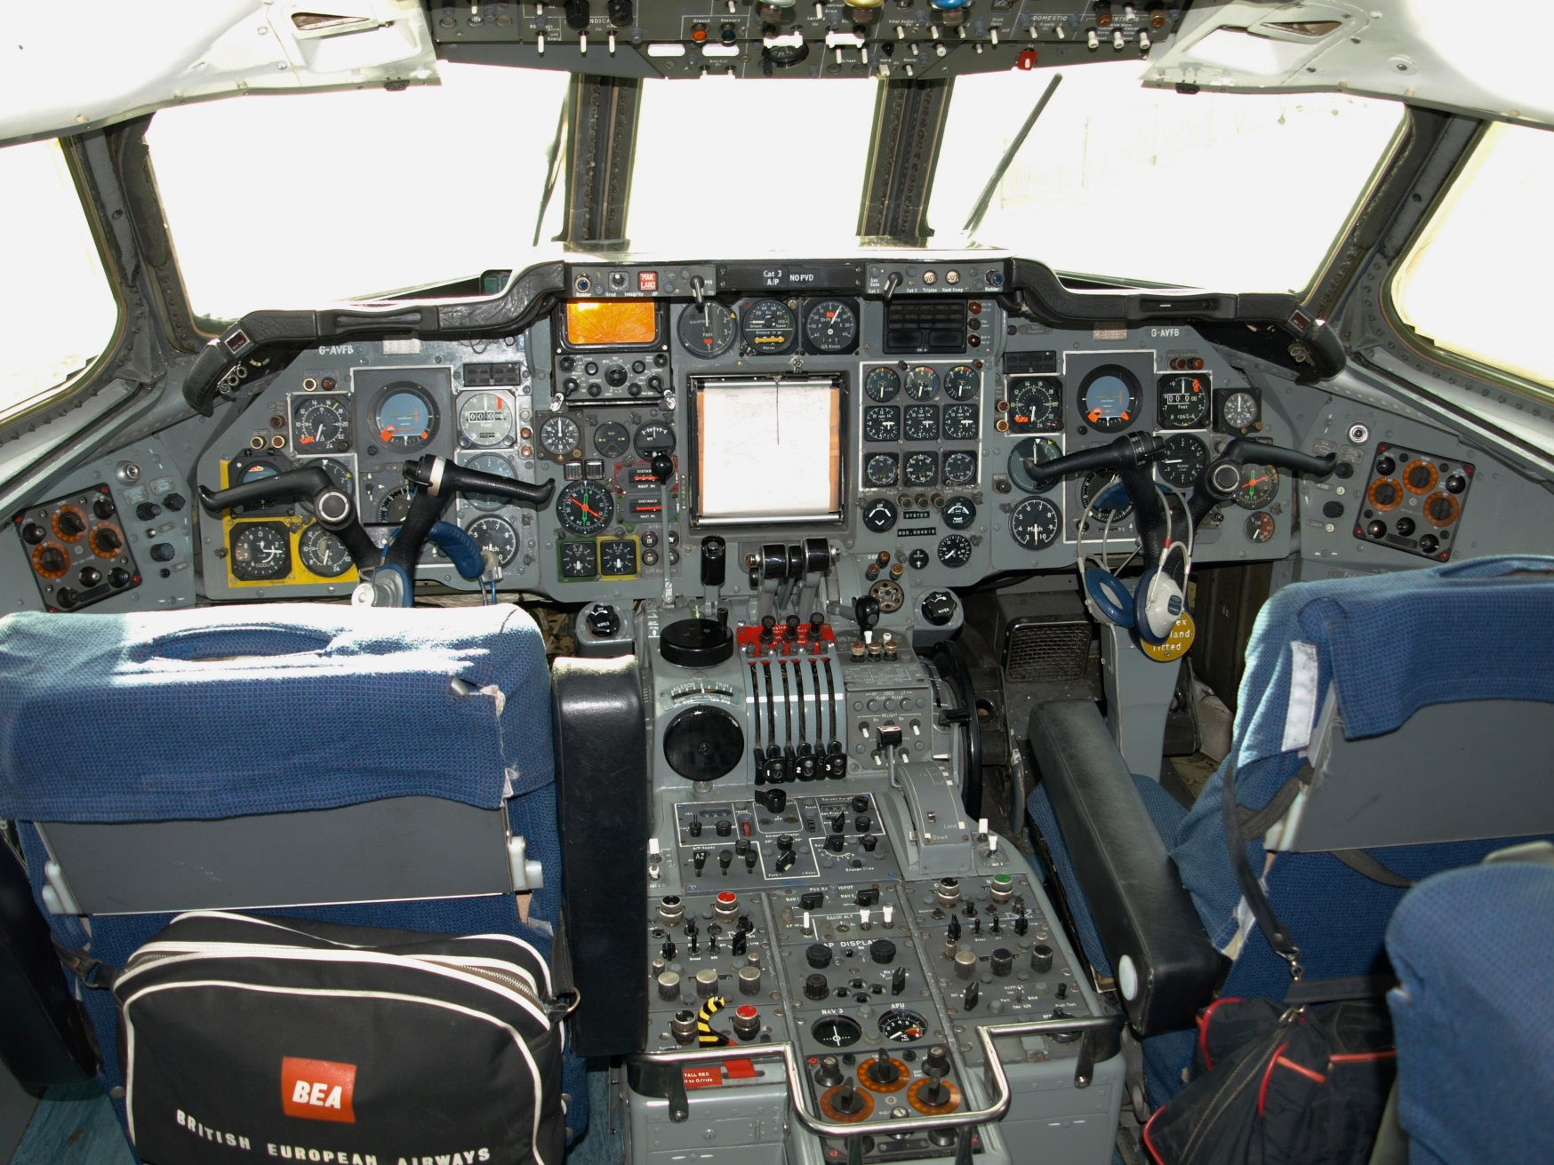
…is still immensely complex!

Slide 4
Android: Java vs Red
<?xml version="1.0" encoding="utf-8"?>
<LinearLayout xmlns:android="http://schemas.android.com/apk/res/android"
xmlns:tools="http://schemas.android.com/tools"
android:layout_width="match_parent"
android:layout_height="match_parent"
android:orientation="horizontal">
<Text android:id="@+id/edit_message"
android:layout_weight="1"
android:layout_width="0dp"
android:layout_height="wrap_content"
android:hint="@string/hello_message" />
<Button
android:layout_width="wrap_content"
android:layout_height="wrap_content"
android:text="@string/button_send" />
</LinearLayout>
package com.example.simpleform;
import android.app.Activity;
import android.app.AlertDialog;
import android.content.DialogInterface;
import android.os.Bundle;
import android.view.View;
import android.view.View.OnClickListener;
import android.widget.Button;
import android.widget.Text;
public class MainActivity extends Activity {
@Override
protected void onCreate(Bundle savedInstanceState) {
super.onCreate(savedInstanceState);
setContentView(R.layout.activity_main);
final Text fname=(EditText) findViewById(R.id.hello_message);
Button button=(Button) findViewById(R.id.button1);
button.setOnClickListener(new OnClickListener() {
@SuppressWarnings("deprecation")
@Override
public void onClick(View arg0) {
AlertDialog alertDialog = new AlertDialog.Builder(MainActivity.this).create();
alertDialog.setMessage("It Works!");
alertDialog.show();
}
});
}
}
Red [
Title: "Red on Android"
Needs: 'View
]
view [
below
text "Hello World!" 200
button "Alert" 180x80 [
alert "It Works!"
]
]

Slide 5
First full-stack language!
Abstraction level
Rascal
Red
Meta DSL
Ruby
REBOL
DSL
Python
Javascript
Scripting
C
Pascal
Java
C++
Applications
OS
ASM
Drivers
Hardware

Slide 6
Cross-platform: desktop, mobile, web development
Trend
Embedded
Desktop
Legacy
Android
Windows
Linux
iOS
MacOS X
Raspberry Pi
Syllable
Arduino boards
FreeBSD
IoT
.Net
JVM
Web
Future-proof
Virtual Machines

Slide 7
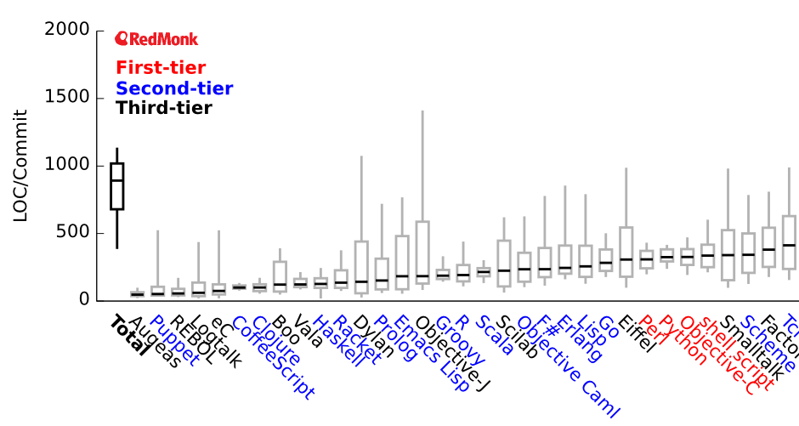
The study below ranks programming languages by expressiveness
Solution
We provide, « Red », a new programming tool, used as the core technology for <Red corp> solutions. Red is simple, since it is closer to natural language.
Source: redmonk.com, 2013
Red = evolution of REBOL
Most expressive general purpose language!
Best!
#1 and #2 are domain-specific languages
Lower is better

Slide 8
Annex: Users public testimonials
“Amazing!” -Hein Hoenjet, Red blog, 29-Oct-2012
“Truly awesome work!” -Ryan at Dash, Red blog, 13-Mar-2012
“This is crazy! How can it do so much with so little!" -Adam Brown, Stackoverflow, 24-Jan-2014
"First time to hear about Red. I hope that brilliant madness succeeds." -Semsem, Stackoverflow, 03-Feb-2014
"I'm rather impressed so far :) It's like lisp on steriods“ –jozefg, Stackoverflow, 17-Sep-2013
“Red looks very exciting its gonna make programming much easier.” -Clark Barrera, Red blog, 31-Oct-2012
“Great! I think Red is by far the most exciting new computer language project.” -Λύκινος, Red blog, 31-Oct-2012
“OK, I've been in Red-land for the last week or two, and have to say I'm never leaving...” -Josh Shireman, Stackoverflow, 14-Oct-2013
“One of the most promising (futuristic) language projects. I happened to see the presentation the day before yesterday. It's cool..I must say.” -Amanda, Red blog, 11-Apr-2012
“Nenad is working hard for the better of all of us. He's a person of planetary importance who should be given the resources of a Mars mission. Just being around him is so incredibly inspiring. The future is Red.” –Marco H.Sobol, LinkedIn, 23-Jan-2014
“I have to say that I haven't been this excited about something for a long time. Red will allow me to develop and deliver all my code from one platform and replace the three other languages that I have to use for various tasks. A big thanks to Nenad and everyone else working on Red!” -ZM76, Red blog, 29-Nov-2012
“Red is arguably the most mouth-watering language project out there—drawing from the rich vocabulary of Rebol and applying it to every level of software development, it pries open the murky depths of hardware and OS operations making it accessible to us mere mortals.” -Chris Ross-Gill, Red blog, 08-Feb-2014
“I don't have the skill to do what you're doing with RED but I get it. It's a crime that "C" compilers are 50MB and the last JAVAscript update was 18MB or whatever. Sludge piled on top of sludge. Thank you for your labors.” -Samhuih, Red blog, 28-Jan-2014
"I enjoy using Red because it reminds me of programming in the 80's, back when programming was fun. For instance, I think it amazing that it's possible to write a complete surveillance camera solution, from the embedded hardware that captures and processes the video to the user interface running on Windows/Mac/Android that allows review of the captured and processed video.“ -Bo Lechnowsky, Red blog, 07-Feb-2014

