Slide 1
Introduction to Red
A full-stack programming language

Slide 2

Introducing myself
Nenad Rakocevic, 41, french
Programmer, geek, passionate, entrepreneur
Author of many open source projects for REBOL:
  MySQL, PostgresQL, LDAP native drivers
  UniServe: asynchronous, event-driven network engine (Twister-like)
  Cheyenne Web Server: full-featured web application server
  CureCode: very fast web-based bug tracker (Mantis-like)

Slide 3
Why make yet another language?
To be in full control of my programming stack.
To have a performant implementation of REBOL language.

Slide 4
What is REBOL?
Innovative programming language
Invented by Carl Sassenrath (AmigaOS kernel father)
Available since 1998
Abandoned since 2+ years by its author
REBOL3 alpha open sourced in December 2012

Slide 5
Why use a REBOL-like language?
Simple to learn (natural syntax), simple to use (powerful yet understandable abstractions).
The language is its own data format.
Paradigm-neutral (default to imperative/functional style).
Strong symbolic and meta-programming abilities.
Live coding (REPL with console).
Ideal for building DSL.

Slide 6
Why use Red?
Faster than any other REBOL implementation
  Currently: 2-150 times faster
  v1 with optimizers: 5-300+ times faster (typical Red code will run 10 times faster)
Strong system programming abilities (Red/System)
Strong concurrency support
  Actor-like abstraction, cooperative and premptive tasking
  Parallel processing support (parallel collections, SIMD acceleration)
Not dependent on third-party tool-chains
Red has a leader committed to work on it full-time!

Slide 7
Red quick tour: Genealogy
LISP
Forth
Logo
REBOL
Lua
Scala
Red

Slide 8
Red quick tour: Natural range of application
Abstraction level
Ruby
REBOL
Red
DSL
Python
Javascript
Scripting
C
Pascal
Java
C++
Applications
OS
ASM
Red/System
Drivers
Hardware

Slide 9
Red quick tour: Language stack
Red
Red/System
Native code
compiles to
compiles to

Slide 10
Red quick tour: Red vs Red/System
Values storage
Red
Red/System
Boxed values
Primitives values
32 bits
96 bits
32 bits
123
123
Header
Payload

Slide 11
Red quick tour: Red vs Red/System
Performances
Red
Red/System
Reasonably fast,
C performances by a factor of 10-30
Very fast,
C performances by a factor of 1-3

Slide 12
Red quick tour: Red vs Red/System
Completion
Red
Red/System
Alpha state
Beta state

Slide 13
Red quick tour: Unified execution model (1/2)
AOT-compiler
Compile-time
Compiled code
Run-time
JIT-compiler
Interpreter

Slide 14
Red quick tour: Unified execution model (2/2)
Red [
title: "Unified execution model"
]
code: [print 1]
append code [+ 2]
do code
inc: function [n][n + 1]
code: [inc 2]
do code
code: [loop 1000 [print "."]]
do code
Interpreter
Interpreter
JIT-compiler

Slide 15
Red quick tour: One binary to bind them all
Compile script and run it from memory
  $ red script.red
Compile script and output an executable
  $ red –o script script.red
Cross-compile script and output an executable
  $ red –t Windows script.red
Compile a Red/System script and output an executable
  $ red script.reds
Launch Red in REPL mode
  $ red
Compile script as CGI
  $ red –c –o script.cgi script.red
Compile script as shared library
  $ red –dlib script.red

Slide 16
Red quick tour: Target platforms
Embedded
Desktop
Android devices
Windows
Linux
iOS devices
MacOS X
Raspberry Pi
Red
Syllable
FreeBSD
FreeBSD
Arduino boards
(AVR 8/32-bit)
Haiku
JVM
Javascript
.NET
AVM2
(Flash)
VM

Slide 17
Red quick tour: Goals
Simplicity
Compactness
Speed
Be Green
Ubiquity
Portability
Flexibility
An IDE should not be necessary to write code.
Being highly expressive maximizes productivity.
If too slow, it cannot be general-purpose enough.
Have a small footprint, resources are not limitless.
Plug it everywhere.
The least expected from a programming language.
Best Good fit for any task!

Slide 18
Red quick tour: bird's view roadmap
Red (v0.4) and Red/System compilers written in REBOL
  Add Unicode support to console
  Add function creation support to interpreter
  Implement more datatypes (error!, date!, time!, binary!,…)
  Add object! and port! support
  Add I/O sub-system
  Add concurrency support
  Add more natives/actions
Red/System compiler rewritten in Red (v0.5)
Red (AOT & JIT) compiler rewritten in Red (v1)

Slide 19
Red quick tour: Project metrics
BSD license
Source code hosted on Github since March 2011
  version 0.3.1, 7 commiters, ~1600 public commits
  396 tickets (366 closed)
  ~15000 unit tests (framework built by Peter WA Wood)
  330 KiB of sources for Red/System
  7000 LOC for Red/System compiler
  2200 LOC for Red/System linker
  2400 LOC for Red compiler
  12000 LOC for Red runtime library (~100KiB compiled)

Slide 20
Red online channels
Home: http://red-lang.org
Twitter: #red_lang
IRC channel: #red-lang on freenode
Mailing list hosted on Google Groups

Slide 21
Red/System

Slide 22
Red/System: features (1/2)
Purely imperative, C-level language, with a Red syntax
Statically compiled (naïve compilation for now)
Limited type system:
  Logic!, byte!, integer!, float!, float32!, struct!, pointer!, c-string!, function!
  Simple type inference
  Type casting supported
Compiler directives: #define, #include, #import, #syscall, #if, #either, #switch,…
Low-level CPU support (interruptions, I/O, stack, privileged mode)
Inlined ASM support

Slide 23
Red/System: features (2/2)
Linker
  Link-time shared libraries binding
  Output types: Exe, Shared library, Static library
  Formats: PE, ELF, mach-o, Intel-hex
  Link third-party static libraries
Targets: IA-32, ARM, JVM, CLR, x64, AVM2
Red/System as an inlined dialect in Red

Slide 24
Red/System: Hello world!
Red/System [
title: "Hello World demo"
]
print "hello world!"

Slide 25
Red/System: variables and expressions
a: 1
b: a + 2 * 4
c: a < b
d: "hello"
if a < b [print "b is greater"]
either a < b [print "b"][print "a"]
print either a < b ["b"]["a"]
print [a " is less than " b "," c "," d]
1 is less than 12,false,hello
print-wide [a "is less than" b c d]
1 is less than 12 false hello

Slide 26
Red/System: functions
nothing: function [][]
print-zero: function [n [integer!]][
print either zero? n ["zero"]["not zero"]
]
abs: function [n [integer!] return: [integer!]][
either positive? n [n][negate n]
]
uppercase: function [s [c-string!] /local offset][
offset: #"a" - #"A"
if any [#"a" <= b/1 b/1 <= #"z"][
s/1: s/1 + offset
]
]

Slide 27
Red/System: shared libraries
#import [
"libc.so.6" cdecl [
allocate: "malloc" [
size [integer!]
return: [byte-ptr!]
]
free: "free" [
block [byte-ptr!]
]
quit: "exit" [
status [integer!]
]
printf: "printf" [[variadic]]
]
]
printf ["%i %s" 123 "hello"]
123 hello

Slide 28
Red/System: CPU low-level features
timer-handler: func [[interrupt]][...]
#interruptions [
0000h :reset
0004h :timer-handler
]
a: read-io 0376h
write-io 0376h 1
a: get-modes privileged
set-modes privileged false
set-modes interrupt true
set-modes interrupt-mask FF000000h

Slide 29
Red/System: keywords
% * +
- -** /
// /// <
<< <= <>
= > >>
>= >>> alias
all and any
as assert case
comment declare either
exit false func function if not
or pop push return size? switch
true until while
xor repeat loop
set-modes get-modes read-io write-io

Slide 30
Red/System: library bindings
C library binding
cURL binding
ZeroMQ binding
SDL binding
GTK+ binding
SQLite binding
WebKit GTK+ binding
OpenStreetMap binding
ImageMagick binding (done by Oldes)
Almost all written by Kaj de Vos.

Slide 31

That's all folks!

Slide 32
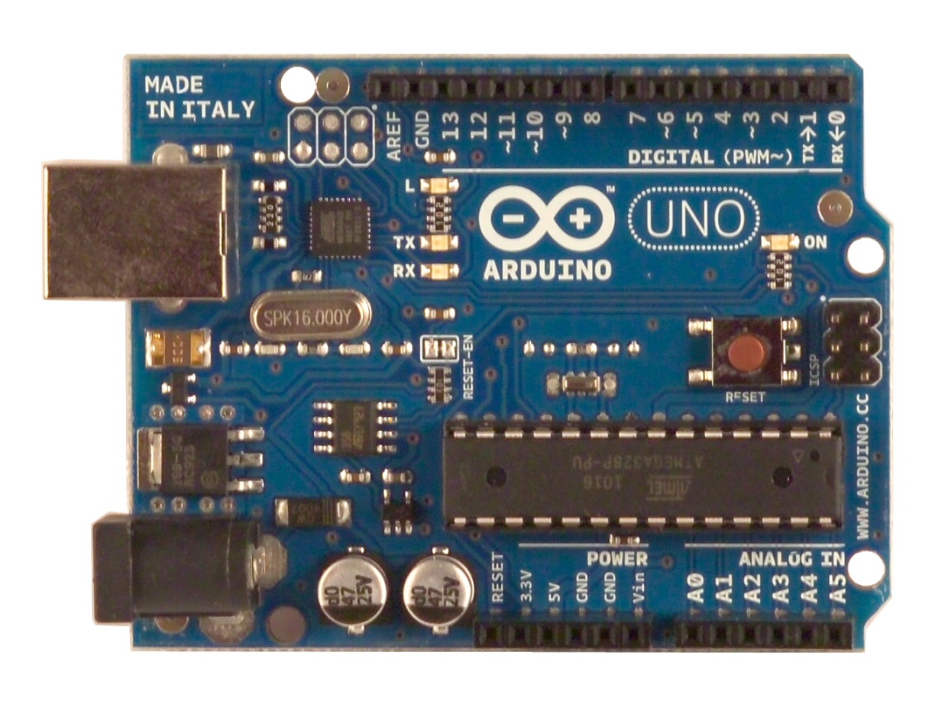
Arduino Uno
  Microcontroller ATmega328
  Flash Memory 32 KB of which 0.5 KB used by bootloader
  SRAM 2 KB
  EEPROM 1 KB (ATmega328)
  Clock Speed 16 MHz

Slide 33
Red quick tour: Types tree
Rich type system: up to 50 first-class datatypes
value!
none!
logic!
symbol!
context!
scalar!
error!
word!
lit-word!
set-word!
…
object!
function!
module!
port!
integer!
date!
time!
char!
…
action!
closure!
…
tuple!
series!
block!
binary!
string!
path!
hash!
list!
map!
…
ipv6!
file!
url!
email!
tag!
issue!
…

Slide 34
Red quick tour: Red vs Red/System (1/6)
Memory management
Red
Red/System
Automatic
Compacting garbage collector
Manual
Allocate / Free

Slide 35
Red quick tour: Red vs Red/System (2/6)
I/O
Red
Red/System
High level abstractions
Very limited native I/O

Slide 36
Red quick tour: Red vs Red/System (3/6)
Type system
Red
Red/System
Rich, more than 50 types
Poor, 6 primitives types
Limited type inference

